Slide 1
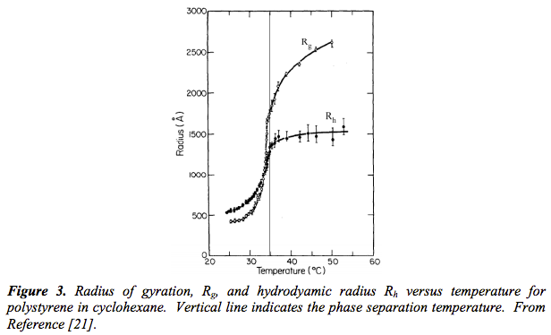

Measurement of the Hydrodynamic Radius, R_{h}
R_{g}/R_{h}
1.5 Theta
1.6 Expanded
0.774 Sphere
0.92 Draining Sphere
Kirkwood, J. Polym. Sci. 12 1(1953).
http://theor.jinr.ru/~kuzemsky/kirkbio.html
A Harmonic Mean
(based on an average of transport rates, D = kT/(6πηR_{h}))
http://www.eng.uc.edu/~gbeaucag/Classes/Properties/HydrodyamicRadius.pdf
An Arithmetic Mean

Slide 2
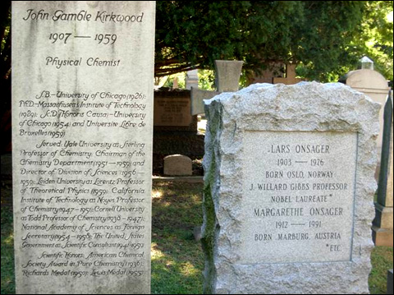
Measurement of the Hydrodynamic Radius, R_{h}
R_{g}/R_{h}
1.5 Theta
1.6 Expanded
0.774 Sphere
0.92 Draining Sphere
Kirkwood, J. Polym. Sci. 12 1(1953).
http://theor.jinr.ru/~kuzemsky/kirkbio.html
http://www.eng.uc.edu/~gbeaucag/Classes/Properties/HydrodyamicRadius.pdf

Slide 3
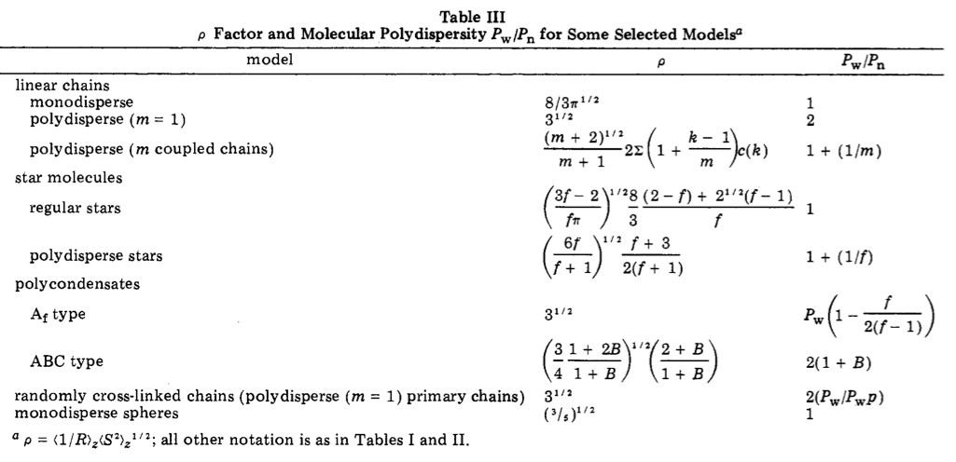
R_{g}/R_{H} Ratio
1.5
1.73
1.73
0.77
Burchard, Schmidt, Stockmayer, Macro. 13 1265 (1980) (http://www.eng.uc.edu/~gbeaucag/Classes/Properties/RgbyRhRatioBurchardma60077a045.pdf)

Slide 4

Poiseuille’s Law (Q = V/time)

Slide 5
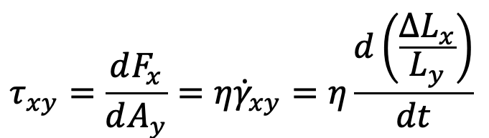
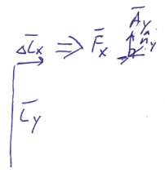
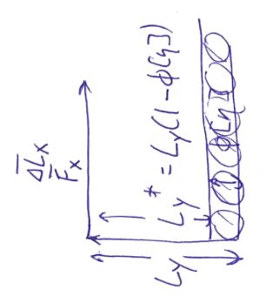
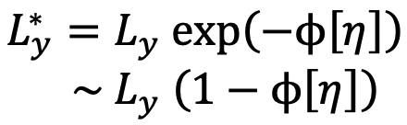
Intrinsic “viscosity” as a linear displacement law
At very small φ

Slide 6
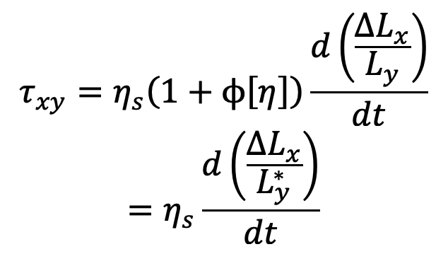
Intrinsic “viscosity” as a linear displacement law

Slide 7
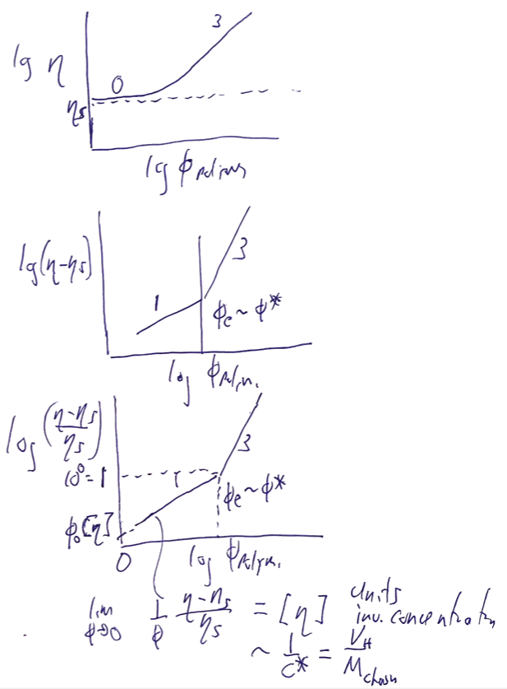
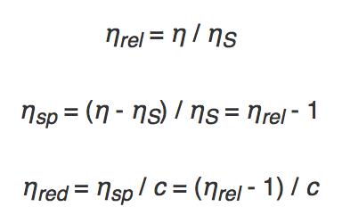
Intrinsic, specific & reduced “viscosity”
Shear Flow (may or may not exist in a capillary/Couette geometry)
η_{s} = η₀ (1+φ[η])

Slide 8
Intrinsic, specific & reduced “viscosity”
Shear Flow (may or may not exist in a capillary/Couette geometry)
(1)
Reminiscent
of a virial expansion.
n = order of interaction (2 = binary, 3 = ternary etc.)
Reduced Viscosity
Intrinsic Viscosity
We can approximate (1) as:
Relative Viscosity
Martin Equation
Utracki and Jamieson “Polymer Physics From Suspensions to Nanocomposites and Beyond” 2010 Chapter 1

Slide 9
Intrinsic, specific & reduced “viscosity”
(1)
n = order of interaction (2 = binary, 3 = ternary etc.)
Reduced Viscosity
We can approximate (1) as:
Relative Viscosity
Martin Equation
Reduced Viscosity
Huggins Equation
Kraemer Equation
(exponential expansion)
Utracki and Jamieson “Polymer Physics From Suspensions to Nanocomposites and Beyond” 2010 Chapter 1

Slide 10
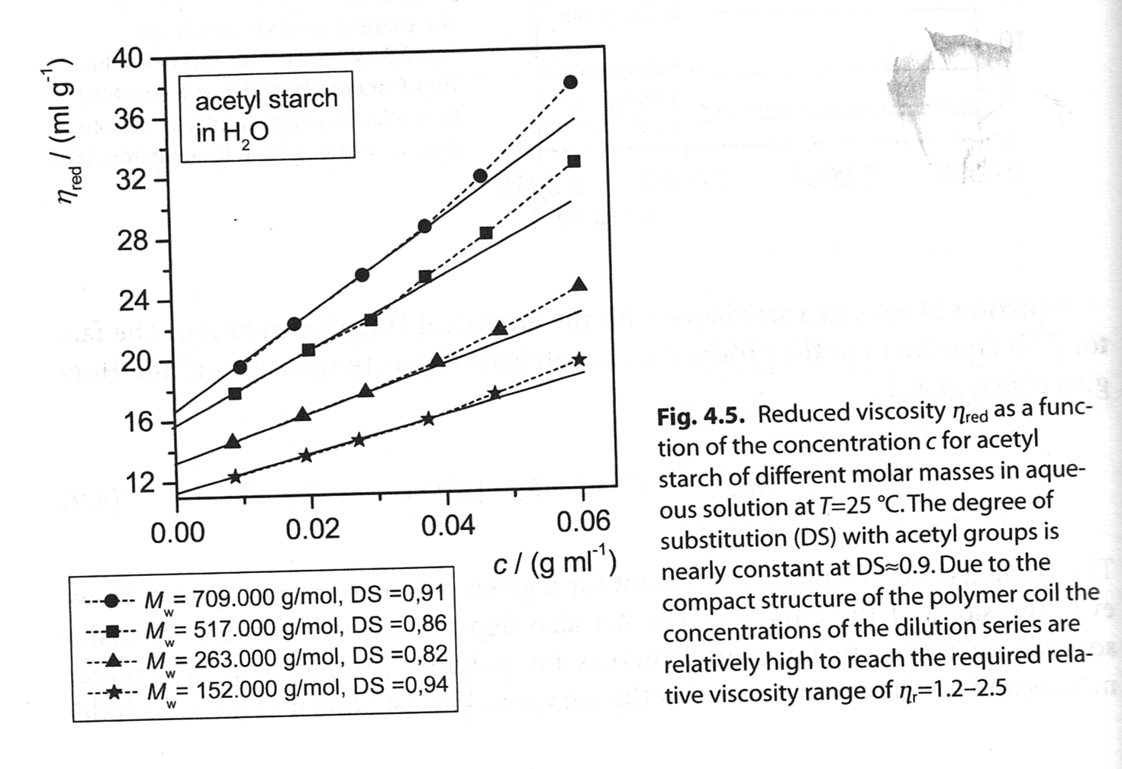
Intrinsic, specific & reduced “viscosity”
(1)
n = order of interaction (2 = binary, 3 = ternary etc.)
Reduced
Viscosity
Concentration Effect
Reduced
Viscosity
Kulicke & Clasen “Viscosimetry of Polymers and Polyelectrolytes (2004)

Slide 11
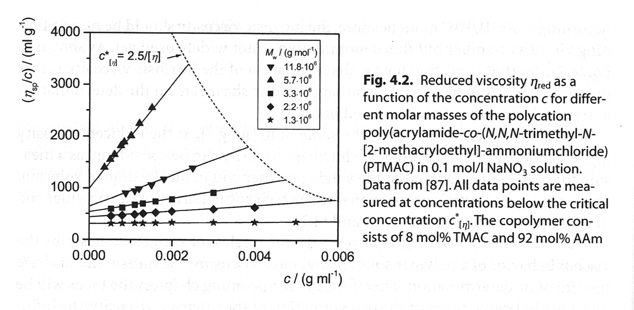
Intrinsic, specific & reduced “viscosity”
(1)
n = order of interaction (2 = binary, 3 = ternary etc.)
Concentration Effect, c*
Reduced
Viscosity
Kulicke & Clasen “Viscosimetry of Polymers and Polyelectrolytes (2004)

Slide 12
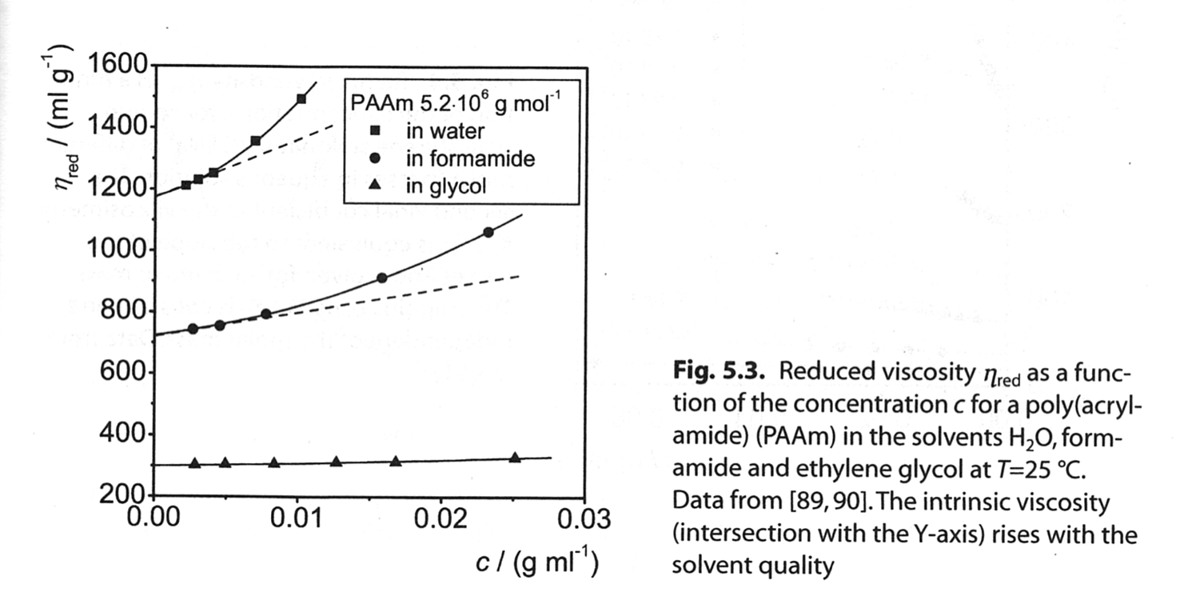
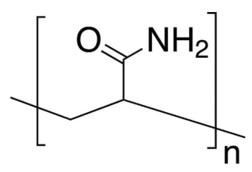
Intrinsic, specific & reduced “viscosity”
(1)
n = order of interaction (2 = binary, 3 = ternary etc.)
Solvent Quality
Reduced
Viscosity
Kulicke & Clasen “Viscosimetry of Polymers and Polyelectrolytes (2004)

Slide 13
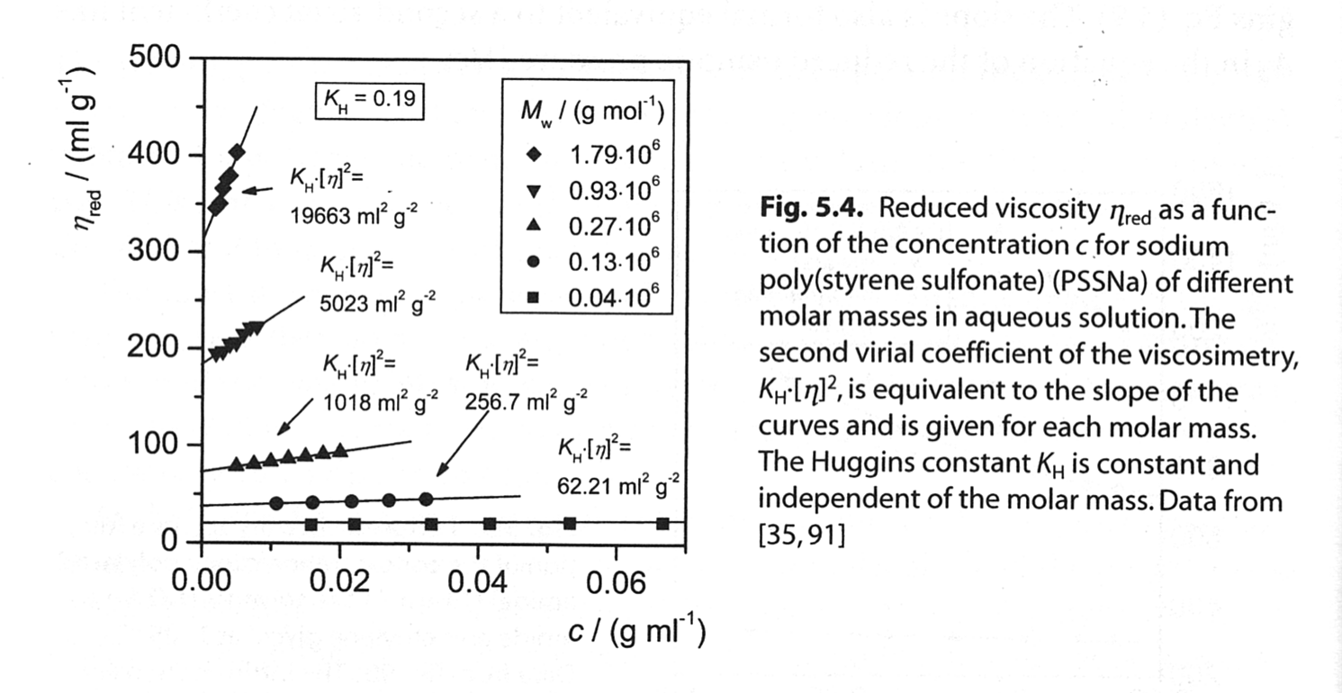
Intrinsic, specific & reduced “viscosity”
(1)
n = order of interaction (2 = binary, 3 = ternary etc.)
Reduced
Viscosity
Molecular Weight Effect
Huggins Equation
Kulicke & Clasen “Viscosimetry of Polymers and Polyelectrolytes (2004)

Slide 14
V

Slide 15
This is the “Zimm Model”
Or
Non-draining model

Slide 16
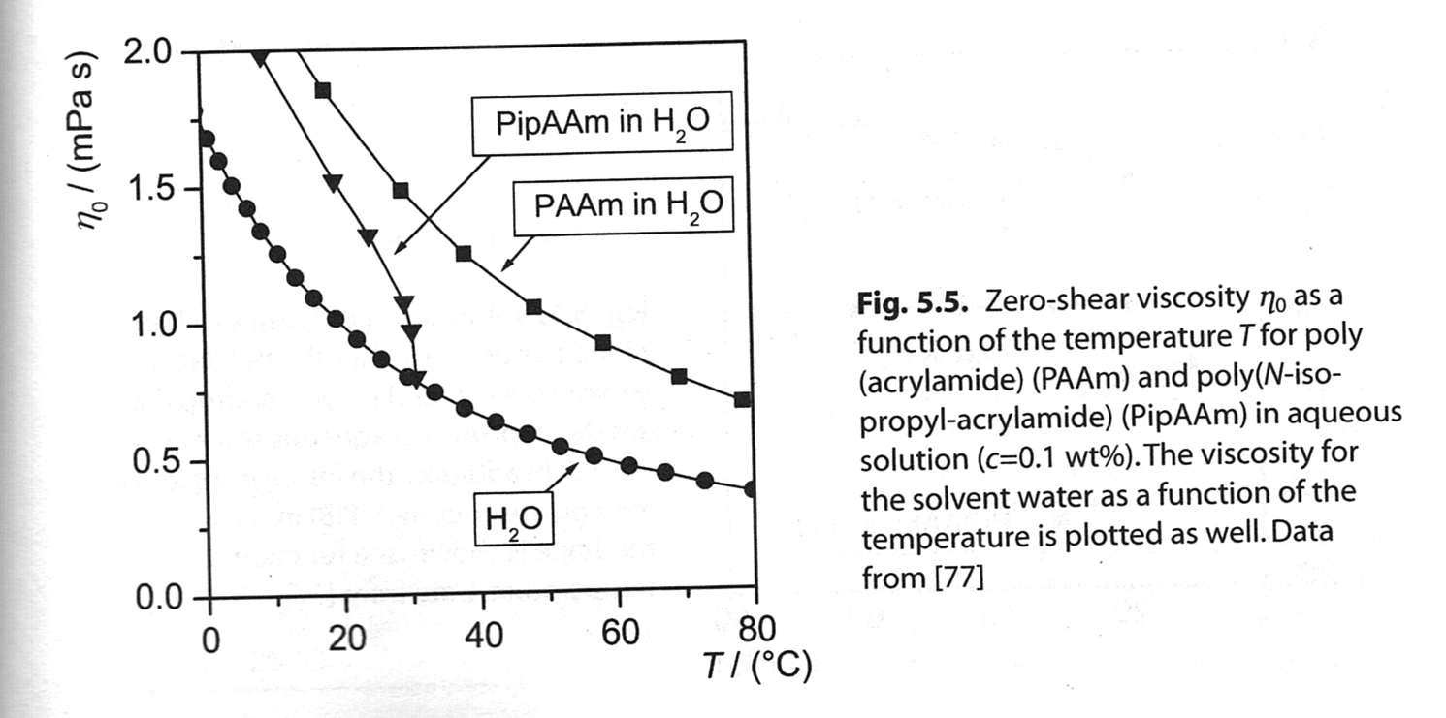
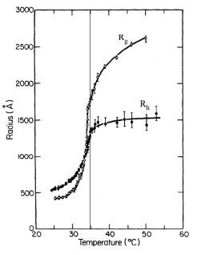
Intrinsic, specific & reduced “viscosity”
(1)
n = order of interaction (2 = binary, 3 = ternary etc.)
Viscosity itself has a strong temperature dependence. But intrinsic viscosity depends on temperature as far as coil expansion changes with temperature (R_{H}³).
Temperature Effect
Weaker and
Opposite Dependency

Slide 17


Arrhenius Behavior
Williams-Landel-Ferry (WLF) Equation
$\frac{η}{η_{0}}$=exp$\left(\frac{H_{a}}{kT}\right)$=> exp$\left(\frac{H_{a}}{k\left(T−T_{V}\right)}\right)$=> exp$\left(\frac{E_{a}}{k\left(T−T_{V}\right)}\right)$=> exp$\left(\frac{H_{a}−TS_{a}}{k\left(T−T_{V}\right)}\right)$
3 constants T_{r}, H_{a}, S_{a}; WLF has 3 constants T_{V}, C₁, C₂
If exp(x) =10y then y =x/(ln(10)) = x/2.30
T_{V} = (C₂ – T_{r}); S_{a} = 2.30 C₁; H_{a} = 2.30C₁T_{r}
If you choose T_{r} = T_{g} then C₁ ~ 17.44 and C₂ ~ 51.6
If you choose T_{r} = T_{g} + 43K then C₁ ~ 8.86 and C₂ ~ 101.6
It might be best to measure H and S and find the Vogel temperature experimentally

Slide 18
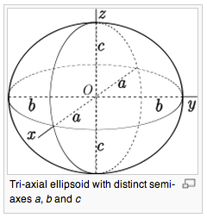
Intrinsic “viscosity” for colloids (Simha, Case Western)
https://physicstoday.scitation.org/do/10.1063/pt.4.2224/full/
For a solid object with a surface, v is a constant in molecular weight, depending only on shape
For a symmetric object (sphere) v = 2.5 (Einstein)
For ellipsoids v is larger than for a sphere,
prolate
a, b, b :: a>b
J = a/b
oblate
a, a, b :: a<b

Slide 19
Intrinsic “viscosity” for colloids (Simha, Case Western)
Hydrodynamic volume for “bound” solvent
Partial Specific Volume
Bound Solvent (g solvent/g polymer)
Molar Volume of Solvent

Slide 20
Intrinsic “viscosity” for colloids (Simha, Case Western)
Long cylinders (TMV, DNA, Nanotubes)
J=L/d
End Effect term ~ 2 ln 2 – 25/12 Yamakawa 1975

Slide 21
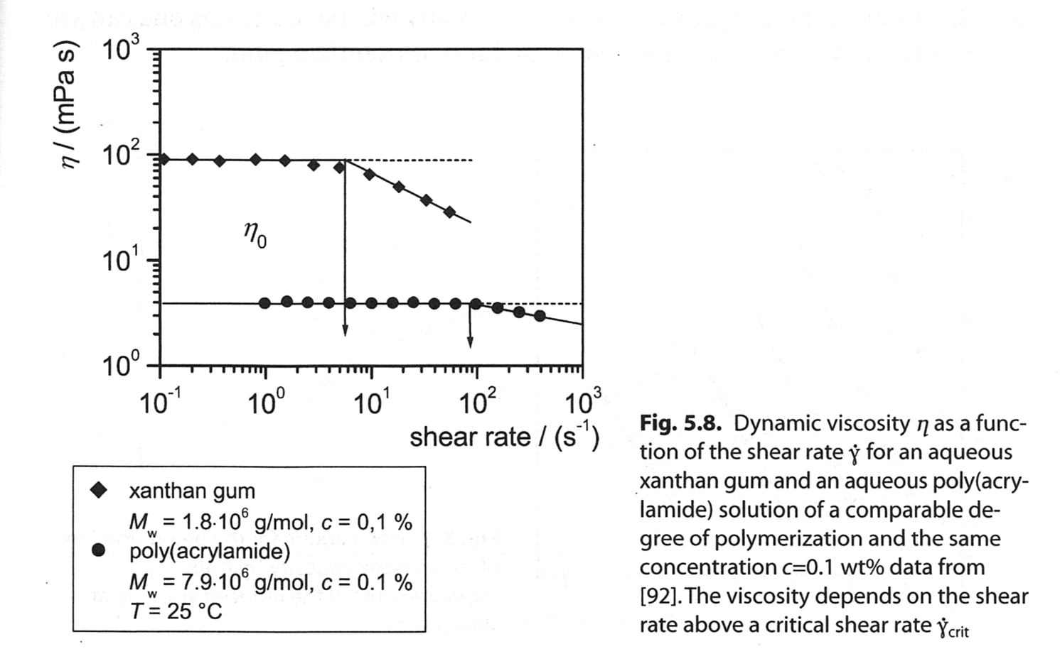
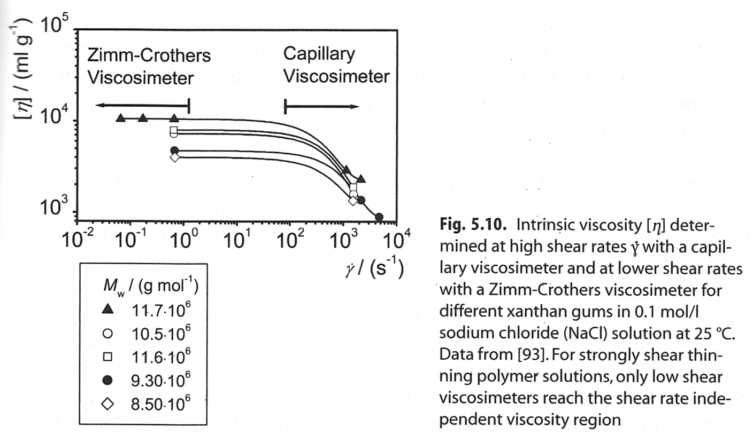
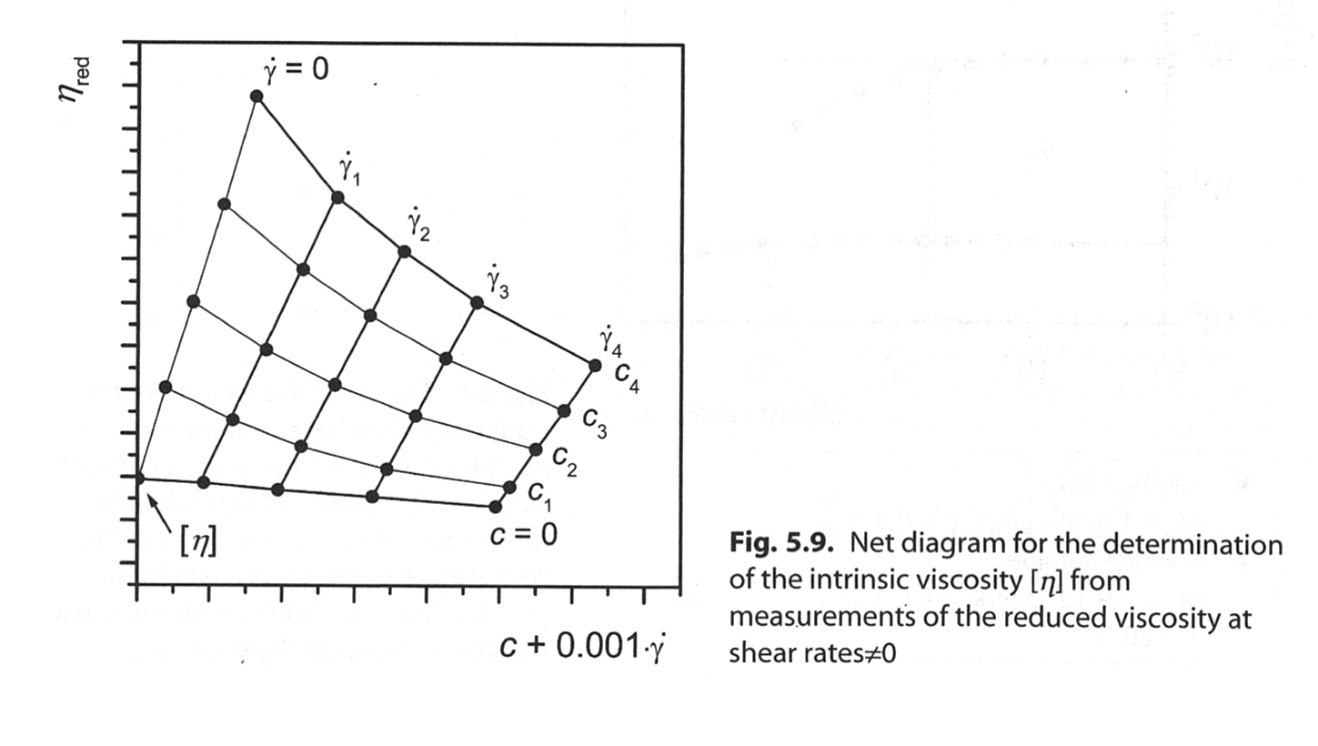
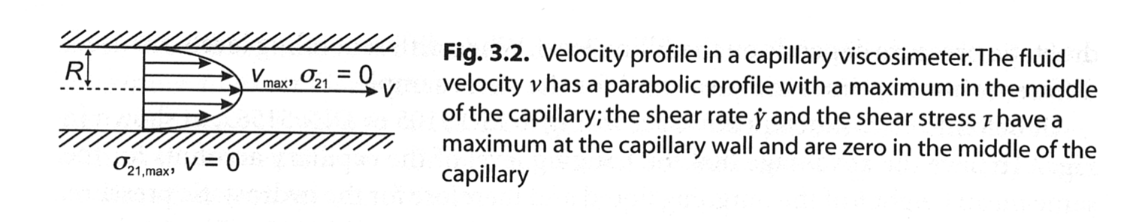
Shear Rate Dependence for Polymers
Capillary Viscometer
Kulicke & Clasen “Viscosimetry of Polymers and Polyelectrolytes (2004)

Slide 22
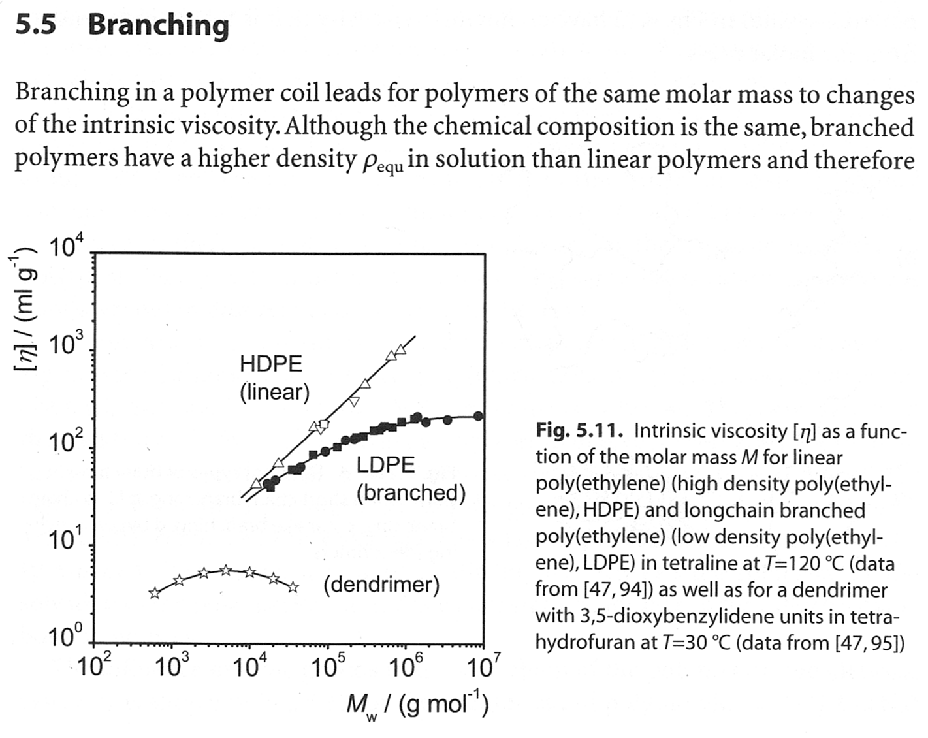
Branching and Intrinsic Viscosity
Kulicke & Clasen “Viscosimetry of Polymers and Polyelectrolytes (2004)

Slide 23
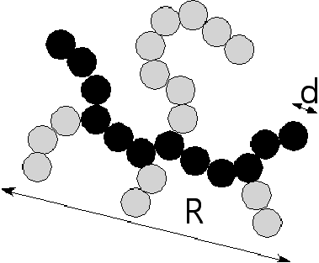
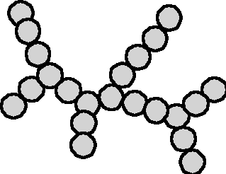
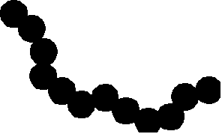
How Complex Mass Fractal Structures Can be Decomposed
Tortuosity
Connectivity
z
df
p
dmin
s
c
R/d
27
1.36
12
1.03
22
1.28
11.2

Slide 24
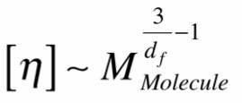
Branching and Intrinsic Viscosity
R_{H} ~ p^{1/dmin}
z ~ p^{c}
R_{H} ~ z^{cdmin} = z^{df}
At low z; d_{min} = 2, c = 1; d_{f} = d_{min}c = 2 (linear chain)
At high z; d_{min} => 1, c => 2 or 3; d_{f} = d_{min}c => 2 or 3
(highly branched chain or colloid)

Slide 25
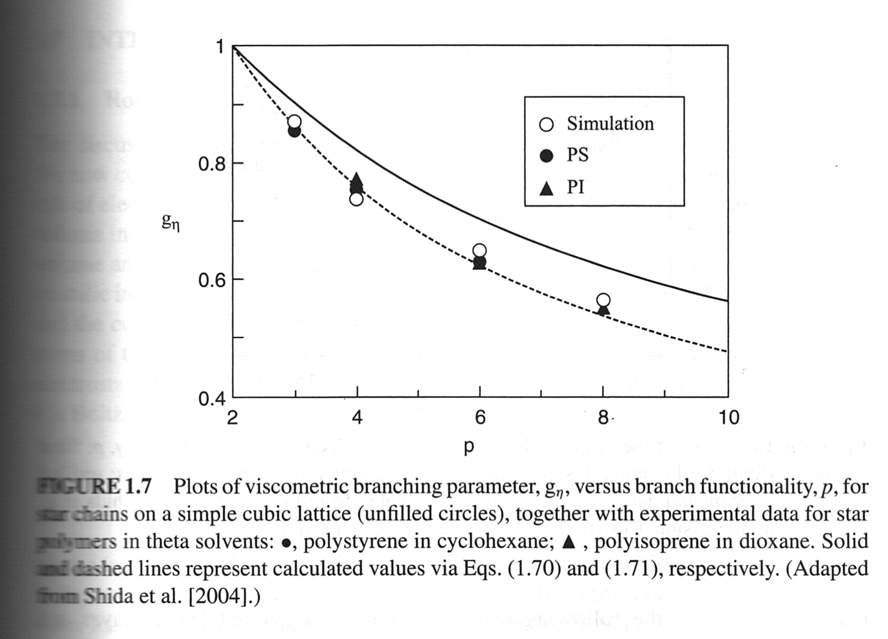
Branching and Intrinsic Viscosity
Keep in mind stars are a special case!
Utracki and Jamieson “Polymer Physics From Suspensions to Nanocomposites and Beyond” 2010 Chapter 1

Slide 26
Branching and Intrinsic Viscosity
(R_{H,B}/ R_{H,L})² ~ z^{2(df,B - df,L)}
This is still just looking at density! There is not topological information here which is critical to describe branching
At low z; d_{min} = 2, c = 1; d_{f} = d_{min}c = 2 (linear chain)
At high z; d_{min} => 1, c => 2 or 3; d_{f} = d_{min}c => 2 or 3
(highly branched chain or colloid)

Slide 27
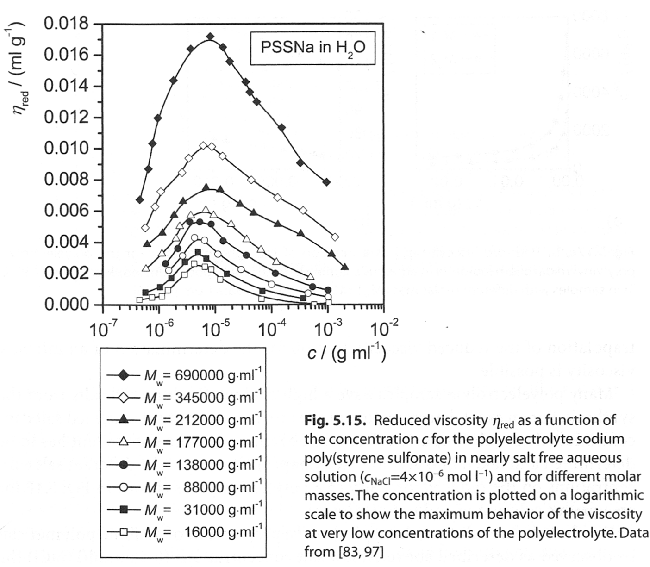
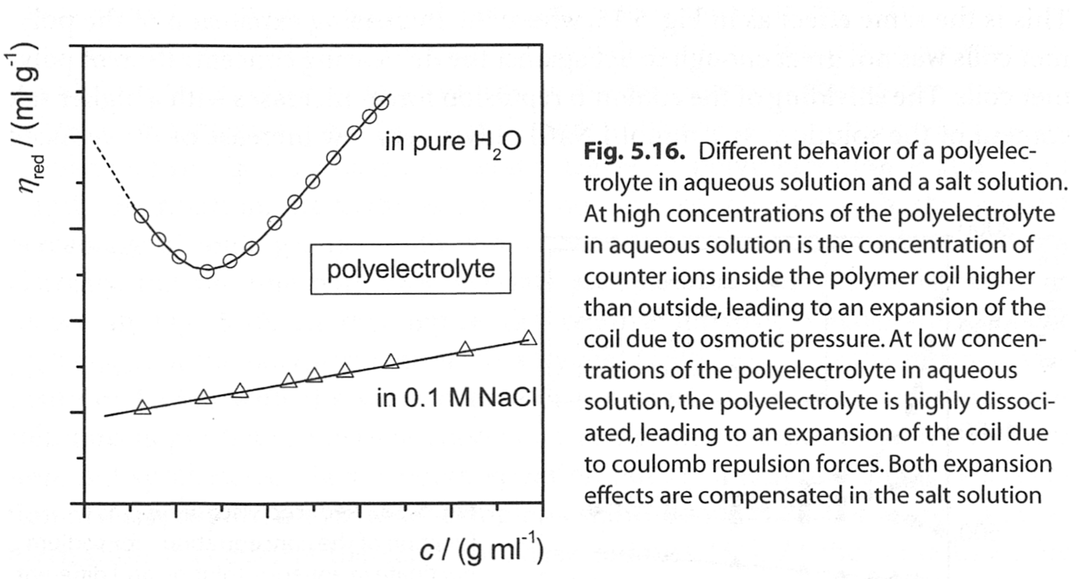

Polyelectrolytes and Intrinsic Viscosity
Low Concentration
Very High Concentration
Initially rod structures, increasing concentration
Followed by charge screening
Finally uncharged chains
Kulicke & Clasen “Viscosimetry of Polymers and Polyelectrolytes (2004)

Slide 28
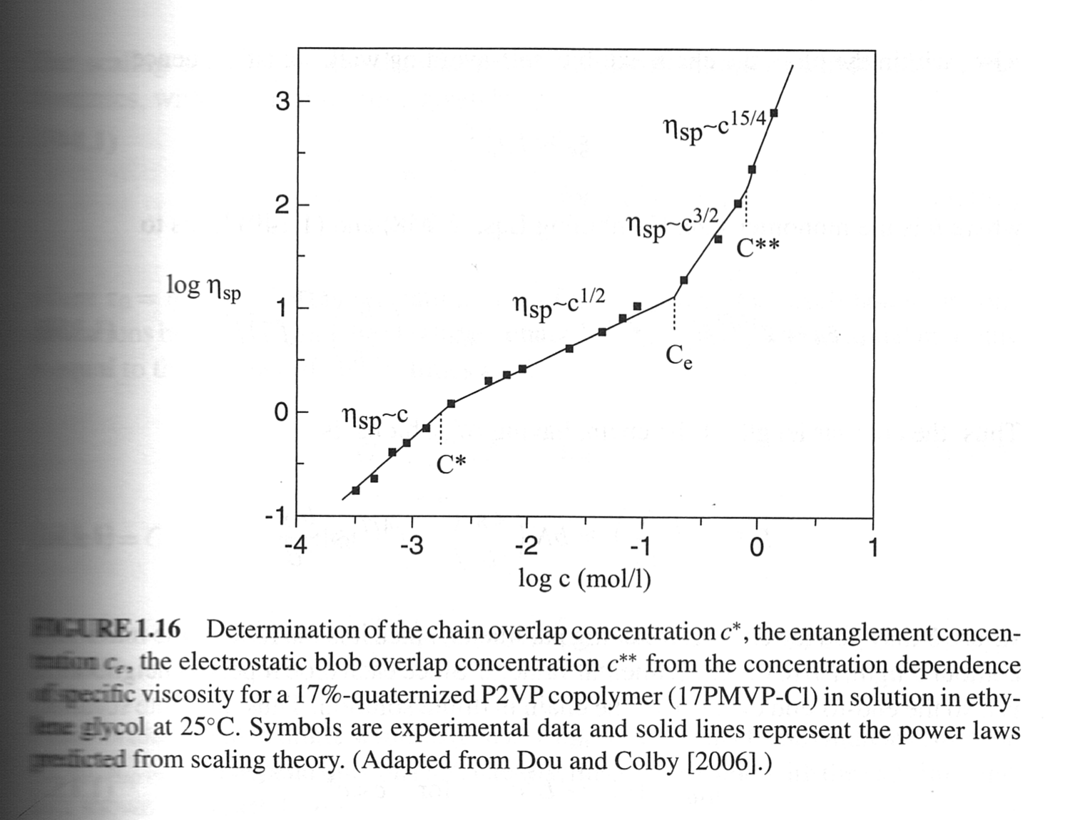
Polyelectrolytes and Intrinsic Viscosity
η_{sp} = (η−1)/ η₀
= φ [η]
Kulicke & Clasen “Viscosimetry of Polymers and Polyelectrolytes (2004)

Slide 29
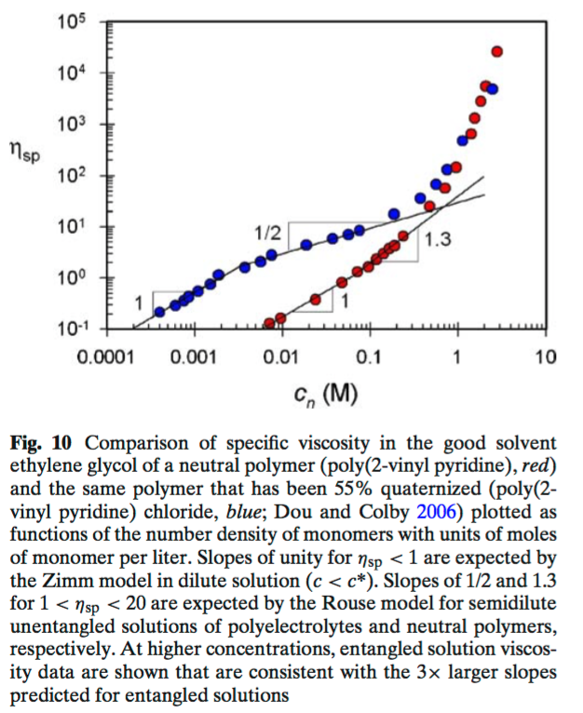
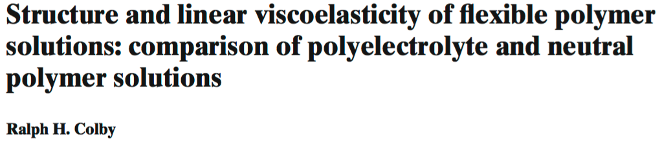

η_{sp} = (η−1)/ η₀
= φ [η]

Slide 30
Hydrodynamic Radius from Dynamic Light Scattering
http://www.eng.uc.edu/~gbeaucag/Classes/Properties/HiemenzRajagopalanDLS.pdf
http://www.eng.uc.edu/~gbeaucag/Classes/Physics/DLS.pdf
http://www.eng.uc.edu/~gbeaucag/Classes/Properties/HydrodyamicRadius.pdf

Slide 31
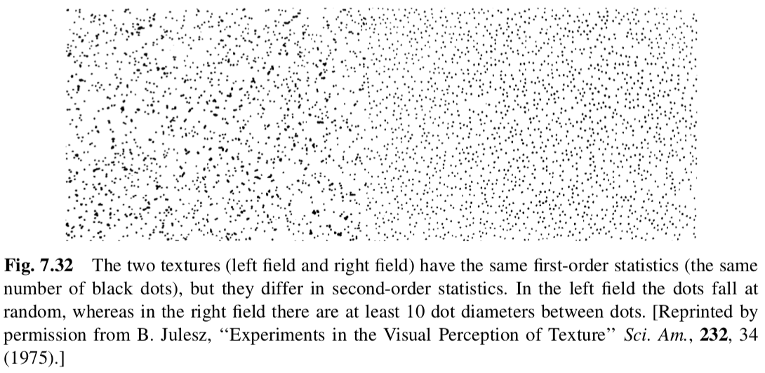
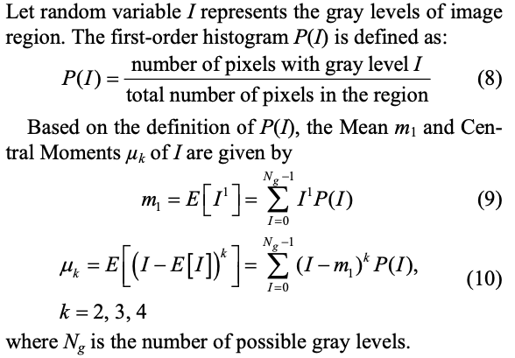
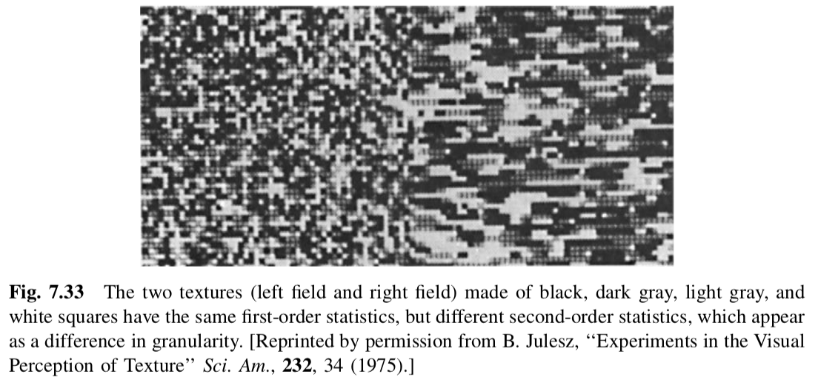
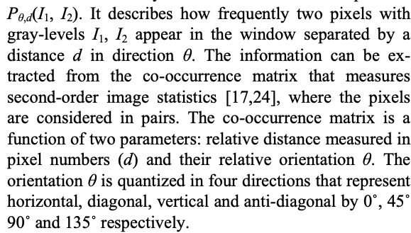

Correlation Functions (Tadmor and Gogos pp. 381)

Slide 32
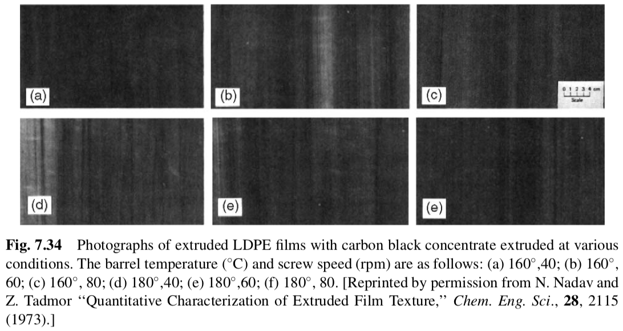
Correlation Functions (Tadmor and Gogos pp. 381)

Slide 33
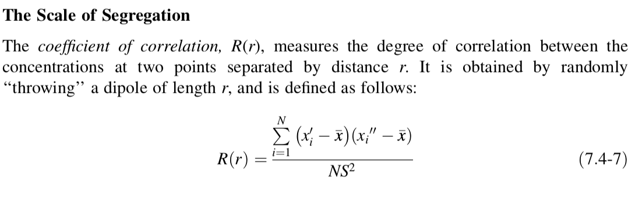

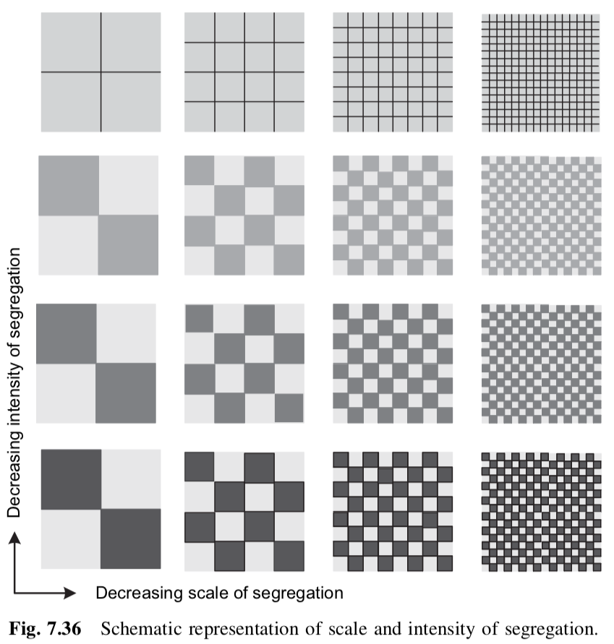
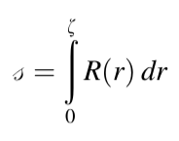
Correlation Functions (Tadmor and Gogos pp. 381)
Gross Uniformity: Gaussian distribution of samples, First order
Scale of Segregation: Second order
0 to 1
Diffusion/Gradient
Non-reversible
Scale of Segregation
Laminar Flow
Before/After
Shear strain
Reversible

Slide 34
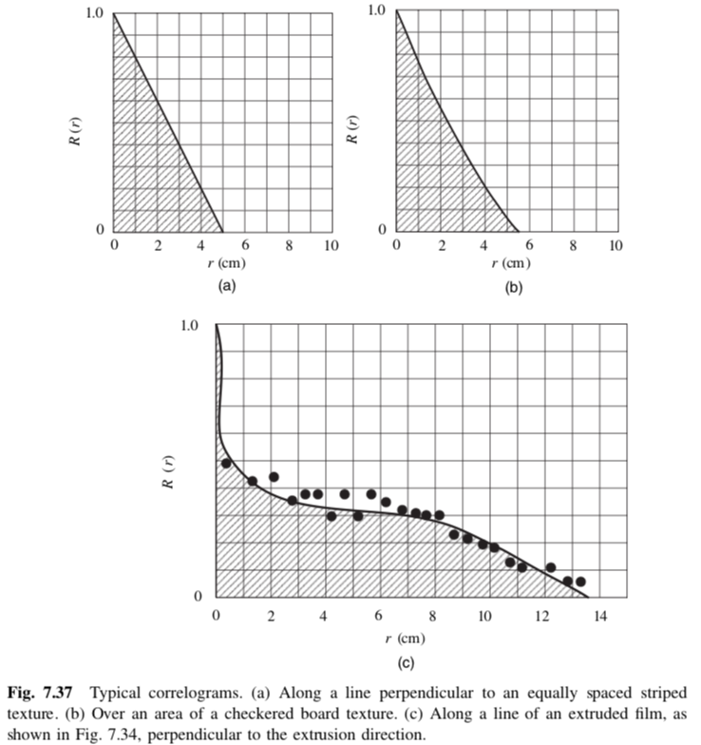
Correlation Functions (Tadmor and Gogos pp. 381)

Slide 35
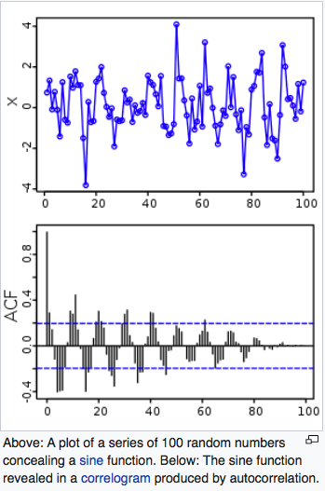
Correlation Functions
DLS deals with a time correlation function at a given “q” = 2π/d

Slide 36
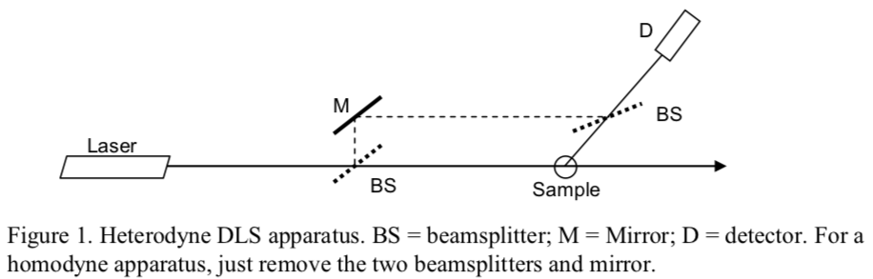
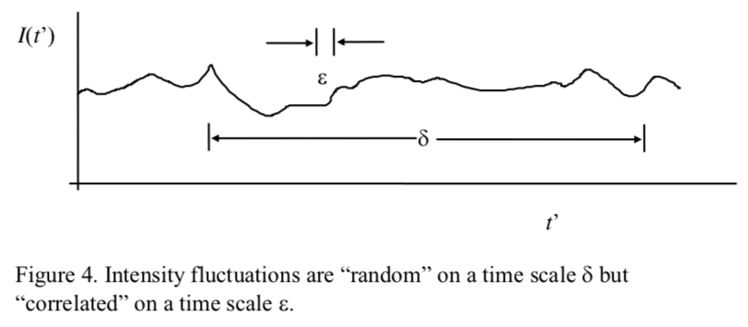
Paul Russo Lab
Dynamic Light Scattering
LSU
Georgia Tech

Slide 37




Fick’s Laws
Brownian Motion

Slide 38

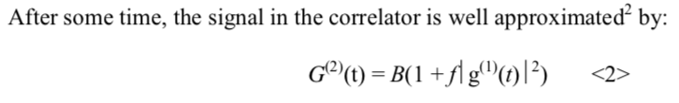



Paul Russo Lab
Not normalized second order correlation function (capital G, normalized is small g)

Slide 39

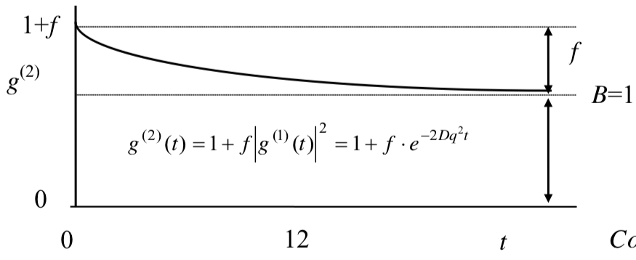
Paul Russo Lab

Slide 40
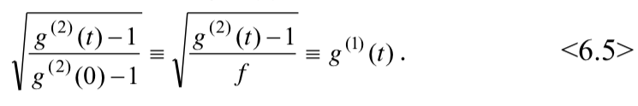
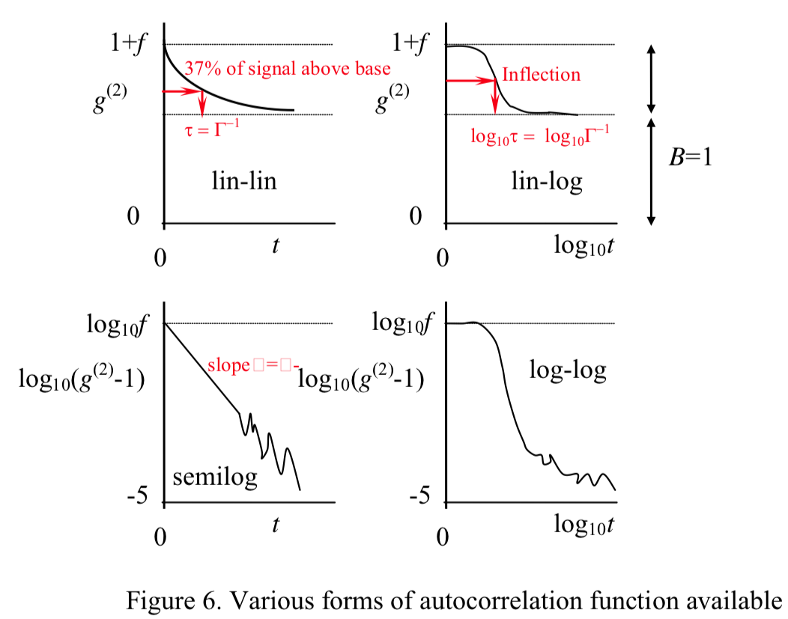
Paul Russo Lab

Slide 41
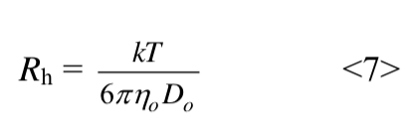

Paul Russo Lab

Slide 42

Paul Russo Lab

Slide 43
Consider motion of molecules or nanoparticles in solution
Particles move by Brownian Motion/Diffusion
The probability of finding a particle at a distance x from the starting point at t = 0 is a Gaussian Function that defines the diffusion Coefficient, D
The Stokes-Einstein relationship states that D is related to R_{H},
A laser beam hitting the solution will display a fluctuating scattered intensity at “q” that varies with q since the particles or molecules move in and out of the beam
I(q,t)
This fluctuation is related to the diffusion of the particles

Slide 44
Video of Speckle Pattern (http://www.youtube.com/watch?v=ow6F5HJhZo0)
For static scattering p(r) is the binary spatial auto-correlation function
We can also consider correlations in time, binary temporal correlation function
g1(q,τ)
For dynamics we consider a single value of q or r and watch how the intensity changes with time
I(q,t)
We consider correlation between intensities separated by t
We need to subtract the constant intensity due to scattering at different size scales
and consider only the fluctuations at a given size scale, r or 2π/r = q

Slide 45





Dynamic Light Scattering (http://www.eng.uc.edu/~gbeaucag/Classes/Physics/DLS.pdf)
Q_{e} = quantum efficiency
R = 2π/q
E_{s} = amplitude of scattered wave
q or K squared since size scales with the square root of time

Slide 46








Dynamic Light Scattering
a = R_{H} = Hydrodynamic Radius
The radius of an equivalent sphere following Stokes’ Law

Slide 47
Dynamic Light Scattering
my DLS web page
http://www.eng.uc.edu/~gbeaucag/Classes/Physics/DLS.pdf
Wiki
https://en.wikipedia.org/wiki/Dynamic_light_scattering
Wiki Einstein Stokes
http://webcache.googleusercontent.com/search?q=cache:yZDPRbqZ1BIJ:en.wikipedia.org/wiki/Einstein_relation_(kinetic_theory)+&cd=1&hl=en&ct=clnk&gl=us

Slide 48

Diffusing Wave Spectroscopy (DWS)
Traditional Rheology: Place a fluid in a shear field, measure torque/force and displacement
Microrheology: Observe the motion of a tracer.
Two types, passive or active microrheology. DWS is passive.

Slide 49
Diffusing Wave Spectroscopy (DWS)

Slide 50






Diffusing Wave Spectroscopy (DWS)
Viscous Motion
Elastic Motion

Slide 51


Diffusing Wave Spectroscopy (DWS)
For back scatter:

Slide 52

Diffusing Wave Spectroscopy (DWS)
For back scatter:

Slide 53

Link rheology to micelle structure
Ron Larson/Mike Weaver
persistence
length
Micelle
radius
DWS = blue lines
bending
modes
τ_{r}
c
Entanglement
Length
G₀
terminal
relaxation
1
Rouse
modes
2
G”_{min}
Mesh
Size
Structure inferred from rheology, using Standard Cates Model and newer developments (Larson group, others…)
Average
Micellar Length
Beth Schubert, 2003

Slide 54
Quasi-Elastic Neutron (and X-ray) Scattering
In the early days of DLS there were two approaches:
Laser light flickers creating a speckle pattern that can be analyzed in the time domain
The flickering is related to the diffusion coefficient through an exponential decay of the time correlation function
A more direct method is to take advantage of the Doppler effect. Train whistle appears to change pitch as the train passes since the speed of the train is close to 1/ω for the sound
If we know the frequency of the sound, we can determine the speed of the train
Measuring the spectrum from a laser, and the broadening of this spectrum after interaction with particles the diffusion coefficient can be determined from an exponential decay in the frequency, peak broadening. This is called quasi-elastic light scattering and measures the same thing as DLS by a different method.
For Neutrons and X-rays the time involved is too fast for correlators, pico- to nanoseconds. But line broadening can be observed (though there are no X-ray or neutron lasers i.e., monochromatic and columnated).
https://neutrons.ornl.gov/sites/default/files/QENSlectureNXS2019.pdf

Slide 55


Neutron and X-ray “Lasers”
For X-rays a synchrotron with an undulator insertion device can produce close to monochromatic and fairly coherent radiation. NSLS II Brookhaven National Laboratory near Stony Brook, Long Island NY (near NYC)

Slide 56



Neutron and X-ray “Lasers”
For neutrons, a spallation source with a time-of-flight detection system or a reactor with a velocity selector can result in a reasonably coherent and monochromatic (spectral in time) beam. SNS at Oak Ridge National Laboratory, Tennessee (near Knoxville) and NCNR at NIST Gaithersburg MD (near Washington DC).

Slide 57


Slide 58


Slide 59


Slide 60


Slide 61


Slide 62


Slide 63


Slide 64


Slide 65


Slide 66


Slide 67

R_{g}/R_{H} Ratio
R_{g} reflects spatial distribution of structure
R_{H} reflects dynamic response, drag coefficient in terms of an equivalent sphere
While both depend on “size” they have different dependencies on the details of structure
If the structure remains the same and only the amount or mass changes the ratio between these parameters remains constant. So the ratio describes, in someway, the structural connectivity, that is, how the structure is put together.
This can also be considered in the context of the “universal constant”
Lederer A et al. Angewandte Chemi 52 4659 (2013). (http://www.eng.uc.edu/~gbeaucag/Classes/Properties/DresdenRgbyRh4659_ftp.pdf)

Slide 68




R_{g}/R_{H} Ratio
Lederer A et al. Angewandte Chemi 52 4659 (2013). (http://www.eng.uc.edu/~gbeaucag/Classes/Properties/DresdenRgbyRh4659_ftp.pdf)

Slide 69
R_{g}/R_{H} Ratio
1.5
1.73
0.77
Burchard, Schmidt, Stockmayer, Macro. 13 1265 (1980) (http://www.eng.uc.edu/~gbeaucag/Classes/Properties/RgbyRhRatioBurchardma60077a045.pdf)

Slide 70


R_{g}/R_{H} Ratio
Burchard, Schmidt, Stockmayer, Macro. 13 1265 (1980) (http://www.eng.uc.edu/~gbeaucag/Classes/Properties/RgbyRhRatioBurchardma60077a045.pdf)

Slide 71


R_{g}/R_{H} Ratio
1.5 = Random Coil
~0.56 = Globule
Globule to Coil => Smooth Transition
Coil to Globule => Intermediate State
Less than (3/5)^{1/2} = 0.77 (sphere)
Wang X., Qiu X. , Wu C. Macro. 31 2972 (1998). (http://www.eng.uc.edu/~gbeaucag/Classes/Properties/RgbyRhPNIPAAMma971873p.pdf)

Slide 72

R_{g}/R_{H} Ratio
1.5 = Random Coil
~0.56 = Globule
Globule to Coil => Smooth Transition
Coil to Globule => Intermediate State
Less than (3/5)^{1/2} = 0.77 (sphere)
Wang X., Qiu X. , Wu C. Macro. 31 2972 (1998). (http://www.eng.uc.edu/~gbeaucag/Classes/Properties/RgbyRhPNIPAAMma971873p.pdf)

Slide 73



R_{g}/R_{H} Ratio
1.5 to 0.92 (> 0.77 for sphere)
Zhou K., Lu Y. , Li J., Shen L., Zhang F., Xie Z., Wu C. Macro. 41 8927 (2008). (http://www.eng.uc.edu/~gbeaucag/Classes/Properties/RgbyRhCoiltoGlobulema8019128.pdf)

Slide 74
R_{g}/R_{H} Ratio
This ratio has also been related to the shape of a colloidal particle

Slide 77

Static Scattering for Fractal Scaling

Slide 78


Slide 79


Slide 80


Slide 81


For qRg >> 1
df = 2

Slide 82
Ornstein-Zernike Equation
Has the correct functionality at high q
Debye Scattering Function =>
So,

Slide 83
Ornstein-Zernike Equation
Has the correct functionality at low q
Debye =>
The relatoinship between R_{g} and correlation length differs for the two regimes.

Slide 85
How does a polymer chain respond to external perturbation?

Slide 86







The Gaussian Chain
Boltzman Probability
For a Thermally Equilibrated System
Gaussian Probability
For a Chain of End to End Distance R
By Comparison The Energy to stretch a Thermally Equilibrated Chain Can be Written
Force
Force
Assumptions:
-Gaussian Chain
-Thermally Equilibrated
-Small Perturbation of Structure (so it is still Gaussian after the deformation)

Slide 87




For Larger Perturbations of Structure
-At small scales, small lever arm, structure remains Gaussian
-At large scales, large lever arm, structure becomes linear
Perturbation of Structure leads to a structural transition at a size scale
Tensile Blob
For weak perturbations of the chain
Application of an external stress to the ends of a chain create a transition size where the coil goes from Gaussian to Linear called the Tensile Blob.

Slide 88


For sizes larger than the blob size the structure is linear, one conformational state so the conformational entropy is 0. For sizes smaller the blob has the minimum spring constant so the weakest link governs the mechanical properties and the chains are random below this size.

Slide 89
Semi-Dilute Solution Chain Statistics

Slide 90



In dilute solution the coil contains a concentration c* ~ 1/[η]
for good solvent conditions
For semi-dilute solution the coil contains a concentration c > c*
At large sizes the coil acts as if it were in a concentrated solution (c>>>c*), d_{f} = 2. At small sizes the coil acts as if it were in a dilute solution, d_{f} = 5/3. There is a size scale, ξ, where this “scaling transition” occurs.
We have a primary structure of rod-like units, a secondary structure of expanded coil and a tertiary structure of Gaussian Chains.
What is the value of ξ?
ξ is related to the coil size R since it has a limiting value of R for c < c* and has a scaling relationship with the reduced concentration c/c*
There are no dependencies on n above c* so (3+4P)/5 = 0 and P = -3/4

Slide 91

Coil Size in terms of the concentration
This is called the “Concentration Blob”

Slide 92

Three regimes of chain scaling in concentration.

Slide 93


Thermal Blob
Chain expands from the theta condition to fully expanded gradually.
At small scales it is Gaussian, at large scales expanded (opposite of concentration blob).

Slide 94



Thermal Blob

Slide 95
Thermal Blob
Energy Depends on n, a chain with a mer unit of length 1 and n = 10000
could be re cast (renormalized) as a chain of unit length 100 and n = 100
The energy changes with n so depends on the definition of the base unit
Smaller chain segments have less entropy so phase separate first.
We expect the chain to become Gaussian on small scales first.
This is the opposite of the concentration blob.
Cooling an expanded coil leads to local chain structure collapsing to a Gaussian structure first.
As the temperature drops further the Gaussian blob becomes larger until the entire chain is
Gaussian at the theta temperature.

Slide 96



Thermal Blob
Flory-Krigbaum Theory yields:
By equating these:

Slide 97



Slide 98

Digitized from Farnoux

Slide 100




Fractal Aggregates and Agglomerates

Slide 101

Polymer Chains are Mass-Fractals
RRMS = n^{1/2} l
Mass ~ Size²
3-d object
Mass ~ Size³
2-d object
Mass ~ Size²
1-d object
Mass ~ Size¹
df-object
Mass ~ Size^{df}
This leads to odd properties:
density
For a 3-d object density doesn’t depend on size,
For a 2-d object density drops with Size
Larger polymers are less dense

Slide 104
How Complex Mass Fractal Structures
Can be Decomposed
Tortuosity
Connectivity
z
df
p
dmin
s
c
R/d
27
1.36
12
1.03
22
1.28
11.2

Slide 106



Disk
Random Coil
Extended β-sheet
(misfolded protein)
Unfolded Gaussian chain

Slide 107
Fractal Aggregates and Agglomerates
Primary Size for Fractal Aggregates

Slide 108


Fractal Aggregates and Agglomerates
Primary Size for Fractal Aggregates
-Particle counting from TEM
-Gas adsorption V/S => dp
-Static Scattering Rg, dp
-Dynamic Light Scattering
http://www.phys.ksu.edu/personal/sor/publications/2001/light.pdf
http://www.koboproductsinc.com/Downloads/PS-Measurement-Poster-V40.pdf

Slide 109

Fractal Aggregates and Agglomerates
Primary Size for Fractal Aggregates
-Particle counting from TEM
-Gas adsorption V/S => dp
-Static Scattering Rg, dp
-Dynamic Light Scattering
http://www.koboproductsinc.com/Downloads/PS-Measurement-Poster-V40.pdf

Slide 110
For static scattering p(r) is the binary spatial auto-correlation function
We can also consider correlations in time, binary temporal correlation function
g1(q,τ)
For dynamics we consider a single value of q or r and watch how the intensity changes with time
I(q,t)
We consider correlation between intensities separated by t
We need to subtract the constant intensity due to scattering at different size scales
and consider only the fluctuations at a given size scale, r or 2π/r = q

Slide 111
Dynamic Light Scattering
a = RH = Hydrodynamic Radius

Slide 112
Dynamic Light Scattering
my DLS web page
http://www.eng.uc.edu/~gbeaucag/Classes/Physics/DLS.pdf
Wiki
http://webcache.googleusercontent.com/search?q=cache:eY3xhiX117IJ:en.wikipedia.org/wiki/Dynamic_light_scattering+&cd=1&hl=en&ct=clnk&gl=us
Wiki Einstein Stokes
http://webcache.googleusercontent.com/search?q=cache:yZDPRbqZ1BIJ:en.wikipedia.org/wiki/Einstein_relation_(kinetic_theory)+&cd=1&hl=en&ct=clnk&gl=us

Slide 113








Gas Adsorption
A + S <=> AS
Adsorption
Desorption
Equilibrium
=
http://www.chem.ufl.edu/~itl/4411L_f00/ads/ads_1.html

Slide 114



Gas Adsorption
Multilayer adsorption
http://www.chem.ufl.edu/~itl/4411L_f00/ads/ads_1.html

Slide 115


http://www.eng.uc.edu/~gbeaucag/Classes/Nanopowders/GasAdsorptionReviews/ReviewofGasAdsorptionGOodOne.pdf

Slide 116
From gas adsorption obtain surface area by number of gas atoms times an area for the adsorbed gas atoms in a monolayer
Have a volume from the mass and density.
So you have S/V or V/S
Assume sphere S = 4πR², V = 4/3 πR³
So dp = 6V/S
Sauter Mean Diameter dp = <R³>/<R²>

Slide 117





Log-Normal Distribution
Mean
Geometric standard deviation and geometric mean (median)
Gaussian is centered at the Mean and is symmetric. For values that are positive (size) we need an asymmetric distribution function that has only values for greater than 1. In random processes we have a minimum size with high probability and diminishing probability for larger values.
http://www.eng.uc.edu/~gbeaucag/PDFPapers/ks5024%20Japplcryst%20Beaucage%20PSD.pdf
http://en.wikipedia.org/wiki/Log-normal_distribution

Slide 118



Log-Normal Distribution
Mean
Geometric standard deviation and geometric mean (median)
Static Scattering Determination of Log Normal Parameters
http://www.eng.uc.edu/~gbeaucag/PDFPapers/ks5024%20Japplcryst%20Beaucage%20PSD.pdf

Slide 119

Fractal Aggregates and Agglomerates
Primary Size for Fractal Aggregates
-Particle counting from TEM
-Gas adsorption V/S => dp
-Static Scattering Rg, dp
-Dynamic Light Scattering
http://www.eng.uc.edu/~gbeaucag/PDFPapers/ks5024%20Japplcryst%20Beaucage%20PSD.pdf

Slide 120




Fractal Aggregates and Agglomerates
Primary Size for Fractal Aggregates
-Particle counting from TEM
-Gas adsorption V/S => dp
-Static Scattering Rg, dp
Smaller Size = Higher S/V
(Closed Pores or similar issues)
http://www.eng.uc.edu/~gbeaucag/PDFPapers/ks5024%20Japplcryst%20Beaucage%20PSD.pdf

Slide 121



Fractal Aggregates and Agglomerates
Primary Size for Fractal Aggregates
Fractal Aggregate Primary Particles
http://www.eng.uc.edu/~gbeaucag/PDFPapers/ks5024%20Japplcryst%20Beaucage%20PSD.pdf

Slide 122
Fractal Aggregates and Agglomerates
Aggregate growth
Some Issues to Consider for Aggregation/Agglomeration
Path of Approach, Diffusive or Ballistic (Persistence of velocity for particles)
Concentration of Monomers
persistence length of velocity compared to mean separation distance
Branching and structural complexity
What happens when monomers or clusters get to a growth site:
Diffusion Limited Aggregation
Reaction Limited Aggregation
Chain Growth (Monomer-Cluster), Step Growth (Monomer-Monomer to Cluster-Cluster) or a Combination of Both (mass versus time plots)
Cluster-Cluster Aggregation
Monomer-Cluster Aggregation
Monomer-Monomer Aggregation
DLCA Diffusion Limited Cluster-Cluster Aggregation
RLCA Reaction Limited Cluster Aggregation
Post Growth: Internal Rearrangement/Sintering/Coalescence/Ostwald Ripening
http://www.eng.uc.edu/~gbeaucag/Classes/Nanopowders/AggregateGrowth.pdf

Slide 123

Fractal Aggregates and Agglomerates
Aggregate growth
Consider what might effect the dimension of a growing aggregate.
Transport Diffusion/Ballistic
Growth Early/Late (0-d point => Linear 1-d => Convoluted 2-d => Branched 2+d)
Speed of Transport Cluster, Monomer
Shielding of Interior
Rearrangement
Sintering
Primary Particle Shape
DLA df = 2.5 Monomer-Cluster (Meakin 1980 Low Concentration)
DLCA df = 1.8 (Higher Concentration Meakin 1985)
Ballistic Monomer-Cluster (low concentration) df = 3
Ballistic Cluster-Cluster (high concentration) df = 1.95

Slide 124

Fractal Aggregates and Agglomerates
Aggregate growth
Reaction Limited,
Short persistence of velocity
From DW Schaefer Class Notes

Slide 125

Fractal Aggregates and Agglomerates
Aggregate growth
From DW Schaefer Class Notes

Slide 126

Fractal Aggregates and Agglomerates
Aggregate growth
From DW Schaefer Class Notes

Slide 127


Fractal Aggregates and Agglomerates
Aggregate growth
Vold-Sutherland Model particles with random linear trajectories are added to a growing cluster of particles at the position where they first contact the cluster
Eden Model particles are added at random with equal probability to any unoccupied site adjacent to one or more occupied sites
(Surface Fractals are Produced)
Witten-Sander Model particles with random Brownian trajectories are added to a growing cluster of particles at the position where they first contact the cluster
Sutherland Model pairs of particles are assembled into randomly oriented dimers. Dimers are coupled at random to construct tetramers, then octoamers etc. This is a step-growth process except that all reactions occur synchronously (monodisperse system).
In RLCA a “sticking probability is introduced in the random growth process of clusters. This increases the dimension.
In DLCA the “sticking probability is 1. Clusters follow random walk.
http://www.eng.uc.edu/~gbeaucag/Classes/MorphologyofComplexMaterials/MeakinVoldSunderlandEdenWittenSanders.pdf
From DW Schaefer Class Notes

Slide 128

Fractal Aggregates and Agglomerates
Aggregate growth
From DW Schaefer Class Notes

Slide 129

Fractal Aggregates and Agglomerates
Aggregate growth
From DW Schaefer Class Notes

Slide 130
Fractal Aggregates and Agglomerates
Primary: Primary Particles
Tertiary: Agglomerates
Primary: Primary Particles
Secondary: Aggregates
Tertiary: Agglomerates
From DW Schaefer Class Notes
http://www.eng.uc.edu/~gbeaucag/PDFPapers/ks5024%20Japplcryst%20Beaucage%20PSD.pdf

Slide 131
Hierarchy of Polymer Chain Dynamics

Slide 132


Dilute Solution Chain
Dynamics of the chain
The exponential term is the “response function”
response to a pulse perturbation

Slide 133






Dilute Solution Chain
Dynamics of the chain
Damped Harmonic
Oscillator
For Brownian motion
of a harmonic bead in a solvent
this response function can be used to calculate the
time correlation function <x(t)x(0)>
for DLS for instance
τ is a relaxation time.

Slide 134





Dilute Solution Chain
Dynamics of the chain
Rouse Motion
Beads 0 and N are special
For Beads 1 to N-1
For Bead 0 use R-1 = R0 and for bead N RN+1 = RN
This is called a closure relationship

Slide 135


Dilute Solution Chain
Dynamics of the chain
Rouse Motion
The Rouse unit size is arbitrary so we can make it very small and:
With dR/dt = 0 at i = 0 and N
Reflects the curvature of R in i,
it describes modes of vibration like on a guitar string

Slide 136




Dilute Solution Chain
Dynamics of the chain
Rouse Motion
Describes modes of vibration like on a guitar string
For the “p’th” mode (0’th mode is the whole chain (string))

Slide 137
Dilute Solution Chain
Dynamics of the chain
Rouse Motion
Predicts that the viscosity will follow N which is true for low molecular weights in the melt and for fully draining polymers in solution
Rouse model predicts
Relaxation time follows N² (actually follows N³/df)
Diffusion constant follows 1/N (zeroth order mode is translation of the molecule) (actually follows N^{-1/df})
Both failings are due to hydrodynamic interactions (incomplete draining of coil)

Slide 138


Dilute Solution Chain
Dynamics of the chain
Rouse Motion
Predicts that the viscosity will follow N which is true for low molecular weights in the melt and for fully draining polymers in solution
Rouse model predicts
Relaxation time follows N² (actually follows N³/df)

Slide 139
Hierarchy of Entangled Melts

Slide 140
Hierarchy of Entangled Melts
Chain dynamics in the melt can be described by a small set of “physically motivated, material-specific paramters”
Tube Diameter dT
Kuhn Length lK
Packing Length p
http://www.eng.uc.edu/~gbeaucag/Classes/MorphologyofComplexMaterials/SukumaranScience.pdf

Slide 141


Quasi-elastic neutron scattering data demonstrating the existence of the tube
Unconstrained motion => S(q) goes to 0 at very long times
Each curve is for a different q = 1/size
At small size there are less constraints (within the tube)
At large sizes there is substantial constraint (the tube)
By extrapolation to high times
a size for the tube can be obtained
dT

Slide 142

There are two regimes of hierarchy in time dependence
Small-scale unconstrained Rouse behavior
Large-scale tube behavior
We say that the tube follows a “primitive path”
This path can “relax” in time = Tube relaxation or Tube Renewal
Without tube renewal the Reptation model predicts that viscosity follows N³ (observed is N^{3.4})

Slide 143

Without tube renewal the Reptation model predicts that viscosity follows N³ (observed is N^{3.4})

Slide 144

Reptation predicts that the diffusion coefficient will follow N² (Experimentally it follows N²)
Reptation has some experimental verification
Where it is not verified we understand that tube renewal is the main issue.
(Rouse Model predicts D ~ 1/N)

Slide 145

Reptation of DNA in a concentrated solution

Slide 146

Simulation of the tube

Slide 147

Simulation of the tube

Slide 148


Plateau Modulus
Not Dependent on N, Depends on T and concentration

Slide 149
Kuhn Length- conformations of chains <R²> = lKL
Packing Length- length were polymers interpenetrate p = 1/(ρchain <R²>)
where ρchain is the number density of monomers

Slide 150

this implies that dT ~ p

Slide 151


Slide 155

McLeish/Milner/Read/Larsen Hierarchical Relaxation Model
http://www.engin.umich.edu/dept/che/research/larson/downloads/Hierarchical-3.0-manual.pdf

Slide 156
Block Copolymers
http://www.eng.uc.edu/~gbeaucag/Classes/MorphologyofComplexMaterials/BCP%20Section.pdf

Slide 157




Block Copolymers
SBR Rubber

Slide 158

http://www.eng.uc.edu/~gbeaucag/Classes/MorphologyofComplexMaterials/Amphiphilic.pdf

Slide 159

http://www.eng.uc.edu/~gbeaucag/Classes/MorphologyofComplexMaterials/BCP%20Modeling.pdf

Slide 160

Hierarchy in BCP’s and Micellar Systems
Pluronics (PEO/PPO block copolymers)
We consider primary structure as the block nature of the polymer chain.
This is similar to hydrophobic and hydrophilic interactions in proteins.
These cause a secondary self-organization into rods/spheres/sheets.
A tertiary organizaiton of these secondary structures occurs.
There are some similarities to proteins but BCP’s are extremely simple systems by comparison.

Slide 161



What is the size of a Block Copolymer Domain?
Masao Doi, Introduction to Polymer Physics
-For and symmetric A-B block copolymer
-Consider a lamellar structure with Φ = 1/2
-Layer thickness D in a cube of edge length L, surface energy σ
- so larger D means less surface and a lower Free Energy F.
-The polymer chain is stretched as D increases. The free energy of
a stretched chain as a function of the extension length D is given by
- where N is the degree of polymerization for A or B,
b is the step length per N unit, νc is the excluded volume for a unit step
So the stretching free energy, F, increases with D².
-To minimize the free energies we have

Slide 163


Chain Scaling (Long-Range Interactions)
Long-range interactions are interactions of chain units separated by such a
great index difference that we have no means to determine if they are from the same chain
other than following the chain over great distances to determine the connectivity. That is,
Orientation/continuity or polarity and other short range linking properties are completely lost.
Long-range interactions occur over short spatial distances (as do all interactions).
Consider chain scaling with no long-range interactions.
The chain is composed of a series of steps with no orientational relationship to each other.
So <R> = 0
<R²> has a value:
We assume no long range interactions so that the second term can be 0.

