Slide 1
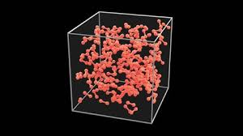

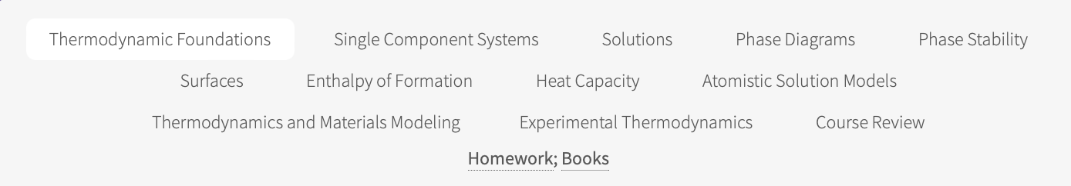
Advanced Materials Thermodynamics
Course Outline
Course webpage:
https://www.eng.uc.edu/~beaucag/Classes/AdvancedMaterialsThermodynamics/AdvMatThermo.html#Intro
Class meets Tuesday and Thursday 12:30-1:45 Baldwin 643
Greg Beaucage

Slide 2
Advanced Materials Thermodynamics
Course Outline
Weekly homework due on Monday at noon
You can work with other students but need a unique paper
You can use ChatGPT to help but you need to write your own answers
Format is like the PhD qualifier questions (sometimes the same questions appear)
Final homework
The final homework is an individual assignment and is due Friday December 12 (counts as 4 weekly homework)

Slide 3
Advanced Materials Thermodynamics
Course Outline
Format of the homework:
Usually focuses on a paper related to the class topics
Five questions on the paper
Best approach is to read the paper then answer the questions based on what was covered that week

Slide 4
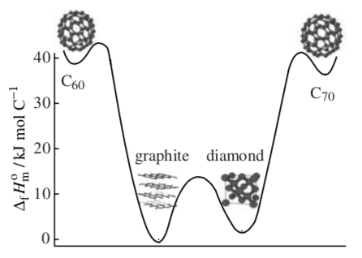
Introduction
Definition of Terms:
Homogeneous Heterogeneous
Ergotic and Non-Ergotic
(Odyssey way path)
(Ergotic try all paths => crystal)
(Non-Ergotic stuck on one path => glass)
Meta-stable
Equilibrium
Extent, extensive: V, Mass
Intensive: Density, Temperature
State Function T, P, ρ, G, H, S,…
First Law, Energy is Conserved
ΣdU = Σdq + Σdw = 0
Internal Energy, Heat, Work
Adiabatic, Exothermic, Endothermic
For thermodynamics we prefer ergodic, equilibrium states.

Slide 5
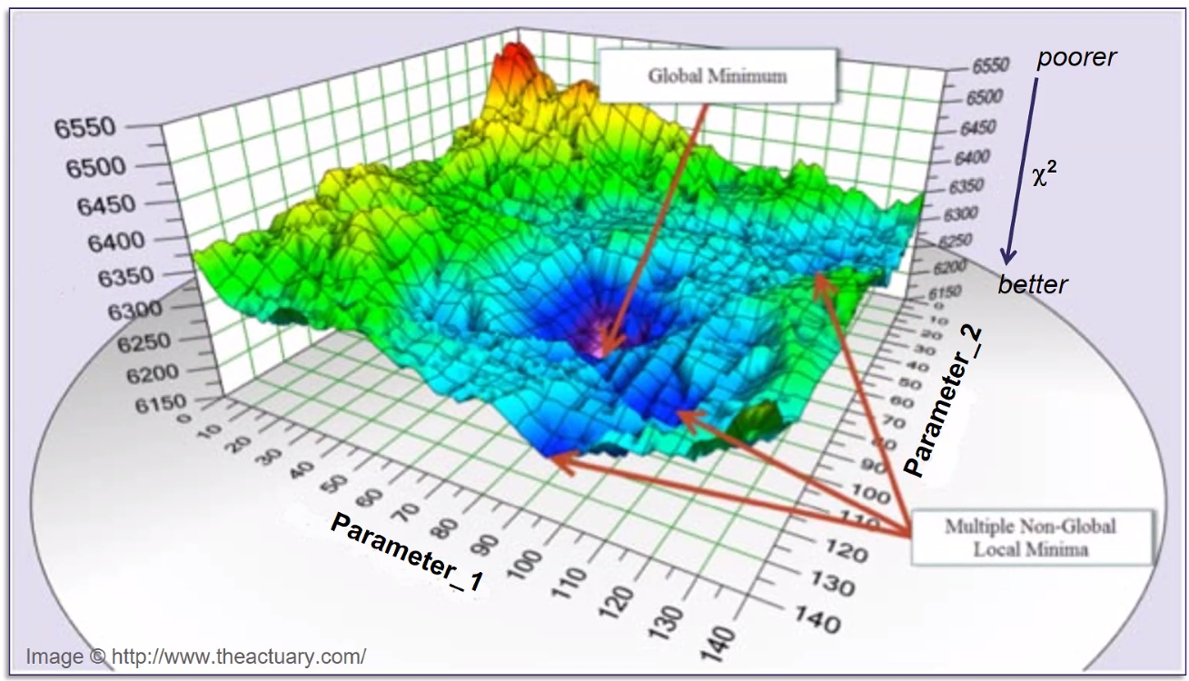
Energy Landscape, typically Gibbs Free Energy G = H - TS
Energy

Slide 6
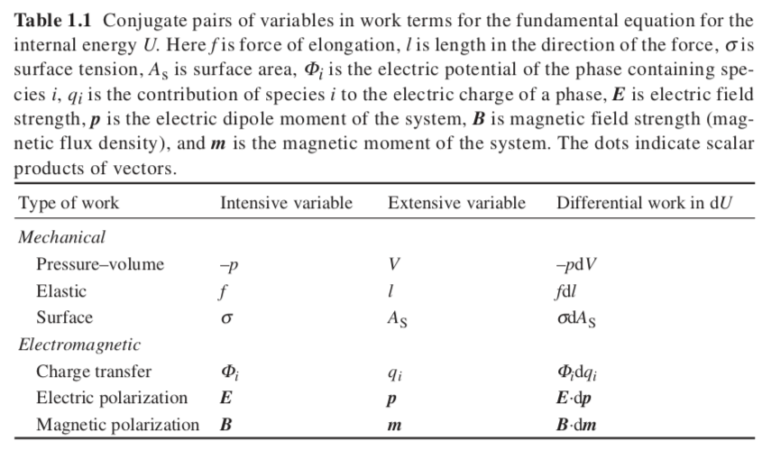

Slide 7
What happens to the energy when I heat a material?
Or How much heat, dq, is required to change the temperature dT? (Heat Capacity, C)
dq = C dT
C = dq/dT
Constant Volume, C_{V}
dU = dq + dw
With only pV work (expansion/contraction), dw_{ec} = -pdV
dU = dq – pdV
For constant volume
(dU)_{V} = dq, so
C_{V} = (dU/dT)_{V}, or the energy change with T: (dU)_{V} = C_{V} dT
Constant Volume
Computer Simulation
Helmholtz Free Energy, A
A = U – TS = G - pV
Constant Pressure, C_{p}
dU = dq + dw = dq – pdV (only e/c work, i.e. no shaft work)
Invent Entropy H = U + PV so dH = dU + pdV + Vdp
(dH)_{p} = dU + pdV for constant pressure
Rearrange first equation and equate to (dH)_{p}
dq = dU + pdV = (dH)_{p} and C = dq/dT so
C_{p} = (dH/dT)_{p} , or the enthalpy change with T: (dH)_{p} = C_{p} dT
Constant Pressure
Atmospheric Experiments
Gibbs Free Energy, G
G = H – TS = A + pV

Slide 8

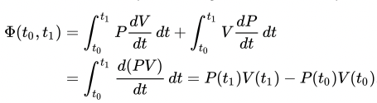
State Functions (https://en.wikipedia.org/wiki/State_function)
Parameters that depend only on the current equilibrium state (Pressure, temperature, enthalpy, specific volume, energy)
Not on the path taken to reach that state (work and heat). Work is not a conserved value like energy.
Dimension of the “state space” which is always two for us. PV = nRT so with two state functions we can describe the “state” PV or P/T or P/V or VT describe the state. (see Steam Table)
For the 2-dimensional state space we can trace out a path:
The end point is not dependent on the path for equilibrium states. So, you could take a constant pressure path and add a constant volume path to replace a variable pressure and volume path and calculate the state parameters of the end state.
Generally, we don’t know absolute values for H, S, G, A state parameters so we are always using a “reference state”.
That is, should we consider the energy of fusion in calculating the energy of water.

Slide 9
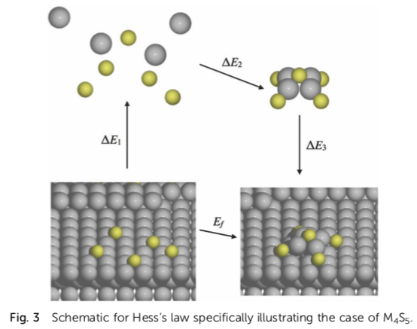
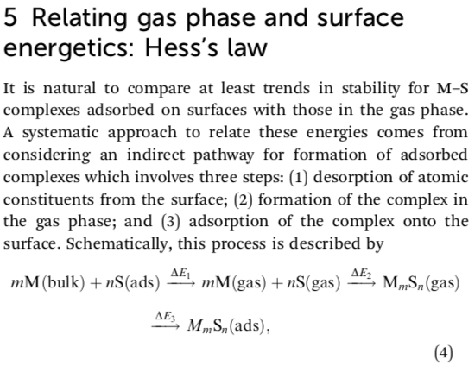
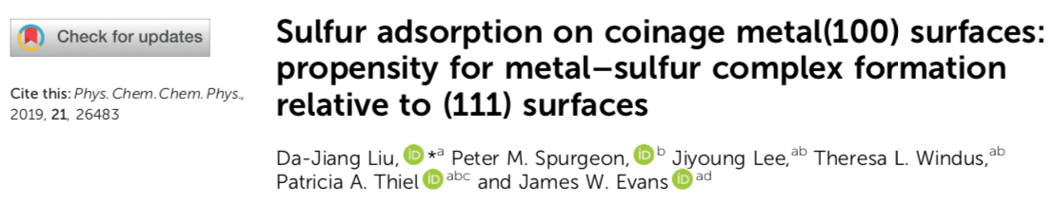
Hess’ Law
(total enthalpy of a reaction is the sum of the changes regardless of the path;
Justification for the use of standard enthalpy of formation)

Slide 10
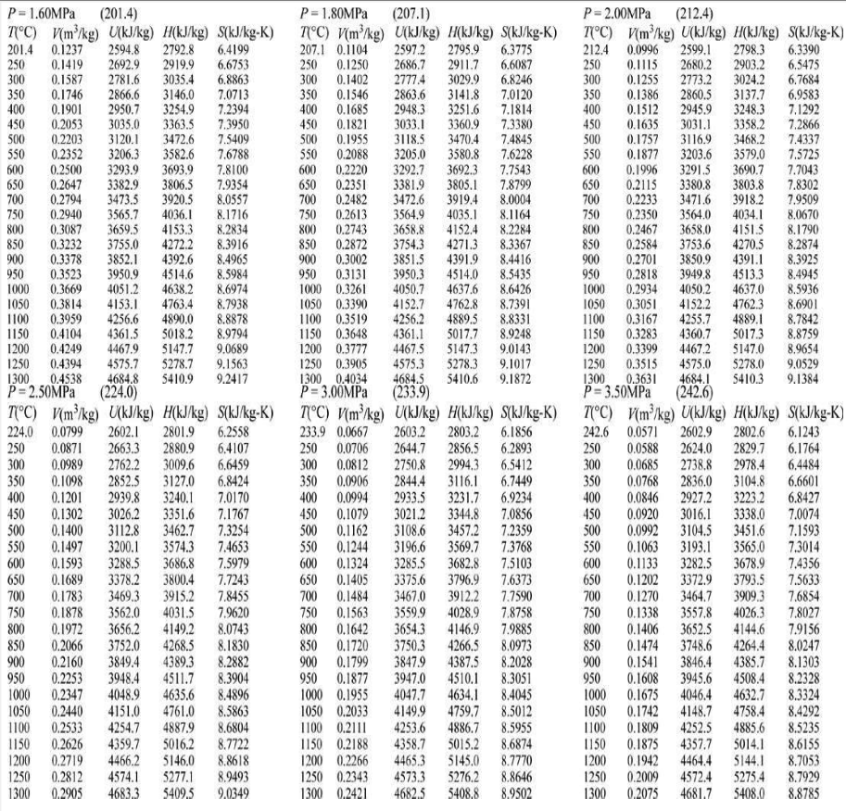
Steam Tables
If I know P and T
I can get V, U, H, S
If I know H and S
I can get P, T, V, U
These tables are generated by the PREOS Equation of State which is a state function like PV=nRT
State Functions (https://en.wikipedia.org/wiki/State_function)

Slide 11
Thermodynamic Square
-S U V
H A
-p G T
H = U + PV
A = U – TS = G - pV
G = H – TS = A + pV

Slide 12
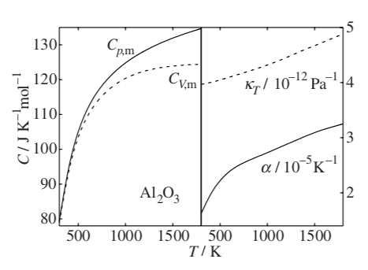
C_{p} - C_{v} = α²VT/κ_{T}
α = (1/V) (dV/dT)_{p}
κ_{T} = (1/V) (dV/dP)_{T}
We will obtain this later

Slide 13
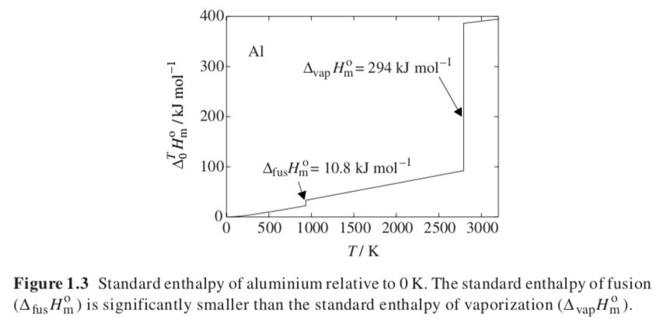
Slope is C_{p}, this is not defined at first order transitions
(melting and vaporization, crystalline phase change, order/disorder transition)

Slide 14
Size dependent enthalpy of melting
(Gibbs-Thompson Equation)
For bulk materials, r = ∞, at the melting point ΔG = ΔH – T∞ΔS = 0
So, T∞ = ΔH/ΔS Larger bonding enthalpy leads to higher T∞ , Greater randomness gain on melting leads to lower T∞.
For nanoparticles there is also a surface term,
(ΔG) V = (ΔH – T_{r}ΔS)V + σA = 0, where T_{r} is the melting point for size r nanoparticle
If V = r³ and A = r² and using ΔS = ΔH/T∞ this becomes,
ΔS r = σ/(ΔH(1– T_{r}/T∞)) or T_{r} = T∞ (1 - σ/(r ΔH))
Smaller particles have a lower melting point, and the dependence suggests a plot of T_{r}/T∞ against 1/r with negative slope -σ/ΔH

Slide 15
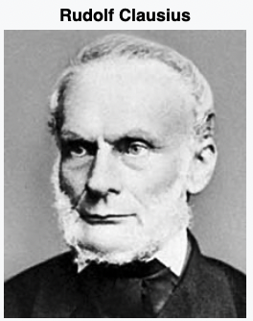
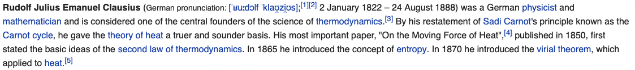
Second Law: Reversibility
For an adiabatic reversible system ΔS = 0
In a process this is often used by engineers in calculations
1) Assume ΔS = 0, calculate ΔH for the process
2) Use an efficiency, η, to modify ΔH to a larger value
3) Calculate the actual ΔS > 0 for the process
The change in entropy is tied to the concept of efficiency
100% efficient process has ΔS = 0
Calusius Theorem is that entropy increases or stays the same but can not spontaneously decrease
For a reversible process dS_{rev} = (dq/T)_{rev}
For any process dS ≥ (dq/T)

Slide 16
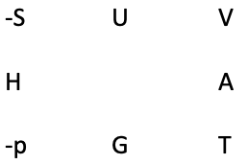
Equilibrium
For any process dS ≥ (dq/T) (Calusius Theorem)
Or dq – TdS <= 0
dq – TdS we can call the “Change in Free Energy”
(This is the free energy available to do work.)
For a reversible process at thermodynamic equilibrium, it is equal to 0
This is a quantitative definition for equilibrium
At constant volume (Simulations) dq = dU
The Helmholtz Free Energy is defined: A = U – TS so dA = dU –TdS - SdT
dA = dU –TdS (at constant temperature)
dA = 0 at equilibrium for constant V and T
At constant pressure (Experiments) dq = dH
The Gibbs Free Energy is defined: G = H – TS so dG = dH – TdS – SdT
dG = dH – TdS (at constant temperature)
dG = 0 at equilibrium for constant p and T

Slide 17
Third Law
S = k_{B}lnΩ
is the number of states
For an infinite perfect crystal there is only one state
Ω = 1 and lnΩ = 0 so S = 0
This could only occur at T = 0 for an ergodic system where there is no thermal motion. (without thermal motion the system can’t be ergodic, so it is not possible to reach this hypothetical state)

Slide 18
Legendre transformation to obtain Maxwell Relationship
These are relationships that are useful to relate differential thermodynamic properties
Like heat capacities, thermal expansion coefficient etc.
dU = dq + dw
1) For only ec work
dU = dq – pdV
2) dq = TdS for a reversible process
dU = TdS – pdV
So U is naturally broken into functions of S and V
(dU/dS)_{V} = T Use below
(dU/dV)_{S} = -p Use below
dU = (dU/dS)_{V} dS + (dU/dV)_{S} dV
dU = (dU/dS)_{V} dS + (dU/dV)_{S} dV
Take the second derivative
d²U/(dSdV) =(d (dU/dV)_{S} /dS)_{V} = (d (dU/dS) _{V} /dV) _{S} = d²U/(dVdS)
Using the above expressions and the middle two terms
-(dp/dS)_{V} = (dT/dV)_{S}
This is a Maxwell Relationship, and the process is called a Legendre transformation
This can be done for all four fundamental equations, U; H; G; A

Slide 19
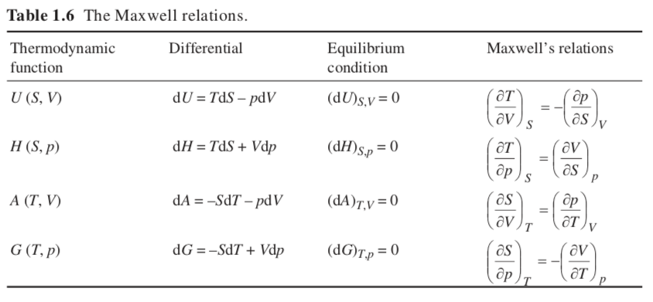

Slide 20
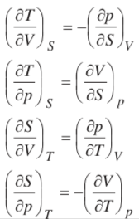
Thermodynamic Square
-S U V
H A
-p G T

Slide 21
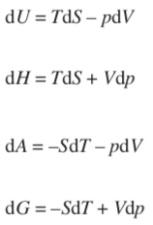
Thermodynamic Square
-S U V
H A
-p G T
Definition of G = H – TS
dG = dH –T dS – S dT
Definition of H = U + PV
dH = dU + PdV + V dP
Definition of dU = dw + dq
No shaft work and reversible (2’d law)
dU = -PdV + TdS
So, dH = -PdV + TdS + PdV + VdP = TdS + VdP
dG = TdS + VdP – TdS – SdT
= VdP - SdT

Slide 22
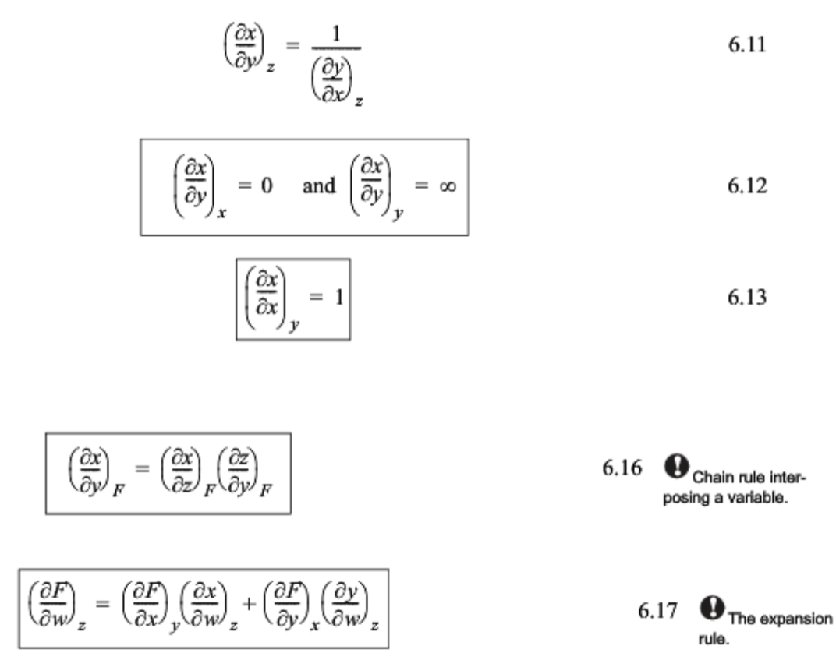
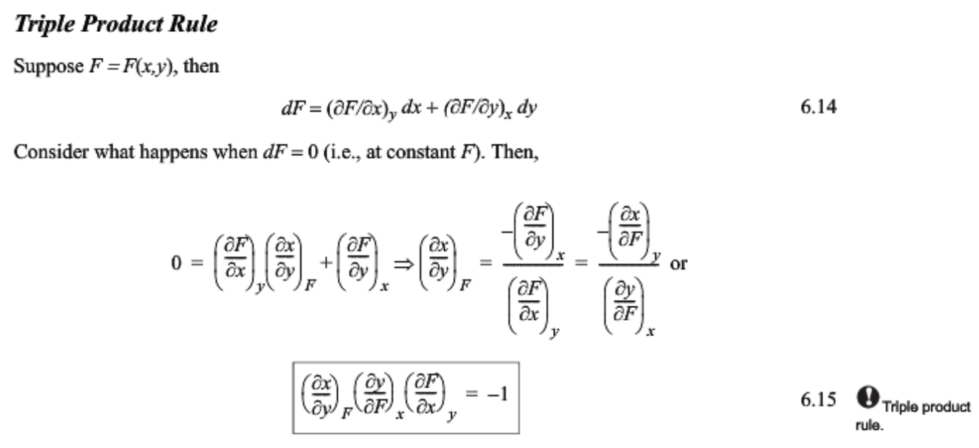
Useful Rules for thermodynamic differentials

Slide 23
Derive the expression for C_{p} – C_{V}
-S U V
H A
-p G T
C_{p} - C_{v} = α²VT/κ_{T}
α = (1/V) (dV/dT)_{p}
κ_{T} = (1/V) (dV/dP)_{T}
C_{V} = (dU/dT)_{V}
From the Thermodynamic Square
dU = TdS – pdV so C_{V} = (dU/dT)_{V} = T (dS/dT)_{V} - p (dV/dT)_{V}
Second term is 0 dV at constant V is 0
(dS/dT)_{V} = C_{V} /T
Similarly
C_{p} = (dH/dT)_{p}
From the Thermodynamic Square
dH = TdS + Vdp so C_{p} = (dH/dT)_{p} = T (dS/dT)_{p} - V (dp/dT)_{p}
Second term is 0 dp at constant p is 0
(dS/dT)_{p} = C_{p} /T
Write a differential expression for dS as a function of T and V
dS = (dS/dT)_{V}dT + (dS/dV)_{T}dV using expression for C_{V} above and Maxwell for (dS/dV)_{T}
dS = C_{V} /T dT + (dp/dT)_{V}dV use chain rule: (dp/dT)_{V} = -(dV/dT)_{p} (dP/dV)_{T} = Vα / (Vκ_{T})
Take the derivative for C_{p}: C_{p}/T = (dS/dT)_{p} = C_{V} /T (dT/dT)_{p} + (α/κ_{T})(dV/dT)_{p} = C_{V} /T + (Vα²/κ_{T})
C_{p} - C_{v} = α²VT/κ_{T}

Slide 24
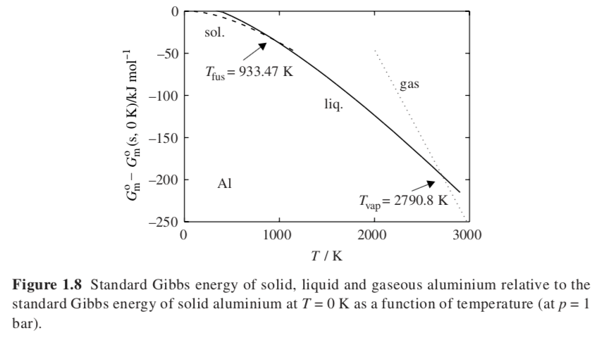

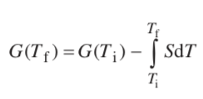
Lowest Gibbs Free Energy is the stable phase
Why does G decrease with T?
-S U V
H A
-p G T
dG = VdP - SdT
S generally increases
With temperature

Slide 25

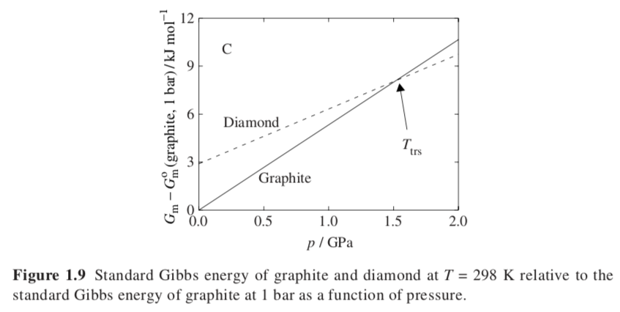
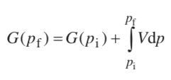
-S U V
H A
-p G T
Lowest Gibbs Free Energy is the stable phase
Why does G increase with p?
dG = VdP - SdT
Volume is positive
So G increases with pressure
Diamond is denser than graphite so weaker slope
Hence graphite is more stable at low pressure

Slide 26
Phases at Equilibrium, Chemical Potential or partial molar Gibbs free energy
(For multiple phases and/or components)
Consider water and water vapor at equilibrium. A molecule of water can leave liquid water and join the water vapor due to thermal energy. At equilibrium it can just as likely leave water vapor to join liquid water. We are not considering the interfacial energy.
The total number of moles in the container (system), n_{total}, is fixed. But the number in liquid water can change by dn_{liquid} = -dn_{vapor}. This change would change the Gibbs free energy (we are doing an experiment at constant atmospheric pressure).
μ_{liq} = (dG_{liq}/dn_{liq}) = (dG_{vap}/dn_{vap}) = μ_{vap} at equilibrium
so that the change for liquid = -the change for vapor;
dn_{liq} = -dn_{vap} for conservation of mass.
dn_{liq} μ_{liq} = dn_{vap} μ_{vap}
μ_{vap} is called the chemical potential of water in the vapor phase.
Chemical potential always has two qualifiers, of what component in what phase.
μ_{vap} is the partial molar Gibbs Free Energy of water in the vapor phase.
H, S, V can also have partial molar values in the same way usually signified by a bar.

Slide 27
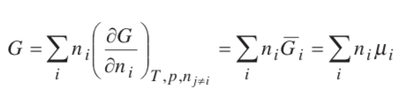






-S U V
H A
-p G T
Gibbs-Duhem Equation
(For multiple phases and/or components)
Consider a binary system A + B makes a solution
Fundamental equation with chemical potential:
At constant T and p:
So, at constant T and p:
Reintroducing the T and p dependences:
Gibbs-Duhem Equation
Changes in the chemical potential of the phases are related to the temperature and pressure through the entropy and specific volume
(Often used under isothermal and isobaric conditions)

Slide 28

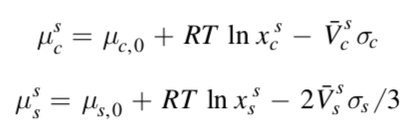
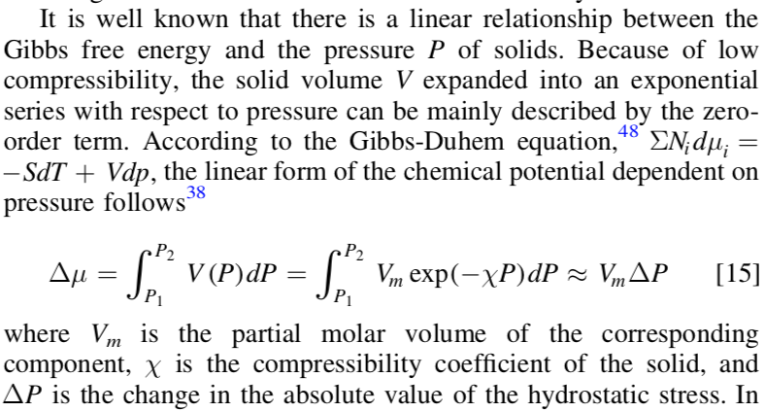
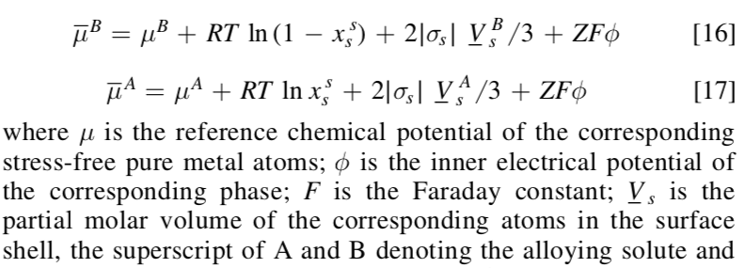
Corrosion in nanoparticles can be higher or lower
Consider a binary solution in a nanoparticle. There is significant stress on the surface, s, compared to the core, c. Break particle into core and surface regions with different stress, σ_{c}, σ_{s}, molar composition of the solute in core, x_{c}, and surface, x_{s}. Assume equilibrium, μ_{c} = μ_{s}. “ln” term is gaseous mixing entropy, 0 terms are for infinite dilution.
Gibbs-Duhem Equation
For the two components with an electric potential the equilibrium corrosion potential can be calculated for each component which changes with particle size.
σ = the stress (ΔP) so the contribution to chemical potential from stress is proportional to σ V depending on geometry

Slide 29
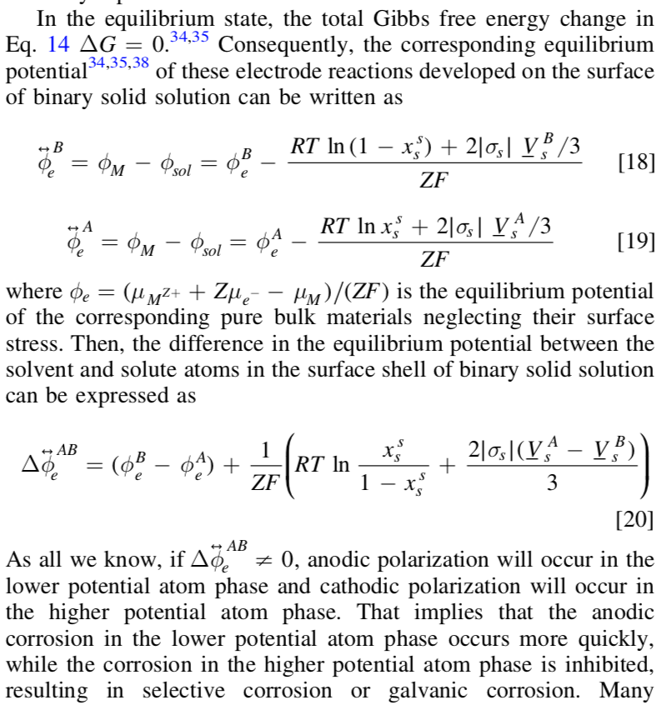

Slide 30
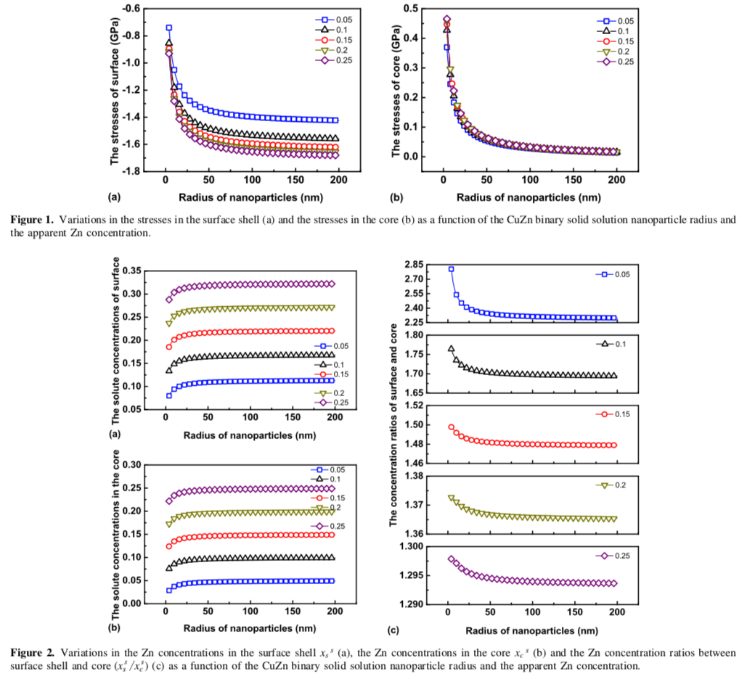

Slide 31
