Slide 1
Chapter 9: Phase Diagrams
ISSUES TO ADDRESS...
• When we combine two elements...
what is the resulting equilibrium state?
• In particular, if we specify...
-- the composition (e.g., wt% Cu - wt% Ni), and
-- the temperature (T )
then...
How many phases form?
What is the composition of each phase?
What is the amount of each phase?
What is the structure of each phase
Phase Behavior
Laughlin p. 67
Phase A
Phase B
Nickel atom
Copper atom

Slide 2
Components and Phases
• Components:
The elements or compounds which are present in the alloy
(e.g., Al and Cu)
• Phases:
The physically and chemically distinct material regions
that form (e.g., α and β).
Optical Mettalography
α
(lighter
phase)
β
(darker
1µm
phase)
Aluminum-Copper Alloy

Slide 3
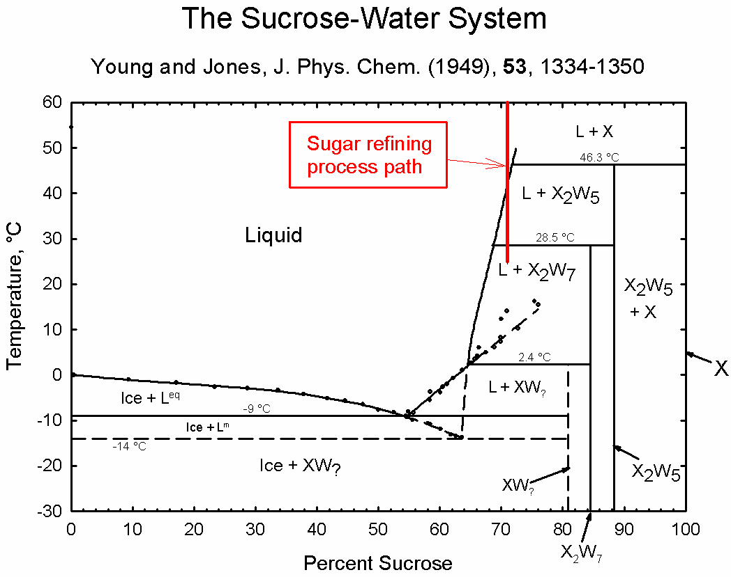
Solubility Limit
• Solution – solid, liquid, or gas solutions, single phase
• Mixture – more than one phase
Sugar/Water Phase Diagram
• Solubility Limit:
Maximum concentration for
which only a single phase
solution exists.
10
0
Solubility
8
0
Limit
L
(liquid)
6
0
L
+
Temperature (ºC)
Question: What is the
solubility limit for sugar in
water at 20ºC?
S
4
0
(syrup)
(solid
20
sugar)
0
20
40
60
65
80
100
Composition (wt% sugar)
Problem 9.2: At 170°C, what is the maximum solubility (a) of Pb in Sn? (b) of Sn in Pb? The lead-tin phase diagram is shown in the Animated Figure 9.8.
Notes:
Answer: 65 wt% sugar.
At 20ºC, if C < 65 wt% sugar: syrup
At 20ºC, if C > 65 wt% sugar:
syrup + sugar

Slide 4
Isomorphous Binary Phase Diagram
Cu-Ni phase diagram
1600
• System is:
1500
L (liquid)
-- binary
2 components: Cu and Ni.
1400
T(ºC)
liquidus
α
1300
L
+
-- isomorphous
i.e., complete solubility of
one component in another
solidus
1200
α
1100
solid solution
1000
0
20
40
60
80
100
wt% Ni

Slide 5
Criteria for Solid Solubility: Hume–Rothery rules
Same crystal structure
Similar electronegativities
Similar atomic radii
 | Crystal Structure | electroneg | r (nm)
Ni | FCC | 1.9 | 0.1246
Cu | FCC | 1.8 | 0.1278
Ni and Cu are totally soluble in one another for all proportions.

Slide 6
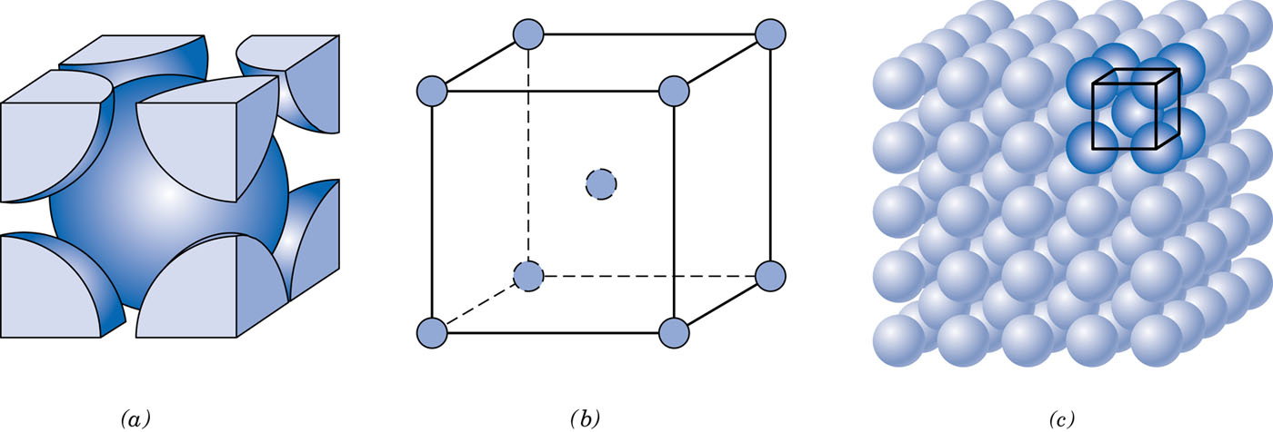
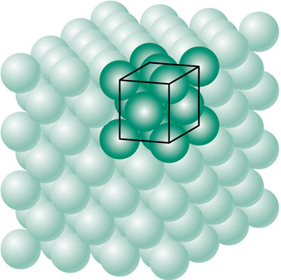
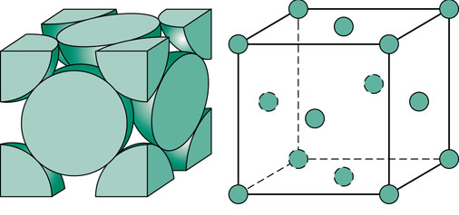
Structure
BCC
FCC

Slide 7
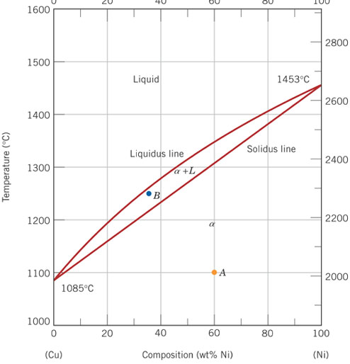
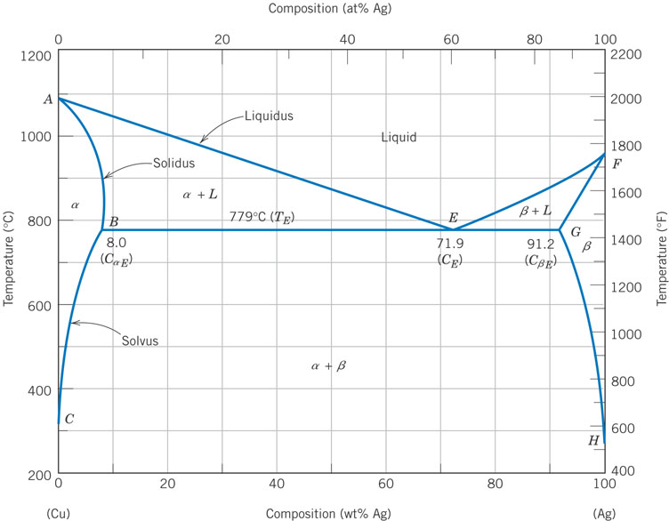
Periodic Table

Slide 8
Determination of phases present
• If we know T and C_{o}, then we know which phases are present.
Cu-Ni phase diagram
1600
• Examples:
1500
L
A(1100ºC, 60 wt% Ni):
1 phase: α
1400
(1250ºC,35)
T(ºC)
α
B
(1250ºC, 35 wt% Ni):
1300
L
+
2 phases: L + α
B
1200
α
1100
A(1100ºC,60)
1000
0
20
40
60
80
100
wt% Ni

Slide 9
Determination of phase compositions: Lever Rule
Tie line –– also sometimes called an isotherm
T(ºC)
What fraction of each phase?
Think of the tie line as a lever
(teeter-totter)
tie line
1300
L
α
L
+
B
T
B
M_{L}
M_{α}
α
1200
R
S
20
3
0
C_{L}
C₀
4
0
C_{α}
5
0
R
S
wt% Ni

Slide 10
Slow Cooling of a Cu-Ni Alloy
C₀ = 35 wt% Ni alloy
T(ºC)
L
L: 35wt%Ni
130
0
L: 35 wt% Ni
α: 46 wt% Ni
35
32
46
43
24
36
L: 32 wt% Ni
α: 43 wt% Ni
120
0
L: 24 wt% Ni
α
α: 36 wt% Ni
110
0
20
3
0
35
4
0
5
0
C₀
wt% Ni

Slide 11
Cored vs Equilibrium Structures
Uniform C_{α}:
35 wt% Ni
T(ºC)
L
130
0
35
46
32
43
24
36
120
0
First α to solidify:
46 wt% Ni
α
Last α to solidify:
< 35 wt% Ni
110
0
20
3
0
35
4
0
5
0
C₀
wt% Ni

Slide 12
Mechanical Properties: Cu-Ni System
• Effect of solid solution strengthening on:
-- Tensile strength (TS)
-- Ductility (%EL)
60
%EL
for pure Cu
400
50
%EL
for
TS for
pure Ni
Elongation (%EL)
Tensile Strength (MPa)
pure Ni
40
300
TS for pure Cu
30
200
20
0
20
40
60
80
100
0
20
40
60
80
100
Cu
Ni
Cu
Ni
Composition, wt% Ni
Composition, wt% Ni

Slide 13
Binary-Eutectic Systems
=low melting
2 components
Cu-Ag system
Ex.: Cu-Ag system
1200
• 3 single phase regions
L (liquid)
(L, α, β)
1000
α
L
+
α
800
779ºC
L
+
β
β
T_{E}
8.0
91.2
71.9
600
α
+
β
400
200
0
20
40
60
C_{E}
80
100
wt% Ag
Eutectic Phase Reaction:
cooling
heating

Slide 14
Microstructural Development in Eutectic Systems I
Pb-Sn
• For alloys for which
C₀ < 2 wt% Sn
• Result: at room temperature
-- polycrystalline with grains of
a phase having
composition C₀
T(ºC)
L: C₀ wt% Sn
400
L
α
300
L
L
+
α
α
200
T_{E}
α: C₀ wt% Sn
100
α
+
β
0
10
20
30
C₀
wt% Sn
2
(room T solubility limit)

Slide 15
Microstructural Development in Eutectic Systems II
• For alloys for which
2 wt% Sn < C₀ < 18.3 wt% Sn
• Result:
at temperatures in α + β range
-- polycrystalline with a grains
and small β-phase particles
T(ºC)
L: C₀ wt% Sn
400
L
L
300
α
L
+
α
a: C₀ wt% Sn
α
200
T_{E}
α
β
100
α
+
β
0
10
20
30
C
2
C₀
,
wt% Sn
(sol. limit at T
room
)
18.3
(sol. limit at T_{E})

Slide 16
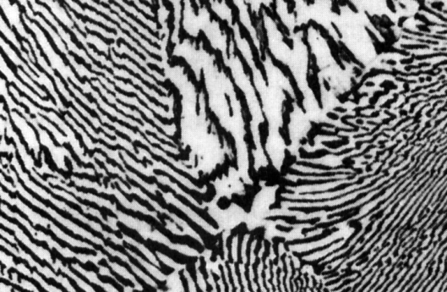
Microstructural Development in Eutectic Systems III
• For alloy of composition C₀ = C_{E}
• Result: Eutectic microstructure (lamellar structure)
-- alternating layers (lamellae) of α and β phases.
T(ºC)
Micrograph of Pb-Sn eutectic microstructure
L: C₀ wt% Sn
300
L
L
+
α
α
β
200
183ºC
T_{E}
100
160 μm
β: 97.8 wt% Sn
α: 18.3 wt%Sn
0
20
40
60
80
100
18.3
C_{E}
97.8
61.9
wt% Sn

Slide 17
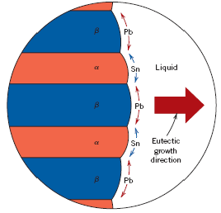
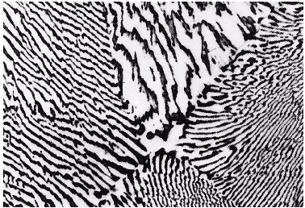
Lamellar Eutectic Structure

Slide 18
Microstructural Development in Eutectic Systems IV
• For alloys for which 18.3 wt% Sn < C₀ < 61.9 wt% Sn
• Result: α phase particles and a eutectic microconstituent
• Just above T_{E} :
T(ºC)
L: C₀
wt% Sn
C_{α}
= 18.3 wt% Sn
L
300
L
_{α}
C_{L}
= 61.9 wt% Sn
W_{α}
S
L
+
α
=
= 0.50
α
R
+
S
200
R
S
W_{L}
= (1-
W
α
)
= 0.50
T_{E}
R
S
• Just below T_{E} :
100
C
_{α}
= 18.3 wt% Sn
primary
α
C
_{β}
= 97.8 wt% Sn
eutectic
α
S
eutectic
β
W
_{α}
=
= 0.73
0
20
40
60
80
100
R
+
S
18.3
61.9
97.8
W
_{β}
= 0.27
wt% Sn

Slide 19
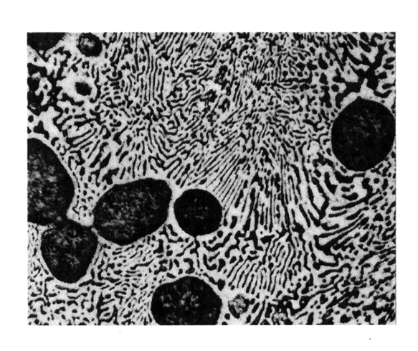

Hypoeutectic & Hypereutectic
300
L
T(ºC)
α
L
+
α
200
L
+
β
β
T_{E}
α
+
β
System)
100
0
20
40
60
80
100
C, wt% Sn
hypoeutectic: C₀ = 50 wt% Sn
eutectic
61.9
hypereutectic: (illustration only)
α
eutectic: C₀ = 61.9 wt% Sn
β
α
β
α
α
β
β
α
β
α
β
175 mm
160 mm
eutectic micro-constituent

Slide 20
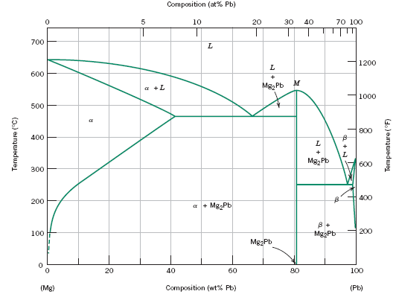
Intermetallic Compounds
Mg₂Pb
Note: intermetallic compound exists as a line - not an area – because stoichiometry (i.e. composition of a compound) is fixed.

Slide 21
Eutectic, Eutectoid, & Peritectic
Eutectic - liquid transforms to two solid phases
  L S₁+S₃ (For Pb-Sn, 183ºC, 61.9 wt% Sn)
cool
heat
Eutectoid –all solid phases
  S₂ S₁+S₃
  ϒ α+ Fe₃C (For Fe-C, 727ºC, 0.76 wt% C)
intermetallic compound - cementite
cool
heat
Peritectic - liquid and one solid phase transform to a second solid phase
  S₁ + L S₂
  δ + L ϒ (For Fe-C, 1493ºC, 0.16 wt% C)
cool
heat
Peritectoid – all solid phases
  S₁ + S₂ S₃

Slide 22
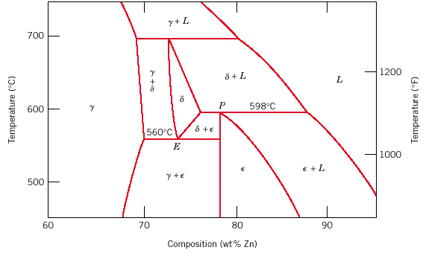
Eutectoid & Peritectic
Cu-Zn Phase diagram
Peritectic transformation γ + L δ
Eutectoid transformation δ γ + ε

Slide 23
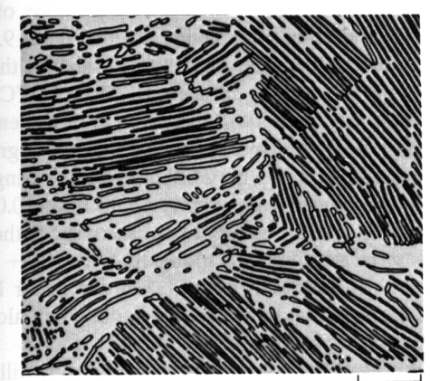
Iron-Carbon (Fe-C) Phase Diagram
T(ºC)
1600
δ
- Eutectic (A):
1400
L
L
→
γ
+
Fe₃C
γ
γ
+L
A
L+Fe₃C
- Eutectoid (B):
1200
1148ºC
(austenite)
γ
→
α
+
Fe₃C
1000
γ
γ
γ
γ
+Fe₃C
α
γ
+
Fe₃C (cementite)
800
γ
B
727ºC = T
α
eutectoid
600
α
+Fe₃C
400
0
1
2
3
4
4.30
5
6
6.7
(Fe)
0.76
wt% C
120 mm
Result: Pearlite =
Fe₃C (cementite-hard)
alternating layers of
α
and Fe₃C phases
α
(ferrite-soft)

Slide 24
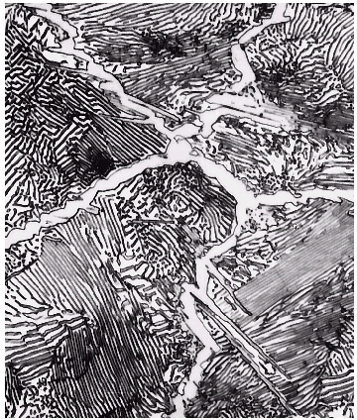
Hypereutectoid Steel
T(ºC)
1600
δ
L
proeutectoid Fe₃C
1400
γ
γ
γ
γ
+L
γ
γ
1200
1148ºC
L+Fe₃C
(austenite)
γ
γ
1000
γ
+Fe₃C
Fe₃C
800
γ
a
60 μm
600
α
+Fe₃C
pearlite
400
0
1
C₀
2
3
4
5
6
6.7
(Fe)
0.76
C, wt%C
pearlite

Slide 25
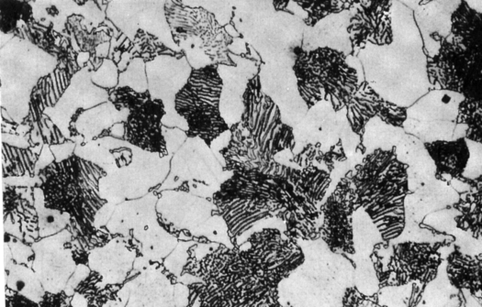
Hypoeutectoid Steel
T(ºC)
1600
δ
1400
L
γ
γ
γ
γ
+L
γ
γ
1200
1148ºC
L+Fe₃C
100 μm
(austenite)
1000
γ
+ Fe₃C
α
pearlite
γ
γ
800
727ºC
proeutectoid ferrite
γ
γ
α
600
α
+ Fe₃C
400
0
1
2
3
4
5
6
6.7
α
(Fe)
C₀
C, wt% C
0.76
pearlite
For a 99.6 wt% Fe-0.40 wt% C steel at a temperature just below the eutectoid, determine the following:
The compositions of Fe₃C and ferrite (α).
The amount of cementite (in grams) that forms in 100 g of steel.
The amounts of pearlite and proeutectoid ferrite (α) in the 100 g.

Slide 26
Solution to Example Problem
The compositions of Fe₃C and ferrite (α).
    RS tie line just below the eutectoid
C_{α} = 0.022 wt% C
C_{Fe3C} = 6.70 wt% C
pearlite
Wight Fraction of cementite
1600
δ
1400
L
T(ºC)
γ
+L
γ
1200
(austenite)
1148ºC
L+Fe₃C
1000
γ
+ Fe₃C
Fe₃C (cementite)
800
727ºC
Amount of Fe₃C in 100 g
= (100 g)W_{Fe3C}
= (100 g)(0.057) = 5.7 g
R
S
600
α
+ Fe₃C
400
0
1
2
3
4
5
6
6.7
C₀
C_{Fe C}
C_{α}
C , wt% C
3

Slide 27
The amounts of pearlite in the 100 g.
c) Using the VX tie line just above the eutectoid and realizing that
C₀ = 0.40 wt% C
C_{α} = 0.022 wt% C
C_{pearlite} = C_{γ} = 0.76 wt% C
α
pearlite
1600
δ
1400
L
T(ºC)
γ
+L
γ
1200
(austenite)
1148ºC
L+Fe₃C
1000
γ
+ Fe₃C
Fe₃C (cementite)
800
727ºC
V
X
Amount of pearlite in 100 g
= (100 g)W_{pearlite}
= (100 g)(0.512) = 51.2 g
600
α
+ Fe₃C
400
0
1
2
3
4
5
6
6.7
C_{α}
C_{γ}
C₀
C, wt% C

Slide 28
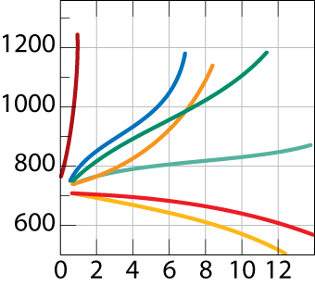
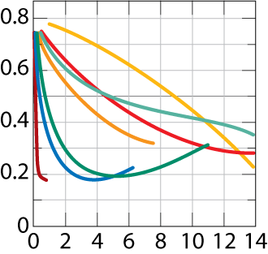
Alloying with Other Elements
• T_{eutectoid} changes:
• C_{eutectoid} changes:
Ti
Si
(wt% C)
(ºC)
Mo
W
Ni
Cr
Eutectoid
Cr
eutectoid
Si
Mn
Mn
Ti
W
T
C
Mo
Ni
wt. % of alloying elements
wt. % of alloying elements

Slide 29
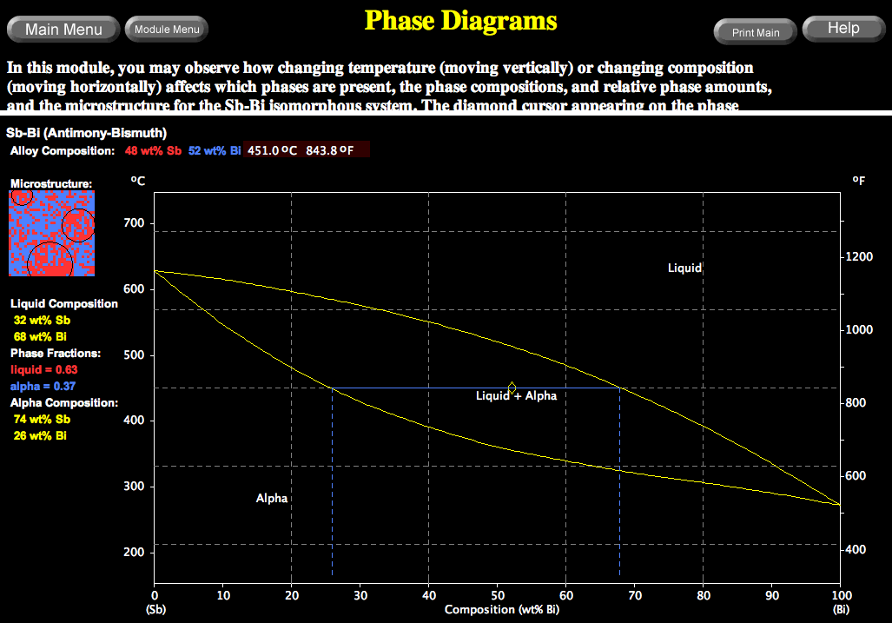
VMSE: Interactive Phase Diagrams
Microstructure, phase compositions, and phase fractions respond interactively
Change alloy composition

Slide 30
Summary
• Phase diagrams are useful tools to determine:
-- the number and types of phases present,
-- the composition of each phase,
-- and the weight fraction of each phase
given the temperature and composition of the system.
• The microstructure of an alloy depends on
-- its composition, and
-- whether or not cooling rate allows for maintenance of
equilibrium.
• Important phase diagram phase transformations include
eutectic, eutectoid, and peritectic.

Slide 32
Effect of Temperature & Composition
• Altering T can change # of phases:
path A to B.
Altering C can change # of phases:
path B to D.
B (100ºC,C = 70)
1 phase
D (100ºC,C = 90)
2 phases
100
80
L
(liquid)
60
+
L
S
Temperature (ºC)
(
liquid solution
40
(solid
i.e., syrup)
sugar)
20
A (20ºC,C = 70)
2 phases
0
0
20
40
60
70
80
100
C
= Composition (wt% sugar)

Slide 33
EX 1: Pb-Sn Eutectic System
• For a 40 wt% Sn-60 wt% Pb alloy at 150ºC
C_{α} = 11 wt% Sn
Pb-Snsystem
T(ºC)
C_{β} = 99 wt% Sn
300
L (liquid)
-- the relative amount
of each phase
α
L
+
α
200
183ºC
L
+
β
β
18.3
61.9
97.8
150
R
S
S
C_{β} - C₀
100
W
_{α}
=
=
α
+
β
R+S
C_{β} - C_{α}
99 - 40
59
=
=
= 0.67
99 - 11
88
0
11
20
40
60
80
99
100
R
C₀ - C_{α}
C_{α}
C₀
wt% Sn
C_{β}
W
_{β}
=
=
R+S
C_{β} - C_{α}
40 - 11
29
=
=
= 0.33
99 - 11
88

Slide 34
EX 2: Pb-Sn Eutectic System
• For a 40 wt% Sn-60 wt% Pb alloy at 220ºC
C_{a} = 17 wt% Sn
T(ºC)
C_{L} = 46 wt% Sn
300
L
L
+
α
220
α
200
R
S
L
+
β
β
the relative amount
of each phase
183ºC
C_{L} - C₀
46 - 40
100
a
+
b
W
a
=
=
C_{L} - C_{α}
46 - 17
6
0
17
20
40
46
60
80
100
=
= 0.21
C_{α}
C₀
C_{L}
29
wt% Sn
C₀ - C_{α}
23
W_{L}
=
=
= 0.79
C_{L} - C_{α}
29

