Slide 1
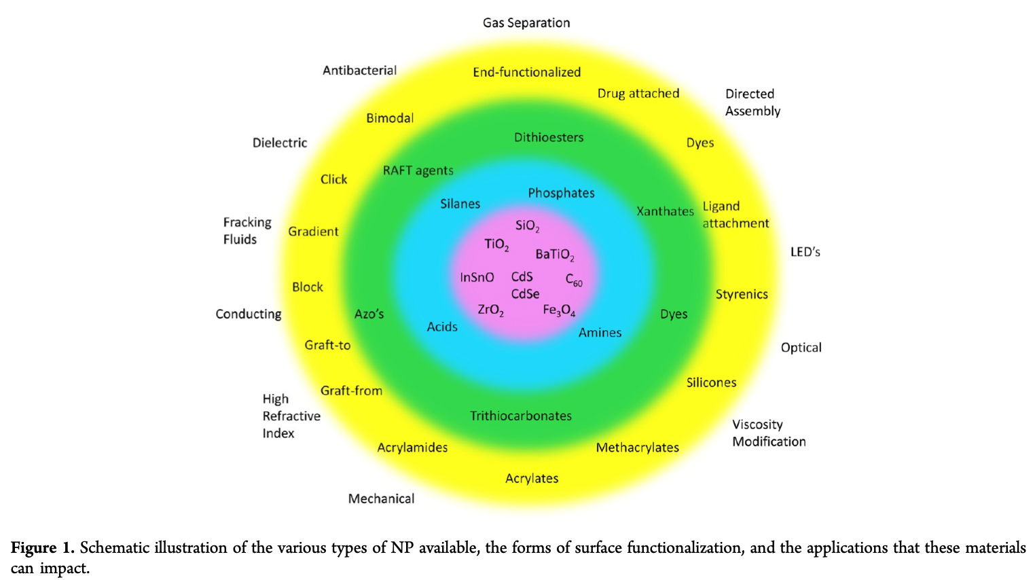
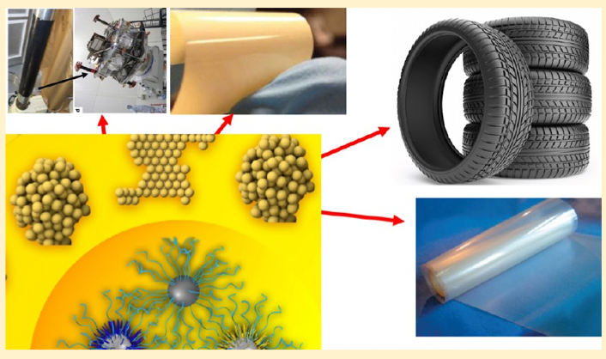
Kumar SK, Benicewicz BC, Vaia RA, Winey KI 50th Anniversary Perspective: Are Polymer Nanocompsites Practical for Applications? Macromolecules 50 714-731 (2017).

Slide 2
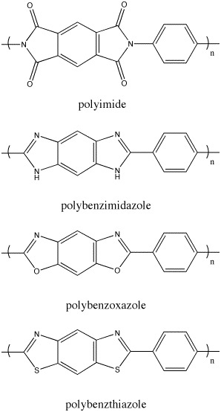
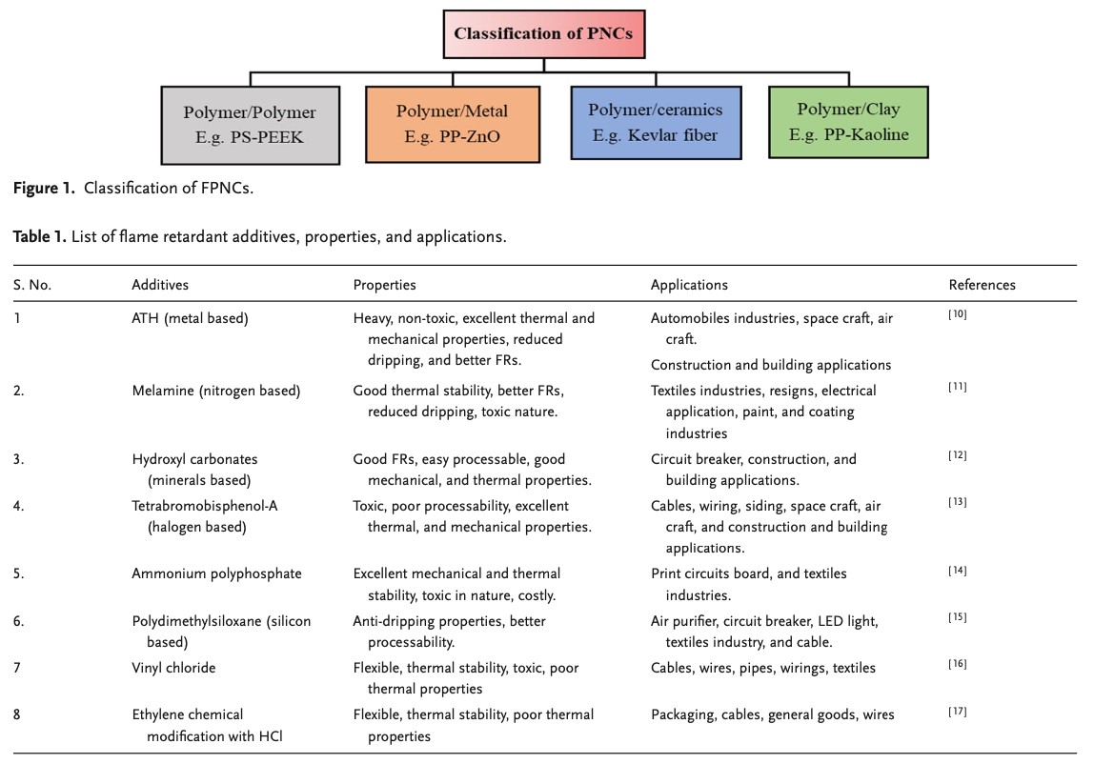
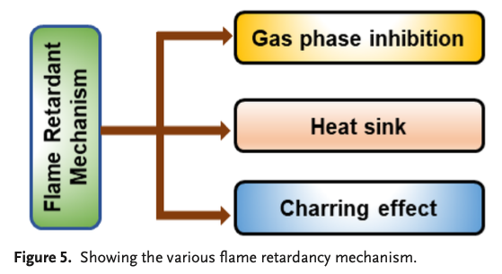
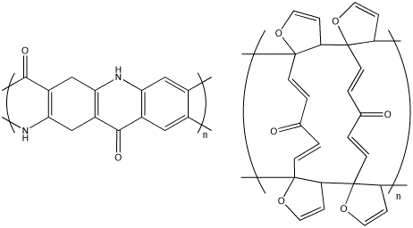
So, take an example
You are interested in flame retardancy and have two routes:
Pick a polymer with inherent flame retardancy like Teflon® (thermally stable, low flame propagation)
or polyimides (large char) or polysiloxanes (inorganic components to polymer)
Add a material with high thermal conductivity, high heat capacity, char formation or protection of
char that is formed (and is cheap) like Exfoliated clay works. Silica, titania. Calcium carbonate
(ground up rock) can be effective. Nanoparticles can possibly enhance already flame-retardant polymers.
Flame Retardant Polymer Nanocomposites: An Overview Kumar S(different one), Dhawan R, Shukla SK Macromol. Symp. 407 2200089 (2023).

Slide 3
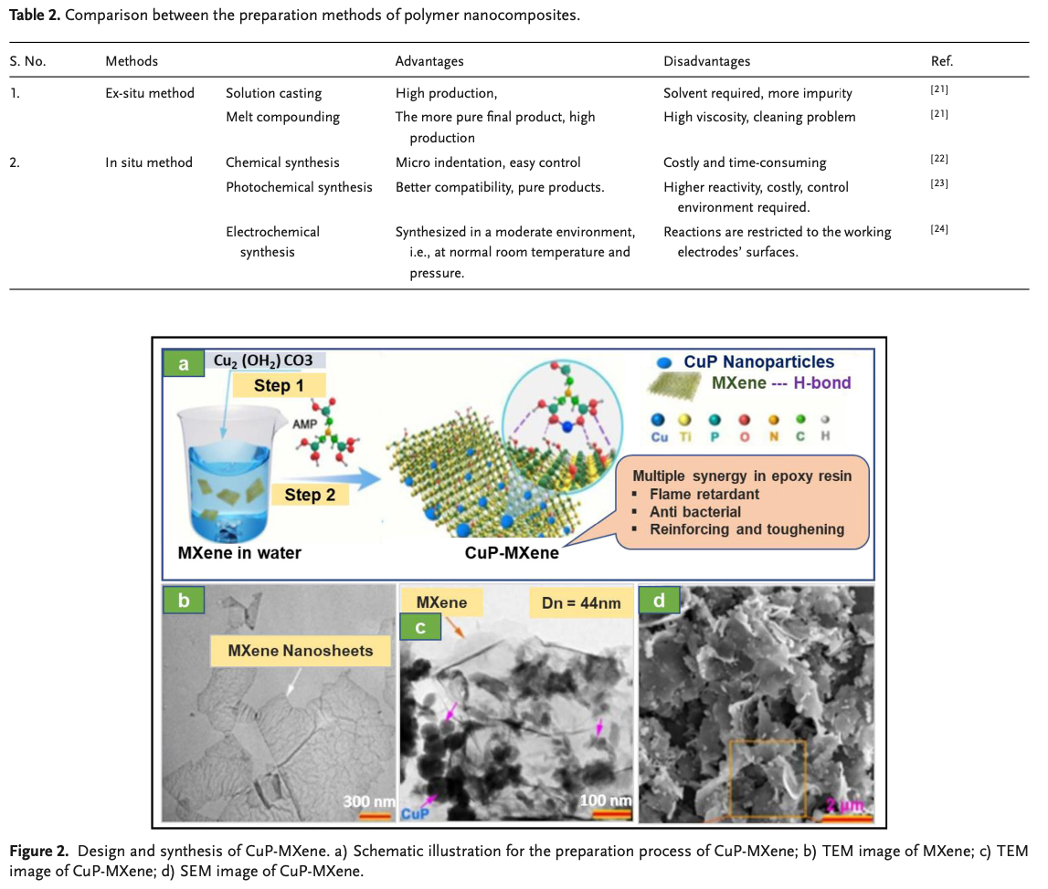
Flame Retardant Polymer Nanocomposites: An Overview Kumar S(different one), Dhawan R, Shukla SK Macromol. Symp. 407 2200089 (2023).

Slide 4
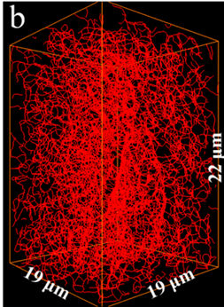
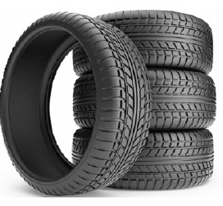
The original nanocomposite
Polydisperse aggregates
Processed under shear
Kinetically mixed
Objective:
Tear resistance
Static charge dissipation
100,000x larger
Song, L; Wang, Z; Tang, X.; Chen, L.; Chen, P.; Yuan, Q.; Li, L. Visualizing the Toughening Mechanism of Nanofiller with 3D X-ray Nano-CT: Stress-Induced Phase Separation of Silica Nanofiller and Silicone Polymer Double Networks Macromolecules 50 7249-7257 (2017).
Notes:
In stark contrast the original nanocomposite, an automobile tire, comprises of ~50-100nm non-spherical nanoparticles, generally carbon black and silica. Mixing of nanofillers is achieved by applying mechanical shear resulting in high polydispersity in size. The main objective for using carbon black in a tire, other than structural stability, is to enhance tear strength and ensure static charge dissipation. These two properties are dictated by the micron-mm scale filler networks in the polymer bulk.

Slide 5
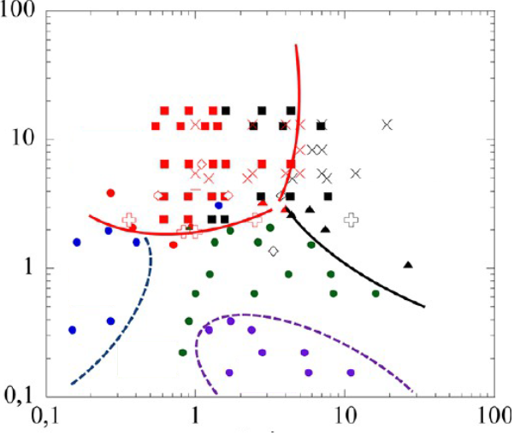


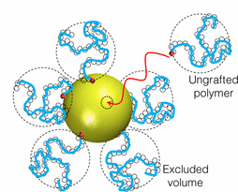
Physics Nanocomposites
Monodisperse colloidal particles
Colloidal Solution cast
Thermally
Dispersed
Well dispersed
Phase separated
Density of grafted chains
Sheets, strings, etc.
50Å
Objective:
Enhance miscibility
Grafted vs Matrix chain length
Kumar, S.K., Jouault, N., Benicewicz, B. and Neely, T., 2013. Nanocomposites with polymer grafted nanoparticles. Macromolecules, 46(9), pp.3199-3214.
Kumar, S.K., Benicewicz, B.C., Vaia, R.A. and Winey, K.I., 2017. 50th anniversary perspective: are polymer nanocomposites practical for applications?. Macromolecules, 50(3), pp.714-731.
Asai, M., Zhao, D. and Kumar, S.K., 2017. Role of grafting mechanism on the polymer coverage and self-assembly of hairy nanoparticles. ACS Nano, 11(7), pp.7028-7035.
Notes:
The current state of the art engineered nanocomposites comprise of ~5nm spherical nanoparticles, generally colloidal silica. These nanocomposites are solution cast, thermally dispersed and are monodisperse in size. Aimed at enhancing miscibility of these nanoparticles in the polymer matrix, polymer chains are chemically grafted onto their surface. A great body of work has been and is being currently undertaken to understand how the properties of these nanocomposites be tuned by altering the state of dispersion of the nanoparticles. An elegant phase diagram by Sanat Kumar’s group at Columbia shows that increasing the grafting density on the particles and by varying the graft to matrix chain length different emergent structures can be realized.

Slide 6
The original nanocomposite
Polydisperse aggregates
Processed under shear
Kinetically mixed
Objective:
Tear resistance
Static charge dissipation
100,000x larger
Song, L; Wang, Z; Tang, X.; Chen, L.; Chen, P.; Yuan, Q.; Li, L. Visualizing the Toughening Mechanism of Nanofiller with 3D X-ray Nano-CT: Stress-Induced Phase Separation of Silica Nanofiller and Silicone Polymer Double Networks Macromolecules 50 7249-7257 (2017).
Notes:
In stark contrast the original nanocomposite, an automobile tire, comprises of ~50-100nm non-spherical nanoparticles, generally carbon black and silica. Mixing of nanofillers is achieved by applying mechanical shear resulting in high polydispersity in size. The main objective for using carbon black in a tire, other than structural stability, is to enhance tear strength and ensure static charge dissipation. These two properties are dictated by the micron-mm scale filler networks in the polymer bulk.

Slide 7
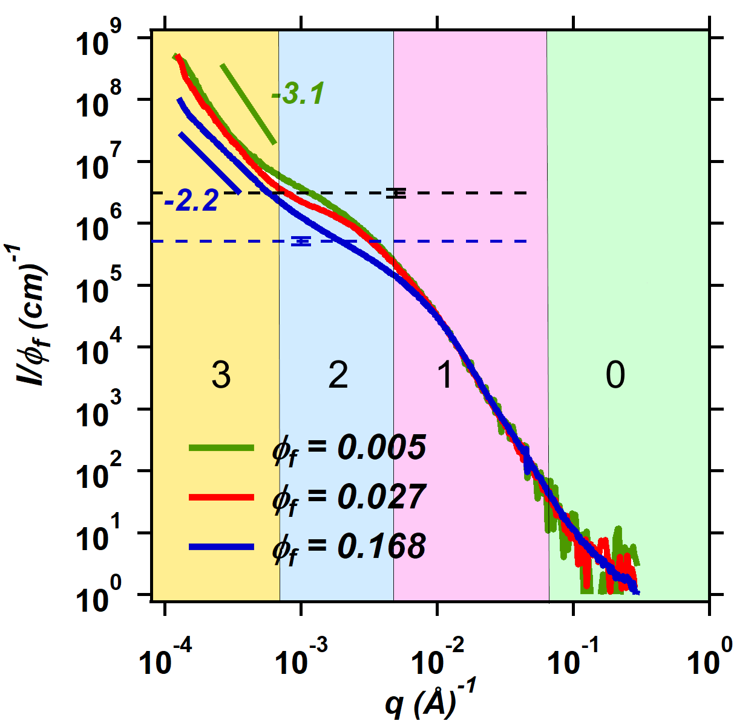
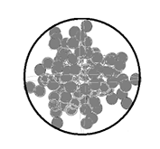
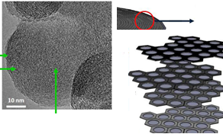
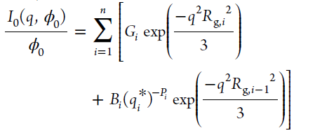

Multiscale Hierarchical Structures (Dilute filler content)
Size
Agglomerates of aggregates
~100nm
Aggregates of primary particles
primary particles
Graphitic layers
L. Pahalagedara, H. Sharma, C.H. Kuo, S. Dharmarathna, A. Joshi, S.L. Suib, A.B. Mhadeshwar, Structure and oxidation activity correlations for carbon blacks and diesel soot, Energy and Fuels. 26 (2012) 6757–6764
Rishi, K., Beaucage, G., Kuppa, V., Mulderig, A., Narayanan, V., McGlasson, A., Rackaitis, M. and Ilavsky, J., 2018. Impact of an emergent hierarchical filler network on nanocomposite dynamics. Macromolecules, 51(20), pp.7893-7904.
Mulderig, A., Beaucage, G., Vogtt, K., Jiang, H. and Kuppa, V., 2017. Quantification of branching in fumed silica. Journal of Aerosol Science, 109, pp.28-37. Beaucage, G. Approximations Leading to a Unified Exponential/Power-Law Approach to Small-Angle Scattering. J. Appl. Crystallogr. 1995, 28, 717−728.
Notes:
Spheres are simple objects, in the sense that they are symmetrical, and can be easily characterized. Physicists love spheres. In contrast, nanoparticles such as carbon black, and silica are structurally complex. For one, their exists are structural hierarchy in these fillers that extends over multiple size scales. Under dilute concentrations, we used combined SAXS/USAXS to probe the particle structure. The plot in the center shows the scattered intensity as a function of the scattering vector, which is inversely related to the incident wavelength and directly related to the scattering angle.
For X-rays the incident wavelength is on the order of angstroms so at large scattering angles the crystallographic distances can be probed, for example in XRD. For a fixed wavelength, scattering at smaller angles provides information of larger size. The figure in the middle shows the scattered intensity for carbon black in polybutadiene over 4 decades in size.
Specific features of the plot includes a distinct power law slope, and a corresponding knee region as one goes from right to left. The power law slope provides information about the structure, substructure morphology whereas the knee region provides information about the Rg of these structures.
The versatile unified scattering function combines the morphology and size of hierarchical structures, such that level 0 correponds to the graphitic layer, the sheet like morphology is reflected in the -2 power law slope. (see green curve) Level 1 corresponds to primary particles which could be coarse of fine spheres. These primary particles are sintered into aggregates which are agglomerated.
Although SAXS / TEM are complimentary techniques, TEMs provide only a local measure of the structure whereas this limitation is not observed in SAXS. Where scattering lacks is the visualization of the structure, although this limitation was overcome by the works of Andrew Mulderig in our group. Clearly, the simulated structure based on the Unified scattering fits agrees well with the TEM micrographs

Slide 8
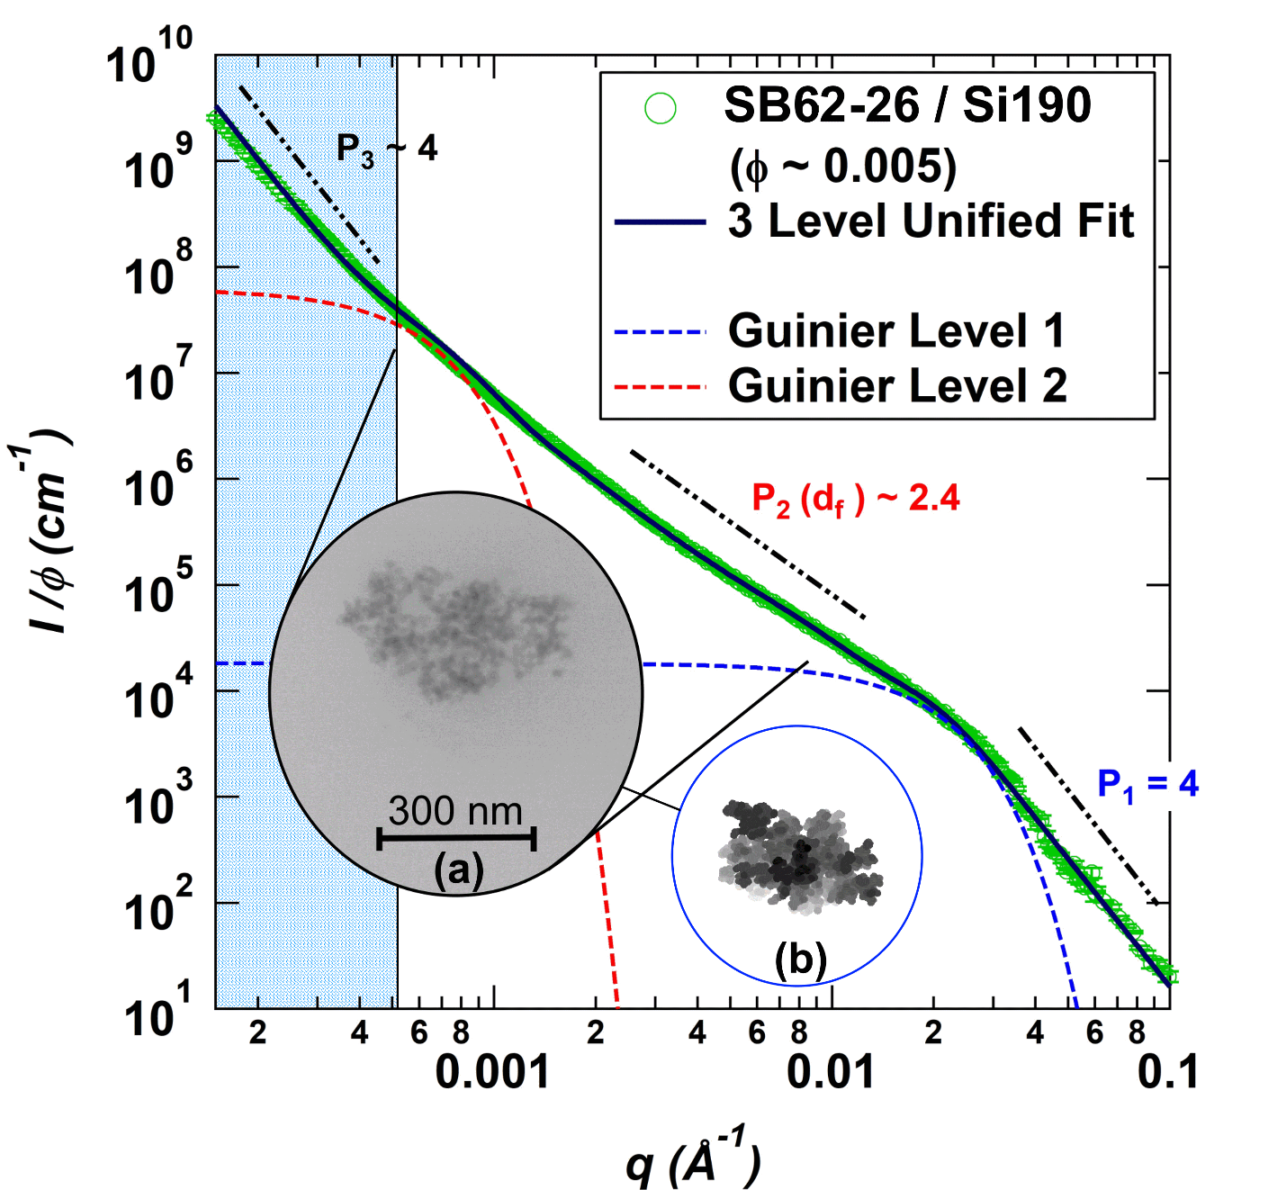
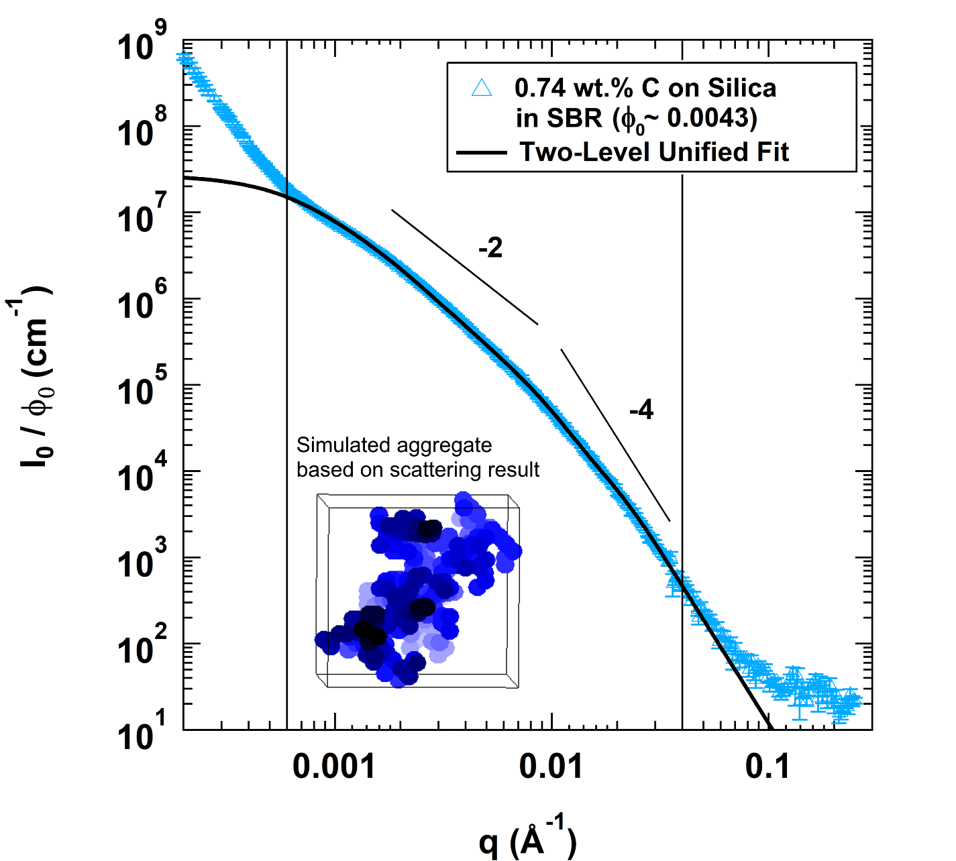
Multiscale Hierarchical Structures (Dilute)
Carbon coated fumed silica
Precipitated Silica
Notes:
This structural hierarchy extending over multiple size scales is also observed for precipitated silica, and fumed silica nanoparticles in SBR matrices. The main differences in the structure is that whereas carbon black has a open, chain like aggregates with fewer branches, fumed silica is highly branched. Precipitated silica on the other hand is more convoluted comprising of compact aggregates with voids.

Slide 9
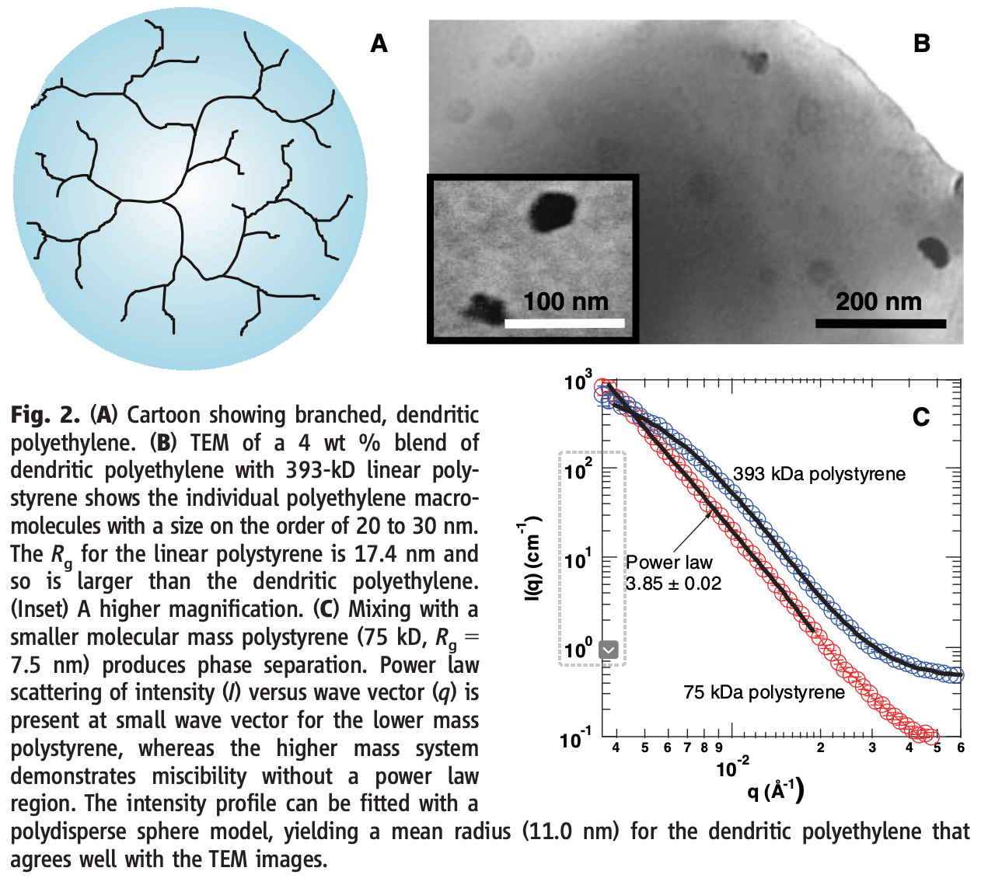
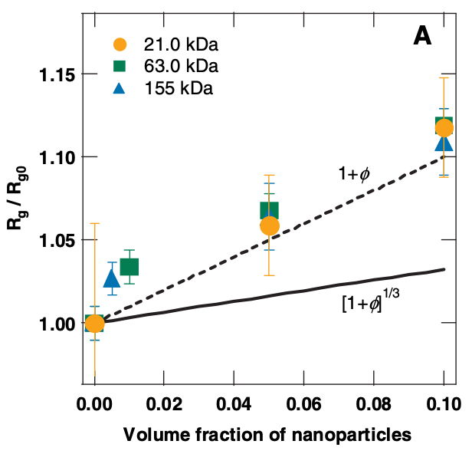
Mackay ME, Tuteja A, Duxbury PM, Hawker CJ, Van Horn B, Guan Z, Chen G, Krishnan RS General Strategies for Nanoparticle Dispersion Science 311 1740-173 (2006)
Studied C60 (Buckeyballs) in PS; PS NP in PS; and dendritic PE in PS
When chains are larger than particles system is “dispersed”
Linear chains are swelled in the presence of nanoparticles, R_{g} grows with volume fraction NP

Slide 10
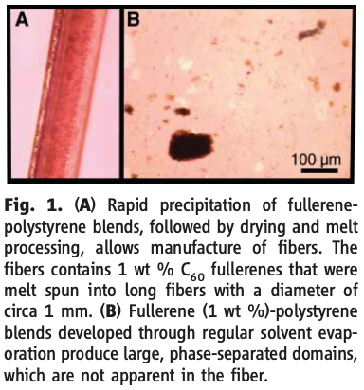
Mackay ME, Tuteja A, Duxbury PM, Hawker CJ, Van Horn B, Guan Z, Chen G, Krishnan RS General Strategies for Nanoparticle Dispersion Science 311 1740-173 (2006)
An enthalpic mechanism that arises from nanoparticle packing effects operates at the nanoscale and is necessary in order to understand dispersion in this size regime.
-Polymer blend “Chain insertion enthalpy” = Nχ
-”NP insertion enthalpy” = Aχ = 4πa²χ
-Dispersion depends on processing
-When φ_{p} ~ 0 the binodal is defined by
φ_{p} ~ exp(-(1+ Nχ))
for NP φ_{p} ~ exp(-(1+ 4πa²χ))
The limit of dispersion of C60 is 2%
so, χ ~ zε/kT and ε ~ 0.02 eV
Can quench a super-saturated “solution”

Slide 11
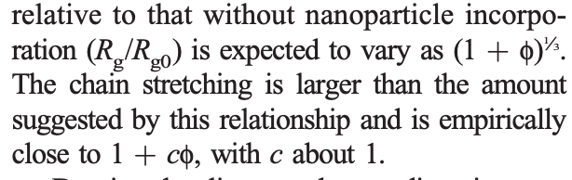
Mackay ME, Tuteja A, Duxbury PM, Hawker CJ, Van Horn B, Guan Z, Chen G, Krishnan RS General Strategies for Nanoparticle Dispersion Science 311 1740-173 (2006)
When chains are larger than particles system is “dispersed”
Linear chains are expanded when in the presence of nanoparticles
Excluded volume (1 + φ) predicts (1 + φ)^{1/3}

Slide 12
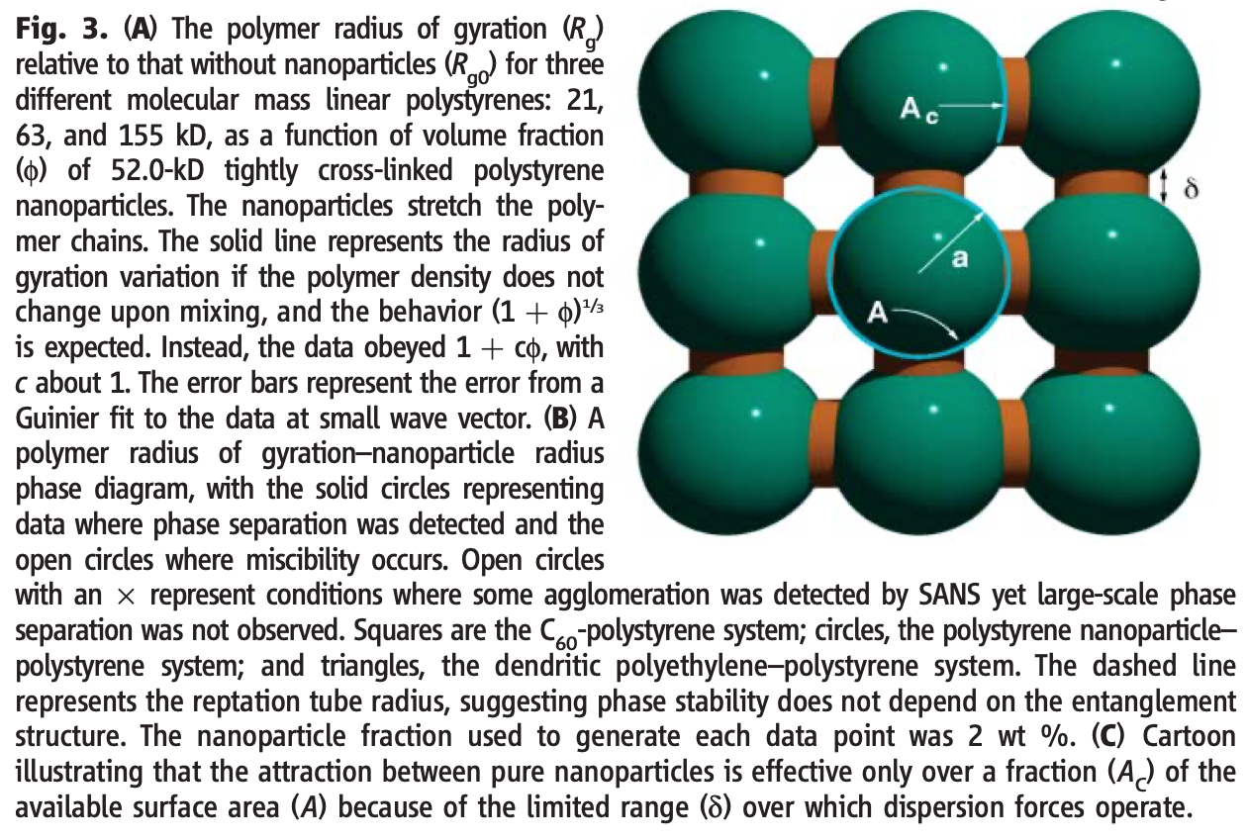

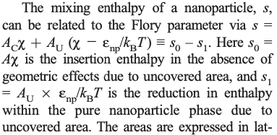
Mackay ME, Tuteja A, Duxbury PM, Hawker CJ, Van Horn B, Guan Z, Chen G, Krishnan RS General Strategies for Nanoparticle Dispersion Science 311 1740-173 (2006)
When chains are larger than particles system is “dispersed”
For PS NP in dPS a negative χ is found (compared to positive for PS in dPS)
Short-range VdW forces between particles only act in the orange region. Polymer/NP interaction acts over the whole surface. So, dispersion is favored. The VdW area (orange) changes with particle size.

Slide 13
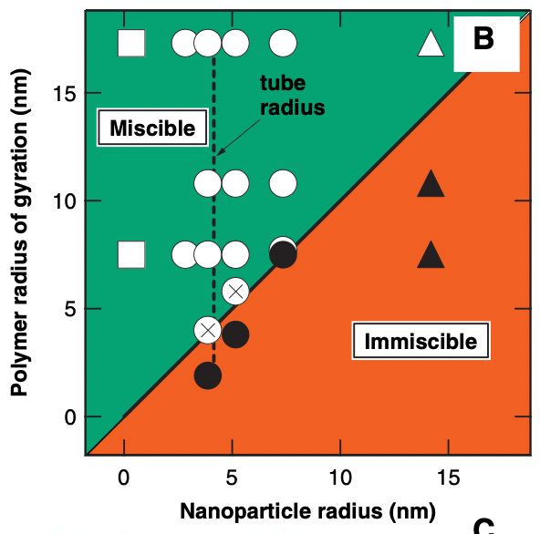
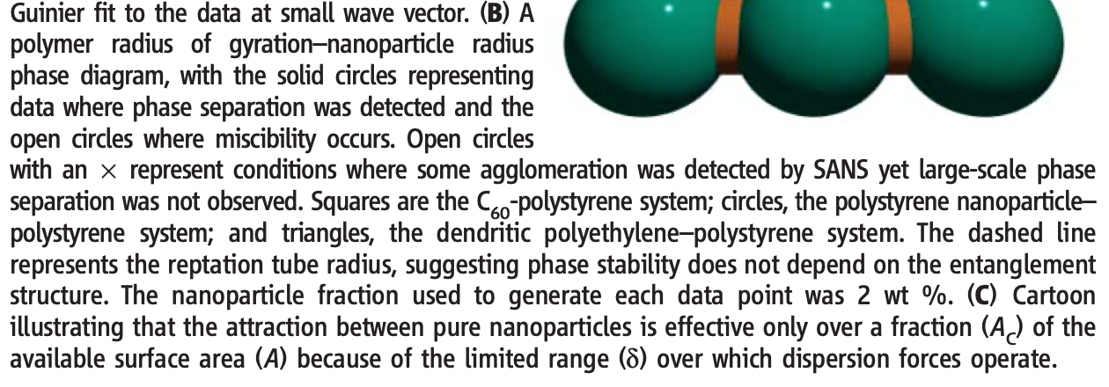
Mackay ME, Tuteja A, Duxbury PM, Hawker CJ, Van Horn B, Guan Z, Chen G, Krishnan RS General Strategies for Nanoparticle Dispersion Science 311 1740-173 (2006)

Slide 14
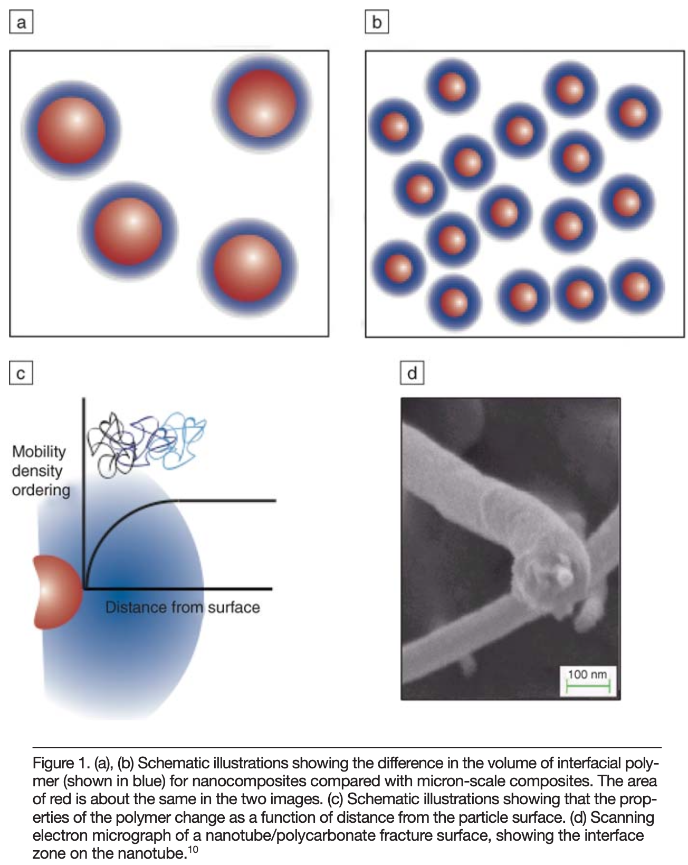
Schadler LS, Kumar SK, Benicewicz BC, Lewis SL, Harton SE Designed Interfaces in Polymer Nanocomposites: A Fundamental Viewpoint MRS Bulltin 32 335-340 (2007).
Why nanoparticles?
First, they can have properties distinct from micron-scale fillers. For example, carbon nanotubes are as stiff as graphite fibers, but are almost an order of magnitude stronger.
Second, nanoscale fillers play the role of small mechanical, optical, and electrical defects. These provide an opportunity for multi- functionality (e.g., scratch-resistant, transparent polymers).
Third, they create a large volume of interfacial polymer with properties different from the bulk, providing an opportunity for tailoring properties.

Slide 15
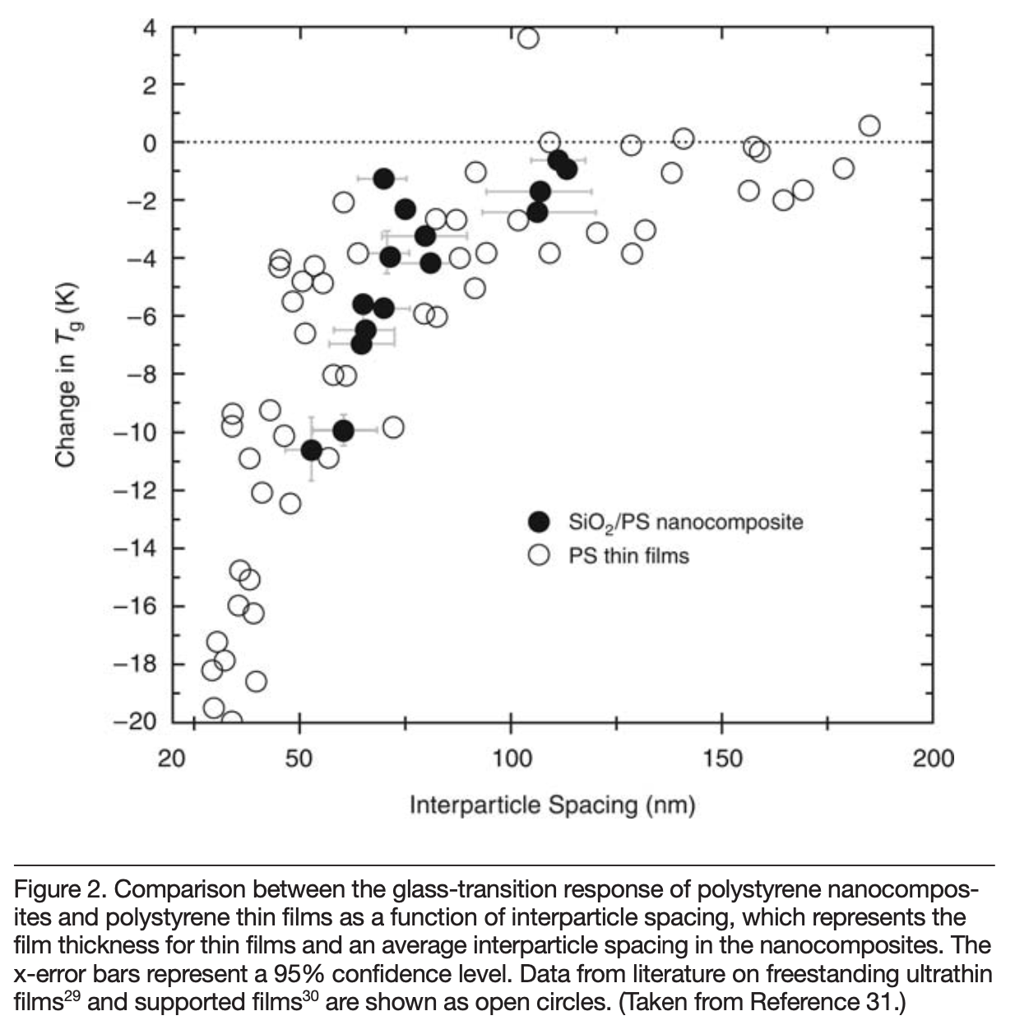
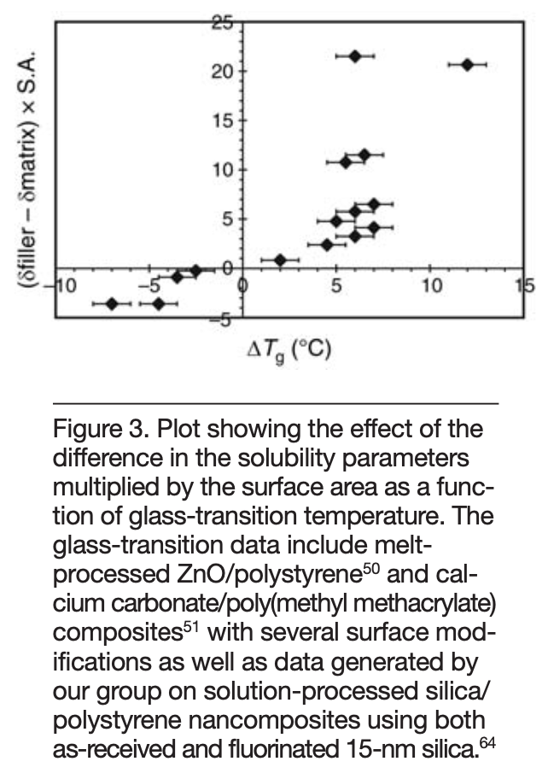
Polymer wets surface
Polymer de-wets surface

Slide 16
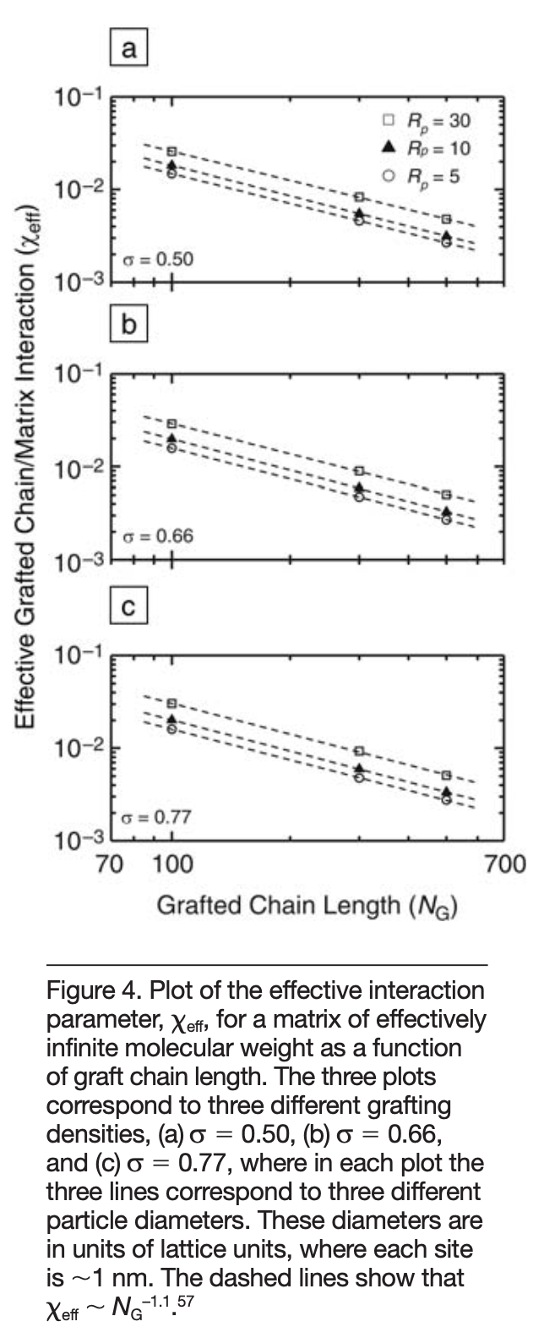
An effective mean-field interaction (χ_{eff}) that arises because of the entropic penalty associated with the interface formed between the brush and the matrix chains.
Lower χ means greater “miscibility”
Matrix is infinite molecular weight
Top low graft density, σ, bottom high
Larger particles have lower “miscibility”
Three curves
Greater miscibility with longer graft chain length

Slide 17
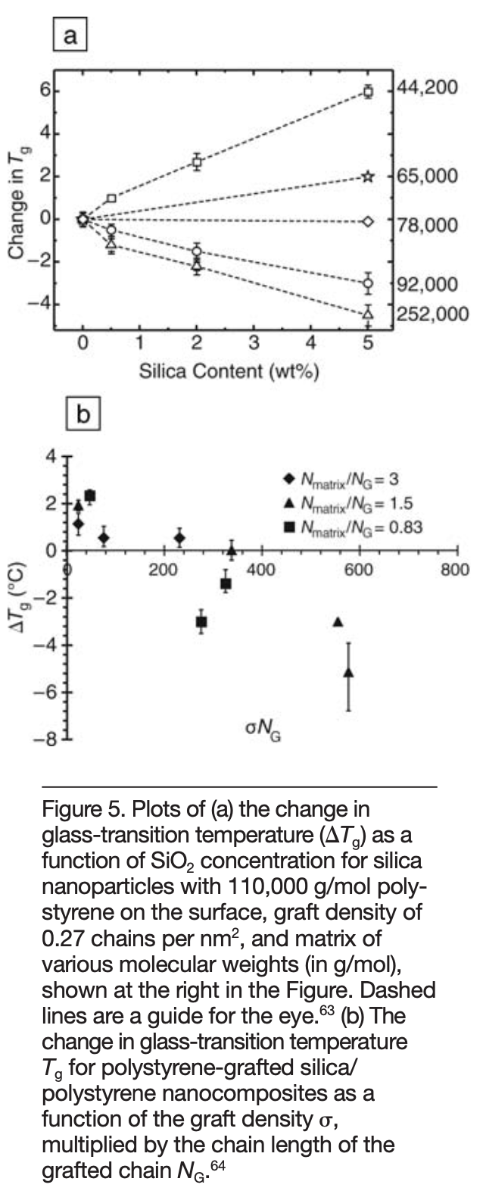
Wetting
Vary matrix MW for 110,000 g/mole grafts of PS on silica in PS
De-wetting
Wetting
De-wetting

Slide 18
Vary matrix MW for 110,000 g/mole grafts of PS on silica in PS
Wetting
Wetting
De-wetting
De-wetting

Slide 19
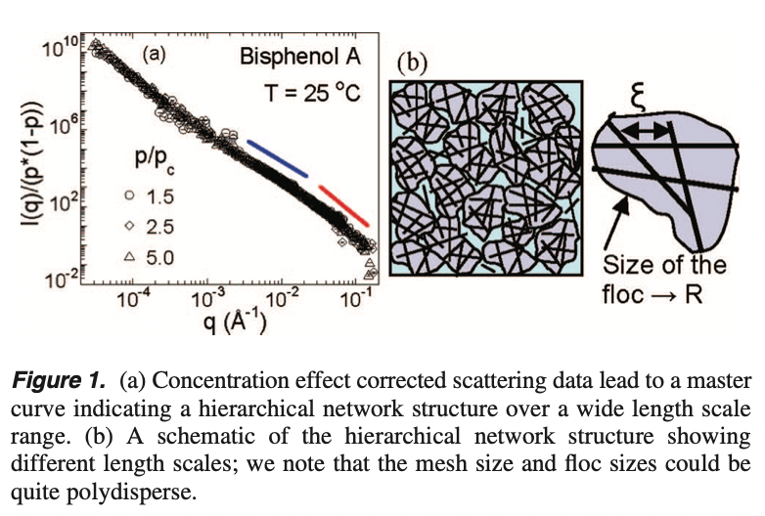
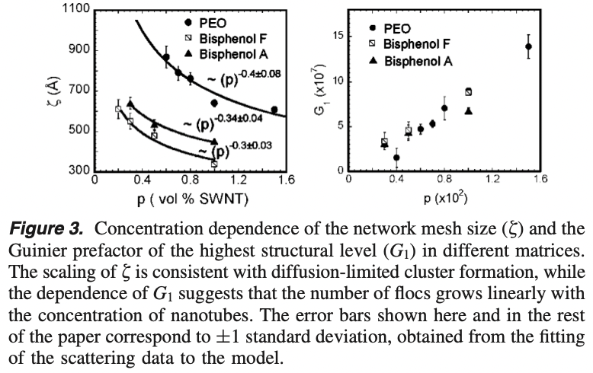
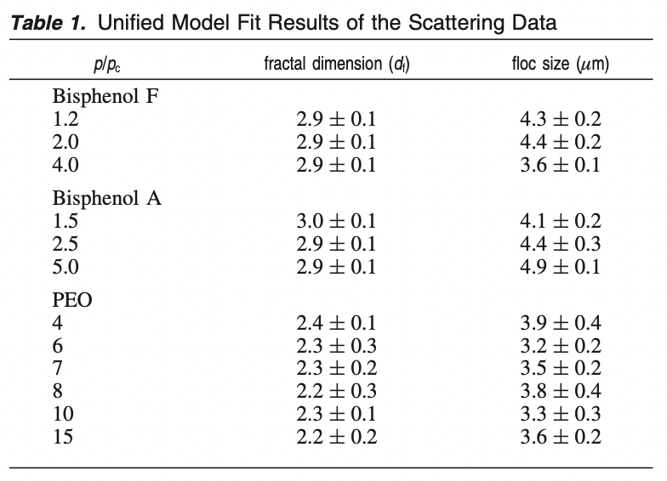
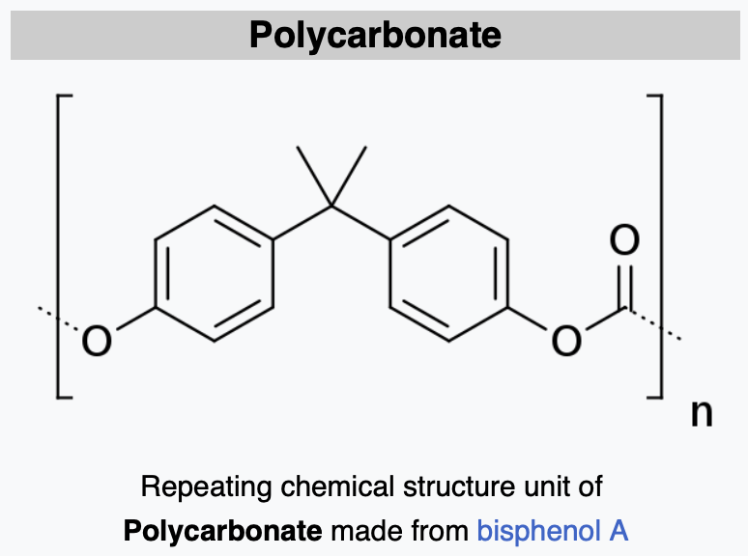
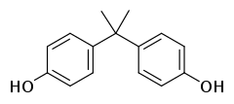

Chatterjee T, Jackson A, Krishnamoorti R Hierarchical Structure of Carbon Nanotube Networks JACS 130 6934-6935 (2008).
-4
-2
-4
A
F

Slide 20


Quantitative measure of nano-dispersion (Mean Field)
The rate of decrease in I(q)/φ with concentration in this intermediate q-range is an indicator of
how well the filler is dispersed in the elastomer. ν
This diminution is directly related to the molar excluded volume per aggregate, B₂.
Interaction leads to structural screening
$$Π=kT(\frac{1}{V}+\frac{B2}{V2})$$
Correlation length,
ξ = 2$\text{}$/q*
Pedersen, J. S.; Sommer, C. Temperature Dependence of the Virial Coefficients and the Chi Parameter in Semi-Dilute Solutions of PEG. In Scattering Methods and the Properties of Polymer Materials; Springer Berlin Heidelberg: Berlin, Heidelberg, 2005; pp 70–78.
Vogtt, K.; Beaucage, G.; Weaver, M.; Jiang, H. Thermodynamic Stability of Worm-like Micelle Solutions. Soft Matter 2017, 13 (36), 6068–6078.
Jin, Y.; Beaucage, G.; Vogtt, K.; Jiang, H.; Kuppa, V.; Kim, J.; Ilavsky, J.; Rackaitis, M.; Mulderig, A.; Rishi, K.; Narayanan, V. A Pseudo-Thermodynamic Description of Dispersion for Nanocomposites. Polymer (Guildf). 2017, 129, 32–43.
Greg Beaucage, University of Cincinnati gbeaucage@gmail.com

Slide 21
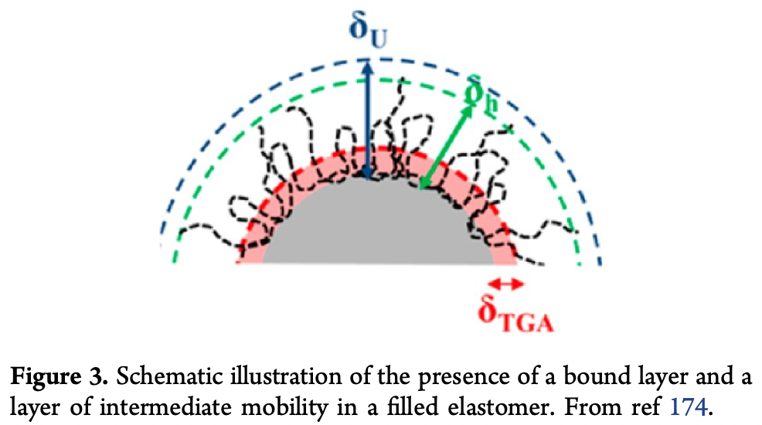
(174) Jouault, N.; Moll, J. F.; Meng, D.; Windsor, K.; Ramcharan, S.;
Kearney, C.; Kumar, S. K. Bound Polymer Layer in Nanocomposites. ACS Macro Lett. 2013, 2, 371−74.

Slide 22
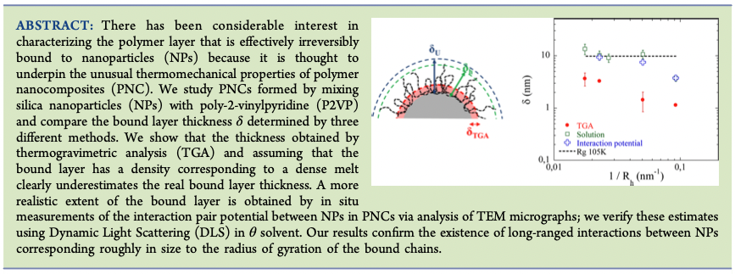

Slide 23
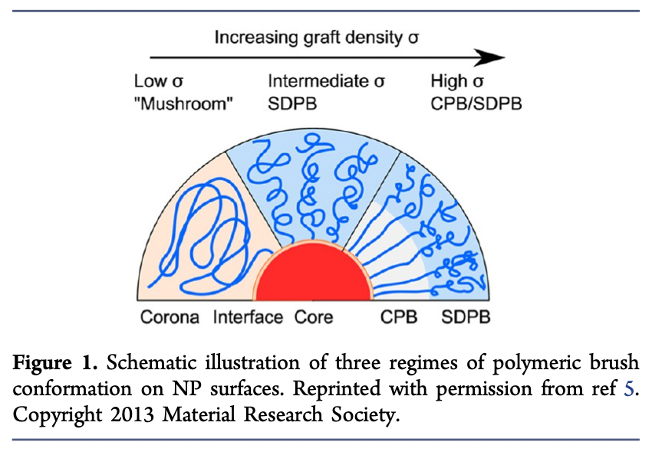
Yi C, Zhang S, Webb KT, Nie Z Anisotropic Self-Assembly of Hairy Inorganic Nanoparticles Accounts of Chem. Res. 50 12-21 (2017).
As σ exceeds the overlap threshold of chains, polymers are stretched from anchor points toward the solvent medium, entering the semidilute polymer brush (SDPB) regime. At even higher σ, the concentrated polymer brush (CPB) regime is accessed, which is featured by non-Gaussian chain characteristics and more extended chain conformations.

Slide 24
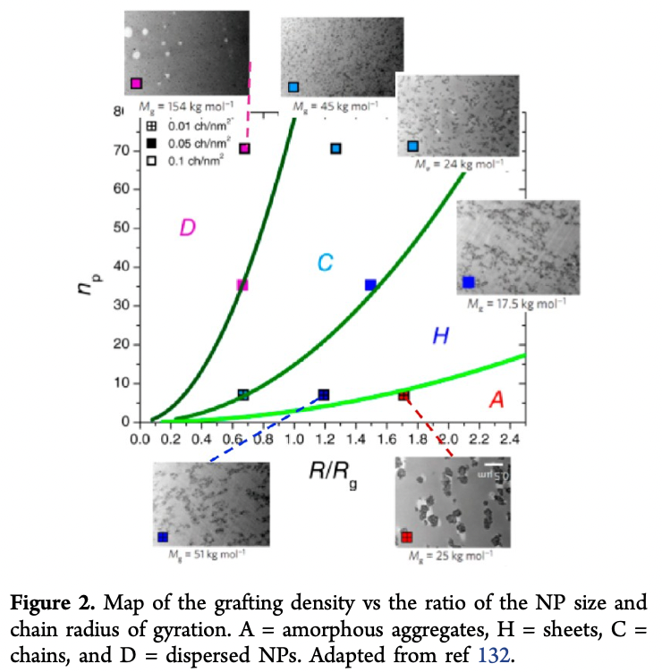
(132) Rungta, A.; Natarajan, B.; Neely, T.; Dukes, D.; Schadler, L. S.; Benicewicz, B. C. Grafting Bimodal Polymer Brushes on Nanoparticles Using Controlled Radical Polymerization. Macromolecules 2012, 45, 9303−11.
“Dispersed”
Chains
Thermally dispersed particles
Diffusion is more efficient for smaller particles
Greater grafting density improves colloidal dispersion
Sheets
“Aggregates”

Slide 25
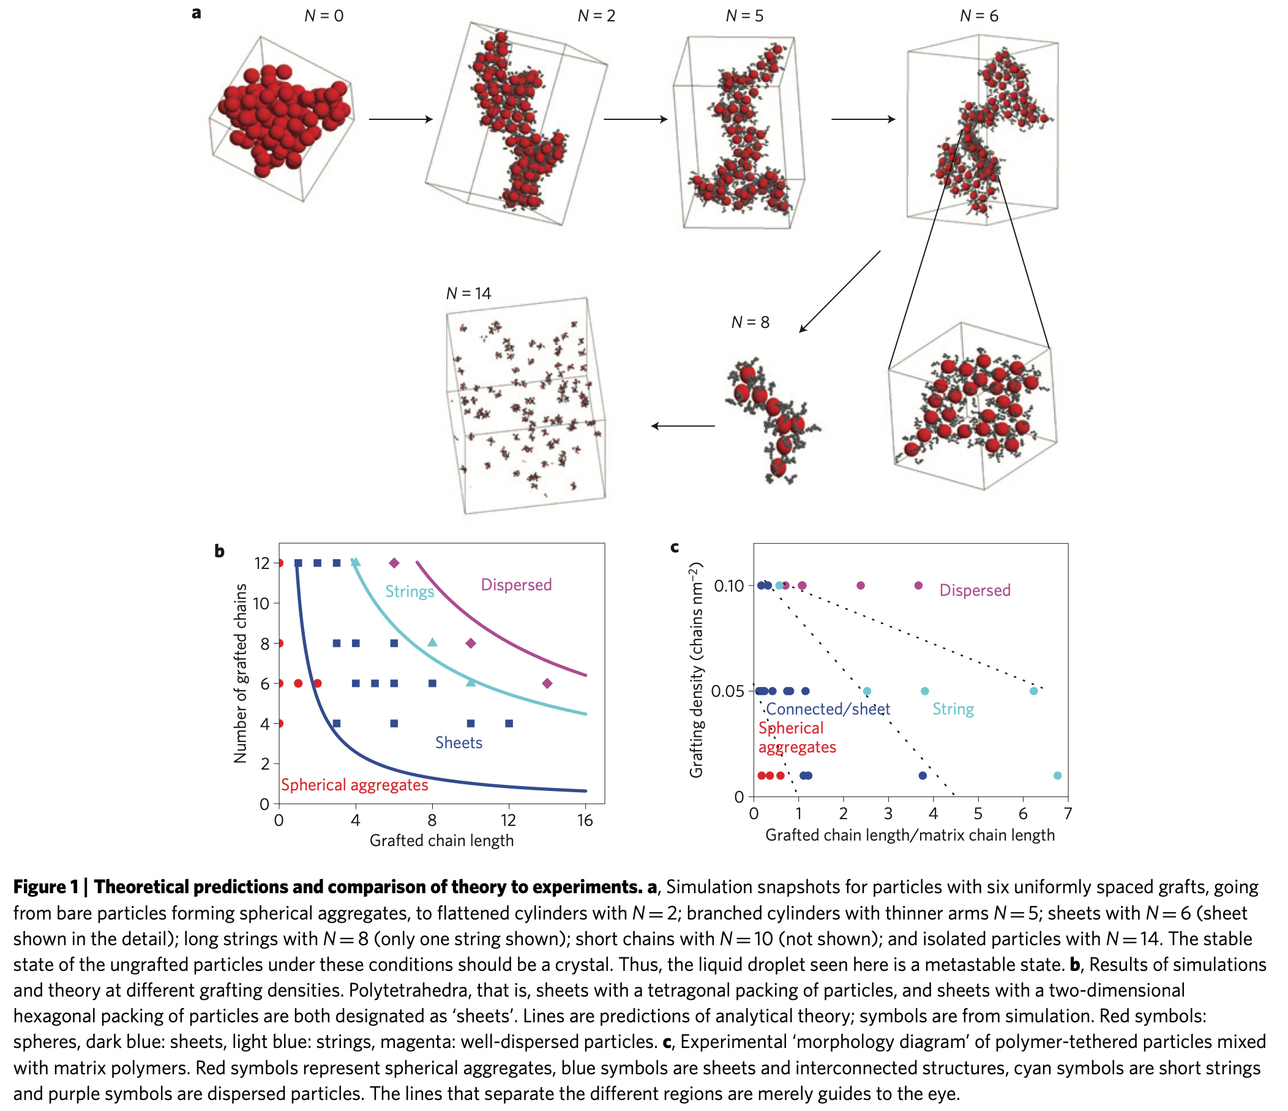
Akcora P, Liu H, Kumar SK, Moll J, Li Y, Benicewicz BC, Schadler LS, Acehan D, Panagiotopoulos AZ, Pryamitsyn V, Ganesan V, Ilavsky J, Thiyagarajan P, Colby RH, Douglas JF Anisotropic self-assembly of spherical polymer-grafted nanoparticles Nat. Mat. 8 354-359 (2009).
Model:
Short-range attraction
δε/kT fitting parameter (attraction)
Countered by entropy of distortion of grafted polymer chains
Entropy of distortion from coil-globule transition model

Slide 26
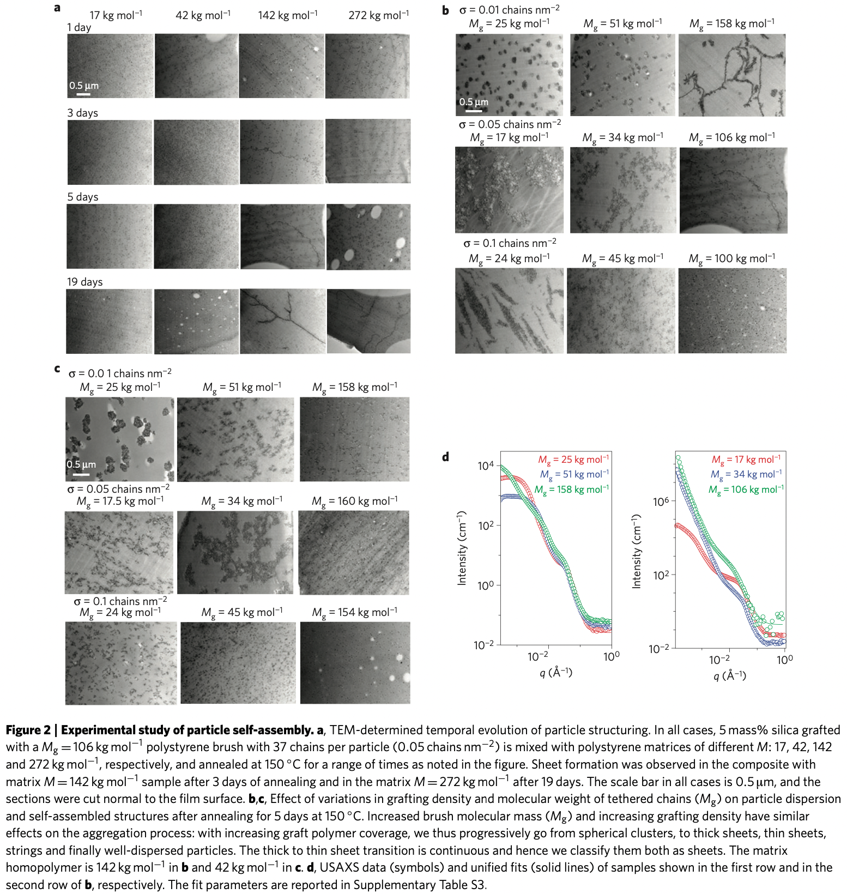
106 kg/mole graft
Variable matrix
0.05 graft/nm²
5% silica
150°C
5-day 150°C annealing
Variable graft MW
And graft density
142 kg/mol matrix
The TEM data in Fig. 2a were taken from slices normal to the surfaces. We have taken 15 adjacent ≈100-nm-thick slices from a film with a matrix of M = 142kgmol⁻¹, which show string-like morphologies in Fig. 2a, and find that the same ‘string- like’ structure is seen in each slice (see Supplementary Fig. S4b). Consequently, these objects are sheet-like. We have also analysed slices parallel to the casting surface and found qualitatively similar results (see Supplementary Fig. S4c). Evidently, these particles spontaneously assemble into sheets that are 2–5 particles (<100 nm) wide with lateral dimensions in the 1–10 μm range. A point to note here is that we see only hexagonal particle packings in the sheets (see Supplementary Fig. S5d). We do not see the other packings predicted by the theory/simulation.
1st Row b
2nd Row b
5-day 150°C annealing
Variable graft MW
And graft density
42 kg/mol matrix

Slide 27
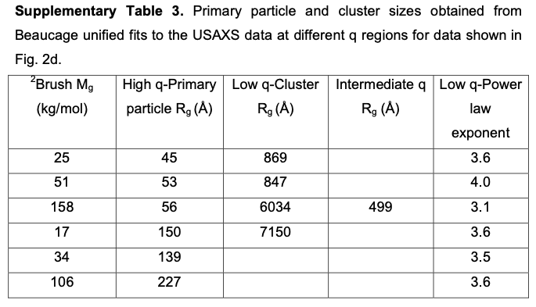
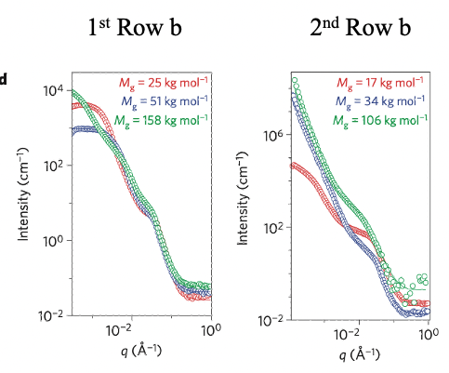
Akcora P, Liu H, Kumar SK, Moll J, Li Y, Benicewicz BC, Schadler LS, Acehan D, Panagiotopoulos AZ, Pryamitsyn V, Ganesan V, Ilavsky J, Thiyagarajan P, Colby RH, Douglas JF Anisotropic self-assembly of spherical polymer-grafted nanoparticles Nat. Mat. 8 354-359 (2009).
Lower graft density
Higher graft density
These are either correlated or screened
Fractal d_{f} ~ 1?
Fractal of aggregates
d_{f} ~ 1
-4
Fractal d_{f} ~ 1
-4
The USAXS gives the size of the primary particles, and also indicates the existence of larger scale mass fractal structures (with fractal dimension ~ 3). It is unclear why the particle sizes vary in the last three rows, while they remain relatively constant for the first three rows. We conjecture that this might represent local particle clustering. USAXS does not provide the dimensions of the large-scale clusters seen in the second row of Fig. 2b (samples with brush molecular mass of 34 and 106 kg/mol. respectively). This indicates that the cluster sizes are larger than 1 μm.
-2
-2
-1
-1

Slide 28
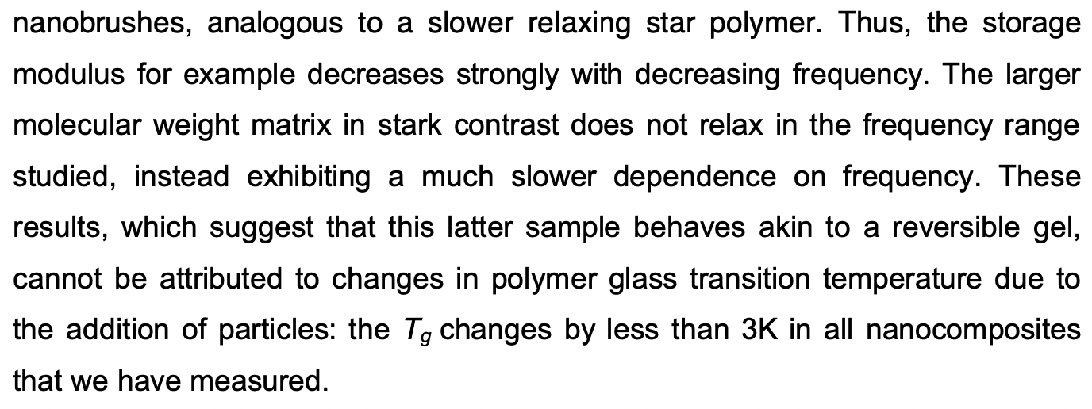
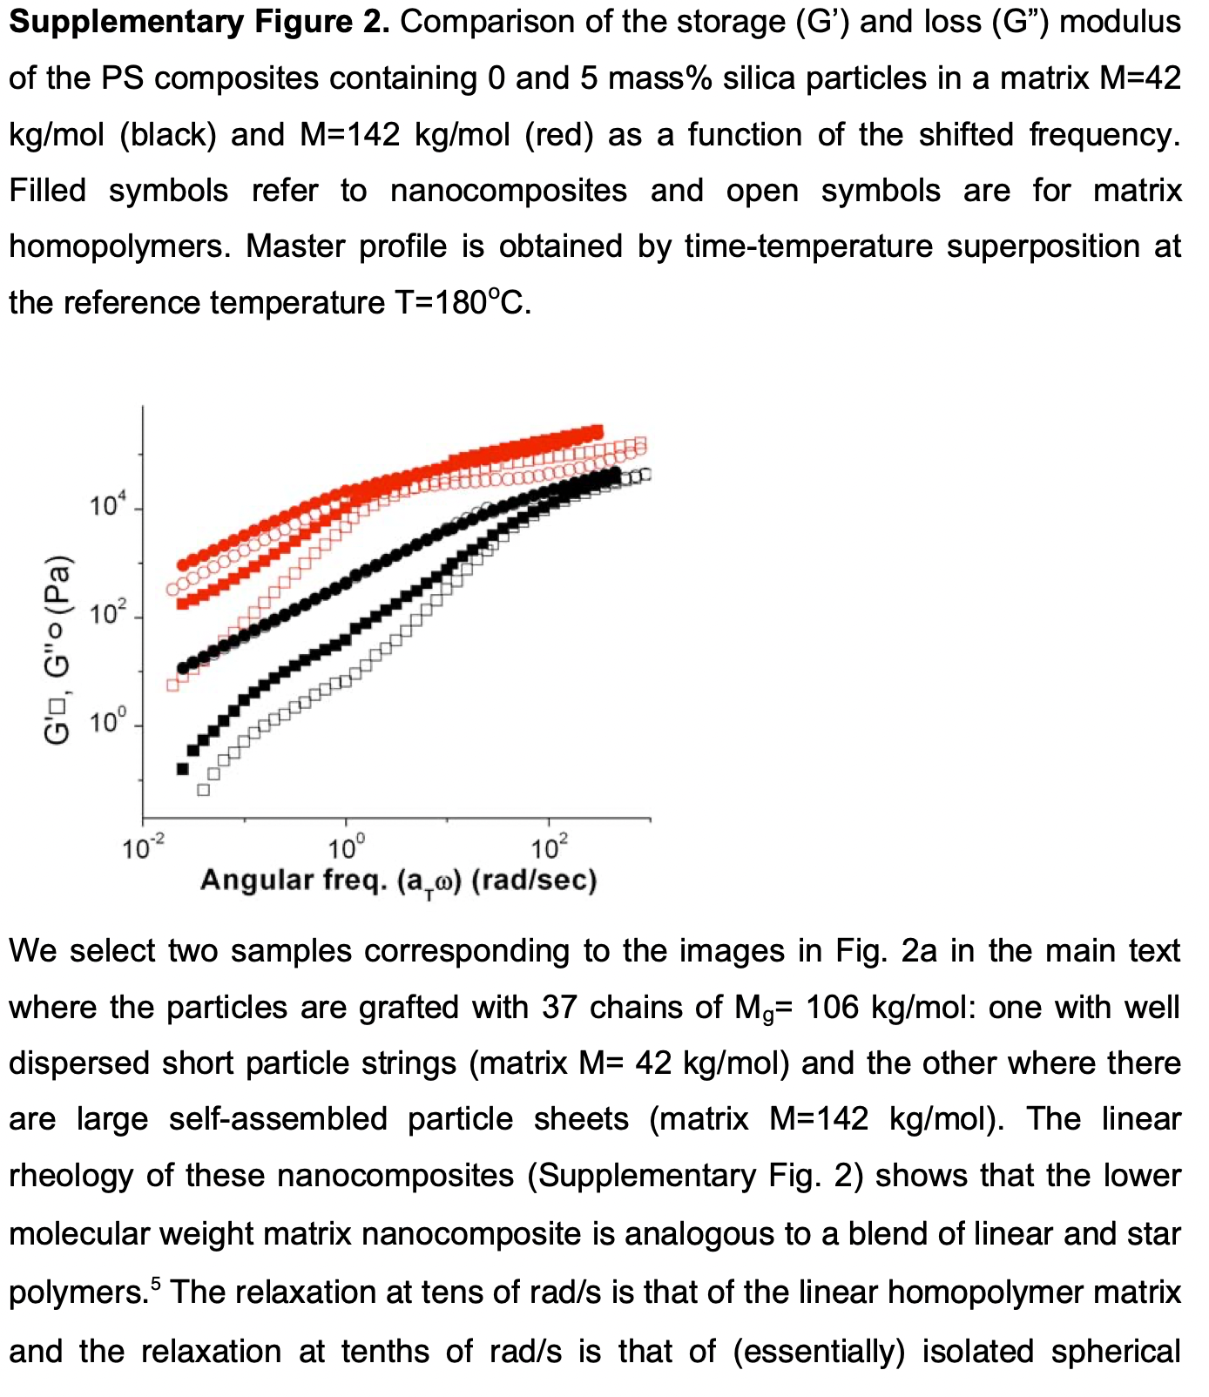
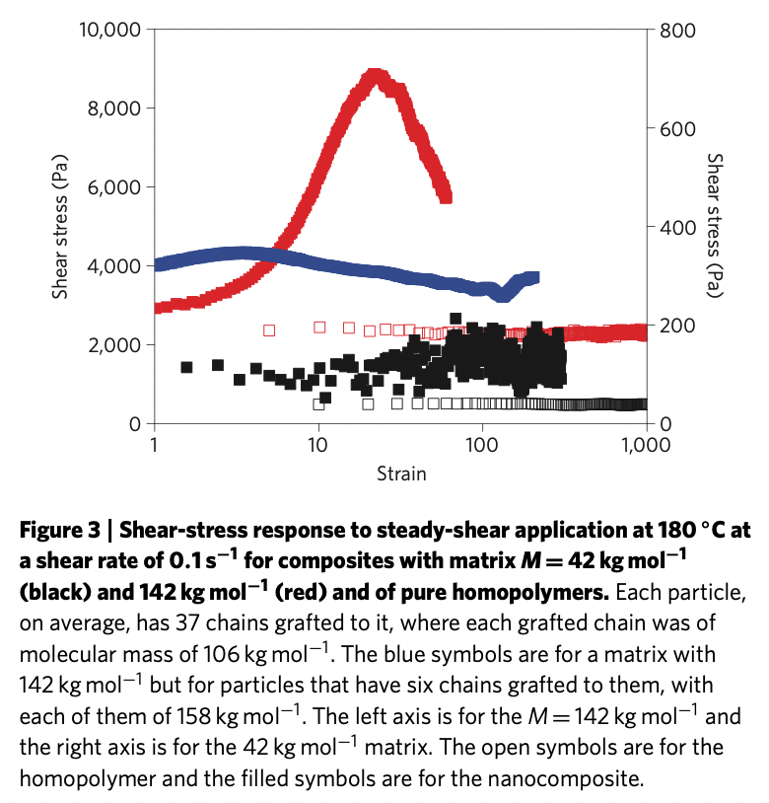
G’ ~ G” => Network
Circle G”; Square G’
Filled = 5% Nanocomposite
Open = Polymer
Red = 142 kg/mole (Large Sheets)
Black = 42 kg/mole (Short Strings)
180°C
Steady Shear 0.1 s⁻¹ 180°C
Red open = 142 kg/mole Matrix
Red filled = Filled 106 kg/mole 0.05/nm² (Large Sheets)
Black open = 42 kg/mole Matrix
Black filled = Filled 106 kg/mole 0.05/nm² (Short Strings)
Blue = 142 kg/mole Filled 158kg/mole 0.01/nm²
142 kg/mole
42 kg/mole

Slide 29
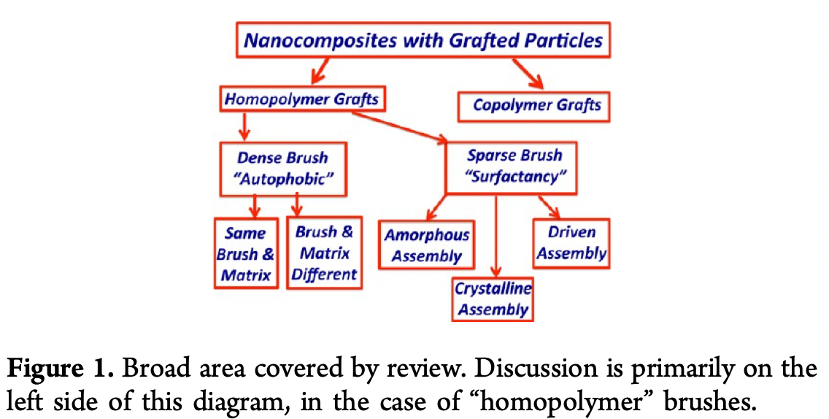
Kumar SK, Jouault N, Benicewicz B, Neely T Nanocomposites with Polymer Grafted Nanoparticles Macromolecules 46 3199-3214 (2013).

Slide 30
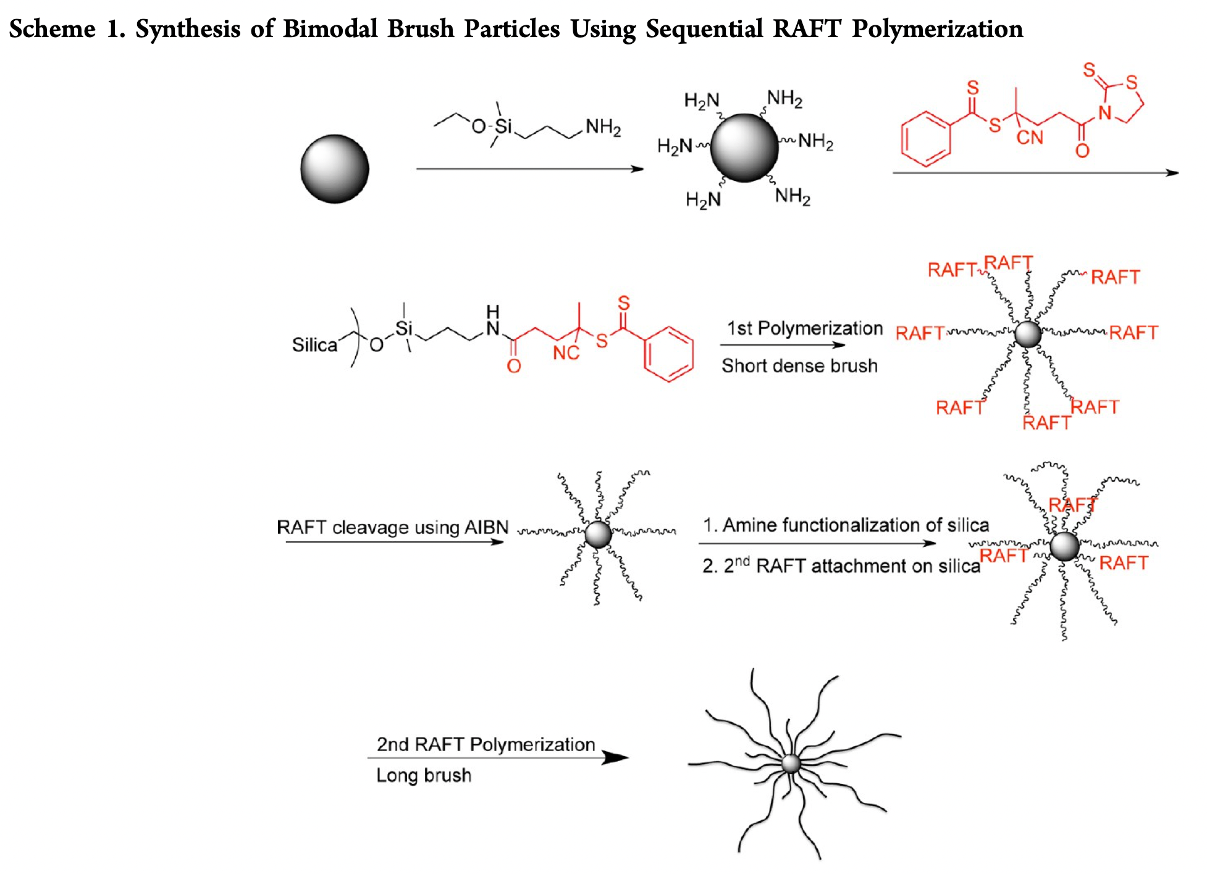

Slide 31
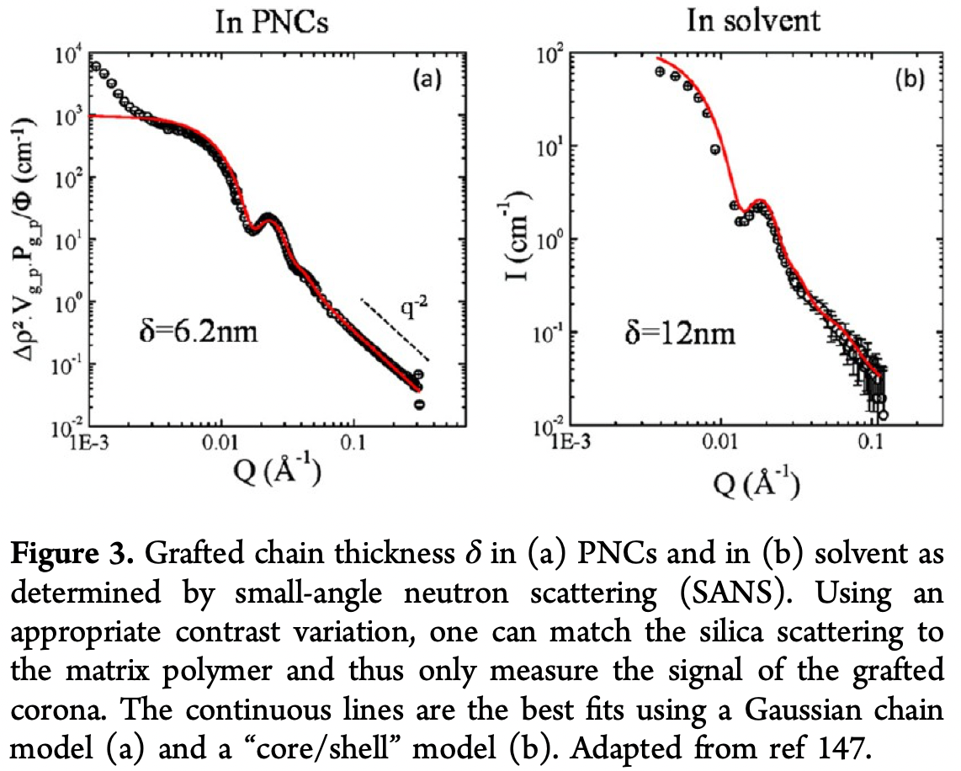
-4
-2

Slide 32
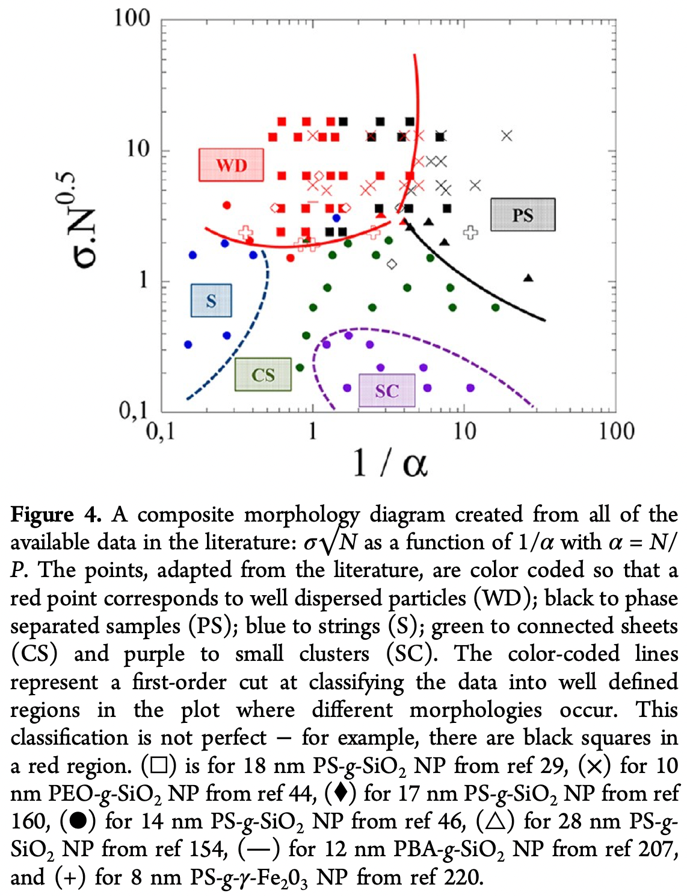
Well Dispersed
Phase Separated
“Extent of Crowding”
σ = surface coverage
N = Graft MW
N^{0.5} ~ Radius
Number/area * thickness
Strings
Sheets
Clusters
1/α = Matrix/Graft MW
0.1 short matrix MW
10 long matrix MW
Kumar, S.K., Jouault, N., Benicewicz, B. and Neely, T., 2013. Nanocomposites with polymer grafted nanoparticles. Macromolecules, 46(9), pp.3199-3214.

Slide 33

Akcora P, Liu H, Kumar SK, Moll J, Li Y, Benicewicz BC, Schadler LS, Acehan D, Panagiotopoulos AZ, Pryamitsyn V, Ganesan V, Ilavsky J, Thiyagarajan P, Colby RH, Douglas JF Anisotropic self-assembly of spherical polymer-grafted nanoparticles Nat. Mat. 8 354-359 (2009).

Slide 34


Slide 35

D = kT/(6πR_{H}η)
<x²> = 2Dt

Slide 36


Slide 37

Agglomerated
Network
Sheets
Network
Sheets
Agglomerated

Slide 38


Slide 39

Short graft
Long graft
α = graft/matrix MW

Slide 40


Slide 41

He J, Liu Y, Babu T, Wei Z, Nie Z Self-assembly of inorganic nanoparticle vesicles and tubules driven by tethered linear block copolymers. J. Am. Chem. Soc. 134 11342−11345 (2012).

Slide 42

Huang J, Zhou J, Liu M Interphase in Polymer Nanocomposites JACS Au 2 280-291 (2022).

Slide 43



Slide 44



Slide 45


Slide 46


Slide 47

Bailey EJ, Winey KI Dynamics of polymer segments, polymer chains, and nanoparticles in polymer nanocomposite melts: A review Prog. Polym. Sci. 105 101242 (2020)

Slide 48


Slide 49


Slide 50


Slide 51


Slide 52


Slide 53


Slide 54


Slide 55


Slide 56


Slide 57


Slide 58


Slide 59


Slide 60

SE = Stokes-Einstein

Slide 61


Slide 62


Slide 63


