Slide 1
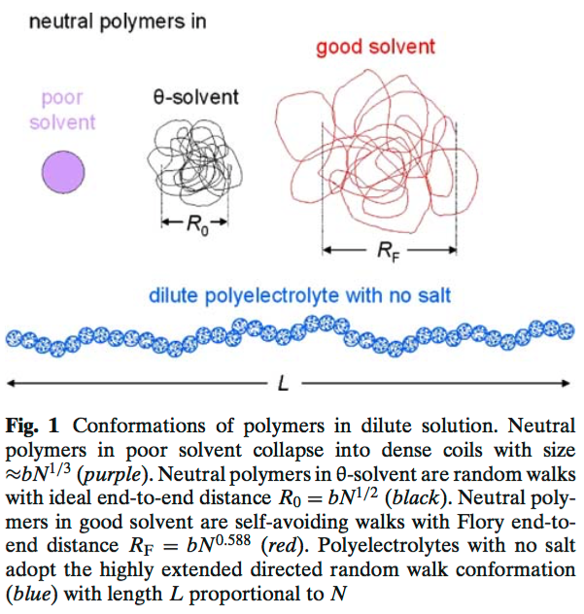
Long Range Interactions

Slide 2
van der Waals’ Equation
p = nRT/V
i.g. from kinetic theory of gasses
Atoms can pass through each other
No enthalpy of interaction
Totally entropic
Modify for excluded volume “b”
p = nRT/(V-b)
Which increases pressure
Modify for excluded volume “b”
and
Attractive enthalpic interaction
“a”
p = nRT/(V-b) – a(n/V)²
-TΔS + ΔH
n/V = ρ ∼ φ or c
Binary attractive interactions (can form a liquid)
Which decreases pressure

Slide 3
Van der Waals’ Equation
p = nRT/(V-b) – a(n/V)² Van der Waals Equation
Compressibility Factor Z = pV_{molar}/RT = p/ρRT = 1 + B₂ ρ + … Virial Expansion
B₂ has units of molar volume
Solve for B₂ using the van der Waals Equation
B₂ = b – a/RT for molar volume or B₂ = b – a/k_{B}T for molecular volume
Flory and Krigbaum knew they needed an energy for an expanded chain of the van der Waals form
Molar Energy = pV_{molar} = RT (1 + B₂ / V_{molar})
Where: B₂ = Excluded Volume – Attractive Potential/RT = b – a/RT
Energy = Ideal + repulsive “b” and attractive “a”
When T* = a/Rb, interactions disappear, B₂ = 0, and system becomes “ideal”. This is a “critical point” just before phase separation.

Slide 4
Van der Waals’ Equation
p = nRT/(V-b) – a(n/V)² Van der Waals Equation
Compressibility Factor Z = pV_{molar}/RT = p/ρRT = 1 + B₂ ρ + … Virial Expansion
B₂ has units of molar volume
Z_{VdW} = pV_{molar}/RT = V/(V-b) – aρ = 1/(1-bρ) – aρ/RT
Geometric series Σar^{k} = a/(1-r) sum from 0 to ∞
So, 1/(1-bρ) = Σar^{k} = 1 + bρ + (bρ)² + … and for bρ = b/V is very small
Z_{VdW} = 1/(1-bρ) – aρ/RT = 1 + (b – a/RT) ρ + (bρ)² +…
Compare with the virial expansion
Z = pV_{molar}/RT = p/ρRT = 1 + B₂ ρ + B₃ ρ² + …
B₂ = b – a/RT and B₃ = b²

Slide 5

Van der Waals’ Equation
p = nRT/(V-b) – a(n/V)² + c (n/V)³ Van der Waals Equation with repulsive ternary interactions
Compressibility Factor Z = pV_{molar}/RT = p/ρRT = 1 + B₂ ρ + B₃ ρ² + … Virial Expansion
B₂ has units of molar volume
Z_{VdW} = pV_{molar}/RT = V/(V-b) – aρ/RT = 1/(1-bρ) – aρ/RT + cρ²/RT
Geometric series Σar^{k} = a/(1-r) sum from 0 to ∞
So, 1/(1-bρ) = Σar^{k} = 1 + bρ + (bρ)² + … and for bρ = b/V is very small
Z_{VdW} = 1/(1-bρ) – aρ/RT = 1 + (b – a/RT) ρ + (b² + c/RT) ρ² +…
Compare with the virial expansion
Z = pV_{molar}/RT = p/ρRT = 1 + B₂ ρ + B₃ ρ² + …
B₂ = b – a/RT and B₃ = b² + c/RT
For an immiscible system B₂ is negative or very small (low temperature)
B₃ can be positive leading to a discrete phase transition or negative leading to a continuous transition
Red detracts from Black

Slide 6







The Secondary Structure for Synthetic Polymers
Long-Range Interactions
Boltzman Probability
For a Thermally Equilibrated System
Gaussian Probability
For a Chain of End-to-End Distance R
By Comparison, The Energy to stretch a Thermally Equilibrated Chain Can be Written
For a Chain with Long-Range Interactions There is and Additional Term
Number of pairs
So,
Flory-Krigbaum Theory
Result is called a Self-Avoiding Walk

Slide 7
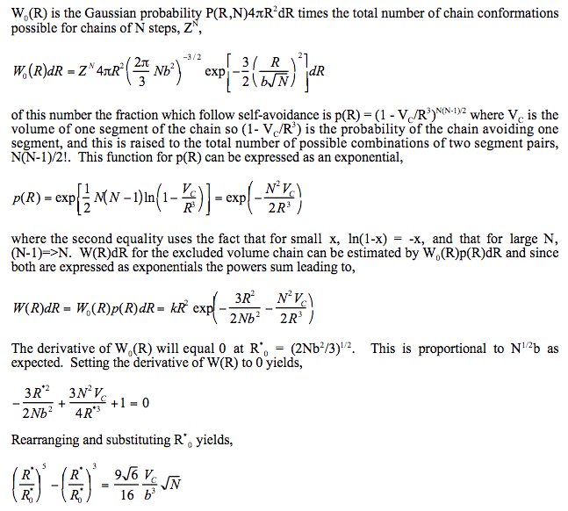
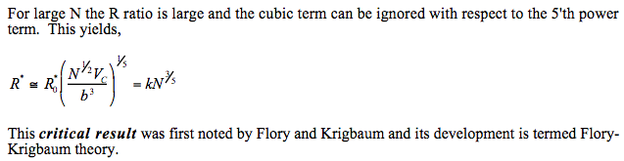

Slide 8
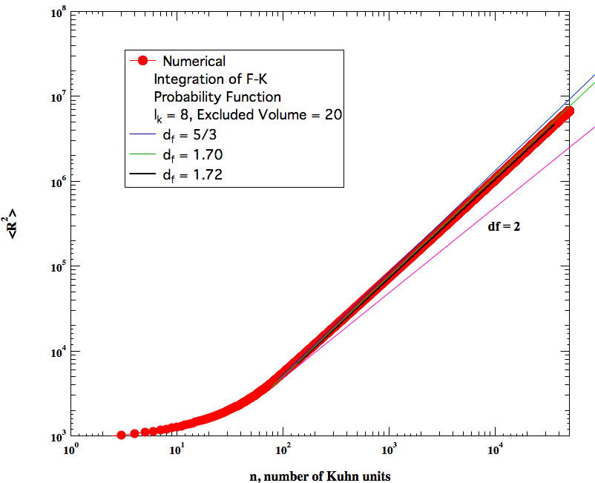

Slide 9
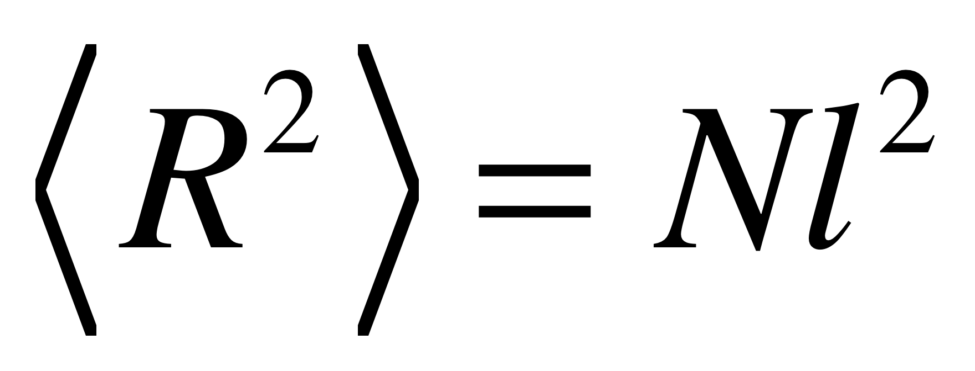
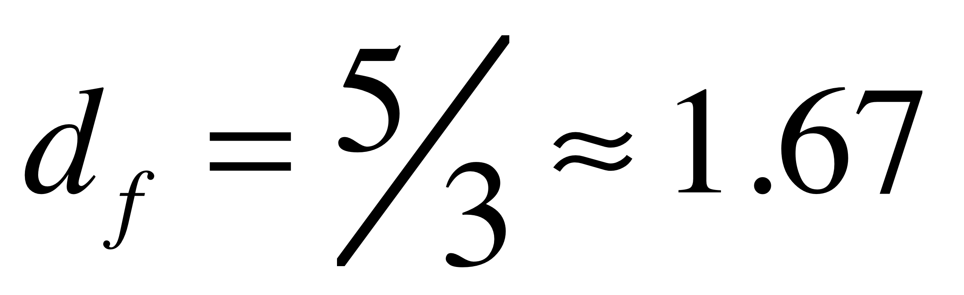
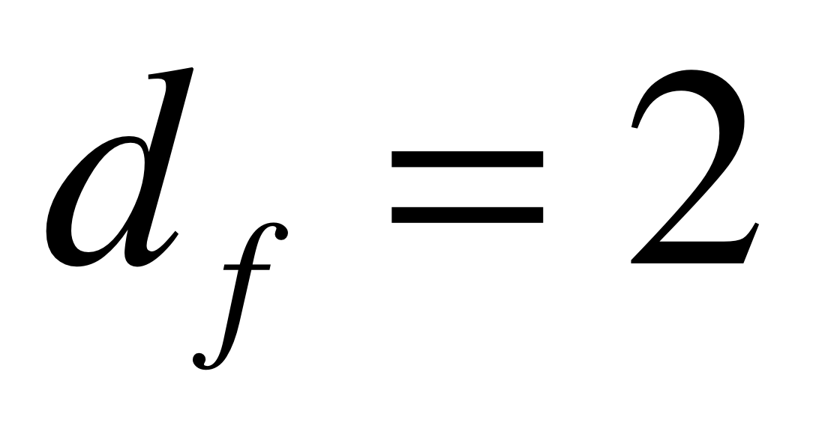
The Secondary Structure for Synthetic Polymers
Linear Polymer Chains have Two Possible Secondary Structure States:
Gaussian Chain
Random Walk
Theta-Condition
Brownian Chain
(The Normal Condition in the Melt/Solid)
Self-Avoiding Walk
Good Solvent
Expanded Coil
(The Normal Condition in Solution)
These are statistical features. That is, a single simulation of a SAW and a GC could look identical.

Slide 10
The Secondary Structure for Synthetic Polymers
Linear Polymer Chains have Two Possible Secondary Structure States:
Gaussian Chain
Random Walk
Theta-Condition
Brownian Chain
(The Normal Condition in the Melt/Solid)
Self-Avoiding Walk
Good Solvent
Expanded Coil
(The Normal Condition in Solution)
Concentration driven contraction
Consider going from dilute conditions, c < c*, to the melt by increasing concentration.
The transition in chain size is gradual not discrete.
Synthetic polymers at thermal equilibrium accommodate concentration changes through a scaling transition. Primary, Secondary, Tertiary Structures.

Slide 11
The Secondary Structure for Synthetic Polymers
Linear Polymer Chains have Two Possible Secondary Structure States:
Gaussian Chain
Random Walk
Theta-Condition
Brownian Chain
(The Normal Condition in the Melt/Solid)
Self-Avoiding Walk
Good Solvent
Expanded Coil
(The Normal Condition in Solution)
Thermally driven expansion
Consider going from Theta Temperature, T = θ, to the expanded coil by increasing temperature.
The transition in chain size is gradual not discrete.
Synthetic polymers at thermal equilibrium accommodate thermal changes through a scaling transition. Primary, Secondary, Tertiary Structures.

Slide 12
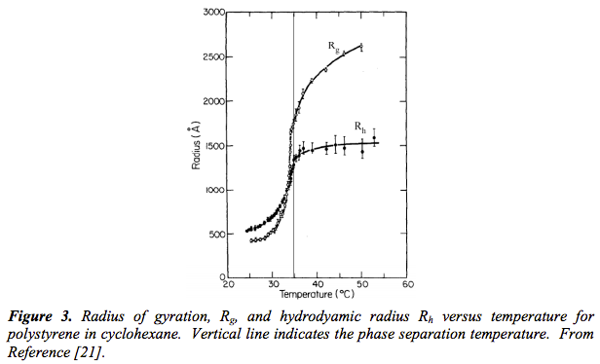
Problem: The transition in chain size is gradual not discrete as predicted by FK theory.

Slide 13
We have considered an athermal hard core potential (excluded volume, ‘b’, from VdW equation)
VdW equation
p = nRT/(V-b) – a(n/V)²
B₂ = b – a/RT
PV = RT + RT B₂/V (Virial Expansion)
Energy = Ideal + repulsive “b” and attractive “a”
Excluded volume like “b”
But V_{c} actually has an inverse temperature component associated with attractive enthalpic interactions between monomers and solvent molecules (attractive binary interactions, ‘a’, from VdW equation)
The interaction (attractive) energy between a monomer and the polymer/solvent system is on average <E(R)> for a given end-to-end distance R (defining a conformational state). This modifies the probability of a chain having an end-to-end distance R by the Boltzmann probability,
<E(R)> is made up of pp, ps, ss interactions with an average change in attractive energy on solvation of a polymer Δε = (ε_{pp}+ε_{ss}-2ε_{ps})/2
For a monomer with z sites of interaction we can define a unitless attractive energy parameter
χ = zΔε/kT that reflects the average enthalpy of attractive interaction per kT per monomer

Slide 14
For a monomer with z sites of interaction we can define a unitless energy parameter
χ = zΔε/kT that reflects the average enthalpy of attractive interaction per kT for a monomer
The volume fraction of monomers in the polymer coil with a conformational state of end-to-end distance R is nV_{c}/R³
And there are n monomers in the chain, attractive chain energy “nχ”, so,
We can then write the energy of the chain as, (remember χ ~ 1/T)
PV = RT(1 + B₂/V)
B₂ = b – a/RT
When T* = a/Rb interactions disappear
This indicates that when χ = ½ the coil acts as if it were an ideal chain, excluded volume disappears. This condition is called the theta-state and the temperature where χ = ½ is called the theta-temperature. It is a critical point for the polymer coil in solution.

Slide 15
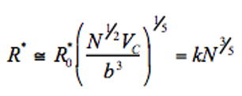
The effective excluded volume is now V_{ex} = V₀ (1/2-χ)
The Flory-Krigbaum result for coil size is:
Using this approximation for conditions of large molecular weight:
where
χ = zΔε/kT

Slide 16
This Solves the Problem: The transition in chain size is gradual not discrete as predicted by FK theory.

Slide 17
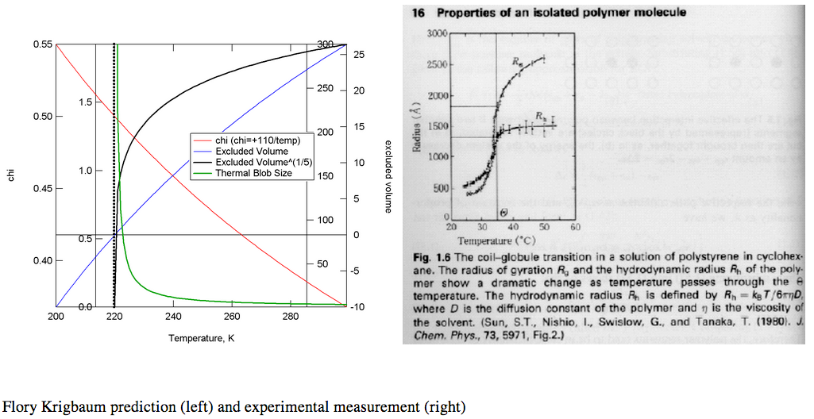

Slide 18
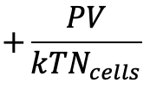
For a single polymer coil
Average attractive enthalpy of interaction
χ = zΔε/kT
PV = RT(1 + B₂/V)
B₂ = b – a/RT
When T* = a/Rb interactions disappear
B₂ = V_{c}/2 – V_{c} χ
χ = zΔε/kT
For a polymer mixture (polymer/polymer or polymer/solvent)
Flory-Huggins Equation

Slide 19
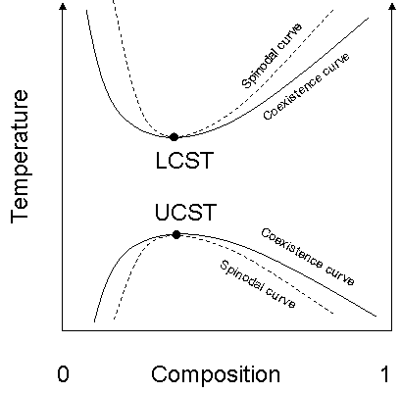
Lower-Critical Solution Temperature (LCST)
Polymers can order or disorder on mixing leading to a noncombinatorial entropy term, A in the interaction parameter.
If the polymer orders on mixing then A is positive and the energy is lowered.
If the polymer-solvent shows a specific interaction then B can be negative.
This Positive A and Negative B favors mixing at low temperature and demixing at high temperature, LCST behavior.

Slide 20
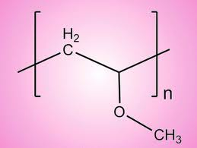
Lower-Critical Solution Temperature (LCST)
Poly vinyl methyl ether/Water
PVME/PS
Also see Poly(N-isopropylacrylamide)/Water

Slide 21
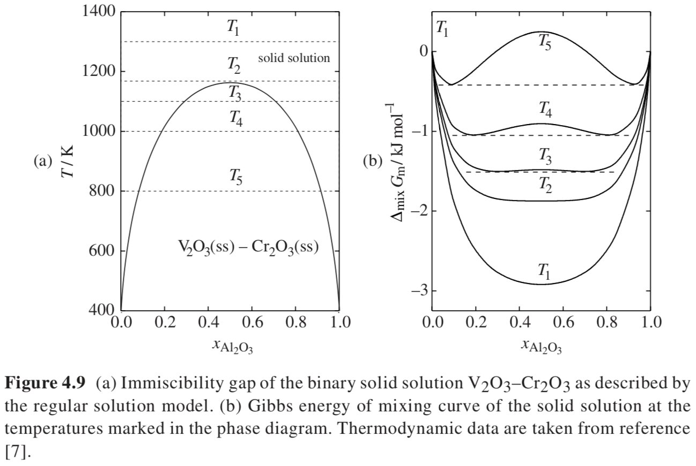
ΔG_{m} = RT(x_{A} ln(x_{A}) + x_{B} ln(x_{B})) + Ω x_{A}x_{B}
Miscibility Limit
Binodal
Spinodal
Critical Point
One
Phase
Two Phases
at Equilibrium

Slide 22
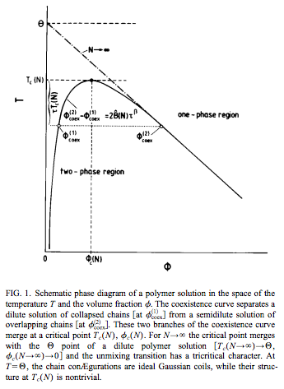



Flory-Huggins Equation
Hildebrandt Regular Solution Model
Miscibility Limit
Binodal
$$\frac{PV}{{kTN}_{Cells}}$$
Spinodal
Critical Point
All three equalities apply
At the critical point
http://rkt.chem.ox.ac.uk/lectures/liqsolns/regular_solutions.html

Slide 23


Slide 24
T_{c} = θ(1-2Φ_{c})
Linear Relationship

Slide 25
Overlap Composition
Consider also φ* which is the coil composition, generally below the critical composition for normal n or N

Slide 26
Overlap Composition
Both φ* and φ_{c} depend on 1/√N
Below φ* the composition is fixed since the coil can not be diluted!
Φ*

Slide 27
Overlap Composition
Coil
Collapse
Both φ* and φ_{c} depend on 1/√N
Below φ* the composition is fixed since the coil can not be diluted!
So, there is a region (yellow) of coil collapse below the binodal at φ* in composition and temperature
Φ*

Slide 28
GS-Coil
Θ
Coil
Overlap Composition
Coil
Collapse
Both φ* and φ_{c} depend on 1/√N
Below φ* the composition is fixed since the coil can not be diluted!
So, there is a regime of coil collapse below the binodal at φ* in composition and temperature
Phase
Separation
Φ*

Slide 29
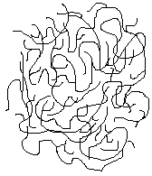
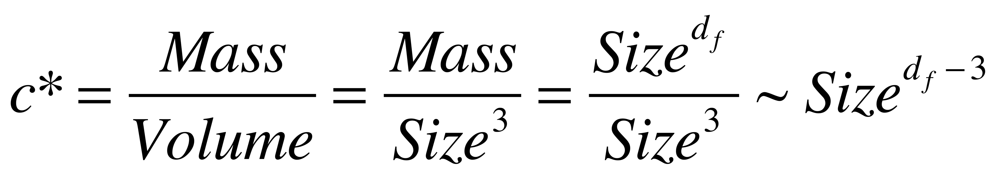
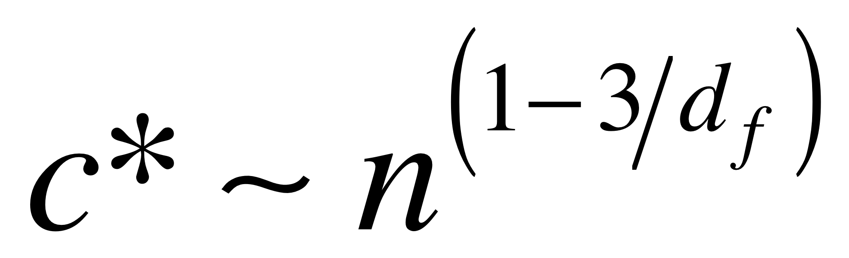
For a polymer in solution there is an inherent concentration to the chain
since the chain contains some solvent
The polymer concentration is Mass/Volume, within a chain
When the solution concentration matches c* the chains “overlap”
Then an individual chain is can not be resolved and the chains entangle
This is called semi-dilute since the solution is still of very low concentration.
The regime below c* is called dilute. Very high concentrations, θ-coil, are called concentrated.

Slide 30
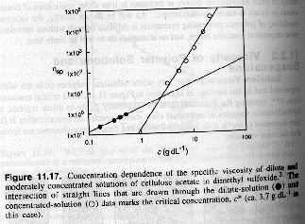
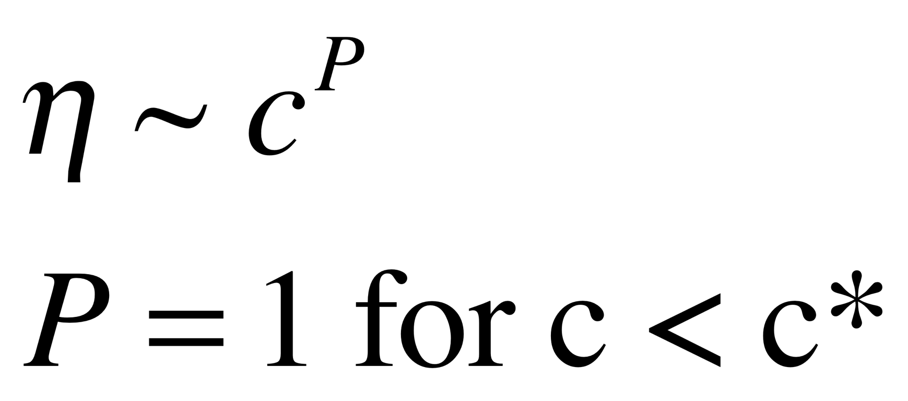
In concentrated solutions with chain overlap
chain entanglements lead to a higher solution viscosity
J.R. Fried Introduction to Polymer Science
Later called c_{e}, entanglement concentration

Slide 31
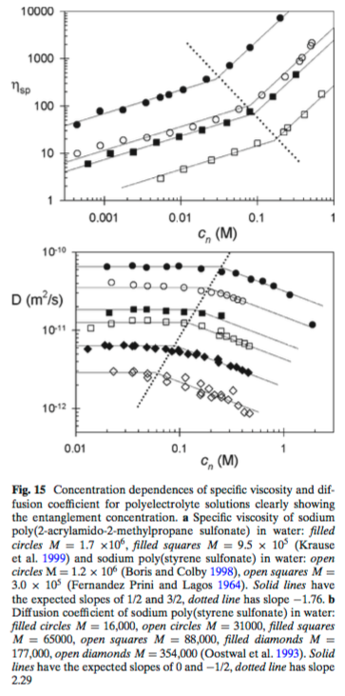
Structure and linear viscoelasticity of flexible polymer solutions: comparison of polyelectrolyte and neutral polymer solutions R. Colby, Rheo. Acta 49 425-442 (2010)
η = η₀ (1 + [η]c)
η_{sp}= (η - η₀)/η₀
[η] = lim_{c=>0} (η_{sp}/c)
[η] = V_{coil}/m = 1/c* = m^{3/df - 1}

Slide 32
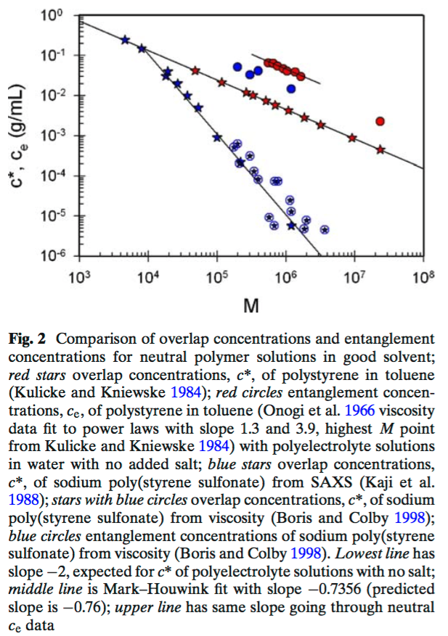
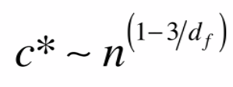
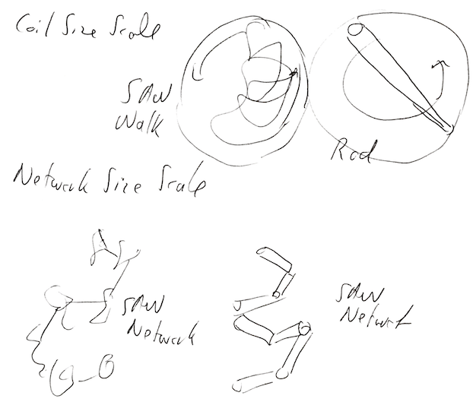
Structure and linear viscoelasticity of flexible polymer solutions: comparison of polyelectrolyte and neutral polymer solutions R. Colby, Rheo. Acta 49 425-442 (2010)
This can be explained if you consider that c* is on a chain size-scale while c_{e} is on a bulk size scale, that is c_{e} is for bulk network pathways while c* is for the coil pathway. c_{e} behaves the same in rigid rods and coils because both make a self-avoiding network on large size scales, c* is different because one chain is a rod the other a self-avoiding walk.
Red circles neutral good solvent c_{e}
Red stars neutral good solvent c*
Blue circles polyelectrolyte c_{e}
Blue stars polyelectrolyte c*
-0.8
-2
d_{f} = 5/3 -0.8
d_{f} = 2 -0.5
d_{f} = 1. -2

Slide 33
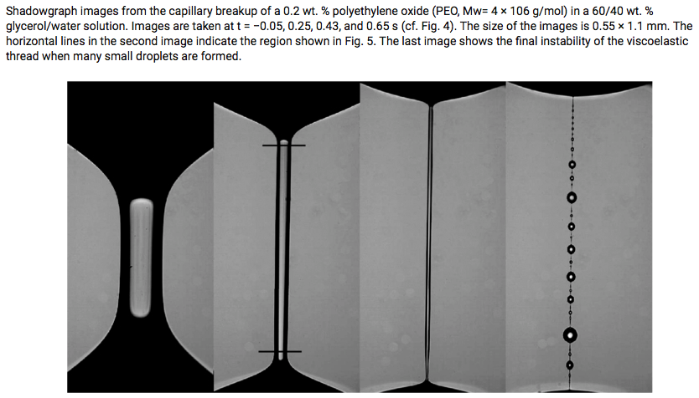
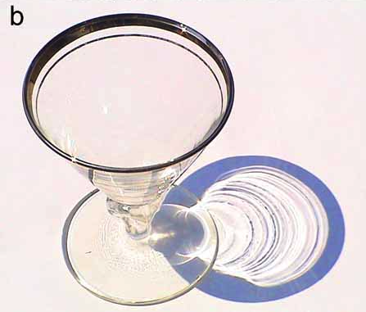
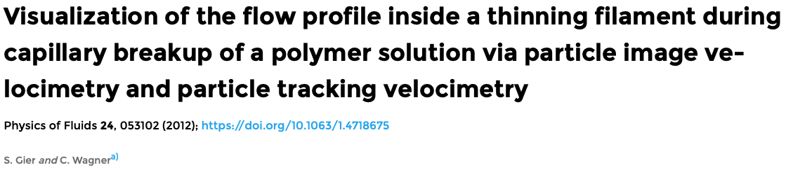
Extensional Flow

Slide 34
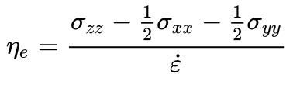

Extensional Flow
Trouton Viscosity = 3 Shear Viscosity for a Newtonian fluid
For a constant extensional strain rate, γ’_{zz} = dv_{z}/dz = constant
So, v_{z} = dz/dt = constant z
dz/z = constant dt
z = exp(Kt)
You need to stretch the fluid with exponentially increasing length.
That is hard to do in a lab.

Slide 35
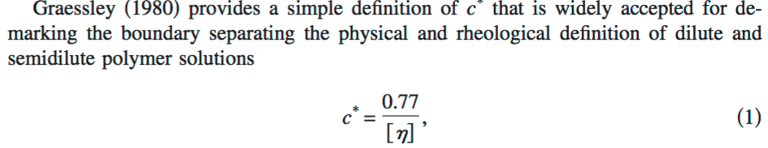
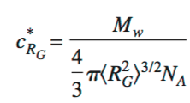
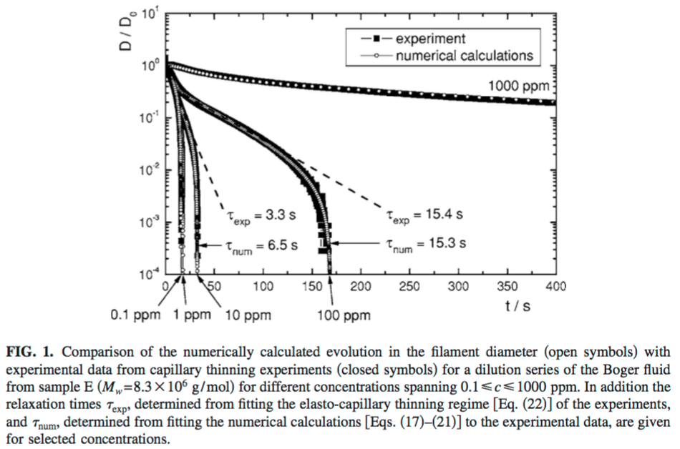

How dilute are dilute solutions in extensional flows? C. Clasen, J. P. Plog,, W.-M. Kulicke, M. Owens, C. Macosko, L. E. Scriven, M. Verani and G. H. McKinley, J. Rheol. 50 849-881 (2006);
Diameter from capillary thinning experiments

Slide 36
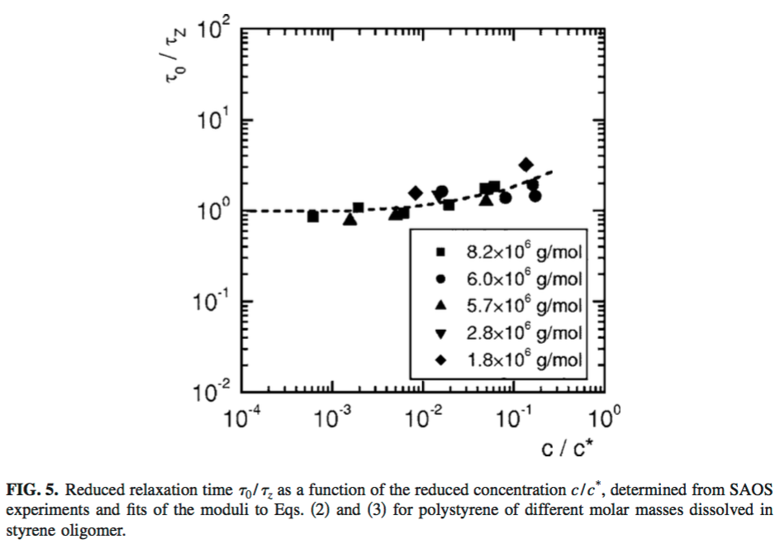
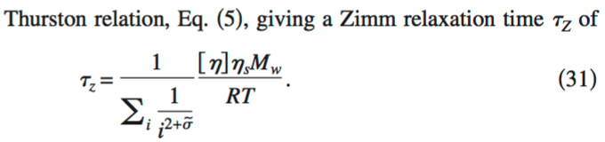
How dilute are dilute solutions in extensional flows? C. Clasen, J. P. Plog,, W.-M. Kulicke, M. Owens, C. Macosko, L. E. Scriven, M. Verani and G. H. McKinley, J. Rheol. 50 849-881 (2006);
SAOS = small amplitude oscillatory shear
Shear Measurement

Slide 37
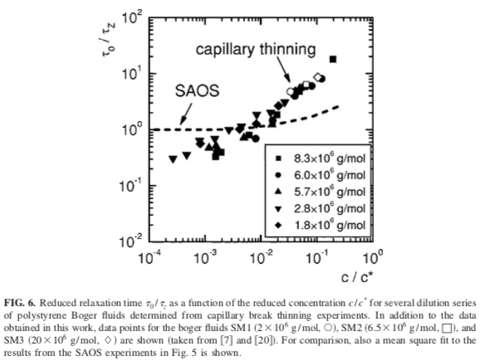
How dilute are dilute solutions in extensional flows? C. Clasen, J. P. Plog,, W.-M. Kulicke, M. Owens, C. Macosko, L. E. Scriven, M. Verani and G. H. McKinley, J. Rheol. 50 849-881 (2006);
Extensional Measurement

Slide 38
Structure and linear viscoelasticity of flexible polymer solutions: comparison of polyelectrolyte and neutral polymer solutions R. Colby, Rheo. Acta 49 425-442 (2010)

Slide 39
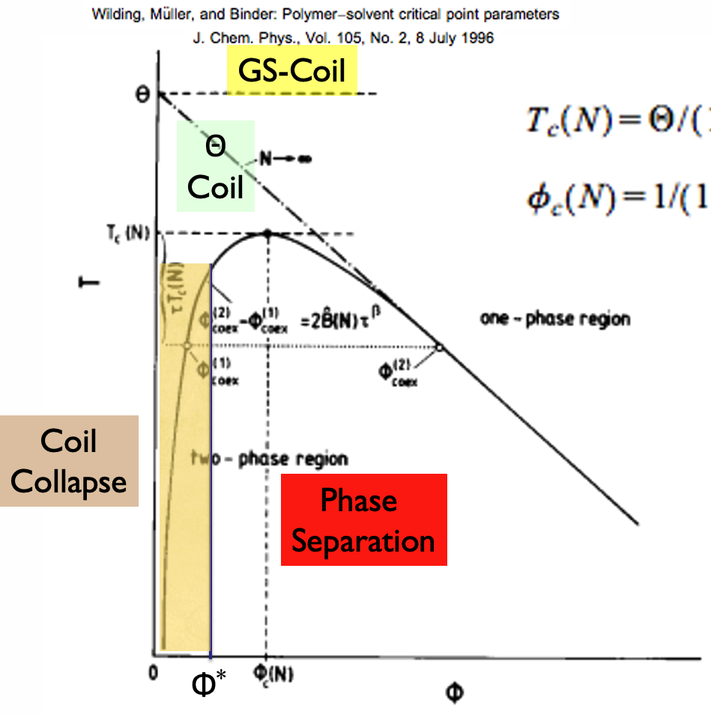
Structure and linear viscoelasticity of flexible polymer solutions: comparison of polyelectrolyte and neutral polymer solutions R. Colby, Rheo. Acta 49 425-442 (2010)

Slide 40
Coil Collapse Following A. Y. Grosberg and A. R. Khokhlov “Giant Molecules”
What Happens to the left of the theta temperature?
Coil Expansion Factor α
Grosberg uses:
Rather than the normal definition used by Flory:

Slide 41
Coil Collapse Following A. Y. Grosberg and A. R. Khokhlov “Giant Molecules”
Page 167
What Happens to the left of the theta temperature?
Grosberg uses:
Rather than the normal definition used by Flory:
Short-Range Interactions
We had C∞ = R²/R²₀ = n_{K}l_{K}²/n₀l₀² = Ll_{K}/Ll₀ = l_{K}/l₀
Long-Range Interactions
Flory α = R²/R²₀ = n^{6/5}l²/nl² ~ n^{1/5}
Grosberg
α² = R²/R²₀ :: α ~ n^{1/10}

Slide 42
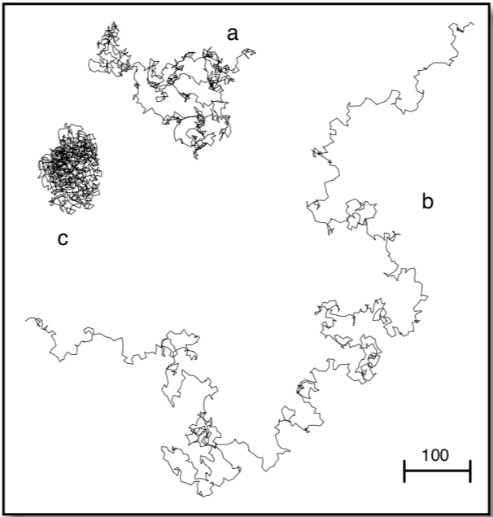
Coil Collapse Following A. Y. Grosberg and A. R. Khokhlov “Giant Molecules”
What Happens to the left of the theta temperature?
Grosberg uses:
Rather than the normal definition used by Flory:

Slide 43
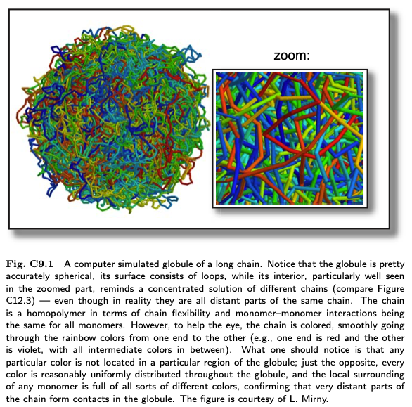

Slide 44
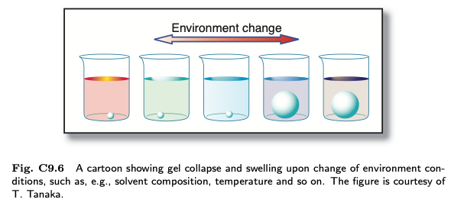

Slide 45
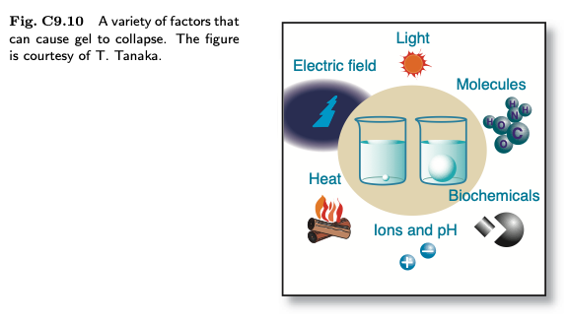

Slide 46
Flory-Krigbaum couldn’t integrate R² P(R) so they took the derivative and found the maximum probability for R² P(R).
Grosberg takes a different approach that leads to the same answer.
Write the single chain free energy in terms of the coil expansion factor, α, then find the minimum free energy by taking the derivative in α of the free energy and setting it to 0 to find the equilibrium α*

Slide 47
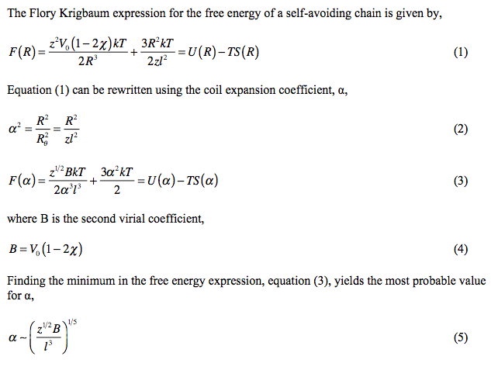




Van der Waals
dF(α)/dα = 0
This is an exact solution by Grosberg’s method

Slide 48
Van der Waals’ Equation
p = nRT/(V-b) – a(n/V)² + c (n/V)³ Van der Waals Equation with repulsive ternary interactions
Compressibility Factor Z = pV_{molar}/RT = p/ρRT = 1 + B₂ ρ + B₃ ρ² + … Virial Expansion
B₂ has units of molar volume
Z_{VdW} = pV_{molar}/RT = V/(V-b) – aρ = 1/(1-bρ) – aρ + cρ²
Geometric series Σar^{k} = a/(1-r) sum from 0 to ∞
So, 1/(1-bρ) = Σar^{k} = 1 + bρ + (bρ)² + … and for bρ = b/V is very small
Z_{VdW} = 1/(1-bρ) – aρ = 1 + (b – a/RT) ρ + (b² + c/RT) ρ² +…
Compare with the virial expansion
Z = pV_{molar}/RT = p/ρRT = 1 + B₂ ρ + B₃ ρ² + …
B₂ = b – a/RT and B₃ = b² + c/RT
For an immiscible system B₂ is negative or very small (low temperature)
B₃ can be positive leading to a discrete phase transition or negative leading to a continuous transition
Red detracts from Black

Slide 49


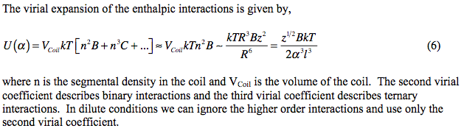
n ~ z/R³
B changes sign, positive for miscible, negative for phase separation below the Boyle temperature T_{B} = a/b (B = b – a/T so “a” (or χ) is negative for miscibility/repulsive pp)
C is always positive, i.e., favors coil expansion.
C is important below the theta temperature to model the coil to globule transition at high
monomer density
For simplicity we ignore higher order terms because C is enough to give the gross features
of this transition.
Generally, it is known that this transition can be either first-order for
biopolymers such as protein folding, or second-order for synthetic polymers.
First-order means that the first derivative of the free energy is not continuous, i.e., a jump in
free energy at a discrete transition temperature, such as a melting point, heat of melting.
Second order, free energy, volume, entropy etc. are continuous through the transition, slope
changes in T (heat capacity, thermal expansion coefficient).

Slide 50
d_{f} = 2 for coil
d_{f} = 3 for blob
Blob model for coil collapse
-The expanded coil transitions to a Gaussian chain by locally forming Gaussian “blobs” called “thermal blobs” (will cover later). Neutron scattering provides evidence.
-These blobs grow as the theta point is approached.
-Thermally driven structural changes occur from the bottom up.
-Propose a similar model for the collapse of the theta coil using a different kind of “blob” in analogy to “thermal blobs” but 3d blobs not 2d thermal blobs.
Gaussian
Scaling of
g* Blobs

Slide 51

d_{f} = 2 for coil
d_{f} = 3 for blob
Blob model for coil collapse
Number of
Blobs = z/g*
Gaussian
Scaling of
g* Blobs

Slide 52
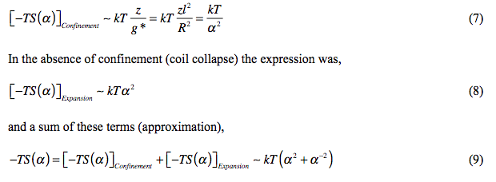

Entropic Part of Collapse Free Energy
Number of Blobs (z/g*) times kT is the Confinement Entropy
Total Collapse Free Energy
kT C n³ = kT C z³/R³
= kT C/(α⁶l⁶)

Slide 53
Free Energy Including Third Virial Coefficient
α > 1 for expansion
α < 1 for contraction

Slide 54
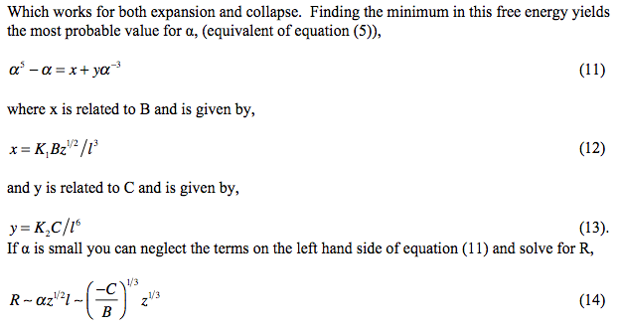
Ratio of C/B determines behavior
The collapsed coil is 3d

Slide 55
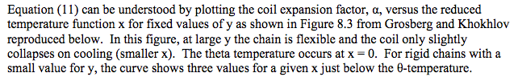
x ~ B; y ~ C
B ~ 1/T; α ~ V^{1/3}
Maxwell Construction

Slide 56
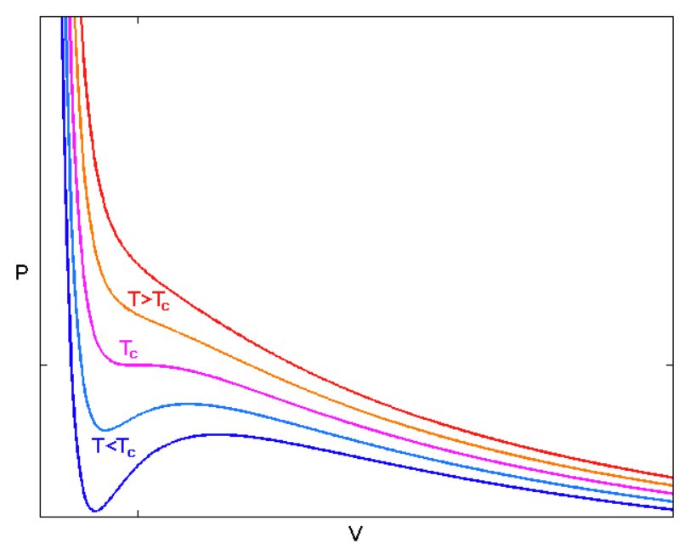
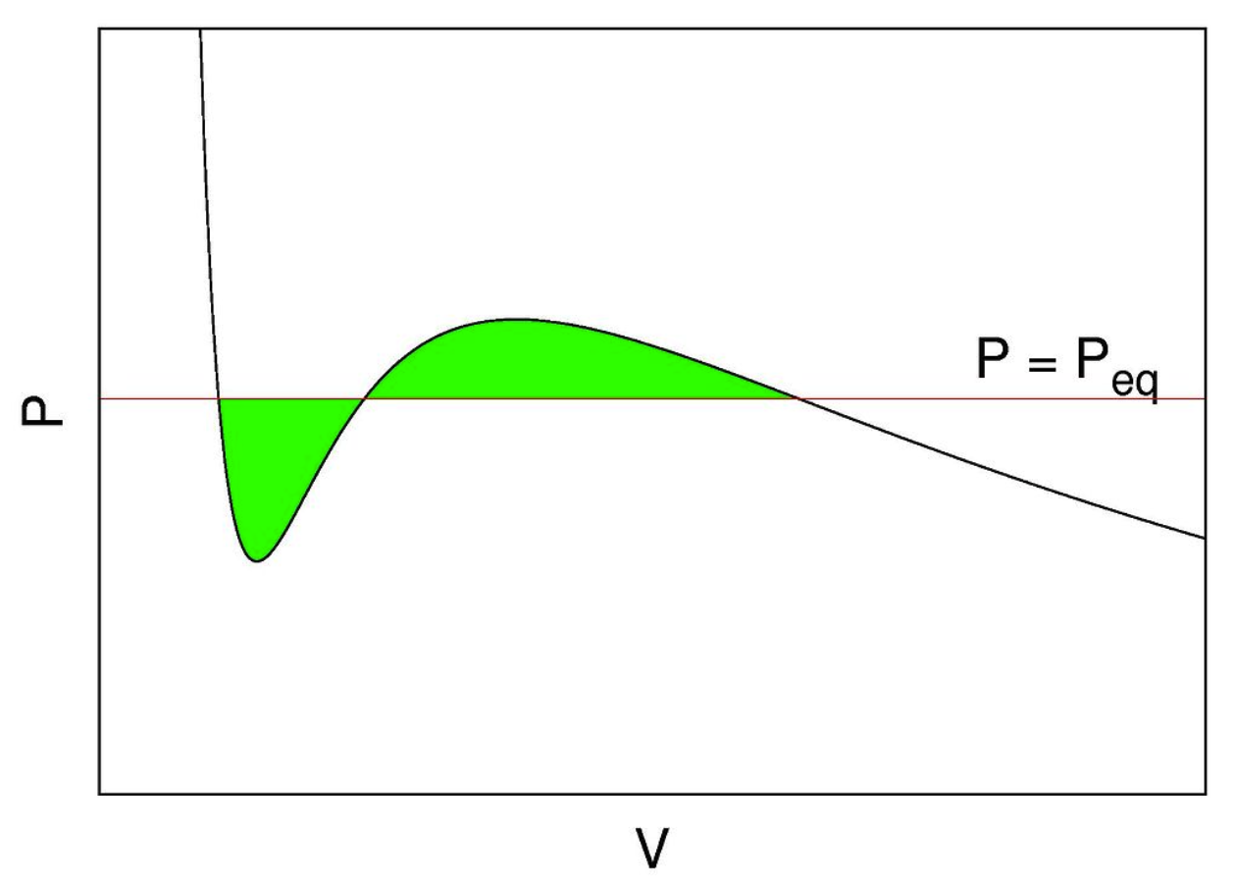
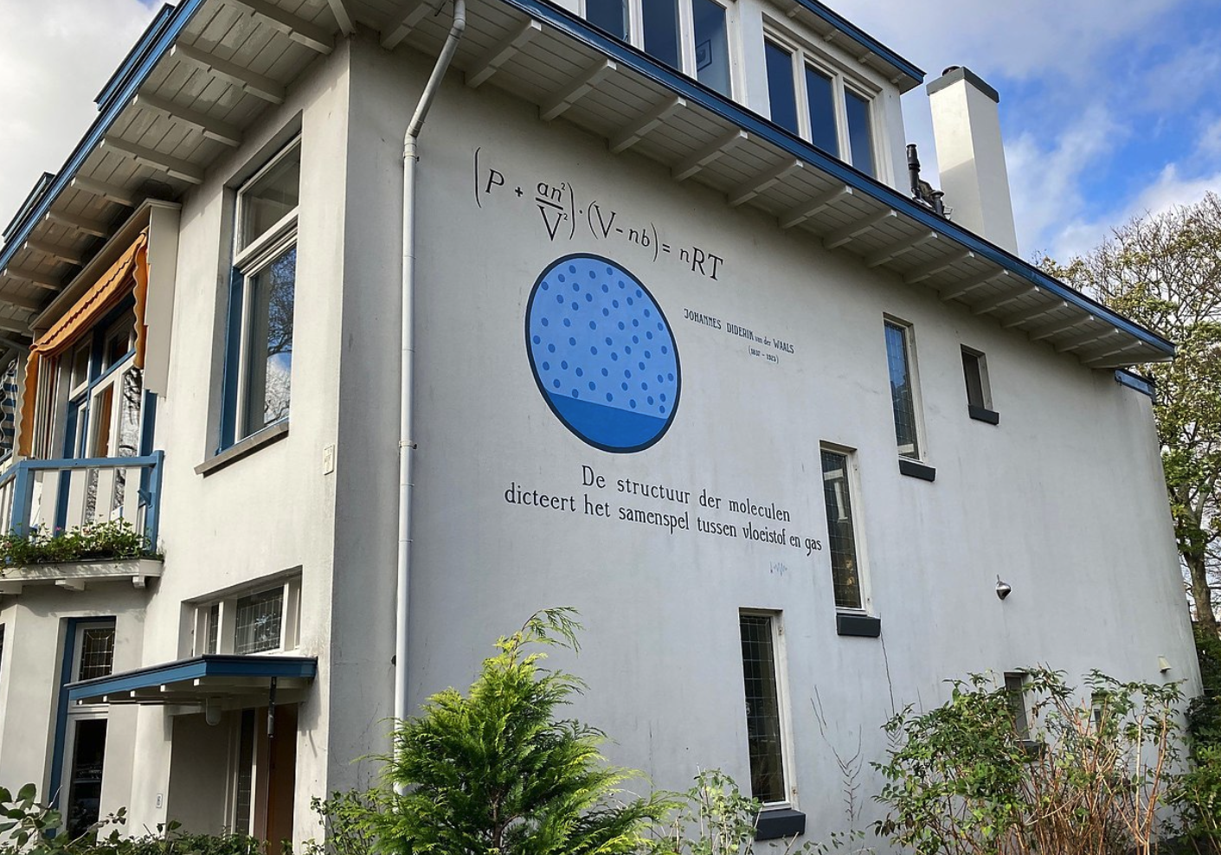
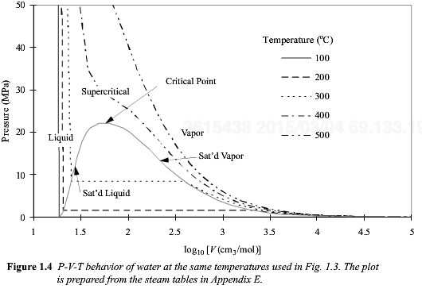
Maxwell Construction
Isotherm of a Cubic Equation of State
in the Two-Phase Region of Temperature
Lieden the Netherlands
van der Waals place
There are three possible roots, two points are at equilibrium, middle is not real.

Slide 57
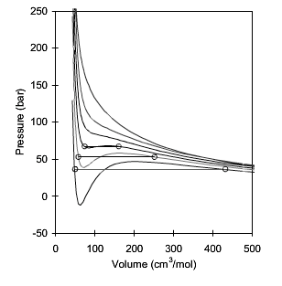
x ~ B; y ~ C
B ~ 1/T; α ~ V^{1/3}
EOS Calculation
Phase Diagram

Slide 58
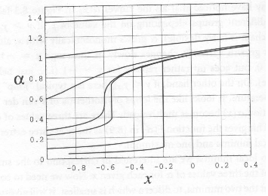
EOS Calculation
x ~ B; y ~ C
B ~ 1/T; α ~ V^{1/3}
Phase Diagram

Slide 59
x ~ B; y ~ C
B ~ 1/T; α ~ V^{1/3}

Slide 60
x ~ B; y ~ C
B ~ 1/T; α ~ V^{1/3}
Generally, it is known that this transition can be either first-order for
biopolymers such as protein folding, or second-order for synthetic polymers.
First order means that the first derivative of the free energy is not continuous, i.e. a jump in
Free energy at a discrete transition temperature, such as a melting point.

Slide 61
x ~ B; y ~ C
B ~ 1/T; α ~ V^{1/3}
Second-Order
α is Continuous
First-Order
Discrete change in α
Generally, it is known that this transition can be either first-order for
biopolymers such as protein folding, or second-order for synthetic polymers.
First order means that the first derivative of the free energy is not continuous, i.e. a jump in
Free energy at a discrete transition temperature, such as a melting point.

Slide 62







1.5 Theta
1.6 Expanded
0.774 Sphere
0.92 Draining Sphere
(We will Look at this
further)

Slide 63


1.5 Theta
1.6 Expanded
0.774 Sphere
0.92 Draining Sphere
(We will Look at this
further)

Slide 64



Size of a Chain, “R”
(You can not directly measure the End-to-End Distance)

Slide 65





What are the measures of Size, “R”, for a polymer coil?
Radius of Gyration, R_{g}
http://www.eng.uc.edu/~gbeaucag/Classes/Physics/Chapter1.pdf

Slide 66

What are the measures of Size, “R”, for a polymer coil?
Radius of Gyration, R_{g}
http://www.eng.uc.edu/~gbeaucag/Classes/Physics/Chapter1.pdf

Slide 67



What are the measures of Size, “R”, for a polymer coil?
Radius of Gyration, R_{g}
eted
2.45 R_{g} = R_{eted}
R_{g} is a direct measure of the end-to-end distance for a linear Gaussian chain
http://www.eng.uc.edu/~gbeaucag/Classes/Physics/Chapter1.pdf

Slide 68

Moment of Intertia, I is <R_{g}²> weighted by mass
For M = 1
R_{g}/R
Disk/Cylinder Hoop Sphere Rod
Sym. Axis Sym. Axis Solid Center
1/√2=0.707 1 √(2/5)=0.632 1/√12=0.289
Cylinder Hoop Sph. Shell Rod R_{g}/L
Center Diameter End
√(1/4+(L²/R²)/12) 1/√2=0.707 √(2/3)=0.816 √(1/3)=0.577

Slide 69
For a distribution of chain lengths/object sizes what moment of the distribution is R_{g}?
Typically, low order moments are desired such as the mean (first order)

Slide 70


For a polydisperse sample
what moment of R_{g} is obtained form scattering?
Polydispersity Index,
D = M_{w}/M_{n} = <M²>/<M¹>²
D = 1 is monodisperse
2 is most probable distribution
Commercial PE is D=14 and bimodal

Slide 71




For a polydisperse sample
what moment of R_{g} is obtained form scattering?
At low qR_{g}²
For polydisperse R_{g}’s weighted by
For a beach with sand, rocks, and boulders we only measure the boulders with R_{g}

Slide 72

For a polydisperse sample
what moment of R_{g} is obtained form scattering?
R. J. Roe p. 170 Methods of X-Ray and Neutron Scattering in Polymer Science (2000)

Slide 73

Static Light Scattering for R_{g}
Guinier’s Law
Guinier Plot linearizes this function
The exponential can be expanded at low-q and linearized to make a Zimm Plot

Slide 74


Slide 75


Slide 80

π

Slide 81


Slide 82


Slide 83


Slide 84


Slide 85


Slide 87


Slide 88


Slide 89


Slide 90


Slide 91


Static Light Scattering for Radius of Gyration
Consider binary interference at a distance “r” for a particle with arbitrary orientation
Rotate and translate a particle so that two points separated by r lie in the particle for all rotations
and average the structures at these different orientations
Guinier’s Law
Binary Autocorrelation
Function
Lead Term is
Scattered Intensity is the Fourier Transform of
The Binary Autocorrelation Function
A particle with no surface
Beaucage G J. Appl. Cryst. 28 717-728 (1995).

Slide 92


Slide 93


Slide 94


Slide 95

Debye Scattering Function for Gaussian Polymer Coil

Slide 96
What are the measures of Size, “R”, for a polymer coil?
Radius of Gyration, R_{g}
http://www.eng.uc.edu/~gbeaucag/Classes/Physics/Chapter1.pdf

Slide 97

Debye Paper Deriving this Equation

Slide 98
Low-q and High-q Limits of Debye Function
At high q the last term => 0
Q-1 => Q
g(q) => 2/Q ~ q⁻²
Which is a mass-fractal scaling law with d_{f} = 2
At low q, exp(-Q) => 1-Q+Q²/2-Q³/6+…
Bracketed term => Q²/2-Q³/6+…
g(q) => 1-Q/3+… ~ exp(-Q/3) = exp(-q²R_{g}²/3)
Which is Guinier’s Law

Slide 99

Ornstein-Zernike Function, Limits and Related Functions
The Zimm equation involves a truncated form of the Guinier Expression intended
For use at extremely low-qR_{g}:
If this expression is generalized for a fixed composition and all q, R_{g} is no longer
the size parameter and the equation is empirical (no theoretical basis) but has a form
similar to the Debye Function for polymer coils:
This function is called the Ornstein-Zernike function and ξ is called a correlation length.
The inverse Fourier transform of this function can be solved and is given by
(Benoit-Higgins Polymers and Neutron Scattering p. 233 1994):
This function is empirical and displays the odd (impossible) feature that the correlation
function for a “random” system is not symmetric about 0, that is + and – values for r
are not equivalent even though the system is random. (Compare with the normal
behavior of the Guinier correlation function.)

Slide 100


The Flory Expression indicates a linear dependence of osmotic pressure in concentration at low concentration and a dependence on concentration to the power 2 at high concentration.
From Gert Strobl, Polymer Physics

Slide 101
Ornstein-Zernike Function, Limits and Related Functions
Ornstein-Zernike (Empirical)
Debye (Exact)
High-q limit
Low-q limit

Slide 102
Ornstein-Zernike Function, Limits and Related Functions
Empirical Correlation Function
Transformed Empirical Scattering Function
Ornstein-Zernike Function
Debye-Bueche Function
Teubner-Strey Function
(F Brochard and
JF Lennon 1975
J. de Phy. 36(11) 1035)
c₂ is negative to create a peak
Sinha Function
Correlation function in all of these cases is not symmetric about 0 which is physically impossible for a random system. The resulting scattering functions can be shown to be non-physical, that is they do not follow fundamental rules of scattering. Fitting parameters have no physical meaning.

Slide 103

Zimm Plot (Berry Plot)
At q => 0 this is 1/osmotic compressibility, dΠ/dφ = 1/Ν + φΒ₂ = (1/Ν + (1−2χ)φ)

Slide 104





Zimm Plot
In a GPC you have φ ~ 0 for each fraction
Measure light scattering at a few angles and extrapolate q² to 0 to find weight average MW for each fraction. For each fraction the polydispersity, M_{w}/M_{n} ~ 1 so M_{w} = M_{n} = M_{z}

Slide 105

Behavior of the Lead Term (isothermal compressibility)
Mean-Field Interactions
Specific Interactions
The license of the image source clearly states that it can be used for commercial and noncommercial purposes and there is no need to ask permission from or provide credit to the photographer or Unsplash, although it is appreciated when possible.
Reprinted (adapted) with permission from McGlasson, A.; Rishi, K.; Beaucage, G.; Chauby, M.; Kuppa, V.; Ilavsky, J.; Rackaitis, M. Quantification of Dispersion for Weakly and Strongly Correlated Nanofillers in Polymer Nanocomposites. Macromolecules 2020, https://doi.org/10.1021/acs.macromol.9b02429. Copyright 2020 American Chemical Society

Slide 106



Figure 1 – For dilute dispersions, all structural features can be observed (left). With increasing concentration (going from left to right), the nano-aggregates begin to overlap and the larger features become obscured by the screening phenomenon (dotted line). Above the overlap concentration, the largest observable structural feature is the mesh size. At even higher concentrations, the mesh size decreases further and large-scale structural information is lost.

Slide 107





Pedersen Sommer Paper 2005

Slide 108

Random Phase Approximation (RPA) Equation
$$\frac{φ}{I\left(q\right)}=\frac{φ_{0}}{I_{0}\left(q\right)}−2χφ$$
Polymer in Solution
At high-q, I₀(q) is small and 1/I₀(q) is much larger than 2χ.
At low-q, I₀(q) is large, and 2χ is much larger than 1/I₀(q).
Negative 2χ indicates miscibility, positive, phase separation.
Concentration
Temperature, χ ~ B/T, high T small χ

Slide 109














How to observe the concentration blob?
Concentration
Contrast match the solvent with a mixture of deuterated and hydrogenous solvents
Tag one chain by deuteration (1% of chains)
$$\frac{φ}{I\left(q\right)}=\frac{φ_{0}}{I_{0}\left(q\right)}−2χφ$$

Slide 110


Two types of correlation: Mean Field and Specific Interactions are Experimentally Observed

Slide 111




These are related to Thermodynamics:
Virial Coefficient = Mean Field = FH χ
EOS like Van der Waals = Specific Interaction
(There is overlap)
At large-scale (q => 0)
they appear the same.
We expect I/φ(q=>0) to drop at higher concentrations as a measure of 1/(φ B₂) for both.
Woven
fabric
Non-woven fabric
(fleece, tissue, paper)

Slide 112


Critical ordering concentration
Rishi, K.; Pallerla, L.; Beaucage, G.; Tang, A. Dispersion of Surface-Modified, Aggregated, Fumed Silica in Polymer Nanocomposites. J. Appl. Phys. 2020, 127 (17), 174702.

Slide 113





Slide 114



Slide 115




Slide 116



Slide 117


Slide 118
Go to slides 2 second half

Slide 120
Measurement of the Hydrodynamic Radius, R_{h}
Kirkwood, J. Polym. Sci. 12 1(1953).
http://theor.jinr.ru/~kuzemsky/kirkbio.html
http://www.eng.uc.edu/~gbeaucag/Classes/Properties/HydrodyamicRadius.pdf

Slide 122
Intrinsic, specific & reduced “viscosity”
Shear Flow (may or may not exist in a capillary/Couette geometry)
(1)
n = order of interaction (2 = binary, 3 = ternary etc.)
We can approximate (1) as:
Martin Equation
Utracki and Jamieson “Polymer Physics From Suspensions to Nanocomposites and Beyond” 2010 Chapter 1

Slide 123

Intrinsic, specific & reduced “viscosity”
(1)
n = order of interaction (2 = binary, 3 = ternary etc.)
Concentration Effect
Kulicke & Clasen “Viscosimetry of Polymers and Polyelectrolytes (2004)

Slide 124

Intrinsic, specific & reduced “viscosity”
(1)
n = order of interaction (2 = binary, 3 = ternary etc.)
Concentration Effect, c*
Kulicke & Clasen “Viscosimetry of Polymers and Polyelectrolytes (2004)

Slide 125

Intrinsic, specific & reduced “viscosity”
(1)
n = order of interaction (2 = binary, 3 = ternary etc.)
Solvent Quality
Kulicke & Clasen “Viscosimetry of Polymers and Polyelectrolytes (2004)

Slide 126

Intrinsic, specific & reduced “viscosity”
(1)
n = order of interaction (2 = binary, 3 = ternary etc.)
Molecular Weight Effect
Kulicke & Clasen “Viscosimetry of Polymers and Polyelectrolytes (2004)

Slide 129

Intrinsic, specific & reduced “viscosity”
(1)
n = order of interaction (2 = binary, 3 = ternary etc.)
Temperature Effect
Kulicke & Clasen “Viscosimetry of Polymers and Polyelectrolytes (2004)

Slide 130
Intrinsic, specific & reduced “viscosity”
(1)
n = order of interaction (2 = binary, 3 = ternary etc.)
We can approximate (1) as:
Martin Equation
Huggins Equation
Kraemer Equation
(exponential expansion)
Utracki and Jamieson “Polymer Physics From Suspensions to Nanocomposites and Beyond” 2010 Chapter 1

Slide 131

Intrinsic “viscosity” for colloids (Simha, Case Western)
For a solid object with a surface v is a constant in molecular weight, depending only on shape
For a symmetric object (sphere) v = 2.5 (Einstein)
For ellipsoids v is larger than for a sphere,
prolate
a, b, b :: a>b
J = a/b
oblate
a, a, b :: a<b

Slide 132
Intrinsic “viscosity” for colloids (Simha, Case Western)
Hydrodynamic volume for “bound” solvent
Partial Specific Volume
Bound Solvent (g solvent/g polymer)
Molar Volume of Solvent

Slide 133
Intrinsic “viscosity” for colloids (Simha, Case Western)
Long cylinders (TMV, DNA, Nanotubes)
J=L/d
End Effect term ~ 2 ln 2 – 25/12 Yamakawa 1975

Slide 134




Shear Rate Dependence for Polymers
Capillary Viscometer
Kulicke & Clasen “Viscosimetry of Polymers and Polyelectrolytes (2004)

Slide 135

Branching and Intrinsic Viscosity
Kulicke & Clasen “Viscosimetry of Polymers and Polyelectrolytes (2004)

Slide 136

Branching and Intrinsic Viscosity
Utracki and Jamieson “Polymer Physics From Suspensions to Nanocomposites and Beyond” 2010 Chapter 1

Slide 137


Polyelectrolytes and Intrinsic Viscosity
Kulicke & Clasen “Viscosimetry of Polymers and Polyelectrolytes (2004)

Slide 138

Polyelectrolytes and Intrinsic Viscosity
Kulicke & Clasen “Viscosimetry of Polymers and Polyelectrolytes (2004)

Slide 139
Hydrodynamic Radius from Dynamic Light Scattering
http://www.eng.uc.edu/~gbeaucag/Classes/Properties/HiemenzRajagopalanDLS.pdf
http://www.eng.uc.edu/~gbeaucag/Classes/Physics/DLS.pdf
http://www.eng.uc.edu/~gbeaucag/Classes/Properties/HydrodyamicRadius.pdf

Slide 140
Consider motion of molecules or nanoparticles in solution
Particles move by Brownian Motion/Diffusion
The probability of finding a particle at a distance x from the starting point at t = 0 is a Gaussian Function that defines the diffusion Coefficient, D
The Stokes-Einstein relationship states that D is related to R_{H},
A laser beam hitting the solution will display a fluctuating scattered intensity at “q” that varies with q since the particles or molecules move in and out of the beam
I(q,t)
This fluctuation is related to the diffusion of the particles

Slide 141
For static scattering p(r) is the binary spatial auto-correlation function
We can also consider correlations in time, binary temporal correlation function
g1(q,τ)
For dynamics we consider a single value of q or r and watch how the intensity changes with time
I(q,t)
We consider correlation between intensities separated by t
We need to subtract the constant intensity due to scattering at different size scales
and consider only the fluctuations at a given size scale, r or 2π/r = q

Slide 142








Dynamic Light Scattering
a = RH = Hydrodynamic Radius
The radius of an equivalent sphere following Stokes’ Law

Slide 143
Dynamic Light Scattering
my DLS web page
http://www.eng.uc.edu/~gbeaucag/Classes/Physics/DLS.pdf
Wiki
http://webcache.googleusercontent.com/search?q=cache:eY3xhiX117IJ:en.wikipedia.org/wiki/Dynamic_light_scattering+&cd=1&hl=en&ct=clnk&gl=us
Wiki Einstein Stokes
http://webcache.googleusercontent.com/search?q=cache:yZDPRbqZ1BIJ:en.wikipedia.org/wiki/Einstein_relation_(kinetic_theory)+&cd=1&hl=en&ct=clnk&gl=us

Slide 144
Diffusing Wave Spectroscopy (DWS)
Will need to come back to this after introducing dynamics
And linear response theory
http://www.formulaction.com/technology-dws.html

Slide 145
Static Scattering for Fractal Scaling

Slide 146


Slide 147


Slide 148


Slide 149


For qRg >> 1
df = 2

Slide 150
Ornstein-Zernike Equation
Has the correct functionality at high q
Debye Scattering Function =>
So,

Slide 151
Ornstein-Zernike Equation
Has the correct functionality at low q
Debye =>
The relatoinship between R_{g} and correlation length differs for the two regimes.

Slide 153
How does a polymer chain respond to external perturbation?

Slide 154



The Gaussian Chain
Boltzman Probability
For a Thermally Equilibrated System
Gaussian Probability
For a Chain of End to End Distance R
By Comparison The Energy to stretch a Thermally Equilibrated Chain Can be Written
Force
Force
Assumptions:
-Gaussian Chain
-Thermally Equilibrated
-Small Perturbation of Structure (so it is still Gaussian after the deformation)

Slide 155




For Larger Perturbations of Structure
-At small scales, small lever arm, structure remains Gaussian
-At large scales, large lever arm, structure becomes linear
Perturbation of Structure leads to a structural transition at a size scale
Tensile Blob
For weak perturbations of the chain
Application of an external stress to the ends of a chain create a transition size where the coil goes from Gaussian to Linear called the Tensile Blob.

Slide 156


For sizes larger than the blob size the structure is linear, one conformational state so the conformational entropy is 0. For sizes smaller the blob has the minimum spring constant so the weakest link governs the mechanical properties and the chains are random below this size.

Slide 157
Semi-Dilute Solution Chain Statistics

Slide 158



In dilute solution the coil contains a concentration c* ~ 1/[η]
for good solvent conditions
For semi-dilute solution the coil contains a concentration c > c*
At large sizes the coil acts as if it were in a concentrated solution (c>>>c*), d_{f} = 2. At small sizes the coil acts as if it were in a dilute solution, d_{f} = 5/3. There is a size scale, ξ, where this “scaling transition” occurs.
We have a primary structure of rod-like units, a secondary structure of expanded coil and a tertiary structure of Gaussian Chains.
What is the value of ξ?
ξ is related to the coil size R since it has a limiting value of R for c < c* and has a scaling relationship with the reduced concentration c/c*
There are no dependencies on n above c* so (3+4P)/5 = 0 and P = -3/4

Slide 159

Coil Size in terms of the concentration
This is called the “Concentration Blob”

Slide 160

Three regimes of chain scaling in concentration.

Slide 161

Thermal Blob
Chain expands from the theta condition to fully expanded gradually.
At small scales it is Gaussian, at large scales expanded (opposite of concentration blob).

Slide 162



Thermal Blob

Slide 163
Thermal Blob
Energy Depends on n, a chain with a mer unit of length 1 and n = 10000
could be re cast (renormalized) as a chain of unit length 100 and n = 100
The energy changes with n so depends on the definition of the base unit
Smaller chain segments have less entropy so phase separate first.
We expect the chain to become Gaussian on small scales first.
This is the opposite of the concentration blob.
Cooling an expanded coil leads to local chain structure collapsing to a Gaussian structure first.
As the temperature drops further the Gaussian blob becomes larger until the entire chain is
Gaussian at the theta temperature.

Slide 164



Thermal Blob
Flory-Krigbaum Theory yields:
By equating these:

Slide 166




Fractal Aggregates and Agglomerates

Slide 167

Polymer Chains are Mass-Fractals
RRMS = n^{1/2} l
Mass ~ Size²
3-d object
Mass ~ Size³
2-d object
Mass ~ Size²
1-d object
Mass ~ Size¹
df-object
Mass ~ Size^{df}
This leads to odd properties:
density
For a 3-d object density doesn’t depend on size,
For a 2-d object density drops with Size
Larger polymers are less dense

Slide 170



How Complex Mass Fractal Structures
Can be Decomposed
Tortuosity
Connectivity
z
df
p
dmin
s
c
R/d
27
1.36
12
1.03
22
1.28
11.2

Slide 172



Disk
Random Coil
Extended β-sheet
(misfolded protein)
Unfolded Gaussian chain

Slide 173
Fractal Aggregates and Agglomerates
Primary Size for Fractal Aggregates

Slide 174


Fractal Aggregates and Agglomerates
Primary Size for Fractal Aggregates
-Particle counting from TEM
-Gas adsorption V/S => dp
-Static Scattering Rg, dp
-Dynamic Light Scattering
http://www.phys.ksu.edu/personal/sor/publications/2001/light.pdf
http://www.koboproductsinc.com/Downloads/PS-Measurement-Poster-V40.pdf

Slide 175

Fractal Aggregates and Agglomerates
Primary Size for Fractal Aggregates
-Particle counting from TEM
-Gas adsorption V/S => dp
-Static Scattering Rg, dp
-Dynamic Light Scattering
http://www.koboproductsinc.com/Downloads/PS-Measurement-Poster-V40.pdf

Slide 176
For static scattering p(r) is the binary spatial auto-correlation function
We can also consider correlations in time, binary temporal correlation function
g1(q,τ)
For dynamics we consider a single value of q or r and watch how the intensity changes with time
I(q,t)
We consider correlation between intensities separated by t
We need to subtract the constant intensity due to scattering at different size scales
and consider only the fluctuations at a given size scale, r or 2π/r = q

Slide 177
Dynamic Light Scattering
a = RH = Hydrodynamic Radius

Slide 178
Dynamic Light Scattering
my DLS web page
http://www.eng.uc.edu/~gbeaucag/Classes/Physics/DLS.pdf
Wiki
http://webcache.googleusercontent.com/search?q=cache:eY3xhiX117IJ:en.wikipedia.org/wiki/Dynamic_light_scattering+&cd=1&hl=en&ct=clnk&gl=us
Wiki Einstein Stokes
http://webcache.googleusercontent.com/search?q=cache:yZDPRbqZ1BIJ:en.wikipedia.org/wiki/Einstein_relation_(kinetic_theory)+&cd=1&hl=en&ct=clnk&gl=us

Slide 179








Gas Adsorption
A + S <=> AS
Adsorption
Desorption
Equilibrium
=
http://www.chem.ufl.edu/~itl/4411L_f00/ads/ads_1.html

Slide 180



Gas Adsorption
Multilayer adsorption
http://www.chem.ufl.edu/~itl/4411L_f00/ads/ads_1.html

Slide 181


http://www.eng.uc.edu/~gbeaucag/Classes/Nanopowders/GasAdsorptionReviews/ReviewofGasAdsorptionGOodOne.pdf

Slide 182
From gas adsorption obtain surface area by number of gas atoms times an area for the adsorbed gas atoms in a monolayer
Have a volume from the mass and density.
So you have S/V or V/S
Assume sphere S = 4πR², V = 4/3 πR³
So dp = 6V/S
Sauter Mean Diameter dp = <R³>/<R²>

Slide 183





Log-Normal Distribution
Mean
Geometric standard deviation and geometric mean (median)
Gaussian is centered at the Mean and is symmetric. For values that are positive (size) we need an asymmetric distribution function that has only values for greater than 1. In random processes we have a minimum size with high probability and diminishing probability for larger values.
http://www.eng.uc.edu/~gbeaucag/PDFPapers/ks5024%20Japplcryst%20Beaucage%20PSD.pdf
http://en.wikipedia.org/wiki/Log-normal_distribution

Slide 184



Log-Normal Distribution
Mean
Geometric standard deviation and geometric mean (median)
Static Scattering Determination of Log Normal Parameters
http://www.eng.uc.edu/~gbeaucag/PDFPapers/ks5024%20Japplcryst%20Beaucage%20PSD.pdf

Slide 185

Fractal Aggregates and Agglomerates
Primary Size for Fractal Aggregates
-Particle counting from TEM
-Gas adsorption V/S => dp
-Static Scattering Rg, dp
-Dynamic Light Scattering
http://www.eng.uc.edu/~gbeaucag/PDFPapers/ks5024%20Japplcryst%20Beaucage%20PSD.pdf

Slide 186




Fractal Aggregates and Agglomerates
Primary Size for Fractal Aggregates
-Particle counting from TEM
-Gas adsorption V/S => dp
-Static Scattering Rg, dp
Smaller Size = Higher S/V
(Closed Pores or similar issues)
http://www.eng.uc.edu/~gbeaucag/PDFPapers/ks5024%20Japplcryst%20Beaucage%20PSD.pdf

Slide 187



Fractal Aggregates and Agglomerates
Primary Size for Fractal Aggregates
Fractal Aggregate Primary Particles
http://www.eng.uc.edu/~gbeaucag/PDFPapers/ks5024%20Japplcryst%20Beaucage%20PSD.pdf

Slide 188
Fractal Aggregates and Agglomerates
Aggregate growth
Some Issues to Consider for Aggregation/Agglomeration
Path of Approach, Diffusive or Ballistic (Persistence of velocity for particles)
Concentration of Monomers
persistence length of velocity compared to mean separation distance
Branching and structural complexity
What happens when monomers or clusters get to a growth site:
Diffusion Limited Aggregation
Reaction Limited Aggregation
Chain Growth (Monomer-Cluster), Step Growth (Monomer-Monomer to Cluster-Cluster) or a Combination of Both (mass versus time plots)
Cluster-Cluster Aggregation
Monomer-Cluster Aggregation
Monomer-Monomer Aggregation
DLCA Diffusion Limited Cluster-Cluster Aggregation
RLCA Reaction Limited Cluster Aggregation
Post Growth: Internal Rearrangement/Sintering/Coalescence/Ostwald Ripening
http://www.eng.uc.edu/~gbeaucag/Classes/Nanopowders/AggregateGrowth.pdf

Slide 189

Fractal Aggregates and Agglomerates
Aggregate growth
Consider what might effect the dimension of a growing aggregate.
Transport Diffusion/Ballistic
Growth Early/Late (0-d point => Linear 1-d => Convoluted 2-d => Branched 2+d)
Speed of Transport Cluster, Monomer
Shielding of Interior
Rearrangement
Sintering
Primary Particle Shape
DLA df = 2.5 Monomer-Cluster (Meakin 1980 Low Concentration)
DLCA df = 1.8 (Higher Concentration Meakin 1985)
Ballistic Monomer-Cluster (low concentration) df = 3
Ballistic Cluster-Cluster (high concentration) df = 1.95

Slide 190

Fractal Aggregates and Agglomerates
Aggregate growth
Reaction Limited,
Short persistence of velocity
From DW Schaefer Class Notes

Slide 191

Fractal Aggregates and Agglomerates
Aggregate growth
From DW Schaefer Class Notes

Slide 192

Fractal Aggregates and Agglomerates
Aggregate growth
From DW Schaefer Class Notes

Slide 193


Fractal Aggregates and Agglomerates
Aggregate growth
Vold-Sutherland Model particles with random linear trajectories are added to a growing cluster of particles at the position where they first contact the cluster
Eden Model particles are added at random with equal probability to any unoccupied site adjacent to one or more occupied sites
(Surface Fractals are Produced)
Witten-Sander Model particles with random Brownian trajectories are added to a growing cluster of particles at the position where they first contact the cluster
Sutherland Model pairs of particles are assembled into randomly oriented dimers. Dimers are coupled at random to construct tetramers, then octoamers etc. This is a step-growth process except that all reactions occur synchronously (monodisperse system).
In RLCA a “sticking probability is introduced in the random growth process of clusters. This increases the dimension.
In DLCA the “sticking probability is 1. Clusters follow random walk.
http://www.eng.uc.edu/~gbeaucag/Classes/MorphologyofComplexMaterials/MeakinVoldSunderlandEdenWittenSanders.pdf
From DW Schaefer Class Notes

Slide 194

Fractal Aggregates and Agglomerates
Aggregate growth
From DW Schaefer Class Notes

Slide 195

Fractal Aggregates and Agglomerates
Aggregate growth
From DW Schaefer Class Notes

Slide 196
Fractal Aggregates and Agglomerates
Primary: Primary Particles
Tertiary: Agglomerates
Primary: Primary Particles
Secondary: Aggregates
Tertiary: Agglomerates
From DW Schaefer Class Notes
http://www.eng.uc.edu/~gbeaucag/PDFPapers/ks5024%20Japplcryst%20Beaucage%20PSD.pdf

Slide 197
Hierarchy of Polymer Chain Dynamics

Slide 198


Dilute Solution Chain
Dynamics of the chain
The exponential term is the “response function”
response to a pulse perturbation

Slide 199






Dilute Solution Chain
Dynamics of the chain
Damped Harmonic
Oscillator
For Brownian motion
of a harmonic bead in a solvent
this response function can be used to calculate the
time correlation function <x(t)x(0)>
for DLS for instance
τ is a relaxation time.

Slide 200





Dilute Solution Chain
Dynamics of the chain
Rouse Motion
Beads 0 and N are special
For Beads 1 to N-1
For Bead 0 use R-1 = R0 and for bead N RN+1 = RN
This is called a closure relationship

Slide 201


Dilute Solution Chain
Dynamics of the chain
Rouse Motion
The Rouse unit size is arbitrary so we can make it very small and:
With dR/dt = 0 at i = 0 and N
Reflects the curvature of R in i,
it describes modes of vibration like on a guitar string

Slide 202




Dilute Solution Chain
Dynamics of the chain
Rouse Motion
Describes modes of vibration like on a guitar string
For the “p’th” mode (0’th mode is the whole chain (string))

Slide 203
Dilute Solution Chain
Dynamics of the chain
Rouse Motion
Predicts that the viscosity will follow N which is true for low molecular weights in the melt and for fully draining polymers in solution
Rouse model predicts
Relaxation time follows N² (actually follows N³/df)
Diffusion constant follows 1/N (zeroth order mode is translation of the molecule) (actually follows N^{-1/df})
Both failings are due to hydrodynamic interactions (incomplete draining of coil)

Slide 204


Dilute Solution Chain
Dynamics of the chain
Rouse Motion
Predicts that the viscosity will follow N which is true for low molecular weights in the melt and for fully draining polymers in solution
Rouse model predicts
Relaxation time follows N² (actually follows N³/df)

Slide 205
Hierarchy of Entangled Melts

Slide 206
Hierarchy of Entangled Melts
Chain dynamics in the melt can be described by a small set of “physically motivated, material-specific paramters”
Tube Diameter dT
Kuhn Length lK
Packing Length p
http://www.eng.uc.edu/~gbeaucag/Classes/MorphologyofComplexMaterials/SukumaranScience.pdf

Slide 207


Quasi-elastic neutron scattering data demonstrating the existence of the tube
Unconstrained motion => S(q) goes to 0 at very long times
Each curve is for a different q = 1/size
At small size there are less constraints (within the tube)
At large sizes there is substantial constraint (the tube)
By extrapolation to high times
a size for the tube can be obtained
dT

Slide 208

There are two regimes of hierarchy in time dependence
Small-scale unconstrained Rouse behavior
Large-scale tube behavior
We say that the tube follows a “primitive path”
This path can “relax” in time = Tube relaxation or Tube Renewal
Without tube renewal the Reptation model predicts that viscosity follows N³ (observed is N^{3.4})

Slide 209

Without tube renewal the Reptation model predicts that viscosity follows N³ (observed is N^{3.4})

Slide 210

Reptation predicts that the diffusion coefficient will follow N² (Experimentally it follows N²)
Reptation has some experimental verification
Where it is not verified we understand that tube renewal is the main issue.
(Rouse Model predicts D ~ 1/N)

Slide 211

Reptation of DNA in a concentrated solution

Slide 212

Simulation of the tube

Slide 213

Simulation of the tube

Slide 214


Plateau Modulus
Not Dependent on N, Depends on T and concentration

Slide 215
Kuhn Length- conformations of chains <R²> = lKL
Packing Length- length were polymers interpenetrate p = 1/(ρchain <R²>)
where ρchain is the number density of monomers

Slide 216

this implies that dT ~ p

Slide 217


Slide 221

McLeish/Milner/Read/Larsen Hierarchical Relaxation Model
http://www.engin.umich.edu/dept/che/research/larson/downloads/Hierarchical-3.0-manual.pdf

Slide 222
Block Copolymers
http://www.eng.uc.edu/~gbeaucag/Classes/MorphologyofComplexMaterials/BCP%20Section.pdf

Slide 223




Block Copolymers
SBR Rubber

Slide 224

http://www.eng.uc.edu/~gbeaucag/Classes/MorphologyofComplexMaterials/Amphiphilic.pdf

Slide 225

http://www.eng.uc.edu/~gbeaucag/Classes/MorphologyofComplexMaterials/BCP%20Modeling.pdf

Slide 226

Hierarchy in BCP’s and Micellar Systems
Pluronics (PEO/PPO block copolymers)
We consider primary structure as the block nature of the polymer chain.
This is similar to hydrophobic and hydrophilic interactions in proteins.
These cause a secondary self-organization into rods/spheres/sheets.
A tertiary organizaiton of these secondary structures occurs.
There are some similarities to proteins but BCP’s are extremely simple systems by comparison.

Slide 227



What is the size of a Block Copolymer Domain?
Masao Doi, Introduction to Polymer Physics
-For and symmetric A-B block copolymer
-Consider a lamellar structure with Φ = 1/2
-Layer thickness D in a cube of edge length L, surface energy σ
- so larger D means less surface and a lower Free Energy F.
-The polymer chain is stretched as D increases. The free energy of
a stretched chain as a function of the extension length D is given by
- where N is the degree of polymerization for A or B,
b is the step length per N unit, νc is the excluded volume for a unit step
So the stretching free energy, F, increases with D².
-To minimize the free energies we have

Slide 229


Chain Scaling (Long-Range Interactions)
Long-range interactions are interactions of chain units separated by such a
great index difference that we have no means to determine if they are from the same chain
other than following the chain over great distances to determine the connectivity. That is,
Orientation/continuity or polarity and other short range linking properties are completely lost.
Long-range interactions occur over short spatial distances (as do all interactions).
Consider chain scaling with no long-range interactions.
The chain is composed of a series of steps with no orientational relationship to each other.
So <R> = 0
<R²> has a value:
We assume no long range interactions so that the second term can be 0.

