Slide 1
General Descriptions
Overview
Physical description of an isolated polymer chain
Dimensionality and fractals
Short-range and long-range interactions
Packing length and tube diameter
Long-range interactions and chain scaling
Flory-Krigbaum theory
The semi-dilute and concentrated regimes
Blob theory (the tensile, concentration, and thermal blobs)
Coil collapse/protein folding
Analytic Techniques for Polymer Physics
Measurement of the size of a polymer chain
R_{g}, R_{h}, R_{eted}
Small-angle neutron, x-ray scattering and static light scattering
Intrinsic viscosity
Dynamic light scattering
Polymer melt rheology
DSC/DMTA/TGA
Polymer Physics
10:10 – 11:05
Baldwin 661
Greg Beaucage
Prof. of Chemical and Materials Engineering
University of Cincinnati, Cincinnati OH
Rhodes 491
beaucag@uc.edu
https://www.eng.uc.edu/~beaucag/Classes/Properties.html
Zoom Meeting: https://ucincinnati.zoom.us/j/85441549694?pwd=mktG1NStvD8zvoT8spbseBiWYOYUEO.1

Slide 2
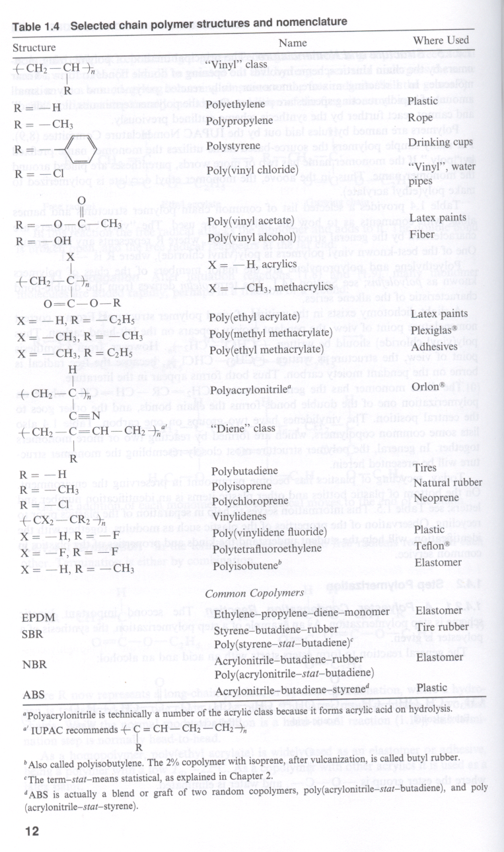
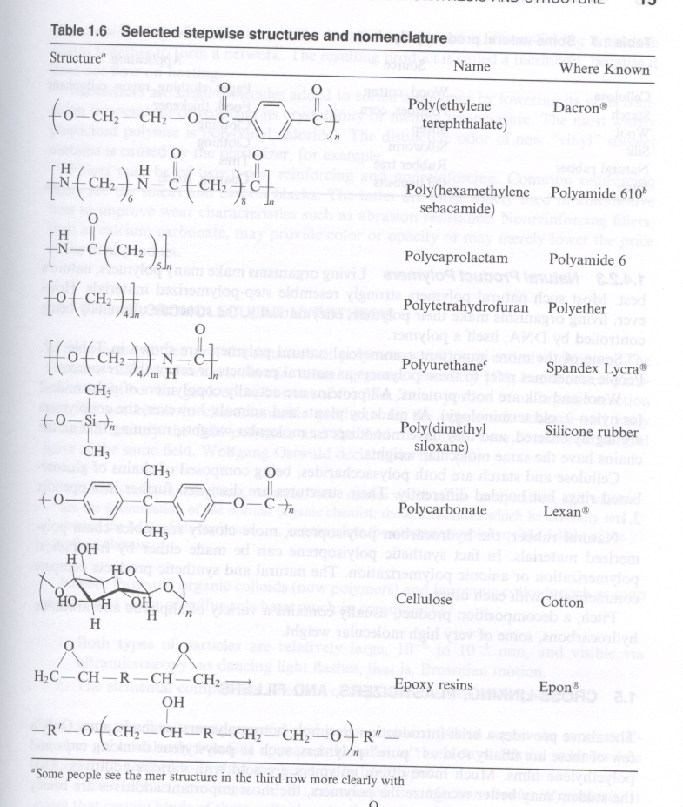
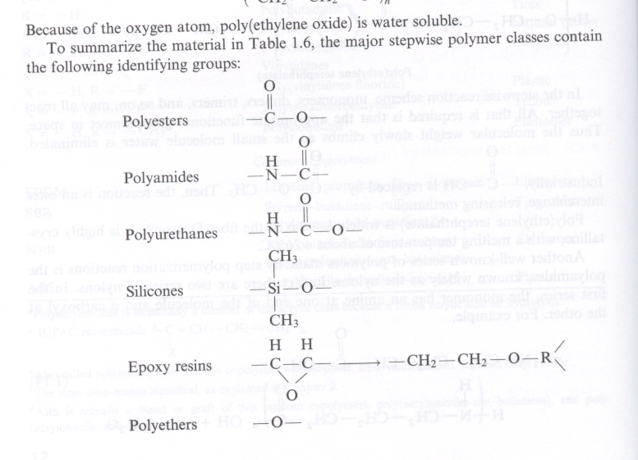
Polymers
http://www.eng.uc.edu/~gbeaucag/Classes/IntrotoPolySci/PolymerChemicalStructure.html

Slide 3
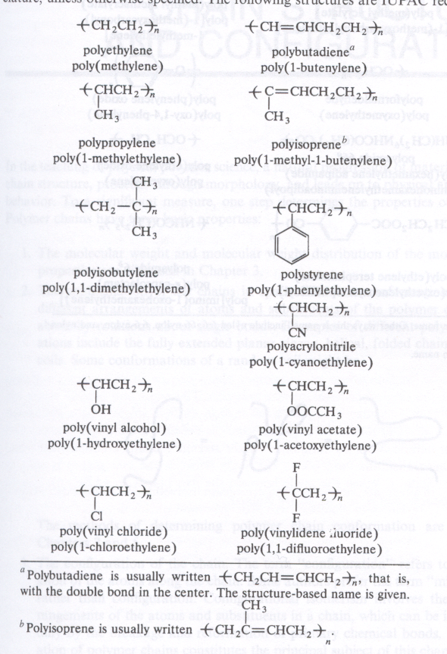
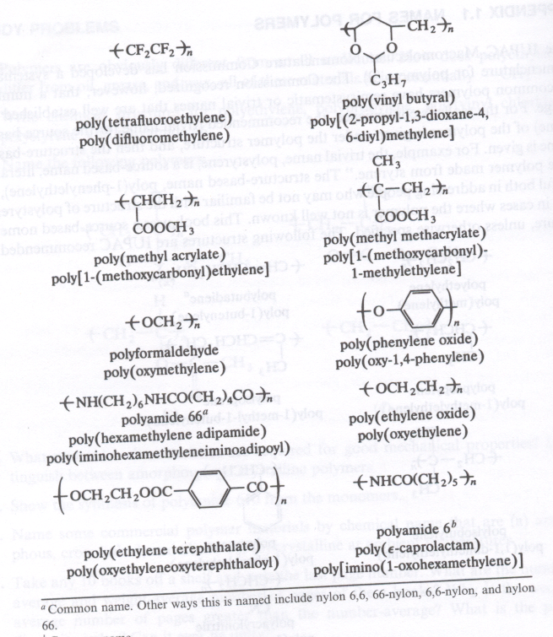
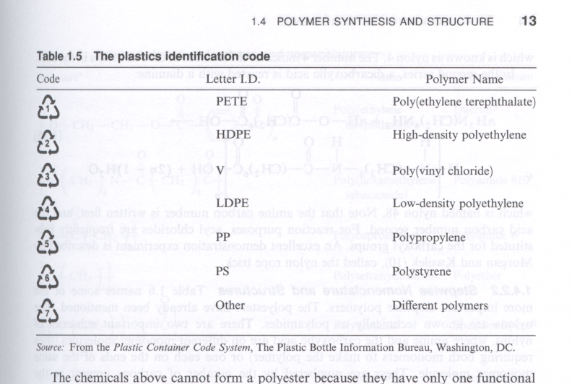
Polymers
http://www.eng.uc.edu/~gbeaucag/Classes/IntrotoPolySci/PolymerChemicalStructure.html

Slide 4
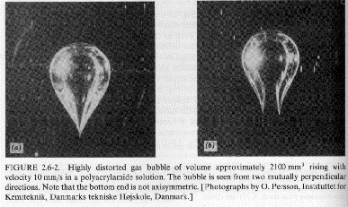

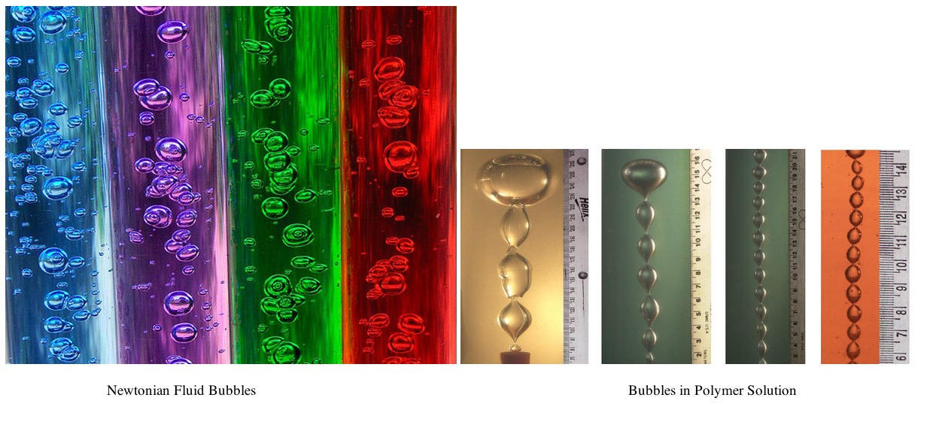
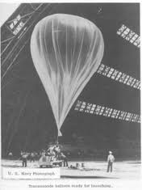
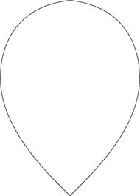
Polymers
From Bird, Armstrong, Hassager, "Dynamics of Polymeric Liquids, Vol. 1"
Polymer Rheology
http://www.eng.uc.edu/~gbeaucag/Classes/IntrotoPolySci/PolymerChemicalStructure.html

Slide 5
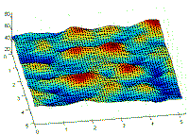
Polymers
Paul Flory [1] states that "…perhaps the most significant structural characteristic of a long polymer chain… (is) its capacity to assume an enormous array of configurations."
Which are Polymers?
http://www.eng.uc.edu/~beaucag/Classes/IntrotoPolySci/PicturesDNA.html
http://www.eng.uc.edu/~beaucag/Classes/IntrotoPolySci/What Does Searching Configurational Space Mean for Polymers.html
1) Principles of Polymer Chemistry, Flory PJ, (1953).
ww.eng.uc.edu/~gbeaucag/Classes/IntrotoPolySci/WhatIsAPolymerPlastic.html
http://www.eng.uc.edu/~gbeaucag/Classes/IntrotoPolySci/MacroMolecularMaterials.html

Slide 6
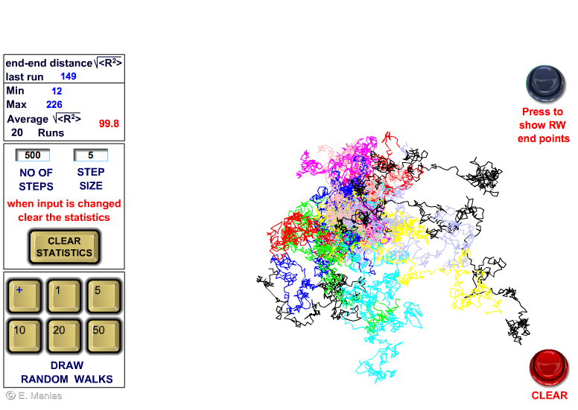
Random Walk Generator (Manias Penn State)
http://zeus.plmsc.psu.edu/~manias/MatSE443/Study/7.html
http://e.sci.osaka-cu.ac.jp/yoshino/download/rw/
-Polymers do not have a discrete size, shape or conformation.
-Looking at a single simulation of a polymer chain is of no use.
-We need to consider average features.
-Every feature of a polymer is subject to a statistical description.
-Scattering is a useful technique to quantify a polymer since it describes structure from a statistically averaged perspective.
-Rheology is a major property of interest for processing and properties
-Simulation is useful to observe single chain behavior in a crowded environment etc.

Slide 7
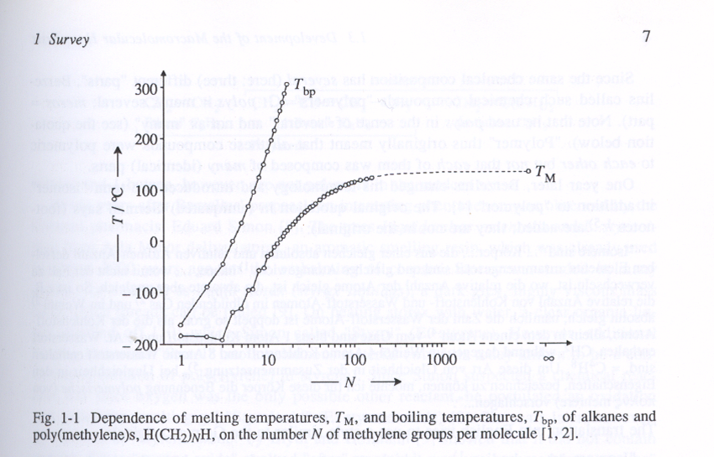
Polymers

Slide 8
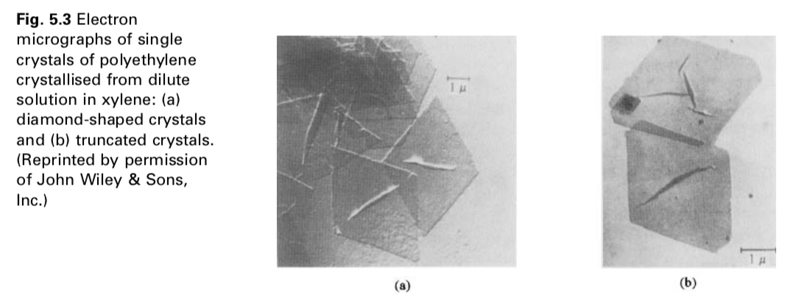
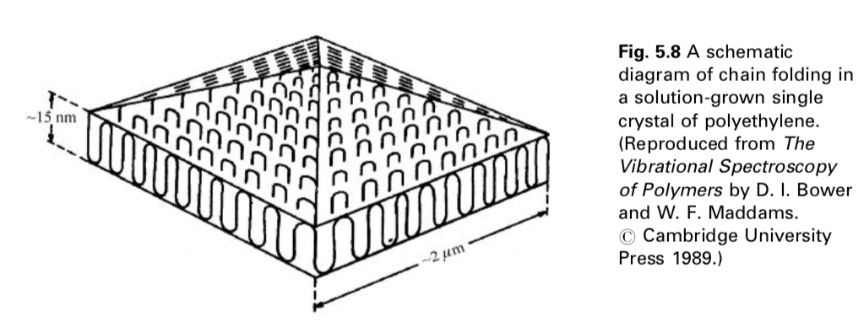
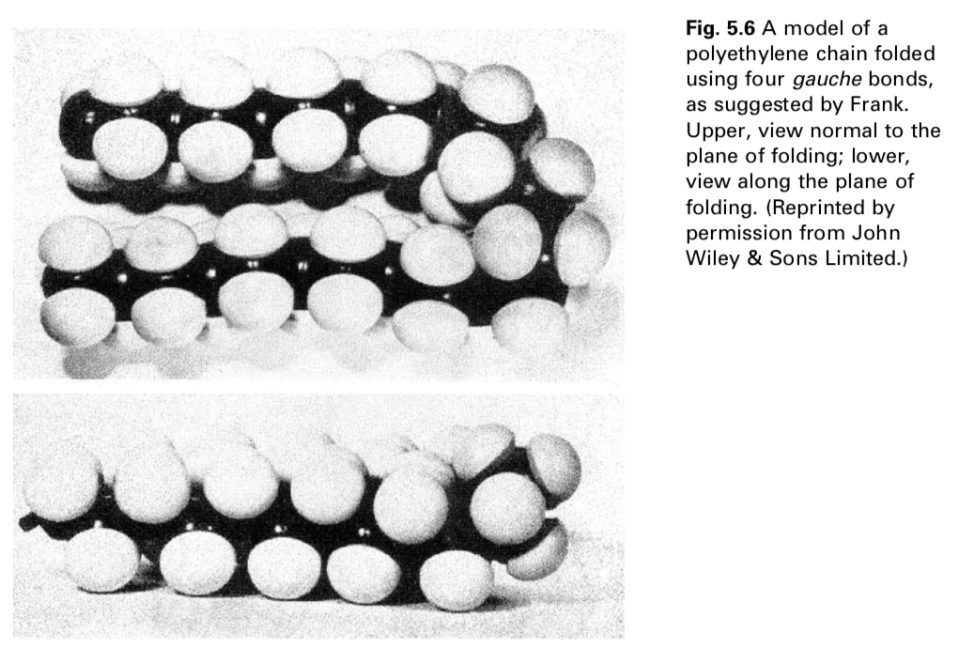
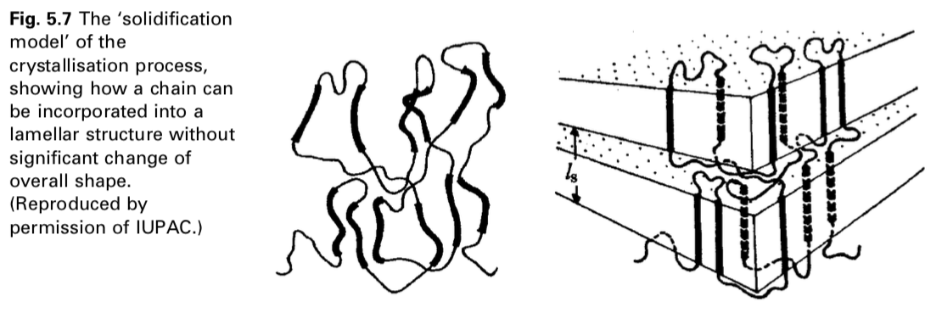
Polymers
Fold surface energy ~ 2 e-5 J/cm2
Enthalpy of melting ~ 300 J/cm3
T∞ ~ 414K (141°C)
T ~ 110°C
t = 2σT∞/(ΔH_{m} (T∞-T)) (Hoffman-Lauritzen)
~ 1.78e-6 cm or 17.8 nm thick crystals regardless of N

Slide 9
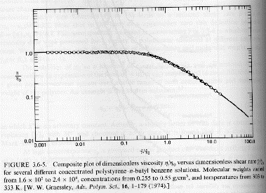
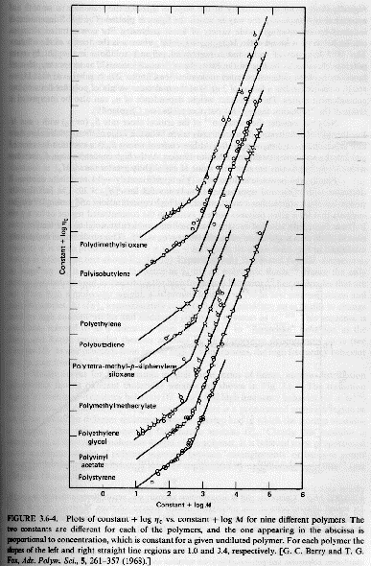
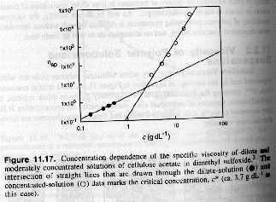
Viscosity versus Rate of Strain
Zero Shear Rate Viscosity versus Molecular Weight
Polymers
Specific Viscosity versus Concentration for Solutions
From J. R. Fried,
"Polymer Science and Technology"
From Bird, Armstrong, Hassager, "Dynamics of Polymeric Liquids Vol. 1"

Slide 10
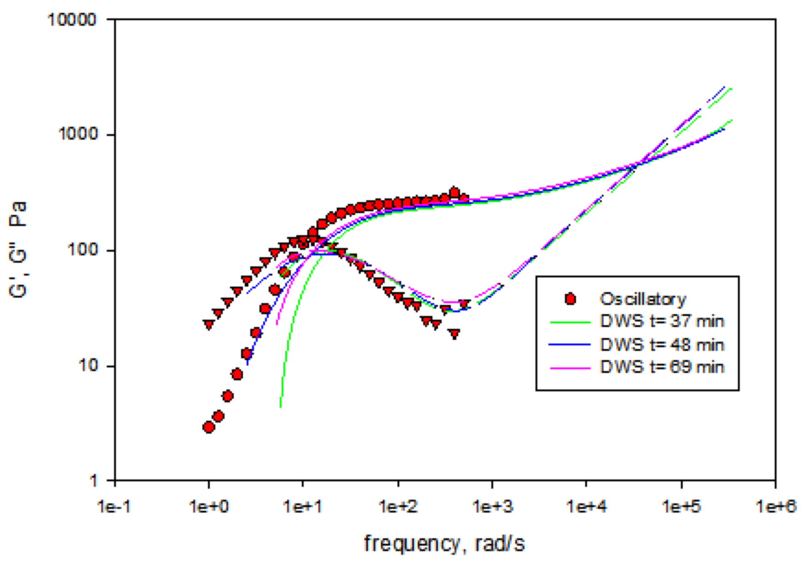
Polymers
Local Molecular Dynamics
G’ ~ ω²
G” ~ ω
If polymers are defined by dynamics, why should we consider first statics?
Statistical Mechanics: Boltzmann (1896)
Statistical Thermodynamics: Maxwell, Gibbs (1902)
We consider the statistical average of a thermally determined structure, an equilibrated structure
Polymers are a material defined by dynamics and described by statistical thermodynamics
Power Law Fluid/Rubbery Plateau
Mesh or
Entanglement
Size
Kuhn Length/Tube Diameter
Newtonian Bulk Flow

Slide 11
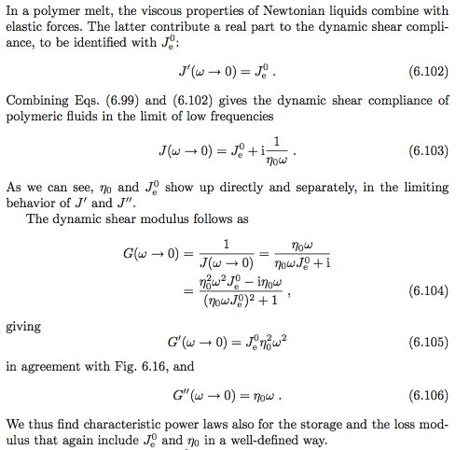
Polymers
Local Molecular Dynamics
Power Law Fluid/Rubbery Plateau
Mesh or
Entanglement
Size
Kuhn Length
Newtonian Bulk Flow

Slide 12
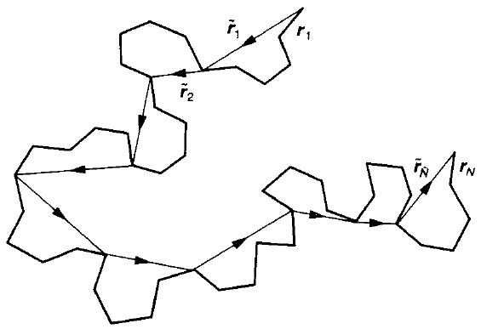
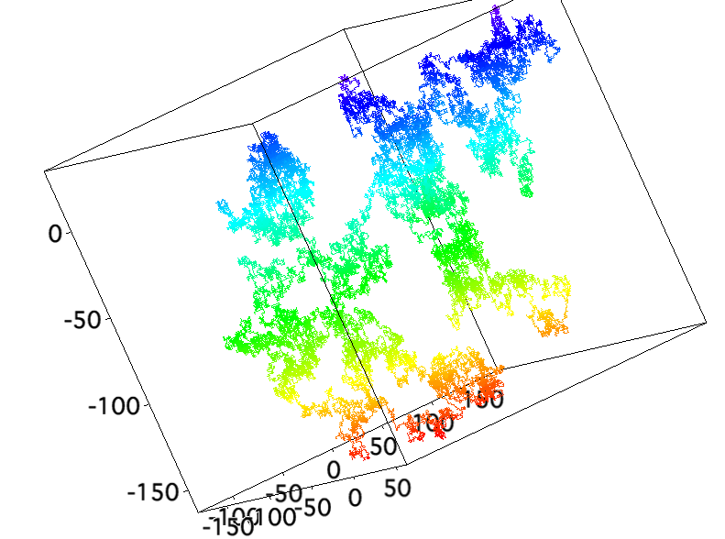
Small Angle Neutron Scattering
The vector r ~ 2π/q

Slide 13
The vector d ~ 2π/q
d = λ/(2 sin θ)
q = 4π/λ sin θ

Slide 15
Synthetic Polymer Chain Structure
(A Statistical Hierarchy)

Slide 16
Synthetic Polymer Chain Structure
(A Statistical Hierarchy)
Consider that all linear polymer chains can be reduced to a step length and a free, universal joint
This is the Kuhn Model, and the step length is called the Kuhn length, l_{K}
This is extremely easy to simulate
Begin at the origin, (0,0,0)
Take a step in a random direction to (i, j, k)
Repeat for N steps
On average for a number of these “random walks” we will find that the final position tends towards (0,0,0) since there is no preference for direction in a “random” walk
The walk does have a breadth (standard deviation), i.e. depending on the number of steps, N, and the step length l_{K}, the breadth of the walk will change.
l_{K} just changes proportionally the scale of the walk so <R²>^{1/2} ~ l_{K}
https://www.doitpoms.ac.uk/tlplib/polymerbasics/HTML5/Kuhn_randomwalk2.html

Slide 17
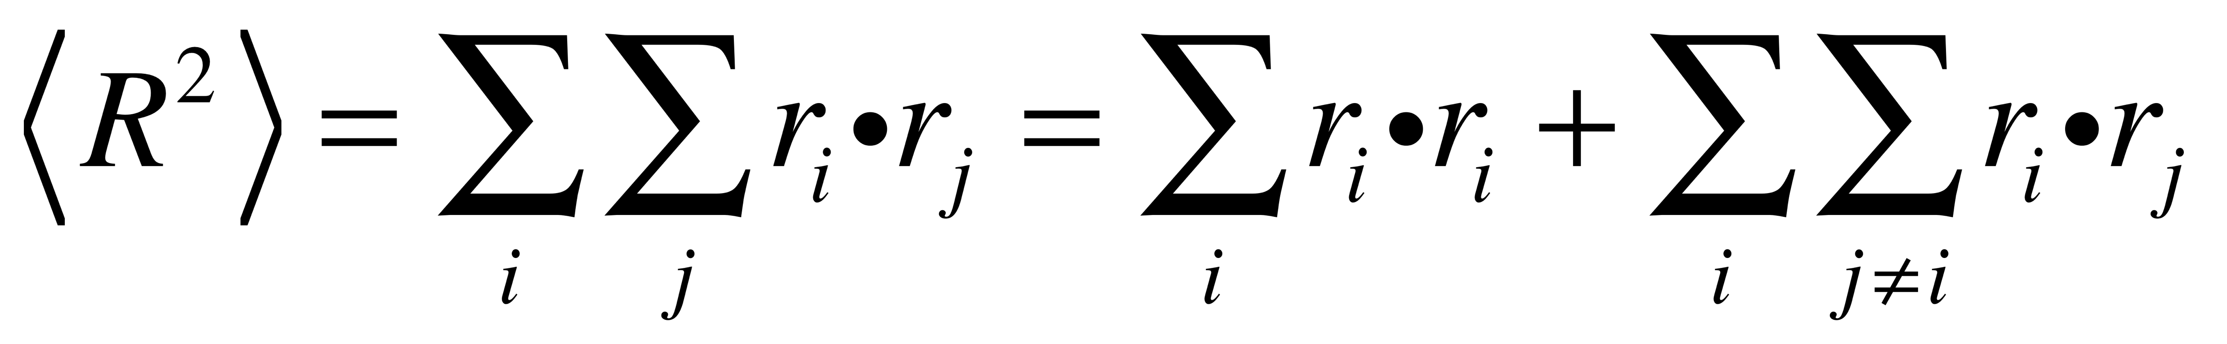
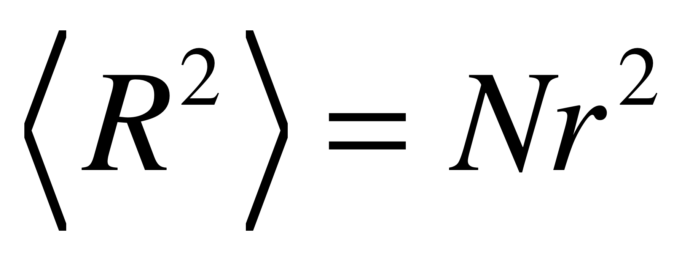
Synthetic Polymer Chain Structure
(A Statistical Hierarchy)
The walk does have a breadth, i.e. depending on the number of steps, N, and the step length l_{K}, the breadth of the walk will change.
l_{K} just changes proportionally the scale of the walk so <R²>^{1/2} ~ l_{K}
The chain is composed of a series of steps with no orientational relationship to each other.
So <R> = 0
<R²> has a value:
We assume no long-range interactions so that the second term can be 0.
<R²>^{1/2} ~ N^{1/2} l_{K}
https://www.doitpoms.ac.uk/tlplib/polymerbasics/HTML5/Kuhn_randomwalk2.html

Slide 18
Synthetic Polymer Chain Structure
(A Statistical Hierarchy)
<R²>^{1/2} ~ N^{1/2} l_{K}
This function has the same origin as the function describing the root mean square distance of a diffusion pathway
<R²>^{1/2} ~ t^{1/2}(2D)^{1/2}
So, the Kuhn length bears some resemblance to the diffusion coefficient
And the random walk polymer chain bears some resemblance to Brownian Motion
The random chain is sometimes called a “Brownian Chain”, a drunken walk, a random walk, a Gaussian Coil or Gaussian Chain among other names.

Slide 19
<R²>^{1/2} = n^{1/2} l
Concentration within a coil = n/(n^{3/2} l³) ~ n^{-1/2} = c* overlap concentration
Below c* ~ 1 mg/ml dilute conditions (most analytic measurements), Above c* “semi-dilute”
Below c*, dilute scattering curve; above c*;
the scattering is screened in the semi-dilute regime;
when screening/mesh size matches the persistence length we reach the concentrated regime or the melt

Slide 20
<R²>^{1/2} = n^{1/2} l
Concentration within a coil = n/(n^{3/2} l³) ~ n^{-1/2} = c* overlap concentration
Below c* ~ 1 mg/ml dilute conditions (most analytic measurements), Above c* “semi-dilute”
Below c*, dilute scattering curve; above c*;
the scattering is screened in the semi-dilute regime;
when screening/mesh size matches the persistence length we reach the concentrated regime or the melt
Rheology view linear below c*, c* and entanglement concentration might be similar

Slide 21
Random Walk Generator (Manias Penn State)
http://zeus.plmsc. http://e.sci.osaka-cu.ac.jp/yoshino/download/rw/psu.edu/~manias/MatSE443/Study/7.html
http://e.sci.osaka-cu.ac.jp/yoshino/download/rw/
-Polymers do not have a discrete size, shape or conformation.
-Looking at a single simulation of a polymer chain is of no use.
-We need to consider average features.
-Every feature of a polymer is subject to a statistical description.
-Scattering is a useful technique to quantify a polymer since it
describes structure from a statistically averaged perspective.
https://www.doitpoms.ac.uk/tlplib/polymerbasics/HTML5/Kuhn_randomwalk2.html

Slide 22
The Primary Structure for Synthetic Polymers
Worm-like Chain
Freely Jointed Chain
Freely Rotating Chain
Rotational Isomeric State Model Chain (RISM)
Persistent Chain
Kuhn Chain
These refer to the local state of the polymer chain.
Generally, the chain is composed of chemical bonds
that are directional, that is they are rods connected at their ends.
These chemical steps combine to make an effective
rod-like base unit, the persistence length,
for any synthetic polymer chain (this is larger than the chemical step).
The persistence length can be measured in scattering
or can be inferred from rheology through the Kuhn length
l_{K} = 2 l_{P}

Slide 23
Small Angle Neutron Scattering

Slide 24
The vector r ~ 2π/q
d = λ/(2 sin θ)
q = 4π/λ sin θ

Slide 25
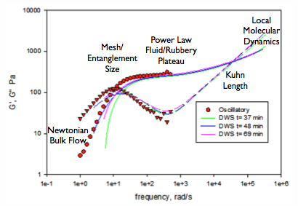
The Primary Structure for Synthetic Polymers

Slide 26
The synthetic polymer is composed of linear bonds, covalent or ionic bonds have a direction.
Coupling these bonds into a chain involves some amount of memory of this direction for each coupled bond.
Cumulatively this leads to a persistence length that is longer than an individual bond.
Observation of a persistence length requires that the persistence length is much larger than the diameter of the chain. Persistence can be observed for worm-like micelles, synthetic polymers, DNA but not for chain aggregates of nanoparticles, strings or fibers where the diameter is on the order of the persistence length.
https://www.eng.uc.edu/~beaucag/Classes/IntrotoPolySci/PicturesDNA.html

Slide 27
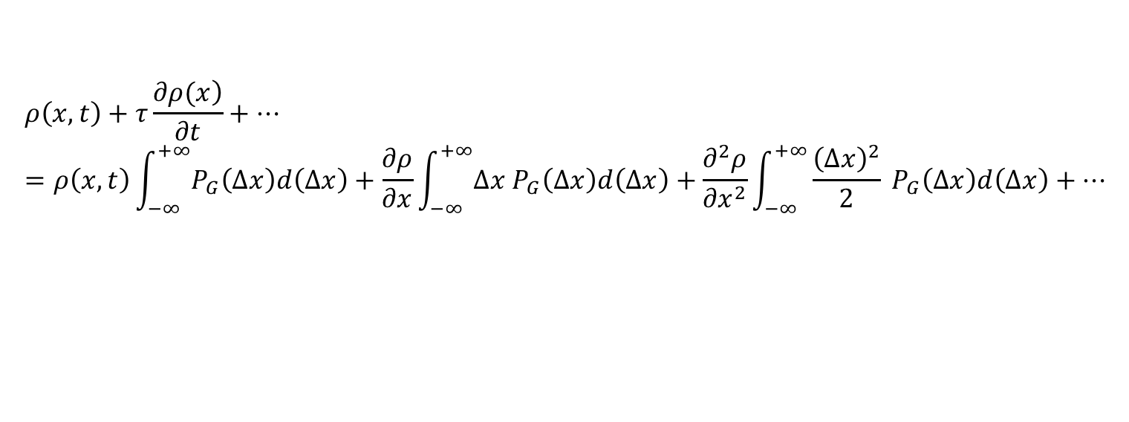
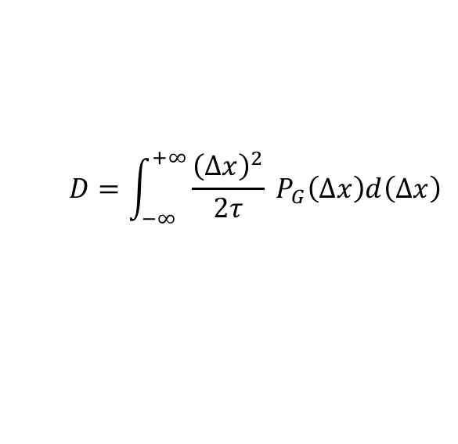
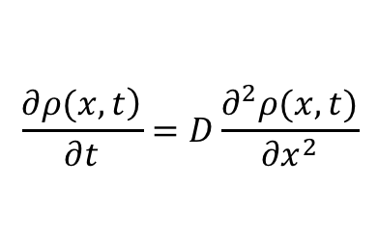
The Gaussian Chain
Gaussian chain is based on Brownian walk or Brownian motion that was described mathematically by Einstein in a 1905 paper
For particles (or a particle) subject to thermal, diffusive motion initially at a fixed position, the density of the particles is a function of time and space. These dependencies can be expressed as Taylor series expansions. For simplicity consider a one-dimensional space (though this can be worked out in any dimensional space). Particles have an equal probability of moving to the left or to the right. The motion is symmetric about the zero point. The dependence with time, in contrast, is in only one direction. (This, it turns out, is the essence of Brownian motion as compared to ballistic motion where both space and time move in only one direction.)
$$ρ\left(x,t\right)+τ\frac{\left.∂ρ(x\right)}{∂t}+…=ρ\left(x,t\right)\int_{−∞}^{+∞}{P_{G}\left(∆x\right)d\left(∆x\right)}+\frac{∂ρ}{∂x}\int_{−∞}^{+∞}{{∆x P}_{G}\left(∆x\right)d\left(∆x\right)}+\frac{∂^{2}ρ}{∂x^{2}}\int_{−∞}^{+∞}{{\frac{{\left(∆x\right)}^{2}}{2} P}_{G}\left(∆x\right)d\left(∆x\right)}+…$$
P_{G}(Δx) is a normalized, symmetric probability distribution where Δx is the change in x from 0. The integral of P_{G}(Δx) is 1 since it is normalized. The integral of ${∆x P}_{G}\left(∆x\right)$ is zero since it it symmetric.
$$\frac{\left.∂ρ(x,t\right)}{∂t}=D\frac{∂^{2}ρ(x,t)}{∂x^{2}}$$
$$D=\int_{−∞}^{+∞}{{\frac{{\left(∆x\right)}^{2}}{2τ} P}_{G}\left(∆x\right)d\left(∆x\right)}$$
with

Slide 28
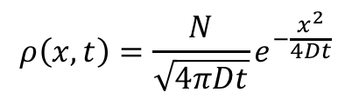
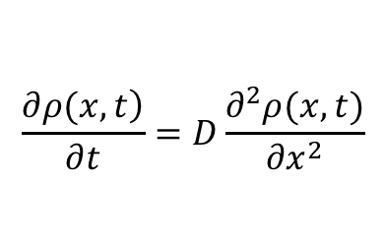

The Gaussian Chain
$$\frac{\left.∂ρ(x,t\right)}{∂t}=D\frac{∂^{2}ρ(x,t)}{∂x^{2}}$$
For N particles starting at x = 0 and time = 0,
$$ρ\left(x,t\right)=\frac{N}{\sqrt{4πDt}}e^{−\frac{x^{2}}{4Dt}}$$
First moment in space is 0, second moment (variance of Gaussian) is:
$〈x^{2}〉$ = 2Dt
For polymer chain <R²> = l_{K}² N

Slide 29
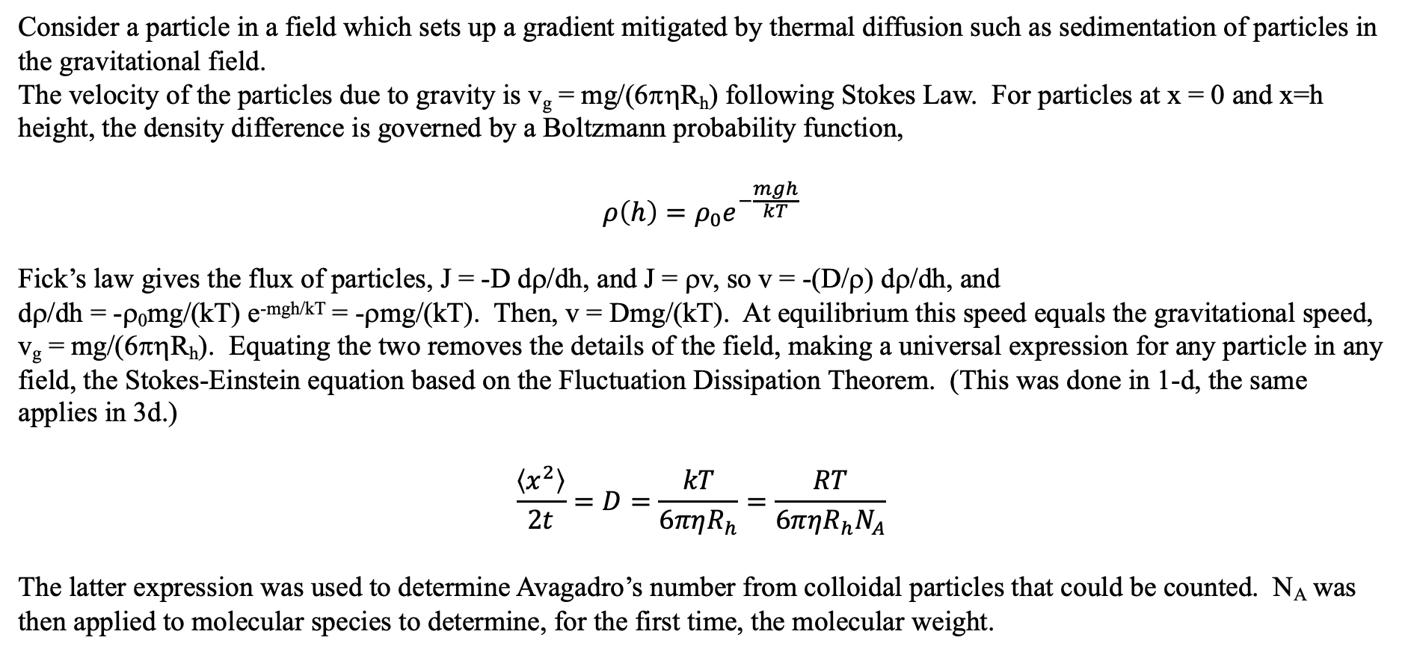
The Einstein-Stokes Equation/Fluctuation Dissipation Theorem
Consider a particle in a field which sets up a gradient mitigated by thermal diffusion such as sedimentation of particles in the gravitational field.
The velocity of the particles due to gravity is v_{g} = mg/(6πηR_{h}) following Stokes Law. For particles at x = 0 and x=h height, the density difference is governed by a Boltzmann probability function,
$$ρ\left(h\right)=ρ_{0}e^{−\frac{mgh}{kT}}$$
Fick’s law gives the flux of particles, J = -D dρ/dh, and J = ρv, so v = -(D/ρ) dρ/dh, and
dρ/dh = -ρ₀mg/(kT) e^{-mgh/kT} = -ρmg/(kT). Then, v = Dmg/(kT). At equilibrium this speed equals the gravitational speed, v_{g} = mg/(6πηR_{h}). Equating the two removes the details of the field, making a universal expression for any particle in any field, the Stokes-Einstein equation based on the Fluctuation Dissipation Theorem. (This was done in 1-d, the same applies in 3d.)
$$\frac{〈x^{2}〉}{2t}=D=\frac{kT}{6πηR_{h}}=\frac{RT}{6πηR_{h}N_{A}}$$
The latter expression was used to determine Avagadro’s number from colloidal particles that could be counted. N_{A} was then applied to molecular species to determine, for the first time, the molecular weight.

Slide 30
The Einstein-Stokes Equation/Fluctuation Dissipation Theorem
For a particle in a field the velocity can be calculated from Fick’s First Law
or from a balance of acceleration and drag forces
v_{g} = mg/6πR_{h}η = -D/ρ dρ/dh = Dmg/kT
This yields the Einstein-Stokes Equation D = kT/6πR_{h}η

Slide 31



The Gaussian Chain
Boltzman Probability
For a Thermally Equilibrated System
Gaussian Probability
For a Chain of End-to-End Distance R
By Comparison, The Energy to stretch a Thermally Equilibrated Chain Can be Written

Slide 32
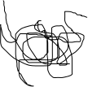
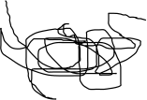
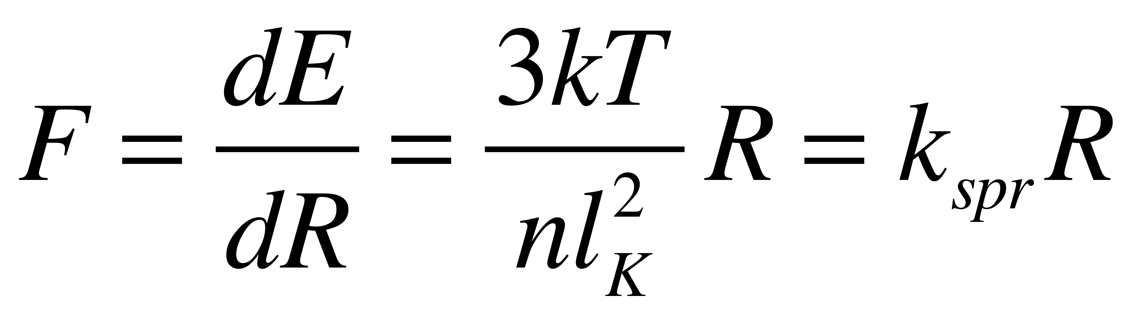
The Gaussian Chain
Boltzman Probability
For a Thermally Equilibrated System
Gaussian Probability
For a Chain of End-to-End Distance R
By Comparison, The Energy to stretch a Thermally Equilibrated Chain Can be Written
Force
Force
Assumptions:
-Gaussian Chain
-Thermally Equilibrated
-Small Perturbation of Structure (so it is still Gaussian after the deformation)

Slide 33
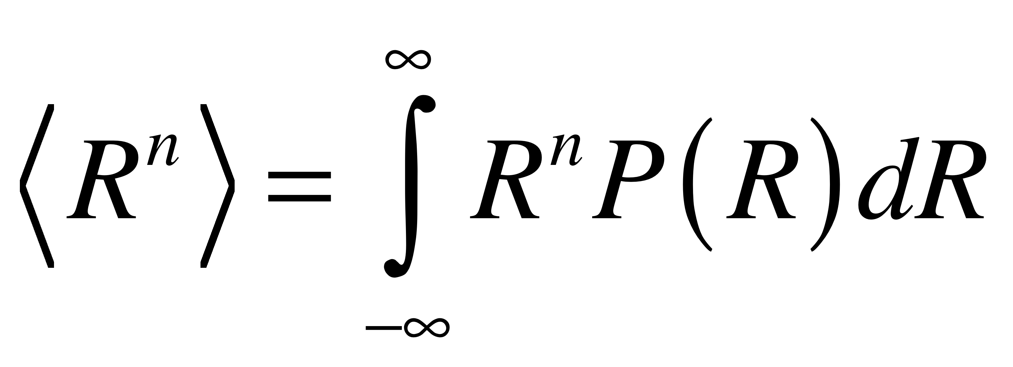
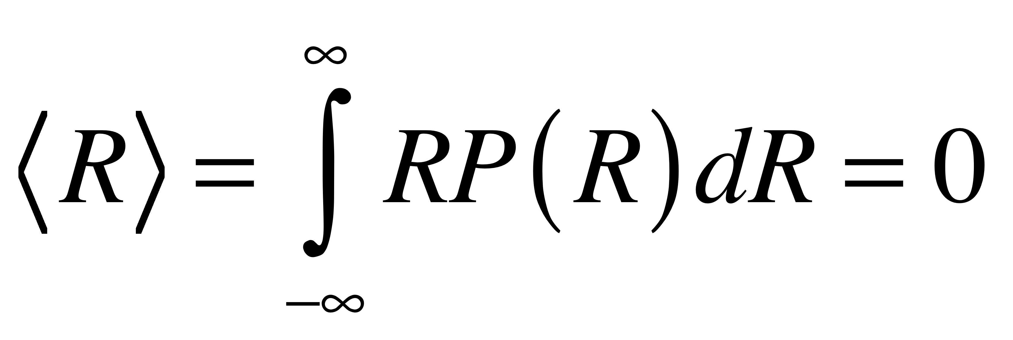
The Gaussian Chain
Boltzman Probability
For a Thermally Equilibrated System
Gaussian Probability
For a Chain of End-to-End Distance R
Use of P(R) to Calculate Moments:
Mean is the 1’st Moment:

Slide 34
The Gaussian Chain
Boltzman Probability
For a Thermally Equilibrated System
Gaussian Probability
For a Chain of End-to-End Distance R
Use of P(R) to Calculate Moments:
Mean is the 1’st Moment:
This is a consequence of symmetry of the Gaussian function about 0.

Slide 35
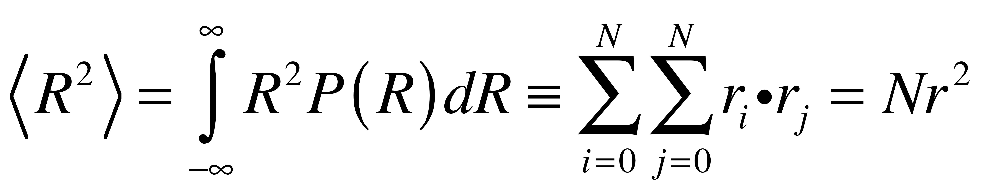
The Gaussian Chain
Boltzman Probability
For a Thermally Equilibrated System
Gaussian Probability
For a Chain of End-to-End Distance R
Use of P(R) to Calculate Moments:
Mean Square is the 2’ndMoment:

Slide 36
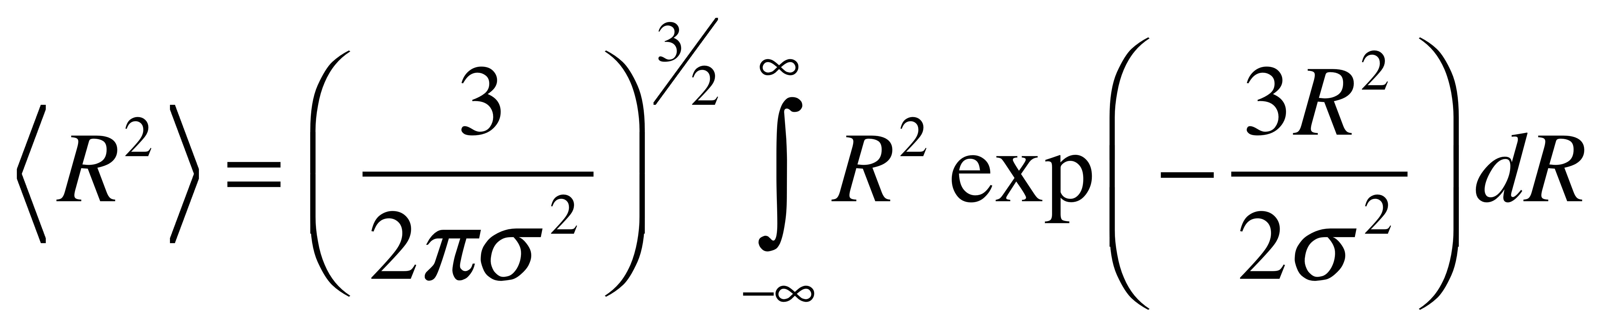
The Gaussian Chain
Gaussian Probability
For a Chain of End-to-End Distance R
Mean Square is the 2’nd Moment:
There is a problem to solve this integral since we can solve an integral of the form k exp(kR) dR
R exp(kR²) dR but not R² exp(kR²) dR
There is a trick to solve this integral that is of importance to polymer science and to other random systems that follow the Gaussian distribution.

Slide 37
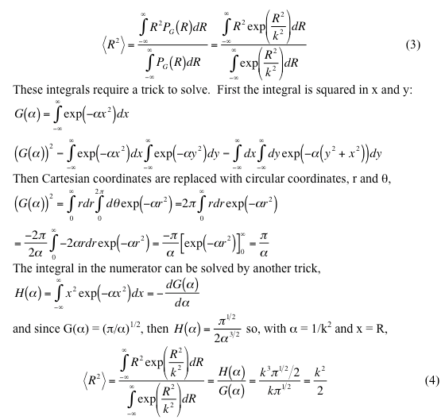
http://www.eng.uc.edu/~gbeaucag/Classes/Properties/GaussianProbabilityFunctionforEnd.pdf

Slide 38
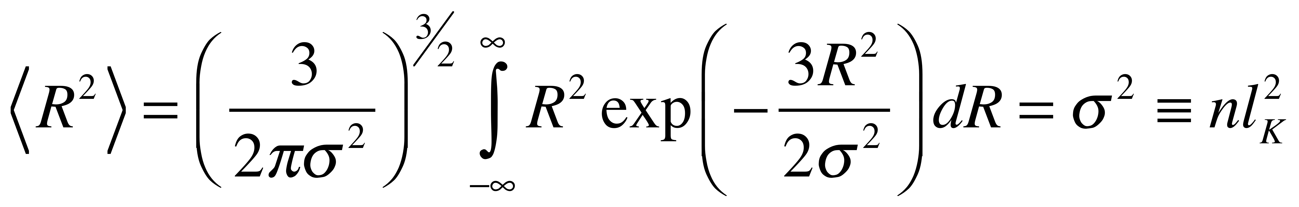
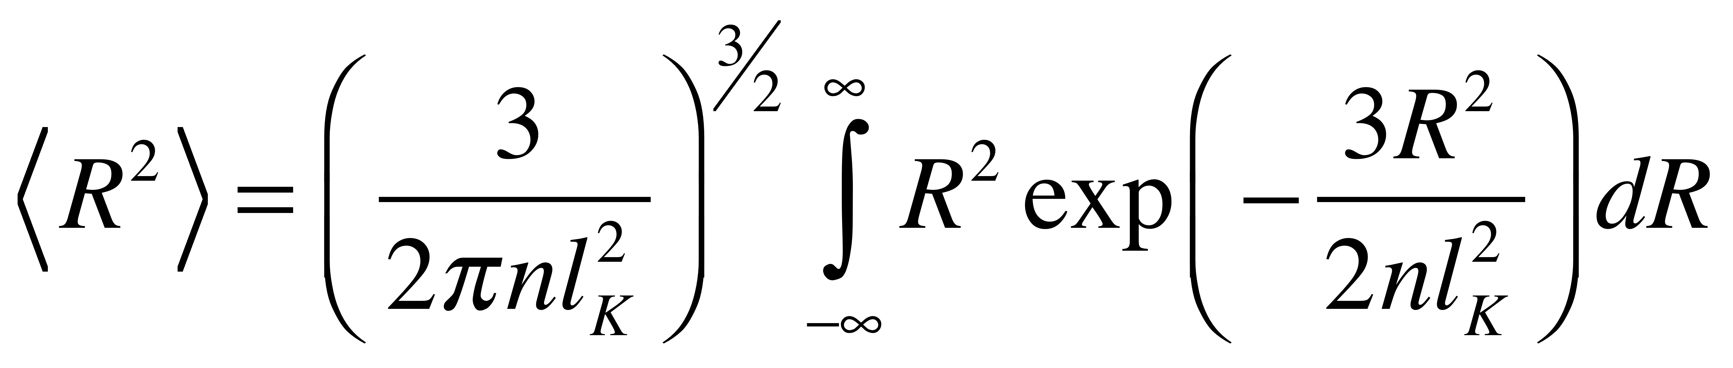
The Gaussian Chain
Gaussian Probability
For a Chain of End-to-End Distance R
Mean Square is the 2’nd Moment:
So, the Gaussian function for a polymer coil is:

Slide 39
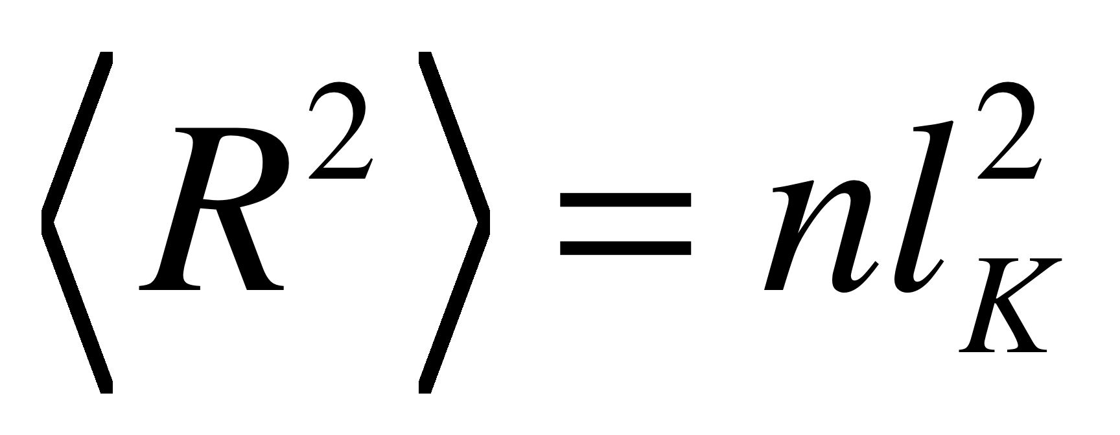
The Gaussian Chain
Means that the coil size scales with n^{1/2}
Or
Mass ~ n ~ Size²
Generally, we say that
Mass ~ Size^{df}
Where d_{f} is the mass fractal dimension
A Gaussian Chain is a kind of 2-dimensional object like a disk.

Slide 40
The Gaussian Chain
A Gaussian Chain is a kind of 2-dimensional object like a disk.
The difference between a Gaussian Chain and a disk lies in other dimensions of the two objects.
Consider an electric current flowing through the chain, it must follow a path of n steps. For a disk the current follows a path of n^{1/2} steps since it can short circuit across the disk. If we call this short circuit path p we have defined a connectivity dimension c such that:
p^{c} ~ n
And c has a value of 1 for a linear chain and 2 for a disk

Slide 41
The Gaussian Chain
A Gaussian Chain is a kind of 2-dimensional object like a disk.
A linear Gaussian Chain has a connectivity dimension of 1 while the disk has a connectivity dimension of 2.
The minimum path p is a fractal object and has a dimension, d_{min} so that,
p ~ R^{dmin}
For a Gaussian Chain d_{min} = 2 since p is the path n
For a disk d_{min} = 1 since the short circuit is a straight line.
We find that d_{f} = c d_{min}
There are other scaling dimensions, but they can all be related to two independent structural scaling dimensions such as c and d_{min}
or d_{min} and d_{f}

Slide 42

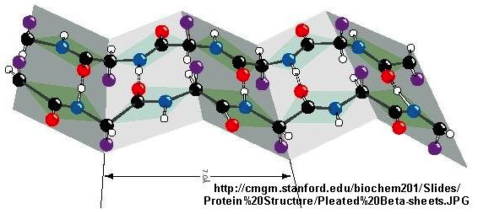
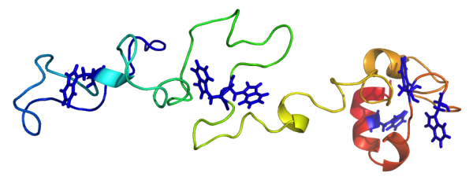
Disk
Random Coil
Extended β-sheet
(misfolded protein)
Unfolded Gaussian chain

Slide 43
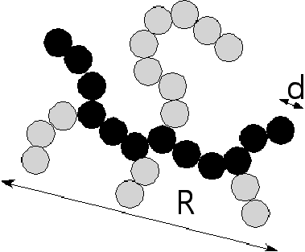
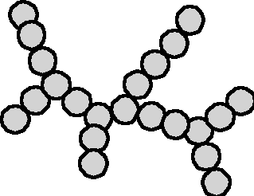
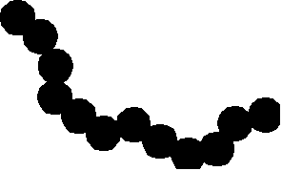
How Complex Mass Fractal Structures
Can be Decomposed
Tortuosity
Connectivity
z
df
p
dmin
s
c
R/d
27
1.36
12
1.03
22
1.28
11.2

Slide 44
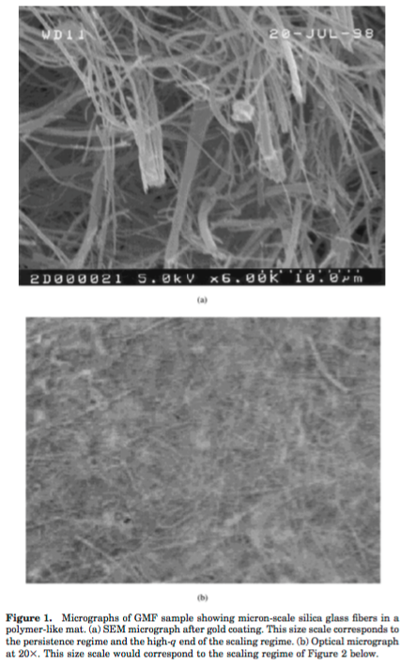



Fibers follow either Gaussian or Self-avoiding structure depending on binding of fibers
Orientation partly governs separation
Pore size and fractal structure govern wicking

Slide 45
The Primary Structure for Synthetic Polymers
Short-Range Interactions
The persistence length is created due to interactions between
units of the chain that have similar chain indices
These interactions are termed “short-range interactions” because they
involve short distances along the chain minimum path
Short-range interactions lead to changes in the chain persistence. For example,
restrictions to bond rotation such as by the addition of short branches can lead to increases
in the persistence length in polymers like polyethylene. Short-range interactions can be
more subtle. For instance, short branches in a polyester can disrupt a natural tendency to
form a helix leading to a reduction in the persistence length, that is making the chain more
flexible.
All interactions occur over short spatial distances, short-range interactions occur over
short-distances but the distinguishing feature is that they occur over short differences in
chain index.
Short-range interactions do not have an effect on the chain scaling.

Slide 46

The Primary Structure for Synthetic Polymers
Short-Range Interactions
Consider the simplest form of short-range interaction
We forbid the chain from the preceding step
Consider a chain as a series of steps r_{i}
r_{i} is a vector of length r and there are n such vectors in the chain
The mean value for r_{i+1} is 0
b_{k} is a unit vector in a coordinate system,
6 of these vectors in a cubic system

Slide 47

The Primary Structure for Synthetic Polymers
Short-Range Interactions
For exclusion of the previous step this sum does not equal 0
so

Slide 48



The Primary Structure for Synthetic Polymers
Short-Range Interactions
For Gaussian Chain
See slide 68
yields
For SRI Chain the first term is not 0.
and
For Cartesian simulation z = 6 and b_{eff} is 1.22 b so about a 25% increase for one step self-avoidance.
http://www.eng.uc.edu/~gbeaucag/Classes/Physics/Chapter1.pdf

Slide 49

Short-Range Interactions

Slide 50
The Primary Structure for Synthetic Polymers
Short-Range Interactions
Short-Range Interactions
Increase the persistence length
Chain scaling is not affected by short-range interactions.
http://www.eng.uc.edu/~gbeaucag/Classes/Physics/Chapter1.pdf

Slide 51
The Primary Structure for Synthetic Polymers
Short-Range Interactions
What kinds of short-range interactions can we expect
-Bond angle restriction
-Bond rotation restriction
-Steric interactions
-Tacticity
-Conjugation
-Main chain aromatics/cyclics
-Charge (poly electrolytes)
-Hydrogen bonds
-Helicity
http://www.eng.uc.edu/~gbeaucag/Classes/Physics/Chapter1.pdf

Slide 52


The Primary Structure for Synthetic Polymers
Short-Range Interactions
What kinds of short-range interactions can we expect
-Bond angle restriction
-Bond rotation restriction
Characteristic Ratio, C∞
http://www.eng.uc.edu/~gbeaucag/Classes/Physics/Chapter1.pdf

Slide 53


The Primary Structure for Synthetic Polymers
Short-Range Interactions
What kinds of short-range interactions can we expect
-Bond angle restriction
-Bond rotation restriction
The Characteristic Ratio varies with N due to chain end effects. There is generally an increase in C with N and it plateaus at high molecular weight.
http://www.eng.uc.edu/~gbeaucag/Classes/Physics/Chapter1.pdf

Slide 54




Molecular weight dependence of persistence length
n_{b} = backbone length
LD = Low branch density
HD = High branch density
This is a 5 parameter model for persistence length!
(used to model 5 or 6 data points!!!)

Slide 55

Molecular weight dependence of persistence length
This is a 5-parameter model for persistence length!
(used to model 5 or 6 data points!!!)
(Also, this model fails to predict an infinite molecular weight
persistence length.)

Slide 56

Molecular weight dependence of persistence length
Proposed End Group Functionality
LD = Low branch density
HD = High branch density

Slide 57



This works better for Yethiraj’s data.
(Except that the infinite persistence length is not monotonic in branch length)
Proposed End Group Functionality

Slide 58
Persistence Length ~ Bending Modulus/(Thermal Energy)
l_{p} = l_{K}/2 ~ E_{bending}/kT
(We will derive this later with respect to the persistent chain Colby/Rubenstein pp. 58)
Motion of the end-groups is proportional to thermal energy and reduces the persistence length
The energy is related to the flexibility of the chain not the stiffness, 1/l_{p}, so we should consider 1/l_{p} as the parameter of interest in terms of an end group effect not l_{p}

Slide 59

Alternative Functionality
based on increase in chain flexibility

Slide 60

Alternative Functionality
based on increase in chain flexibility

Slide 61

Alternative Functionality
based on increase in chain flexibility
LD = Low branch density
HD = High branch density

Slide 62

Alternative Functionality
based on increase in chain flexibility
Fit Parameters versus branch density
LD = Low branch density (0.5 branch per chain unit)
HD = High branch density (1 branch per chain unit)
Equation fails at low n_{b} since it predicts l_{p} => 0 when n_{b} => 0

Slide 63

Alternative Functionality
based on increase in chain flexibility
Equation fails at low n_{b} since it predicts l_{p} => 0 when n_{b} => 0

Slide 64


Alternative Functionality
based on increase in chain flexibility
$$l_{p}=\frac{Ml_{p∞}}{M+2Kl_{p∞}}+l_{p0}$$
Equation fails at low n_{b} since it predicts l_{p} => 0 when n_{b} => 0

Slide 65


Alternative Functionality
based on increase in chain flexibility
$$l_{p}=\frac{Ml_{p∞}}{M+2Kl_{p∞}}+l_{p0}$$
Equation fails at low n_{b} since it predicts l_{p} => 0 when n_{b} => 0

Slide 66

Alternative Functionality
based on increase in chain flexibility
The 2K values imply that end groups become less important for more rigid chains

Slide 67
The Primary Structure for Synthetic Polymers
Short-Range Interactions
What kinds of short-range interactions can we expect
-Bond angle restriction
-Bond rotation restriction
-Steric interactions
-Tacticity
-Conjugation
-Main chain aromatics/cyclics
-Charge (poly electrolytes)
-Hydrogen bonds
-Helicity
http://www.eng.uc.edu/~gbeaucag/Classes/Physics/Chapter1.pdf

Slide 68



The Primary Structure for Synthetic Polymers
Short-Range Interactions
What kinds of short-range interactions can we expect
-Bond angle restriction
-Bond rotation restriction
http://cbp.tnw.utwente.nl/PolymeerDictaat/node4.html
Polyethylene
http://www.eng.uc.edu/~gbeaucag/Classes/Physics/Chapter1.pdf

Slide 69



The Primary Structure for Synthetic Polymers
Short-Range Interactions
What kinds of short-range interactions can we expect
-Bond angle restriction
-Bond rotation restriction
Ethane
Butane
http://www.eng.uc.edu/~gbeaucag/Classes/Physics/Chapter1.pdf

Slide 70
The Primary Structure for Synthetic Polymers
Short-Range Interactions
What kinds of short-range interactions can we expect
-Bond angle restriction
-Bond rotation restriction
Characteristic Ratio, C∞
http://www.eng.uc.edu/~gbeaucag/Classes/Physics/Chapter1.pdf

Slide 71

The Primary Structure for Synthetic Polymers
Short-Range Interactions
What kinds of short-range interactions can we expect
-Bond angle restriction
-Bond rotation restriction
Consider a freely rotating chain that has a bond angle restriction of 109.5 °
Ising Chain Model in Colby/Rubenstein, pp. 59
http://www.eng.uc.edu/~gbeaucag/Classes/Physics/Chapter1.pdf

Slide 72
The Primary Structure for Synthetic Polymers
Short-Range Interactions
For Gaussian Chain
See slide 68
yields
For SRI Chain the first term is not 0.
and
For Cartesian simulation z = 6 and b_{eff} is 1.22 b so about a 25% increase for one step self-avoidance.
http://www.eng.uc.edu/~gbeaucag/Classes/Physics/Chapter1.pdf

Slide 73




The Primary Structure for Synthetic Polymers
Short-Range Interactions
Volkenstein on Flory II
Consider a freely rotating chain that has a bond angle restriction of 109.5 ° = τ
C
109.5°
θ
C
C
See slide 46
Ising Model

Slide 74

The Primary Structure for Synthetic Polymers
Short-Range Interactions
Consider a freely rotating chain that has a bond angle restriction of 109.5 ° = τ
Moderate Flexibility
High Rotational Flexibility
Lower Rot. Flexibility
Bond angles 109.5°: 104.5°
For a Freely Rotating Polyethylene Chain
http://books.google.com/books?id=Iem3fC7XdnkC&pg=PA23&lpg=PA23&dq=coil+expansion+factor&source=bl&ots=BGjRfhZYaU&sig=I0OPb2VRuf8Dm8qnrmrhyjXyEC8&hl=en&sa=X&ei=fSV0T-XqMMHW0QHi1-T_Ag&ved=0CF0Q6AEwBw#v=onepage&q=coil%20expansion%20factor&f=false

Slide 75

The Primary Structure for Synthetic Polymers
Short-Range Interactions
Consider a freely rotating chain that has a bond angle restriction of 109.5 ° = τ
If we consider restrictions to bond rotation for first order interactions
http://books.google.com/books?id=Iem3fC7XdnkC&pg=PA23&lpg=PA23&dq=coil+expansion+factor&source=bl&ots=BGjRfhZYaU&sig=I0OPb2VRuf8Dm8qnrmrhyjXyEC8&hl=en&sa=X&ei=fSV0T-XqMMHW0QHi1-T_Ag&ved=0CF0Q6AEwBw#v=onepage&q=coil%20expansion%20factor&f=false

Slide 76

The Primary Structure for Synthetic Polymers
Short-Range Interactions
Alexei Khokhlov in Soft and Fragile Matter (2000)
Contour length per monomer is 2 * bond length

Slide 77

From Colby/Rubeinstein pp. 66

Slide 78

The Primary Structure for Synthetic Polymers

Slide 79
Linear absorption
dI = -I α dx change is linear in intensity
dl/l = - α dx integrate
ln(I/I₀) = - αx or
I = I₀ exp(-αx)

Slide 80


http://www.eng.uc.edu/~gbeaucag/Classes/MorphologyofComplexMaterials/Persistence/Persistence.html

Slide 81


Slide 82

From Strobl p. 57

Slide 83





The Primary Structure for Synthetic Polymers
Scattering Observation of the Persistence Length
θ
A power-law decay of -1 slope has only one structural interpretation.

Slide 84

The Primary Structure for Synthetic Polymers
Scattering Observation of the Persistence Length
θ
A power-law decay of -1 slope has only one structural interpretation.

Slide 85
Electric Double Layers
x
-
-
-
-
SOLVENT MOLECULES
+
-
+
-
+
+
+
+
-
-
Φ₀
COUNTER IONS
HOP
Helmholtz Outer Plane
CO IONS
Surface Potential
Helmholtz (100+ years ago) proposed that surface charge is balanced by a layer of oppositely charged ions.
All colloids should flocculate.
Dale Schaefer Slides 2010
Notes:
All colloids should flocculate

Slide 86
Zeta (ζ) Potential (Electric potential at the slipping (shear) plane)
Gouy/Chapman diffuse double layer + layer of adsorbed charge.
x
-
-
-
-
-
-
-
Diffuse layer
-
+
+
+
ζ
-
+
-
+
+
-
Φ_{stern}
-
+
-
+
-
Φ_{surface}
+
Shear Plane
Bulk Solution
Stern Plane (δ)
Dale Schaefer Slides 2010
Φ = electrostatic potential (Volt = J/coulomb)
Notes:
The unit of electrostatic potential is the volt (V), and 1 V = 1 J/C = 1 Nm/C. Equation (25.4) shows that as the unit of the electric field we can also use V/m. A common used unit for the energy of a particle is the electron-volt (eV) which is defined as the change in kinetic energy of an electron that travels over a potential difference of 1 V. The electron-volt can be related to the Joule via eq.(25.3). Equation (25.3) shows that the change in energy of an electron when it crosses over a 1 V potential difference is equal to 1.6 . 10⁻¹⁹ J and we thus conclude that 1 eV = 1.6 . 10⁻¹⁹ J

Slide 87


Slide 88
Debye-Hückel approximation for Φ(x)
Gouy-Chapman Model
x
Potential is stronger than kT
+
-
+
+
Φ
-
-
+
+
+
+
-
-
-
Counter ions (n₀) screen the charge
Exponential
function
Dale Schaefer Slides 2010

Slide 89

http://www.eng.uc.edu/~gbeaucag/Classes/MorphologyofComplexMaterials/Persistence/Persistence.html
Polyelectrolytes (proteins, charged polymers (sulfonated polystyrene), polyacrylic acid, polyethylene oxide, polypropylene oxide, poly nucleic acids, etc.)
Strongly charged polyelectrolytes = each monomer unit is charged
Weakly charged polyelectrolytes = some monomers are charged
This can depend on the counter ion concentration
For SCPE the electrostatic persistence length dominates, for WCPE there is a competition between Coulombic and non-electrostatic persistence.
Debye-Hückel Potential (U(r)) between two charges (e) separated by a distance r,
SCPE WCPE
r_{D} is the Debye screening length, n is the counter ion (salt) concentration, r_{D} determines how quickly the electrostatic potential decays
Soft and Fragile Matter, M. E. Cates, M.R. Evans Chapter 3 Alexi Khokhlov (2000); Chines review of polyelectrolytes from web

Slide 90

Distances where a mean field is felt.
Potential is similar to kT
Consider two isolated charges subject to thermal motion at kT
The energy associated with the charge attraction/repulsion
is equal to the thermal energy, kT, at the Bjerrum length, l_{B}.
Thermal diffusion/Brownian motion takes over
https://ocw.mit.edu/courses/chemical-engineering/10-626-electrochemical-energy-systems-spring-2014/study-materials/MIT10_626S14_S11lec28.pdf
In water at room temperature l_{B} ~ 7 Å
Below the Bjerrum length charges will feel specific interactions and will form ordered structures. Above l_{B}, charges feel a ”mean field” and do not form ordered structures but can still feel repulsive and attractive forces.
You hear the report of a gun but can’t tell its location, so you take cover, you are beyond its Bjerrum length. You hear the report of the gun and run in the opposite direction; you are within its Bjerrum length.

Slide 91
Distances where a mean field is felt.
Potential is similar to kT
Consider two isolated charges subject to thermal motion at kT
The energy associated with the charge attraction/repulsion
is equal to the thermal energy, kT, at the Bjerrum length, l_{B}.
Debye Screeening Length 1923
Bjerrum length 1926
Thermal diffusion/Brownian motion takes over
https://ocw.mit.edu/courses/chemical-engineering/10-626-electrochemical-energy-systems-spring-2014/study-materials/MIT10_626S14_S11lec28.pdf
In water at room temperature l_{B} ~ 7 Å
Below the Bjerrum length charges will feel specific interactions and will form ordered structures. Above l_{B}, charges feel a ”mean field” and do not form ordered structures but can still feel repulsive and attractive forces.
You hear the report of a gun but can’t tell its location, so you take cover, you are beyond its Bjerrum length. You hear the report of the gun and run in the opposite direction; you are within its Bjerrum length.

Slide 92
Distances where a mean field is felt.
Potential is similar to kT
Consider two isolated charges subject to thermal motion at kT
The energy associated with the charge attraction/repulsion
is equal to the thermal energy, kT, at the Bjerrum length, l_{B}.
is the ability to store charge per unit length, C/(Vm) or F/m
Energy is kT or CV so a length naturally emerges
Thermal diffusion/Brownian motion takes over
https://ocw.mit.edu/courses/chemical-engineering/10-626-electrochemical-energy-systems-spring-2014/study-materials/MIT10_626S14_S11lec28.pdf
In water at room temperature l_{B} ~ 7 Å
Below the Bjerrum length charges will feel specific interactions and will form ordered structures. Above l_{B}, charges feel a ”mean field” and do not form ordered structures but can still feel repulsive and attractive forces.
You hear the report of a gun but can’t tell its location, so you take cover, you are beyond its Bjerrum length. You hear the report of the gun and run in the opposite direction; you are within its Bjerrum length.

Slide 93


Hard
Core
Mean
Field
https://ocw.mit.edu/courses/chemical-engineering/10-626-electrochemical-energy-systems-spring-2014/study-materials/MIT10_626S14_S11lec28.pdf

Slide 94

Distances where charges are not felt at all.
For Charges separated by distance r in the presence of n = number/volume counter ions or other charges
Debye length is the distance where kT random motion balances the U(r) potential in the presence of n counter ion density
$$r_{D}^{2}=\frac{V_{per charge}kT}{{4πrU(r)}_{with r_{D}=∞}}$$
Below the Debye screening length charges will feel interactions, either specific if r < l_{B} and or mean field if r > l_{B} . Above l_{D}, charges do not feel interactions at all, they act as uncharged species.
You hear the report of a gun but can’t tell its location so you take cover, you are beyond its Bjerrum length but within its Debye screening length. You can’t hear the gun due to too many other guns firing closer to you, you are beyond its Debye screening length.

Slide 95

Charge spacing, a
Counterion
concentration, n
Counterion
condensation
Polymeric
contribution
to screening
Micelles, liquid-
crystalline phases

Slide 96

Increase in persistence length due to charges on chain
A new size scale is introduced:
Charge spacing “a” which contributes an electrostatic persistence length, l_{e}
-Electrostatic Persistence Length
Persistence is increased by electrostatic charge. l_{per} = l_{o} + l_{e}
For a << l_{per}<< r_{D}
Interaction between charges separated by distance less than r_{D}, short range repulsion increases
persistence length (short-range interactions)
Interaction between charges separated by a distance > l_{per} effect chain scaling (long-range
interactions)

Slide 97

Increase in persistence length due to charges on chain
Manning length, ξ
Ratio of Bjerrum length to the spacing of charges on the chain (a or here b)
If ξ = 1 then the charges are at the point where kT = e²/ε and thermal energy equals charge energy
If ξ > 1 we have specific interactions and the persistence can increase This is called a strongly charged polyelectrolyte
If ξ < 1 we have mean-field interactions and the persistence doesn’t change but the chain still has charge interactions, that is if a < λ_{D} This is called a weakly charged polyelectrolyte
For water l_{b} is 7.1 Å

Slide 98



Increase in persistence length due to charges on chain
Odijk-Skolnick-Fixman (OSF) Model
b (or a) is the charge spacing on the chain
so,
$$l_{p,e}=ξ\left(\frac{λ_{D}}{b}\right)\left(\frac{λ_{D}}{4}\right)$$
The Manning parameter is the mean-field cutoff to charge spacing (>1 for SCP) and λ_{D}/b is the charge cutoff to spacing (>>1) so l_{p,e} depends on the Debye screening length by a factor near 1 and inverse to the counter ion concentration

Slide 99





Increase in persistence length due to charges on chain
Odijk-Skolnick-Fixman (OSF) Model

Slide 100
http://www.eng.uc.edu/~gbeaucag/Classes/MorphologyofComplexMaterials/Persistence/Persistence.html
-Counterion Condensation
A counter ion has translational entropy that drives it away from a chain of charged monomers
V₂ and V₁ are the initial and final cylinders
A counter ion has an enthalpy that attracts it to a chain of charged monomers (a = distance of charge separation on chain)
Balancing these two we have the parameter u,
u < 1 entropy is favored, and counter ions move out (disperse into solution),
u > 1 enthalpy favored and counter ions move in (condense on chain)
Counter ions condense until the chain charge is neutralized, when
Ideal gas
dU = -pdV (for dQ = 0)
dU = -RT(dV/V)
U = -RTln(V₂/V₁)
D-H Potential
dU = -e²/εa dr/r
U = -eρ/ε (ln(r₂/r₁))
U = -eρ/2ε (ln(V₂/V₁))
ρ_{eff} is the final chain charge and condensed counter ion charge
Soft and Fragile Matter, M. E. Cates, M.R. Evans Chapter 3 Alexi Khokhlov (2000); Chines review of polyelectrolytes from web

Slide 101


Condensing counterions to neutralize charge on the chain
This removes counterions from the solution so that there is less Debye screening

Slide 102



Slide 103
http://www.eng.uc.edu/~gbeaucag/Classes/MorphologyofComplexMaterials/Persistence/Persistence.html
Polyelectrolytes (proteins, charged polymers, polyethylene oxide, polypropylene oxide, poly nucleic acids, etc.)
-Electrostatic Persistence Length
Persistence is increased by electrostatic charge. l_{per} = l_{o} + l_{e}
For a << l_{per}<< r_{D}
Interaction between charges separated by distance less than r_{D}, short range repulsion increases persistence length
Interaction between charges separated by a distance > l_{per} effect chain scaling
When charge condensation stops since all charge on the chain is neutralized
and a maximum effective linear charge density is reached
Soft and Fragile Matter, M. E. Cates, M.R. Evans Chapter 3 Alexi Khokhlov (2000); Chines review of polyelectrolytes from web

Slide 104
Summary of Polyelectrolyte Persistence Length
3 size scales are important,
“a” spacing of charge groups on the chain
r_{D} or κ⁻¹ Debye Screening length
l_{p,0} bare persistence length with no charge
(l_{B} Bjerrum length for mean field)
“a” must be smaller than r_{D} for there to be a change in persistence, this is so that neighboring charges can interact
r_{D} must be smaller than l_{p,0} for there to be a change in persistence
The parameter “u” enthalpy of attraction divided by T*entropy of dispersion of charge governs u>1 charge condense; u<1 charges disperse

Slide 105



Slide 106




Dobrynin AV Macro. 38 9304 (2005)

Slide 107
Other measures of Local Structure
Kuhn Length, Persistence Length: Static measure of step size
Tube Diameter: Dynamic measure of chain lateral size
Packing Length: Combination of static and dynamic measure of local structure

Slide 108

Packing Length and Tube Diameter
Chain dynamics in the melt can be described by a small set of “physically motivated, material-specific parameters”
Tube Diameter d_{T}
Kuhn Length lK
Packing Length p
Larson Review of Tube Model for Rheology
http://www.eng.uc.edu/~gbeaucag/Classes/MorphologyofComplexMaterials/SukumaranScience.pdf

Slide 109

Larson Review of Tube Model for Rheology

Slide 110



Strobel Chapter 8
u reflects Rouse behavior. In plots versus u, deviations from ideal Rouse Behavior indicate tube constraints.
Quasi-elastic neutron scattering data demonstrating the existence of the tube
Unconstrained motion => S(q) goes to 0 at very long times
Each curve is for a different q = 1/size
At small size there are less constraints (within the tube)
At large sizes there is substantial constraint (the tube)
By extrapolation to high times
a size for the tube can be obtained
dT

Slide 111

Julia Higgins Review Article (2016)

Slide 112

There are two regimes of hierarchy in time dependence
Small-scale unconstrained Rouse behavior
Large-scale tube behavior
We say that the tube follows a “primitive path”
This path can “relax” in time = Tube relaxation or Tube Renewal
A model called Tube Dilation also exists to describe deviations between the tube model and experiment
Without tube renewal the Reptation model predicts that viscosity follows N³ (observed is N^{3.4})

Slide 113

Without tube renewal the Reptation model predicts that viscosity follows N³ (observed is N^{3.4})

Slide 114




Fick’s Second Law
Reptation predicts that the diffusion coefficient will follow N⁻² (Experimentally it follows N⁻²)
Reptation has some experimental verification
Where it is not verified, we understand that tube renewal is the main issue.
(Rouse Model predicts D ~ 1/N)

Slide 115

Reptation of DNA in a concentrated solution

Slide 116

Simulation of the tube

Slide 117

Simulation of the tube

Slide 118

Packing Length
Origin of the Packing Length:
Contemporary Topics in Polym. Sci. Vol. 6 Multiphase Macromolecular Systems, Culbertson BM Ed.
Theory of Stress Distribution in Block Copolymer Microdomains, Witten TA, Milner ST, Wang Z-G p. 656
Consider a di-block copolymer domain interface
(and blends with homopolymers as a compatibilizer)
http://pubs.rsc.org/en/content/articlehtml/2012/cs/c2cs35115c

Slide 119

http://pubs.rsc.org/en/content/articlehtml/2012/cs/c2cs35115c

Slide 120

Free Energy Contributions:
Interfacial Energy Proportional to the Total Surface Area
(makes domains larger to reduce surface area; χ is the average energy per kT per mer unit in a mixture of A and B)
One Chain Interfacial Energy = χkT(Ad_{t})/V_{c}
d_{t} is the thickness of the interfacial layer where the A-B junction is located
A is the cross-sectional area of a polymer chain
V_{c} is the occupied volume of a unit segment of a polymer chain
The total occupied volume of a block copolymer chain is V_{occupied} = N_{AB} V_{c};
This occupied volume is also given by V_{occupied} = d_{AB} A where d_{AB} is the length of the block copolymer chain assuming it forms a cylindrical shaped object and the block copolymer domain spacing. So, d_{AB} = N_{AB}V_{c} /A.
Energy of Elongation of Polymer Chains, Elastic Energy
(makes domains smaller, 3kTR²/(2nl²))
Assumes that one end is at the interface and the other end must fill the space.
Chain Energy of Elongation = -3kT d_{AB}²/(2<R²>) = -3kT N_{AB}V_{c}²/(2l_{K}²A²)
Using d_{AB} = N_{AB} V_{c}/A from above and <R²> = N_{AB}l_{K}²
The free energy will be minimized in A to obtain the optimum phase size d_{AB}. So, it is the packing of the chains at the interface that governs the phase behavior of BCP’s.
ΔG/kT = χAd_{t}/V_{c} - 3 N_{AB}V_{c}²/(2(l_{K}A) ²)
d(ΔG/kT)/dA = χd_{t}/V_{c} + 3 N_{AB}V_{c}²/(l_{K}²A³) = 0
A = {3 N_{AB}V_{c}³/(l_{K}²χd_{t})}^{1/3}
d_{AB} = N_{AB} V_{c}/A = N_{AB}^{2/3}/(3l_{K}²χd_{t}) ^{1/3} This is verified by experiment (Hashimoto papers)
d_{AB}

Slide 121
Three terms arise from the consideration of microphase separation
A is the cross-sectional area of a polymer chain
V_{c} is the occupied volume of a unit segment of a polymer chain
V_{occupied} = N_{AB} V_{c} The total occupied volume of a block copolymer chain
Witten defines the term “a” that he calls the intrinsic elasticity of a polymer chain
Elastic Energy/(3kT) = a <R²>/(2V_{occupied}) where a =V_{occupied}/<R₀²> = V_{occupied}/(N_{K} l_{K}²)
(Previously we had the spring constant k_{spr}/kT = 3/<R₀²> = 3a/V_{occupied}; a = k_{spr} V_{occupied}/3)
“a” has units of length and is termed by Witten the “packing length” since it relates to the packing or occupied volume for a chain unit, V_{occupied}. “a” is a ratio between the packing volume and the molar mass as measured by <R₀²>.
Since V_{occupied} = N_{K} V_{c}, and <R₀²> = N_{K} l_{K}², then a = V_{c}/l_{K}², so the packing length relates to the lateral occupied size of a Kuhn unit, the lateral distance to the next chain. This is a kind of “mesh size” for the polymer melt. The cross-sectional area, A, is defined by “a”, A = πa², and V_{c} = a l_{K}², so the BCP phase size problem can be solved using only the parameter “a”.
Contemporary Topics in Polym. Sci. Vol. 6 Multiphase Macromolecular Systems, Culbertson BM Ed.
Theory of Stress Distribution in Block Copolymer Microdomains, Witten TA, Milner ST, Wang Z-G p. 656

Slide 122
Other uses for the packing length
The packing length is a fundamental parameter for calculation of dynamics for a polymer melt or concentrated solution.
Plateau modulus of a polymer melt G₀ ~ 0.39 kT/a³
Structural Control of “a”
a = m₀/(ρ l_{K} l₀)
Vary mass per chain length, m₀/l₀
Contemporary Topics in Polym. Sci. Vol. 6 Multiphase Macromolecular Systems, Culbertson BM Ed.
Theory of Stress Distribution in Block Copolymer Microdomains, Witten TA, Milner ST, Wang Z-G p. 656
Lin, Y-H Macro. 20 3080 (1987)
Lohse DT J. Macromol. Sci. Part C Polym. Rev. 45 298 (2005).

Slide 123



Strobl, Physics of Polymers
Low Frequency G’ ~ ω²
From definition of viscoelastic
High Frequency G’ ~ ω^{1/2}
From Rouse Theory for T_{g}
Plateau follows rubber elasticity
G’ ~ 3kT/(N_{K,e} l_{K}²)

Slide 124


Plateau Modulus
Not Dependent on N, Depends on T and concentration

Slide 125

this implies that dT ~ p

Slide 126
Kuhn Length- conformations of chains <R²> = lKL
Packing Length- length where polymers interpenetrate p = 1/(ρchain <R²>)
where ρchain is the number density of monomers

Slide 127

“Packing Length” Anywhere Web of Science

Slide 128

“Packing Length” Anywhere Web of Science

Slide 129

Structure and linear viscoelasticity of flexible polymer solutions: comparison of polyelectrolyte and neutral polymer solutions R. Colby, Rheo. Acta 49 425-442 (2010)

Slide 130
Summary

