Slide 1
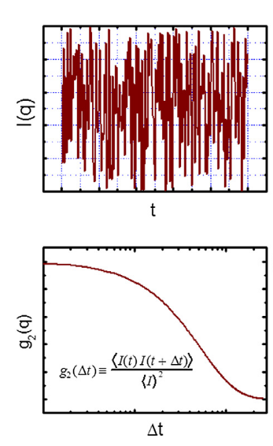
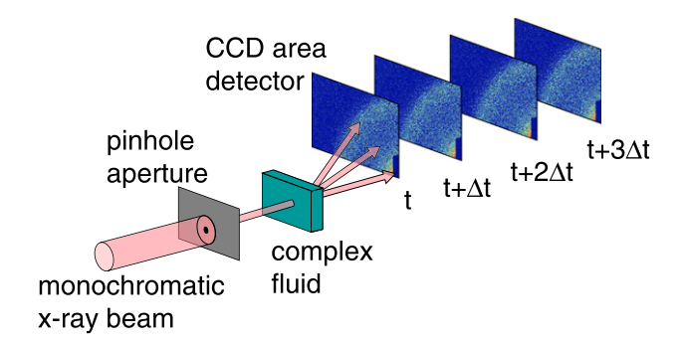
X-ray Photon Correlation Spectroscopy
XPCS – “Characterizing Nanoscale Dynamics”
Δt
Integration of “speckle pattern” produces temporal intensity variation at scattering vector q
Time
“Speckle pattern” - intensity vs. scattering vector q over time interval
Coherent x-ray
beam
Autocorrelation function: Structural change
through decorrelation of scattering intensity at char. relaxation time 𝜏
𝜏
Particle diffusion (D_{eff}) in a complex fluid
Leheny, R. L.; et al. Curr. Opi. Coll. Interf. Sci., 2012, 17(1), 3–12.

Slide 2
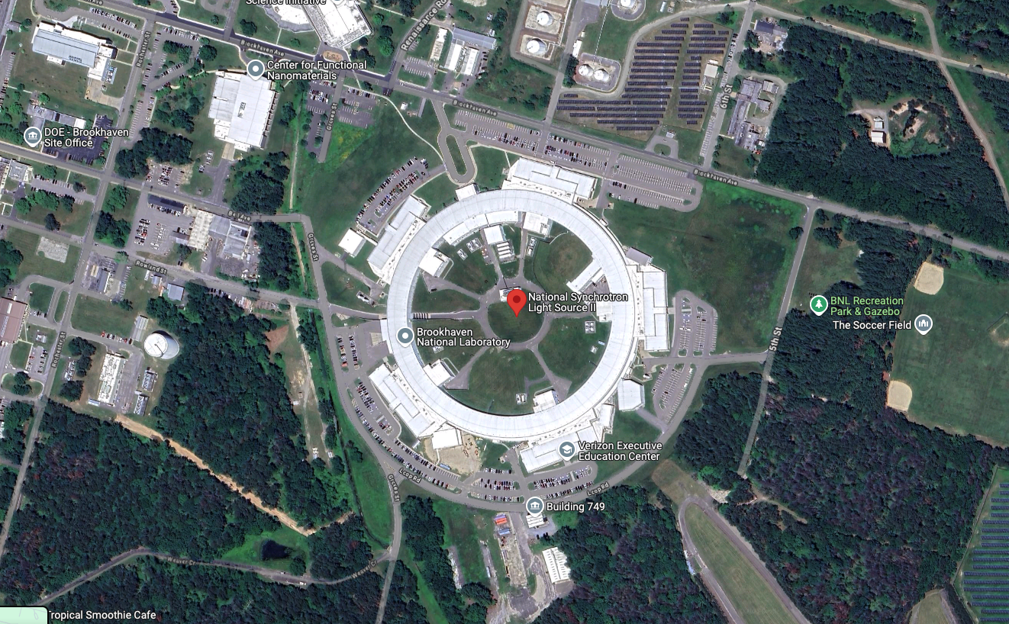
Brookhaven NL

Slide 3
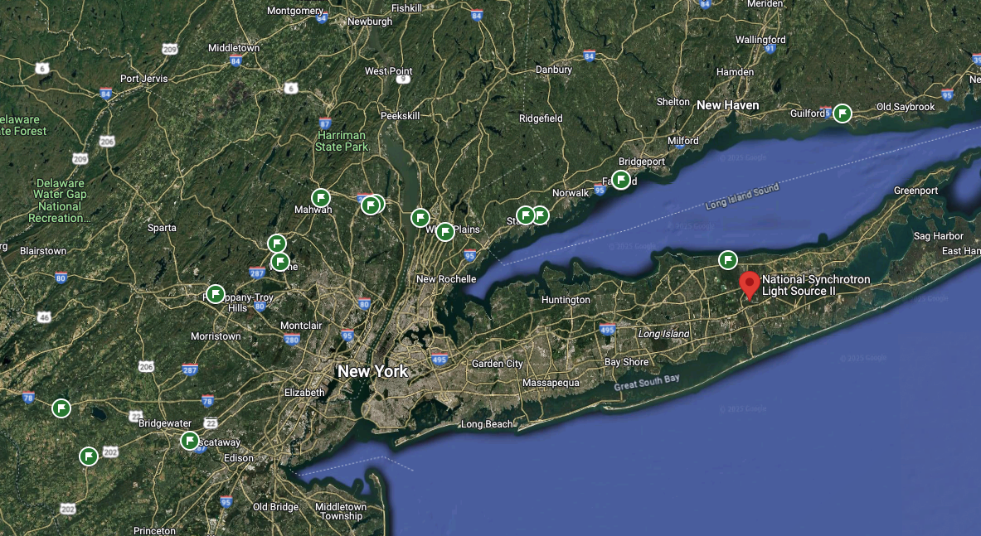
Brookhaven NL

Slide 4
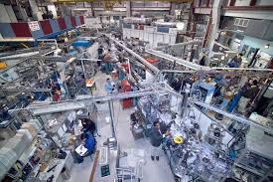
Brookhaven NL

Slide 5
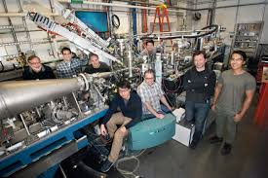
Brookhaven NL

Slide 6
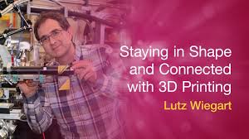
Brookhaven NL

Slide 7
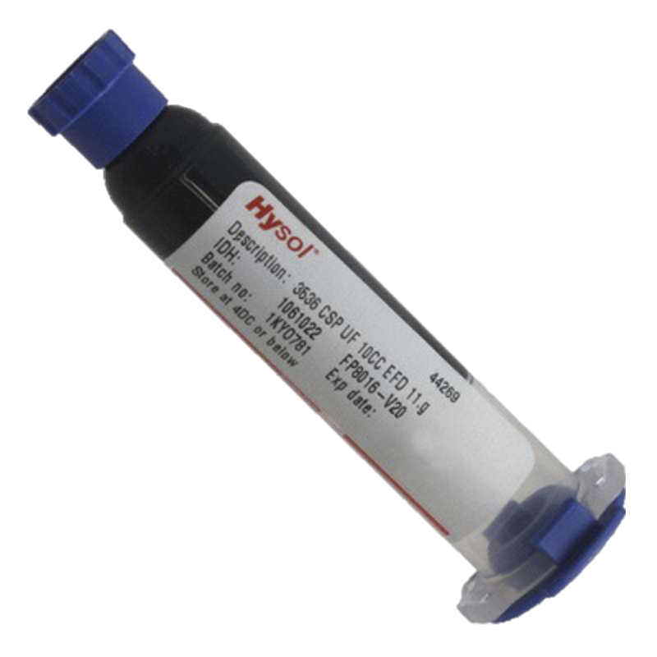

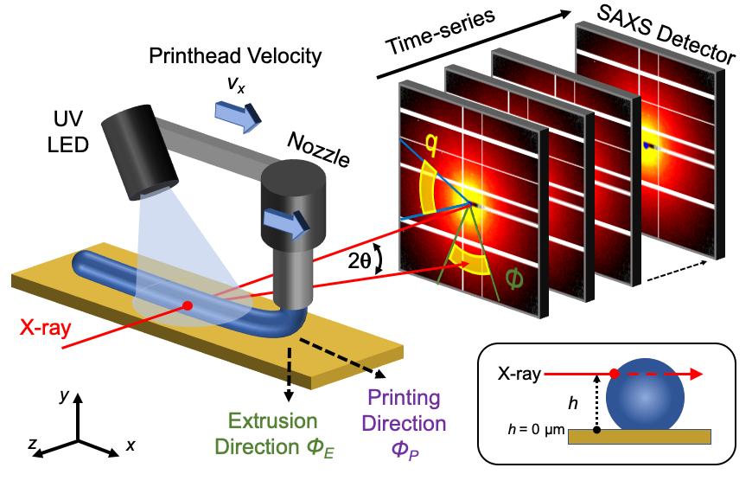
In-situ UV Cure 3D printing
Beamline 11-ID
Pre-cure
Φ_{filler} ~ 15 wt.%
Low crosslinking
High filler mobility
Fast dynamics
UV
Post-cure
High crosslinking
Low filler mobility
Slow dynamics
Yavitt, B.M.; et al. ACS Appl. Poly. Mat. 2020, 2, 4096
Notes:
Scattering contrast btw. filler + polymer resin
Time series of speckle patterns on SAXS detector
Structural change through decorrelation of scattering intensity
Could bring in the other picture if you are uncomfortable.
Need to really say all the aspects here anisotropy and the height characterization.
Need to explain what q is, its behavior at different length scales

Slide 8
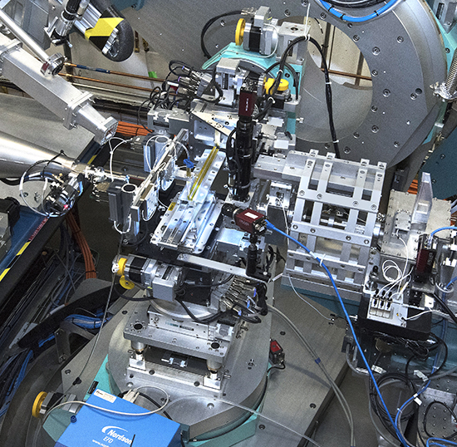
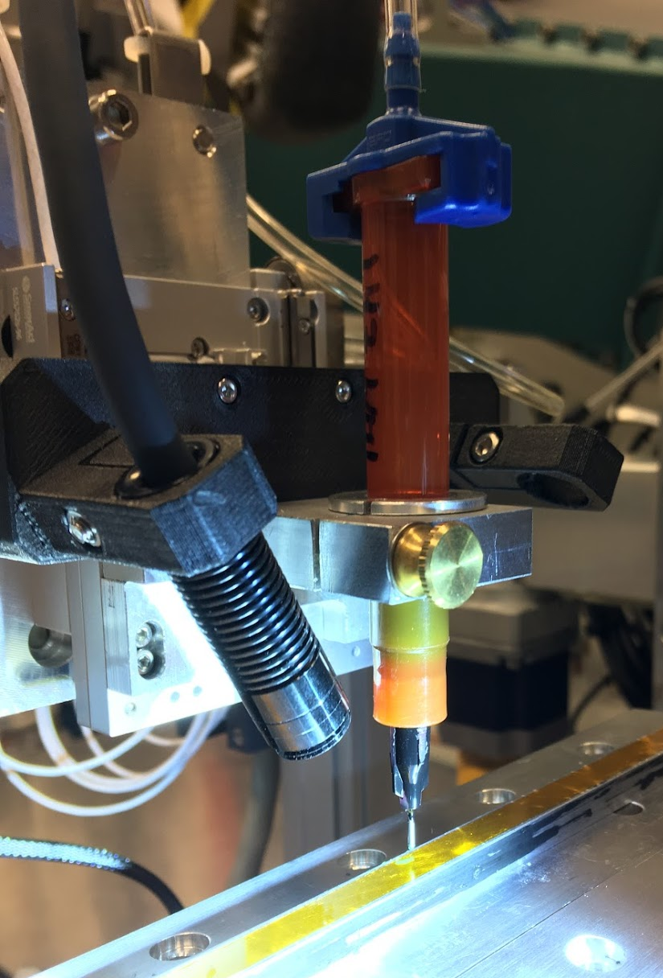
Experimental Set up at CHX
Nordson EFD
UV
X-ray
SmarAct.com

Slide 9

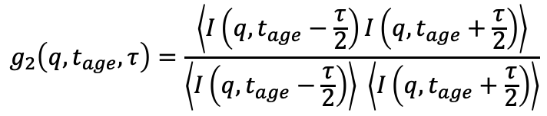
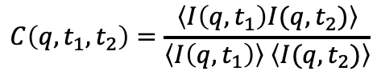
Analysis of Non-equilibrium Printing
Out-of-equilibrium dynamics require two-time correlation function (C)
Quasi-equilibrium dynamics at t_{age} result in one-time correlation function (g₂)
t_{age}
t_{age} = (t₁+ t₂)/2
t_{age}
𝜏 = |t₂-t₁|
$$g_{2}\left(q,t_{age},τ\right)=\frac{\left\langle I\left(q,t_{age}−\frac{τ}{2}\right)I\left(q,t_{age}+\frac{τ}{2}\right)\right\rangle }{\left\langle I\left(q,t_{age}−\frac{τ}{2}\right)\right\rangle \left\langle I\left(q,t_{age}+\frac{τ}{2}\right)\right\rangle }$$
$$C\left(q,t_{1},t_{2}\right)=\frac{\left\langle I\left(q,t_{1}\right)I(q,t_{2})\right\rangle }{\left\langle I\left(q,t_{1}\right)\right\rangle \left\langle I(q,t_{2})\right\rangle }$$
$$g_{2}\left(q,t_{age},τ\right)=﻿c+β(exp(−2({Γτ)}^{γ} ))$$
Yavitt, B.M.; et al. ACS Appl. Poly. Mat. 2020, 2, 4096
Notes:
We would use this relaxation rate to calculate the diffusion constant.

Slide 10
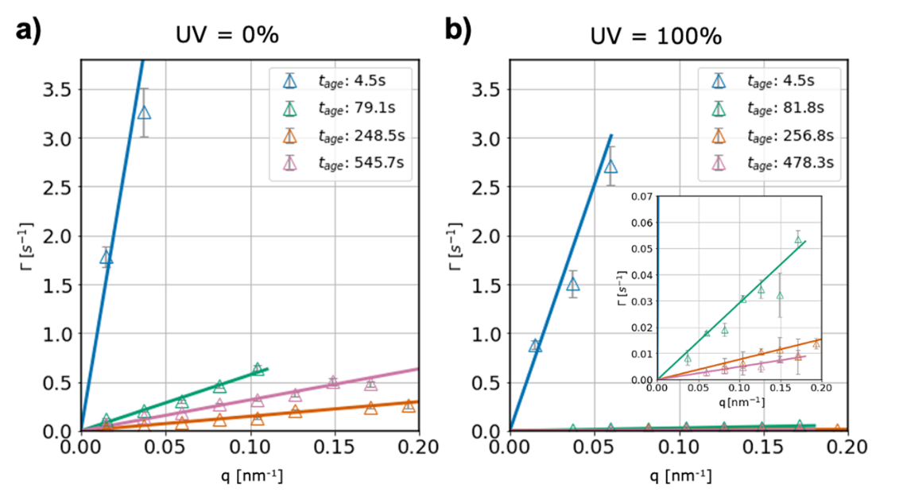
Tracking Ballistic Motion of Fillers
Scattering vector Q ~ local length scale⁻¹
𝛤 ~ Q² – diffusive, Stokes-Einstein
𝛤 ~ Q – collective, ballistic motion
Q independent dynamics: V_{p} = 𝛤/Q (nm/s)
time
Δt
Change in position/change in time ~ velocity
Yavitt, B.M.; et al. ACS Appl. Eng. Mater. 2023, 1 (2), 868–876

Slide 11
Unexpected Curing Process for Filaments
Two-stage power law
  V_{p} ~ (t_{age})^{m}
  m ~ UV during printing
Filament cures faster under higher UV intensity
Dynamic heterogeneity is common
Filament structure evolves beyond the ”printing” step
UV
UV on
Still evolving up to 10 mins after print!
Yavitt, B.M.; et al. ACS Appl. Poly. Mat. 2020, 2, 4096
Notes:
While relaxation rate does slow down with tage. We noticed that it scales linearly with scattering vector q, which is not diffusion but ballistic dynamic, so we quantify the dynamic by a linear velocity Vp and plot that as a function of the filament aging after printing. Dynamics rapidly decay under UV, and much faster at highest UV intensity. Interesting, dynamics continue to evolve up to 10 minutes after the print has finished. This has implications for rapid printing approaches, where the filament is still developing structure as the filaments are added to the part.
Regular printing, hacked and slashed to remove some weird data points
KWW exponent 𝛾 increases from 1 to 2 with aging
diffusive to compressed
From Paper figure 6
UV Curing:
Two stage aging process:
In-situ: Power-law decay of V_{p}
Post: Slower final dynamics with higher UV dose
Maybe don’t need so many words on this slide, you can clean up a little bit an put insets of the two different two time correlation functions showing the DH undulations and the saturated ones for 100 %
Think about the big symbols and dotted lines if this is too simplified
Also would be cool to have the UV shading zone on there to really highly the induced dynamics and further decay.

