Slide 1
Sizing a battery
Dr Max Yan
Chemical Engineer
Ionic Mineral Technologies
maxyan@ionicmt.com

Slide 2








About me
MEng Chemical Engineering (4 year programme)
  Year abroad at University at Buffalo (SUNY)
CDT in Energy Storage and its Applications (PhD)
  http://www.energystorage-cdt.ac.uk/
Supervisor – Prof. Siddharth Patwardhan
  https://www.svplab.com/
Porous silicon anodes for lithium-ion batteries
  Magnesiothermic reduction of silica
Post-doc at Dalhousie University
Ionic Mineral Technologies
  Silicon anodes for lithium-ion batteries

Slide 3
Part 1 – Terminology and calculations

Slide 4
Sizing up a battery – basic parameters and calculations
Voltage (V), Current (A)
Parallel and series circuits
Capacity, energy (Ah, Wh)
C-rate (C)

Slide 5



Sizing up a battery – voltage, current, power
Electrical Engineering parameter | Chemical Engineering equivalent parameter
Voltage (V) | Fluid pressure (kPa, psi)
Current (A) | Flowrate (m³/s)
Electrical power (W) | Mechanical, or pump power (W)
$$Voltage∗Current=Power$$
$$Pressure∗Flowrate=Power$$

Slide 6
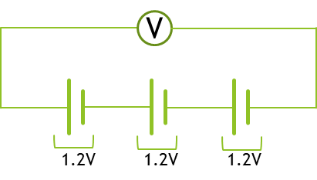
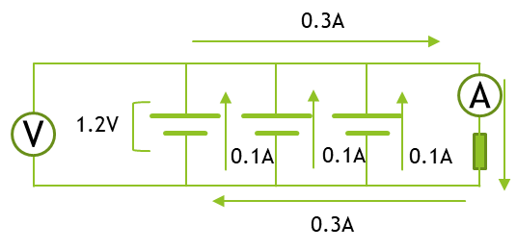



Sizing up a battery – parallel and series circuits
In series circuit (S), output voltage increases, current stays the same
In parallel circuit (P), output current increases, voltage stays the same
Batteries have maximum safe operating voltage (and current)
  Approx. 3.6V for Li-ion
  1.2 - 1.5V for NiMH
Increase voltage and current by connecting in P and S
$V_{Total}=3.6V$
$V_{Total}=1.2V$
$I_{Total}=0.3A$

Slide 7

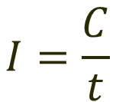

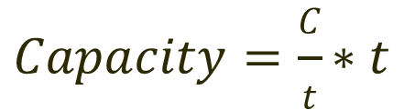
Sizing up a battery - capacity
C = Charge, in coulombs
t = time, in seconds
I = Current, in coulombs/s (amps)
Capacity, measured in amp-hours (Ah)
$$I=\frac{C}{t}$$
$$Capacity=I∗t$$
$$Capacity=\frac{C}{t}∗t$$
$$Capacity=C$$
1 Ah capacity can supply a current of 1 A for 1 hour

Slide 8
Capacity vs energy
Elevation
Ground level
Voltage
Capacity
Negative voltage
No usable energy
Positive voltage
Usable energy

Slide 9




Sizing up a battery - energy
V = Voltage (V)
I = Current (A)
Cap = Capacity (Ah)
t = time (s)
P = Power (W)
E = Energy content (Wh)
Hence, energy content = capacity x voltage
Units of energy content in a battery given in watt-hours
$$P=\frac{E}{t}$$
$$E=P∗t$$
$$Power=Voltage ∗Current$$
$$E=V∗I∗t$$
Capacity

Slide 10
Sizing up a battery – C-rate
Rate of charging/discharging of a battery
Quoted as multiple of capacity of battery
For example: taking a 3 Ah battery
C-rate | Current (A) | Time taken (hrs)
1C | 3 | 1
0.5C | 1.5 | 2
0.1C | 0.3 | 10
0.01C | 0.03 | 100

Slide 11
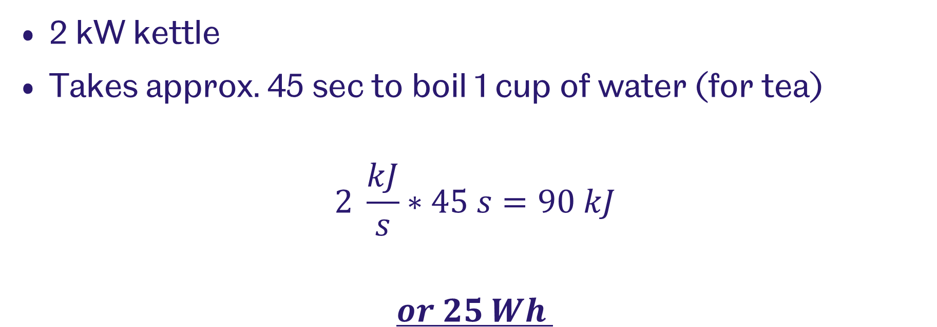
Problem 1 – Boiling the kettle
2 kW kettle
Takes approx. 45 sec to boil 1 cup of water (for tea)
$$2 \frac{kJ}{s}∗45 s=90 kJ$$
$$or 25 Wh$$

Slide 12


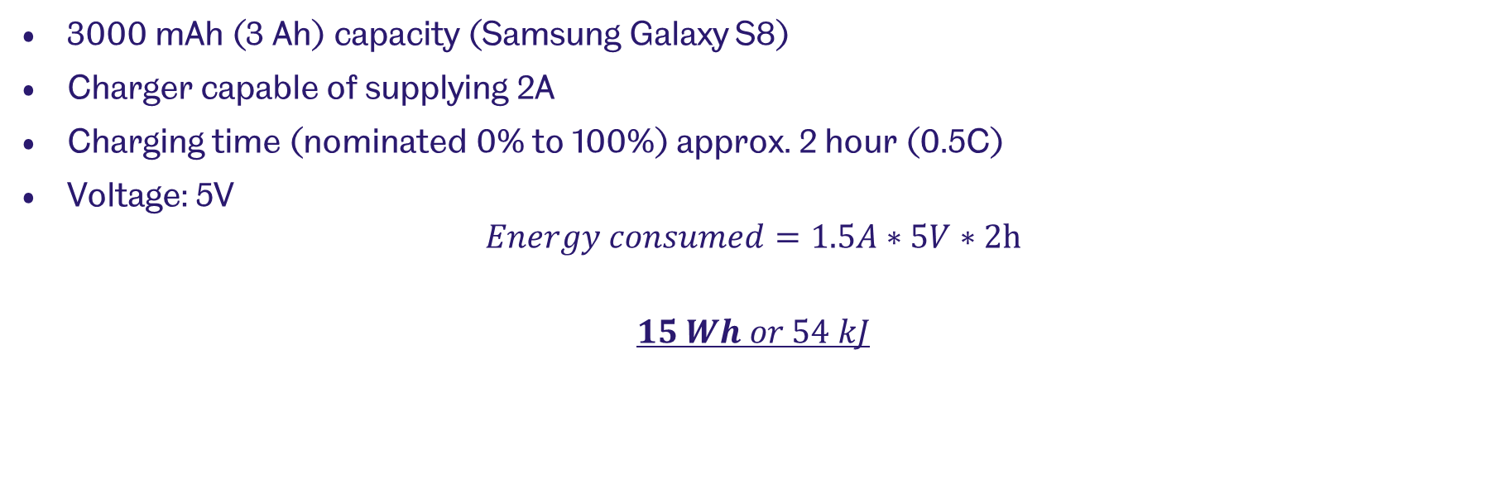
Problem 2 - charging your phone
3000 mAh (3 Ah) capacity (Samsung Galaxy S8)
Charger capable of supplying 2A
Charging time (nominated 0% to 100%) approx. 2 hour (0.5C)
Voltage: 5V
$$Energy consumed=1.5A∗5V∗2h$$
$$15 Wh or 54 kJ$$

Slide 13
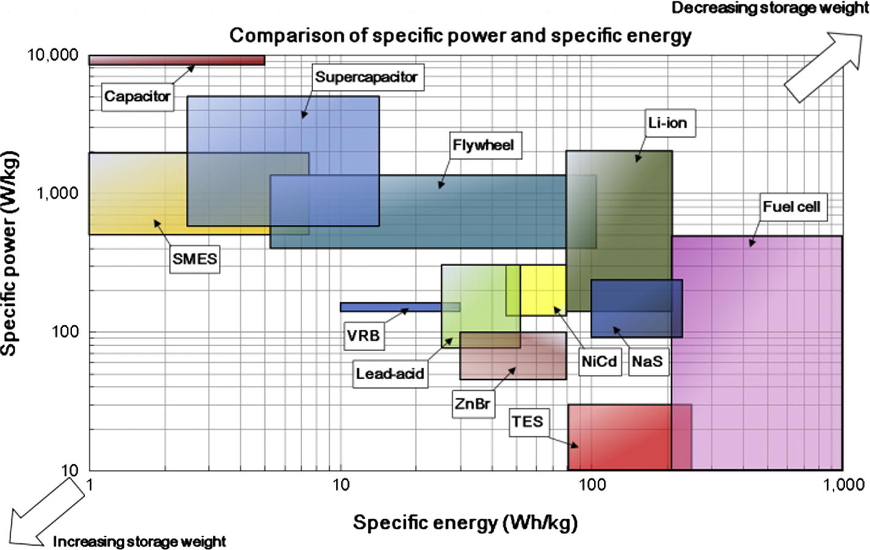
Comparing energy storage devices
Luo, X., Wang, J., Dooner, M., Clarke, J., 2015. Appl. Energy.

Slide 14
Comparing batteries
Tarascon, J.-M., Armand, M., 2001. Nature.

Slide 15
Part 2 – Common battery types

Slide 16
Useful notes
Electrons are negative – flow of electrons is from –ve electrode (anode) to +ve electrode (cathode)
In electronics, current flows from positive to negative – this is convention
In batteries, during charging, you store energy (and electrons) in the anode
In this section, all equations are written so that forward reactions are spontaneous

Slide 17
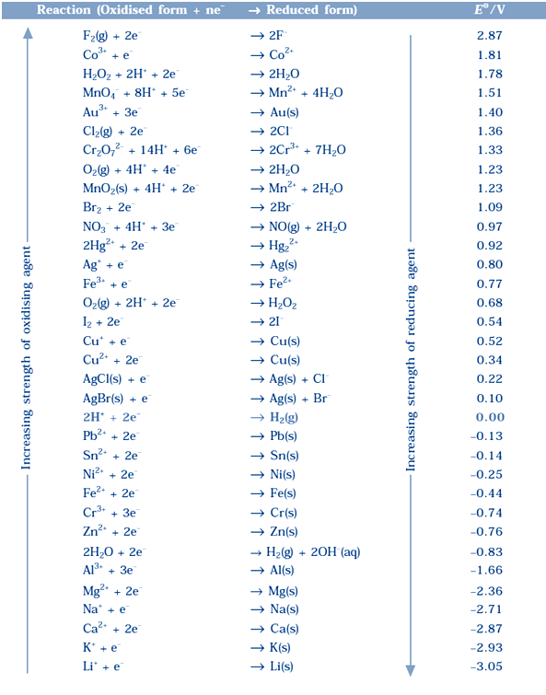
Useful notes - refresher
Reduction reactions
Spontaneous reactions determined from standard electrode potentials
The more positive the potential, the more likely it will (spontaneously) accept electrons

Slide 18
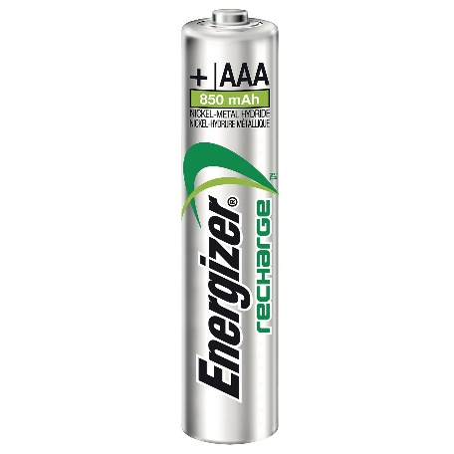
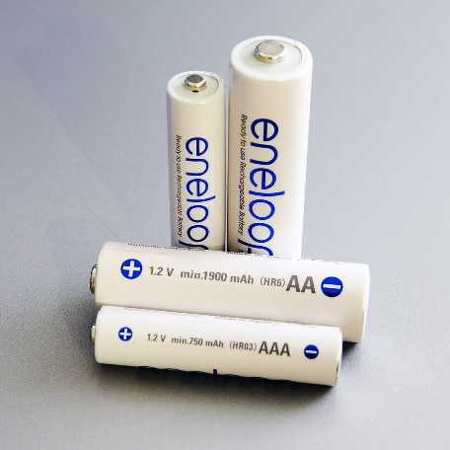
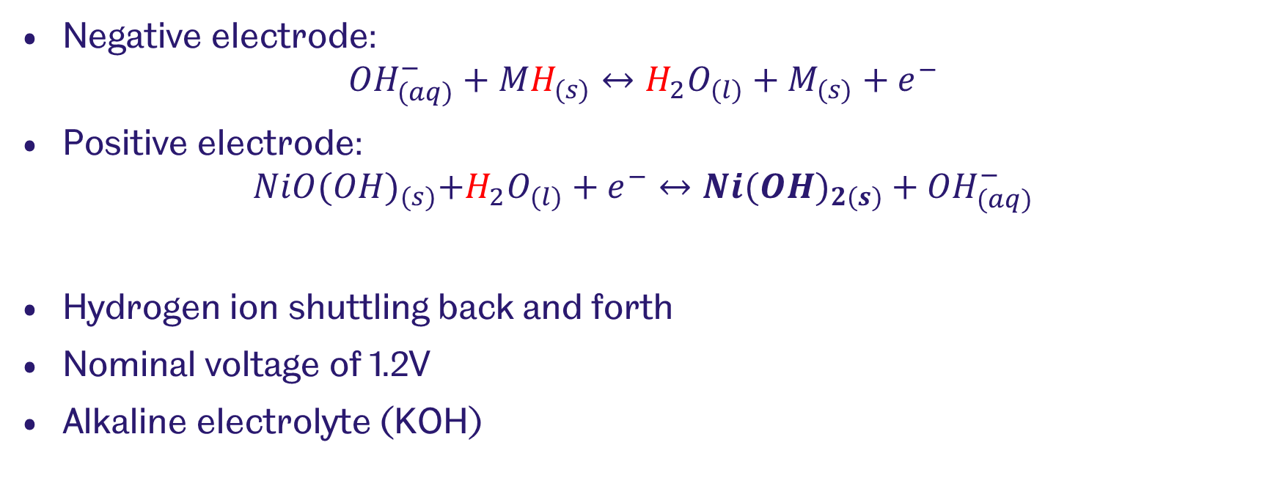
Nickel metal hydride
Negative electrode:
$${OH}_{(aq)}^{−}+{MH}_{(s)}↔H_{2}O_{(l)}+M_{(s)}+e^{−}$$
Positive electrode:
$$NiO{(OH)}_{(s)}+H_{2}O_{(l)}+e^{−}↔{Ni(OH)}_{2(s)}+{OH}_{(aq)}^{−}$$
Hydrogen ion shuttling back and forth
Nominal voltage of 1.2V
Alkaline electrolyte (KOH)
Notes:
La, Nd, Ce, Pr. Ni, Co, Mn, Al.
Ti, V. Zr, Ni, Cr, Co, Fe, Mn

Slide 19
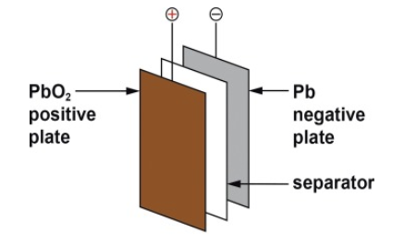
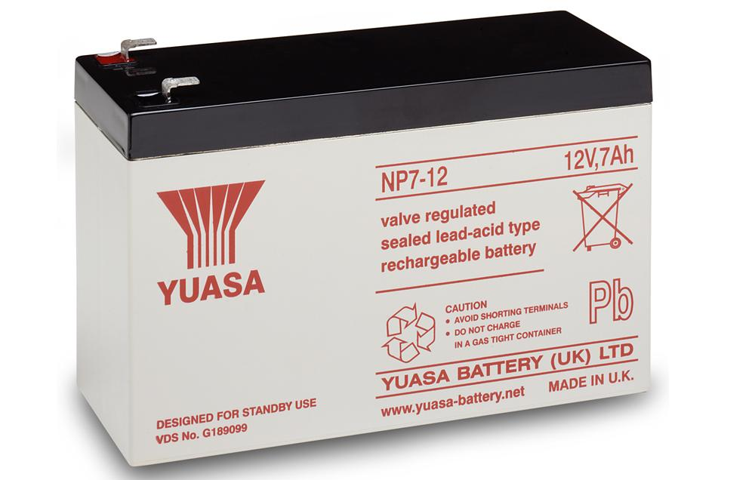
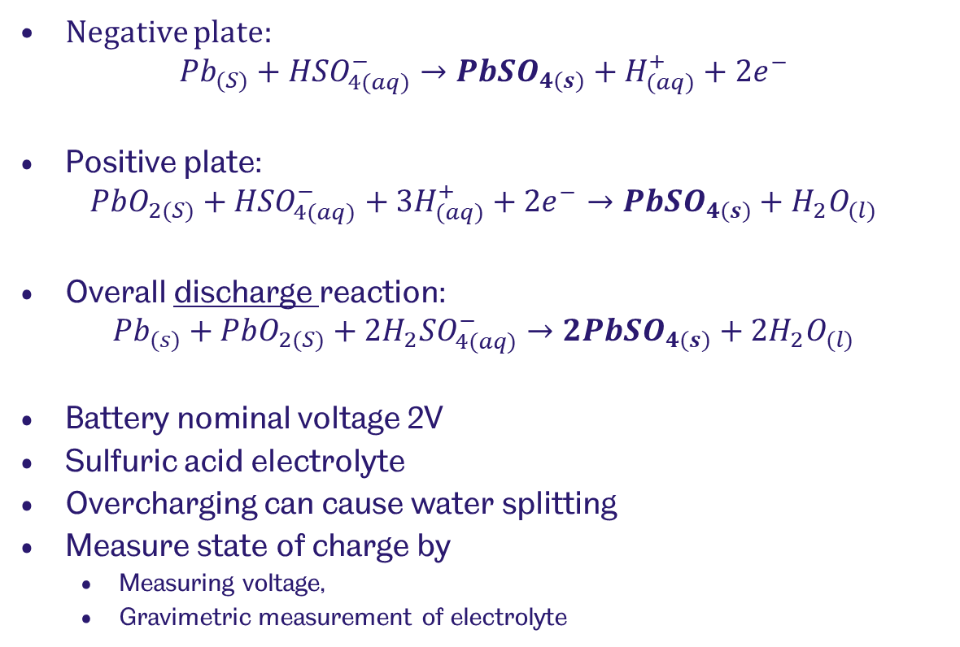
Lead acid
Negative plate:
$${Pb}_{(S)}+{HSO}_{4(aq)}^{−}→{PbSO}_{4(s)}+H_{(aq)}^{+}+{2e}^{−}$$
Positive plate:
$${PbO}_{2(S)}+{HSO}_{4(aq)}^{−}+{3H}_{(aq)}^{+}+{2e}^{−}→{PbSO}_{4(s)}+H_{2}O_{(l)}$$
Overall discharge reaction:
$${Pb}_{(s)}+{PbO}_{2(S)}+2{H_{2}SO}_{4(aq)}^{−}→{2PbSO}_{4(s)}+{2H}_{2}O_{(l)}$$
Battery nominal voltage 2V
Sulfuric acid electrolyte
Overcharging can cause water splitting
Measure state of charge by
  Measuring voltage,
  Gravimetric measurement of electrolyte
May, G.J., Davidson, A., Monahov, B., 2018. J. Energy Storage 15, 145–157.

Slide 20
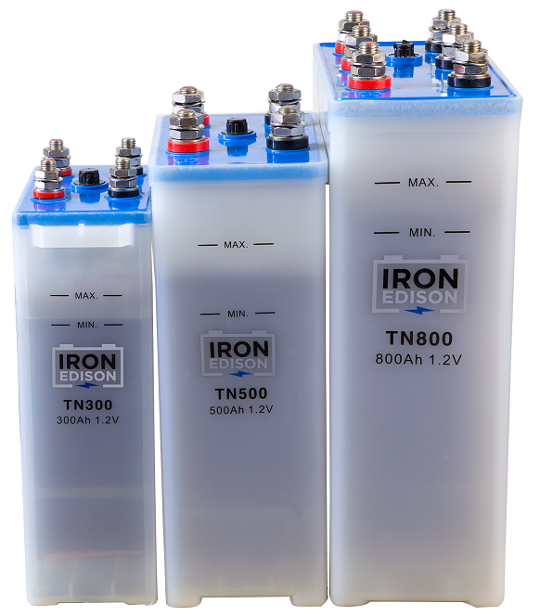
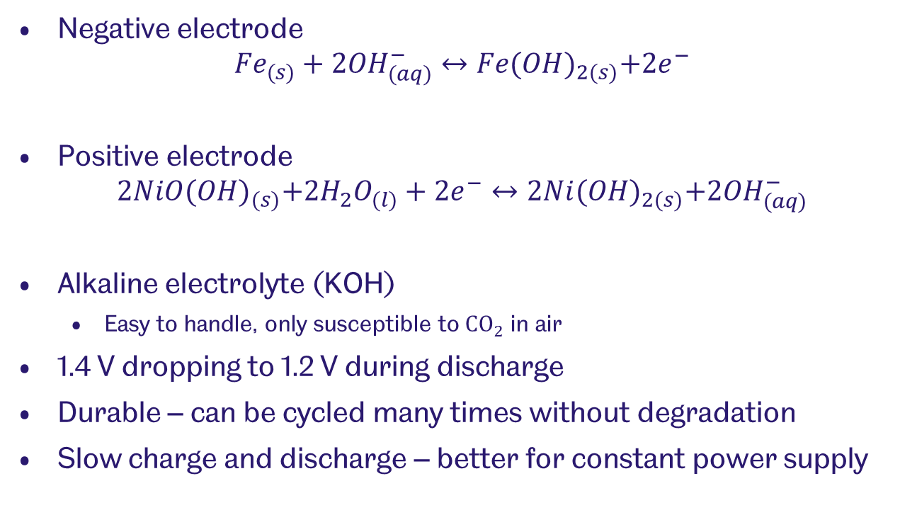
Edison battery
Negative electrode
$${Fe}_{(s)}+2{OH}_{(aq)}^{−}↔Fe{(OH)}_{2(s)}+{2e}^{−}$$
Positive electrode
$$2NiO{(OH)}_{(s)}+2H_{2}O_{(l)}+2e^{−}↔2Ni{(OH)}_{2(s)}+2{OH}_{(aq)}^{−}$$
Alkaline electrolyte (KOH)
  Easy to handle, only susceptible to ${CO}_{2}$ in air
1.4 V dropping to 1.2 V during discharge
Durable – can be cycled many times without degradation
Slow charge and discharge – better for constant power supply

Slide 21
Part 3 – Lithium-ion battery

Slide 22
Lithium-ion battery
Intercalation reactions occur
Lithium-ions move into material lattices
Lithium ions shuttle back and forth
Graphite stores lithium when fully charged
Cathode accepts lithium during discharge
Lithium highly reactive
  Requires absence of water or oxygen during manufacture and operation

Slide 23
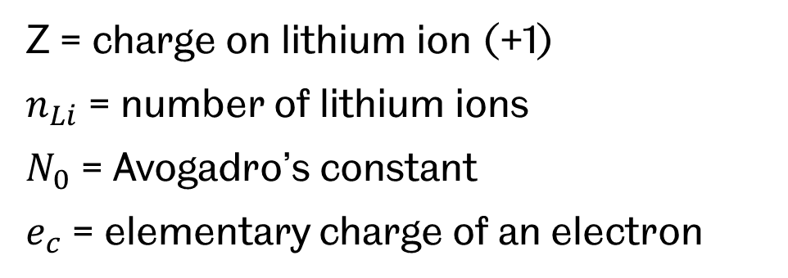


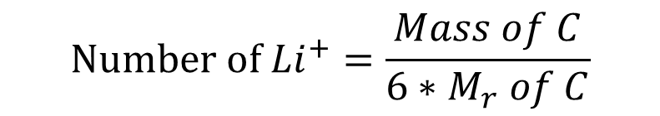
Calculating theoretical specific capacity (mAh/g)
$${Li}^{+}+6C+e^{−}→LiC_{6}$$
$$Number of {Li}^{+}=\frac{Mass of C}{6∗M_{r} of C}$$
$$Total capacity=z∗n_{Li}∗N_{0}∗e_{c}$$
Z = charge on lithium ion (+1)
$n_{Li}$ = number of lithium ions
$N_{0}$ = Avogadro’s constant
$e_{c}$ = elementary charge of an electron
Graphite theoretical specific capacity:
371 mAh/g

Slide 24

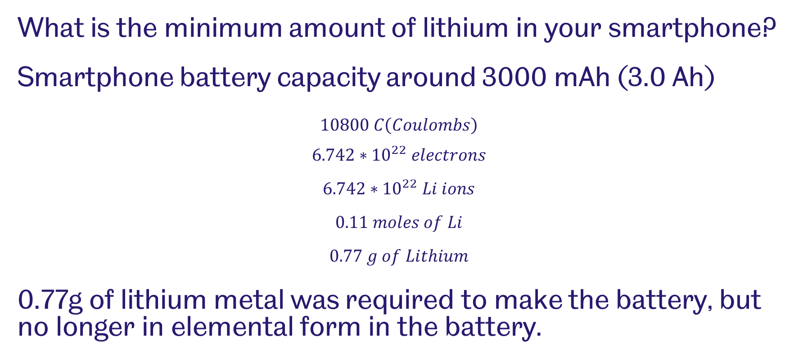


Lithium ion battery calculations
What is the minimum amount of lithium in your smartphone?
Smartphone battery capacity around 3000 mAh (3.0 Ah)
$$10800 C\left(Coulombs\right)$$
$$6.742∗{10}^{22} electrons$$
$$6.742∗{10}^{22} Li ions$$
$$0.11 moles of Li$$
$$0.77 g of Lithium$$
0.77g of lithium metal was required to make the battery, but no longer in elemental form in the battery.
$1 electron=1.602∗{10}^{−19}C$
$$Li→{Li}^{+}+e^{−}$$
$$A_{v}=6.022∗{10}^{23}$$

Slide 25
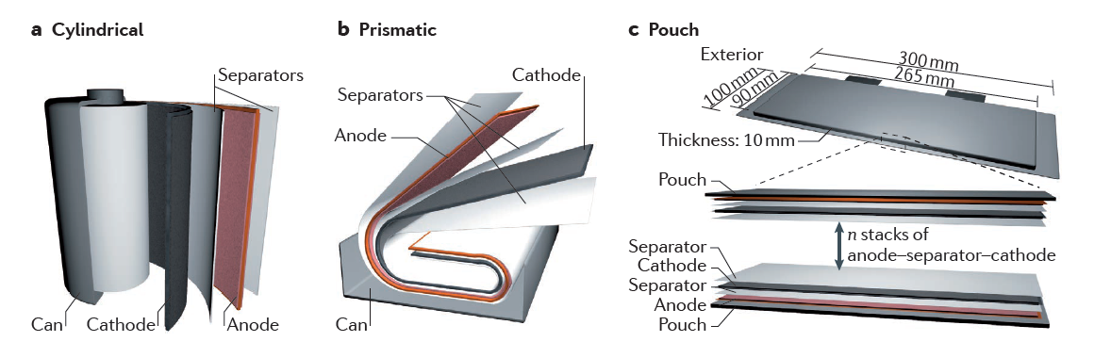
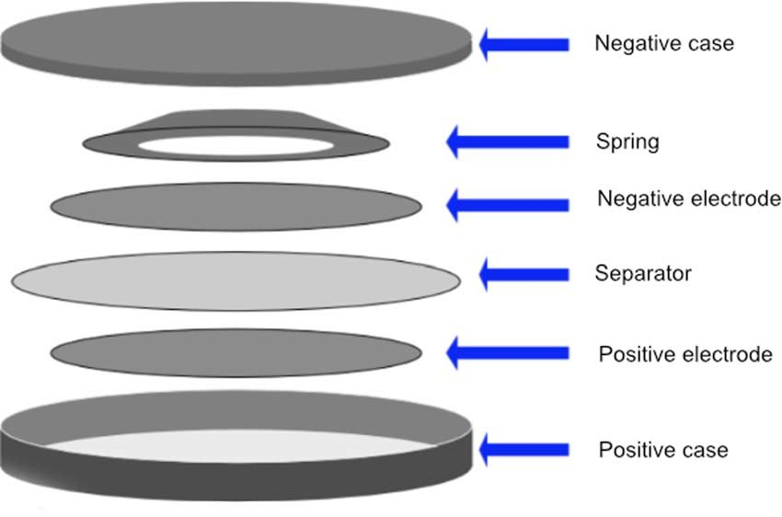
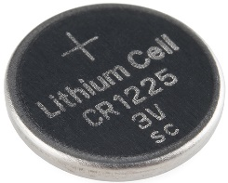
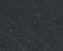
Cell configurations
Cylindrical cells are most efficient
Can be wound with high tension
Commonly made into 18650 (18 mm dia, 65 mm height)
AA batteries are 14500, not usually lithium ion

Slide 26

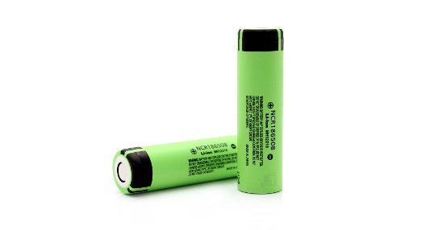

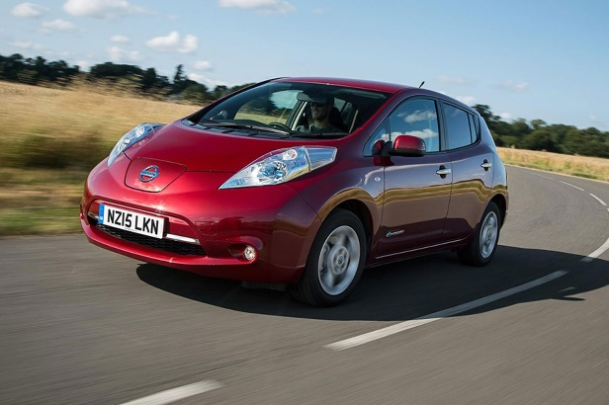
Lithium-ion batteries for EVs
Tesla Model S 85
  85 kWh battery pack
  18650 cell type
  6 cells per module, 16 modules
  74 in parallel
  7104 cells total
  360V
Nissan Leaf
  24 kWh battery
  Pouch-cell type
  4 cells per module, 48 modules
  32.5 Ah per cell
  192 pouch cells total
1 module
1 cell
1 module
1 cell

Slide 27
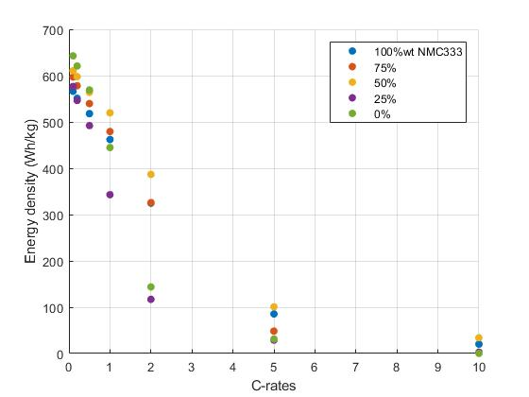
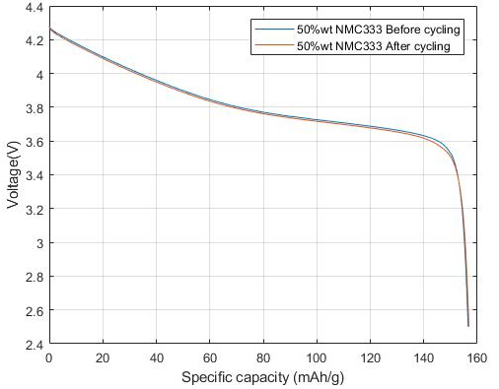
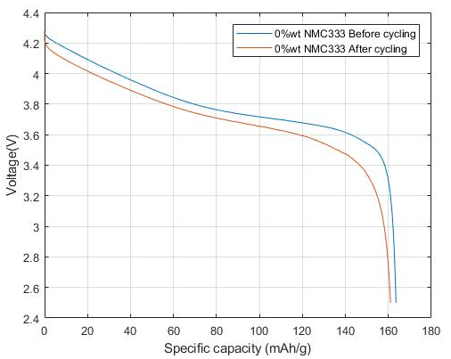
Discharge characteristics
Capacity (and energy stored) is dependent on C-rate
Battery degrades after cycling
Discharge at 0.1C (bottom left)
6 charge cycles (bottom right)

Slide 28
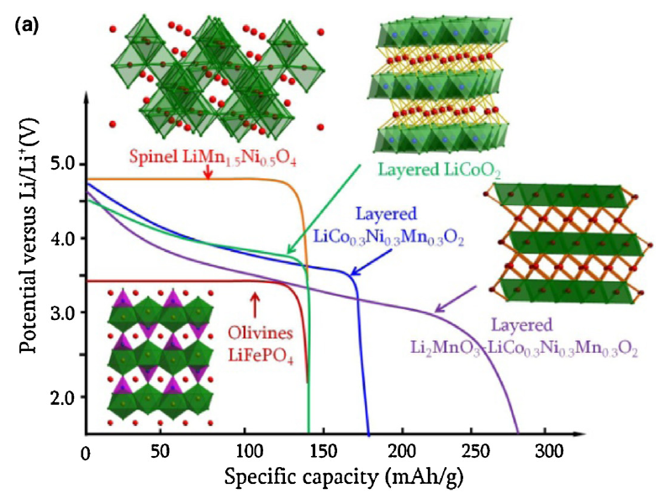
Discharge characteristics
Discharge curve shape is dependent on cathode material
Spinel and olivine
  Have robust structure
  Do not distort when intercalating
Layered structures
  Distort during intercalation
  Energy is lost when lithium forces into structure
  Sloping voltage profile
Liu, C., Neale, Z.G., Cao, G., 2016. Mater. Today.

Slide 29
Part 4 – Silicon anodes

Slide 30
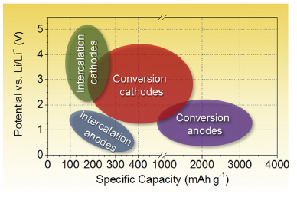
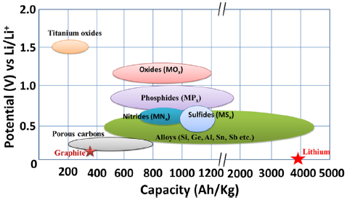
Anode materials

Slide 31
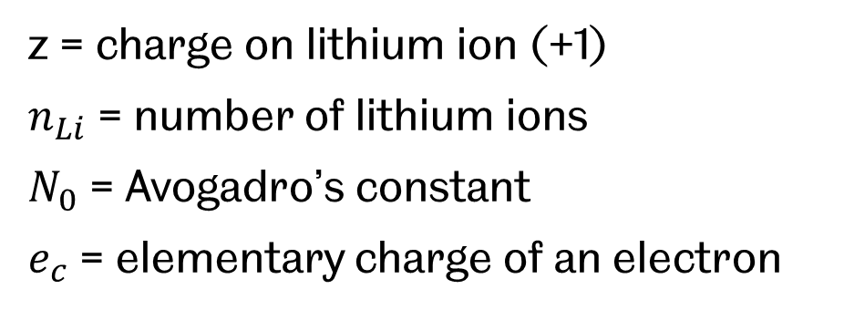


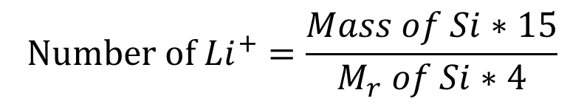
Calculating theoretical specific capacity (mAh/g)
$${15Li}^{+}+4Si+e^{−}→{Li}_{15}{Si}_{4}$$
$$Number of {Li}^{+}=\frac{Mass of Si∗15}{M_{r} of Si∗4}$$
$$Total capacity=z∗n_{Li}∗N_{0}∗e_{c}$$
z = charge on lithium ion (+1)
$n_{Li}$ = number of lithium ions
$N_{0}$ = Avogadro’s constant
$e_{c}$ = elementary charge of an electron
Silicon theoretical specific capacity:
3571 mAh/g
Graphite = 371 mAh/g

Slide 32
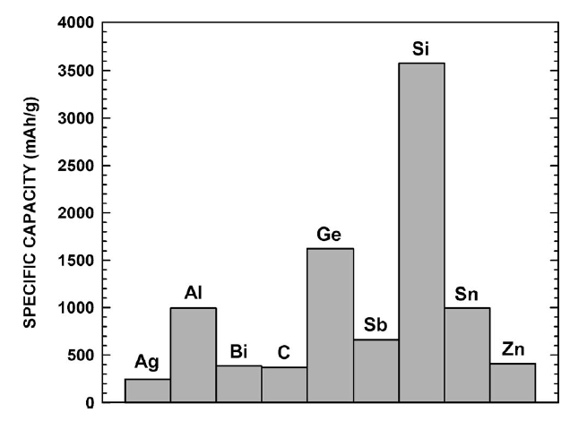
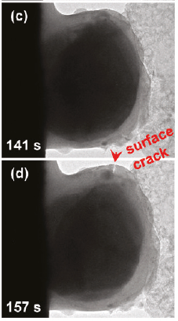
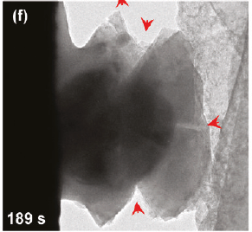
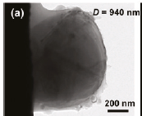
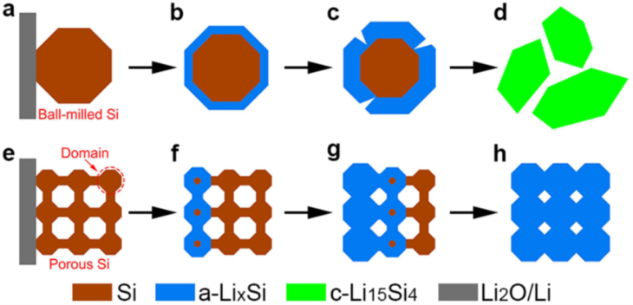
Silicon
Very high capacity
Low cyclability
Needs to be porous

Slide 33
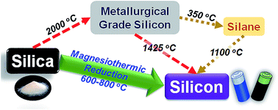
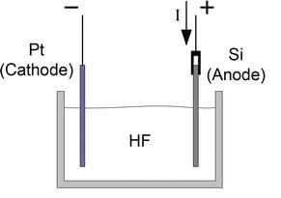
Making silicon
Non-porous: Carbothermal reduction
Porous: electrochemical etching of Si wafer
(1) J. Entwistle, A. Rennie and S. Patwardhan, J. Mater. Chem. A, 2018.
(2) Karbassian, F. Porous Silicon. In Porosity - Process, Technologies and Applications; 2018.

Slide 34

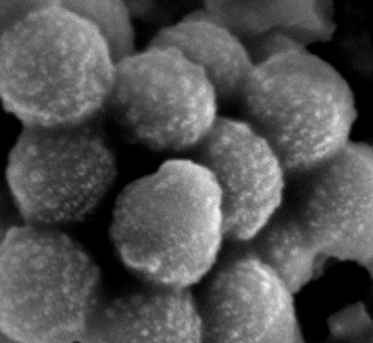
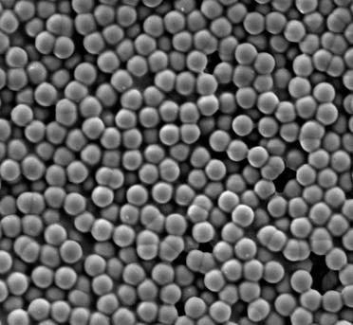
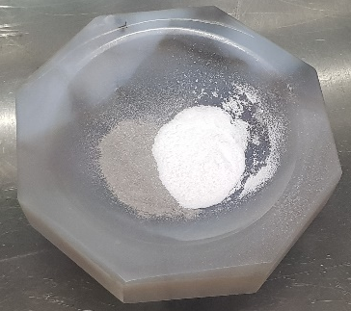
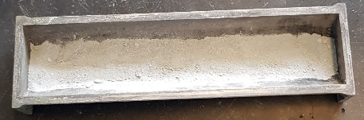
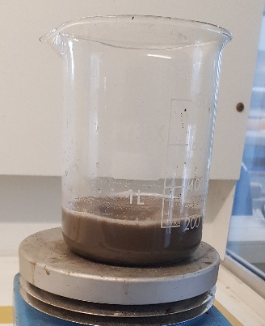
Magnesiothermic reduction (MgTR)
Porous silicon
6h
Ar
Ar
SiO₂
650ºC
£££
1M HCl
MgCl₂
Mg
Notes:
Literature – no reports of low temp and yield?

Slide 35
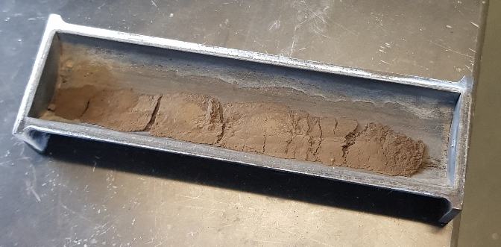
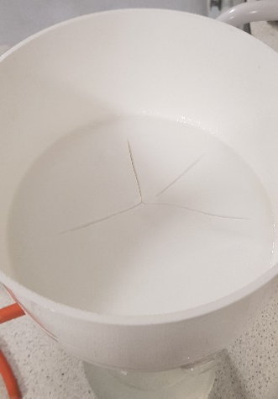
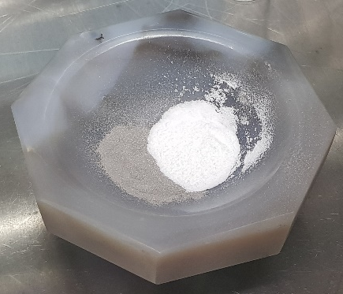
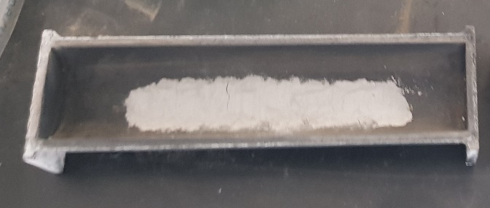


Magnesiothermic reduction
$$Si,{SiO}_{2},MgO, {Mg}_{2}Si$$
$$SiO_{2}, dried$$
Heat at 650ºC, 6 hours
Grind
Mg

Slide 36





Acid washing
Add HCl
Filter
$$Si,{SiO}_{2}MgO, {Mg}_{2}Si$$
$$Si,{SiO}_{2}$$

Slide 37



Drawbacks of MgTR
Lack of pore control
Presently not scalable
Production is not sustainable
Scale bars: 1 μm

Slide 38



Thermal control
Low ramp rates
Low temperatures
Salt – thermal sink
Two-step reduction
Without NaCl
With NaCl
W. Luo, X. Wang, C. Meyers, N. Wannenmacher, W. Sirisaksoontorn, M. M. Lerner and X. Ji, Sci. Rep., 2013.
S. A. Martell, Y. Lai, E. Traver, J. MacInnis, D. D. Richards, S. MacQuarrie and M. Dasog, ACS Appl. Nano Mater., 2019.

Slide 39


Eutectic reduction
Reduction proceeds at 450ºC
Mg-Al eutectic is formed at 650ºC

Slide 40


MgTR – 500 nm
Scale bar: 1 μm

Slide 41


MgTR – 20 nm
Scale bar: 10 nm
Stöber silica (20nm) reduces at 450ºC

Slide 42


MgTR – yields (wt% Si)
Stöber silica
Fumed silica
Fumed and Stöber
Fumed silica (7 nm) reduces at 380ºC

Slide 43
Coin cell electrode preparation
Current collector
Cathode
Anode
Binder
Conductive additive
Separator
Active material

Slide 44




Making the electrode
Mix with carbon, water and binder
$$Si,{SiO}_{2}$$
$$Si,{SiO}_{2}, H_{2}O, Carbon, CMC$$

Slide 45

Drawdown variables
Binder content

Slide 46



Drawdown variables
Water content
Binder content
Drawdown thickness
Drying schedule

Slide 47
Preliminary cell data
Poor initial capacity
Poor cyclability

Slide 48

Ideal drawdown
Smooth (consistent thickness)
No aggregates ‘dragging’ across foil

Slide 49


Coin cell assembly
Punched electrode
2016 Coin cell

Slide 50
Cell data
Low wt% silicon are not electronically connected
Degradation occurs in higher wt% silicon
Consumption of active material during SEI formation
49 wt% Si
58 wt% Si
34 wt% Si
32 wt% Si

Slide 51




BFD, reaction stoichiometry
Dissolution reactions:
$${Mg}_{(s)}+{2HCl}_{(aq)}→2{MgCl}_{2(aq)}+H_{2(g)}$$
$${MgO}_{(s)}+{2HCl}_{(aq)}→{MgCl}_{2(aq)}+H_{2}O_{(l)}$$
$${Mg}_{2}{Si}_{(s)}+{4HCl}_{(aq)}→Mg{Cl}_{2(aq)}+{SiH}_{4(g)}$$
$${SiH}_{4(g)}+{2O}_{2(g)}→{SiO}_{2(s)}+{2H}_{2}O_{(l)}$$
Desirable reaction:
$$2{Mg}_{(s)}+SiO_{2(s)}→2{MgO}_{(s)}+{Si}_{(s)}$$
Parasitic reaction:
$$2{Mg}_{(s)}+{Si}_{(s)}→2{Mg}_{2}{Si}_{(s)}$$

Slide 52
Process handles (variables)
5
3,4
1
2
Reactant molar ratios
Degree of mixing
Size of mixture (reaction mass)
Heating rate
Process times

Slide 53
Measurable outputs
Experimental
  Yield
  Properties
  Performance
Modelling
  Operational cost
  Capital cost
  Payback time

Slide 54




Conversion, selectivity, yield
$$C+\frac{1}{2}O_{2}→CO$$
$$C+O_{2}→{CO}_{2}$$
$$Conversion=\frac{Total moles C reacted}{Total starting moles of C }$$
$$Selectivity=\frac{moles CO_{2}}{Total moles C reacted}$$
Conversion x Selectivity = Yield

Slide 55
Chem Eng approach to Chemistry
Quantify the process
Identify biggest bottlenecks at process level (Chem Eng)
Remove bottlenecks using innovations at molecular level (Chemistry)

Slide 56
Soil moisture sensors

Slide 57
Water management for agriculture
Water is precious in terms of farming – water is in high demand
Cost of water for irrigation, quoted by farmers in Ethiopia – 70%
Drip irrigation used
Water is poured into ground until top layer of soil is moist
Locally determining moisture is by eye – is topsoil moist?
Unsure of whether roots receive enough water, or too much water

Slide 58



Moisture sensors
Readily available, home-use moisture sensor
  Cannot be easily repaired in-house if broken
  Needs to be returned to manufacturer if repair required
  Technology not adaptable – humidity, temp and drip irrigation functions
  No wireless data collection function
Multi-function sensor (light, humidity, automatic irrigation)
  Cost of sensor starts to increase significantly
  Limited access of sensors in developing countries
Notes:
Moisture sensors which are available to farmers, gardeners and hobbyists in the Western world are not so easily accessible by farmers in developing countries. The more affordable analog sensors are difficult to repair if broken, and cannot be adapted to give other readings such as temperature and humidity, nor can they interface with drip irrigation systems.

Slide 59


Printed sensors
Uses printable conductive ink
Doped titania nanoparticles
RFID interrogation
Moisture affects impedance
Can be used for chemical detection (CO)
Notes:
The sensor tag consists of a sheet of paper or acetate, with ink printed in a shape according to the dimensions shown in the diagram on the bottom left. The A signal is sent from an RFID reader to the sensor. The sensor receives the signal, produces an electrical current, which is then converted back into a signal (backscattered signal) that is sent back to the RFID reader. Depending on the amount of moisture on the sensor, the amount of current produced and therefore the strength of the backscattered signal changes. This is due to the relationship between capacitance and moisture – a change in one affects the other. By calibrating the sensors using soil of known moisture content, a graph (bottom right) can be drawn. This graph can then be used as a reference to make future soil moisture measurements.
The sensor tag, being printed on paper or acetate, makes it an attractive design due to low costs. The preparation of the ink required specific techniques such as screen printing – not so easy to carry out. The ink had to be made of a compound called niobium doped titania – more on next slide.

Slide 60

Niobium-doped titania nanoparticles
Chemical synthesis
Reagents:
  Titanium chloride
  Niobium ethioxide
  Tert-butyl alcohol
Challenging to produce printable consistency
Requires screen printer
Alternative to titania is silver nanoparticles
Notes:
The ink had to be made of niobium-doped titania. This was difficult to synthesise since the concentrations of reagents, and the final consistency had to be precise. The samples produced were lumpy as shown in the image, and not suitable for printing.

Slide 61

Electronic sensor
Electronic sensor platform system
5V system
Controlled by microcontroller
Inductive power transfer
Data sent wirelessly to smartphone
Can charge using solar panel
Can be modified to accept power from supercapacitors
Costs roughly £5
(cost does not include smartphone)
Notes:
A cheap electronic sensor was ultimately chosen as this design was also cheap, but easier to build. The sensor was designed by Oz McFarlane, and operates on a 5V system. The microcontroller platform is the NodeMCU. This is a consumer grade microcontroller which as wifi capabilities built in, as such, it finds use in many applications including as a teaching aid in schools. The device sends data to a smartphone, or displays it on an LCD screen. The device is powered wirelessly, which removes the need for having a battery in each sensor – one battery can be used to power multiple controllers, one by one.
The most expensive components are the microcontroller, costing between £1.50 to £3 depending on board version and amount bought, and the wireless charger, costing roughly £1.50.

Slide 62



Electronic sensor
Capacitive sensor
Additional Sensors included, but not necessary
  Temperature
  Humidity
  Light
Expandable (NodeMCU microcontroller has many digital I/O pins)
Notes:
The wireless power source (top and bottom right images) houses the lithium ion battery, along with a solar panel and a charge controller to safely charge the lithium ion battery. The nominal voltage of a lithium ion battery is 3.7V, so a converter is required to boost this to a more suitable 5V. The boost controller also allows for other energy storage device with voltages above or below 5V to be used such as supercapacitors. The image on the left is the sensor device which receives power wirelessly via the inductive coil attached to the top of the housing. The microcontroller is housed in this unit, as well as the various sensors – temperature, moisture, humidity
Other components include header pins, light sensor, screw terminals, resistors, capacitors, switch.

Slide 63





Technology transfer
Meeting arranged with students at Addis Ababa University and Dire Dawa Institute of Technology
Demonstrated simplicity of moisture sensor, and its construction
Printed circuit board design given to electronics engineering students
Notes:
Circuit boards were printed by Oz McFarlane, and the design is to be transferred to students at Addis Ababa University and Dire Dawa Institute of Technology to replicate. The printed circuit board design adds ease to the construction of the circuit – the correct components need only be lined up with the appropriate holes in the board and soldered. Header pins are soldered on to the board to provide non-permanent connections to the microcontroller and other components. If the board fails for any reason, the main components can be removed and put into a working board.

Slide 64




Field test – Addis Ababa
Tested in field
  Initial reading taken
  Reading increased when water added
  Reading decreased as soil dried (10 mins)
Feedback
  Single unit with built in battery preferred
  Shorter sensor sleeve to match shorter roots
  Durable sleeve around the sensor – less digging
  Solar charging not required
Notes:
The capacitance is converted into an arbitrary moisture value between 0 and 100. Soil types, crops and humidity are all variables that determine the amount of water required. When first using the moisture sensor the farmer would water the soil until the desired moisture is reached, determined by traditional methods (judging by colour and touch of the soil), then take a moisture reading on the sensor. This value is then the target value that should be reached each time the soil is watered. The target value may not be the same from plot to plot, based on the variables mentioned, so each farmer will have to determine the target value for their plot.

Slide 65




Supercapacitor fabrication
Proof of concept
Made with common materials:
  Aluminium foil
  Activated carbon powder
  Salt solutions (various, sodium chloride, potassium chloride, potassium nitrate)
  Low melting plastic (parafilm, book backing plastic, laminating sheets
Scalable – thin construction allows stacking to increase output voltage/current
Notes:
Thinking back to one of the objectives; as much as possible, the components need to be non-specialty, cheap, and readily available – if they cannot be sourced, they need to be easily fabricated. The energy storage device – a cylindrical lithium ion battery – may be difficult to source in bulk. Regular AA batteries are not enough to power the device – many cells stacked together are needed to power the device. Power from the solar panel is not consistent enough to power the device for long enough to take a reading. Lithium ion batteries cannot be made easily, however simple supercapacitors with high enough energy density to power the device can be made from common materials. Being able to produce devices cheaply in-house is more desirable than having to acquire it externally.
A supercapacitor consists of electrodes which store opposite charges, an electrolyte for the charge to move around, current collectors for electrons to flow so that power can be drawn from it, and a container to hold everything together. We demonstrate that it is possible to make supercapacitors with simple, easy to find materials. The amount of energy stored in the device is little compared to a commercial battery, however, for the moisture sensor application, it is sufficient, and means that costs and dependency on imported materials can be reduced.
Here, the electrodes are made of activated carbon, the electrolyte is potassium nitrate, the current collector is aluminium foil, and the container is a thin, low melting material – parafilm. Other materials such as book backing plastic and laminating sheets can be used to provide a good seal and ensure the electrolyte does not leak out.

Slide 66



Printed supercapactors – Addis Ababa
Prof. Shimelis – Addis Ababa College of Natural Sciences
Supercapacitor electrode printer
Scalable
  Can increase electrode thickness to store more charge
  Can increase electrode dimensions to provide more surface area (higher current output)
Can achieve 700+ Farad/g of material
Notes:
Prof. Shimelis leads an electrochemistry research group at Addis Ababa College of Natural Sciences, focusing on printed supercapacitors. His students print the active material onto clear, thin plastic, with fixed thickness and dimensions. The red machine in the left photo shows the supercapacitor printer – there is a cylindrical metal roller in the middle, around which the electrode is wrapped. As the roller spins, the nozzle at the top prints the active material onto the acetate. The acetate can then be cut into smaller strips to make individual supercapacitors. This is an easily scalable method, since long tracks of active material can be printed at a time, and cut into many strips to make supercapacitors. Making the link between this research group and Chemical Engineering students at Addis Ababa Institute of Technology (AAIT) was one of the key objectives. The idea is for chemical engineering students at AAIT to start a business which includes the manufacture of the moisture sensors, and sell them alongside the printed supercapacitors. In addition, the chemical engineering students gain exposure to the multidisciplinary field of electrochemistry, a topic which is not traditionally taught in undergraduate courses, but one which chemical engineering students can apply their knowledge to.

Slide 67



Field Test – Dire Dawa
Drip irrigation already implemented on site
Wireless technology required
Desire to link sensor to drip irrigation system for automation
Notes:
At this site, drip irrigation was used and tubing was arranged in rows roughly 2 metres apart to deliver water to different sections of the field. Water was stored in a water tank (middle photo) with a manual valve for controlling the supply of water to the field. Here farmers also check the moisture of the soil by inspecting the topsoil. If the topsoil is dry, then water is added. We showed that despite watering the topsoil, the roots were still dry when we dug the soil. This shows that the conditions of the topsoil and the soil surrounding the roots can be very different, and the only way to tell is by digging the soil to find out whether the soil near the roots is moist enough. The moisture sensor was planted in the ground and extended to 30cm below the surface of the soil. This means the sensor is positioned at a point close to the roots, giving a more accurate indication of whether the roots are receiving enough water. The topsoil was then watered, but the moisture reading was not increasing. When we dug the soil to inspect the environment of the sensor, we found it was dry, and that most of the water remained in the topsoil, rather than penetrate deep enough to reach the roots. Although water is being added to the soil, the plants may not necessarily be receiving it.
Farmers here were interested in the idea of being able to connect many sensors wirelessly to their mobile phone. They suggested that sensors could complement their drip irrigation system, whereby they can gain information on the moisture of the soil across their field using their phone, and irrigate by controlling the valve either automatically or manually, which would lead to more efficient farming practices.

Slide 68



Acknowledgements:

