Slide 1
Course Summary Solar Power for Africa
Gave a little bit of information about Africa
Went through some possible technologies that could be implemented to improve life
Looked into your possible roles in using what you have learned to try to impact the world

Slide 2
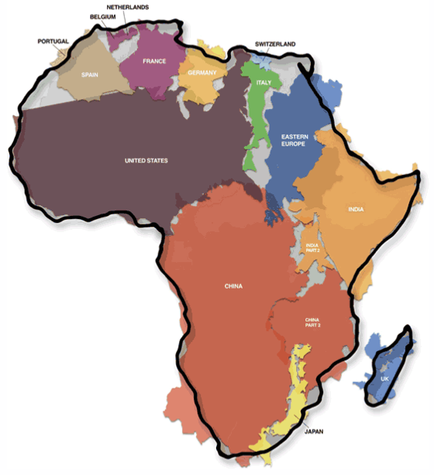
Most of Africa is near the equator, this distorts the size in a 2d projection.

Slide 3
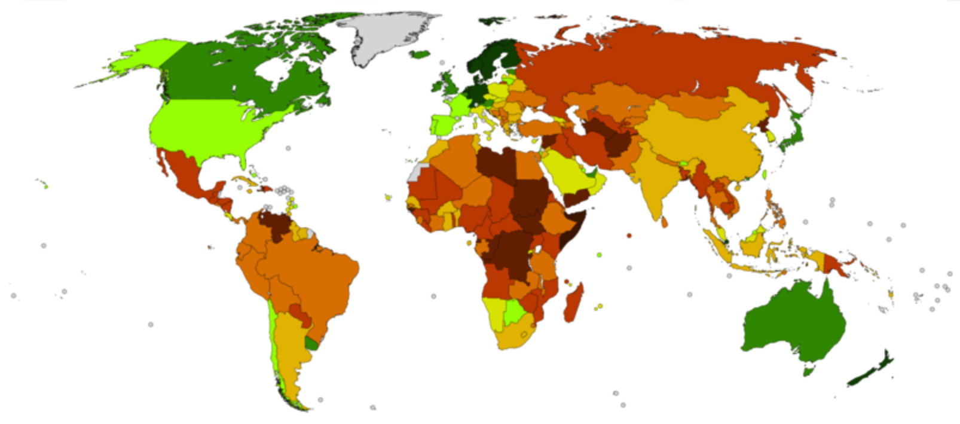
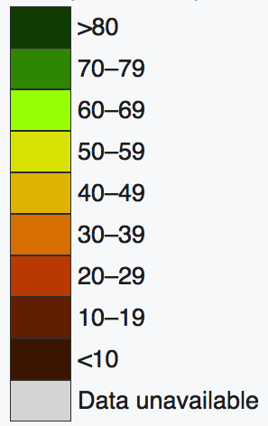
Corruption Index
"the misuse of public power for private benefit"
https://en.wikipedia.org/wiki/Corruption_Perceptions_Index

Slide 4
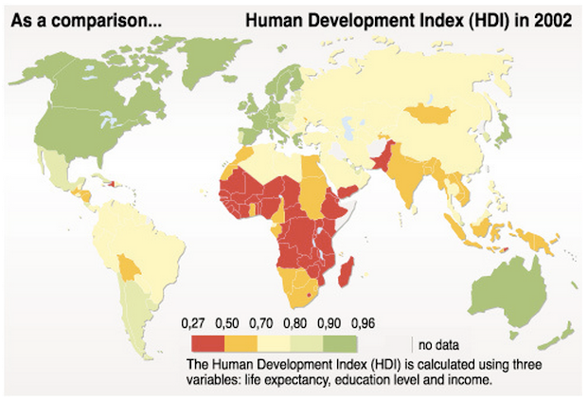
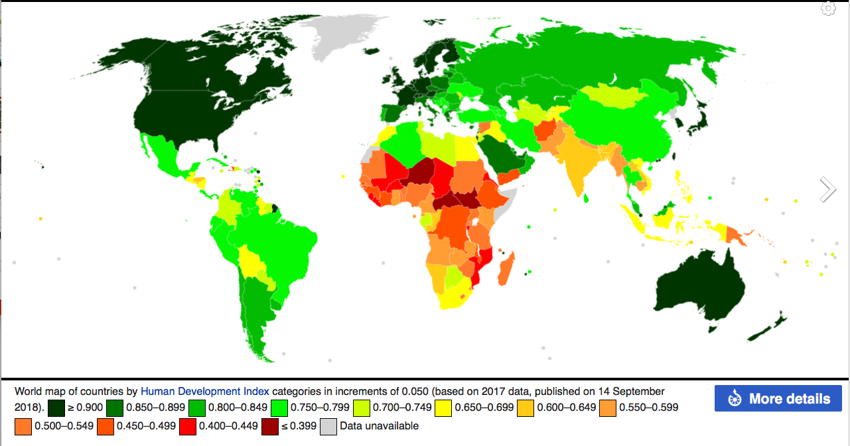
2020

Slide 5
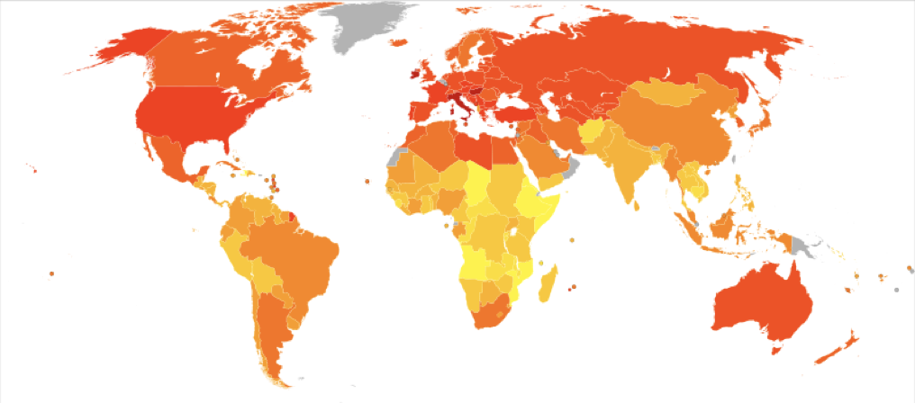
Energy Consumption in the World

Slide 6
% below $5.50/day
Poverty
2011
One cup of rice ~ $0.22
One cup of beans ~ $0.30
A wage of $2/day is a survival wage
Typically 12 hour work
7 days a week (Possibly 10 on Sunday)
% below $1.90/day

Slide 7
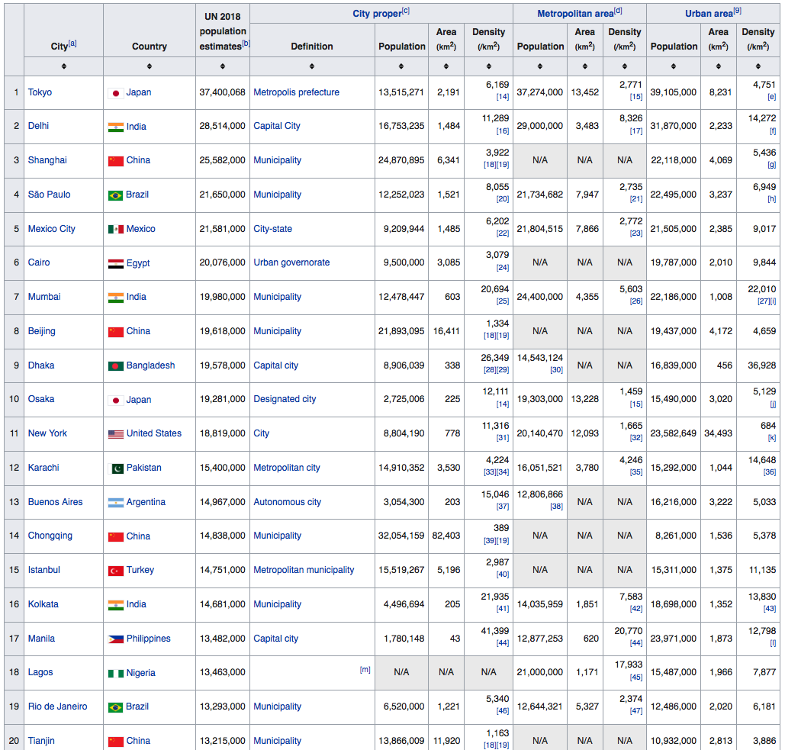
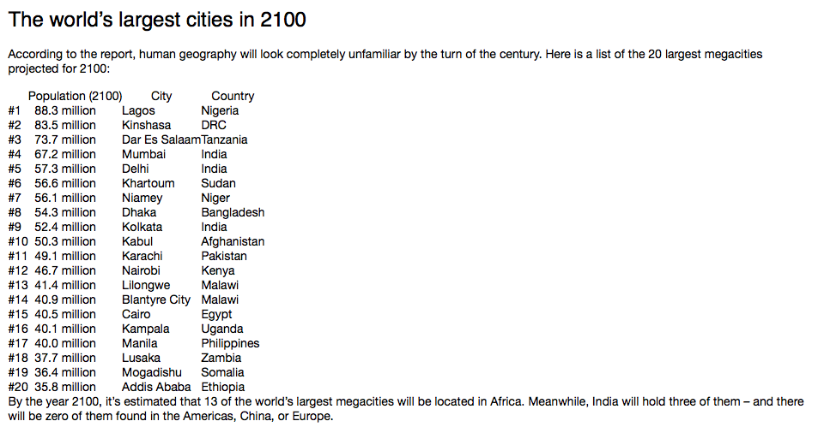
From 2018
2 in Africa
13 drop
None in US
None in China
None in Europe
13 in Africa

Slide 9
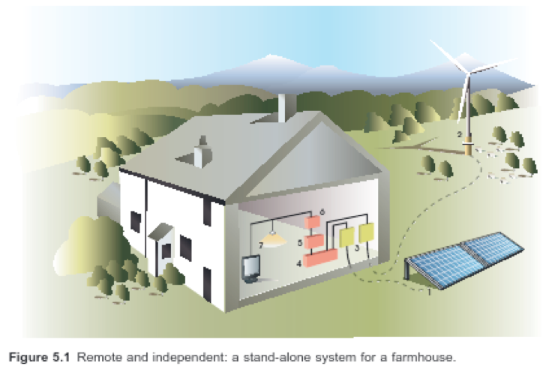
1) PV Panels
2) Other sources of Power: Wind Turbine, Diesel or Gasoline Generator, Hydropower
3) Charge Controllers
4) Battery Bank
5) AC Inverter/Direct DC systems
6) Fuse box(es)
7) Appliances/Loads

Slide 10
50 Solar Street Lights Installed in Village in 2015
Improved Design Installed in 2016 by DDIT Students and Faculty
(Commercialization was not followed through to date)

Slide 11
Power Ethiopia
-Photovoltaics are missing in Ethiopia
high import tariffs
no financing
architectural adaption
no technical support
aversion to new technology
no sales team
-Solve these issues using University Resources
manufacture (assemble) PV panels
train technologists/business people
profit for faculty and students
-HU/DDU area is unique for this opportunity

Slide 12
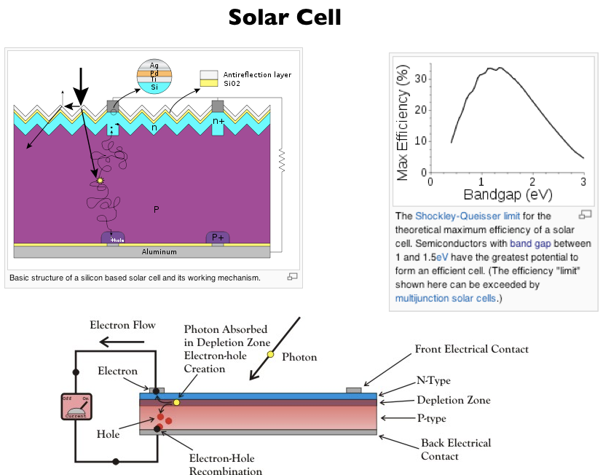

Slide 13
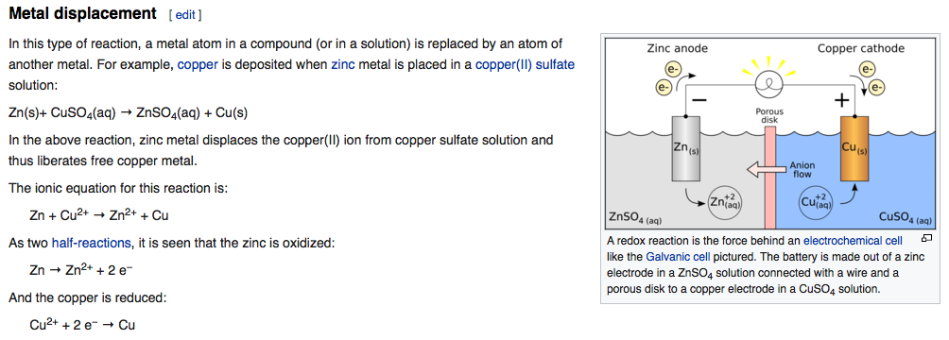
Oxidation/Reduction Metal Displacement Reaction
oxidation
reduction
1.10 Volts for each cell

Slide 14
Zinc Bromide Flow Cell

Slide 15
Comparing energy storage techniques
Luo, X., Wang, J., Dooner, M., Clarke, J., 2015. Appl. Energy.

Slide 16
Lithium ion battery
Intercalation reactions occur
Lithium-ions move into material lattices
Lithium ions shuttle back and forth
Graphite stores lithium when fully charged
Cathode accepts lithium during discharge

Slide 17
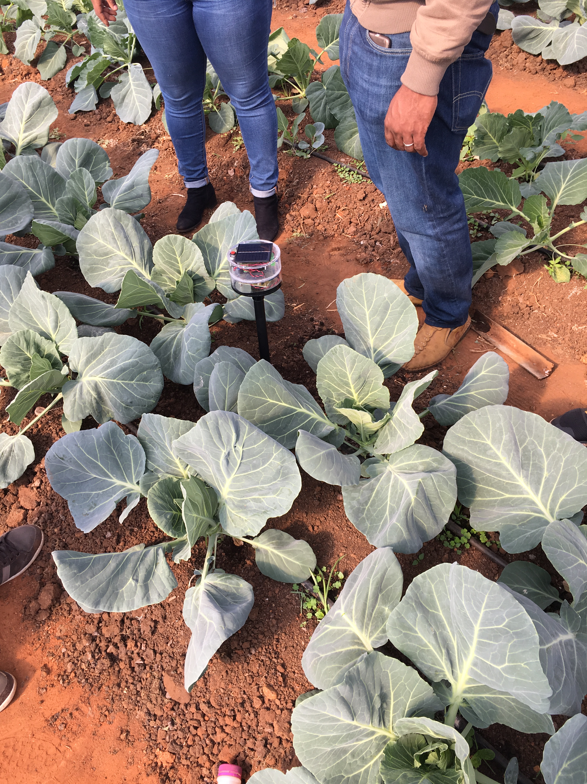
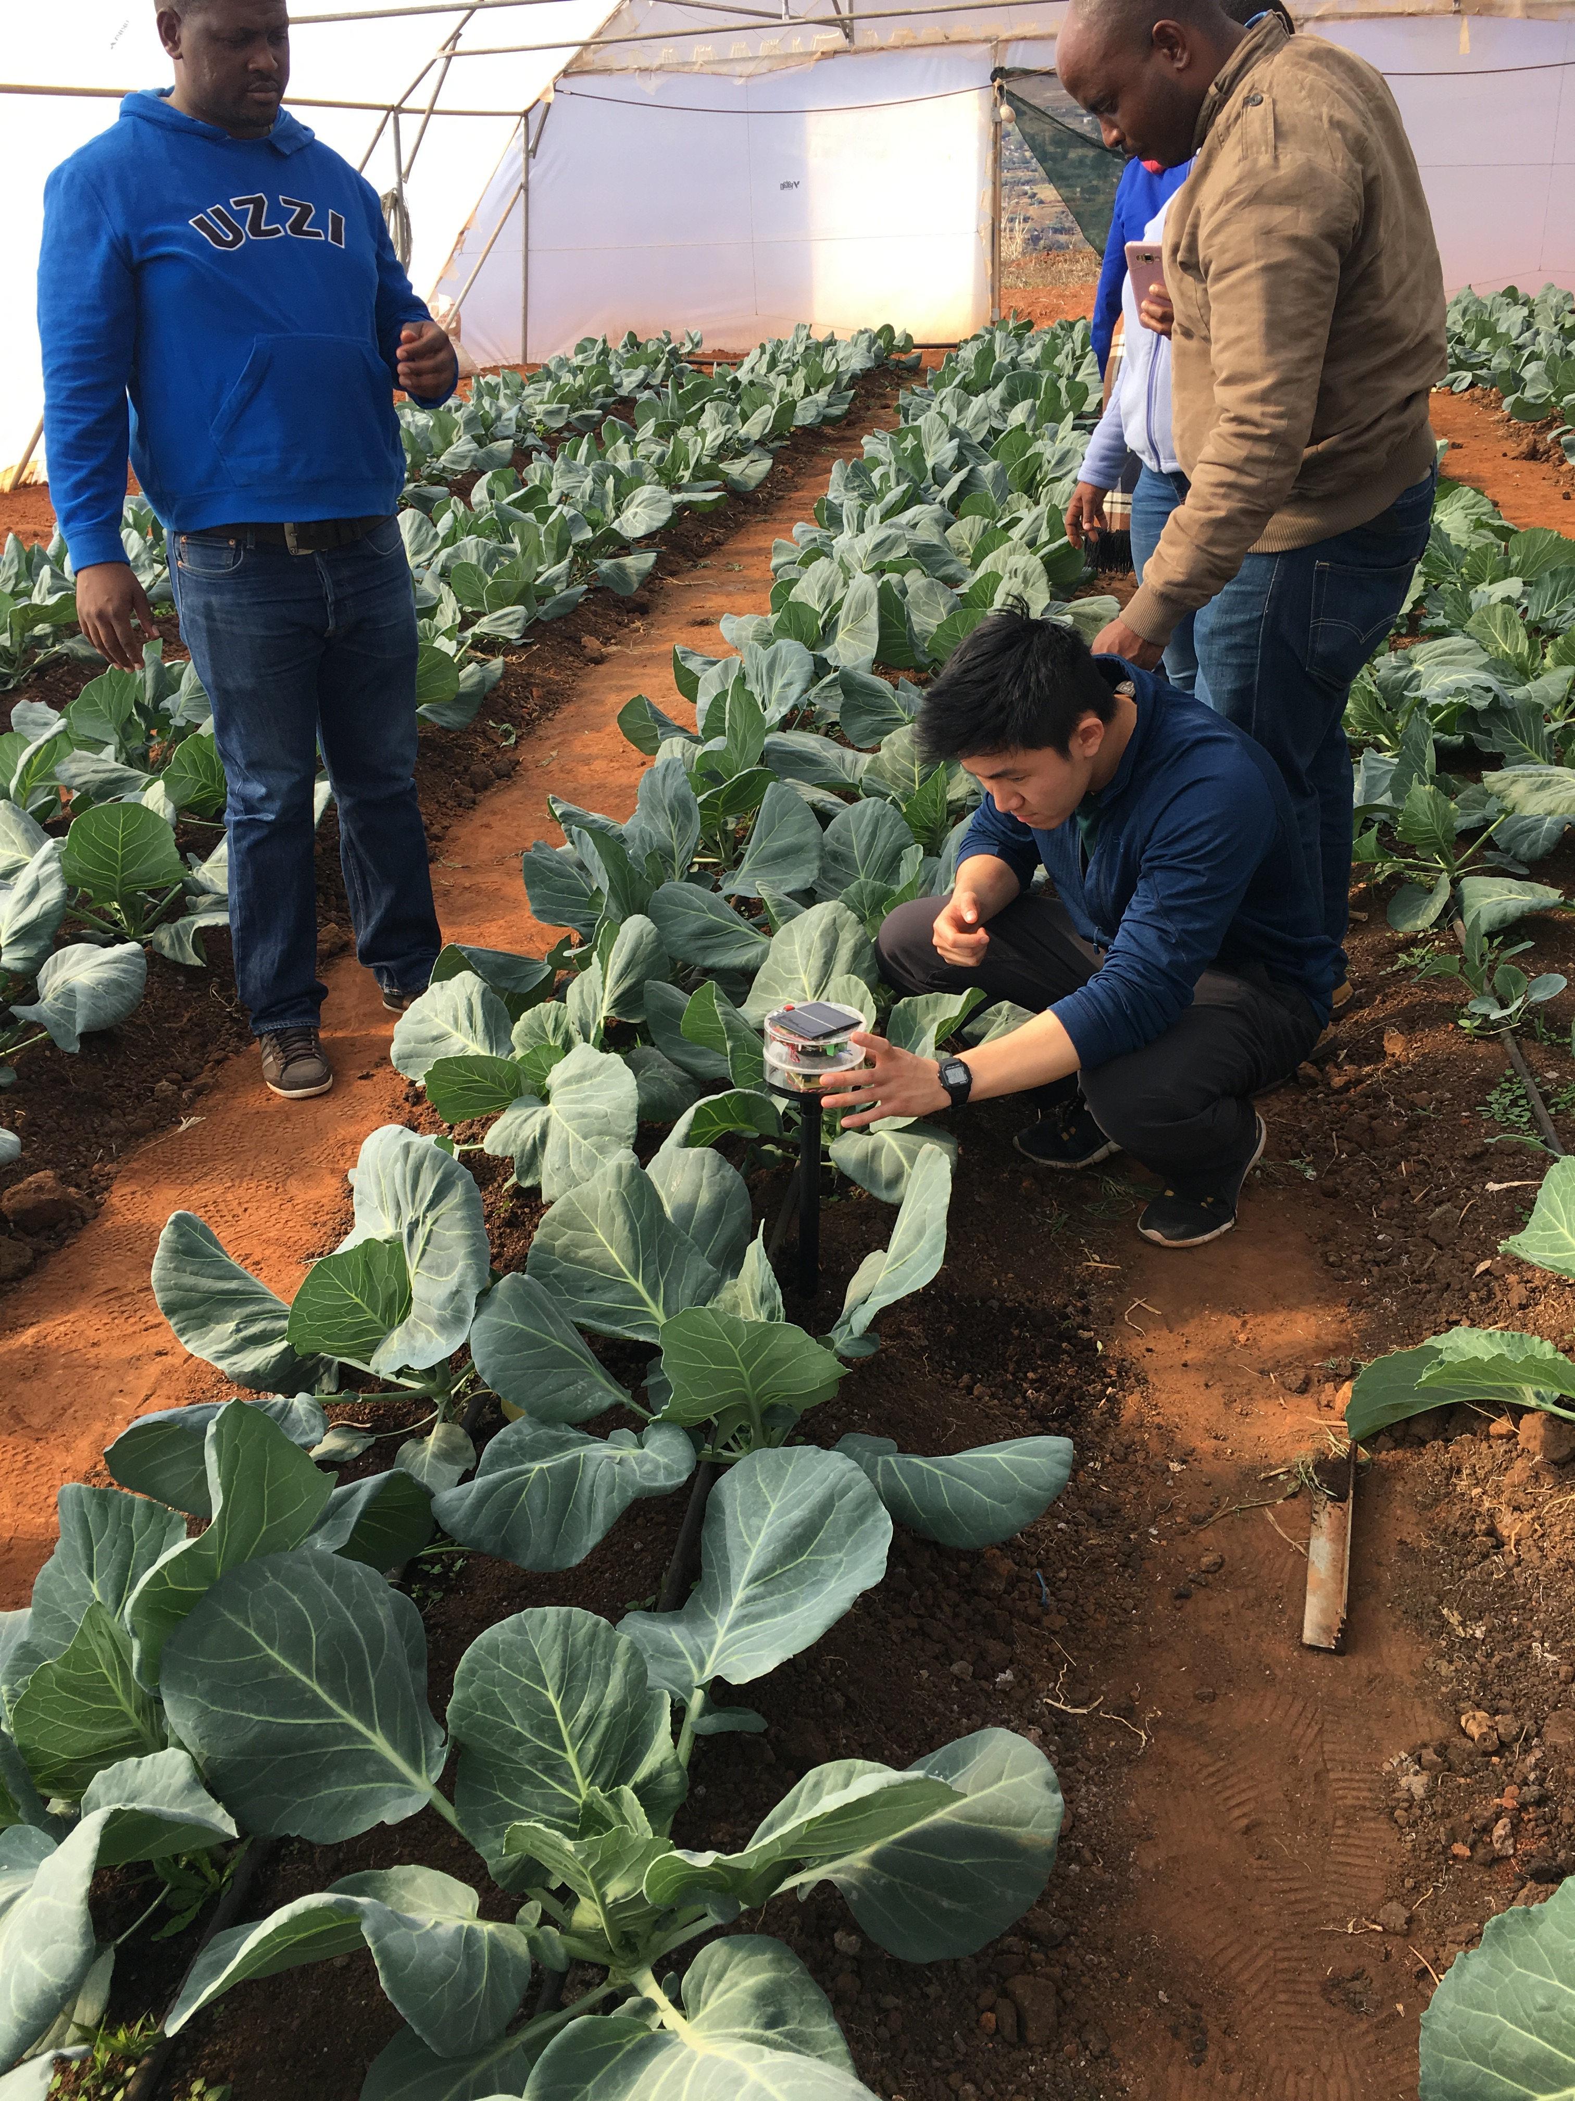

Slide 18
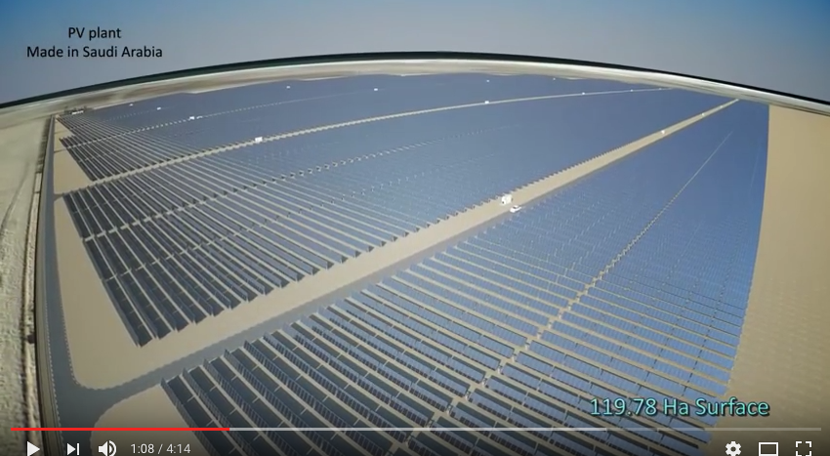
King Abdullah’s Desalinization Plant

Slide 19
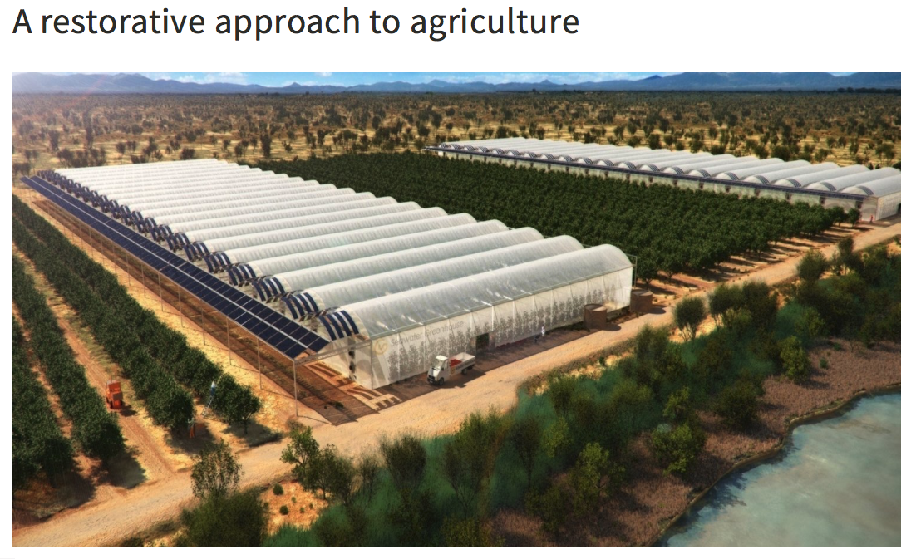
Seawatergreenhouse.com

Slide 20
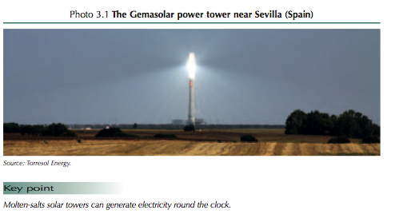

Slide 21
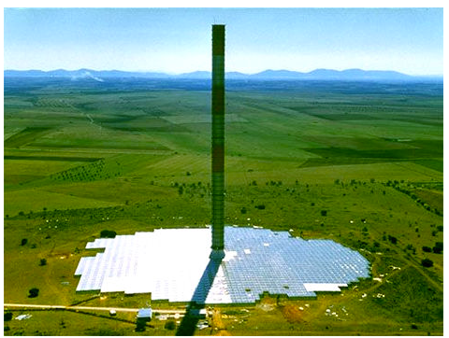
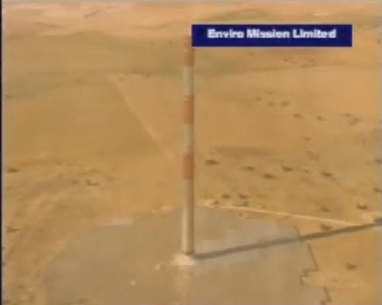
Solar Chimney’s
Enviromission (Australia)
http://www.enviromission.com.au/EVM/content/about_companyprofile.html
Solar Chimney Spain (Madrid)
http://www.youtube.com/watch?v=XCGVTYtJEFk

Slide 22
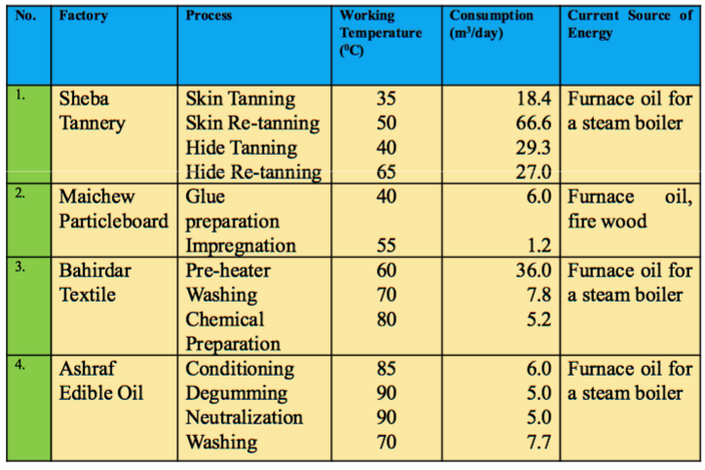
Industrial Solar Water Heating Mek’elle Ethiopia
http://www.solarthermalworld.org/sites/gstec/files/Kahsay_ISES%20Kassel.pdf

Slide 23
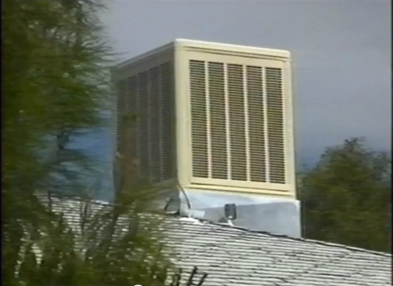
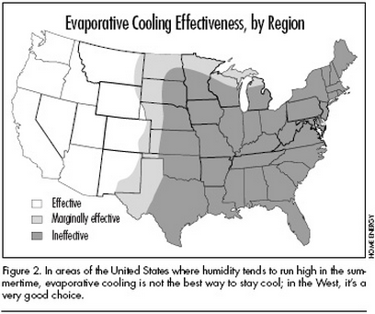
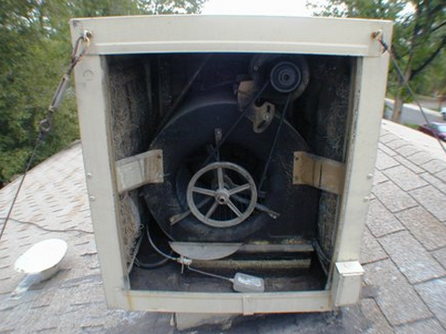
Swamp Cooler (http://www.youtube.com/watch?v=6ooAAcsbf_0)

Slide 24
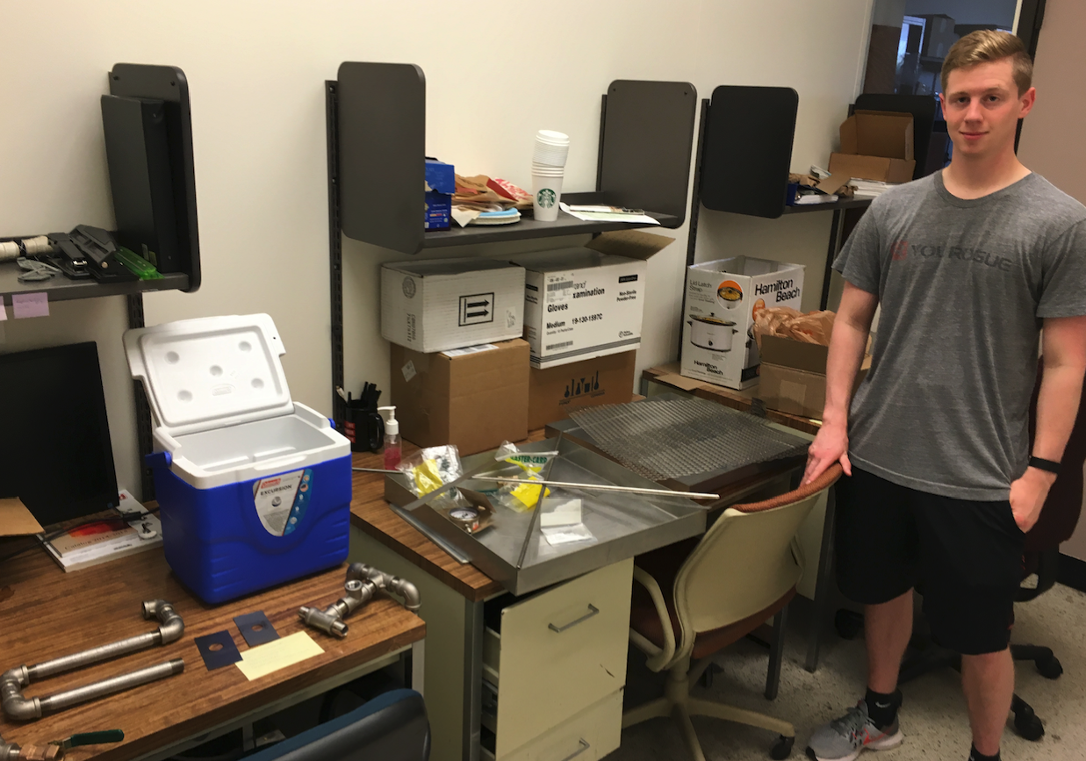
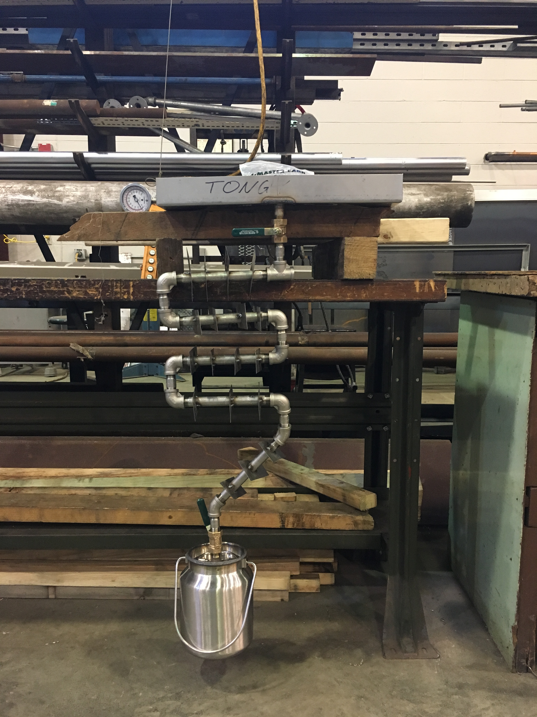
A Simple Solar Ice Maker (Anthony Tong/Amanda)
Methanol/Carbon Based Absorption Refrigerator/Ice Maker

Slide 25
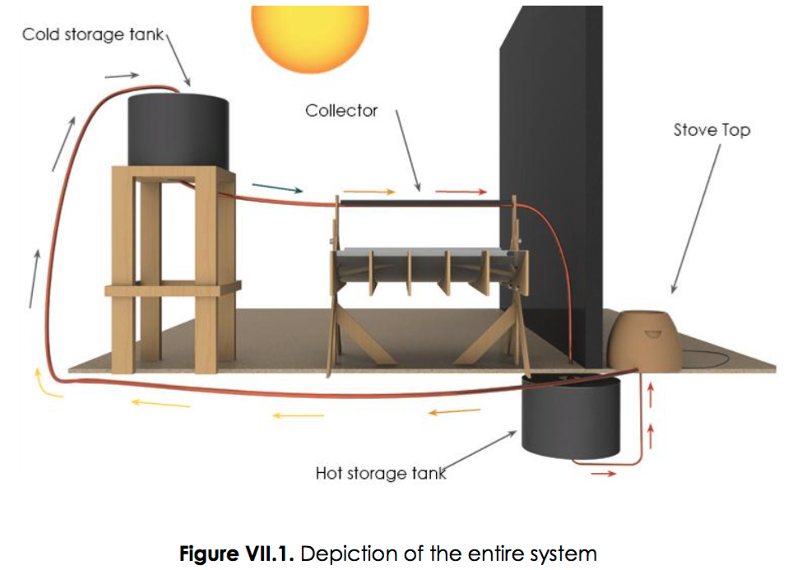
Georgia Tech
https://www.engineeringforchange.org/wp-content/uploads/2015/10/sol_r_final_report.pdf

Slide 26
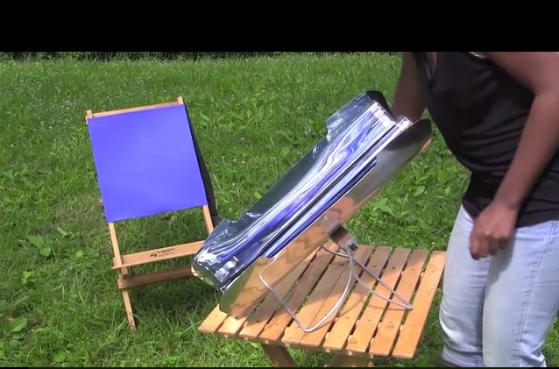
Go Sun Stove (http://www.kickstarter.com/projects/707808908/gosun-stove-portable-high-efficiency-solar-cooker)
Go Sun Fusion

Slide 27
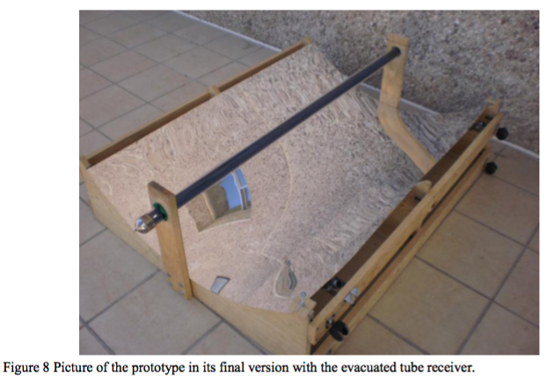
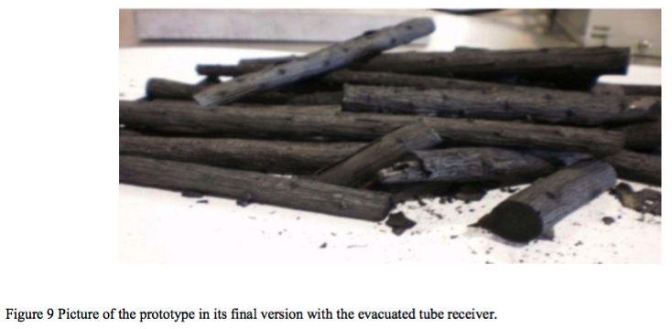

Slide 28
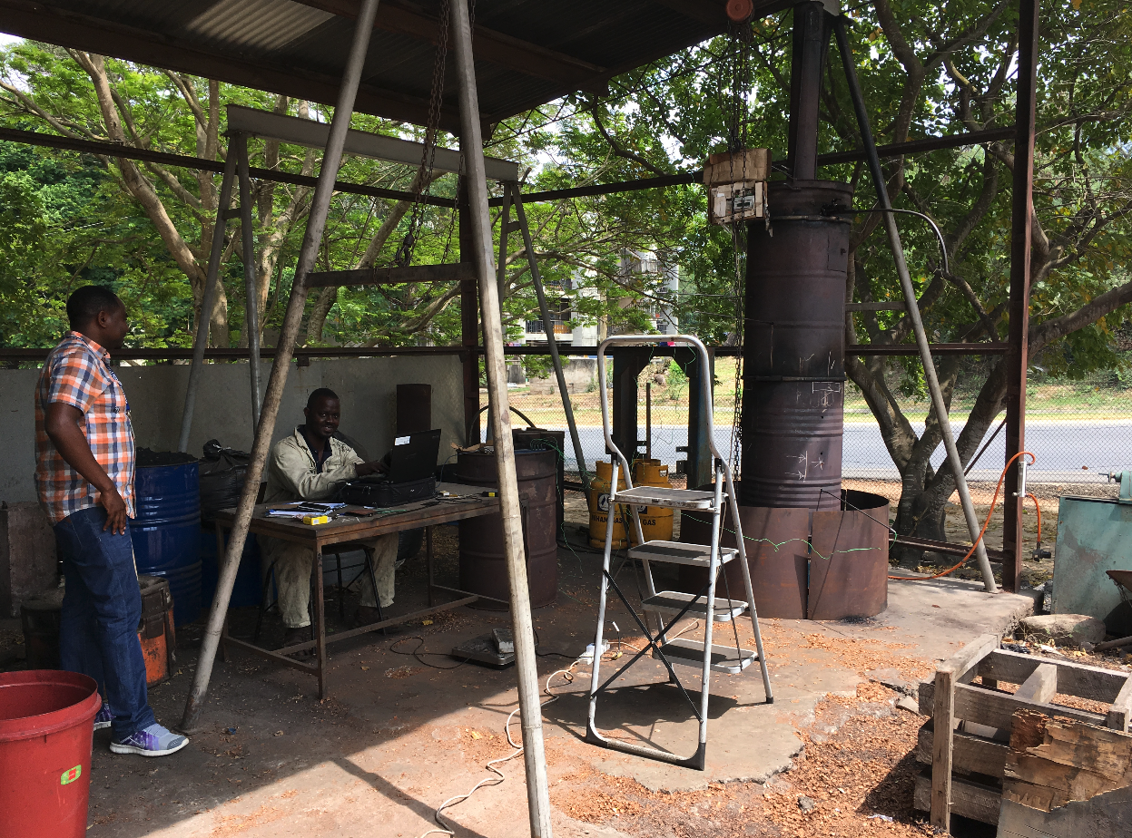

Slide 29
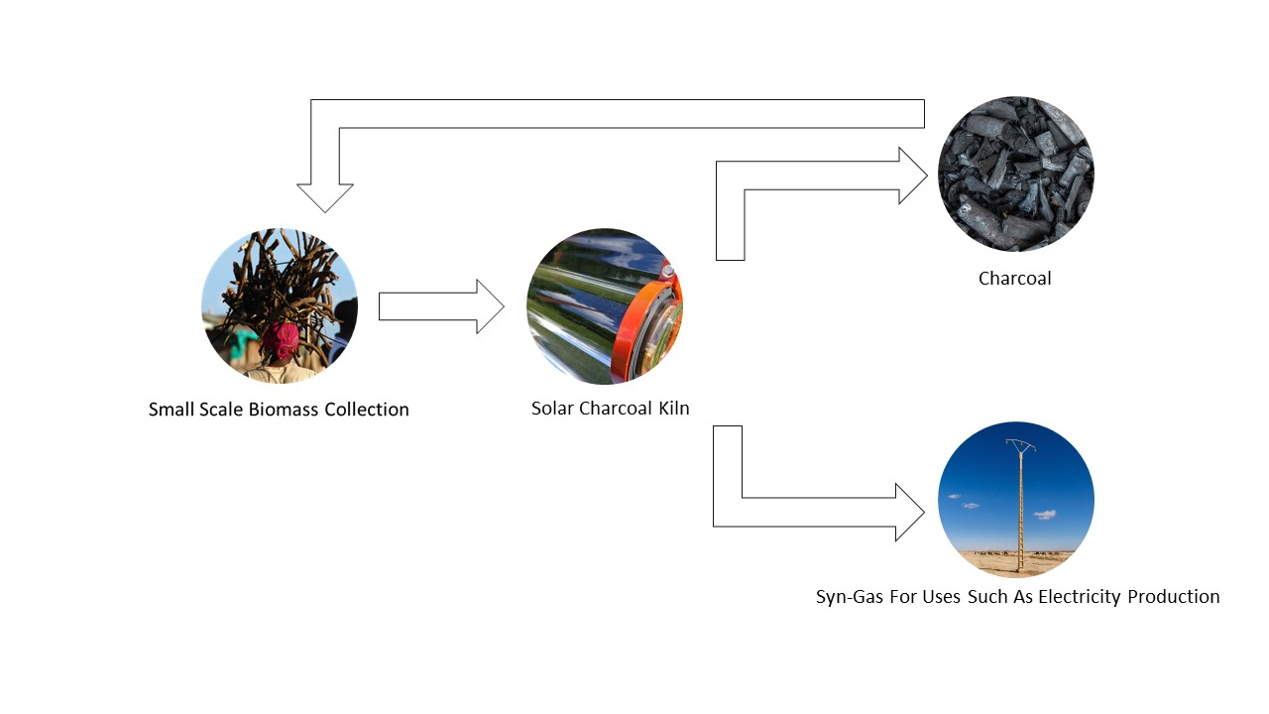
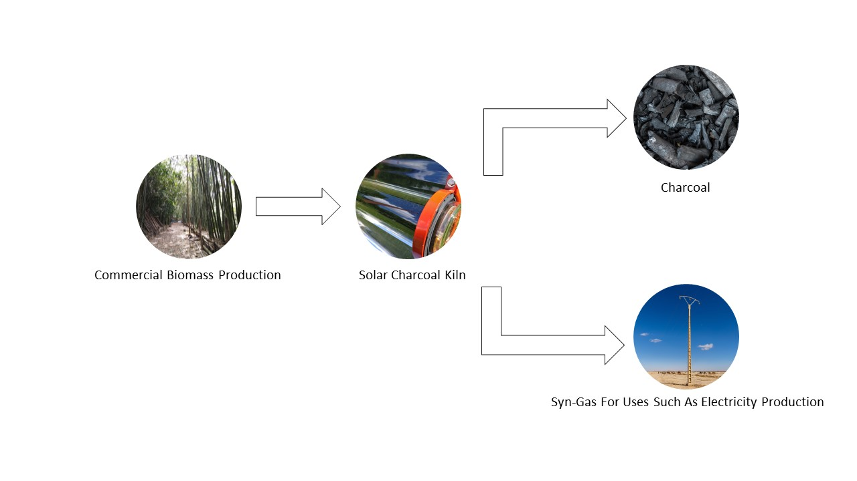

Slide 30
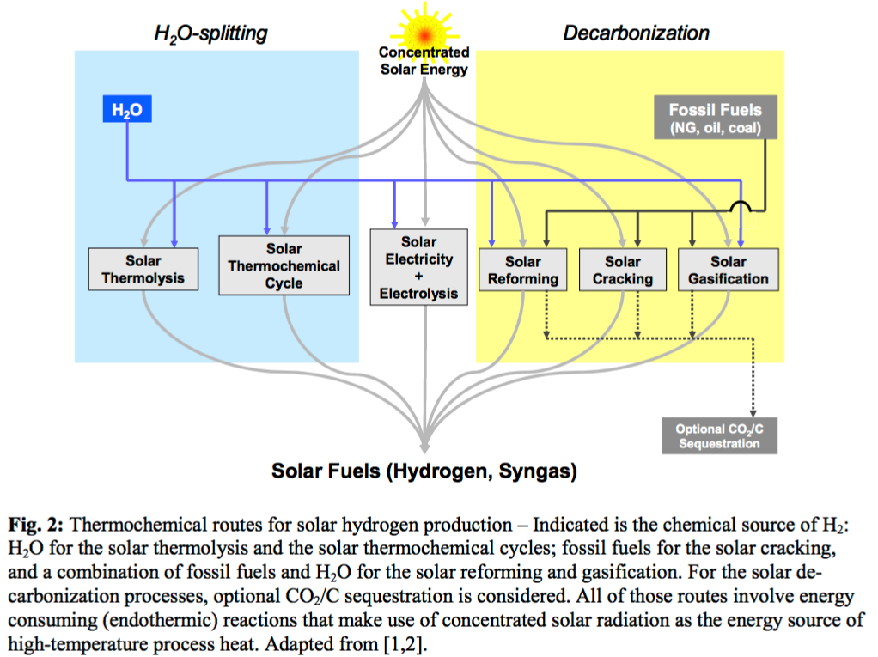

Slide 31
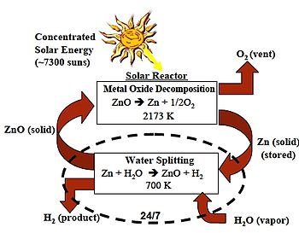
Zn => ZnO Cycle (http://en.wikipedia.org/wiki/Zinc%E2%80%93zinc_oxide_cycle)
UNLV (http://www.hydrogen.energy.gov/pdfs/review06/pd_10_weimer.pdf)
PSI/ETHZ (https://www.psi.ch/media/producing-pure-recycling-zinc-with-concentrated-solar-energy)
France Solar Furnace Talk (http://sfera.sollab.eu/downloads/Conferences/SolarPACES_2012_SFERA_Meier.pdf)

Slide 32
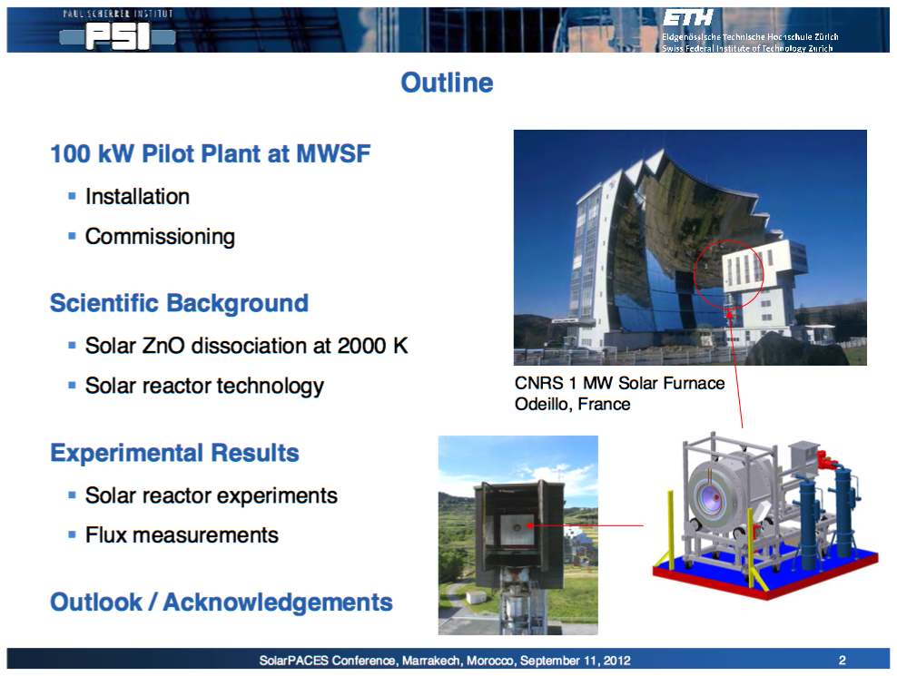
http://sfera.sollab.eu/downloads/Conferences/SolarPACES_2012_SFERA_Meier.pdf

Slide 33
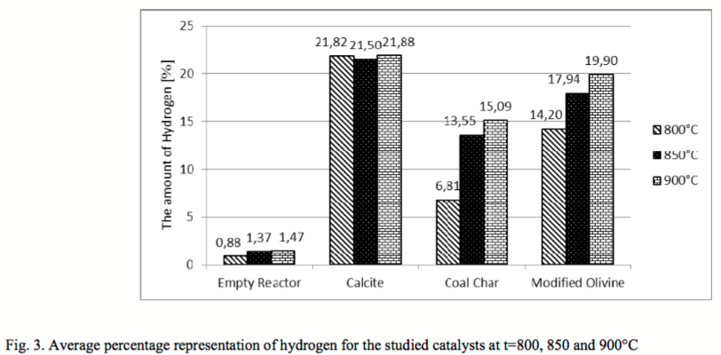
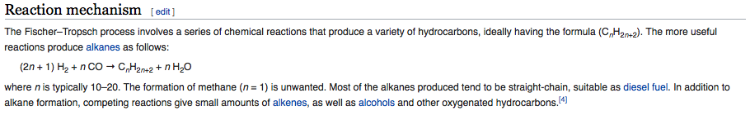
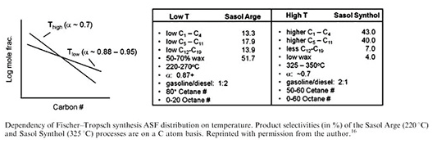
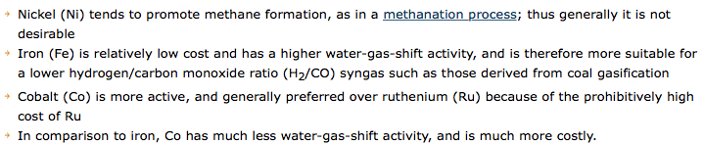
Biomass/Syngas
Steam Reforming Reaction: CH₄ to H₂ and CO
Water Shift Gas Reaction: CO to H₂
Fischer-Tropsch Reaction: H₂ and CO to Liquid Fuel

Slide 34
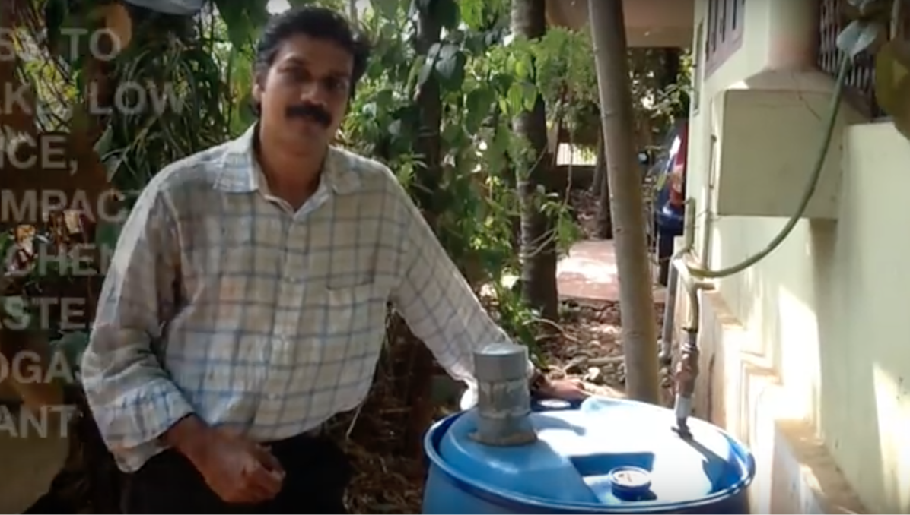
India Biogas Reactor (https://www.youtube.com/watch?v=9kKRdlAFuZw)

Slide 35
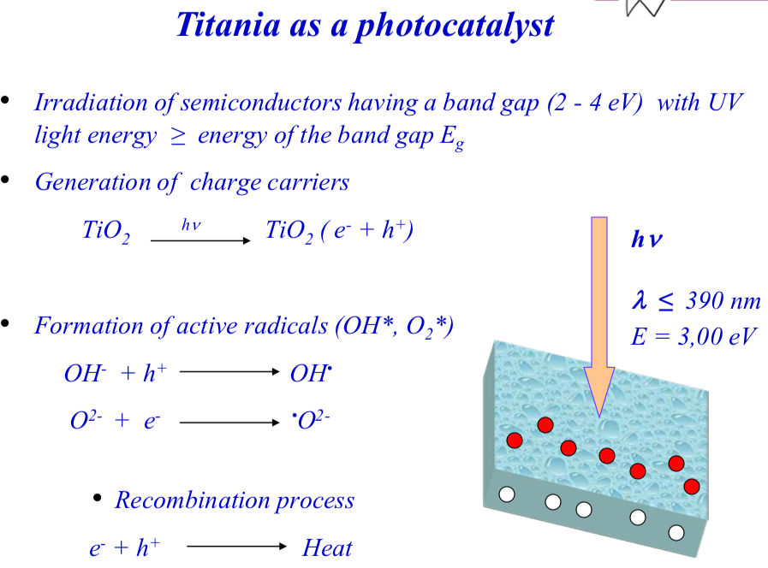

Slide 36
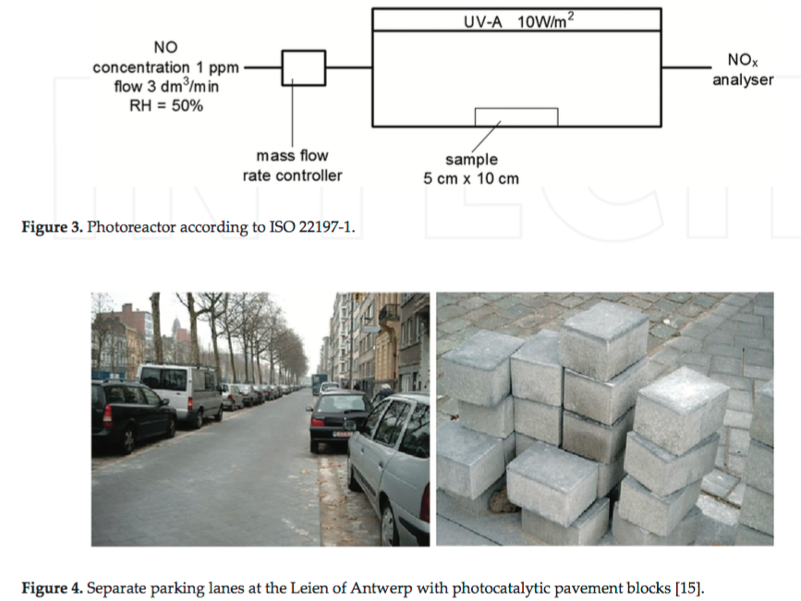
Solar Thermolysis
Titania as a photocatalyst

Slide 37
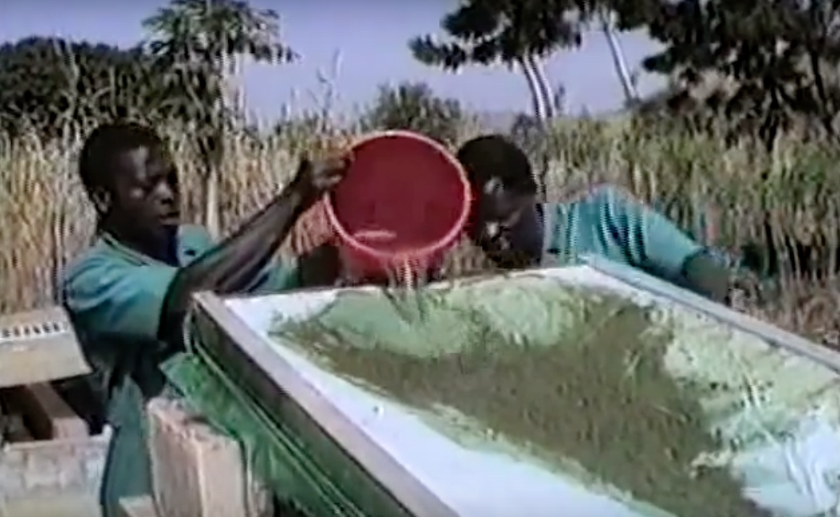
Spirulina Algae in West Africa (https://www.youtube.com/watch?v=CxSA5iiGgiY)
Algae:
Food
Diesel Fuel
Hydrogen

Slide 38
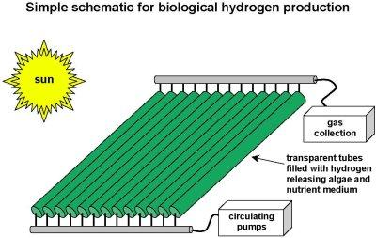
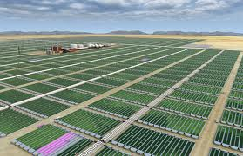
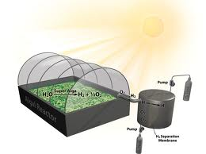

Slide 39
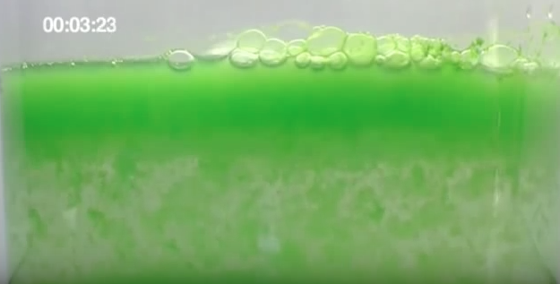
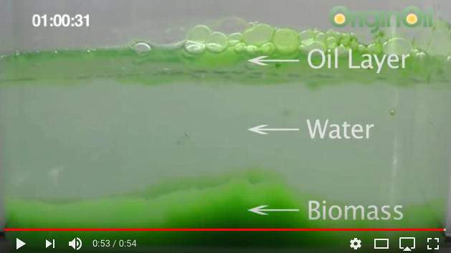
Algae oil extraction
https://www.youtube.com/watch?v=aEZTAJNIxjQ

Slide 40
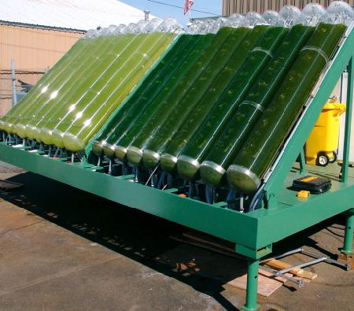
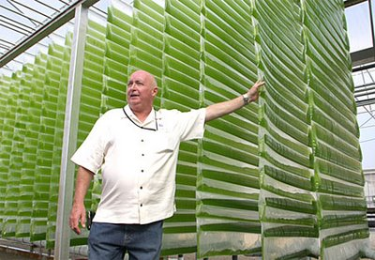
Algae Tower
CNET Algae Tower (http://www.youtube.com/watch?v=DXLy6E9iEnI)
NASA Algae Project (http://www.youtube.com/watch?v=c7Goyg12Reg)
Hydrogen from Algae (http://www.youtube.com/watch?v=Or_F6qC0sK4)
Hydrogen from Algae Imperial College
(https://www.youtube.com/watch?v=OFByDMRbucs)

Slide 41

Vertical Farming in Cincinnati

Slide 42
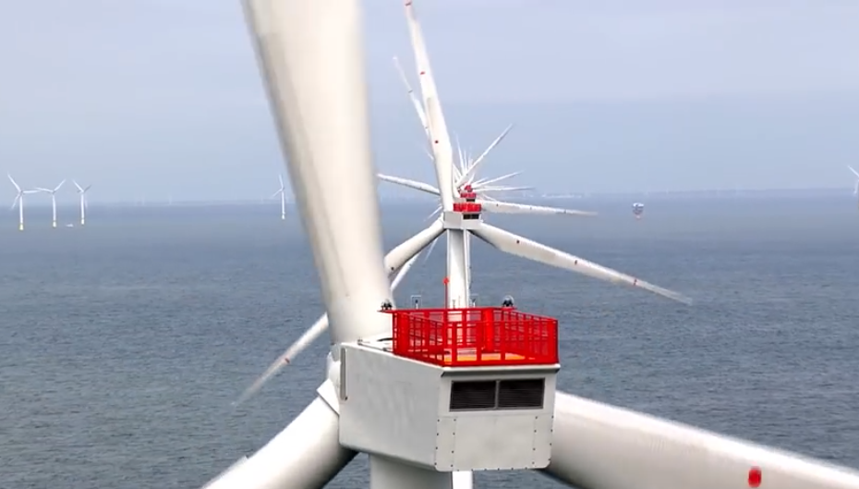
Offshore Wind Power
Wind Turbine Engineer

Slide 43
Course Summary Solar Power for Africa
Hopefully, you learned something about the situation faced by most people on earth, more than half live on less than $10 per day, 1 billion live on less than $1/day about 10%. Africa has the poorest countries so it could be a place to start.
We are technologists. Our skill set is technological solutions to economic development and improvement of quality of life. Hopefully you got some ideas on how this could be reasonably implemented.
China thinks that the future is in Africa as evidenced by their investment $110 billion in 2019 or 20% of Africa’s economic growth. We should consider the business opportunities especially those that could benefit both parties in a partnership.

