Slide 1
US Energy Trends and Electrical Grid Challenges
October 2023
Sean Behm, Environmental & Chemistry Manager

Slide 2
Discussion Topics
Electrical Grid Overview
  Local Transmission Infrastructure & Generation
  Robustness & Fragility –
    June15, 2022 AEP Columbus Incident
    2023 Winter Storm Elliot
    Challenges in CA & TX
Energy Transition in PJM
Energy & Electricity Trends (EIA) [If time]
Ohio Deregulation & Consumer Choice

Slide 3
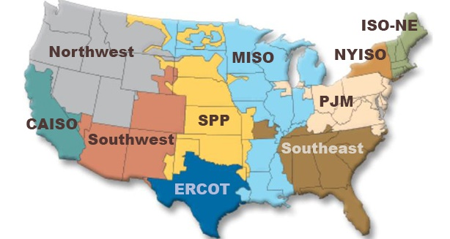
Market Information
PJM (Pennsylvania, New Jersey, and Maryland)
  As the primary task, to ensure the safety, reliability and security of the bulk electric power system.
  Create and operate robust, competitive and non-discriminatory electric power markets.
  Understand customer needs and deliver valued service to meet those needs in a cost-efficient manner.

Slide 4
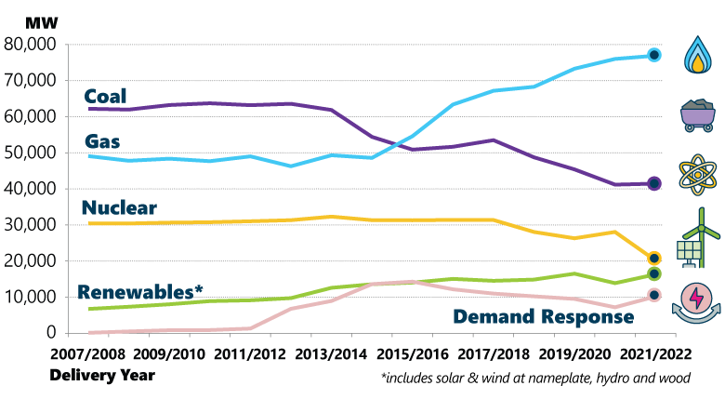
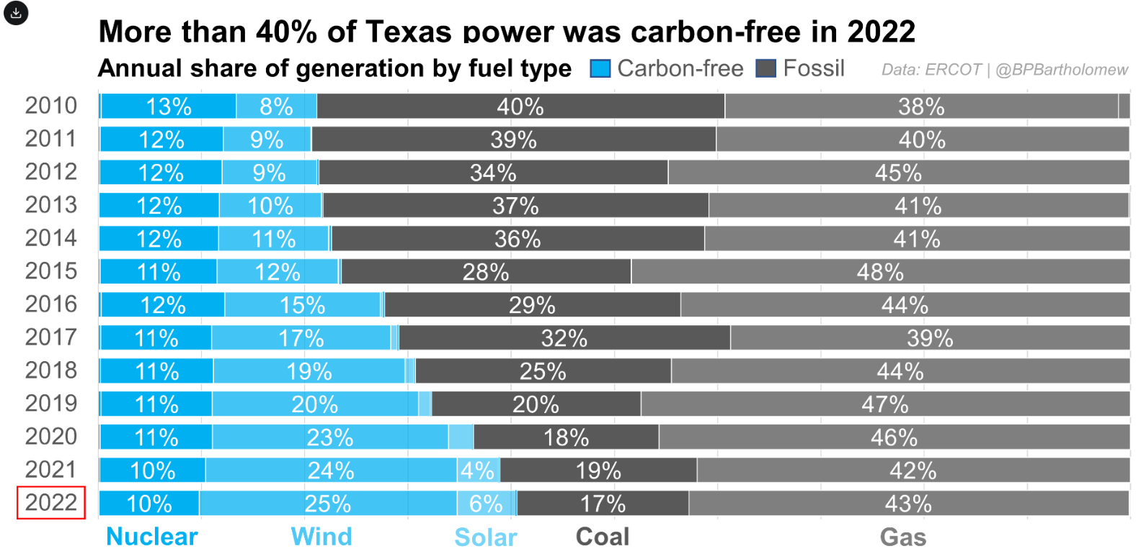
Energy Mix
PJM
ERCOT

Slide 5
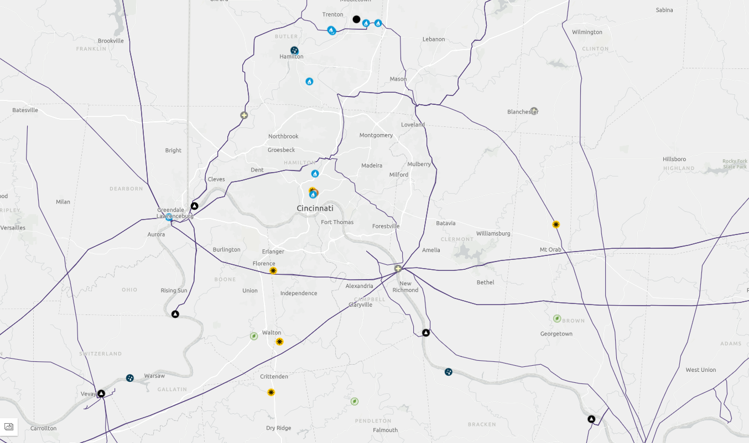
Electric Grid & Generation – Cincinnati - 345 kV
Source: atlas.eia.gov

Slide 6
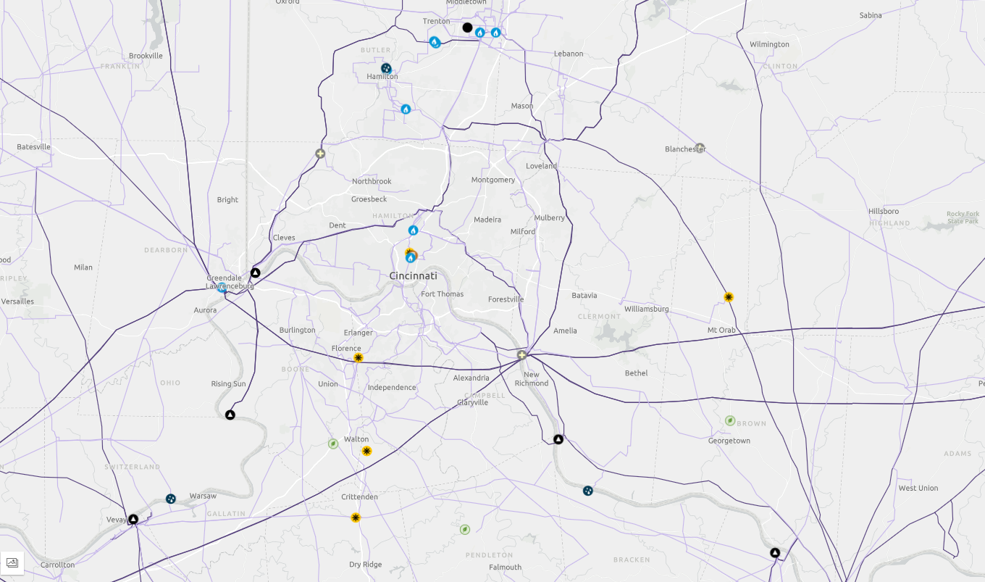
Electric Grid & Generation – Cincinnati – 69 kV+
Source: atlas.eia.gov

Slide 7
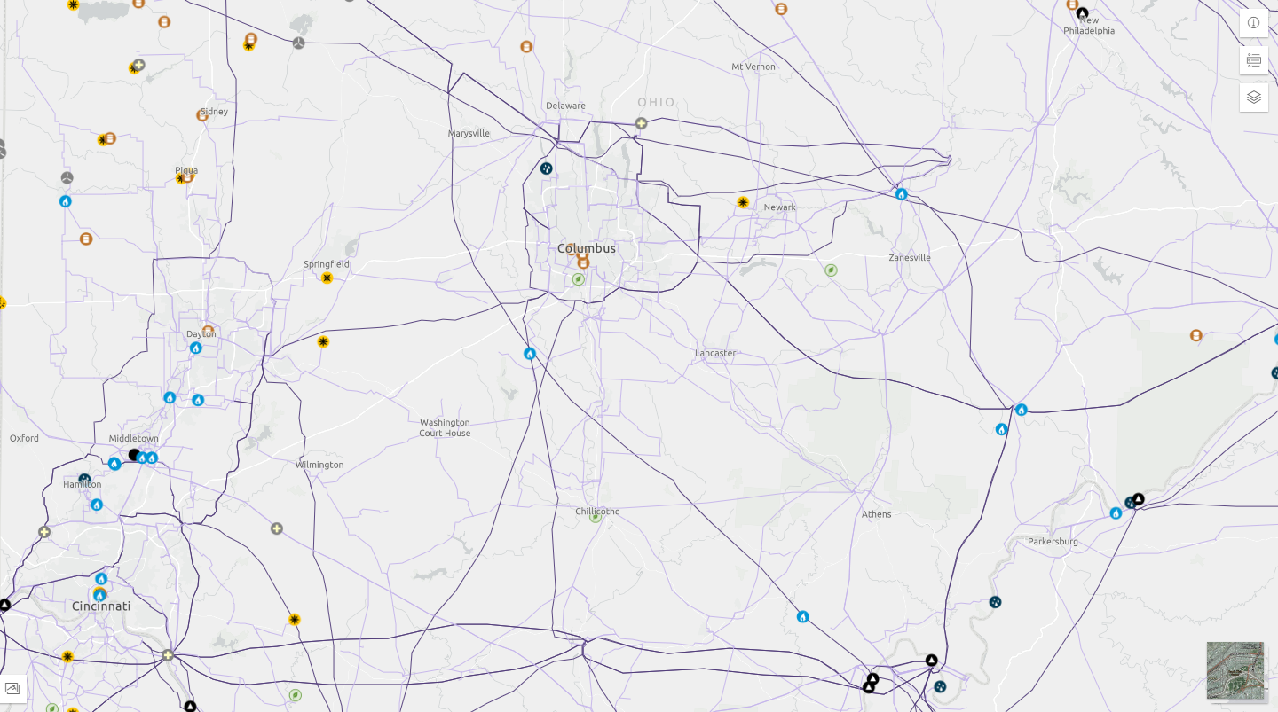
Electric Grid & Generation – Columbus – 69 kV+
Source: atlas.eia.gov

Slide 8
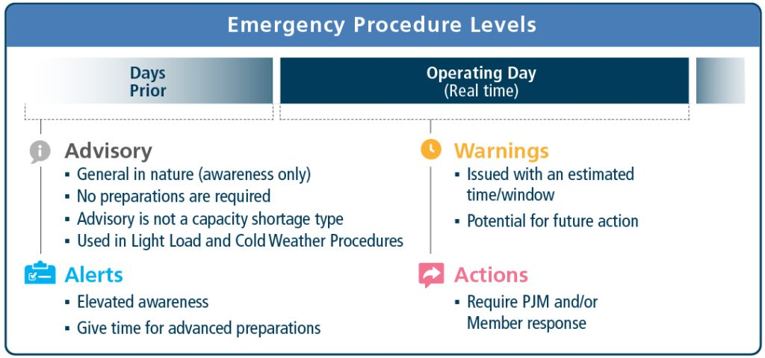
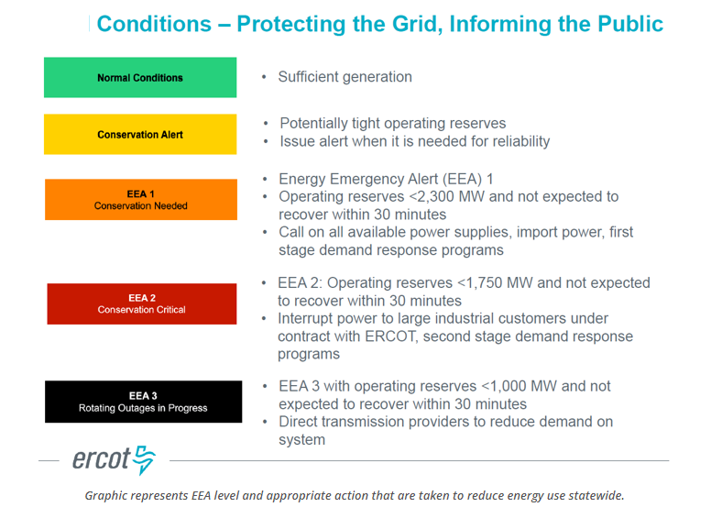
Emergency Alert Levels

Slide 9
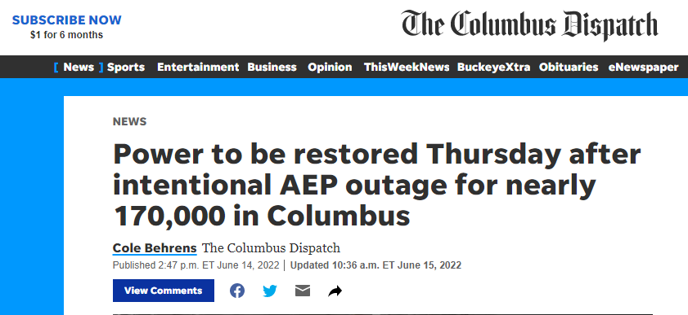
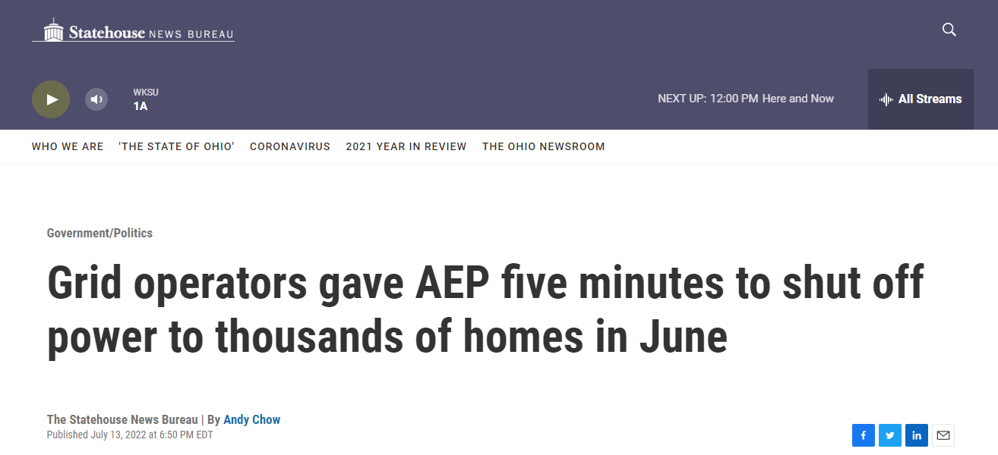
News Articles regarding Columbus June Outages

Slide 10
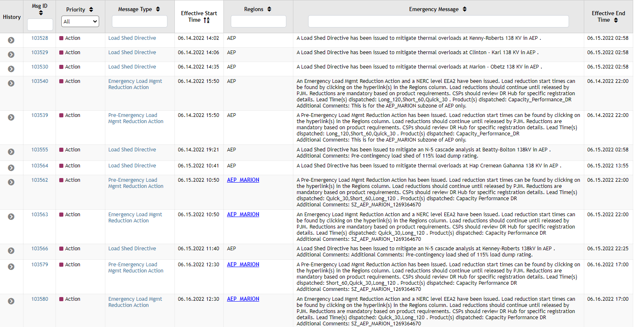
June 13-16th Event – PJM - AEP Load Zone - Columbus
Source: emergencyprocedures.pjm.com

Slide 11
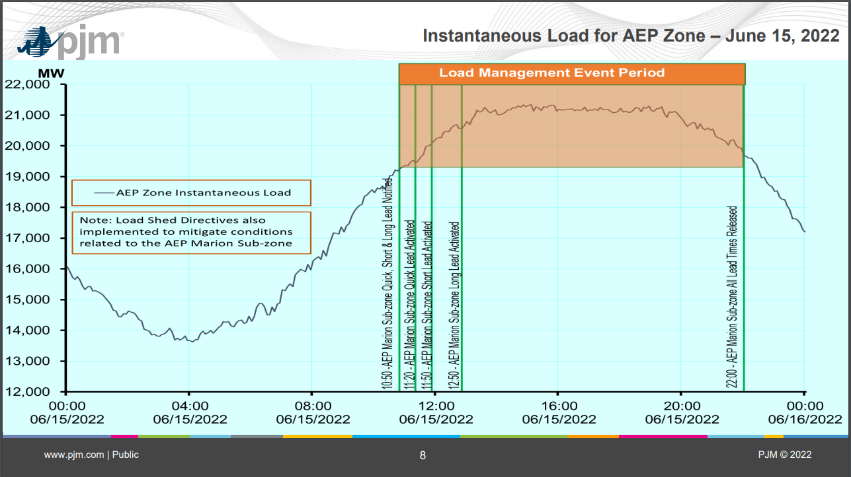
https://www.pjm.com/-/media/markets-ops/demand-response/estimated-demand-response-june-14-15-16-2022.ashx

Slide 12
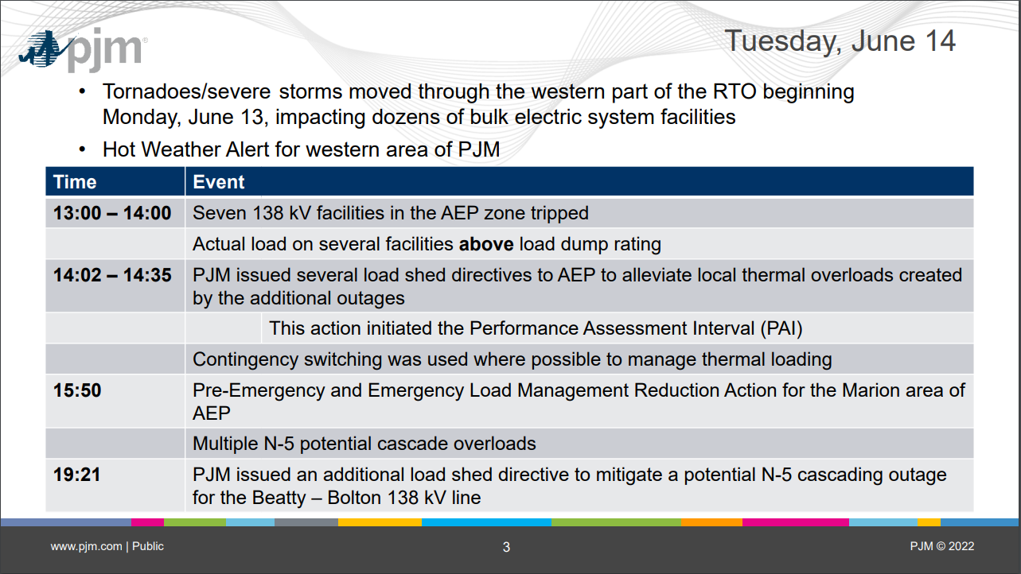
www.pjm.com/-/media/committees-groups/committees/oc/2022/20220714/item-03---june-14-16-operations-review.ashx

Slide 13
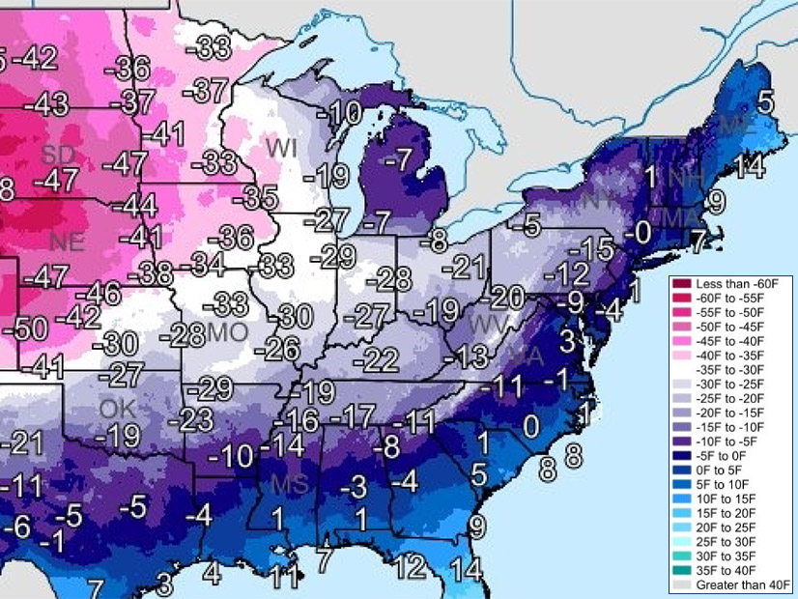
2022 Winter Storm Elliott – 12/23 – 12/26
https://www.rtoinsider.com/32027-pjm-seeks-settlement-elliott-nonperformance-penalties/

Slide 14
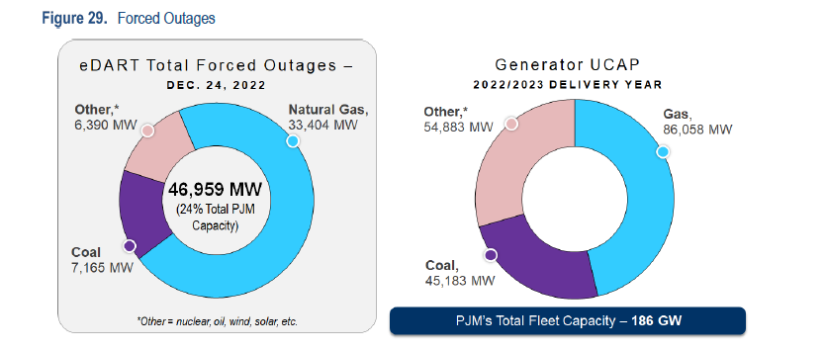
PJM Capacity & Forced Outages – 12/24/22

Slide 15
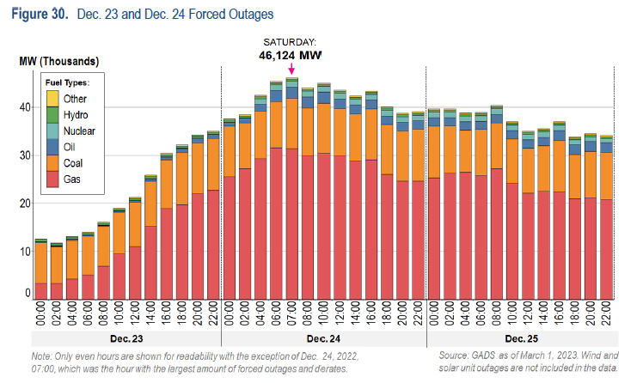
Forced Outages by Tech

Slide 16
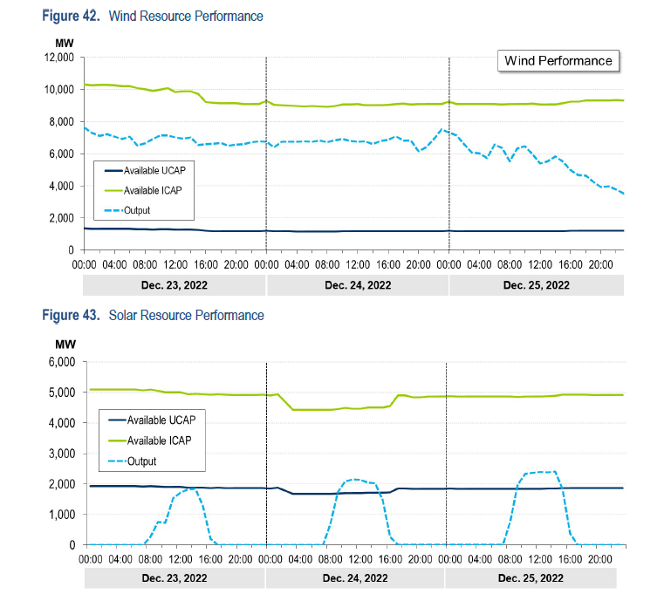
Renewables Performance

Slide 17
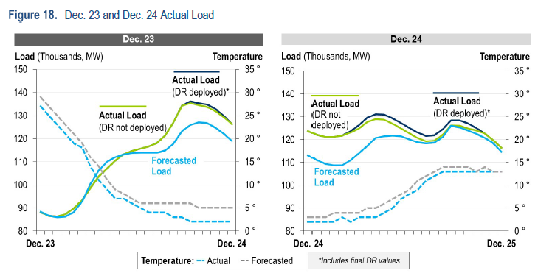
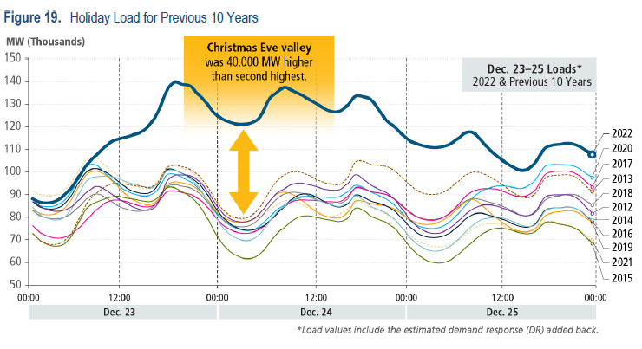
Load Forecasting Challenges

Slide 18
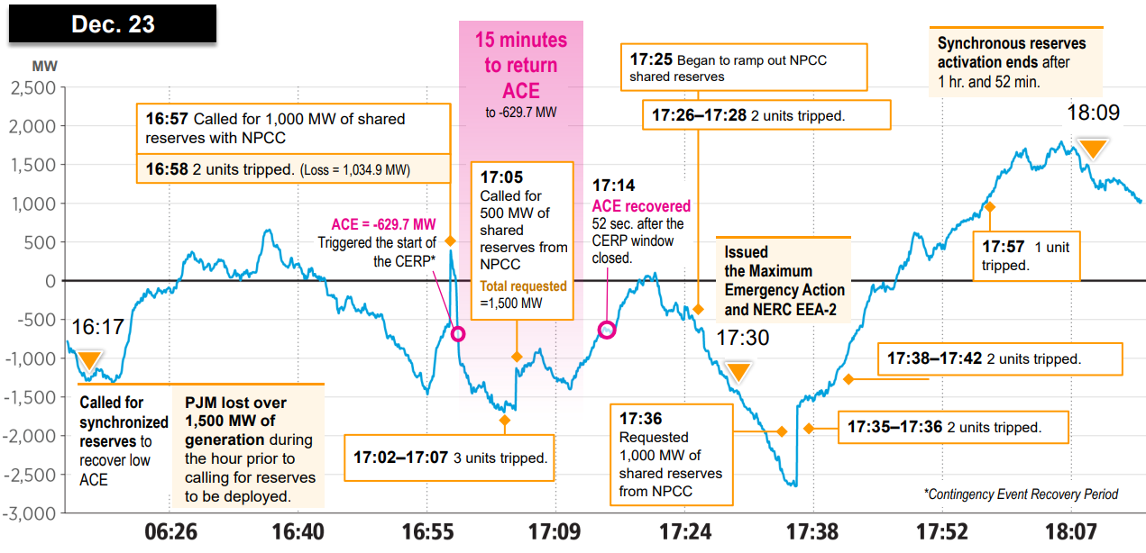
Synchronized Reserves

Slide 19
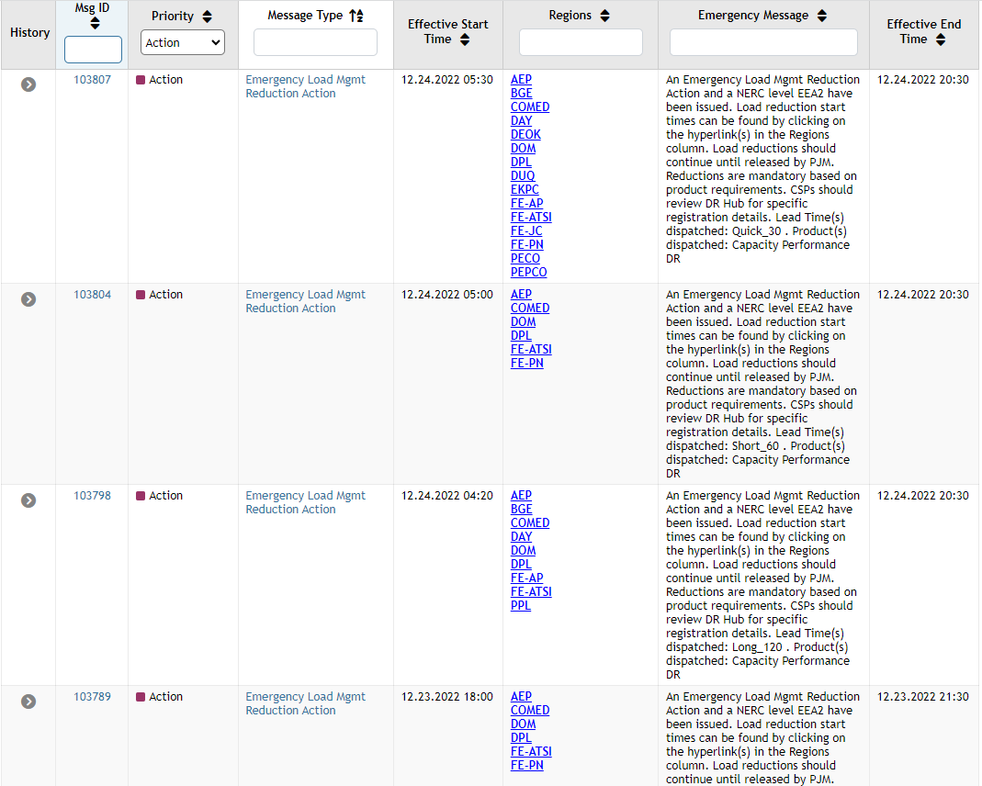
Demand Response

Slide 20
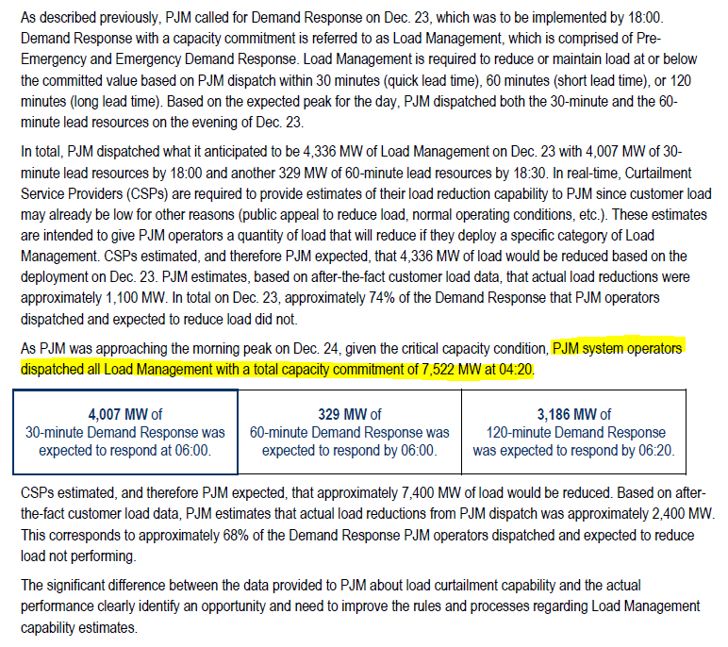
Demand Response

Slide 21
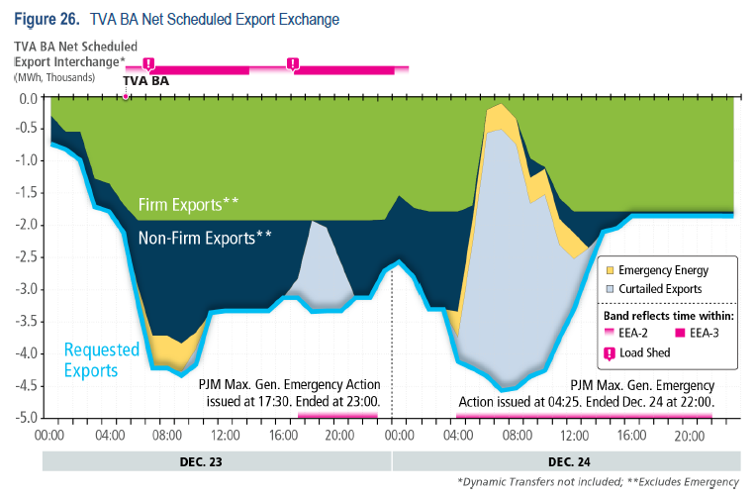
Effects on Energy Exports

Slide 22
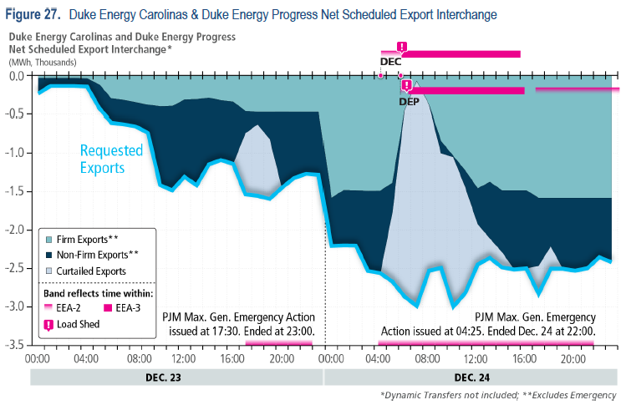
Effects on Energy Exports

Slide 23
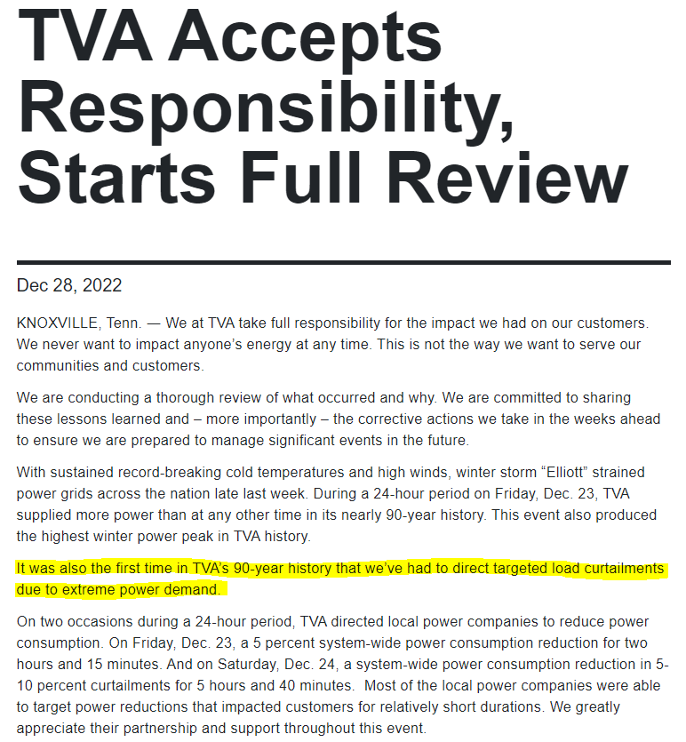
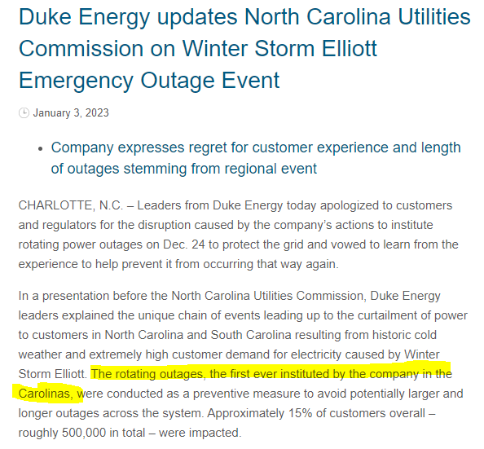

Slide 24
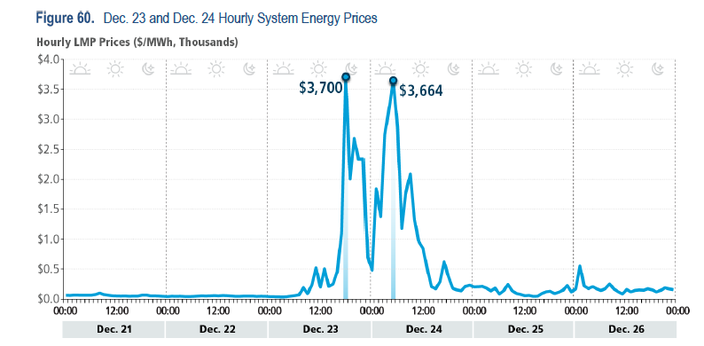
Financial Impacts – Energy Prices

Slide 25
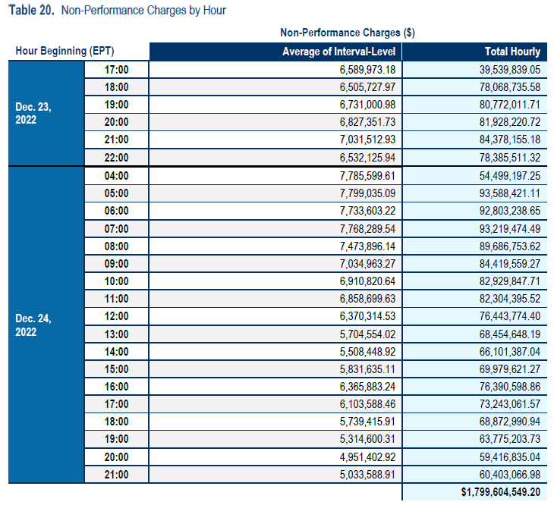
Financial Impacts – Capacity Penalties

Slide 26
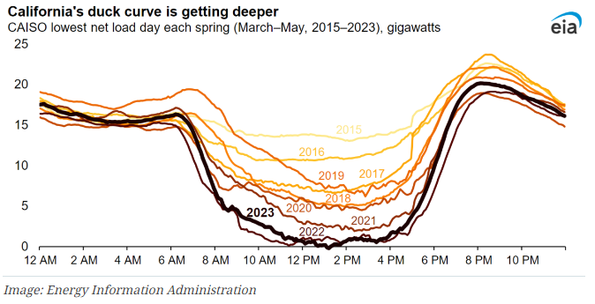
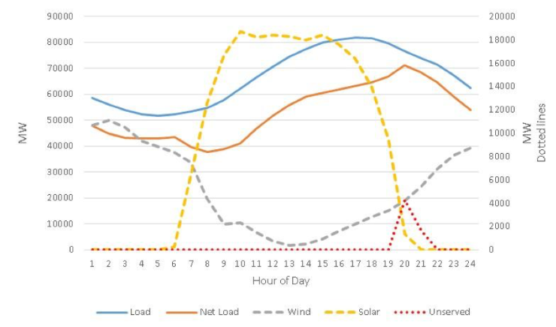
Solar Challenges – Evening Load Ramp

Slide 27
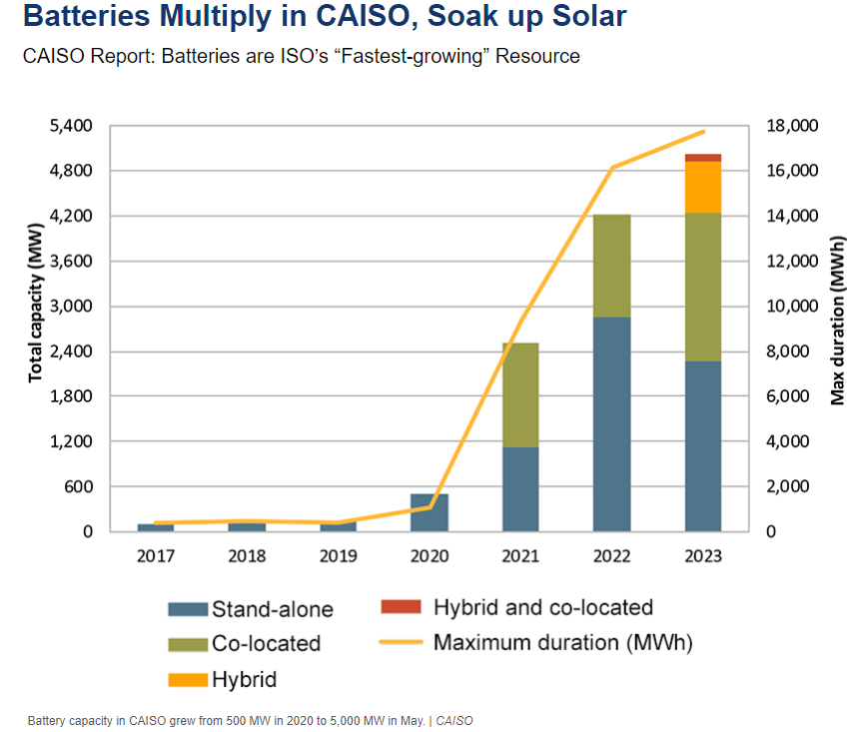
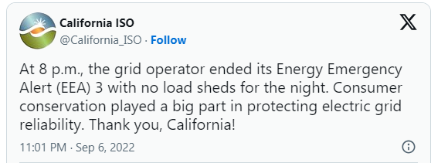
Hot Weather & Generation Challenges

Slide 28
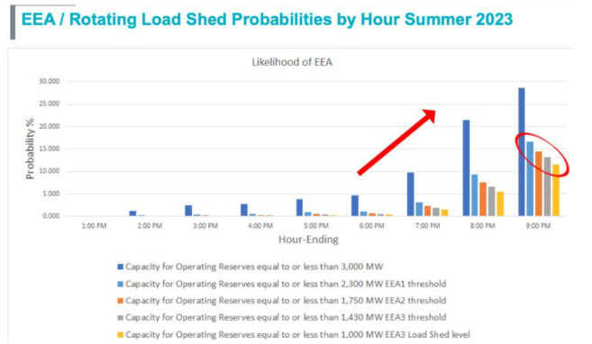
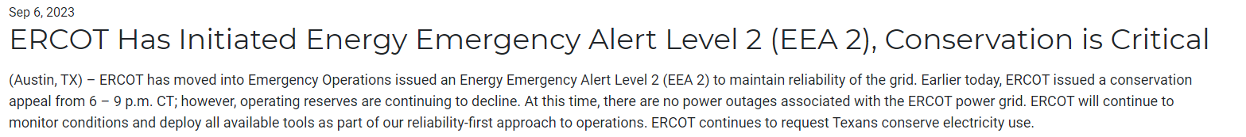

Slide 29

‘Energy Transition in PJM’ - Highlights

Slide 30
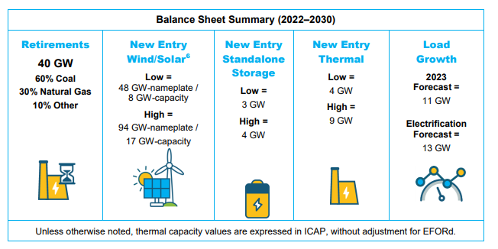
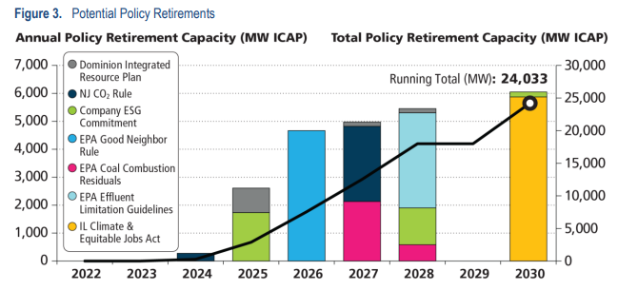

Slide 31
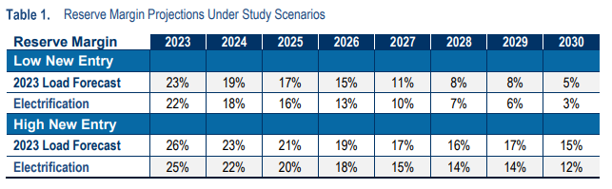
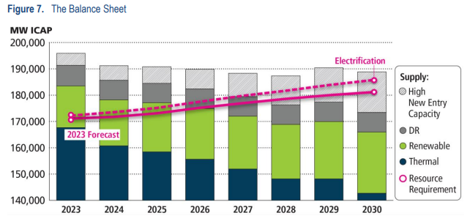
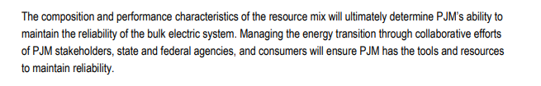

Slide 32
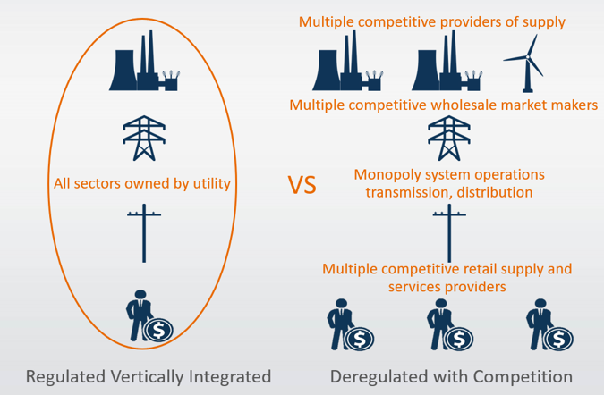
Ohio Energy Choice
Ohio electricity & natural gas supply became deregulated in 1999
  Kentucky, Indiana, West Virginia still regulated utilities
https://www.energyknowledgebase.com/topics/deregulation-electricity.asp

Slide 33
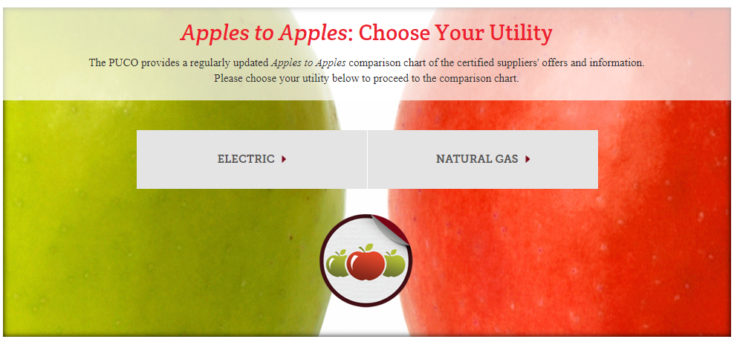
Ohio Energy Choice – ‘Apples to Apples’
https://energychoice.ohio.gov/applestoapples.aspx

Slide 34
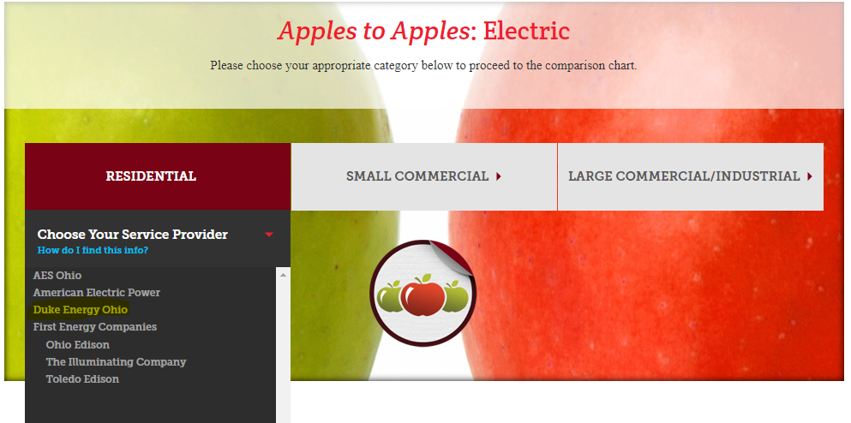

Slide 35
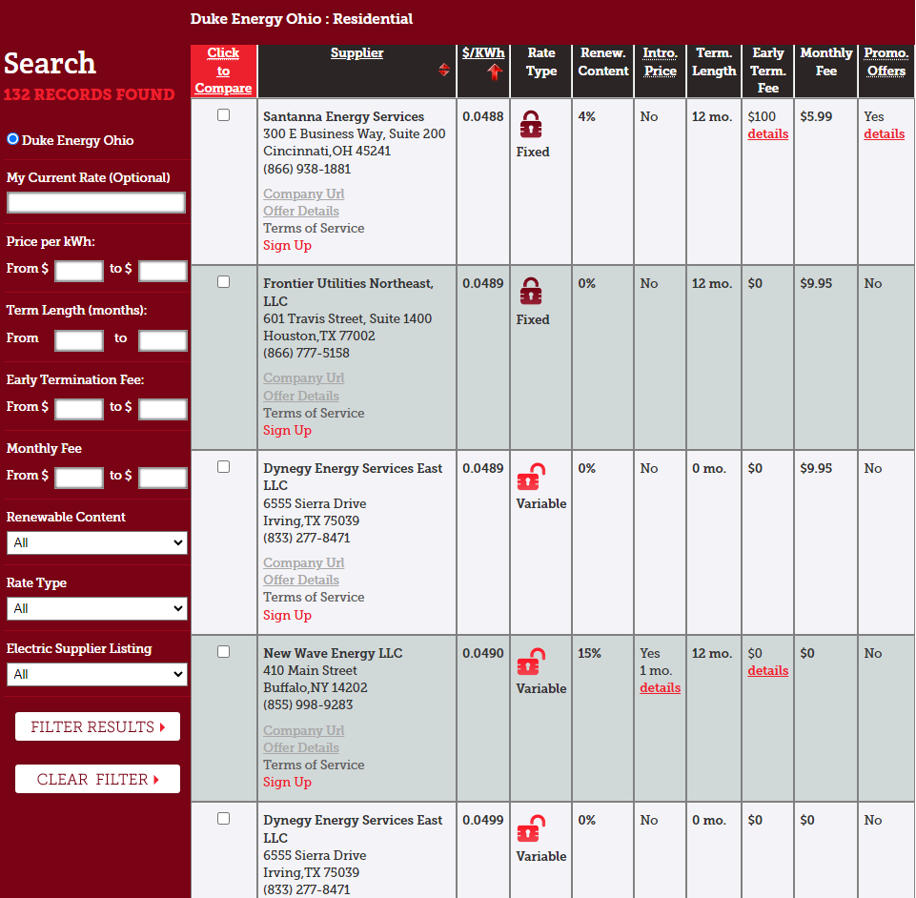
I personally recommend:
Fixed rate
No monthly Fee
No early termination fee
Renewable content will be from purchased Renewable Energy Credits (RECs), worth inquiring for details on location

Slide 36
Appendix

Slide 37
Energy Trends
Sourced from EIA (Energy Information Administration) – 2022 Annual Energy Outlook

Slide 38
Energy production and consumption
Energy production by source
AEO2022 Reference case
quadrillion British thermal units
Energy consumption by fuel
AEO2022 Reference case
quadrillion British thermal units
Note: Biofuels are shown separately and included in petroleum and other liquids.

Slide 39
U.S. natural gas production and prices
U.S. dry natural gas production
AEO2022 oil and gas supply cases
trillion cubic feet
Natural gas spot price at Henry Hub
AEO2022 side cases
2021 dollars per million British thermal unit
2021
history projections
High Oil and
Gas Supply
Reference
Low Oil and
Gas Supply

Slide 40
U.S. dry natural gas production
Dry natural gas production, AEO2022 oil and natural gas supply cases
Reference case
trillion cubic feet
Low Oil and Gas Supply case
trillion cubic feet
High Oil and Gas Supply case
trillion cubic feet
tight &
shale gas
other Lower
48 states
onshore
Lower 48
states
offshore
other
Note: Tight and shale gas includes tight gas, shale gas, and natural gas from tight oil formations.

Slide 41
U.S. electricity generation and shares from selected fuels and renewable sources

Slide 42
U.S. electricity generation levels from selected fuels and renewable sources
U.S. electricity generation, AEO2022 renewables cost cases
Note: Renewables category includes electricity generation from wind, solar, hydroelectric, geothermal, wood, and other biomass sources.

Slide 43
Installed electric generating capacity by source
other diurnal storage solar wind nuclear oil and natural gas coal

Slide 44
U.S. retiring and new generating capacity
Source: Form EIA-860M, Monthly Update to the Annual Electric Generator Report, August 2021
Annual electricity generating capacity additions and retirements
AEO2022 Reference case
gigawatts

Slide 45
Electricity prices by components and long-term average electricity prices

Slide 46
U.S. electricity generation by source
Hourly U.S. electricity generation and load by fuel for selected cases and representative years
billion kilowatthours
AEO2022 Reference case, 2021 AEO2022 Reference case, 2050 AEO2022 Low Renewables Cost case, 2050
hour of the day
curtailment battery storage pumped storage solar wind hydroelectric natural gas combined-cycle natural gas and oil peakers nuclear coal
Note: Negative generation represents charging of energy storage technologies such as pumped hydro and battery storage. Hourly dispatch estimates are illustrative and are developed to determine curtailment and storage operations; final dispatch estimates are developed separately and may differ from total utilization as this figure shows. Solar includes both utility-scale and end-use photovoltaic electricity generation

Slide 47
Transportation sector energy consumption
Transportation sector consumption by mode
AEO2022 Reference case
quadrillion British thermal units
Transportation sector consumption by fuel
AEO2022 Reference case
quadrillion British thermal units
light-duty
vehicles
medium- and
heavy-duty
vehicles
air
commercial
light trucks
rail
marine
other

Slide 48
Transportation sector delivered electricity and natural gas
Delivered electricity by mode
AEO2022 Reference case
quadrillion British thermal units
Delivered compressed and liquefied natural gas by mode
AEO2022 Reference case
quadrillion British thermal units

