Slide 1
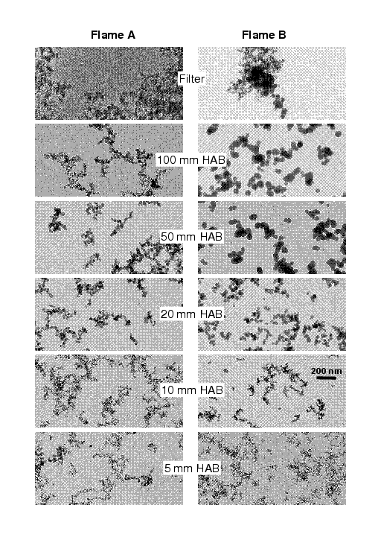
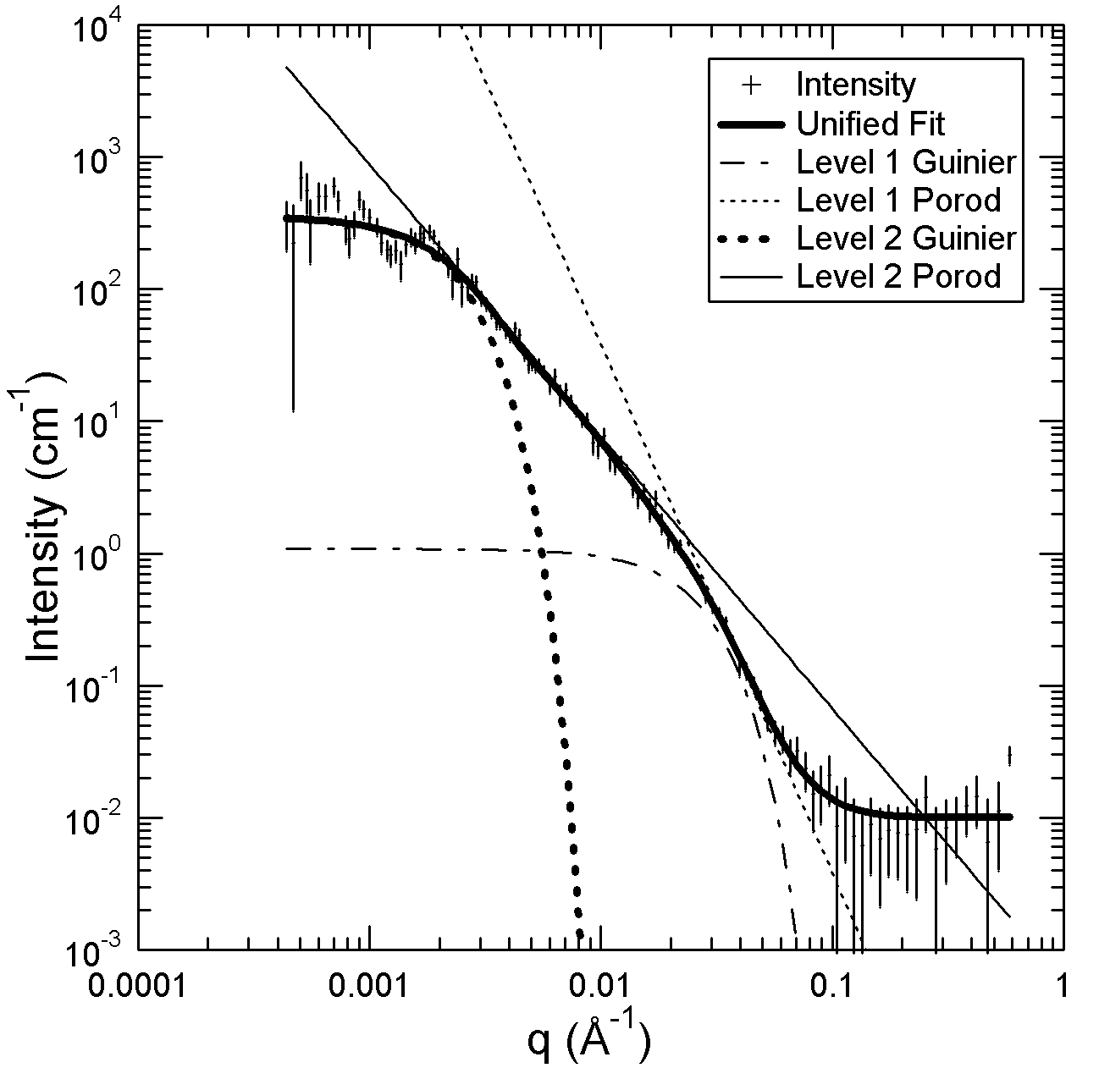
Small-Angle Scattering from Hierarchical Materials
Greg Beaucage, University of Cincinnati
Kammler HK, Beaucage G, Kohls DJ, Agashe N. Ilavsky J
J Appl. Phys. 97(2005) (Article 054309).

Slide 2
Definition of Dilute
Scaling Features in Scattering
Guinier’s Law and Power-Laws
  Derivation of Guinier’s Law from the Correlation Function
  Limitations of Power-Laws at Low- and High-q
The Unified Function for Hierarchical Materials
  Mass-Fractal Scattering
  Quantification of Branching and Topology
  Dilute Unfolded Protein Scattering
Simulated Structures from Scattering
Hybrid Unified Functions
  Worm-like Micelles
  Hybrid Brämer Function
  Correlated Lamellae
Definition of Semi-Dilute Conditions
  Aggregation/Agglomeration (Immiscible System)
  Mean Field Behavior in Scattering
  Specific Interactions in Scattering
Summary

Slide 3
Definition of Dilute

Slide 4
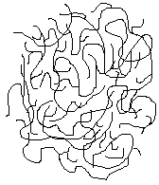
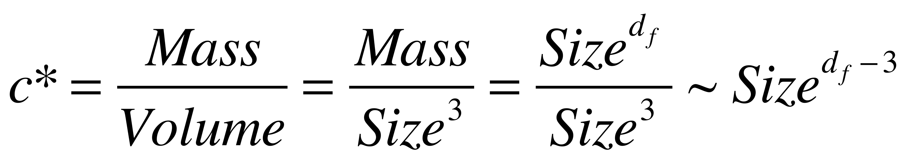
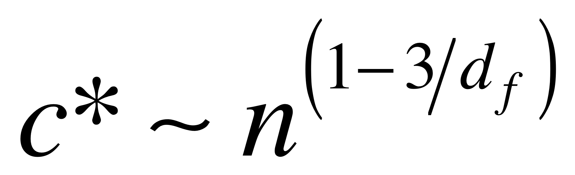
For a complex structure in solution there is an inherent concentration associated with the structure since the structure contains some solvent. For a sphere this is the excluded volume 8V, c* = ρ/8
The fractal concentration is Mass/Volume, within a structure
When the solution concentration matches c* the structures “overlap”
Then an individual structure can not be resolved and the structures entangle
The regime above c* is called semi-dilute
and the regime below c* is called dilute

Slide 5
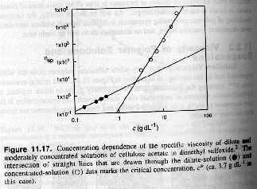
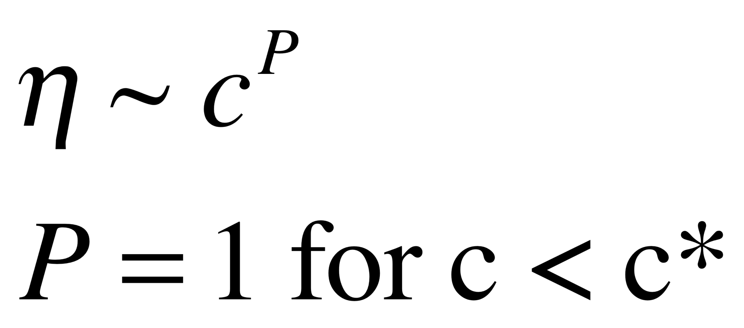
In concentrated solutions with chain overlap
chain entanglements lead to a higher solution viscosity
J.R. Fried Introduction to Polymer Science

Slide 6
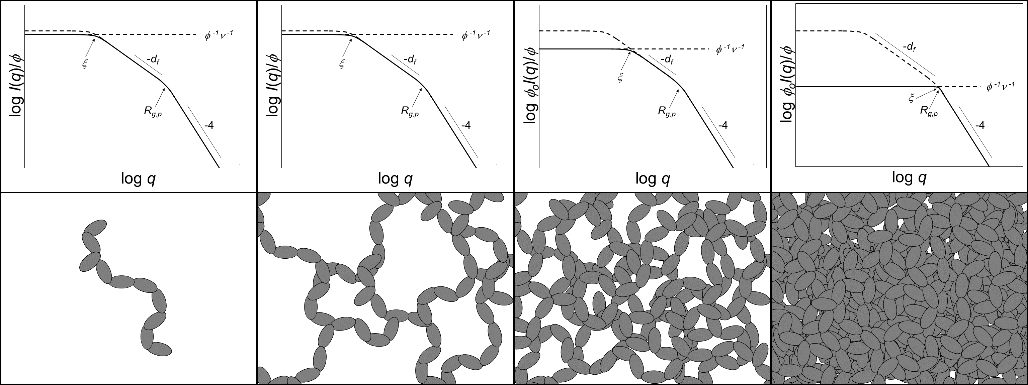
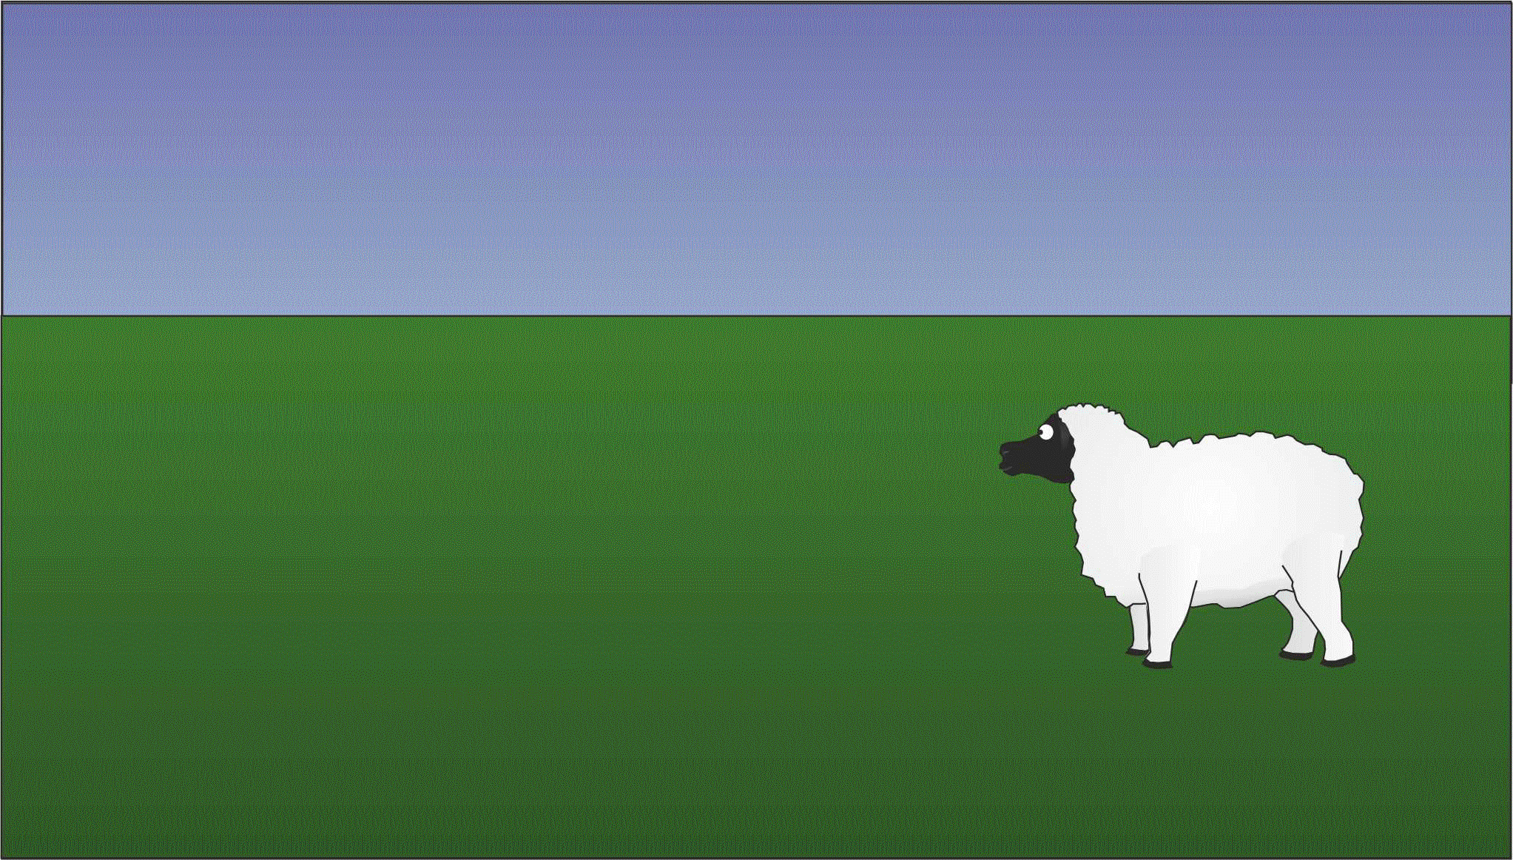
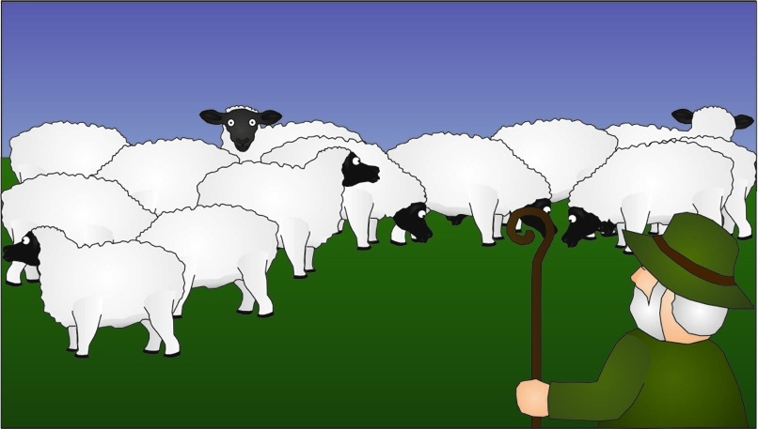
Structural Screening
At least initially we want to work with dilute samples
You must determine if your sample is dilute
The screening length is a useful parameter to obtain
Figure 1 – For dilute dispersions, all structural features can be observed (left). With increasing concentration (going from left to right), the nano-aggregates begin to overlap and the larger features become obscured by the screening phenomenon (dotted line). Above the overlap concentration, the largest observable structural feature is the mesh size. At even higher concentrations, the mesh size decreases further and large-scale structural information is lost.

Slide 7
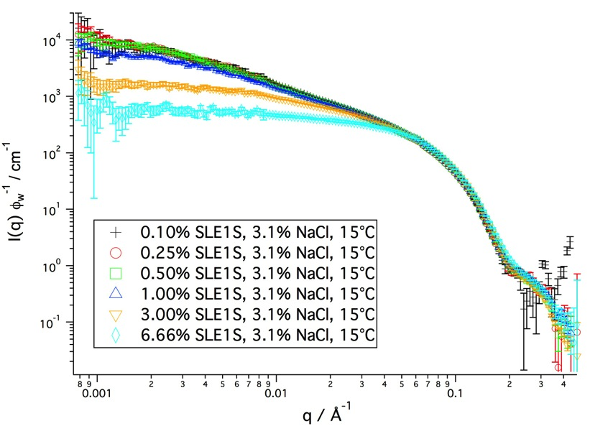
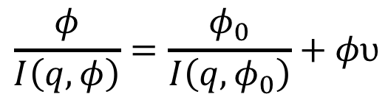
The “screening effect” and the screening parameter ν
Concentrated micelle system
$$\frac{φ}{I\left(q,φ\right)}=\frac{φ_{0}}{I\left(q,φ_{0}\right)}+φυ$$
≈ ideally diluted
entangled

Slide 8
Understanding Contrast

Slide 9
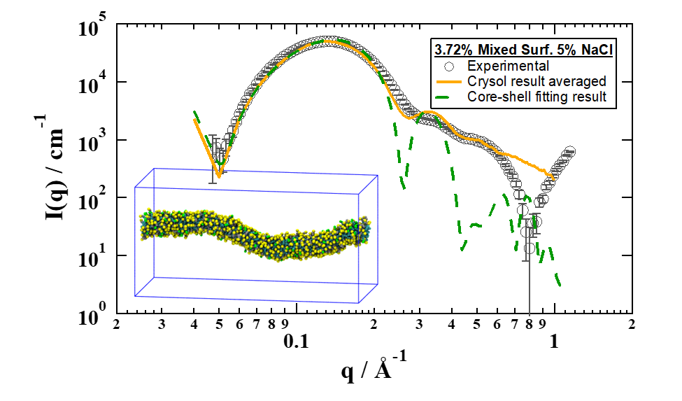
Understanding Contrast
Neutrons and light image hydrocarbons
X-rays image mostly counterions
-4 power-law for the surface
-2 power-law for the shell
Similar Worm-Like Micelle Samples

Slide 10
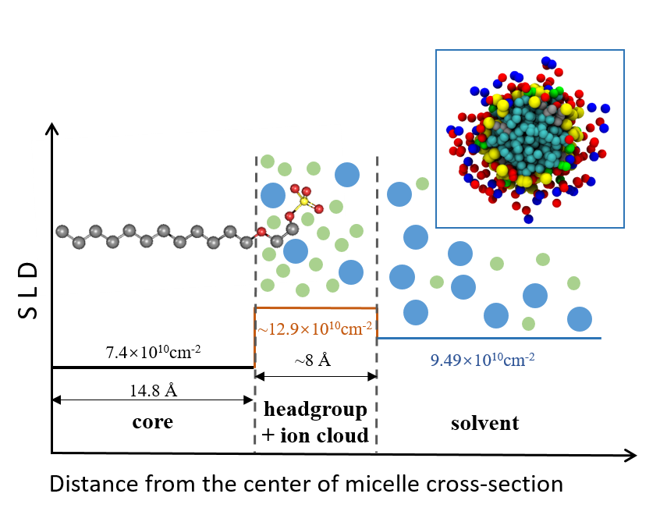
Understanding the local structure of worm-like micelles
SAXS / CRYSOL / Simulation
Sketch of the micelle cross-section and estimated parameter values involved in the core-shell model. The inset in the upper-right corner is a snapshot of the simulated micelle cross-section with accumulated ions.
Measured, fitted, simulated scattering curves of mixed surfactant sample. The inset in the lower-left corner is a snapshot of the simulated micelle segment.
Jiang, H.; Vogtt, K.; Koenig, P; Jiang, R.; Beaucage, G.; Weaver, M. Coupled simulation and scattering for evaluation of the local structure of worm-like micelles. 2018, submitted.

Slide 11
Definition of Dilute
Scaling Features in Scattering

Slide 12
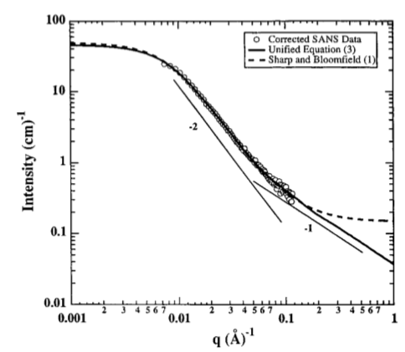
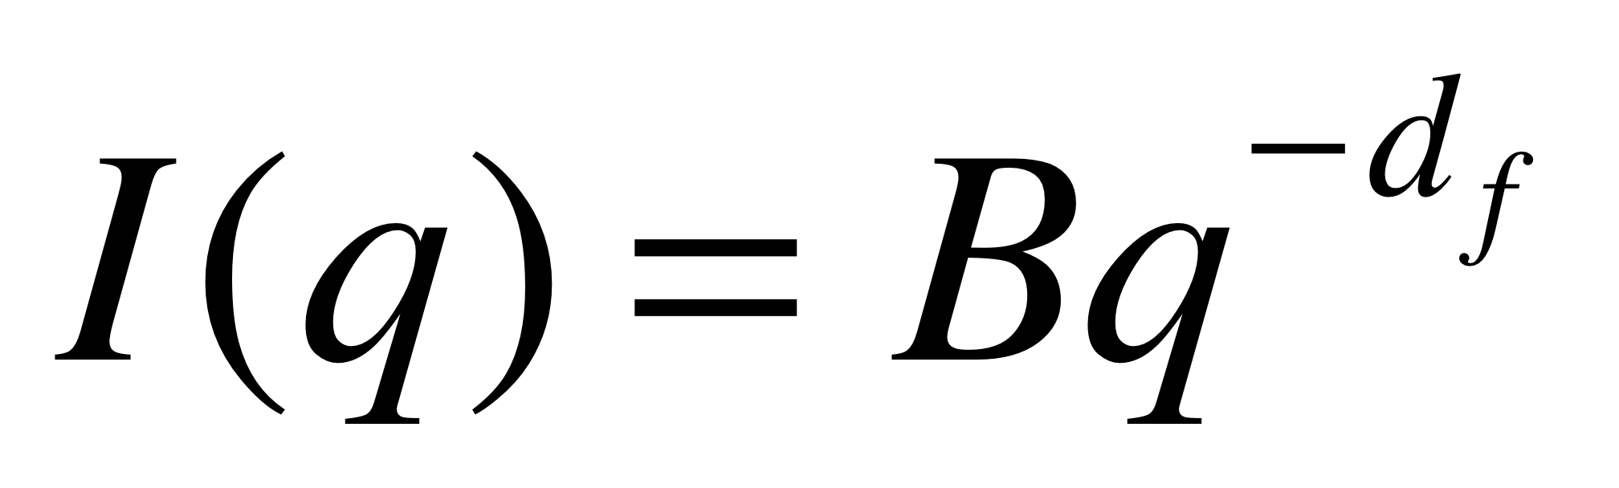
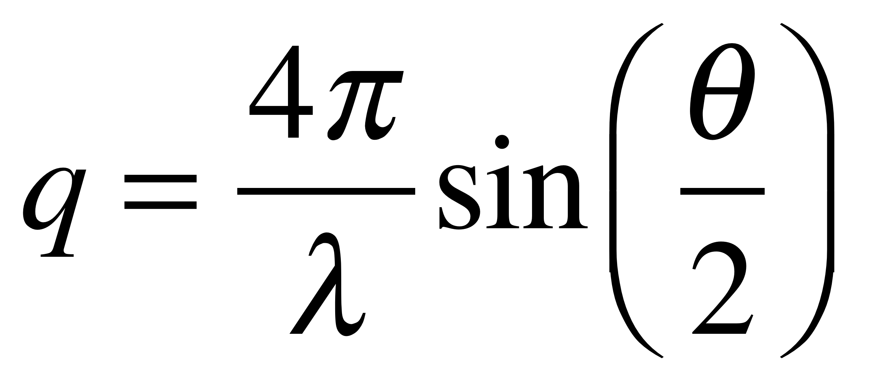
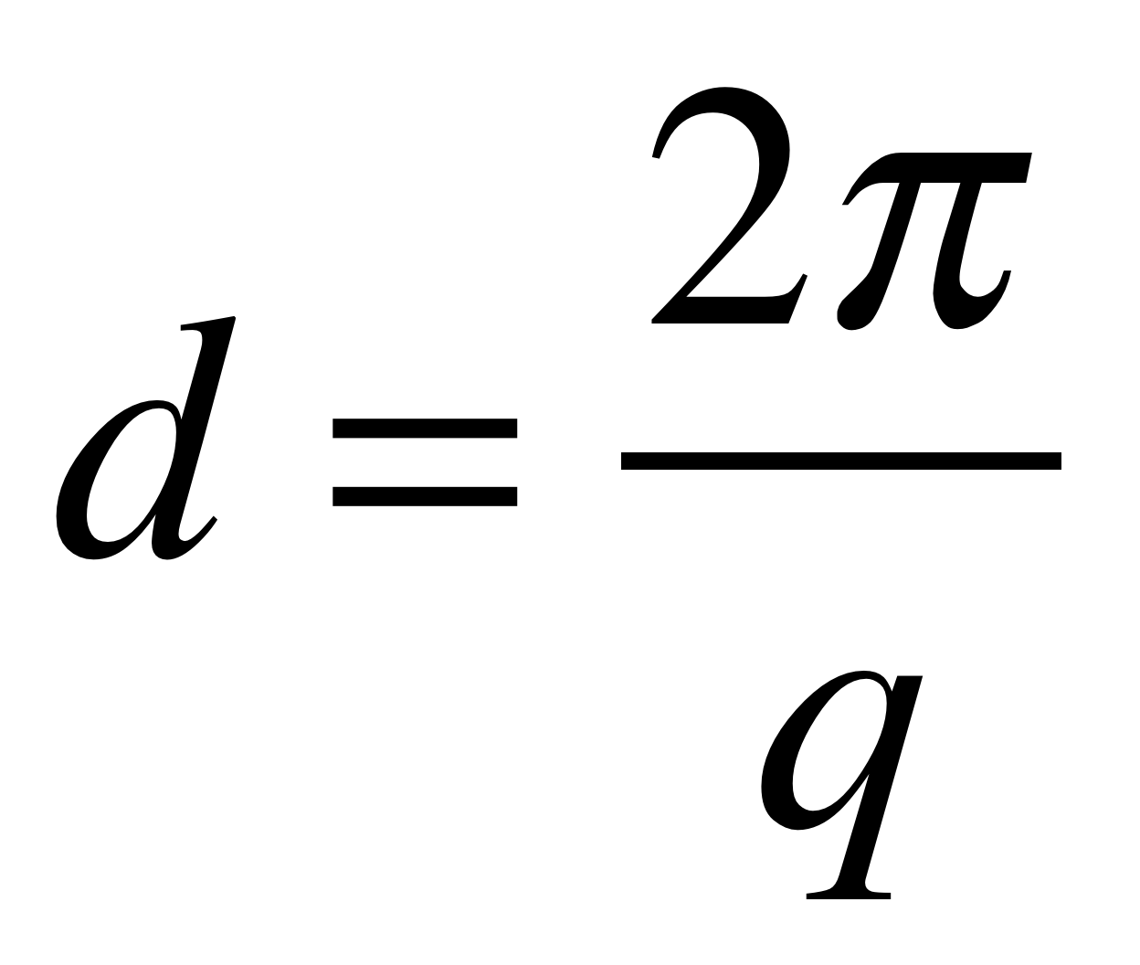
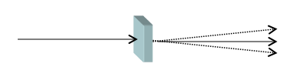
Scaling Behavior of Dilute Synthetic Polymers
Scattering Observation of the Persistence Length
R
r_{i}
θ
Scaling Regimes over a range of q
At low end: a size for that structural level
At the high end a different structural level
A power-law decay of -1 slope has only one structural interpretation.

Slide 13
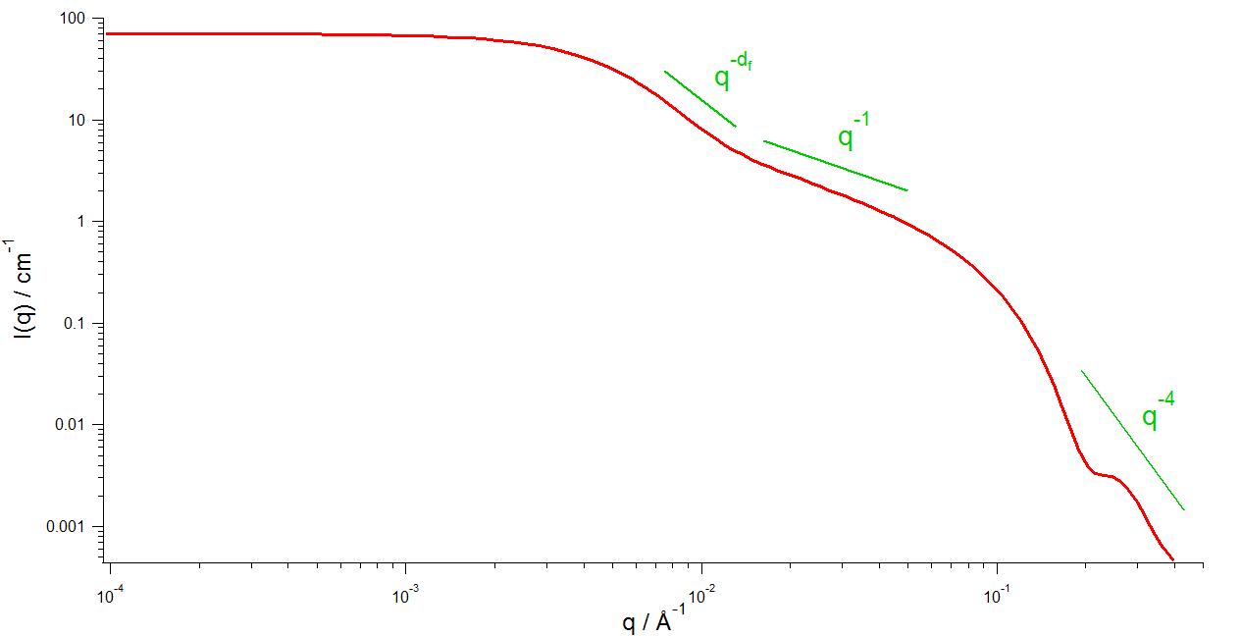
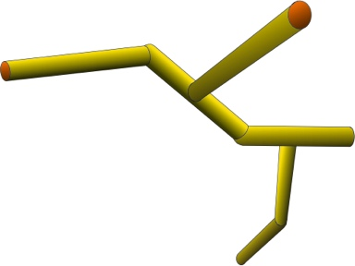
Worm-Like Micelles
With a newly developed approach, the local as well as the global structure can be characterized on the basis of I(q). Using a hybrid scattering function, the local structure (cylinders) and the overall structure (tortuous and/or branched network) are determined.
G₂ = 60 cm⁻¹
G₁ = 10 cm⁻¹
circular
R₁ = 20 Å
7
z = 6
d_{min} = 1.1
d_{f} = 2.46
c = 2.2
n_{br} = 2
C_{p} = 1.46
R_{g,2} = 350 Å
R
R₁ = 20 Å
L₁ = 500 Å
σ_{R,1} = 3 Å
large scale structure
cross
section
subunit

Slide 14
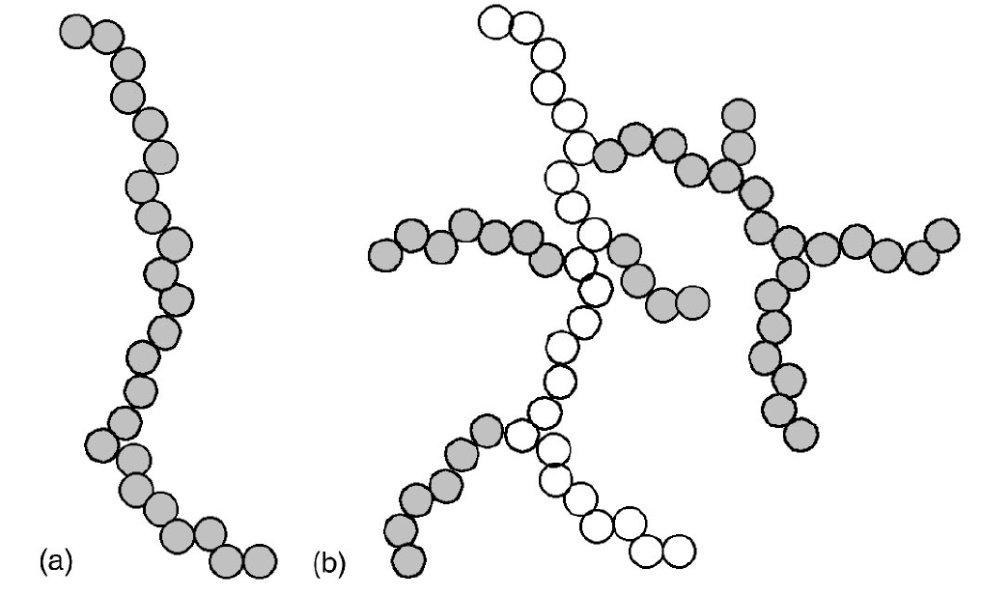
Branched Aggregates
APS UNICAT
Silica Premixed Flames
J. Appl. Phys 97 054309 Feb 2005
5mm LAT 16mm HAB
Typical Branched Aggregate
d_{p} = 5.7 nm
z = 350
c = 1.5, d_{min} = 1.4, d_{f} = 2.1
φ_{br} = 0.8
Beaucage G, Determination of branch fraction and minimum dimension of fractal aggregates Phys. Rev. E 70 031401 (2004).

Slide 15
Definition of Dilute
Scaling Features in Scattering
Guinier’s Law and Power-Laws
Note:
Guinier’s law works for all q. It is sufficient to describe the structural size for a particular structural level.
Power-laws have two problems.
  The overestimate the intensity at low-q near the Guinier Regime.
  They over estimate the intensity at high-q where the Guinier regime for the next structural level occurs.
We need structurally-limited power-laws to unify (sum) Guinier and power-law scattering.

Slide 16
Definition of Dilute
Scaling Features in Scattering
Guinier’s Law and Power-Laws
Derivation of Guinier’s Law from the Correlation Function
This will provide a framework for structurally limited power-laws

Slide 17


Definition of Dilute
Scaling Features in Scattering
Guinier’s Law and Power-Laws
  Derivation of Guinier’s Law from the Correlation Function
Porod’s Characteristic Function
Rotationally averaged
centro-symmetric structures (Debye)

Slide 18
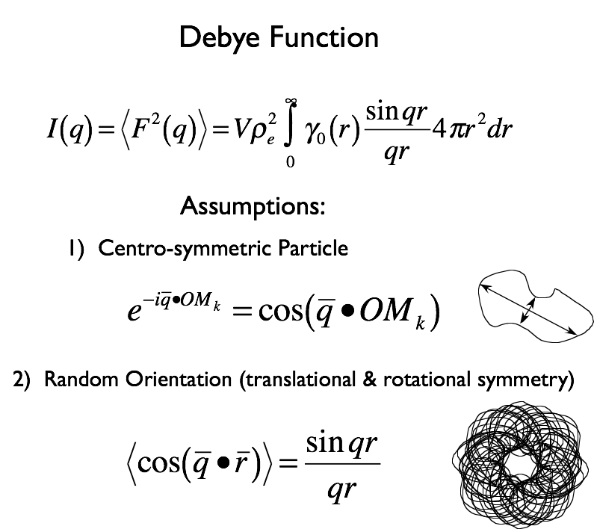

Slide 19
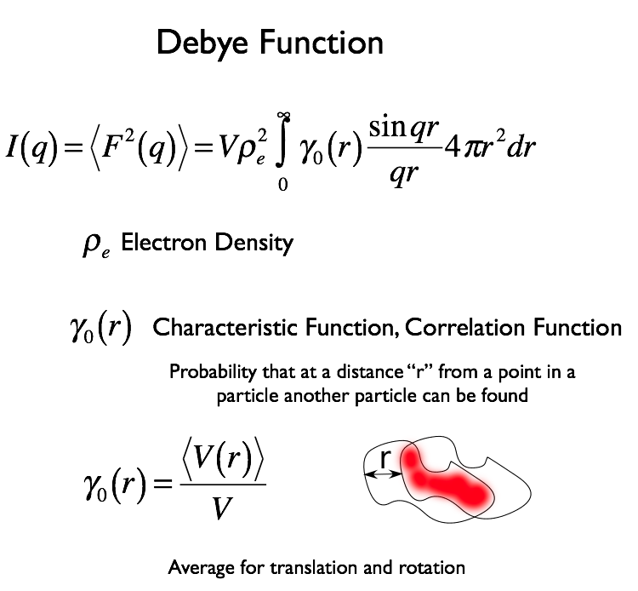

Slide 20
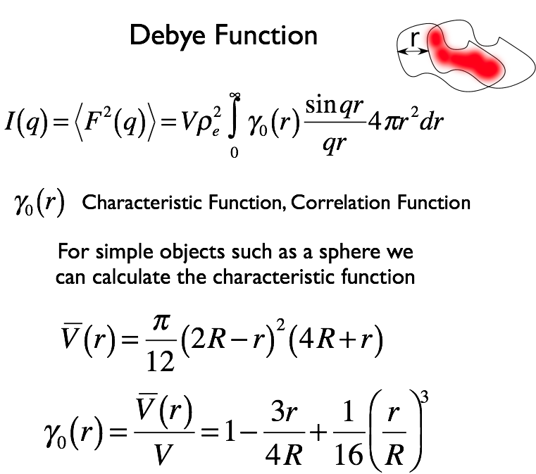
For a sphere

Slide 21
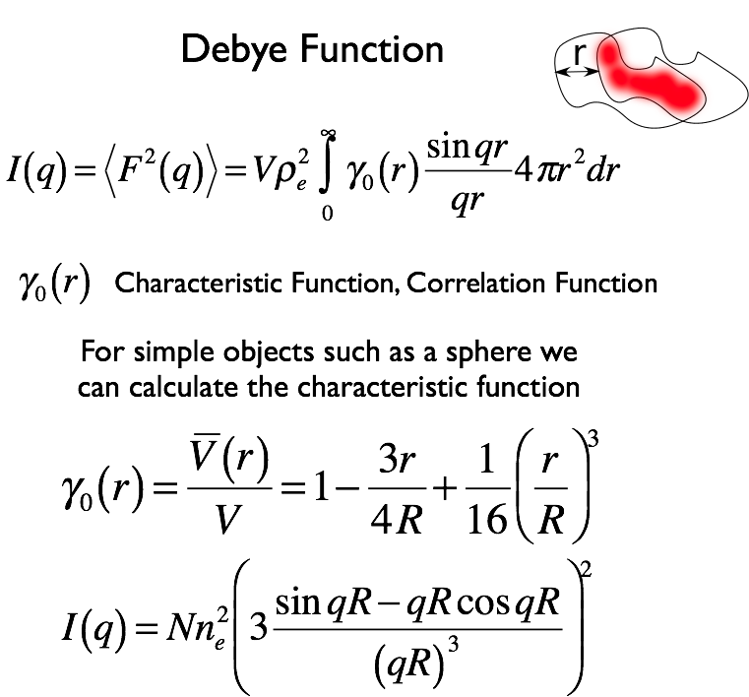

Slide 22
At high-q Porod’s Law
I(q) = 9 Nn_{e}² (qR/(qR)³)² = 9 Nn_{e}²/(qR)⁴
= 2πNVρ_{e}² (S/V) q⁻⁴
At low-q Guinier’s Law
cos x = 1 – x²/2! + x⁴/4!-…
sin x = x – x³/3! + x⁵/5!-…
exp(-x) = 1-x²/2!+x³/3!-..
I(q) = Nn_{e}²exp(-q²R_{g}²/3)

Slide 23
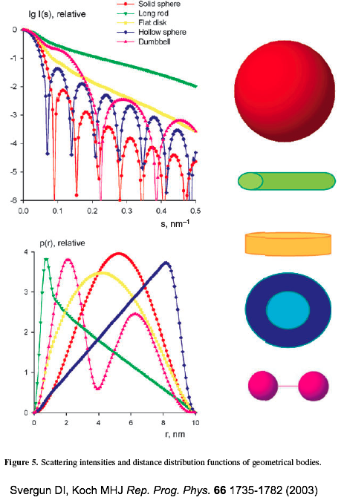

Slide 24
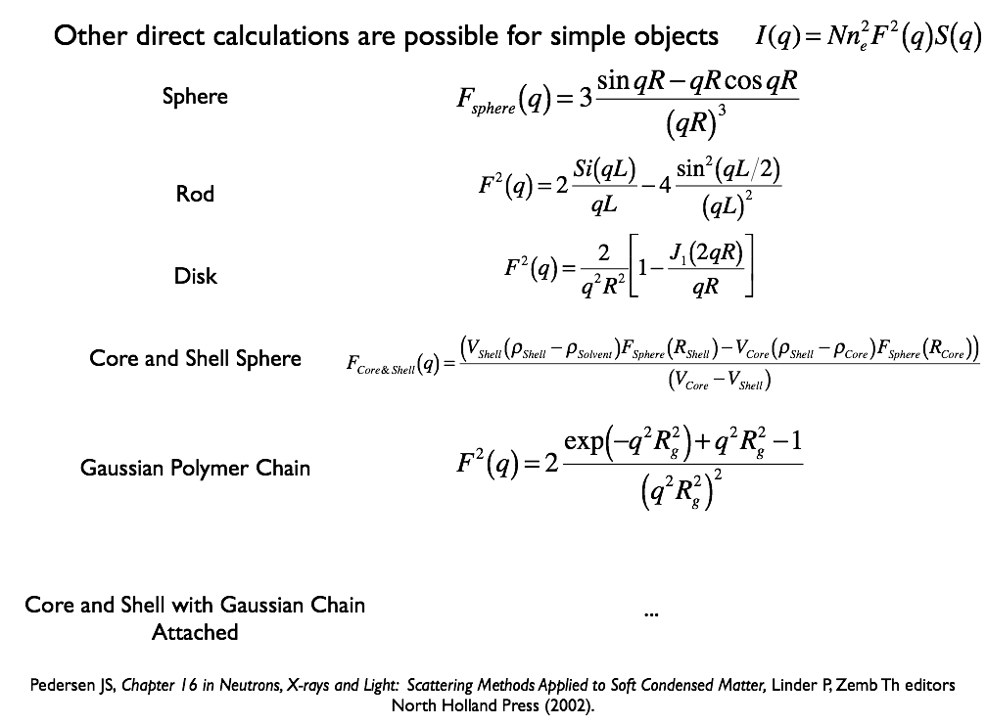

Slide 25
Consider the origin of the vector r

Slide 26
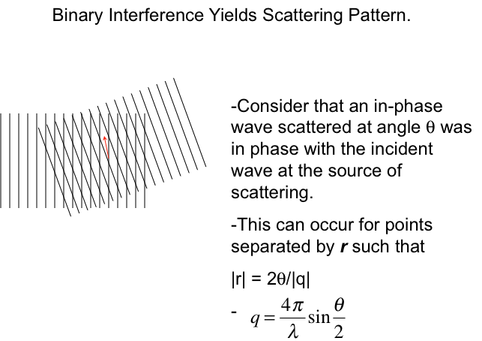

Slide 27
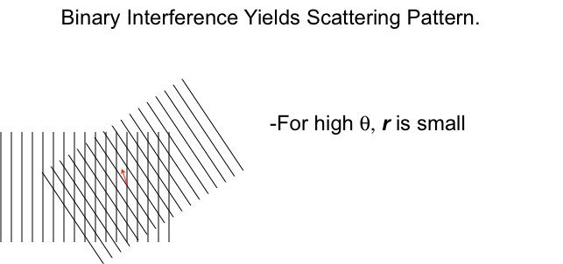

Slide 28
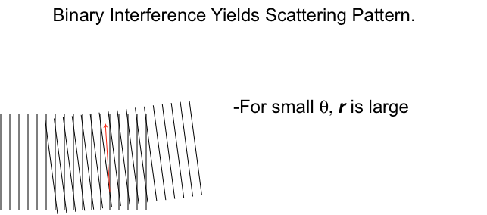

Slide 29
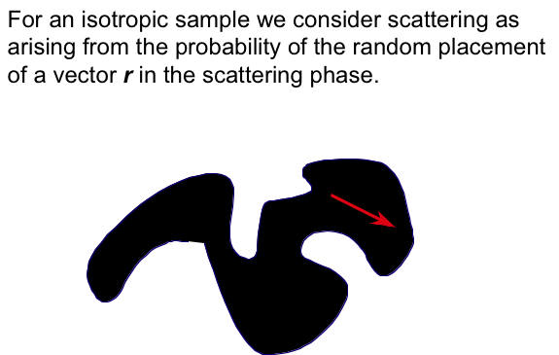

Slide 30
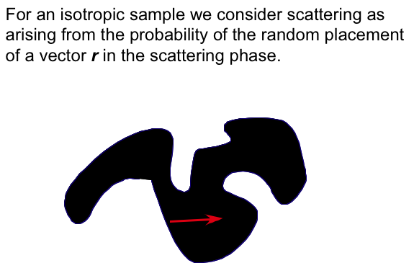

Slide 31
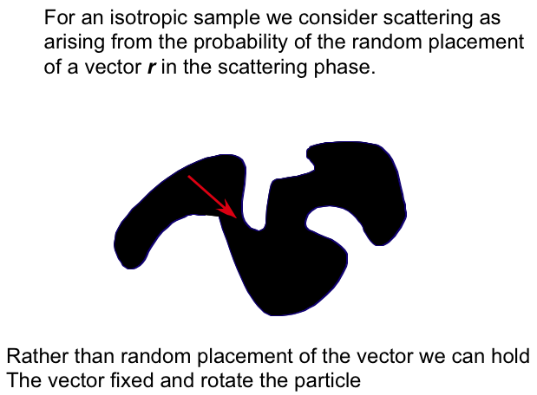

Slide 32
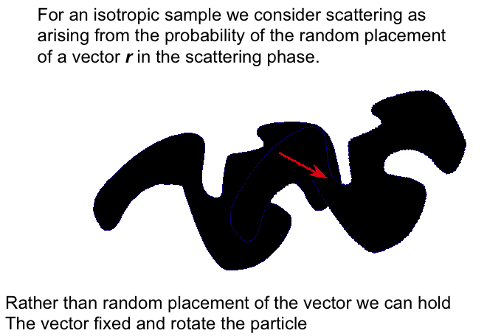

Slide 33
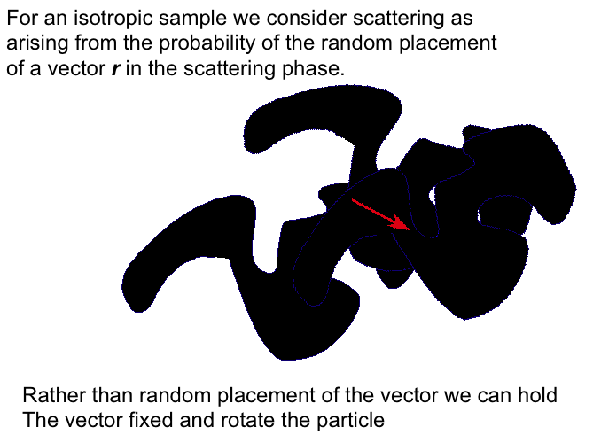

Slide 34
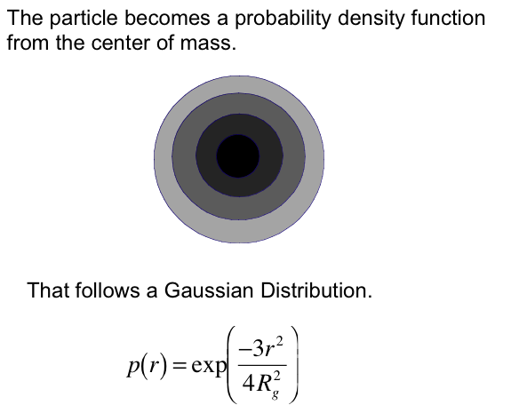
Beaucage, G. "Approximations leading to a unified exponential/power-law approach to small-angle scattering." Journal of Applied Crystallography 28.6 (1995): 717-728.

Slide 35
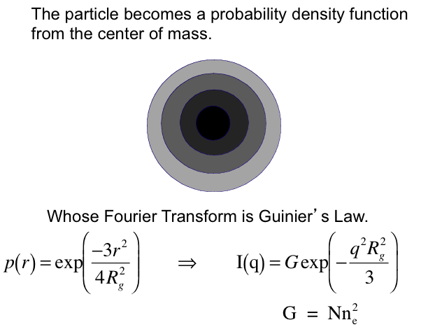

Slide 36
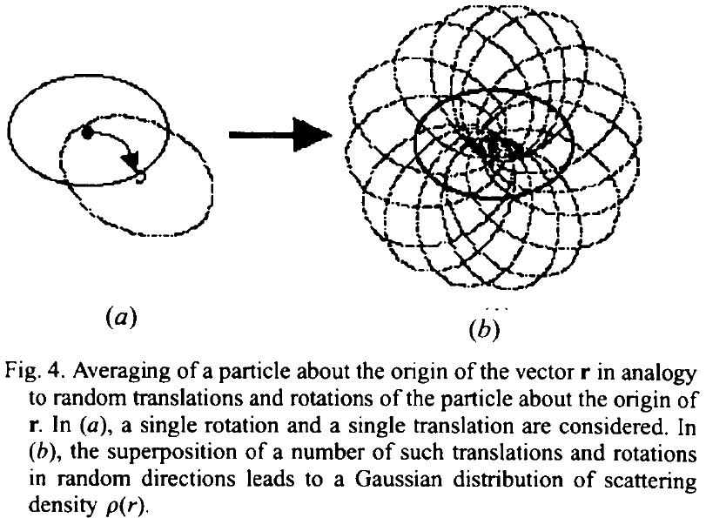
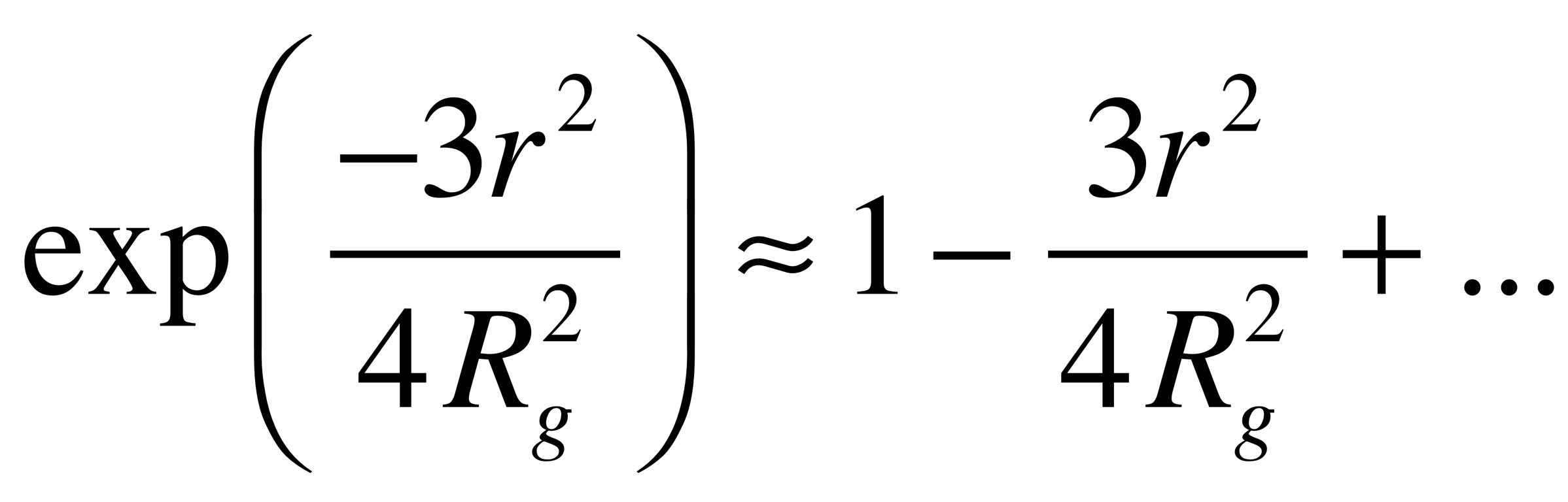
Guinier’s Law describes a particle with no surface or internal structure
Consider binary interference at a distance “r” for a particle with arbitrary orientation
Rotate and translate a particle so that two points separated by r lie in the particle for all rotations
and average the structures at these different orientations
Guinier’s Law
Binary Autocorrelation
Function
Lead Term is
Scattered Intensity is the Fourier Transform of
The Binary Autocorrelation Function
A particle with no surface
Beaucage G J. Appl. Cryst. 28 717-728 (1995).

Slide 37
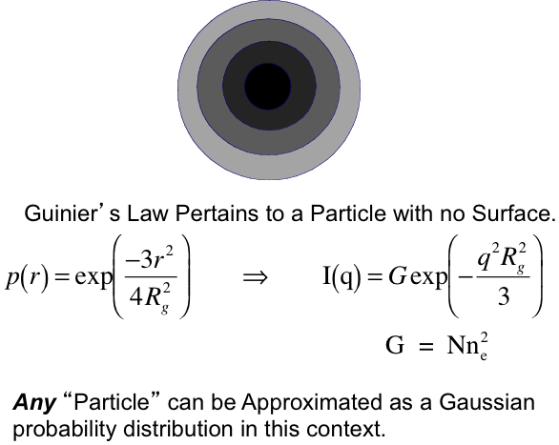

Slide 38
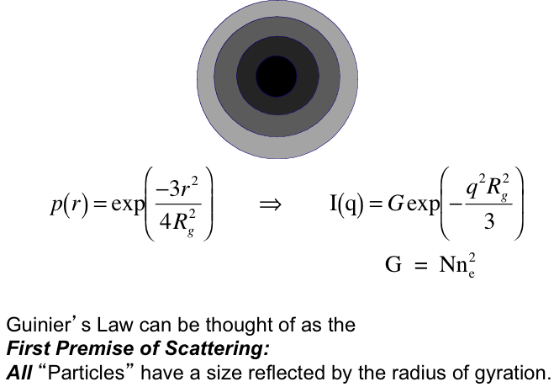

Slide 39
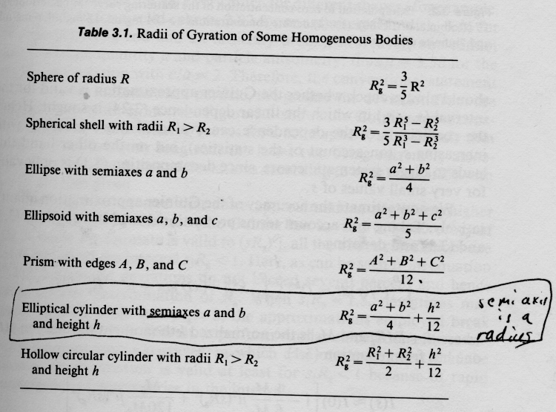

Slide 40
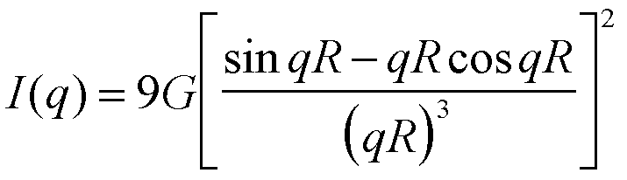
Scattering Function for Monodisperse Spheres
Rayleigh, 1914
G = Nn_{e}²
-4 Power-law for Porod scattering
Solid Surface

Slide 41
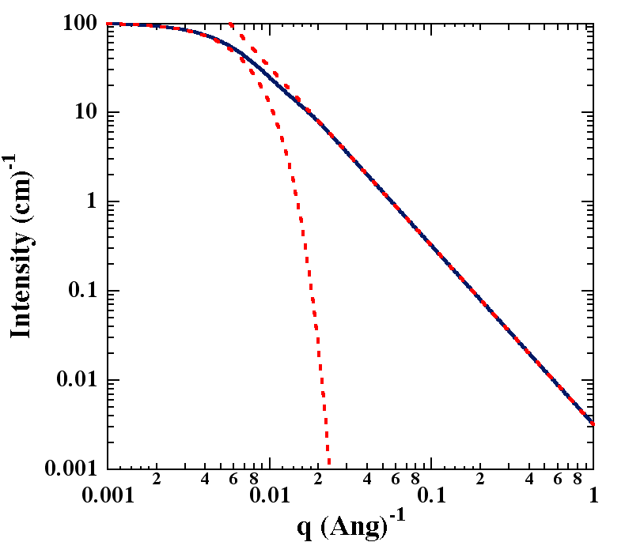
The Debye (1947) Scattering Function for a Polymer Coil
-2 Power-law for Gaussian Chain
d_{f} = 2

Slide 42
Definition of Dilute
Scaling Features in Scattering
Guinier’s Law and Power-Laws
Derivation of Guinier’s Law from the Correlation Function
Limitations of Power-Laws at Low and High q

Slide 44
Second Premise of Scattering All Structures Have a Surface.
I(q) ~ N n_{e}²
n_{e} Reflects the number of electrons in a particle
N is total number of particles

Slide 45
Second Premise of Scattering All Structures Have a Surface.
I(q) ~ N n_{e}²
n_{e} Reflects the number of electrons in a particle
N is total number of particles
The only location for contrast between phases is
at the interface (for every vector r there is a vector r/2)

Slide 46
Second Premise of Scattering All Structures Have a Surface.
I(q) ~ N n_{e}²
n_{e} Reflects the number of electrons in a particle
N is total number of particles
At the other extreme we consider a surface.
We can fill the interface with spheres of size r
N = S/(πr²)

Slide 47
Porod’s Law can be thought of as the
Second Premise of Scattering:
All “Particles” have a surface reflected by S/V.
(d_{p} = (S/V)⁻¹)
N = S/(πr²)

Slide 48
For a Rough Surface: d_{s} < 3
(This Function decays to Porod’s Law at small sizes)

Slide 49




Beaucage, G. "Approximations leading to a unified exponential/power-law approach to small-angle scattering." Journal of Applied Crystallography 28.6 (1995): 717-728.

Slide 50
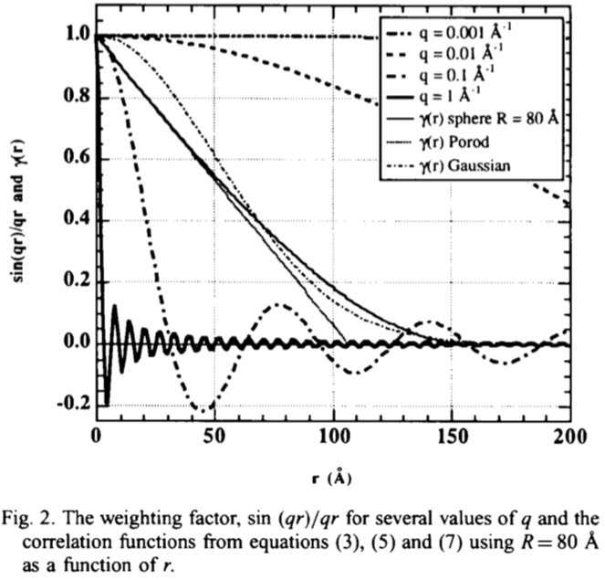
At low-q sin(qr)/qr = 1
(sin x = x – x³/3! + x⁵/5!-…)
Integrate γ(r)r² => particle volume
Integrals for Gaussian and Sphere match at large r
At high-q only the small r values matter
γ(r) for a sphere and Porod match at small r
Slope at r = 0 is S/4V (0 for Gaussian, particle with no surface; it is the same value for sphere and Porod)

Slide 51


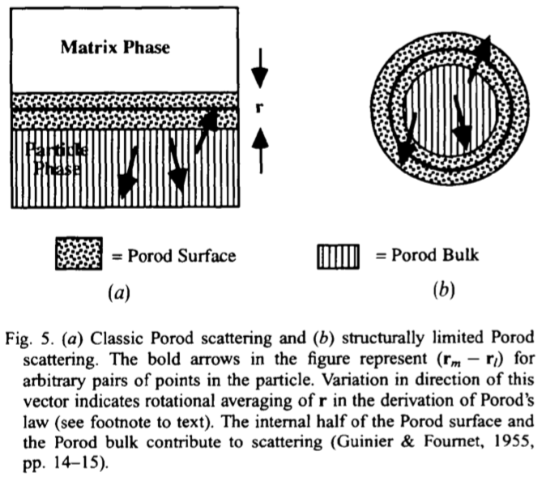
Structurally-Limited Porod’s Law
r x S gives surface volume
Consider ½ of surface doesn’t contribute to scattering
Orientation gives a factor of ½
<cos²θ> = ½
Model fails at large r (small q)
Due to curvature of the surface
This leads to an over estimation of the scattering near R_{g}.

Slide 52
Particle Translation/Rotation are used to obtain a Gaussian characteristic function and Guinier’s Law

Slide 53
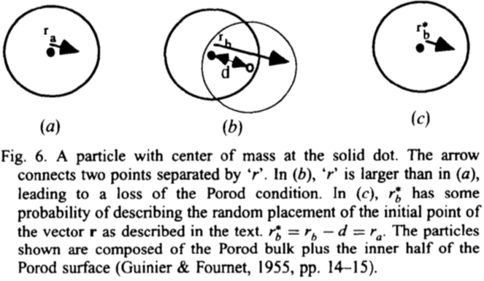
A similar approach can be used to describe the limitation to Porod’s Law at low-q near R_{g}
Consider an “average” Gaussian particle
This sometimes results in a Porod condition (a probability that drops following a Gaussian decay with q or 1/r)
Without translation this doesn’t meet the Porod condition
With translation it meets the Porod condition, effectively shortening r_{b} to the same size as r_{a}. The translation makes low-q is like high-q

Slide 54
The translation effectively reduces r for the original figure. Reduced r ~ increased q.
Due to the Gaussian probability we effectively see high-q scattering at low-q

Slide 55
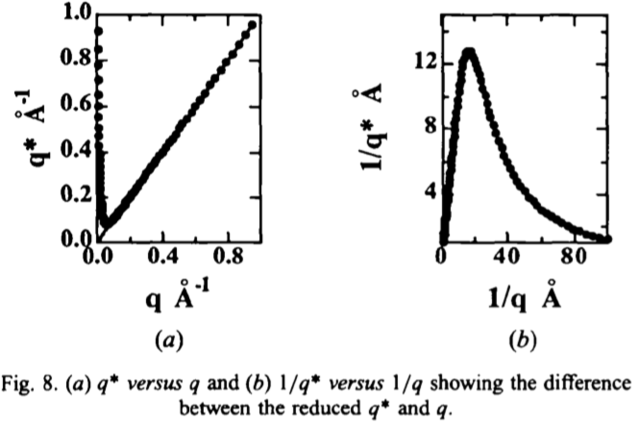
By modification of q rather than the scattering function this is a universal function that can work with any object that displays a radius of gyration and follows Guinier’s Law

Slide 56






We consider one orientation of the vector r (1-d) for 3d translation of the structure
A Gaussian probability following the Guinier derivation
Integrate for all displacement distances

Slide 57



This describes the 1-d probability (one r vector) due to finite structure
This integral is an error function
Cube to get 3-d probability that modifies γ(r) in the Debye Function
So qr in the denominator becomes q*r with q* =q/(erf(qR_{g}/√6)³
As an approximation we also substitute sin(qr) with sin(q*r)
Which enables substitution of q* for q in any power-law

Slide 58
By modification of q rather than the scattering function this is a universal function that can work with any object that displays a radius of gyration and follows Guinier’s Law

Slide 59
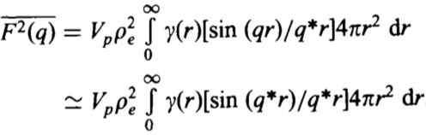
For Porod’s Law we write
This can be summed with Guinier’s Law to yield the Unified scattering function.
Beaucage, G. "Approximations leading to a unified exponential/power-law approach to small-angle scattering." Journal of Applied Crystallography 28.6 (1995): 717-728.

Slide 60


When is this an appropriate approximation? (Most of the time)
Approximation is exact at high-q, q > 2π/R_{g}
sin(qr)/qr = sin(qr)/q*r = sin(q*r)/q*r
Approximation is good at very low-q
sin(qr)/q*r = sin(q*r)/q*r
(See two thin dashed curves in Fig. 7)
Between π/R_{g} < q < 2π/R_{g}
(See bottom two solid curves in Fig. 7)
Approximation leads to steeper decay in integral
This is inconsequential for surface scattering
For mass-fractal scattering the calculated scattering curve is within 95% of actual. An empirical prefactor for R_{g} of k_{Mass Fractal} = 1.06 improves the match to 99.2%.

Slide 61
High q-Limit to Power laws
Power-laws terminate at the next structural level since the conditions for the power-law, such as mass fractal structure, are no longer descriptive of the material at that size scale. The functional form for this loss of power-law scattering is the same as for Guinier’s Law for the next smaller structural level
This high-q limit to power-laws naturally occurs for the scattering functions for disks and rods
Beaucage, G. "Approximations leading to a unified exponential/power-law approach to small-angle scattering." Journal of Applied Crystallography 28.6 (1995): 717-728.

Slide 62
Definition of Dilute
Scaling Features in Scattering
Guinier’s Law and Power-Laws
  Derivation of Guinier’s Law from the Correlation Function
  Limitations of Power-Laws at Low and High q
The Unified Function for Hierarchical Materials
  Mass-Fractal Scattering
  Quantification of Branching and Topology

Slide 63


The Unified Function
$$I_{2}\left(q\right) = \sum_{i}{\left(G_{i} e^{−\frac{R_{g,i}^{2} q^{2}}{3}} + B_{i} e^{−\frac{R_{g,i−1}^{2} q^{2}}{3}}{\left(q_{i}^{∗}\right)}^{−Pi}\right)}$$
$q_{i}^{∗} = \frac{q}{{erf⁡(\frac{kiq R_{g,i} }{\sqrt{3}})}^{3}}$
erf(x): Error function.
Index i=1, 2,… correspond to different structure levels.
R_{g,i} : Radius of gyration correspond to structural level i
P_{i} : Power-law decay slope for level i
k_{i} : Correction factor = 1 for P_{i} > 3 and 1.06 for P_{i} < 3
Beaucage, G. "Approximations leading to a unified exponential/power-law approach to small-angle scattering." Journal of Applied Crystallography 28.6 (1995): 717-728.

Slide 64
Definition of Dilute
Scaling Features in Scattering
Guinier’s Law and Power-Laws
  Derivation of Guinier’s Law from the Correlation Function
  Limitations of Power-Laws at Low and High q
The Unified Function for Hierarchical Materials
  Mass-Fractal Scattering
  Quantification of Branching and Topology
  Dilute Unfolded Protein Scattering

Slide 65



Nanoparticle Formation
Solution Route
Aerosol Route
-Separation
-Surface Tension
(Pore/Particle Collapse)
-Solvent Disposal
-Reaction Rate is Slow
-Transport is Slow
-Batch Process
-Particles are Pre-Separated
-No Surface Tension Issues
-No Solvent Disposal
-Reaction Rate is Fast
-Continuous Process
-Rapid Supersaturation & Dilution
Laplace
Kelvin

Slide 66




Nano-particles form far from equilibrium.
T ~ 2500°K
Time ~ 100 ms
φ_{v} ~ 1 x 10⁻⁶
d_{p} ~ 5 to 50 nm

Slide 67
Kammler HK, Beaucage G, Kohls DJ, Agashe N. Ilavsky J
J Appl. Phys. 97(2005) (Article 054309).

Slide 68


X-ray, λ
2θ
d = λ/(2 sin θ) = 2π/q
Branched Aggregates

Slide 69

X-ray, λ
2θ
d = λ/(2 sin θ) = 2π/q
Guinier’s Law

Slide 70

X-ray, λ
2θ
d = λ/(2 sin θ) = 2π/q
Guinier and
Porod Scattering
Structure of Flame Made Silica Nanoparticles
By Ultra-Small-Angle X-ray Scattering
Kammler/Beaucage Langmuir 2004 20 1915-1921

Slide 71


X-ray, λ
2θ
d = λ/(2 sin θ) = 2π/q
Polydispersity
Particle size distributions from small-angle scattering using global scattering functions, Beaucage, Kammler, Pratsinis J. Appl. Cryst. 37 523-535 (2004).

Slide 72

X-ray, λ
2θ
d = λ/(2 sin θ) = 2π/q
Linear Aggregates
Beaucage G, Small-angle Scattering from Polymeric Mass Fractals of Arbitrary Mass-Fractal Dimension, J. Appl. Cryst. 29 134-146 (1996).

Slide 73

X-ray, λ
2θ
d = λ/(2 sin θ) = 2π/q
Branched Aggregates
Beaucage G, Determination of branch fraction and minimum dimension of fractal aggregates Phys. Rev. E 70 031401 (2004).

Slide 74


Large Scale (low-q) Agglomerates

Slide 75

Small-scale Crystallographic Structure

Slide 76


Branched Aggregates
APS UNICAT
Silica Premixed Flames
J. Appl. Phys 97 054309 Feb 2005
5mm LAT 16mm HAB
Typical Branched Aggregate
d_{p} = 5.7 nm
z = 350
c = 1.5, d_{min} = 1.4, d_{f} = 2.1
φ_{br} = 0.8
Beaucage G, Determination of branch fraction and minimum dimension of fractal aggregates Phys. Rev. E 70 031401 (2004).

Slide 78







TiCl₄ Diffusion Flame Nucleation and Growth
φ* same for all flames!

Slide 79





Activated growth
for z
Titania Diffusion Flame from TiCl₄
Beaucage G, Agashe N, Kohls D, Londono D, Diemer B

Slide 80



Silica Diffusion Flame
Axial Particle Growth follows
Classic Diffusion Limited
Surface Growth, d ~ t^{1/2}

Slide 81
Summary:
SAXS as a tool for in situ
observation of structure
2) Homogeneous nucleation
appears to be a common
feature of flame growth.
3) A wide range of particle
growth mechanisms can
be involved
4) Branching can be monitored
in terms of the mass fractal
dimension but
5) A much richer description of
aggregate growth is give by
inclusion of new model for
branched structure.
Kammler HK, Beaucage G, Kohls DJ, Agashe N. Ilavsky J
J Appl. Phys. 97(2005) (Article 054309).

Slide 82
Definition of Dilute
Scaling Features in Scattering
Guinier’s Law and Power-Laws
  Derivation of Guinier’s Law from the Correlation Function
  Limitations of Power-Laws at Low and High q
The Unified Function for Hierarchical Materials
  Mass-Fractal Scattering
  Quantification of Branching and Topology
  Dilute Unfolded Protein Scattering

Slide 83



How Complex Mass Fractal Structures
Can be Decomposed
Tortuosity
Connectivity
z
df
p
dmin
s
c
R/d
27
1.36
12
1.03
22
1.28
11.2

Slide 84



Disk
Random Coil
Extended β-sheet
(misfolded protein)
Unfolded Gaussian chain

Slide 85

Branch Content from Scattering
p
d_{min}
R₂
R₁
G Beaucage, Physical Review E (2004)
A S Kulkarni and G Beaucage, Journal of Polymer Science, Part B: Polymer Physics (2006)

Slide 86

Branch Content from Scattering
p
d_{min}
R₂
R₁
G Beaucage, Physical Review E (2004)
A S Kulkarni and G Beaucage, Journal of Polymer Science, Part B: Polymer Physics (2006)

Slide 87
Branch Content from Scattering
p
d_{min}
R₂
R₁
c
d_{min}
G Beaucage, Physical Review E (2004)
A S Kulkarni and G Beaucage, Journal of Polymer Science, Part B: Polymer Physics (2006)

Slide 88

 |  |  | d_{f} = c x d_{min}
d_{min} | 2 | 1 | 2
c | 1 | 2 | 2
-2
Topological information can be extracted from this feature arising from combining Local Scattering Laws
G Beaucage, Physical Review E, 70, 031401 (2004)
AS Kulkarni, G Beaucage, J Polym Sci, Part B: Polym Phy, 44, 1395 (2006)

Slide 89

Determination of d_{min}, c and d_{f}.
There appears to be a quantifiable difference in scattering for different d_{min} and the same d_{f}.
Beaucage G, Determination of branch fraction and minimum dimension of fractal aggregates Phys. Rev. E 70 031401 (2004).

Slide 90


Determination of d_{min}, c and d_{f}.
d_{f} c d_{min}
Gaussian
Chain 2 1 2
Disk 2 2 1
Static scattering can be
used to obtain d_{min}.
Beaucage G, Determination of branch fraction and minimum dimension of fractal aggregates Phys. Rev. E 70 031401 (2004).

Slide 91


Branched polystyrene
in a good solvent
d_{min} should be 5/3 (1.67) for
self-avoiding walk
M_{w}/M_{n} ~ 2
Good Solvent Scaling for c = 1 and c > 1

Slide 92

Hyperbranched polyesteramides
Sample R_{g,2} d_{f} d_{min} c Description M_{n}* M_{w}*
1 17.2 (15.5) 1.3 1 1.3 Regular 1.5 3.6
2 22.2 (21.6) 1.64 1.67 1 Linear 1.8 5.9
3 26.8 (30.5) 1.60 (1.63) 1.09 1.47 Close to Regular 2.4 11.0
4 57.5 1.74 (1.68) 1.59 1.09 Close to Linear 2.4 59.0
5 288.3 1.63 (1.63) 1.34 1.21 Branched 2.8 248
One pot synthesis semi-random
Dendrimers
For samples 3 & 4 polydispersity
is apparent due to linear
vs branched chains.
Linear is local persistent branching
Regular is global structural branching
*M_{n} & M_{w} in kg/mole
Molecular Structure Characterization of Hyperbranched Polyesteramides ETF Gelade, B Goderis, K. Mortensen et al. Macromolecules 34 3552-58 (2001)

Slide 93



Branched Polymers at Thermal
Equilibrium: Model Systems for LCB
“2D Slice”
PDI ~ 1.05
F5
F2
For Polymers d_{min} is the
Thermodynamically Relevant
Dimension (5/3 = 1.67 or 2)
d_{f} = d_{min} c
~ thermo x branching

Slide 94


Mole fraction of Branches

Slide 95



Multi-Arm Star Polymers
Horton et al., Macromolecules, 22, 681 (1989)
US Jeng, TL Lin, LY et al. App Phys A, 74, S487 (2002).
# | Sample | R_{g} (Å) | d_{f} | d_{min} | c | φ_{br} | Theoretical φ_{br}
1 | 3 Arm Star | 6.87 | 2.00 | 1.33 | 1.49 | 0.39 | 0.33
2 | 6 Arm Star | 78.27 | 2.00 | 1.25 | 1.59 | 0.71 | 0.67
3 | 18 Arm Star | 4.37 | 2.27 | 1.61 | 1.40 | 0.81 | 0.88

Slide 96


Hyperbranched Polymers
SANS on Hyperbranched Polymers: Beaucage model correctly describes transition from good-solvent to Θ - solvent collapsed state for the minimum path dimension.
a)
b)
E. De Luca, R. W. Richards, I. Grillo, and S. M. King, J. Polym. Sci.: Part B: Polym. Phys. 41, 1352 (2003).
Geladé, E. T. F.; Goderis, B.; et al. Macromolecules, 34, (2001).
AS Kulkarni, G Beaucage, Macromolecular Rapid Communications, accepted, (2007).

Slide 97
This Approach Can Quantify LCB in Polyolefins.
 | M_{n} (g/mol) | Index LCBI | Mole Fraction of Branches φ_{br} | NMR n_{br}/10⁴ C
PE 0 | 46,500 | 0.04 | 0 | 0
PE 2 | 11,500 | 0.91 | 0.39±0.005 | 0.36
PE 3 | 37,900 | 2.27 | 0.63±0.004 | 0.91
Model Based on
Mole Fraction of
Branches

Slide 98


Model Polydisperse Simulations
M_{w}/M_{n} ~ 4
Large aggregates
Growth kinetics show
d_{min} => 1
d_{f} => 1.8 for RLCA
Predicted previously
by Meakin

Slide 99

R
a
L
Mean Primary Particle Size, "a"
Mean Aggregate Size, "R"
Specific Surface Area related to 1/
a
"
R
" is related to "
a
", "N", and Structure
"
S
t
r
u
c
t
u
r
e
"
i
s
R
e
l
a
t
e
d
t
o
G
r
o
w
t
h
M
e
c
h
a
n
i
s
m
"
a
"
i
s
R
e
l
a
t
e
d
t
o
E
a
r
l
y
S
t
a
g
e
"
N
"
a
n
d
"
R
"
t
o
L
a
t
e
r
S
t
a
g
e
N = α (
R
/
a
)
d
f
How Dense?
1≤
d
f
≤ 3
(
/
a
) = (
R
/
a
)
d_{min}
Minimum Path Dim.
1≤
d_{min}
≤ d_{f}
C = d
f
/d_{min} How Branched?
Linear C = 1; Reg. C = d_{f}

Slide 100


















Nano-Aggregates Can Act as Springs
a
σ
E
d_{min} is Dimension
E
= E
(
a
/
R
)
3+
d_{min}
R
of Stressed
Aggregate
Oxide
Path
ε
From:
T. A. Witten, M. Rubinstein, R. H. Colby
J. Phys. II France
3
, 367 (1993).
Static
Stressed
Released
F
1
0
0
n
m
F
1
0
0
n
m
1
0
0
n
m
From:
S. K. Friedlander, H. D. Jang, K. H. Ryu
Appl. Phys. Lett.
72
173 (1998).

Slide 101









Summary of Witten/Rubinstein/Colby Theory
for Mechanics of Springy Aggregates in Elastomers
a
d_{min} is Dimension
R
of Stressed
E
= E
(
a
/
R
)
3+
d_{min}
Path
Aggregate
Oxide
Aggregates are only Effective
below a Critical Size,
R
critical
R
critical
=
a
(E
/E
Rubber
)
1/(3+
d_{min}
)
Oxide
A Critical Concentration is Predicted Beyond which
There is No Higher Reinforcing Effect,
φ
critical
φ
critical
= (
R
/a)
d_{f}-3
The Modulus for a Critical Concentration Composite, E
composite
is given by:
E
composite
= E
φ
critical
(3+
d_{min}
)/(3-d_{f})
Oxide
Test these Propositions using Tuned Nano-Composites

Slide 102
Definition of Dilute
Scaling Features in Scattering
Guinier’s Law and Power-Laws
  Derivation of Guinier’s Law from the Correlation Function
  Limitations of Power-Laws at Low and High q
The Unified Function for Hierarchical Materials
  Mass-Fractal Scattering
  Quantification of Branching and Topology
  Dilute Unfolded Protein Scattering

Slide 103

Unfolded proteins
-Unfolded state is analogous to gas state (following
Flory random walk model as applied by Pande)
-Dense states not associated with biological activity
could be analogous to glassy state (molten globule)
-0 conformational entropy native state is analogous to
crystalline state
-Unfolded state contains some:
Chain persistence associated with fluctuating
helicies and β-sheets
Crosslink/disulfide/cystine-cystine bonds that act as
branching sites
hydrophobic interactins that may appear to be
branching sites
-Conformational transitions should show increase in
d_{f} and c towards a regular 3d structure
Simulation Results,
g is denaturant
Is the molten golbule a third phase of proteins? VS Pande & DS Rohksar, PNAS 95 1490-94 (1998)

Slide 104


Unfolded proteins
“a Gaussian-like conformation”
Mapping the cytochrome C
folding landscape
Julia G. Lyubovitsky
Caltech 2003 Biochemistry
R_{g} d_{f} d_{min} c
125Å 2.05 1.07 1.90
This is almost a regular structure
with dimension 2:
A crumpled sheet!!

Slide 105


Cytochrome C
Native State
Space Filling Model
R_{g} PDI
94.0Å 1.08
This is and almost sperical
domain of
24.3 nm diameter.
Deviation from PDI = 1
can be due to polydispersity
or asymmetry.

Slide 106


Cytochrome C
Molten Globule State
Model of cytochrome b562
A) MG B) N
R_{g} PDI
Native 94.0 Å 1.08
MG 99.0 Å 2.90
(Both also
Show Aggregates at
Low-q)
Alberts B, Bray D, Lewis J, Raff M, Roberts K, Watson JD. Chapter 5: Protein Function. Molecular Biology of the Cell 3rd Ed. Garland Publishing, New York. 1994. pg 213 & 215.

Slide 107
Definition of Dilute
Scaling Features in Scattering
Guinier’s Law and Power-Laws
  Derivation of Guinier’s Law from the Correlation Function
  Limitations of Power-Laws at Low- and High-q
The Unified Function for Hierarchical Materials
  Mass-Fractal Scattering
  Quantification of Branching and Topology
  Dilute Unfolded Protein Scattering
Simulated Structures from Scattering

Slide 108


Descriptors
Beaucage, G. Determination of branch fraction and minimum dimension of mass-fractal aggregates. Physical Review E – Statistical, Nonlinear, and Soft Matter Physics 2004, 70, 031401-1–031401-10.
Rai, D., Beaucage, G., Jonah, E. O., Britton, D. T., Sukumaran, S., & Härting, M. Quantitative investigations of aggregate systems. J. Chem. Phys. 2012, 137, 044311–1–044311-6.
Ramachandran, R., Beaucage, G., Kulkarni, A. S., McFaddin, D., Merrick-Mack, J., & Galiatsatos, V. Branch content of metallocene polyethylene.
Macromolecules 2009, 42, 4746–4750.

Slide 109





Scattering
Unified Fit :
Parameters from Unified Fit used to determine topological parameters:
Beaucage, G. Approximations Leading to a Unified Exponential/Power-Law Approach to Small-Angle Scattering J. Appl. Cryst. 1995, 28 (6), 717–728.
Herrmann, H. J., & Stanley, H. E. The fractal dimension of the minimum path in two- and three-dimensional percolation. Journal of Physics A: Mathematical and General 1988, 21, L829–L833.
Meakin, P., Majid, I., Havlin, S., & Stanley, H. E. Topological properties of diffusion limited aggregation and cluster-cluster aggregation. Journal of Physics A: Mathematical and General 1984, 17, L975–L981.
Witten, T. A., & Sander, L. M. Diffusion-limited aggregation. Physical Review B 1983, 27, 5686–5697.
Sorensen, C. M. Light scattering by fractal aggregates: A review. Aerosol Sci. Tech. 2001, 35, 648–687.

Slide 110
Algorithm:
Input z and a sticking probability
Randomly grow aggregates
Compute the scattering parameters, p, R, n_{Br} etc.
Iterate by varying sticking probability until computed matches experimental
A. Mulderig, G. Beaucage, K. Vogtt, H. Jiang and V. Kuppa, Quantification of branching in fumed silica, J. Aerosol Sci. 2017, 109, 28–37.

Slide 111


Experimental
Simulation
A. Mulderig, G. Beaucage, K. Vogtt, H. Jiang and V. Kuppa, Quantification of branching in fumed silica, J. Aerosol Sci. 2017, 109, 28–37.

Slide 112

A. Mulderig, G. Beaucage, K. Vogtt, H. Jiang and V. Kuppa, Quantification of branching in fumed silica, J. Aerosol Sci. 2017, 109, 28–37.

Slide 113

A. Mulderig, G. Beaucage, K. Vogtt, H. Jiang and V. Kuppa, Quantification of branching in fumed silica, J. Aerosol Sci. 2017, 109, 28–37.

Slide 114

A. Mulderig, G. Beaucage, K. Vogtt, H. Jiang and V. Kuppa, Quantification of branching in fumed silica, J. Aerosol Sci. 2017, 109, 28–37.

Slide 115
Definition of Dilute
Scaling Features in Scattering
Guinier’s Law and Power-Laws
  Derivation of Guinier’s Law from the Correlation Function
  Limitations of Power-Laws at Low- and High-q
The Unified Function for Hierarchical Materials
  Mass-Fractal Scattering
  Quantification of Branching and Topology
  Dilute Unfolded Protein Scattering
Simulated Structures from Scattering
Hybrid Unified Functions
  Worm-like Micelles
  Hybrid Brämer Function
  Correlated Lamellae

Slide 116
Hybrid Unified Functions:
We often have an ideal nanoscale structure that aggregates, agglomerates, becomes convoluted, becomes branched. For example, protein aggregation and agglomeration.
-Form factor at nanoscale is available
-Unified can describe larger-scale power-law scaling regimes composed of perfect structures
Two examples:
Worm-Like Micelles: Polydisperse rods form tortuous and branched chains.
Polymer Crystals: Stacked lamellae (form factor and structure factor from Brämer Function) form fibers and spherulites.

Slide 117

The Unified Function for a Rod Structure
The Unified Function allows decomposing a given structure into its elements e.g. a rod consisting of spherical subunits. The total scattering is the sum of all contributions.
This strategy can be applied to WLMs, too. These exhibit a local cylindrical geometry, so it would be an advantage, to take this explicitly into account.
⟶ The new function employs for the structural level i = 1 the form factor of a cylinder

Slide 118

The Unified Function
The unified function expresses the scattered intensity I(q) of mass fractal-like systems via an exponential Guinier-Term and a power-law term B q^{-d}. In principle an arbitrary number of structural levels can be described in this manner
i = 1
i = 2
(for branched structures)
Beaucage (2004), Phys. Rev. E, 70:031401, Ramachandran et al. (2008), Macromolecules, 41:9802

Slide 119


A Hybrid Unified Function: The Cylindrical Subunits
Fit model:
Unified model for large scale structure, form factor and G₁ = I₀ for cylindrical subunits
Assuming that micelles can be structurally approximated by solid, homogenous cylinder or a cylindrical shell
Self avoiding walk in good solvent → fixed d_{min} = 1.67
radius R₁ polydisperse (Log-Normal distribution with scale parameter σ_{R1})
No end-caps taken into account

Slide 120
Input and fitting parameters
Based on the model a function describing the scattering patters can be formulated. The model
distuingishes between the local, cylindrical structure (index 1) and the large scale assembly of
the cylinders (index 2).
input
parameters
fitting
parameter
meaning
meaning
φ
volume fraction
L₁
length of cylinders
scattering length density
contrast; from mass den-sities of micelles or bead
density from MD-
simulations (shell model)
R₁
radius of cylinders
σ_{R1}
standard deviation
of radii distribution
Δρ
G₂
zero-angle scattering
of global structure
(fractal) dimension of chain
without branches (= 1.67)
R_{g,2}
radius of gyration of
global structure
d_{min,2}
polydispersity factor for size
of large scale structure
(M_{z}/M_{w})
d_{f,2}
fractal dimension of
global structure
C_{p}
ν
screening parameter
(virial coefficient)

Slide 121


Structural hierarchies of worm-like micelles: impact on rheological properties
Contour and subunit lengths of WLMs have a large impact on the macroscopic viscoelastic properties. Interestingly, branching reduces the zero-shear viscosity.
k
k
k
k
Dreiss (2007), Soft Matter, 3:956
⟶ WLM-systems are vastly employed in liquid soaps, drag reducers and fracking fluids
⟶ structure-function relationship

Slide 122

Structural hierarchies of worm-like micelles (WLMs): An assembly of rods
The WLMs are approximated as a chain of cylinders with length L₁ and radius R₁
With symbol z as number of subunits the contour length L equals z⨉L₁
The contributions of the cylinders and the overall chain to the total scattered intensity I(q) can be separated ⟶ “hybrid function” for fitting
i
struct. element
cylindrical sub-unit ⟶ P(q) of a cylinder
1
Overall chain (branching, tortuosity) ⟶ Unified Function
2

Slide 123
The scattered intensity I(q) and the structural domains
With a newly developed approach, the local as well as the global structure can be characterized on the basis of I(q). Using a hybdrid scattering function, the local structure (cylinders) and the overall structure (tortuous and/or branched network) are determined.
G₂ = 60 cm⁻¹
G₁ = 10 cm⁻¹
circular
R₁ = 20 Å
7
z = 6
d_{min} = 1.1
d_{f} = 2.46
c = 2.2
n_{br} = 2
C_{p} = 1.46
R_{g,2} = 350 Å
R
R₁ = 20 Å
L₁ = 500 Å
σ_{R,1} = 3 Å
large scale structure
cross
section
subunit

Slide 124

Structural hierarchies of WLMs: Fitting I(q)

Slide 125

Structural hierarchies of WLMs: Addition of salt
⟶ upon addition of NaCl basically just the large scale structure changes
⟶ number of subunits increases
⟶ possibly onset of branching at 5.0% NaCl
0.232% mixed surf.
Vogtt et al., Langmuir 31:8228-8234

Slide 126

Addition of salt and branching
trend of branch content with NaCl-concentration as expected
error bars are large due to minimum q of SANS-measurements (~ 0.003 Å⁻¹)
further data at low q (USANS, SLS) is required

Slide 127

Structural hierarchies of WLMs: The influence of salt
approximately exponential increase of number of subunits with [NaCl] over the whole observed range
an according increase of zero-shear viscosity is observed
⟶ trend is as predicted for wormlike micelles

Slide 128

Structural hierarchies of WLMs: The influence of salt
⟶ dependence of specific viscosity on contour length L2 as expected for diluted regime
Vogtt et al., Langmuir 31:8228-8234

Slide 129
Summary
A hybrid scattering function was developed to describe the structure of wormlike chains. It employs the unified function for the large-scale structure and the form factor of a cylinder for the local geometry.
The function is relatively simple, easy to understand and accounts for branching.
In principle any form factor P(q) can be employed for the local structure.
The function successfully describes the scattered intensity obtained from wormlike micelles.
The fitting results agree with the expected structural changes upon addition of NaCl.
Error bars for large-scale parameters in present data set are large ⟶ data from USANS or SLS are required for an improvement

Slide 130

Neutron Scattering Function for
Branched Worm-Like Micelles
Greg Beaucage Karsten Vogtt (POSTER 311 at 11) (Durgesh Rai)
Chemical and Materials Engineering
University of Cincinnati

Slide 132

Link rheology to micelle structure
Ron Larson/Mike Weaver
persistence
length
Micelle
radius
bending
modes
c
Entanglement
Length
τ_{r}
G₀
terminal
relaxation
1
Rouse
modes
2
G”_{min}
Mesh
Size
Structure inferred from rheology, using Standard Cates Model and newer developments (Larson group, others…)
Average
Micellar Length
Beth Schubert, 2003

Slide 133
Size Scales of Interest
Micelle Radius/Diameter, r_{cs} (dispersion)
Persistence Length, l_{p}
Micelle Shape (Elliptical or Round)
Contour Length, L
Mesh Size, ξ_{Μ}
Branch Length, L_{br}
Number of Branches, n_{br}
persistence
length
Micelle
radius
Entanglement
Length
Mesh
Size
Structure inferred from rheology, using Standard Cates Model and newer developments (Larson group, others…)
Average
Micellar Length
Beth Schubert, 2003

Slide 134






Scaling Model
Kuhn Segment : size l_{k} or 2l_{p}
TORTUOSITY
Minimum path p : dimension d_{min}
z Kuhn steps, Dimension d_{f} , Size R
CONNECTIVITY
Connective path s : dimension c
Beaucage, G., Determination of branch fraction and minimum dimension of mass-fractal aggregates. Physical Review E 2004, 70 (3).
Notes:
How tortuous/How twisty ..So essentially with the scaling model, we have resolved a complex structure into a topological network of branch sites and a tortuous path through the structure.

Slide 135




SANS From Persistent Polymer Chains
z = G₂/G₁
R₂
d_{f} from slope
G₂
B_{f}
d_{f}
Beaucage, G., Determination of branch fraction and minimum dimension of mass-fractal aggregates. Physical Review E 2004, 70 (3).
G₁
R₁
Notes:
…..So all the sizes and dimensions that are obtained from such an analysis is used in the scaling approach to quantify the branch content…

Slide 136


Quantification of Branching
Mole-Fraction LCB Content
Average number of branch points per chain
Beaucage, G., Determination of branch fraction and minimum dimension of mass-fractal aggregates. Physical Review E 2004, 70 (3).
Ramachandran, R.; Beaucage, G.; Kulkarni, A. S.; McFaddin, D.; Merrick-Mack, J.; Galiatsatos, V., Branch Content of Metallocene Polyethylene. Macromolecules 2009, 42 (13), 4746-4750.

Slide 137


Quantification of Branching
Average LCB length
Hyperbranch Content (Branch-on-Branch)
Beaucage, G., Determination of branch fraction and minimum dimension of mass-fractal aggregates. Physical Review E 2004, 70 (3).
Ramachandran, R.; Beaucage, G.; Kulkarni, A. S.; McFaddin, D.; Merrick-Mack, J.; Galiatsatos, V., Branch Content of Metallocene Polyethylene. Macromolecules 2009, 42 (13), 4746-4750.
Notes:
…So in order to obtain these sizes and dimensions to quantify the branched structure, we use….

Slide 138

Hybrid Unified Function for worm-like micelles

Slide 139


Slide 140


ν = A₂ φ

Slide 141


1 wt. %
SLES
3 wt. % NaCl
Simple Rod Structure

Slide 142

1 wt. %
SLES
6 wt. % NaCl
9 cylinder subunits
About 2 branches

Slide 143

0.26 wt. % SLES + additive
6 wt. % NaCl
12 cylinder subunits
1 branch for 7 chains

Slide 144
Summary
-Hybrid Unified Function for worm-like micelles is introduced.
-Function can be coupled with tools to quantify chain topology to yield quantitative measures of the average branching in the micelles.
-Parameterization is being coupled with rheological models to predict dynamic viscosity by Ron Larson.

Slide 145
Definition of Dilute
Scaling Features in Scattering
Guinier’s Law and Power-Laws
  Derivation of Guinier’s Law from the Correlation Function
  Limitations of Power-Laws at Low- and High-q
The Unified Function for Hierarchical Materials
  Mass-Fractal Scattering
  Quantification of Branching and Topology
  Dilute Unfolded Protein Scattering
Simulated Structures from Scattering
Hybrid Unified Functions
  Worm-like Micelles
  Hybrid Brämer Function
  Correlated Lamellae

Slide 146

Semi-Dilute to Concentrated Lamellae
Pradhan, D.; Ehrlich, P. Morphologies of Microporous Polyethylene and Polypropylene Crystallized from Solution in Supercritical Propane. J. Polym. Sci. Part B Polym. Phys. 1995, 33 (7), 1053–1063. https://doi.org/10.1002/polb.1995.090330709.

Slide 147



The Brämer Function
$$I_{B}\left(q\right)=\frac{B_{1}}{q^{4}}Re\left\{\frac{\left(1−H_{l}\left(q\right)\right)\left(1−H_{a}\left(q\right)\right)}{1−H_{l}\left(q\right)H_{a}\left(q\right)}\right\}$$
$H_{l}\left(q\right)=\exp\left(i〈t_{l}〉q−\left\{{σ_{l}^{2}q^{2}}/2\right\}\right)$
$H_{a}\left(q\right)=exp⁡\left(i〈t_{a}〉q−\left\{{σ_{a}^{2}q^{2}}/2\right\}\right)$.
Brämer, R. Eindimensionale Röntgenkleinwinkelstreuformeln Parakristalliner Lamellenclusterstrukturen. Kolloid-Zeitschrift Zeitschrift für Polym. 1972, 250 (11–12), 1034–1038. https://doi.org/10.1007/BF01498885.
Brämer, R.; Gerdes, C.; Wenig, W. Analysis of the Small-Angle X-Ray Scattering of Linear Polyethylene by a Paracrystalline Lattice Model. Colloid Polym. Sci. 1983, 261 (4), 293–298. https://doi.org/10.1007/BF01413934.
Stribeck, N. Small-Angle X-Ray Scattering Functions in the Vicinity of Zero Scattering Angle with an Application to Polymer Blends. Macromolecules 1996, 29 (22), 7217–7220. https://doi.org/10.1021/ma951656t.
Burger, C.; Zhou, H. W.; Wang, H.; Sics, I.; Hsiao, B. S.; Chu, B.; Graham, L.; Glimcher, M. J. Lateral Packing of Mineral Crystals in Bone Collagen Fibrils. Biophys. J. 2008, 95 (4), 1985–1992. https://doi.org/10.1529/biophysj.107.128355.
Che, J.; Locker, C. R.; Lee, S.; Rutledge, G. C.; Hsiao, B. S.; Tsou, A. H. Plastic Deformation of Semicrystalline Polyethylene by X-Ray Scattering: Comparison with Atomistic Simulations. Macromolecules 2013, 46 (13), 5279–5289. https://doi.org/10.1021/ma4005007.

Slide 148

Not Perfect Lamellae
So Power -2 is incorrect
Locally perfect globally tortuous
Pradhan, D.; Ehrlich, P. Morphologies of Microporous Polyethylene and Polypropylene Crystallized from Solution in Supercritical Propane. J. Polym. Sci. Part B Polym. Phys. 1995, 33 (7), 1053–1063.

Slide 149



The Unified-Hybrid Brämer Function
Power-Law Regime for Tortuosity of Lamellae
Terminate Tortuous Regime
Terminate Lamellar Regime
$$I_{HB}\left(q\right)=\left[{G_{3}\exp\left(\frac{−q^{2}R_{g,3}^{2}}{3}\right)+B_{i}{\left({q_{3}}^{∗}\right)}^{−P_{3}}\exp\left(\frac{−q^{2}R_{g,2}^{2}}{3}\right)+G}_{2}\exp\left(\frac{−q^{2}R_{g,2}^{2}}{3}\right)+I_{Brämer}\left(q_{2}^{∗}\right)\right]$$
$$q_{2}^{∗}={q\left[\operatorname{erf}\left({1.06qR_{g,2}}/{\sqrt{6}}\right)\right]}^{−3}$$
$${q_{3}}^{∗}={q\left[\operatorname{erf}\left({1.06qR_{g,3}}/{\sqrt{6}}\right)\right]}^{−3}$$
$$R_{g,2}=\sqrt{\left(\frac{R^{2}}{2}\right)+\left(\frac{t^{2}}{12}\right)}$$

Slide 150
Not Perfect Lamellae
So Power -2 is incorrect
Locally perfect globally tortuous
Pradhan, D.; Ehrlich, P. Morphologies of Microporous Polyethylene and Polypropylene Crystallized from Solution in Supercritical Propane. J. Polym. Sci. Part B Polym. Phys. 1995, 33 (7), 1053–1063.

Slide 151


Slide 152
Definition of Dilute
Scaling Features in Scattering
Guinier’s Law and Power-Laws
  Derivation of Guinier’s Law from the Correlation Function
  Limitations of Power-Laws at Low- and High-q
The Unified Function for Hierarchical Materials
  Mass-Fractal Scattering
  Quantification of Branching and Topology
  Dilute Unfolded Protein Scattering
Simulated Structures from Scattering
Hybrid Unified Functions
  Worm-like Micelles
  Hybrid Brämer Function
  Correlated Lamellae
Definition of Semi-Dilute Conditions
  Aggregation/Agglomeration (Immiscible System)
  Mean Field Behavior in Scattering
  Specific Interactions in Scattering

Slide 153
Phase Separation/Immiscible System
-Particles can form mass-fractals structures in aggregation above the overlap concentration
-Particles can form 3d agglomerates
These are both dealt with as a new level of structure in the Unified Approach

Slide 154
Definition of Dilute
Scaling Features in Scattering
Guinier’s Law and Power-Laws
  Derivation of Guinier’s Law from the Correlation Function
  Limitations of Power-Laws at Low- and High-q
The Unified Function for Hierarchical Materials
  Mass-Fractal Scattering
  Quantification of Branching and Topology
  Dilute Unfolded Protein Scattering
Simulated Structures from Scattering
Hybrid Unified Functions
  Worm-like Micelles
  Hybrid Brämer Function
  Correlated Lamellae
Definition of Semi-Dilute Conditions
  Aggregation/Agglomeration (Immiscible System)
  Mean Field Behavior in Scattering
  Specific Interactions in Scattering

Slide 155

The RPA Equation
$$\frac{φ}{I\left(q,φ\right)}=\frac{φ_{0}}{I\left(q,φ_{0}\right)}+φυ$$
Reduced high-q intensity remains unchanged,
Reduced low-q intensity is diminished with concentration increase
The q => 0 intercept is a measure of the strength of binary interactions (the Second Order Virial Coefficient)
This assumes no specific interactions. A mean field is considered.

Slide 156






Van der Waals Model
A₂ = b – a/T
b = excluded volume
a = attractive interaction
$$\frac{φ}{I\left(q,φ\right)}=\frac{φ_{0}}{I\left(q,φ_{0}\right)}+kφA2$$
Pedersen Sommer Paper 2005

Slide 157
ν = A₂ φ

Slide 158
The “screening effect” and the screening parameter ν
Concentrated micelle system
$$\frac{φ}{I\left(q,φ\right)}=\frac{φ_{0}}{I\left(q,φ_{0}\right)}+φυ$$
≈ ideally diluted
entangled

Slide 159
Understanding the local structure of worm-like micelles
SAXS / CRYSOL / Simulation
Sketch of the micelle cross-section and estimated parameter values involved in the core-shell model. The inset in the upper-right corner is a snapshot of the simulated micelle cross-section with accumulated ions.
Measured, fitted, simulated scattering curves of mixed surfactant sample. The inset in the lower-left corner is a snapshot of the simulated micelle segment.
Jiang, H.; Vogtt, K.; Koenig, P; Jiang, R.; Beaucage, G.; Weaver, M. Coupled simulation and scattering for evaluation of the local structure of worm-like micelles. 2018, submitted.

Slide 160
Definition of Dilute
Scaling Features in Scattering
Guinier’s Law and Power-Laws
  Derivation of Guinier’s Law from the Correlation Function
  Limitations of Power-Laws at Low- and High-q
The Unified Function for Hierarchical Materials
  Mass-Fractal Scattering
  Quantification of Branching and Topology
  Dilute Unfolded Protein Scattering
Simulated Structures from Scattering
Hybrid Unified Functions
  Worm-like Micelles
  Hybrid Brämer Function
  Correlated Lamellae
Definition of Semi-Dilute Conditions
  Aggregation/Agglomeration (Immiscible System)
  Mean Field Behavior in Scattering
  Specific Interactions in Scattering

Slide 161

Mean Field System
Specific Interaction System
The license of the image source clearly states that it can be used for commercial and noncommercial purposes and there is no need to ask permission from or provide credit to the photographer or Unsplash, although it is appreciated when possible.
McGlasson, A.; Rishi, K.; Beaucage, G.; Chauby, M.; Kuppa, V.; Ilavsky, J.; Rackaitis, M. Quantification of Dispersion for Weakly and Strongly Correlated Nanofillers in Polymer Nanocomposites. Macromolecules 2020

Slide 162




Mean Field
Specific Interactions
Reprinted (adapted) with permission from McGlasson, A.; Rishi, K.; Beaucage, G.; Chauby, M.; Kuppa, V.; Ilavsky, J.; Rackaitis, M. Quantification of Dispersion for Weakly and Strongly Correlated Nanofillers in Polymer Nanocomposites. Macromolecules 2020, https://doi.org/10.1021/acs.macromol.9b02429. Copyright 2020 American Chemical Society
Mean field (RPA^{4,5}):
Specific interactions:
4 Pedersen, J. S.; Sommer, C. Temperature dependence of the virial coefficients and the chi parameter in semi-dilute solutions of PEG In Scattering Methods and the Properties of Polymer Materials; Springer: Berlin, 2005; Vol. 130, p 70.
5 Vogtt, K.; Beaucage, G.; Jiang, H.; Weaver, M. Thermodynamic stability of wormlike micelle solutions. Soft Matter 2017, 13 (36), 6068−6078.

Slide 163



Reprinted (adapted) with permission from McGlasson, A.; Rishi, K.; Beaucage, G.; Chauby, M.; Kuppa, V.; Ilavsky, J.; Rackaitis, M. Quantification of Dispersion for Weakly and Strongly Correlated Nanofillers in Polymer Nanocomposites. Macromolecules 2020, https://doi.org/10.1021/acs.macromol.9b02429
Unified Fit² :
2 Beaucage, G. Approximations Leading to a Unified Exponential/Power-Law Approach to Small-Angle Scattering J. Appl. Cryst. 1995, 28 (6), 717–728.
3 Aggregate simulation code from Mulderig, A.; Beaucage, G.; Vogtt, K.; Jiang, H.; Kuppa, V. Quantification of branching in Fumed Silica. J. Aerosol Sci. 2017, 109 (March), 28–37.

Slide 164

For specific interactions we consider the structure factor S(q)
I(q) = F²(q) S(q)
S(q) = I(q)/φ (φ₀/I₀(q))

Slide 165



Percus-Yevick Fit⁶
Born-Green Fit⁷
Polydisperse Born-Green Fit¹
Reprinted (adapted) with permission from McGlasson, A.; Rishi, K.; Beaucage, G.; Chauby, M.; Kuppa, V.; Ilavsky, J.; Rackaitis, M. Quantification of Dispersion for Weakly and Strongly Correlated Nanofillers in Polymer Nanocomposites. Macromolecules 2020, https://doi.org/10.1021/acs.macromol.9b02429. Copyright 2020 American Chemical Society
6 Percus, J.K. and Yevick, G.J. Analysis of Classical Statistical Mechanics by Means of Collective Coordinates. Phys. Rev. 1958, 110, 1-13.
Wertheim, M. S. Exact Solution of the Percus-Yevick Integral Equation for Hard Spheres. Phys. Rev. Lett. 1963, 10, 321-323.
7 Guinier, A. and Fournet, G. Small Angle Scattering of X-rays; John Wiley & Sons: New York, US, 1955.
1 McGlasson, A.; Rishi, K.; Beaucage, G.; Chauby, M.; Kuppa, V.; Ilavsky, J.; Rackaitis, M. Quantification of Dispersion for Weakly and Strongly Correlated Nanofillers in Polymer Nanocomposites. Macromolecules 2020, https://doi.org/10.1021/acs.macromol.9b02429

Slide 166
McGlasson, A.; Rishi, K.; Beaucage, G.; Chauby, M.; Kuppa, V.; Ilavsky, J.; Rackaitis, M. Quantification of Dispersion for Weakly and Strongly Correlated Nanofillers in Polymer Nanocomposites. Macromolecules 2020

Slide 167





McGlasson, A.; Rishi, K.; Beaucage, G.; Chauby, M.; Kuppa, V.; Ilavsky, J.; Rackaitis, M. Quantification of Dispersion for Weakly and Strongly Correlated Nanofillers in Polymer Nanocomposites. Macromolecules 2020
8 Data from Anderson, B. J. and Zukoski, C.F. Rheology and Microstructure of Polymer Nanocomposite Melts: Variation of Polymer Segment− Surface Interaction. Langmuir 2010, 26, 8709−8720.
9 Data from Jin, Y.; Beaucage, G.; Vogtt, K.; Jiang, H.; Kuppa, V.; Kim, J.; Ilavsky, J.; Rackaitis, M.; Mulderig, A.; Rishi, K.; et al. A Pseudo- Thermodynamic Description of Dispersion for Nanocomposites. Polymer 2017, 129, 32-43.

Slide 168


Ordering criterion:
${\text{ξ}<λ}_{D}$
Adapted from Rishi, K.; Pallerla, A.; Beaucage, G.; Tang, A. Dispersion of surface-modified, aggregated, fumed silica in polymer nanocomposites, J. Appl. Phys. 127 (2020) 174702.

Slide 169


Rishi, K.; Pallerla, A.; Beaucage, G.; Tang, A. Dispersion of surface-modified, aggregated, fumed silica in polymer nanocomposites, J. Appl. Phys. 127 (2020) 174702.

Slide 170




Lamellar Stacking Using Unified and Born-Green Approach
Born-Green Function for Correlated Structures
$$I_{cor}\left(q\right)=\frac{I_{0}\left(q\right)}{1+p A\left(q,ξ\right)}$$
1-d correlations normal to lamellae
$$A\left(q,ξ\right)={\sin\left(qξ\right)}/{qξ}$$
Accounting for random orientation of stacks
$$\int_{0}^{π/2}{\frac{\sin\left(qξ\cos{γ}\right)}{qξ\cos{γ}}}dγ$$
Packing factor for stacked lamellae
$$p=2{\left(\frac{D}{t}\right)}^{2}φ=2{\left(\frac{R}{R_{g,1}}\right)}^{2}\left(\frac{2R_{g,1}}{ξ}\right)=\frac{4R^{2}}{R_{g,1}ξ}$$

Slide 171




Lamellar Stacking Using Unified and Born-Green Approach
Born-Green Function for Correlated Structures
$$I_{cor}\left(q\right)=\frac{I_{0}\left(q\right)}{1+p A\left(q,ξ\right)}$$
Account for orientationally and interfacial disorder (Debye-Waller Type)
$$I_{cor}\left(q\right)=\frac{I_{0}\left(q\right)}{1+p A\left(q,ξ\right)exp\left(−q^{2}ξ^{2}k_{I}\right)}$$
Account for finite crystals and packing disorder (Scherrer Type)
$$q_{mod}=q exp\left(δ\left\{\frac{q−\left(2π/ξ\right)}{q}\right\}\right)$$
Five parameter model
$$I_{cor}\left(q\right)=I_{0}\left(q\right){\left\{1+p \left(\int_{0}^{π/2}{\frac{\sin\left(q_{mod}ξ\cos{γ}\right)}{q_{mod}ξ\cos{γ}}}dγ\right)exp\left(−{q_{mod}}^{2}ξ^{2}k_{I}\right)\right\}}^{−1}$$

Slide 172

Lamellar Stacking Using Unified and Born-Green Approach
Five parameter model
$$I_{cor}\left(q\right)=I_{0}\left(q\right){\left\{1+p \left(\int_{0}^{π/2}{\frac{\sin\left(q_{mod}ξ\cos{γ}\right)}{q_{mod}ξ\cos{γ}}}dγ\right)exp\left(−{q_{mod}}^{2}ξ^{2}k_{I}\right)\right\}}^{−1}$$
Extend to additional structural levels
$$I_{mod cor}\left(q\right)=I_{cor}\left(q\right)+G_{3}\exp\left(\frac{−q^{2}R_{g,3}^{2}}{3}\right)+B_{3}{\left({q_{3}}^{∗}\right)}^{−4}\exp\left(\frac{−q^{2}R_{g,cut−off}^{2}}{3}\right)$$

Slide 173


Hierarchical structures in block copolymer polyolefins

Slide 174
Definition of Dilute
Scaling Features in Scattering
Guinier’s Law and Power-Laws
  Derivation of Guinier’s Law from the Correlation Function
  Limitations of Power-Laws at Low- and High-q
The Unified Function for Hierarchical Materials
  Mass-Fractal Scattering
  Quantification of Branching and Topology
  Dilute Unfolded Protein Scattering
Simulated Structures from Scattering
Hybrid Unified Functions
  Worm-like Micelles
  Hybrid Brämer Function
  Correlated Lamellae
Definition of Semi-Dilute Conditions
  Aggregation/Agglomeration (Immiscible System)
  Mean Field Behavior in Scattering
  Specific Interactions in Scattering
Summary

Slide 175
Steps for analysis of SAXS/SANS from Hierarchical Materials
Determine if your system is dilute or semi-dilute by estimating c*
If your system isn’t dilute, find a way to make it dilute if within reason
Identify the source of contrast in your system with the scattering technique you are using. SAXS, SALS/LS and SANS from WLMs are quite different
Make preliminary measurements on as wide a range of scattering vector as experimentally possible, USAXS (Ilavsky), Multiple range and instrument SANS (ORNL/NIST/ILL)
Identify reasonable power-law regimes in a log-log plot to determine the number of structural levels that are present. You are looking for -4 slope, -2’ish slopes, -1 slopes. Do local Guinier fits between the power-laws to get ball park sizes
Make an assessment of the structural hierarchy, draw a cartoon, compare with micrographs, theory, reason. Make sure your sizes are accurate based on your model and the data. If you are comfortable with your model then determine the scattering range of interest and collect more data. When you run into problems go to step 1 again.
Consider hybrid approach if your base structure is close to perfect and can be quantified, native state protein, rod substructure, spherical substructure. Otherwise use generic Unified Function with constraints dictated by your model.
Consider higher concentrations. Is your system: aggregating (mass fractal), agglomerating (Porod/surface fractal), mean field interactions (random phase approximation), specific interactions (simple Born-Green or other models). For specific interactions determine the structure factor using the dilute scattering curve and fit. Make sure you understand what range of q can be fit with your model for correlations (often large scale aggregates or agglomerates impact the data at low-q).

