Slide 1
The Center for Hierarchical Emergent Materials (CHEM)
Goal: To understand, control and predict the assembly and disassembly (circular economy) of multi-hierarchical materials of industrial relevance. Time dependence in processing/application, 4D.
Business Areas: Reinforced elastomers, paints, inks, semi-crystalline polymers, biomaterials, surfactants, detergents and coacervates, block copolymers, catalysts, filters, membranes, skin, coatings.
Synergy: Dynamic and static properties understood for one field of application could be adapted to other fields. Emergence of structure associated with processing, thermodynamics, kinetics. Rheology simulation methods from polymers to detergents to paints.
Parallelism and Convergence: Similar solutions for different applications. Aggregate pigments and aggregate reinforcing fillers both rely on micron-scale networks in application.

Slide 2
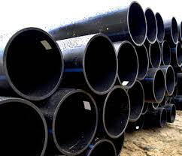
Center Proposition
-We understand chemistry/molecular scale
-We understand processing and the macroscopic
-How do materials self-assemble from the chemistry and
nano-level to the macroscopic in processed industrial materials?
Carbon black filled HDPE pipes for UV absorption.
Dual emergent hierarchical structures.
PE lamella/stacks/fibers/superstructure
CB primary particles/aggregates/clusters/network
How does CB impact rheology and orientation?
How does CB impact crystallinity/crystallization process/crystal hierarchy?
How does crystalline structure impact CB network formation?
How does network formation impact UV absorption/aging/crack formation?

Slide 3
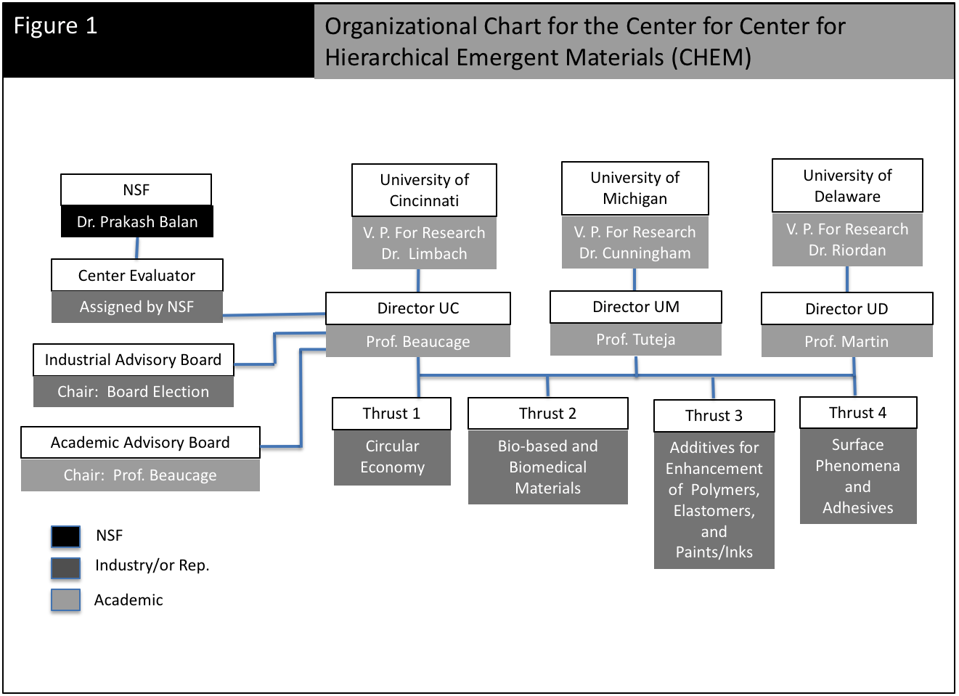
US National Science Foundation funds $450,000 to cover administrative costs/meetings/recruitment/organization
Industrial Members fund $65,000 per Member for research projects jointly administered through the Industrial Advisory Board (IAB)

Slide 4
The Center for Hierarchical Emergent Materials (CHEM)
Thrust 1
Circular Economy
HDPE/iPP removal of additives
Recycling of elastomers
Nanoparticles from tires in electric cars
Interface of HDPE/iPP in compatiblized blends
Thrust 3
Polymer/Paints/Ink Additives
Thermal control of aggregate/particle structure
Dispersion of nano-particles in polymers and inks
Network emergence of carbon black and silica in tires
Network of carbon black in HDPE pipes for UV
Quantification of branching in HDPE
Rheological impact of long-
and short- chain branching
Thrust 2
Bio-based and Biomedical Materials
Leaching from rubber and polyolefins in syringes
(COVID prefilled syringes)
Synthetic skin for cosmetics testing
Thrust 4
Surface Phenomena and Adhesives
Super hydrophobic/super hydrophilic surfaces
Network structural emergence in paints and inks
Polyolefin coatings for barrier properties

Slide 5
The Center for Hierarchical Emergent Materials (CHEM)
Greg Beaucage, Scattering, Nanocomposites, Pigments, Polyolefins,
in situ SAXS
Yoonjee Park, Skin/Surfactants, Biomed delivery
Jon Nickels, Scattering, Aqueous Systems
Neil Ayers, Synthesis, Polymers, Surfactants, Surfaces
Dave Martin, Microscopy, Conjugated Polymers, Crystalline Structure
Arthi Jayaraman, Simulation, Polymer Grafted Nanoparticles
Darrin Pochan, Surfactants, Polymers, Microscopy, CryoSTEM
Norm Wagner, Rheology, Scattering, Rheo-SANS,
in situ SANS
Anish Tuteja, Surfaces, Dispersion
Nick Kotov, Complex Hierarchies
Ron Larson, Rheology, Simulation,
Rheological Modeling
Jinsang Kim, Synthesis, Polymers, Biomedical, Sensors

Slide 6
Participants in planning meeting:
NIOSH (Centers for Disease Control)
Air Force Research Labs
W. L. Gore & Associates
Procter & Gamble
Dupont
Avery Dennison
Becton Dickenson
Sun Chemical
Michelman
Merck
Shepherd Color
LyondellBasell?
Chemours
Sherwin Williams
Bridgestone Firestone
International Paper
Ford
Polyone
ExxonMobil
Omya
Krauss-Maffie
PPG silica
Sumitomo Rubber
BASF
SABIC
Novartis
Evonik
Unilever
Colgate
HP
Clariant
Wacker Chemie
Dow Silicones
Nova Chemicals
Ashland Chemicals
3M
Ticona-Celenese
IBM
Intel
Johnson & Johnson
Others:
Solvay
Merck
Mirexus Biotechnologies
Heraeus Medical Components
Momentive
Arlanxco
Cabot
AkzoNobel
Celanese
Current Center Budget
10 Members
$650,000/yr
NSF 3 sites
$450,000/yr
$1,100,000/yr

Slide 7
Two Approaches to Center Membership
Find a specific project that the center can address and use your
membership to fund that project.
Advantage of Center:
0% overhead rate
Interaction with other industries involved in CHEM, workshops, training
Personnel exchange with Center, identification of new talent
Informal interaction with other faculty in the Center
Ease of formation of a team to address a problem: simulation, rheologists, microscopists
Money transfer with 0% overhead between Michigan, Cincinnati, Delaware and other campuses
2) Preferred approach:
Develop a group of non-competitive, supply line partners to fund a project
Advantage of Center:
Work on common problem that can’t be easily addressed by one company
Take advantage of multiple areas of expertise, Center handles recruitment and organization

Slide 8
Steps Necessary to Develop a Project
Through discussion with faculty and industry identify areas of commercial importance addressable by unique Center capabilities
Identify and recruit non-competitive industrial partners
Solicit Faculty proposals or identify faculty team
Present proposal at IAB meeting or by informal formation of a sub-IAB group
One Center membership can support multiple projects depending on the number of companies involved in a project
Generally a project is expected to cost about $65,000 with no overhead (equivalent to $100,000 for a full overhead grant). This supports one graduate student or one post doc.

Slide 9
Goal: to find problems common to a supply chain
Remove Additives from HDPE/iPP waste stream:
“The recycling supply chain is complicated.
For completeness a supply chain in recycling should include
-a brand owner (e.g. P&G),
-optionally a packaging design firm (if the brand owner does not do themselves),
-a polyolefin producer (e.g. Lyondell),
-a film producer (e.g. Lyondell),
-an ink, adhesives, and coatings producer (Sun Chemical),
-a flexible packaging converter (e.g. Amcor, Bryce, or others),
-a label producer (e.g. Fort Dearborn, American Fuji Seal, or Multi Color Corporation),
-a recycler (e.g. Waste Management, maybe Rumpke in Cincinnati),
-a Materials Recovery Facility (MRF, e.g. Rumpke),
-and equipment manufacturers as needed.
-It may also be useful to involve the APR whose certification may be critical to success at some point.”

Slide 10
Some Potential Areas of
Interest/Academic Expertise for LyondellBasell
-Barrier Properties of Polyolefin Films
-HDPE/iPP removal of additives
-Interface of HDPE/iPP in compatiblized blends
-Network of carbon black in HDPE pipes for UV
-Quantification of branching in HDPE
-Rheological impact of long-
and short- chain branching
- Polyolefin coatings for barrier properties
-Materials data analytics for polyolefins and polyolefin compounds

Slide 11
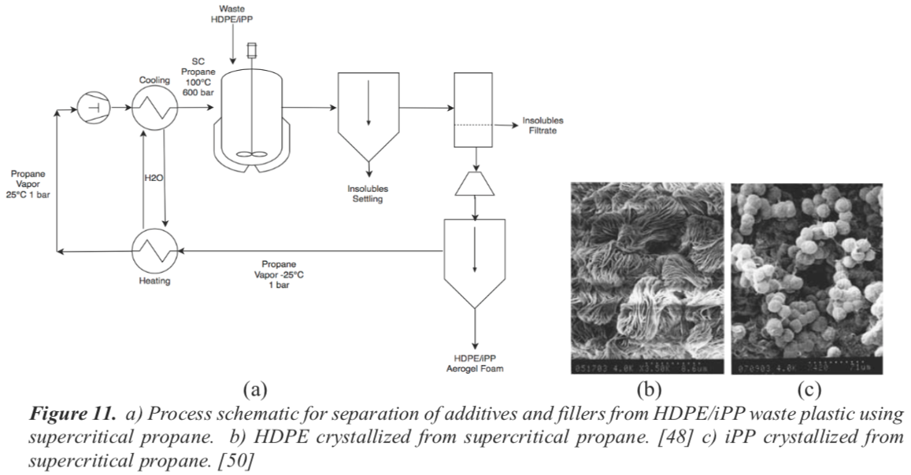
Goal to find problems common to a supply chain
HDPE/iPP removal of additives

Slide 12
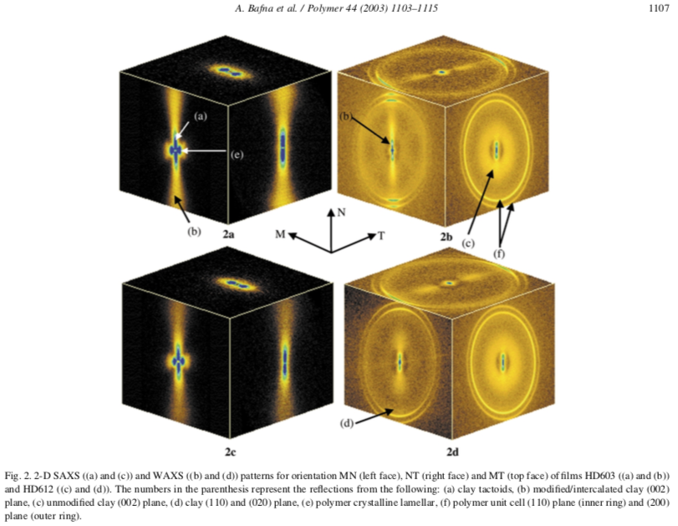
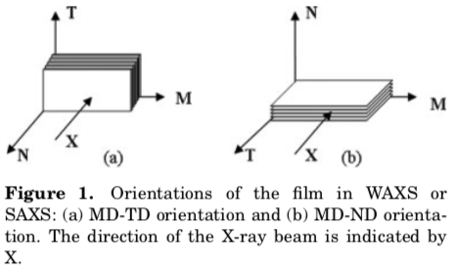
Goal to find problems common to a supply chain
Barrier properties of
polyolefin films
and coatings:

Slide 13
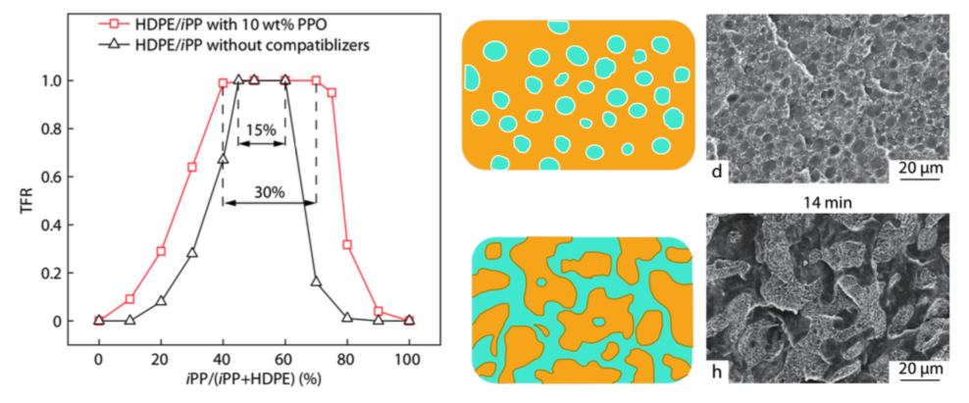
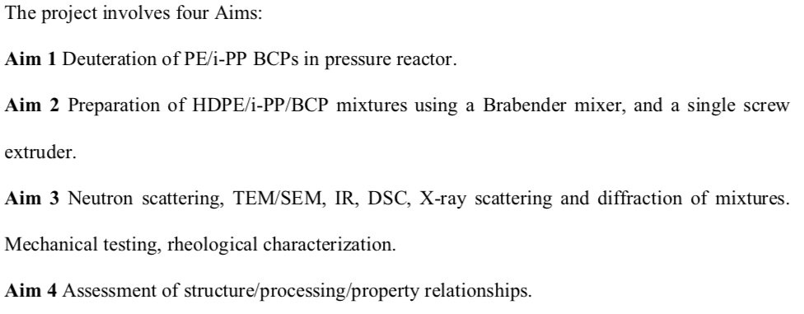
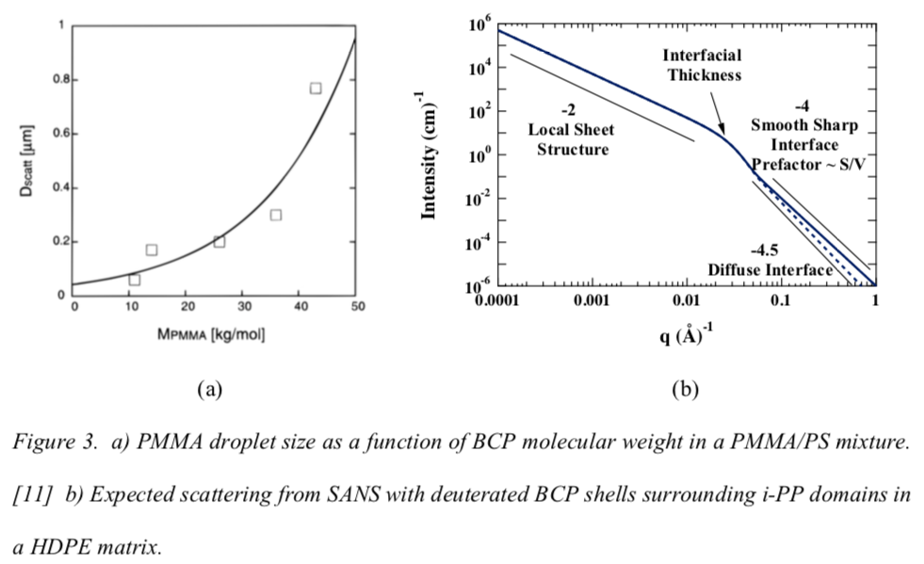
Goal to find problems common to a supply chain
Interface of HDPE/iPP in compatiblized blends :

Slide 14
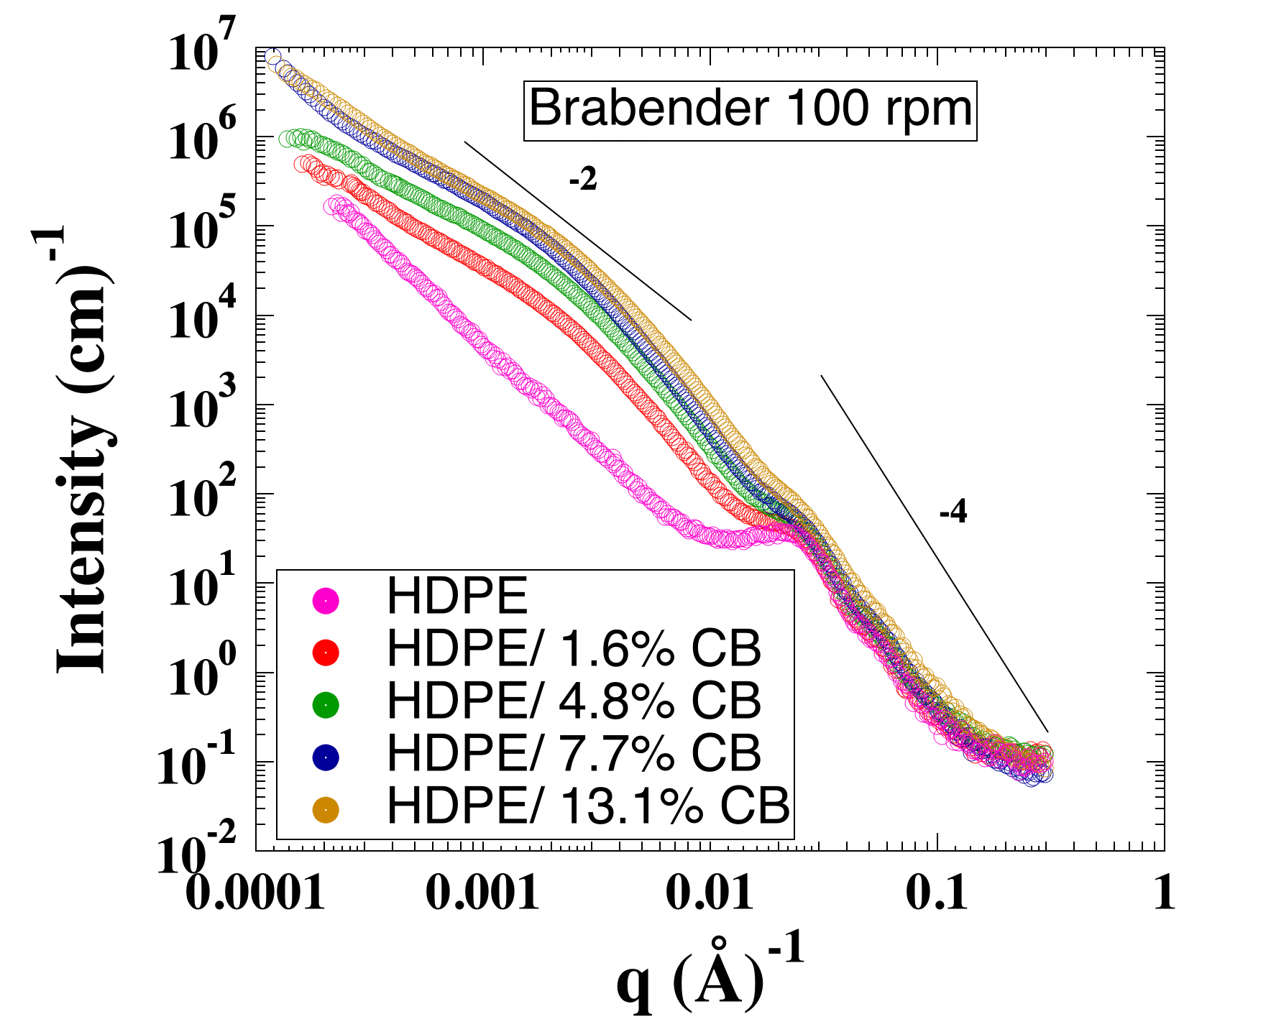
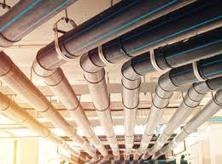
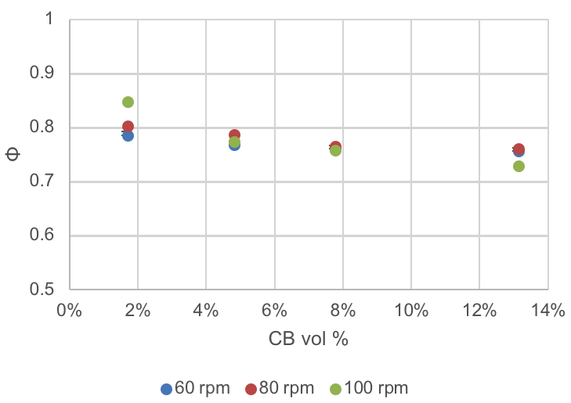
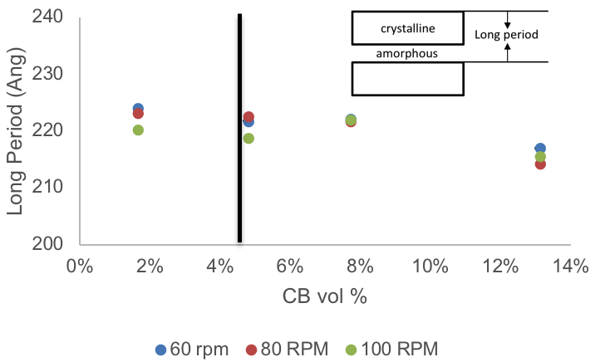
Goal to find problems common to a supply chain
Network of carbon black in HDPE pipes for UV :
As metal piping systems age, water contamination becomes more prevalent
Use of polyethylene (PE) pipes avoids risks of lead and other heavy metal contamination in water
Carbon black (CB) is necessary to provide UV degradation resistance for PE pipes in outdoor applications
While tires filled with CB experience dynamic stresses, PE pipe deals with static stresses with the risk of cracks rapidly propagating leading to catastrophic failures

Slide 15
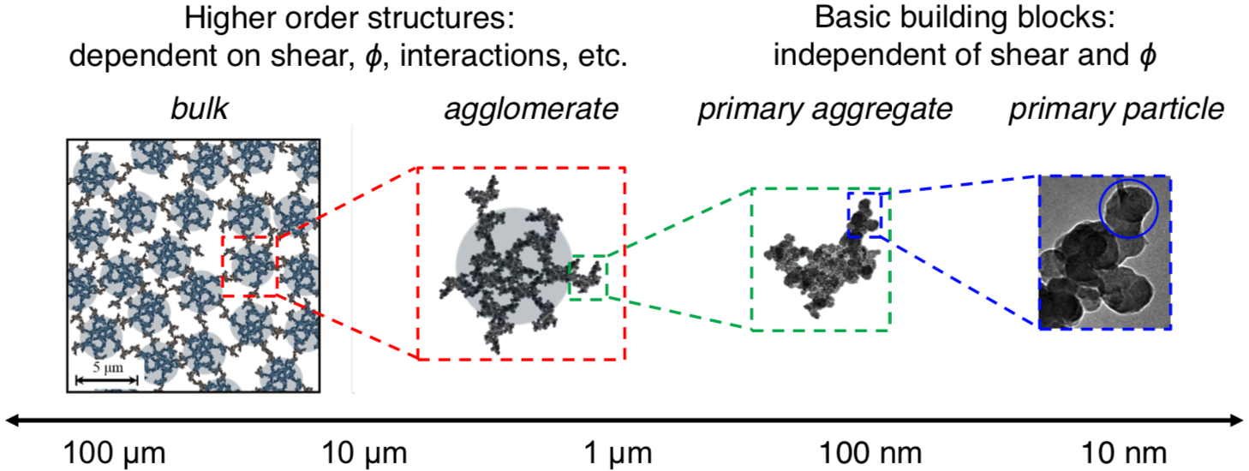
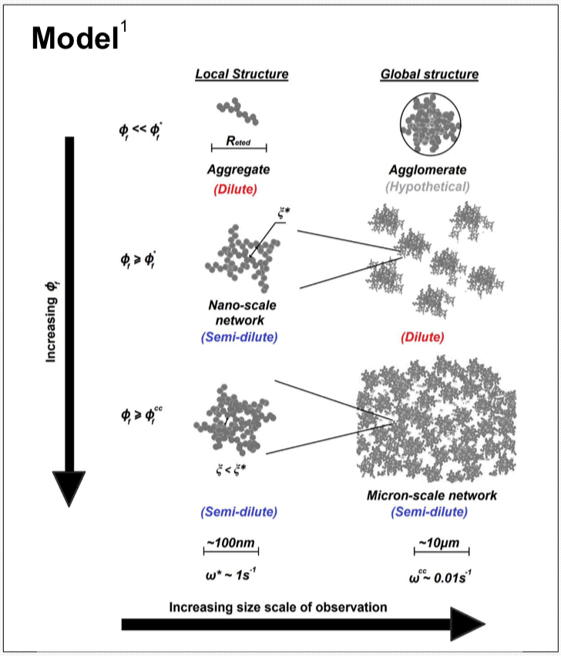
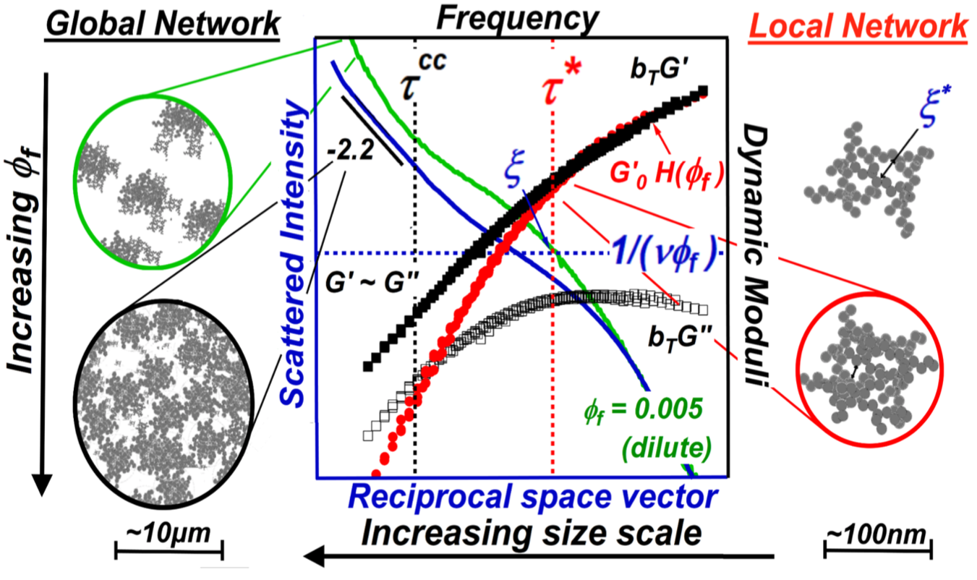
Carbon Black emergent behavior in two applications:
Batteries
Julie Hipp, Jeffery Richards, Norm Wagner (2017 & 2019) Cabot/AkzoNobel
Kabir Rishi, Greg Beaucage (2018) Bridgestone
Tires

Slide 16
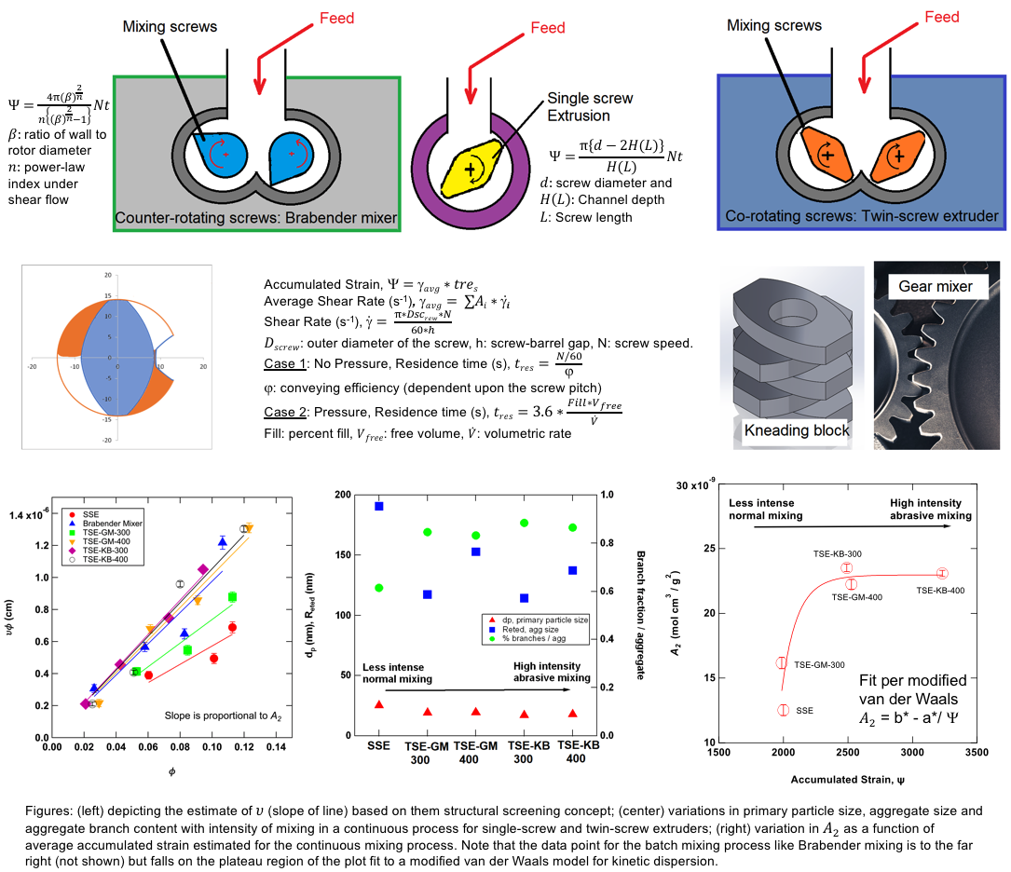
Quantification of nanoscale dispersion and its impact on network formation, KraussMaffei
Beaucage et al.

Slide 17
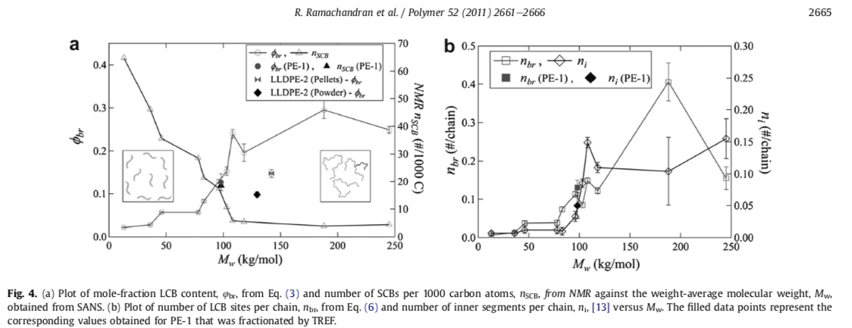
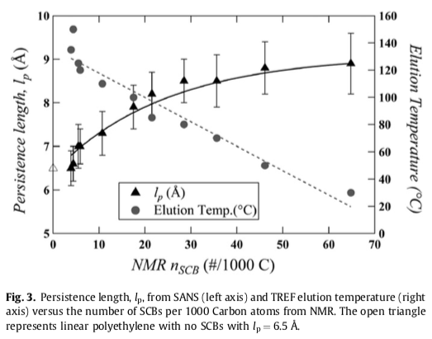
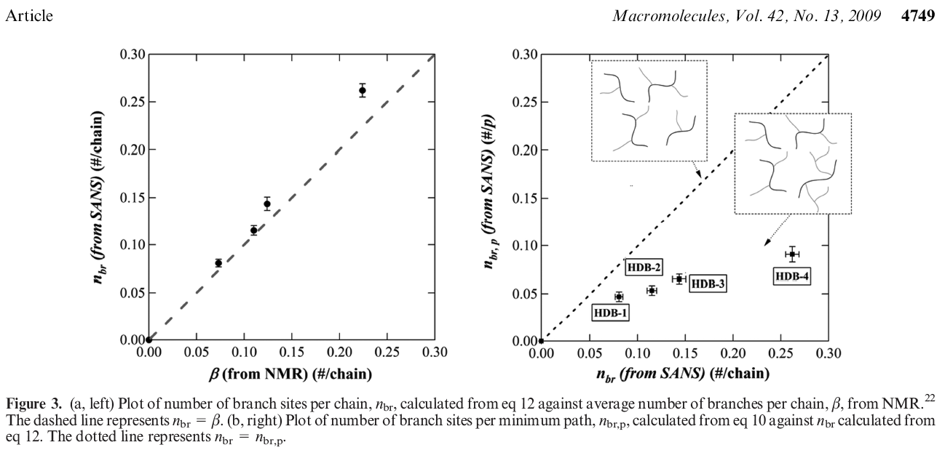
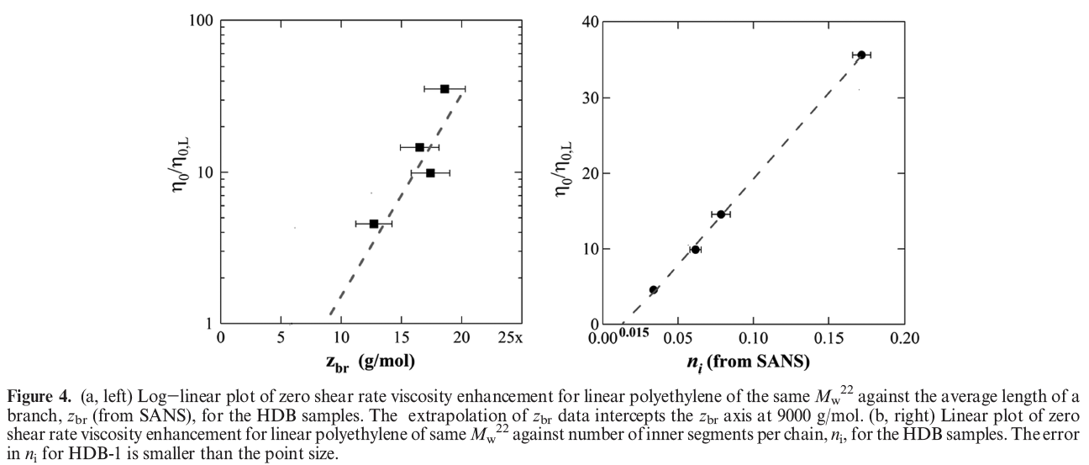
Quantification of branching in HDPE :

Slide 18
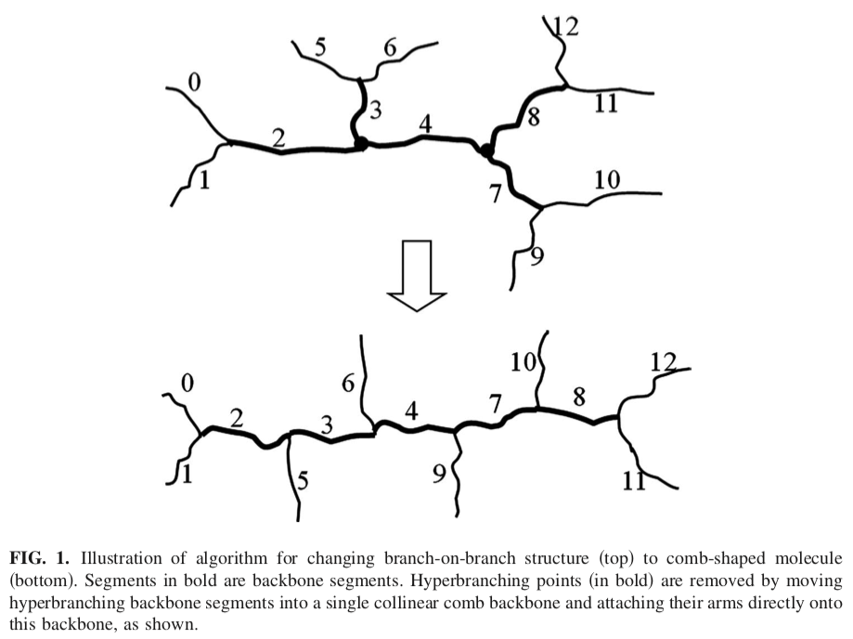
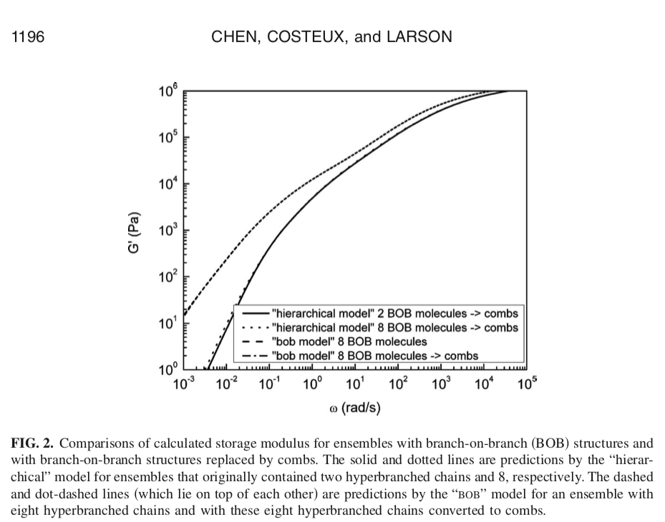
Rheological impact of long-
and short- chain branching
Ron Larson:
Catalysis/rheology/structure
Chen X, Costeux C, Larson RG, Characterization and prediction of long-chain branching in commercial polyethylenes by a combination of rheology and modeling methods J. Rheol. 54 1185-1205 (2010)

Slide 19
Shear thickening fluids
-Norm Wagner: NASA, sports protective equipment, military, many other applications

Slide 20
Materials Data Analytics in Coordination with Dr. Mike Fry of UC Center for Business Analytics, University of Cincinnati

Slide 21
What is needed to form CHEM?
Currently soliciting a letter of intent to join CHEM
If NSF funds the Center in December I will come back and
we will negotiate a membership agreement (draft is available) if
funding is available
Detailed discussion of projects, interaction with team companies to target multiple projects
IAB/Center initiation meeting in February 2022
Initiation of projects
Meetings every 6 months with progress reports
Other interactions: Frequent subgroup meetings, exchange of industrial researchers with universities and university students/faculty with companies
Workshops & training
Access to Center reports on secure webpage

Slide 22
For June 9 need a letter of commitment

Slide 23
The Center for Hierarchical Emergent Materials (CHEM)
Goal: To understand, control and predict the assembly and disassembly (circular economy) of multi-hierarchical materials of industrial relevance. Time dependence in processing/application, 4D.
Business Areas: Reinforced elastomers, paints, inks, semi-crystalline polymers, biomaterials, surfactants, detergents and coacervates, block copolymers, catalysts, filters, membranes, skin, coatings.
Synergy: Dynamic and static properties understood for one field of application could be adapted to other fields. Emergence of structure associated with processing, thermodynamics, kinetics. Rheology simulation methods from polymers to detergents to paints.
Parallelism and Convergence: Similar solutions for different applications. Aggregate pigments and aggregate reinforcing fillers both rely on micron-scale networks in application.

