Slide 1
The Center for Hierarchical Emergent Materials (CHEM)
Goal: To understand, control and predict the assembly and disassembly (circular economy) of multi-hierarchical materials of industrial relevance. Time dependence in processing/application, 4D.
Business Areas: Reinforced elastomers, paints, inks, biomaterials, surfactants, detergents and coacervates, semi-crystalline polymers, block copolymers, catalysts, filters, membranes, skin, coatings.
Synergy: Dynamic and static properties understood for one field of application could be adapted to other fields. Rheology simulation methods from polymers to detergents to paints. Stability of nonionic surfactants and anionic polymers is similar problem in sizing, detergents, pigments, inks, and paints.
Parallelism and Convergence: Similar solutions for different applications. Aggregate pigments and aggregate reinforcing fillers both rely on micron-scale networks in application.

Slide 2
Center Proposition
-We understand chemistry/molecular scale
-We understand processing and the macroscopic
-How do materials self-assemble from the chemistry and nano-level to the macroscopic in processed industrial materials?
Paint is composed of a dispersion of nanoparticles that self assemble during processing, application and during drying to present the final color, translucency, brilliance.
The process is complex. The issues involved are multiscale and hierarchical involving rheology, morphology, chemistry, kinetics. There are many parallel industrial problems involving hierarchical emergence for inks, reinforced elastomers, printed electronics, detergents, co-acerverates, biomimetic and biological systems.

Slide 3
The Center for Hierarchical Emergent Materials (CHEM)
Dave Martin, Microscopy, Conjugated Polymers, Crystalline Structure
Arthi Jayaraman, Simulation, Polymer Grafted Nanoparticles
Darrin Pochan, Surfactants, Polymers, Microscopy
Norm Wagner, Rheology, Scattering
Greg Beaucage, Scattering, Nanocomposites, Pigments
Yoonjee Park, Skin/Surfactants, Biomed delivery
Jon Nickels, Scattering, Aqueous Systems
Neil Ayers, Synthesis, Polymers, Surfactants, Surfaces
Anish Tuteja, Surfaces, Dispersion
Nick Kotov, Complex Hierarchies
Ron Larson, Rheology, Simulation
Jinsang Kim, Synthesis, Polymers, Biomedical, Sensors

Slide 4
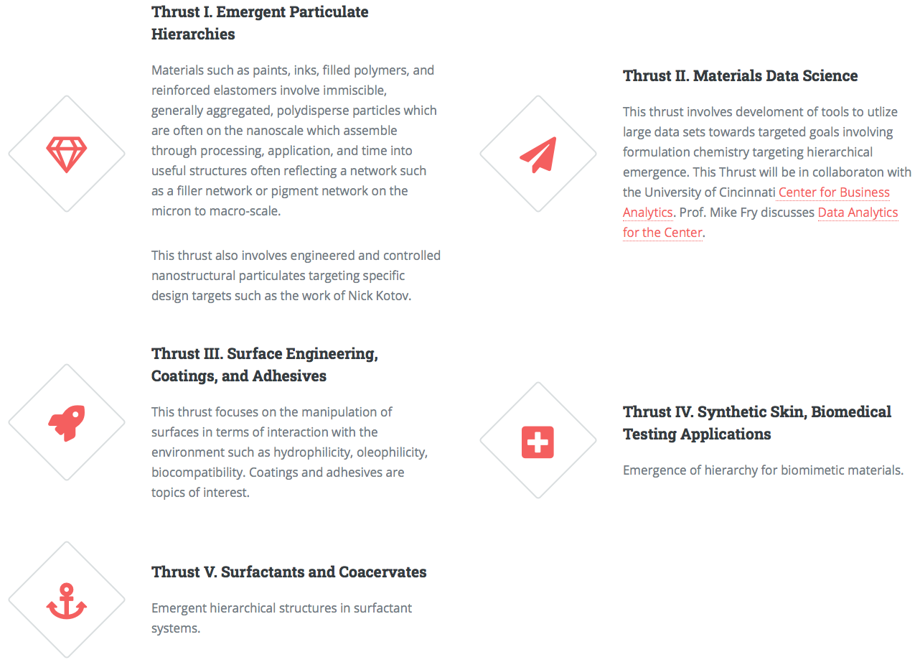
The Center for Hierarchical Emergent Materials (CHEM)

Slide 5
What is needed to form CHEM?
Need 9 to 12 members @ ~$65,000/yr for NSF funding
Need a science/precompetitive approach
For June 9 need a letter of commitment (next slide)
(NSF decision March 2021; Corporate decision and funding May–June 2021)
We hope to grow to ~30 corporate members in 4 years
Fund research projects targeting pre-competitive industrial needs
Recruit new faculty in this area
Purchase equipment for the center needs
Host topical meetings and workshops
Interchange students with industry/National Labs
Encourage industrial participation in research projects Fund industrial residencies for students/post docs (Funded by NSF INTERN)
Host industrial/lab scientists and engineers at the universities
Interact with parallel centers in Europe and Asia
Provide a long-term relationship with potential new hires

Slide 6
For June 9 need a letter of commitment

Slide 7
Participants in planning meeting:
NIOSH (Centers for Disease Control)
Air Force Research Labs
W. L. Gore & Associates
Procter & Gamble
Dupont
Avery Dennison
Becton Dickenson
Sun Chemical
Michelman
Merck
Shepherd Color
LyondellBasell
Chemours
Sherwin Williams
Bridgestone Firestone
International Paper
Ford
Polyone
ExxonMobil
Omya
Krauss-Maffie
PPG silica
Sumitomo Rubber
BASF
SABIC
Novartis
Evonik
Unilever
Colgate
HP
Clariant
Wacker Chemie
Dow Silicones
Nova Chemicals
Ashland Chemicals
3M
Ticona-Celenese
IBM
Intel
Johnson & Johnson
Others:
Solvay
Merck
Mirexus Biotechnologies
Heraeus Medical Components
Momentive
Arlanxco
Cabot
AkzoNobel
Celanese

Slide 8
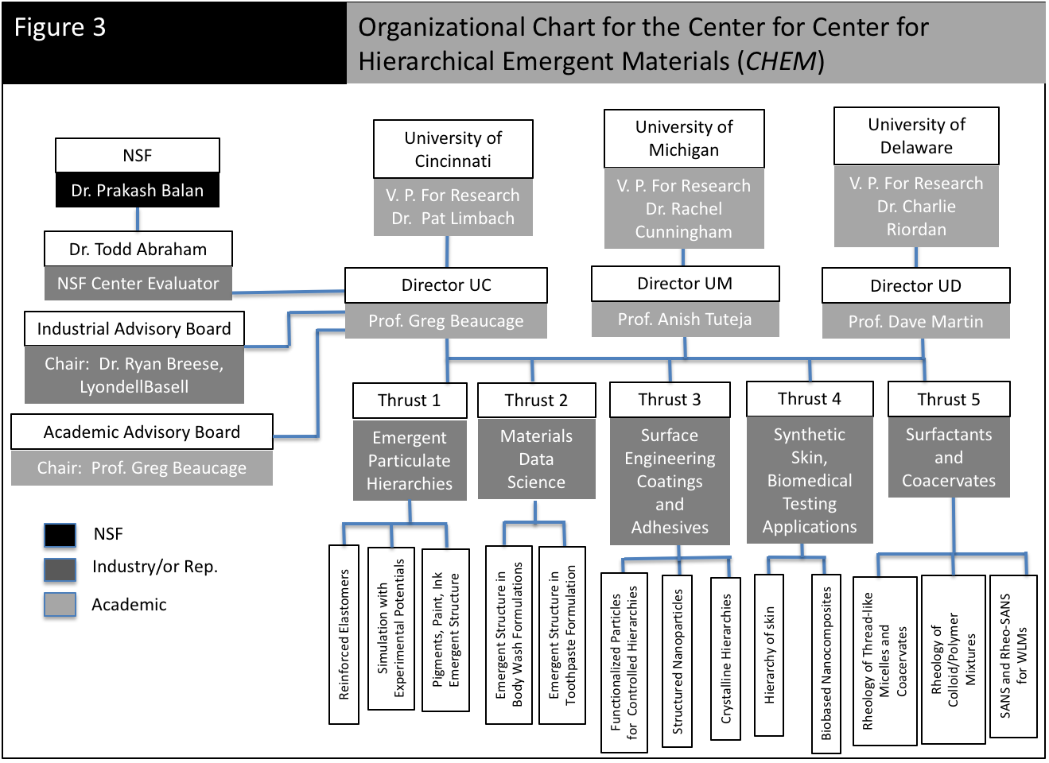

Slide 9
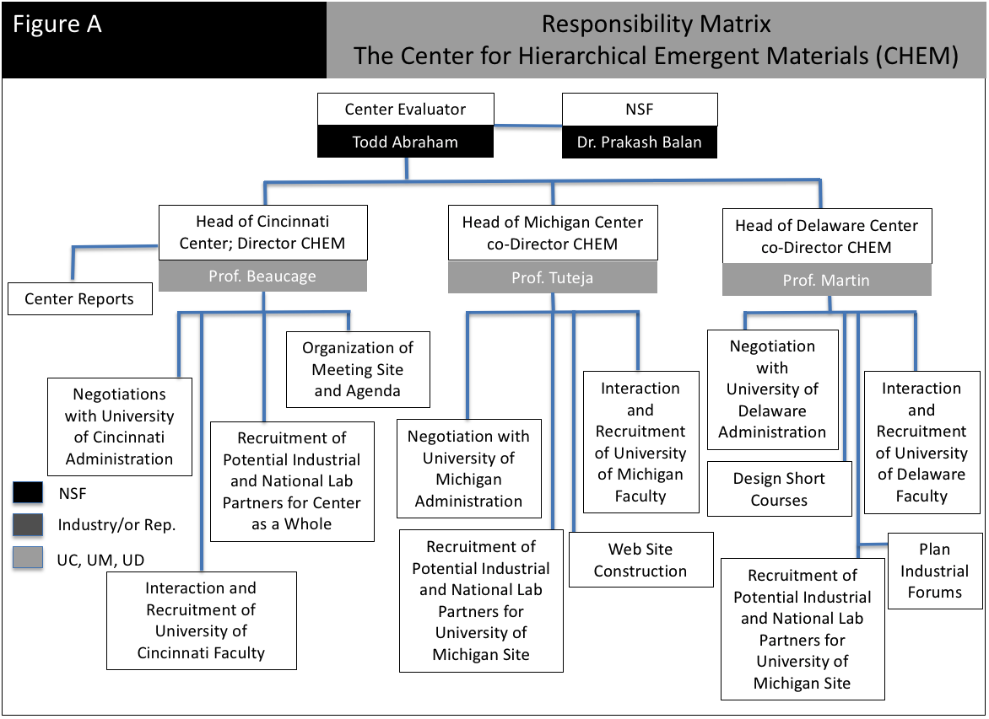

Slide 10
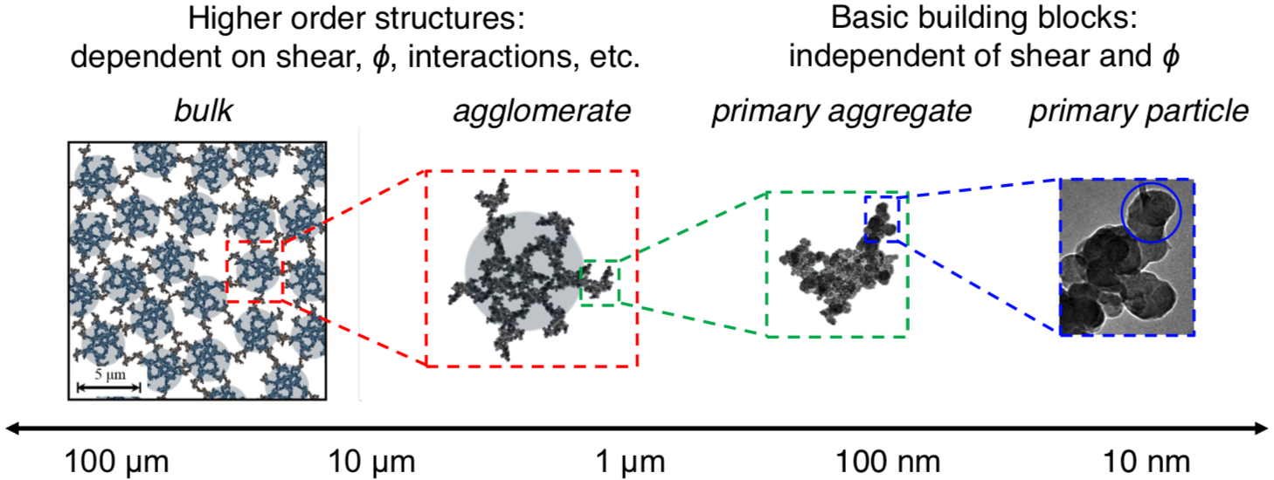
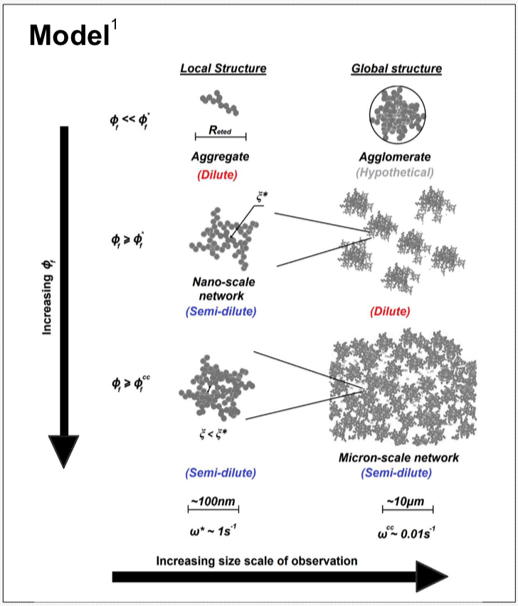
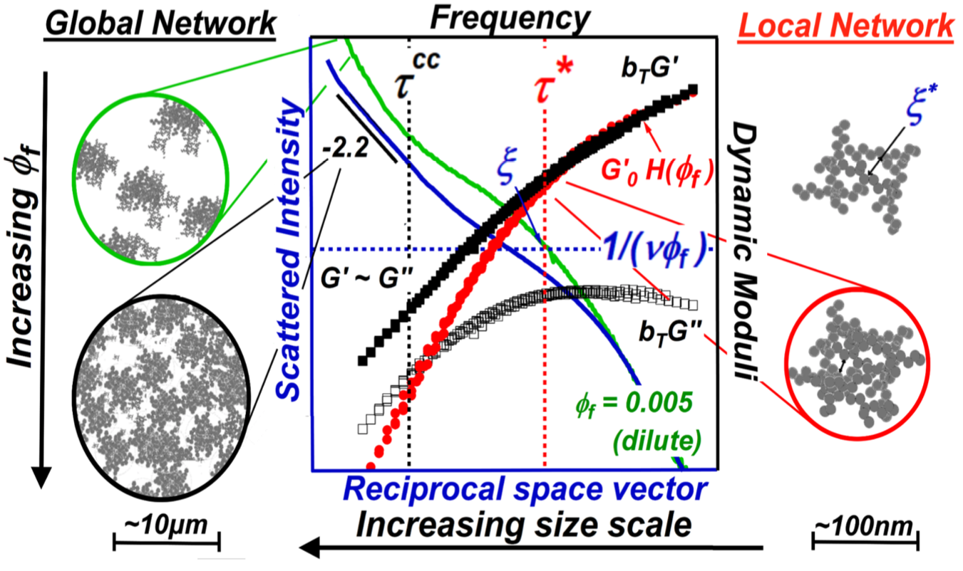
The Center for Hierarchical Emergent Materials (CHEM)
Batteries
Greg Beaucage, Scattering, Nanocomposites, Pigments
Yoonjee Park, Skin/Surfactants, Biomed delivery
Jon Nickels, Scattering, Aqueous Systems
Neil Ayers, Synthesis, Polymers, Surfactants, Surfaces
Julie Hipp, Jeffery Richards, Norm Wagner (2017 & 2019 Poster 001) Cabot/AkzoNobel
Kabir Rishi, Greg Beaucage (2018 Poster 002) Bridgestone
Tires

Slide 11
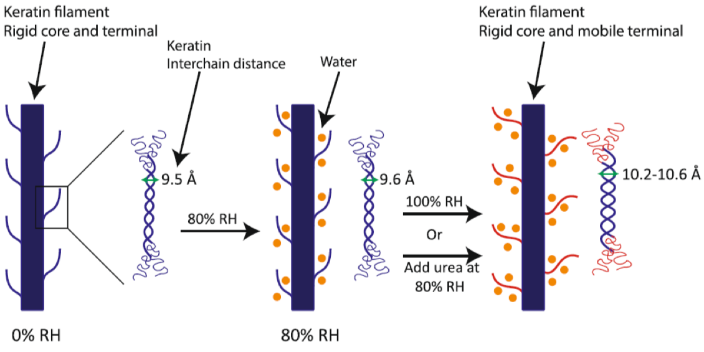
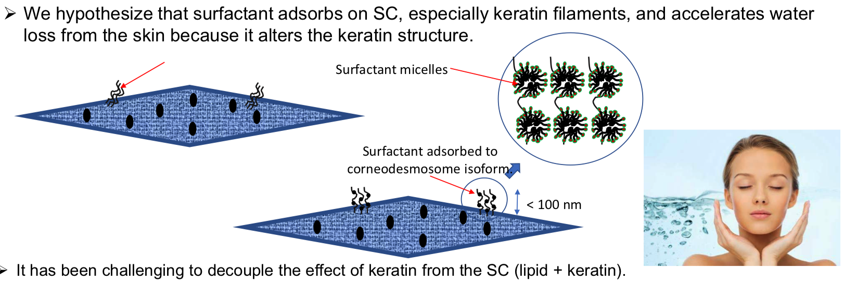
The Center for Hierarchical Emergent Materials (CHEM)
Hierarchy of Skin in the Presence of Surfactants and Moisturizers
Greg Beaucage, Scattering, Nanocomposites, Pigments
Yoonjee Park, Skin/Surfactants, Biomed delivery
Jon Nickels, Scattering, Aqueous Systems
Neil Ayers, Synthesis, Polymers, Surfactants, Surfaces

Slide 12
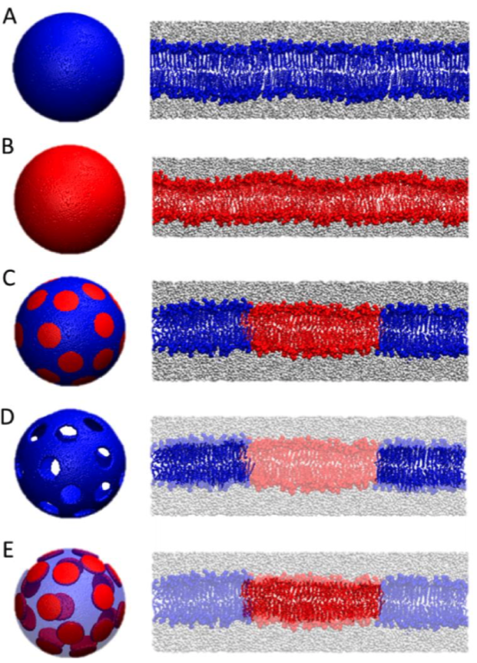
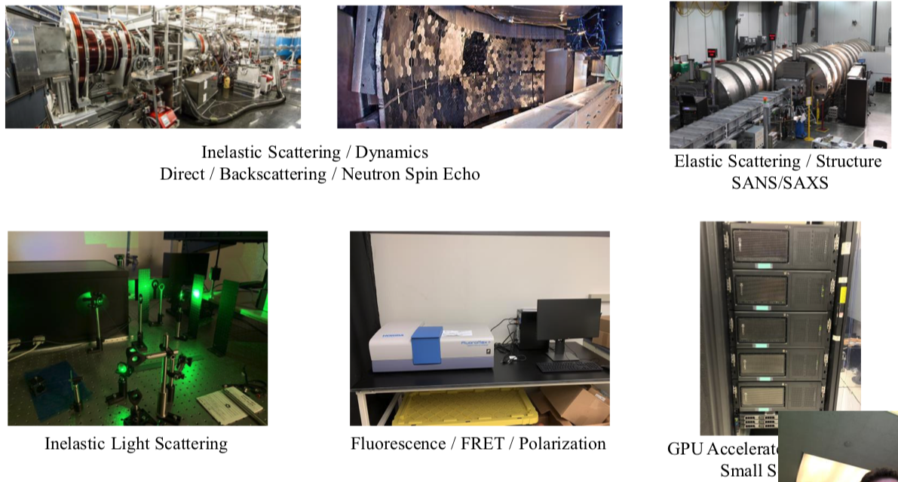
The Center for Hierarchical Emergent Materials (CHEM)
Greg Beaucage, Scattering, Nanocomposites, Pigments
Yoonjee Park, Skin/Surfactants, Biomed delivery
Jon Nickels, Scattering, Aqueous Systems
Neil Ayers, Synthesis, Polymers, Surfactants, Surfaces

Slide 13
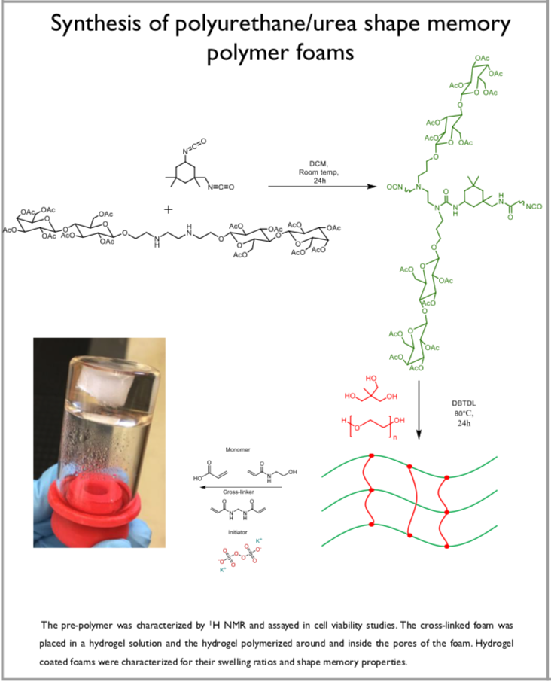
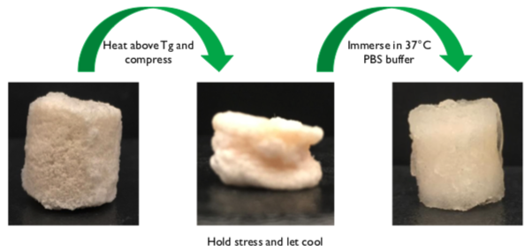
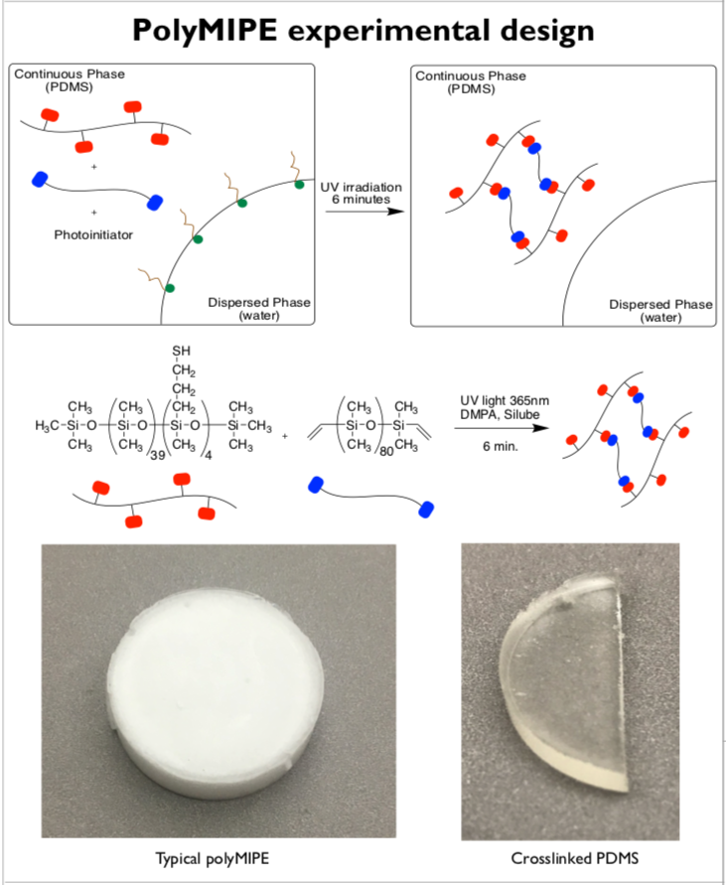
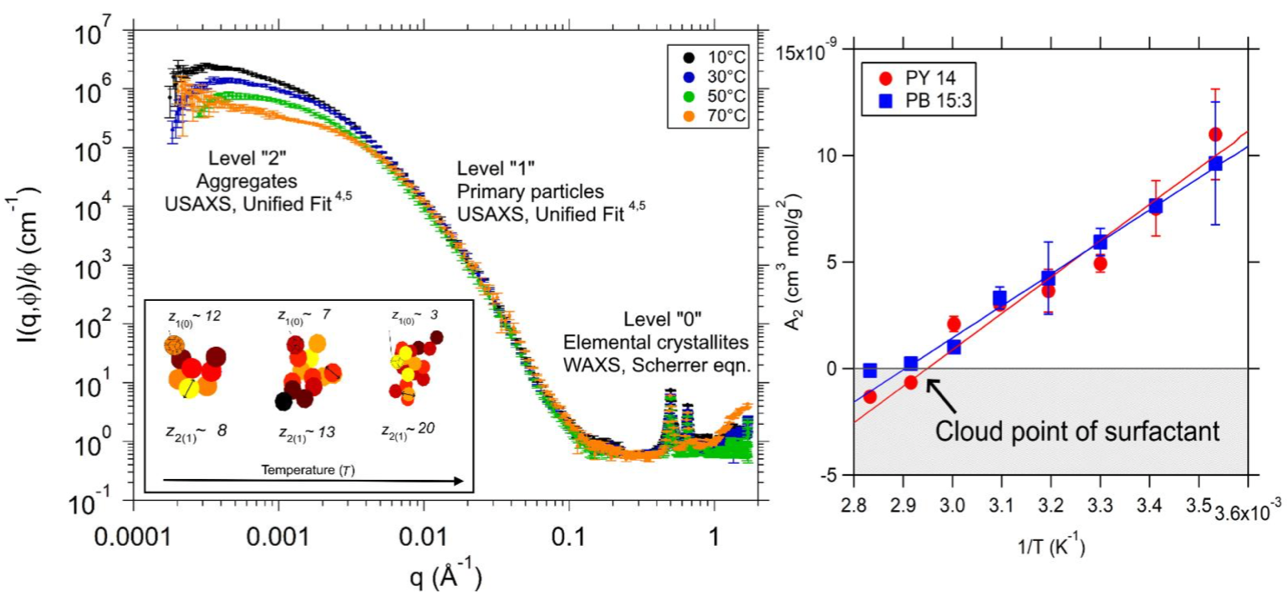
The Center for Hierarchical Emergent Materials (CHEM)
Greg Beaucage, Scattering, Nanocomposites, Pigments
Yoonjee Park, Skin/Surfactants, Biomed delivery
Jon Nickels, Scattering, Aqueous Systems
Neil Ayers, Synthesis, Polymers, Surfactants, Surfaces
Thermal Control of Emergent
Multi-hierarchical Structure in Commercial Pigments

Slide 14
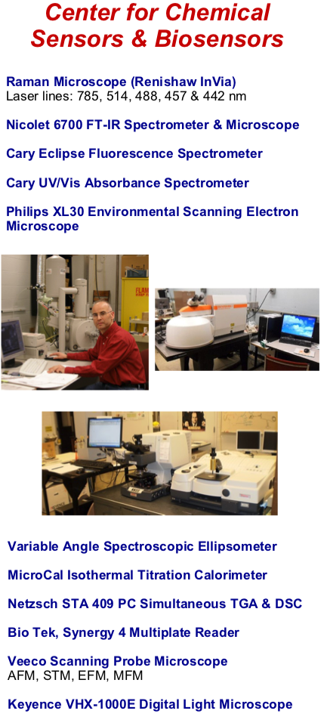
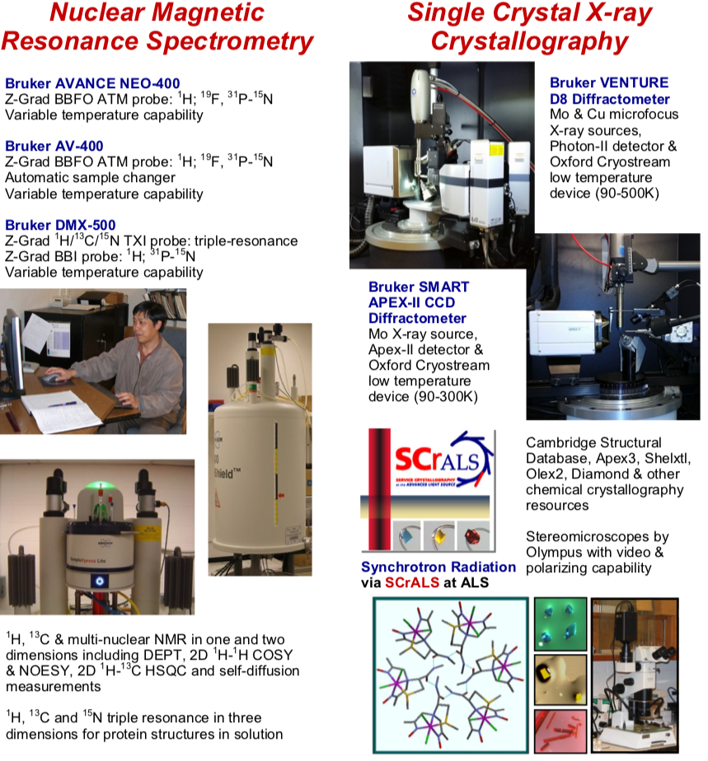
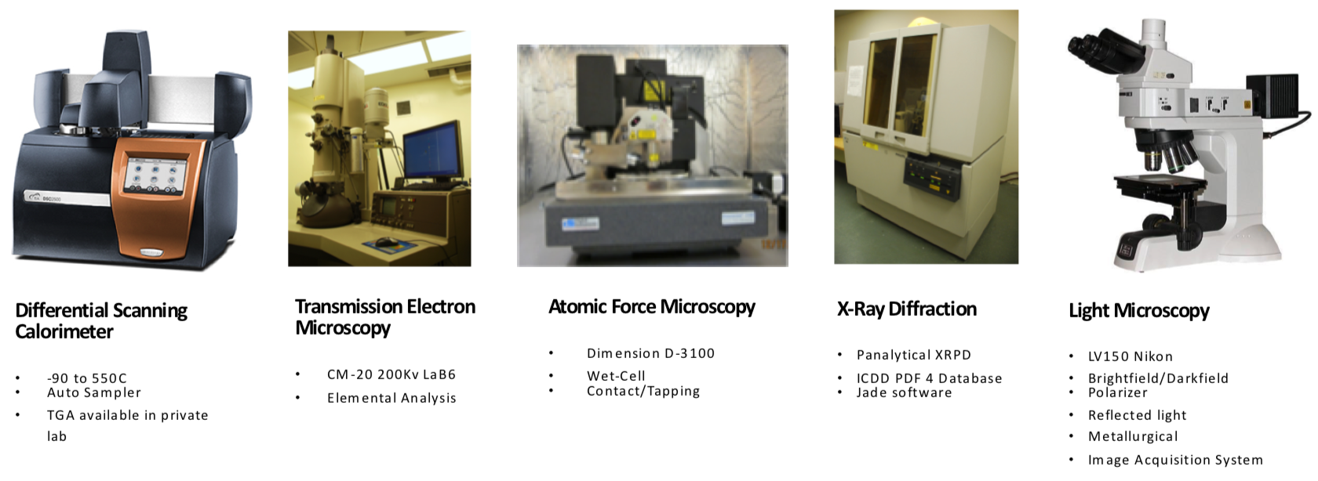
The Center for Hierarchical Emergent Materials (CHEM)

Slide 15
Thrust II Materials Data Analytics in Coordination with Dr. Mike Fry of UC Center for Business Analytics (Section C of the program Analytic Centers)

Slide 16
Anish Tuteja, Site Director Michigan
Dave Martin, Site Director Delaware

