Slide 1
USAXS/SAXS from Organic Pigment Samples
August 2014
Dr. Greg Beaucage, University of Cincinnati
Ms. Hanqiu Jiang, PhD Student, University of Cincinnati
Dr. Karsten Vogtt, Post Doctoral Scientist, University of Cincinnati
Dr. Jan Ilavsky, Scientist, Argonne National Laboratory
Department of Chemical and Materials Engineering, University of Cincinnati, Cincinnati OH 45221-0012, 513 373 3454, beaucag@uc.edu, gbeaucage@gmail.com
Notes:
How tortuous/How twisty ..So essentially with the scaling model, we have resolved a complex structure into a topological network of branch sites and a tortuous path through the structure.

Slide 2
Outline:
-Example Fit
-Table of Fit Results for 0.05% Samples
-Plots for Concentration Series and 1µm Films on Mylar
-Plots of Sample Groups for Comparison
-Summary
Notes:
How tortuous/How twisty ..So essentially with the scaling model, we have resolved a complex structure into a topological network of branch sites and a tortuous path through the structure.

Slide 3
Samples Run at APS August 2014
Notes:
How tortuous/How twisty ..So essentially with the scaling model, we have resolved a complex structure into a topological network of branch sites and a tortuous path through the structure.

Slide 4
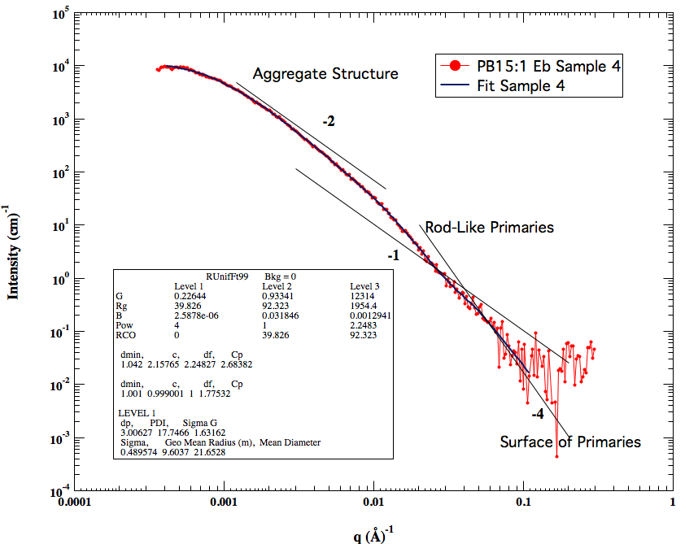
Example Fit
Notes:
How tortuous/How twisty ..So essentially with the scaling model, we have resolved a complex structure into a topological network of branch sites and a tortuous path through the structure.

Slide 5
Notes:
How tortuous/How twisty ..So essentially with the scaling model, we have resolved a complex structure into a topological network of branch sites and a tortuous path through the structure.

Slide 6
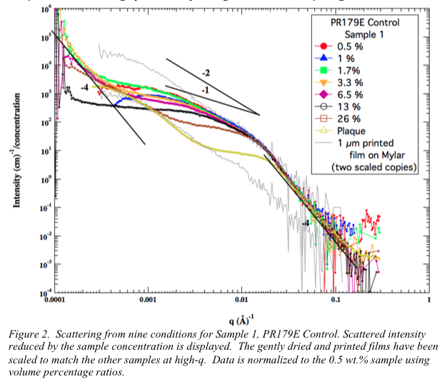
Notes:
How tortuous/How twisty ..So essentially with the scaling model, we have resolved a complex structure into a topological network of branch sites and a tortuous path through the structure.

Slide 7
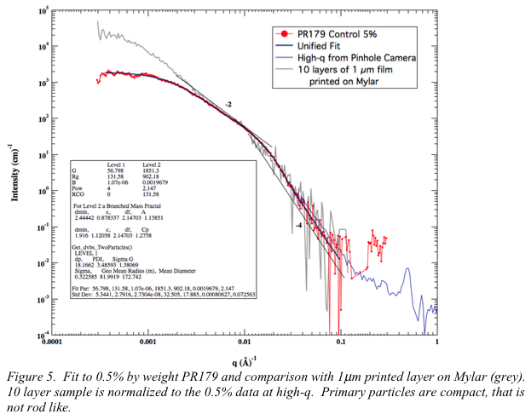
Notes:
How tortuous/How twisty ..So essentially with the scaling model, we have resolved a complex structure into a topological network of branch sites and a tortuous path through the structure.

Slide 8
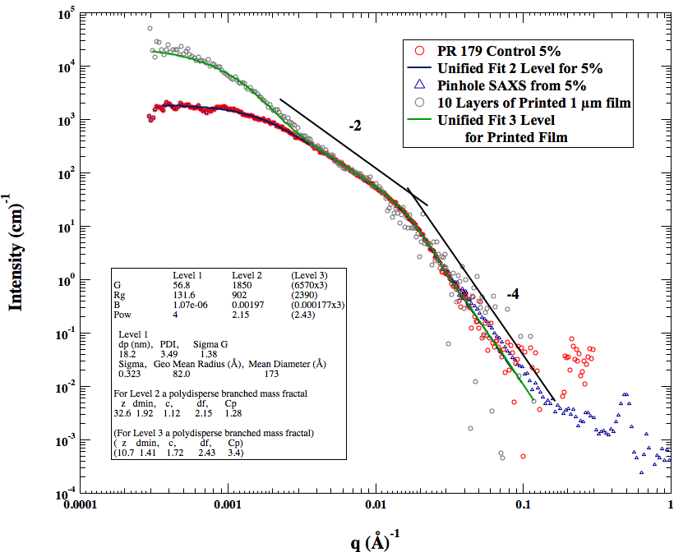
Notes:
How tortuous/How twisty ..So essentially with the scaling model, we have resolved a complex structure into a topological network of branch sites and a tortuous path through the structure.

Slide 9
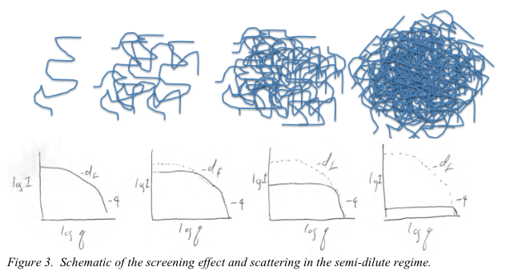

Slide 10
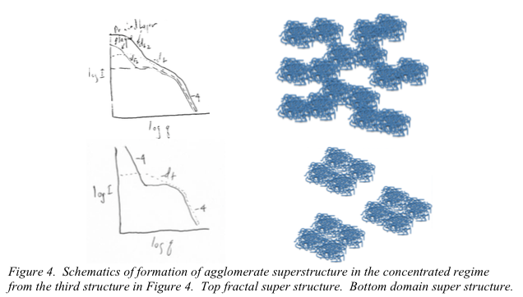

Slide 11
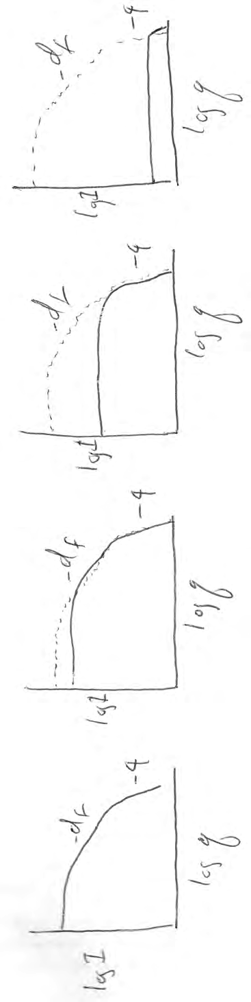
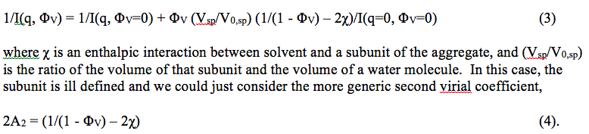
Concentration Series

Slide 12
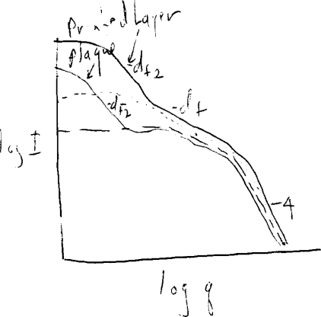
Concentration Series

Slide 13
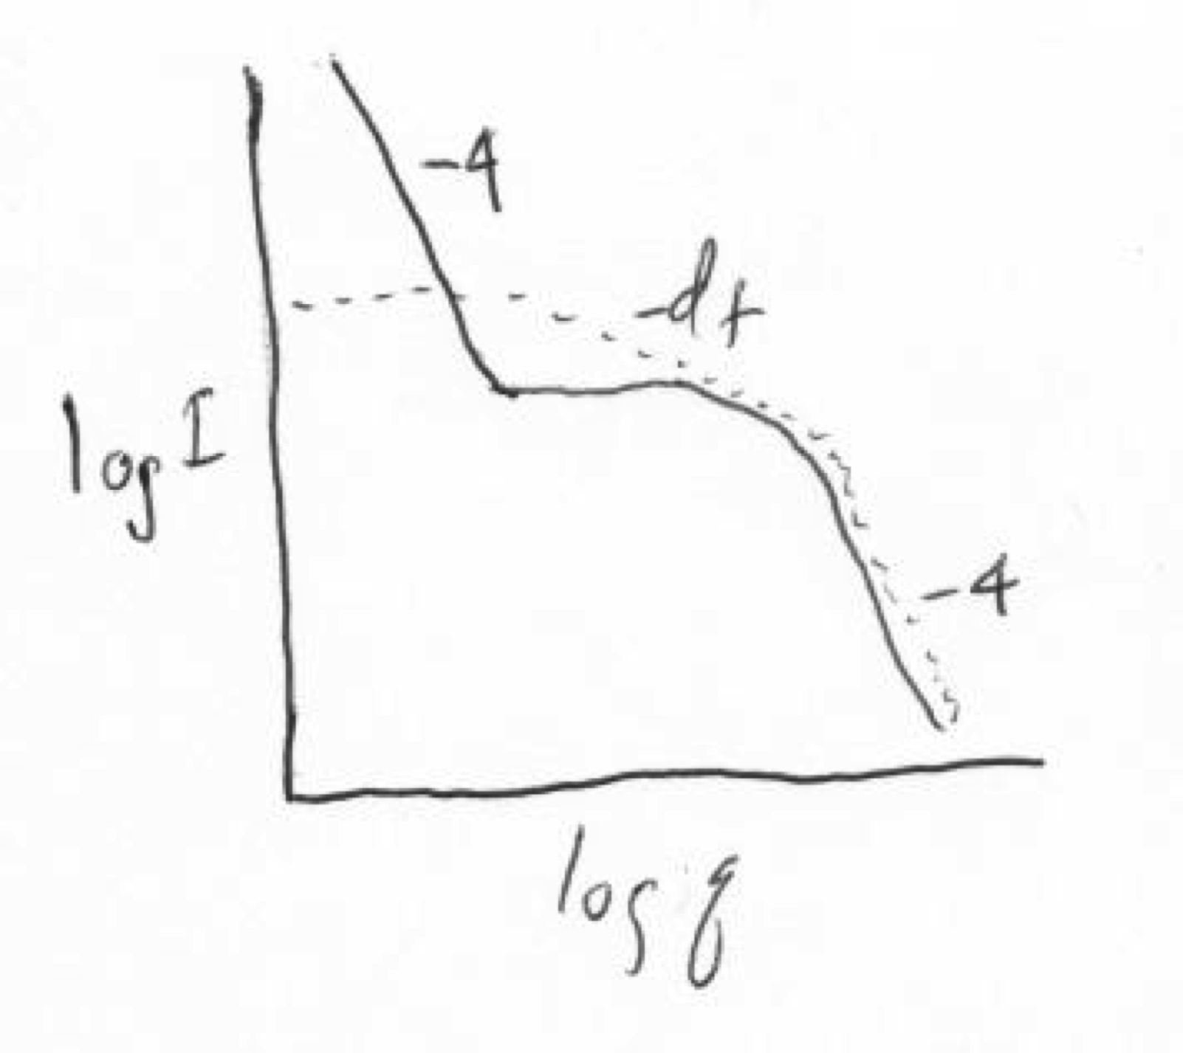
Concentration Series

Slide 14
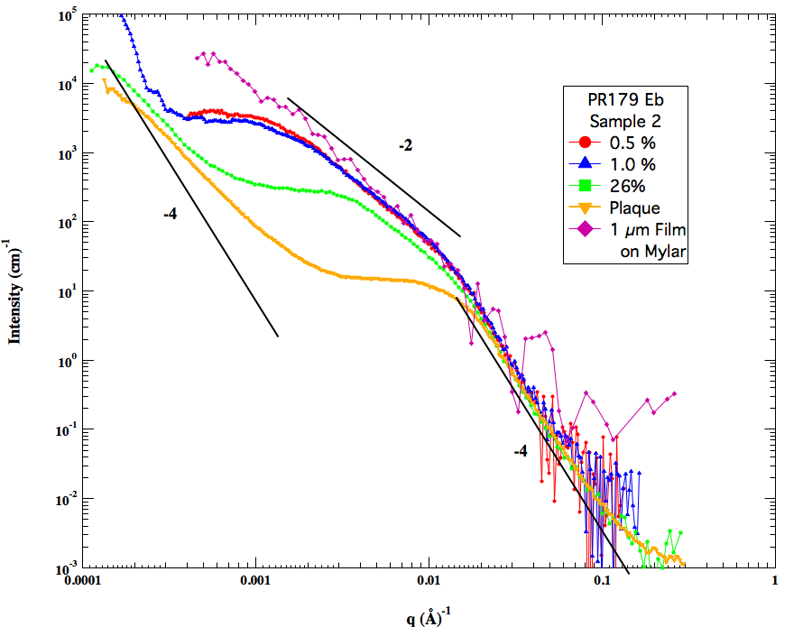
Notes:
How tortuous/How twisty ..So essentially with the scaling model, we have resolved a complex structure into a topological network of branch sites and a tortuous path through the structure.

Slide 15
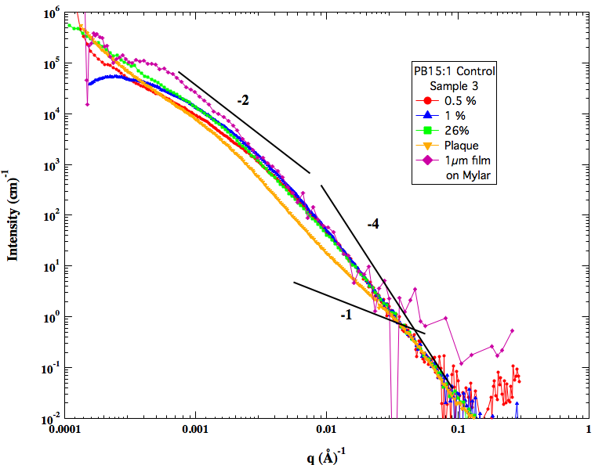
Notes:
How tortuous/How twisty ..So essentially with the scaling model, we have resolved a complex structure into a topological network of branch sites and a tortuous path through the structure.

Slide 16
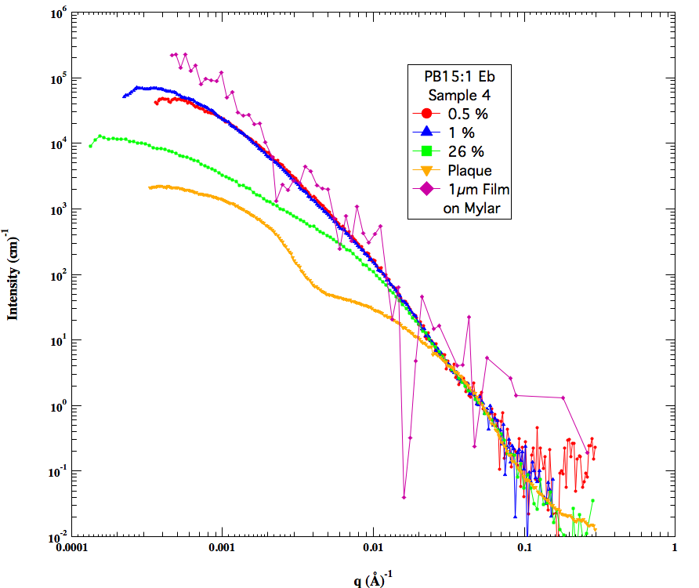
Notes:
How tortuous/How twisty ..So essentially with the scaling model, we have resolved a complex structure into a topological network of branch sites and a tortuous path through the structure.

Slide 17
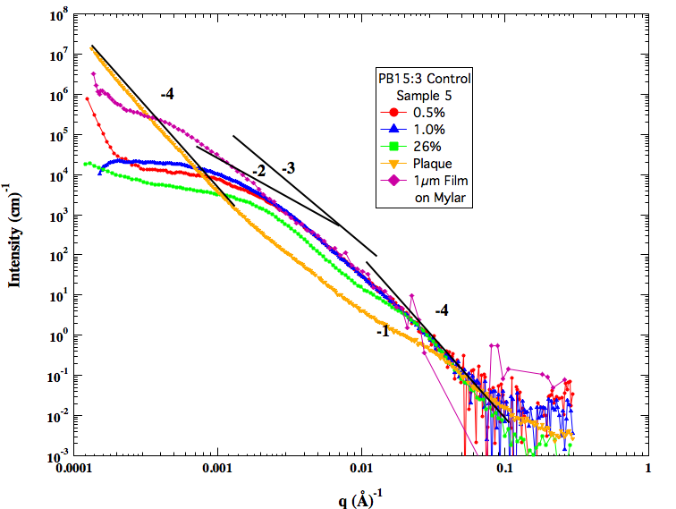
Notes:
How tortuous/How twisty ..So essentially with the scaling model, we have resolved a complex structure into a topological network of branch sites and a tortuous path through the structure.

Slide 18
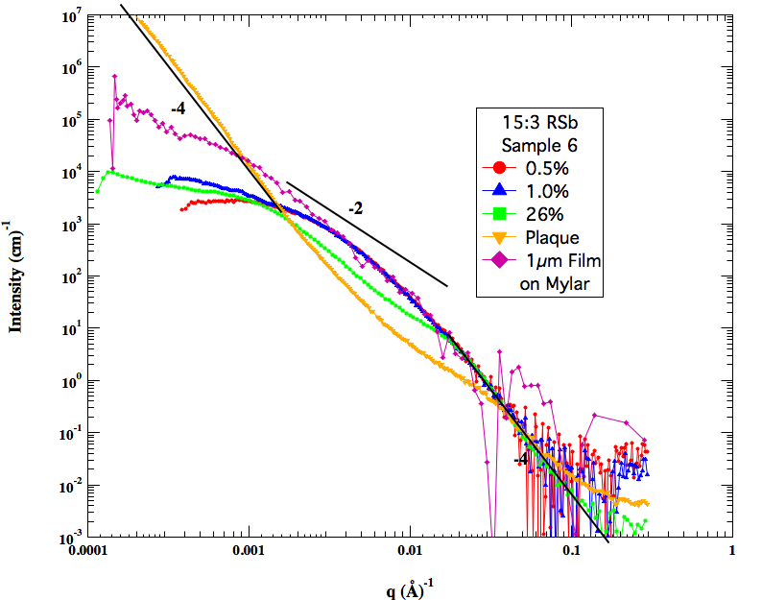
Notes:
How tortuous/How twisty ..So essentially with the scaling model, we have resolved a complex structure into a topological network of branch sites and a tortuous path through the structure.

Slide 19
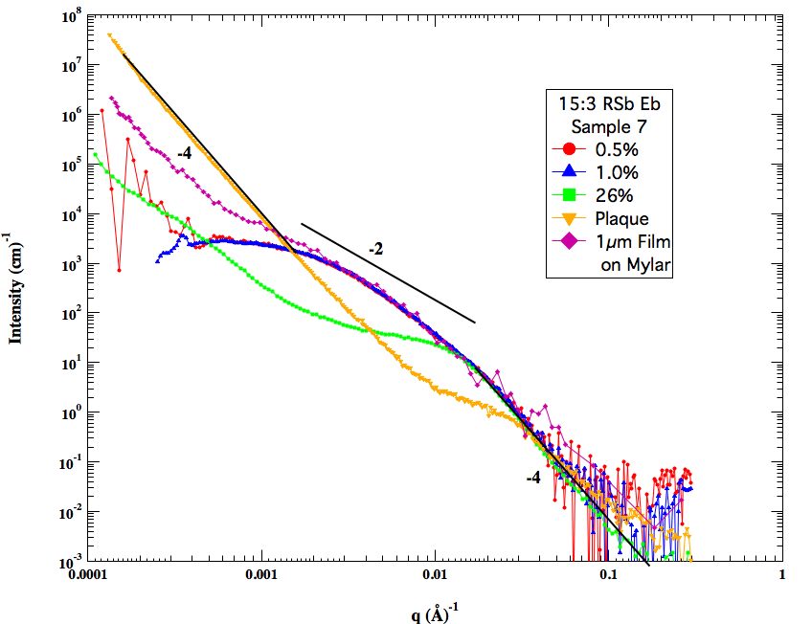
Notes:
How tortuous/How twisty ..So essentially with the scaling model, we have resolved a complex structure into a topological network of branch sites and a tortuous path through the structure.

Slide 20
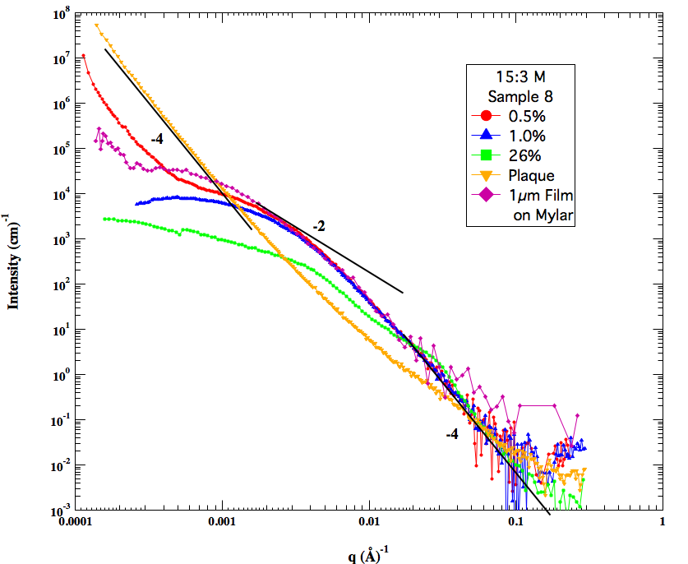
Notes:
How tortuous/How twisty ..So essentially with the scaling model, we have resolved a complex structure into a topological network of branch sites and a tortuous path through the structure.

Slide 21
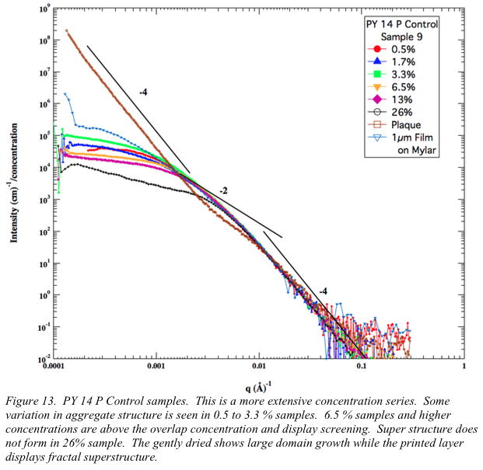
Notes:
How tortuous/How twisty ..So essentially with the scaling model, we have resolved a complex structure into a topological network of branch sites and a tortuous path through the structure.

Slide 22
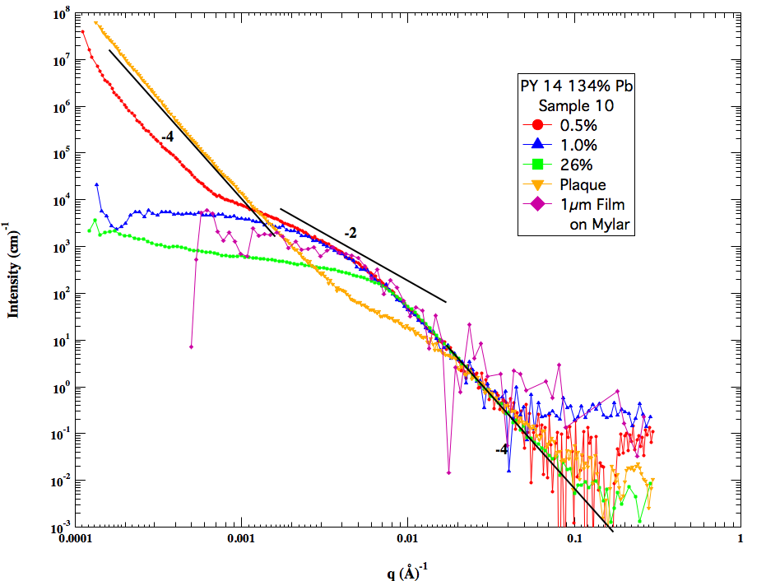
Notes:
How tortuous/How twisty ..So essentially with the scaling model, we have resolved a complex structure into a topological network of branch sites and a tortuous path through the structure.

Slide 23
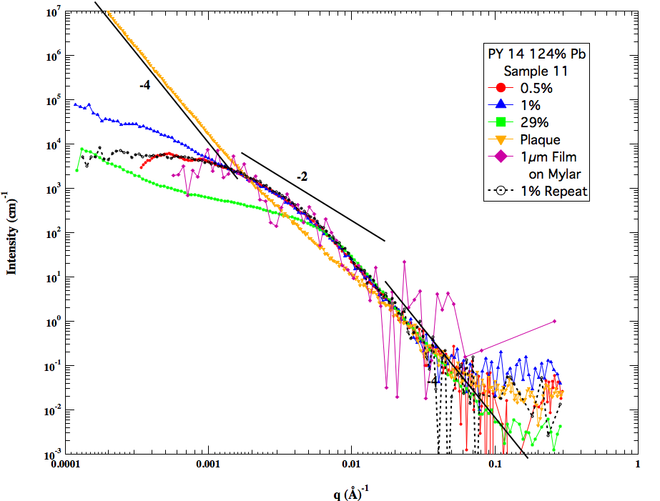
Notes:
How tortuous/How twisty ..So essentially with the scaling model, we have resolved a complex structure into a topological network of branch sites and a tortuous path through the structure.

Slide 24
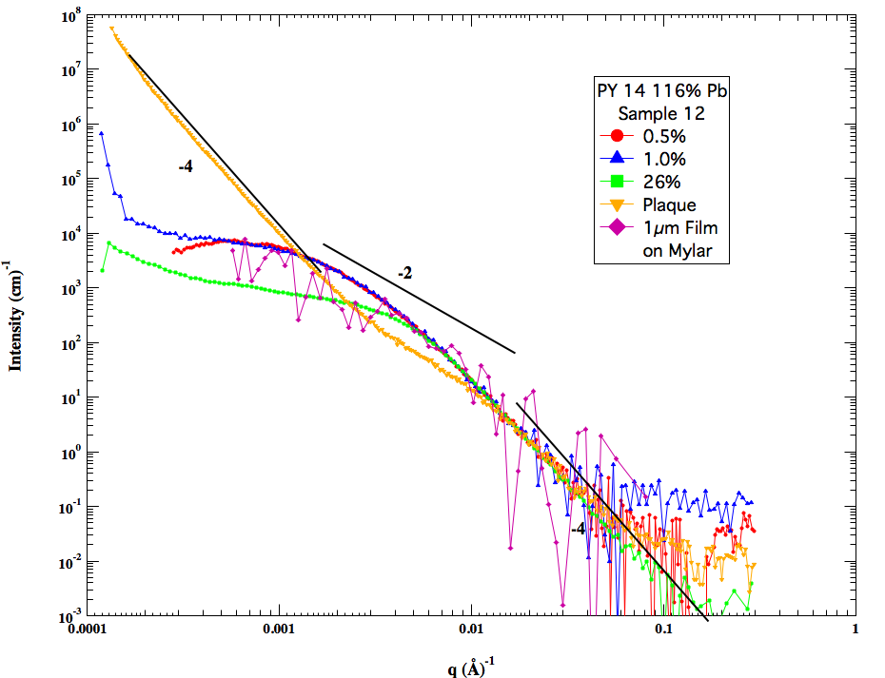
Notes:
How tortuous/How twisty ..So essentially with the scaling model, we have resolved a complex structure into a topological network of branch sites and a tortuous path through the structure.

Slide 25
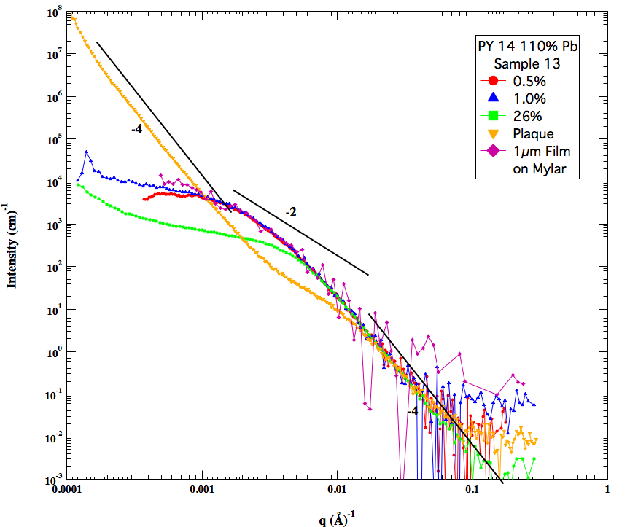
Notes:
How tortuous/How twisty ..So essentially with the scaling model, we have resolved a complex structure into a topological network of branch sites and a tortuous path through the structure.

Slide 26
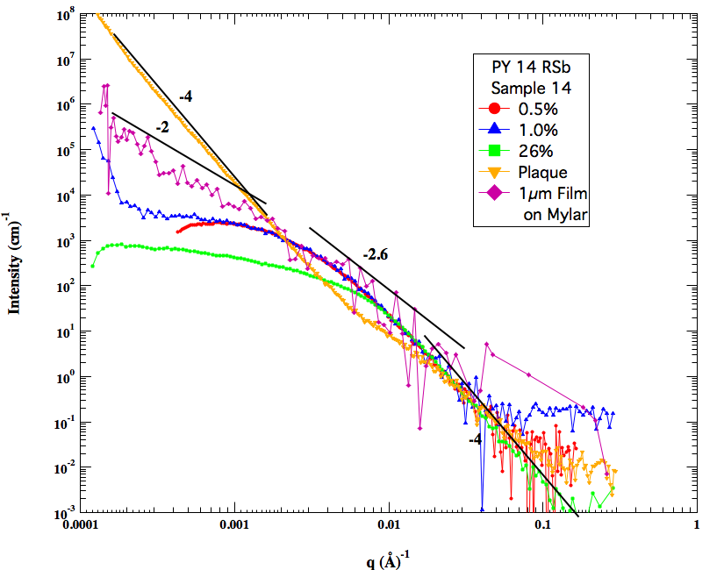
Notes:
How tortuous/How twisty ..So essentially with the scaling model, we have resolved a complex structure into a topological network of branch sites and a tortuous path through the structure.

Slide 27
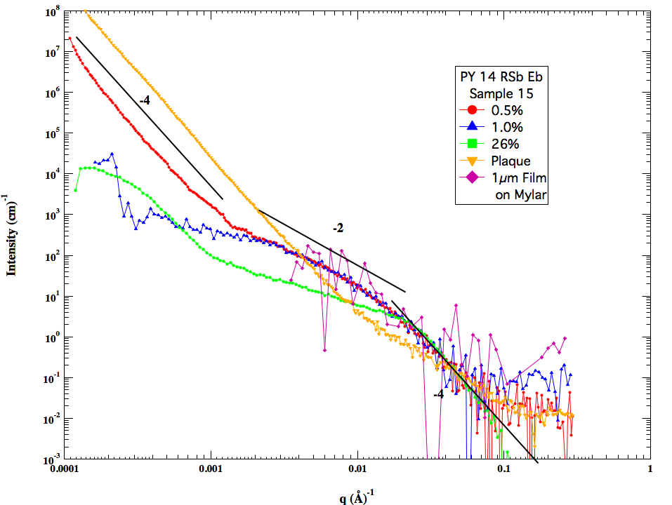
Notes:
How tortuous/How twisty ..So essentially with the scaling model, we have resolved a complex structure into a topological network of branch sites and a tortuous path through the structure.

Slide 28
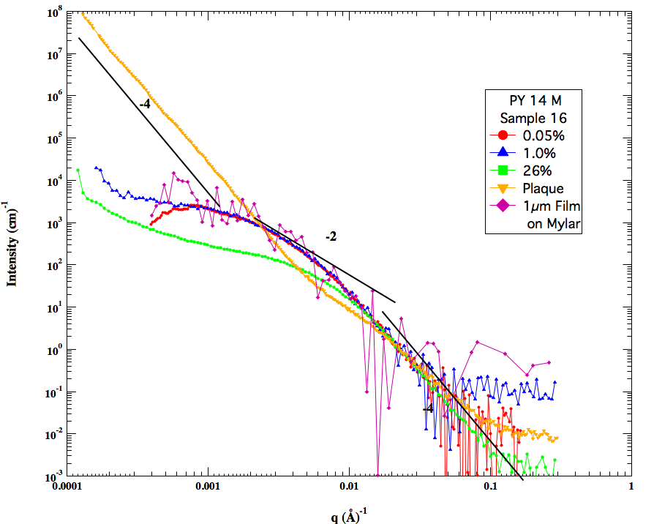
Notes:
How tortuous/How twisty ..So essentially with the scaling model, we have resolved a complex structure into a topological network of branch sites and a tortuous path through the structure.

Slide 29
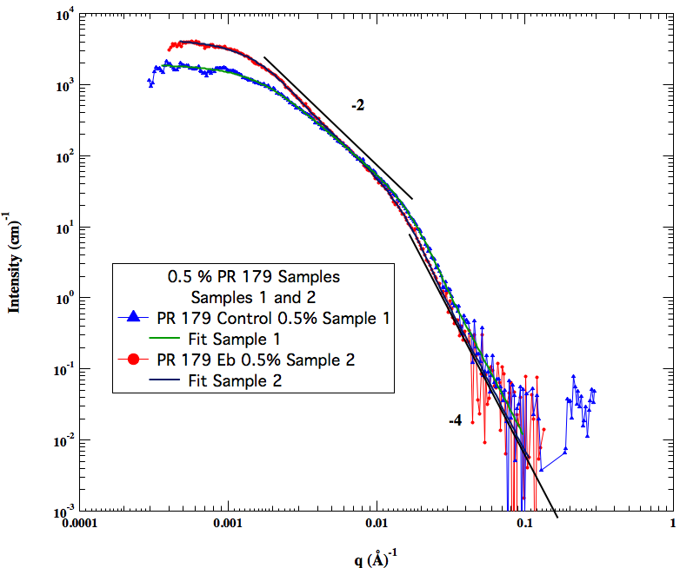
Notes:
How tortuous/How twisty ..So essentially with the scaling model, we have resolved a complex structure into a topological network of branch sites and a tortuous path through the structure.

Slide 30
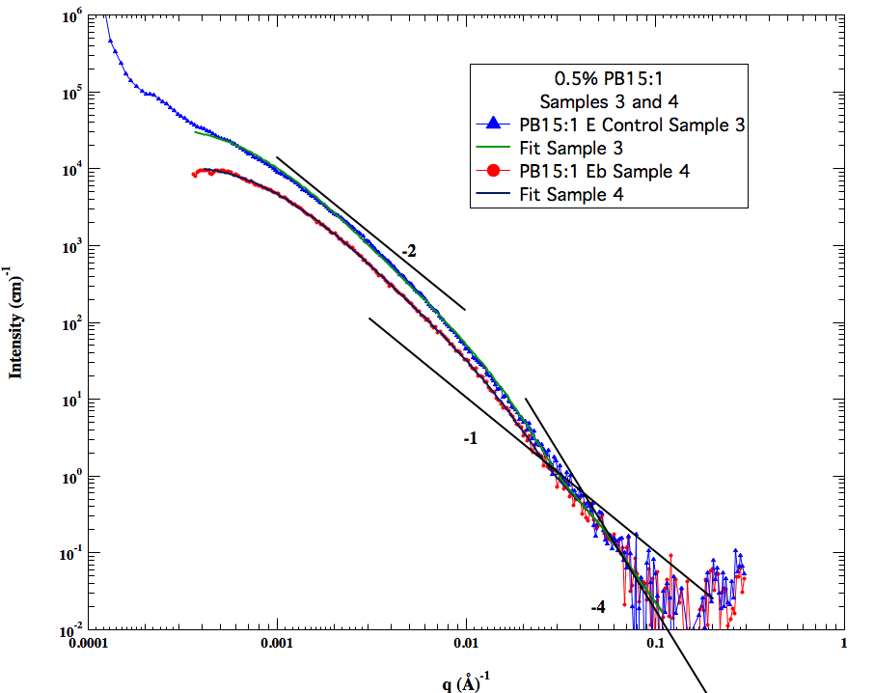
Notes:
How tortuous/How twisty ..So essentially with the scaling model, we have resolved a complex structure into a topological network of branch sites and a tortuous path through the structure.

Slide 31
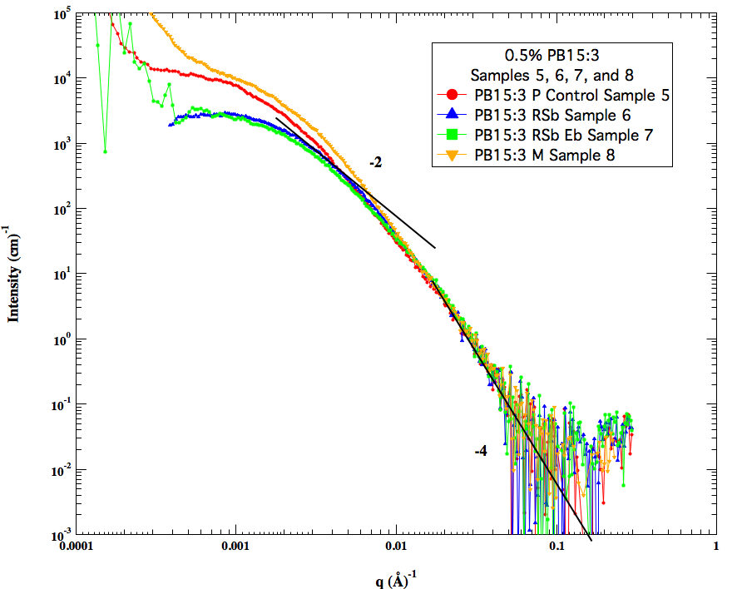
Notes:
How tortuous/How twisty ..So essentially with the scaling model, we have resolved a complex structure into a topological network of branch sites and a tortuous path through the structure.

Slide 32
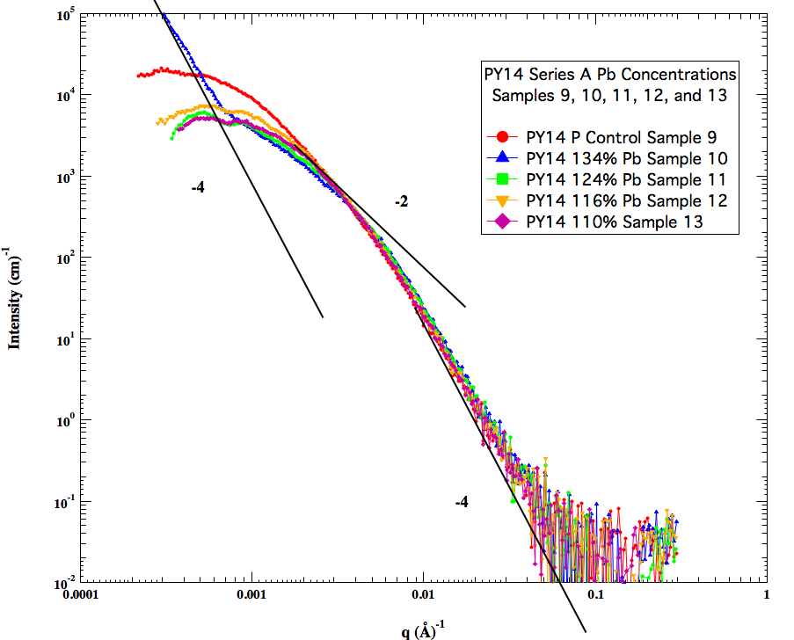
Notes:
How tortuous/How twisty ..So essentially with the scaling model, we have resolved a complex structure into a topological network of branch sites and a tortuous path through the structure.

Slide 33
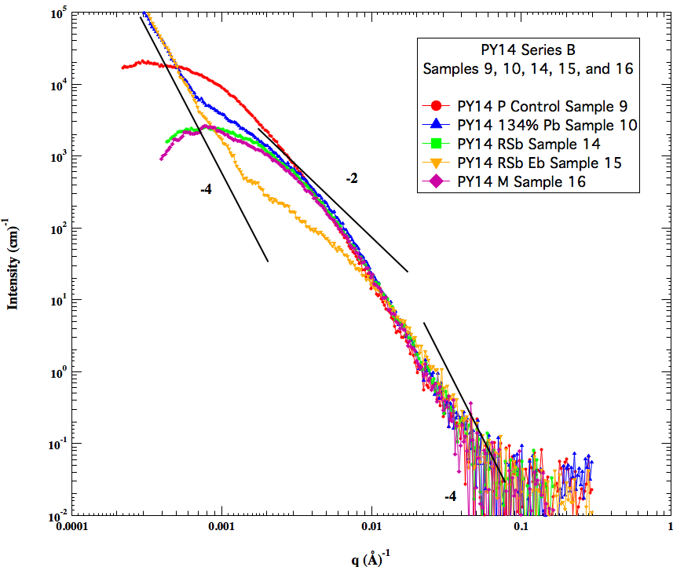
Notes:
How tortuous/How twisty ..So essentially with the scaling model, we have resolved a complex structure into a topological network of branch sites and a tortuous path through the structure.

Slide 34
Summary
16x5 Samples Run
80 Samples (+ 8 Dilutions)
2) 0.05% Samples fit and tabulated
16 Samples
3) Generally concentration series qualitatively follow the RPA formulation
In some cases it didn’t, e.g. PB15:1
4) Generally 1µm Films on Mylar showed enhanced aggregation
In some cases they didn’t, specifically the PY14 samples except Py14 RSb
5) More analysis is needed but this will take several weeks
Notes:
How tortuous/How twisty ..So essentially with the scaling model, we have resolved a complex structure into a topological network of branch sites and a tortuous path through the structure.

Slide 35
Notes:
How tortuous/How twisty ..So essentially with the scaling model, we have resolved a complex structure into a topological network of branch sites and a tortuous path through the structure.

Slide 36

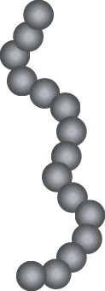
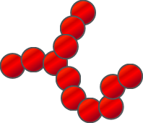
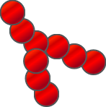
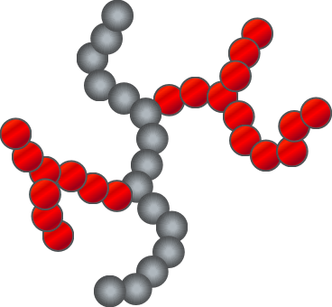
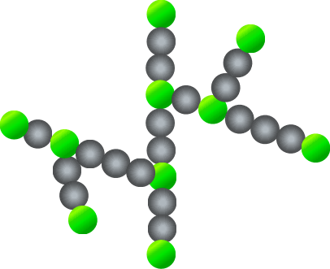
Scaling Model
Primary Particle Size, d_{p}
TORTUOSITY
Minimum path p : dimension d_{min}
z Primary Particles, Dimension d_{f} , Size d_{p}
CONNECTIVITY
Connective path s : dimension c
Beaucage, G., Determination of branch fraction and minimum dimension of mass-fractal aggregates. Physical Review E 2004, 70 (3).
Notes:
How tortuous/How twisty ..So essentially with the scaling model, we have resolved a complex structure into a topological network of branch sites and a tortuous path through the structure.

Slide 37
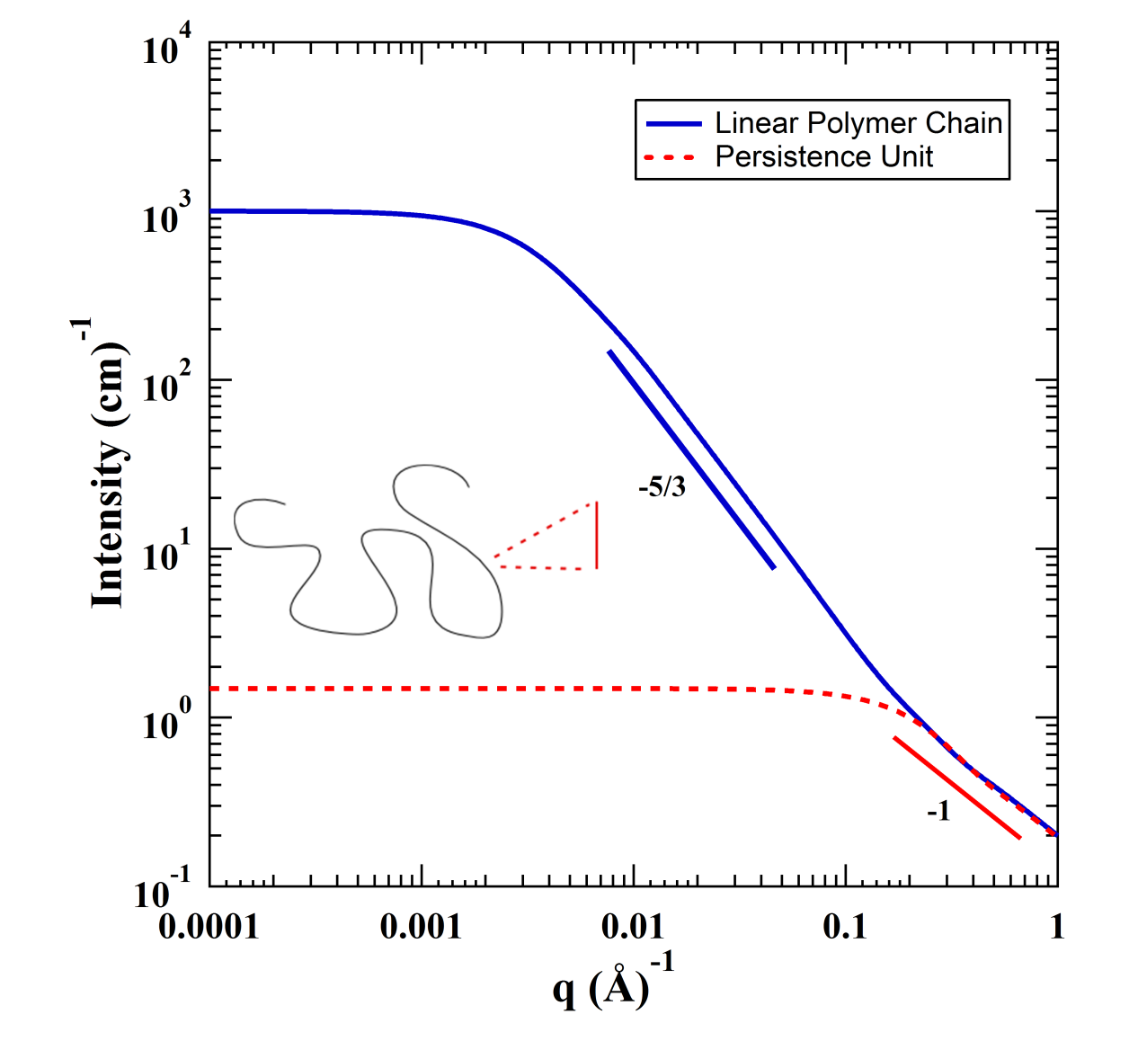
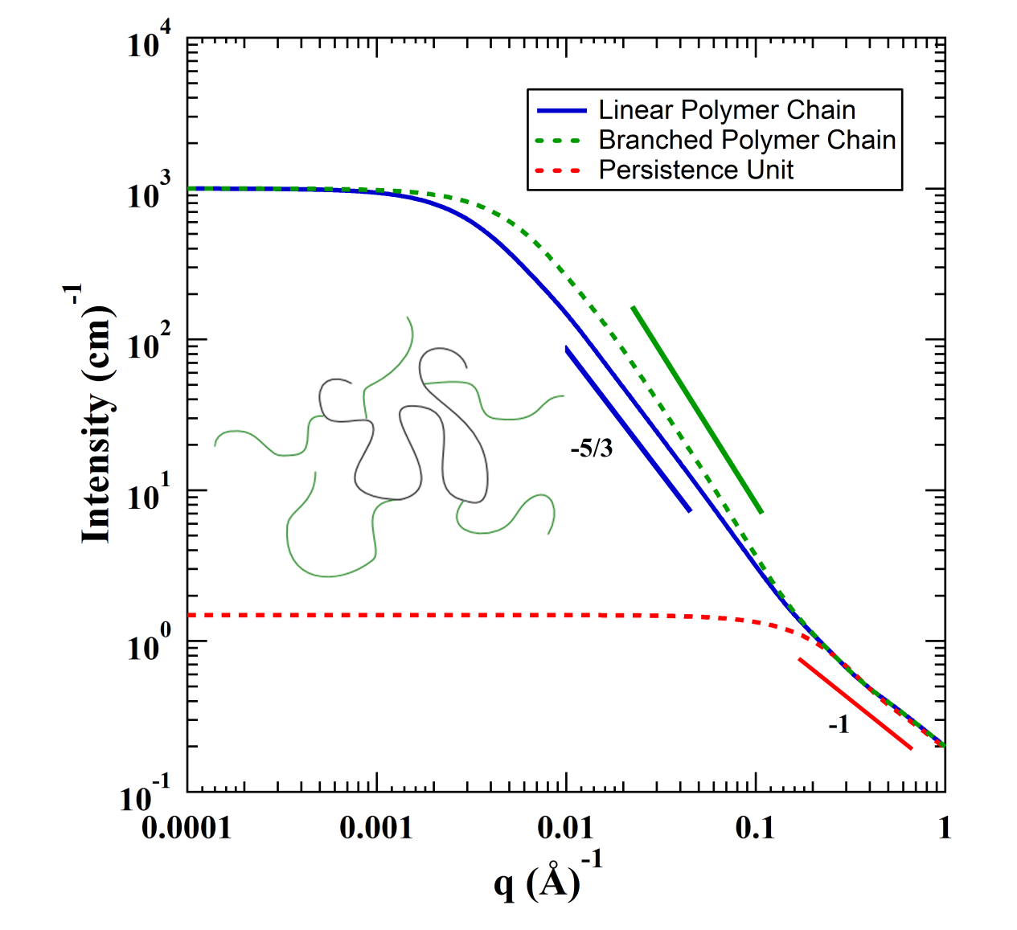

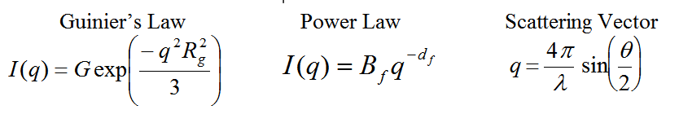
SANS From Persistent Chains
R₂
G₂
B_{f}
d_{f}
Beaucage, G., Determination of branch fraction and minimum dimension of mass-fractal aggregates. Physical Review E 2004, 70 (3).
G₁
R₁
Notes:
…..So all the sizes and dimensions that are obtained from such an analysis is used in the scaling approach to quantify the branch content…

Slide 38
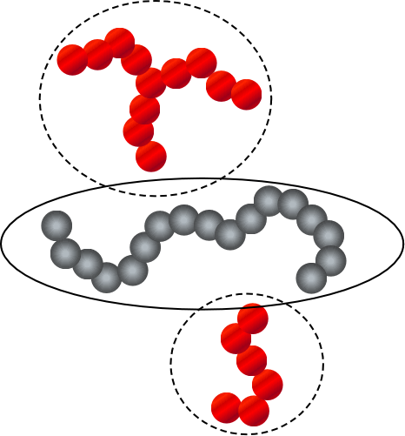
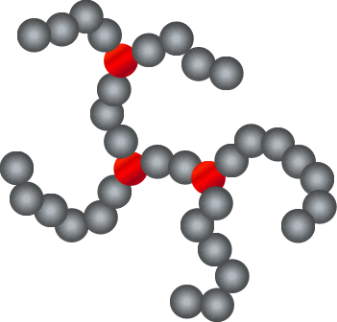
Quantification of Branching
Mole-Fraction LCB Content
Average number of branch points per chain
Beaucage, G., Determination of branch fraction and minimum dimension of mass-fractal aggregates. Physical Review E 2004, 70 (3).
Ramachandran, R.; Beaucage, G.; Kulkarni, A. S.; McFaddin, D.; Merrick-Mack, J.; Galiatsatos, V., Branch Content of Metallocene Polyethylene. Macromolecules 2009, 42 (13), 4746-4750.

Slide 39
Quantification of Branching
Mole-Fraction LCB Content
Average number of branch points per chain
Beaucage, G., Determination of branch fraction and minimum dimension of mass-fractal aggregates. Physical Review E 2004, 70 (3).
Ramachandran, R.; Beaucage, G.; Kulkarni, A. S.; McFaddin, D.; Merrick-Mack, J.; Galiatsatos, V., Branch Content of Metallocene Polyethylene. Macromolecules 2009, 42 (13), 4746-4750.

Slide 40
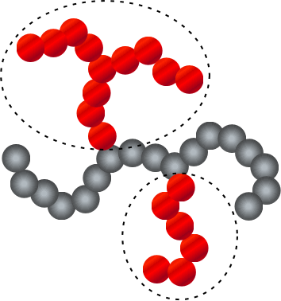
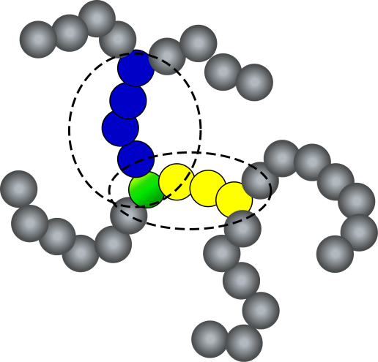
Quantification of Branching
Average LCB length
Hyperbranch Content (Branch-on-Branch)
Beaucage, G., Determination of branch fraction and minimum dimension of mass-fractal aggregates. Physical Review E 2004, 70 (3).
Ramachandran, R.; Beaucage, G.; Kulkarni, A. S.; McFaddin, D.; Merrick-Mack, J.; Galiatsatos, V., Branch Content of Metallocene Polyethylene. Macromolecules 2009, 42 (13), 4746-4750.
Notes:
…So in order to obtain these sizes and dimensions to quantify the branched structure, we use….

Slide 41
Literature Data, Dreiss (2007)
l_{p} = √3R_{g,2} = 14.9 nm
R = 4 R_{g,1}/√3 = 8.3 nm
φ_{Br} = 0.52
n_{Br} = 0.7
z_{Br} = 22
z = 180
L = 0.9 µm

Slide 42
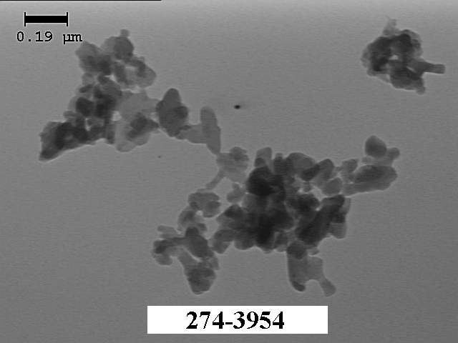
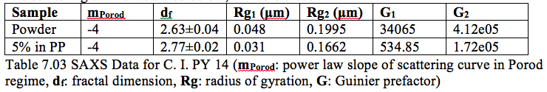
Work of Nikhil Agashe C. I. Pigment Yellow 14
C. I. PY 14

Slide 43
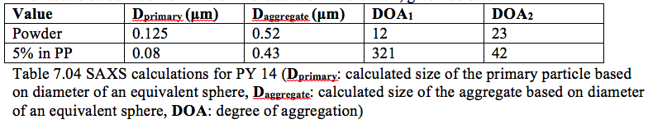
Work of Nikhil Agashe C. I. Pigment Yellow 14
C. I. PY 14

Slide 44
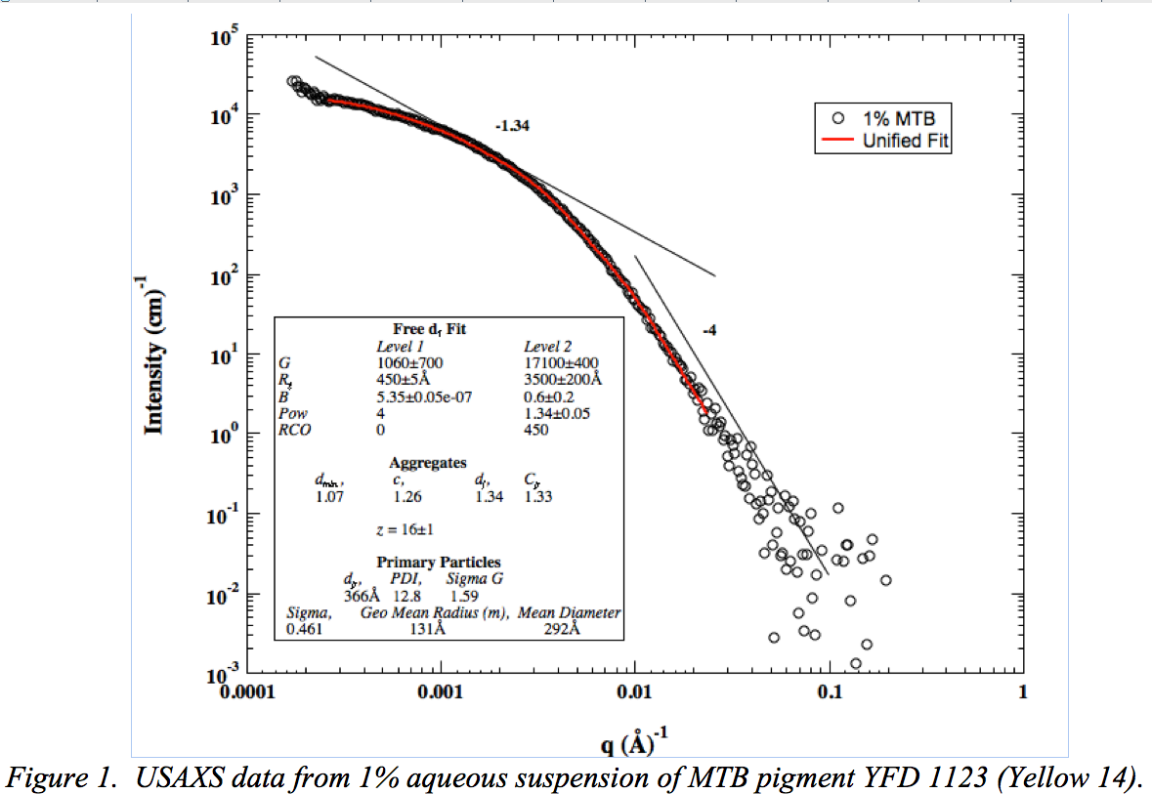

Slide 45
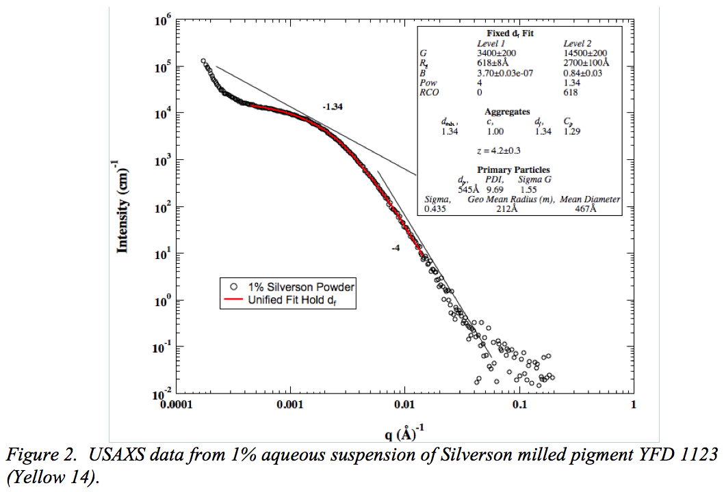

Slide 46
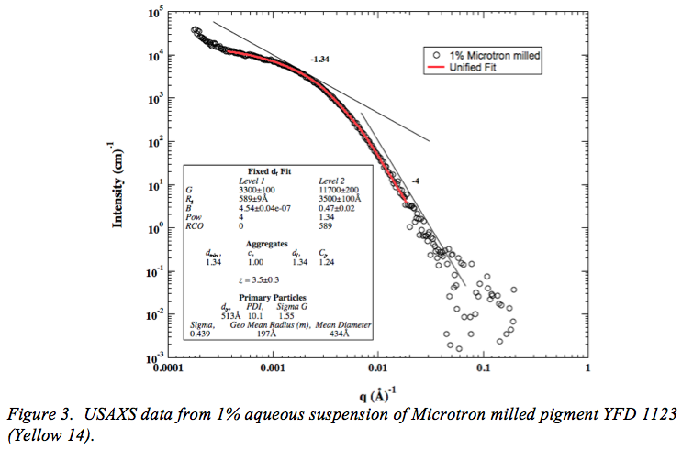

Slide 47
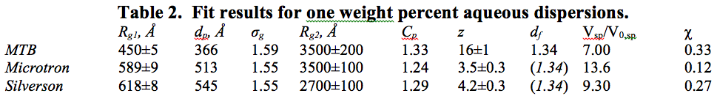

Slide 48
Concentration Series

Slide 49
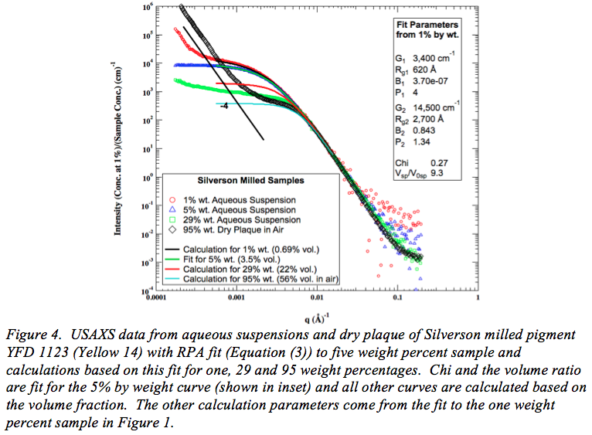

Slide 50


Slide 51


Slide 52


Slide 53


Slide 54


Slide 55


Slide 56

http://www.eng.uc.edu/~beaucag/SunVideo/SunVideos.html

Slide 57
Summary:
-Yellow-14 pigment particles form aggregated structures on the nanoscale that can influence their optical performance. From past studies found large, dense aggregates (d_{f} ~ 2.7, and z ~ 300) are observed in polypropylene dispersions.
-In this study smaller aggregates are observed in surfactant stabilized aqueous dispersions of pigment with about 16 primary particles and a low density with a fractal dimension of 1.34 and about three branches per aggregate.
-The MTB milled sample has primary particles of 36.6 nm Sauter mean diameter. In the previous study the 5% PY14 in polypropylene sample had primary particles of about 80 nm diameter.
-The primary particle size was 60 nm for Microtron milling and 62 nm for Silverson milling. The degree of aggregation dropped to about 4 for the milled samples. The polydispersity of aggregates and primary particles was about the same for all of the aqueous dispersion samples.
-The RPA equation could describe scattering from higher concentration aqueous suspensions with some variation in the enthalpic interaction term, χ, and the volume ratio in Table 1.

Slide 58
Summary:
-Light scattering from the highest concentration 29% samples displayed multiple scattering and/or screening effects that were not seen for x-ray scattering. This may be related to the higher angles used in light scattering or to differences in contrast between x-rays and light. The one percent dispersions didn't match well the light scattering data in the overlapping region.
-LS for the five percent dispersions seemed to agree with USAXS data. All three of the one percent samples displayed highly polydisperse domains or clusters larger than 50 μm in light scattering. The five percent samples displayed mass fractal scattering with mass fractal dimensions of 1.7 and 2.0 for the Microtron sample. The Microtron sample also displayed 12.5 μm clusters while the other two samples displayed fractal clusters larger than 50 μm.
-Distinctions can be made between the Silverson and Microtron milled samples from the five percent light scattering data and from the one percent USAXS data. On the nanoscale, the pigment makes smaller primary particles with a lower degree of aggregation for the Microtron samples. The Silverson aggregates are probably branched to some extent though this couldn’t be quantified from the USAXS data. In light scattering, the Microtron sample has much smaller clusters of fractal aggregates with a higher density and mass fractal dimension for the five percent aqueous dispersion. This is consistent with the optical micrographs shown in Figure 11.

