Slide 1

Center for Macromolecular Topology: Center Concept and Summary
Ronald Larson, Greg Beaucage, Rick Laine, Steve Clarson, Peter Green, Vikram Kuppa, Mike Solomon, Nikos Hadjichristinis and Jimmy Mays
Univ. of Michigan, Univ. of Cincinnati, KAUST/Univ. Athens, Univ. of Tennessee
Associates: Greg Smith, Ron Jones, Jan Ilavsky
Oak Ridge National Lab, National Institute of Standards and Technology, Argonne National Laboratory

Slide 2
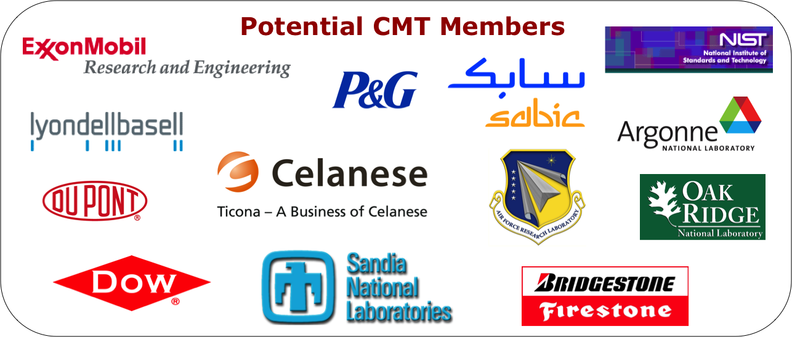
Center Concept
The Center for Macromolecular Topology (CMT) will address the need in the polymer industry to synthetically control, characterize, model and simulate complex macromolecular and nano- architectures for improved mechanical and rheological properties and controlled processing.

Slide 4
Grand Challenge
To develop methods to measure and manipulate chain (and nano-) topology to optimize processing and properties.
If successful, the project would, for example, allow specific molecular topologies to be identified that would enhance processing with little or no reduction in properties. To do this, we would need to show how to enhance extensional rheology while not affecting or improving crystal/amorphous structure and orientation.

Slide 5
Activities of the Center
-Center will fund projects targeting the interests of the Industrial Advisory Board (5 proposed)
-Center organized access to characterization facilities, deuteration of materials, TREF facility for polyethylene, services for routine samples such as filled polymers
-Access to services provided by Associate Members through in-kind contributions such as specialized processing, characterization and synthesis capabilities
-Symposia, short courses, recruitment, reports on research, exclusive license to IP, independent consulting and contract research associated with center activities, software development

Slide 6
Organization
The Center will initially have two sites:
University of Michigan:
Rheology, Synthesis, Experimental Interface Studies, Colloids, Synthesis, Modeling, Simulation
University of Cincinnati:
Scattering, Synthesis, Simulation, Modeling
Affiliate Sites:
University of Tennessee, University of Athens, KAUST, Oak Ridge National Laboratory, National Institute of Standards and Technology, Argonne National Laboratory, Eclipse Film Technology

Slide 7
Organization
An Industrial Advisory Board (IAB):
Full Members: $75,000/year at 10% IDC with a two year commitment. IAB Suggests Projects from Center Fees, suggests bylaws, organization, membership fee rates, suggest approval of Associate Members. Membership fee paid to one of the two sites.
Center Wide Panel:
Associate Members & Full Members: Suggest Projects for 10% IDC and NSF funded startup projects (~$45,000 total funds).
Other administrative structure seen in the diagram that follows.

Slide 8
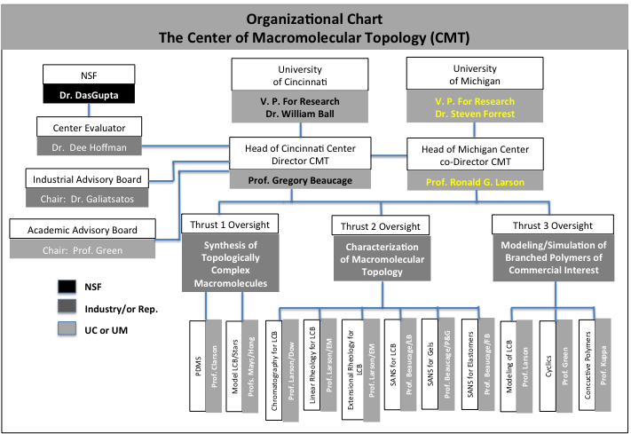
Organization

Slide 10
5 Projects
Potential Supporters
Research Sites
Each Project is described in
the executive summaries and in
separate Power Point slides

Slide 11
Project 1 Controlling Polymer Rheological Properties Using Long-Chain Branching
Dupont Cincinnati
LyondellBasell Michigan
ExxonMobil ORNL/CNMS/Tennessee
Dow NIST Consortium
Nova
Celanese
Procter & Gamble
Project 2 Adsorption, Adhesion, and Topology of Linear and Branched Macromolecules on Curved and Flat Surfaces
AFRL Cincinnati
Bridgestone Michigan
Procter & Gamble ORNL/CNMS/Tennessee

Slide 12
Project 3 Effect of Branching on Flow-Induced Crystallization and Crystalline Orientation
Dupont Cincinnati
LyondellBasell Michigan
ExxonMobil ORNL/CNMS/Tennessee
Dow Argonne National Lab
Nova
Celanese
Procter & Gamble
Project 4 Gel Structure, Molecular Aggregation/Agglomeration and Gelation in Colloidal Fluids
Procter & Gamble Cincinnati
Bridgestone Michigan
Others ORNL/CNMS/Tennessee
NIST Consortium

Slide 13
Project 5 Network/Reinforcing Filler
Mechanical Response
Bridgestone Cincinnati
ExxonMobil Michigan
Dow Argonne National Lab
Procter & Gamble
AFRL
Future Projects
-Network Conductive Polymers for PV
-Software Development for Rheological Analysis
-Synthesis of Topological Systems for Coatings
-Two-Dimensional SAXS/DMA for Reinforcing Fillers
-Model Polymers for Topological Studies

Slide 14
Short Courses, Conferences
Targeted Strategy Groups
Structure and Rheology of Molten Polymers
Ron Larson & Mike Solomon
Scattering Techniques for Topological Structures of Complex Macromolecules
Greg Beaucage, Mike Solomon
Simulation Methods for Prediction of Properties in Branched Polymers
Ron Larson, Vikram Kuppa
Synthetic Mechanisms for Chain Branching in Polyolefins
Ron Largon, Jimmy Mays
Long Chain Branching in Polyethylene Strategy Group

Slide 16
Potential Center Associate Members:
ORNL, Argonne, NIST, Eclipse
Oak Ridge National Laboratory: Neutron Scattering, Synthesis of Model Materials, Other Characterization Facilities
Argonne National Laboratory: Advanced Photon Source: X-ray Scattering
National Institute of Standards and Technology: Neutron Scattering, Other interactions with the Polymer Division
Eclipse Film Technologies: Polymer processing facilities, MDO, processing equipment for in situ SAXS

Slide 17
Relationship with other Centers
Consortium for Soft Material Manufacturing at NIST.
IRC at University of Leeds (and other UK Universities)
CNMS ORNL, Scattering Centers at NIST, Oak Ridge, Argonne

Slide 18
NSF Role
Each site requires a minimum of $150,000/year from Membership Fees and 3 Members. (One member can be an Associate Member.) NSF requires 10% indirect charges on membership fees.
NSF will contribute $60,000/year per site with 56% indirect charges. (Net $109,100) This could go towards center wide projects. NSF will also pay $20,000 to Cincinnati for administration.
NSF provides avenues to other funds:
International Travel Supplements for Centers ($25,000), IGERT, REU, academic center grants. Funds for industrial participants to travel to foreign centers or to have extended stays at university sites or national labs.
NSF audits/certifies the center operations.

Slide 19
Center for Macromolecular Topology: Capabilities
Laboratories of Ronald Larson Greg Beaucage, Rick Laine, Steve Clarson, Peter Green, Vikram Kuppa, Mike Solomon, and Jude Iroh, Jimmy Mays
Univ. of Mich., Univ. of Cincinnati, Univ. of Tennessee

Slide 20
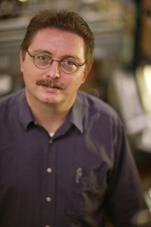
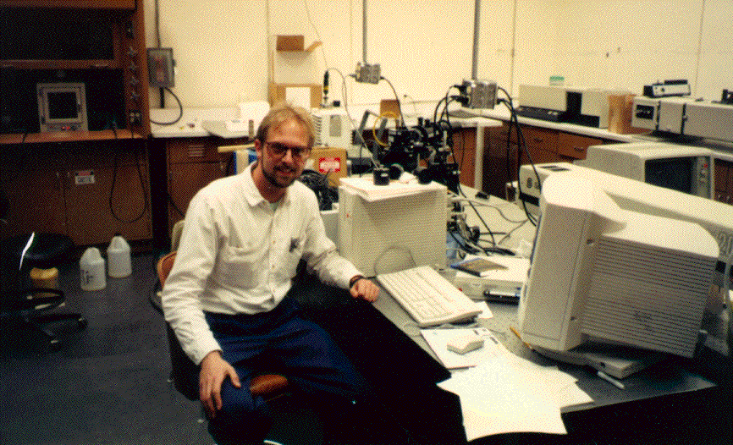
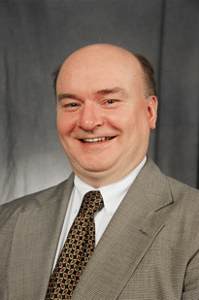
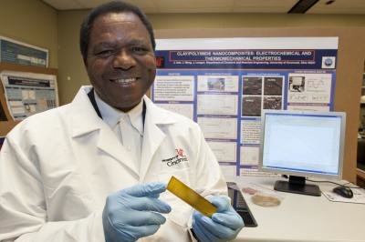
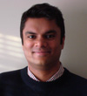
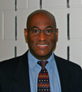

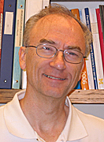
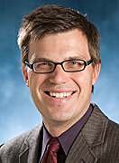
The faculty
Jimmy Mays, UT
Greg Beaucage,UC
Jude Iroh, UC
Vikram Kuppa, UC
Steve Clarson,UC
Peter Green,UM
Ron Larson, UM
Rick Laine, UM
Mike Solomon,UM

Slide 21
Equipment & Facilities

Slide 22
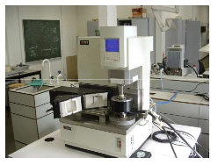
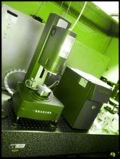
Rheometers
ARES AR-G2 rheometer (low stress)
TA Instruments ARES rheometer
AR 1000 constant stress rheometer
Assessment of impact of changing
Ubbelohde viscometry
Solomon/Larson lab

Slide 23
Collective dynamics by means of dynamic light scattering
Laser
q
I(t)
<I(t)I(0)>
detector
Scattering Intensity
Dynamic Structure Factor
I(t)
f(q,t)
Special methods for non-ergodic samples: Pusey and van Megen, 1989
Solomon lab

Slide 24
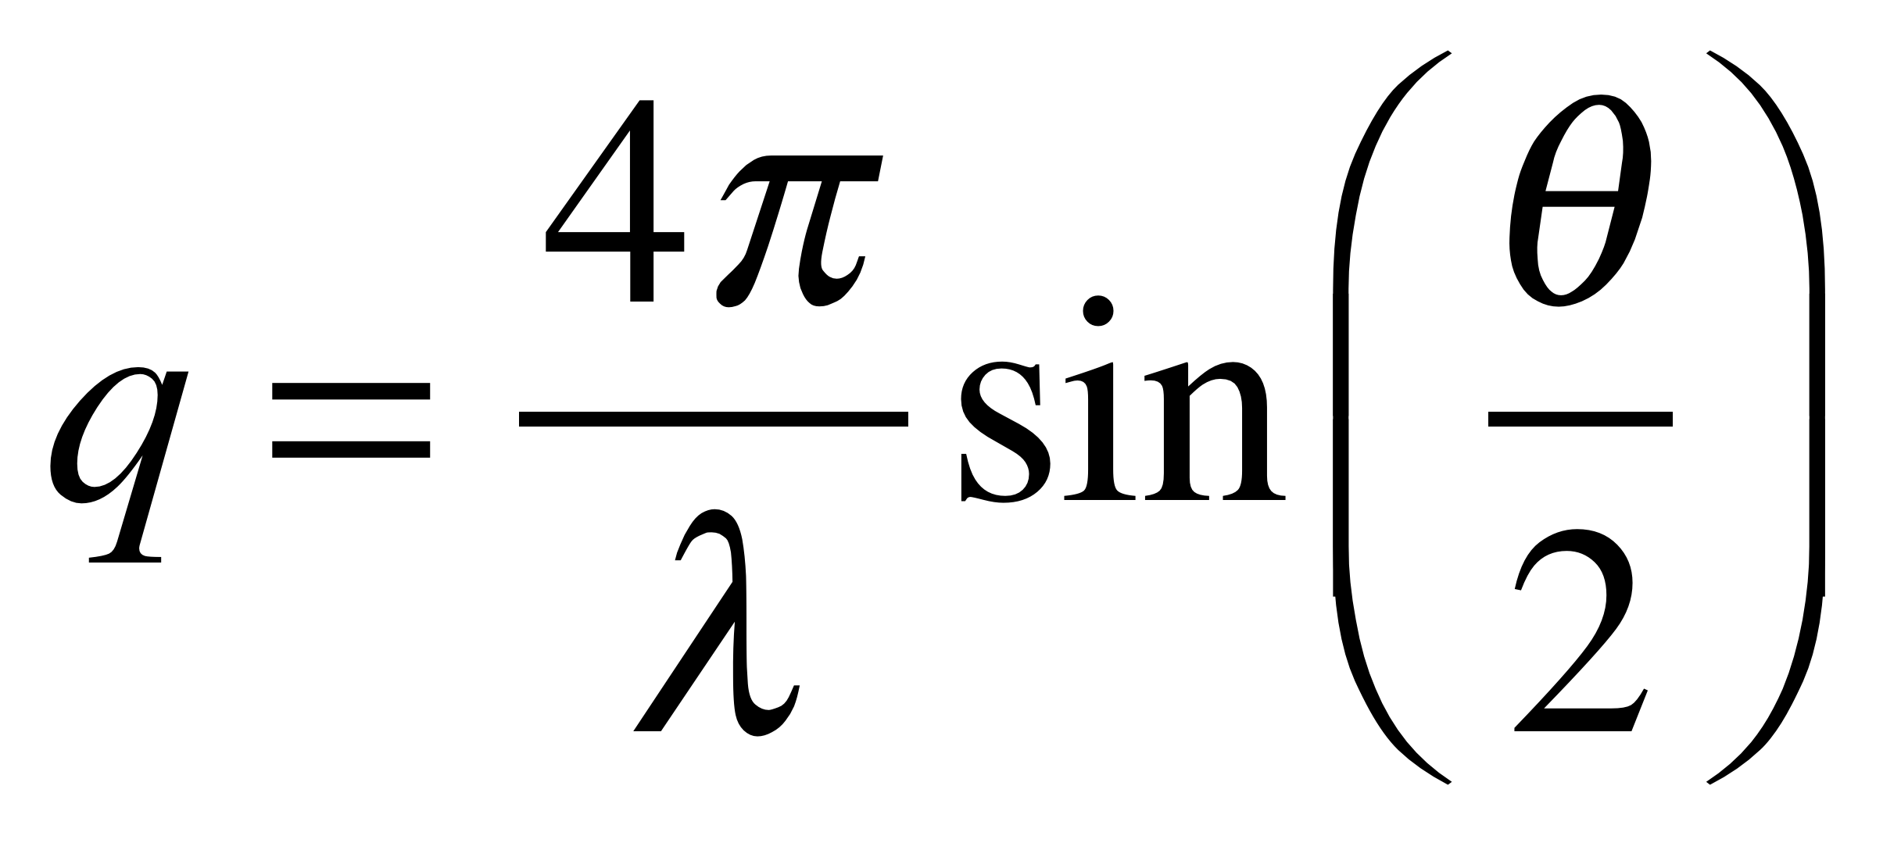
Structure from Scattering
Structure factor, S(q), depends on particle configuration
scattering volume
Incident light, λ
θ
q
Intensity, I_{s}
detector
I_{s} ~ ρP(q)S(q)
q: scattering vector
ρ: density
P(q): form factor
S(q): structure factor
Typical
gel S(q)
Light scattering detects structure on scales from ~20 nm to ~ 20 μm
Solomon lab

Slide 25
Static Light Scattering
Sample
USALS
λ₀ = 0.633 μm
0.0461 μm^{–1} < q < 1.85 μm^{–1}
Beam Expander
Beam Stop
CCD
Camera
Parab.
Mirror
Sample
Detector
Pinhole
CCD
Camera
Beam Stop
Beam Splitter
Beam
Stop
Detector
Index Matching Vat
Sample
SALS
λ₀ = 0.532 μm
0.822 μm^{–1} < q < 6.76 μm^{–1}
WALS
λ₀ = 0.488 μm
3.58 μm^{–1} < q < 33.1 μm^{–1}
Scattered Beam
Solomon lab

Slide 26
In house Pinhole and Bonse-Hart X-ray Scattering Cameras and Static Light Scattering Facilities
In house X-ray reflectivity, spectroscopic elipsometry and a variety of other surface analysis techniques
Access to the Advanced Photon Source (ANL) for USAXS (See poster by Jan Ilavsky attending)
Access to NIST Neutron Scattering Center (Ron Jones attending)
Access to ORNL Neutron Scattering Facilities (Greg Smith attending)
Center for Nanophase Materials Science at ORNL (Jimmy Mays, M.S. Rahman (attending & poster), Greg Smith/Mussie Alemseghed (both attending))

Slide 27
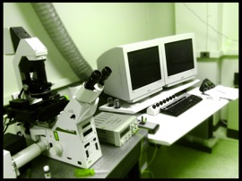
Leica TCS SP2 Confocal Laser Scanning Microscope
Excitation wavelengths : a blue Argon/Argon-Krypton laser (458/488nm), a green laser (543nm), and a red Helium-Neon laser (633nm).
Detectors: wavelengths between 400 - 850nm
Image resolution: up to 4096 x 4096
Image speed up to 3 frames per second at 512 x 512 pixels.
Solomon/Larson/… lab

Slide 28
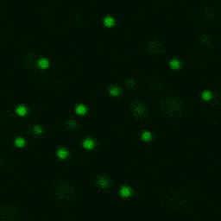
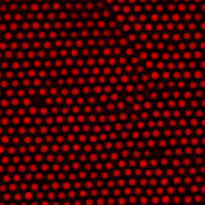
Particle Imaging
Brownian
Motion
Pair potential
interactions
1 nm
10 nm
100 nm
1 μm
10 μm
molecular
granular
(slide from Solomon group)

Slide 29
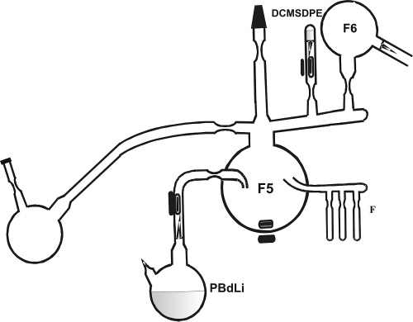
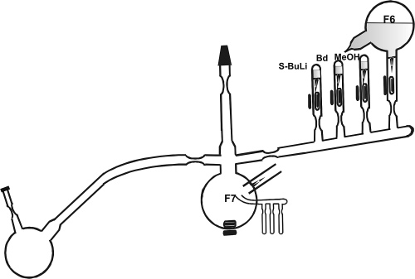
Polymer Synthesis
Synthesis of star
Mays lab
Coupling of two arms

Slide 30
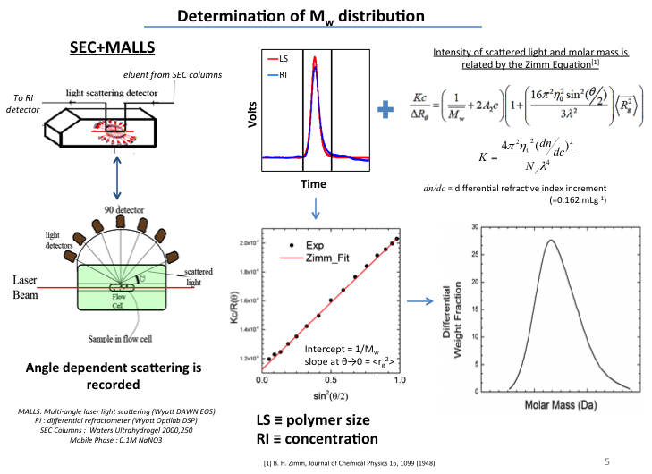
Size exclusion chromatography

Slide 31
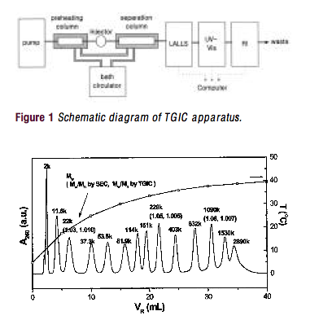
Temperature Gradient Interaction Chromatography (TGIC)
from group of Taihyun Chang, Pohang Univ., Korea

Slide 32
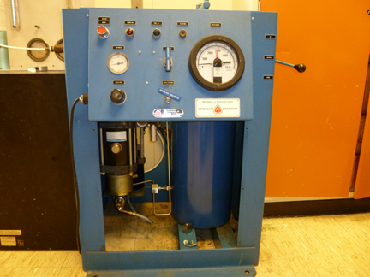
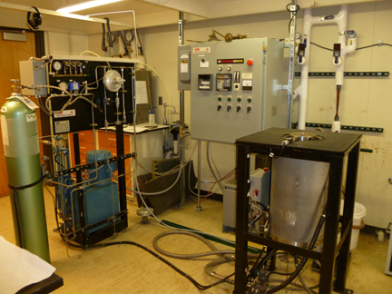
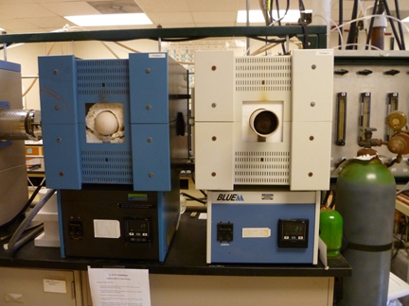
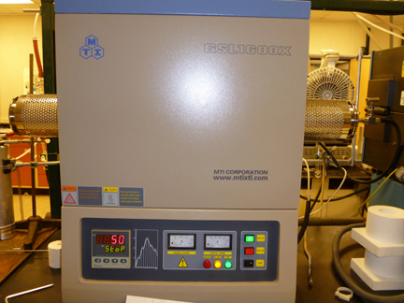
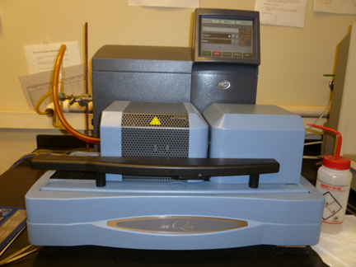
Processing/analysis Equipment
Cold and hot Isostatic Presses
Burnout and sintering furnaces
Differential scanning calorimetry /thermal gravimetric analysis
Dilatometers
Extruders and Lab Scale Film Blowing
Laine lab

Slide 33
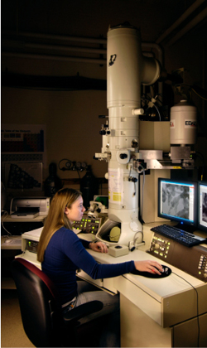
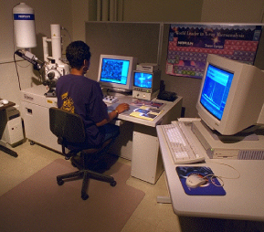
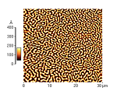
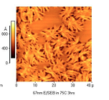
Electron Microbeam Analysis Laboratory
Scanning electron microscopy
Transmission electron microscopy
Atomic force microscopy
Focused Ion beam
X-ray diffraction and SAXS

Slide 34
Computational Capabilities: Kinetic Modeling
Algorithm for Monte Carlo simulation of LCB PE using single-site catalyst
Reaction kinetics of LCB PE using single-site catalyst
Start
monomer addition
Generate random
number R: U(0,1)
addition of unsaturated chain
NO
R>pp
YES
generation of dead structured chain
Propagation
Termination
Generate random
number R: U(0,1)
Save molecule
-hydride elimination
Monte Carlo probabilities
NO
R>lp
YES
Add monomer
Add macromonomer
propagation probability
monomer selection probability
Costeux et al., Macromolecules (2002)

Slide 35
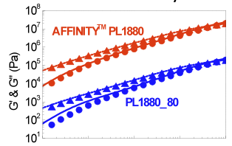
Computational Capabilities: Model of Polymer Linear Rheology
A complex commercial branched polymer is represented by an ensemble of up to 10,000 chains, all with different molecular weights and branching structures.
The ensemble is generated from a combination of GPC characterization, knowledge of reaction kinetics, and rheology.
The ensemble is fed into the “Hierarchical Code,” and a prediction of the linear rheology (G’ and G”) emerges.
Larson et al., (2001, 2006, 2011)

Slide 36
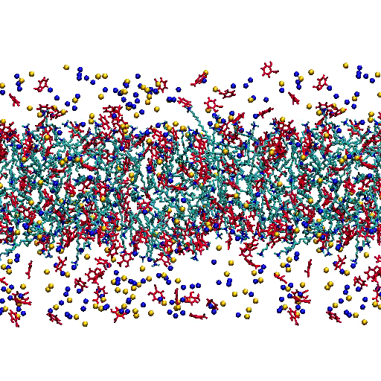
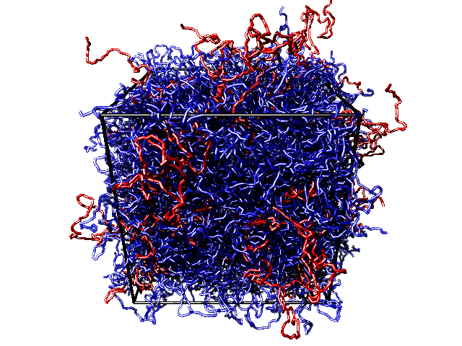
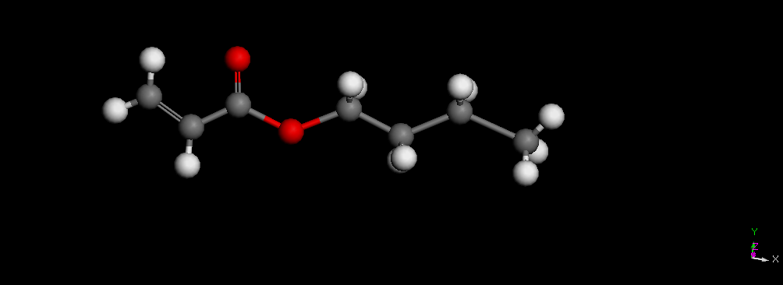
Computational Capabilities: Molecular Simulations
atomistic & coarse-grained simulations of polymers, surfactants, etc.

