Slide 1
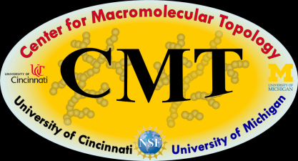
Project 2: Adsorption, Adhesion, and Topology of Linear and Branched Macromolecule on Curved and Flat Surfaces
PI’s: Peter Green¹, Vikarm Kuppa², Steve Clarson², Rick Laine¹
Team: Jimmy Mays³, Nikos Hadjichristidis⁴, Greg Smith⁵
1 Univ. Michigan; 2 Univ. Cincinnati; 3 Univ. Tennessee; 4 Univ. Athens/KAUST; 5 Oak Ridge National Lab
Proposed Budget: $150,000/year; In Kind Support ORNL $40,000/year
Project Duration: 3 years

Slide 2
Outcomes/Deliverables
Insight into polymer absorption, adhesion, surface layer structure, dynamics of absorption as a function of chain topology.
Synthesis of topologically relevant model siloxanes.
Interfacial effects as a function of topological evolution.
Optimization of chain topology for controlled interfacial properties.

Slide 3
Impact
New information and insight into adhesion and absorption.
Understand synthesis/structure/property relationships for new products.
Understanding of complex systems involving polymer/inorganic interfaces with polymer chains of complex topology.

Slide 4
Industrial Relevance
The nature of polymer/surface interactions for supported polymer films, of polymer composites used in different applications is often not well understood.
Equilibrium structure and means of controlling the adsorbed layers for strong adsorption is revealed through simulations
Reinforcement via tuning of topology is studied through both experiments [AFM] and simulations [MC]
Influence of co-monomer content on adsorption is elucidated
The role of chain branching is even less understood. Recent evidence strongly suggests that effects associated with branching are far more significant than one would have previously imagined.
With the suite of techniques and theory we could develop an understanding that enable the development of predictive models.
The understanding we develop would have a long-term impact on materials design and processing for different applications

Slide 5
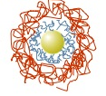
Adsorption of polymers at interfaces
CHALLENGE: The nature of the interactions between macromolecules and interfaces (adhesion, adsorption) play an important role in the performance of thin films and polymer composites. Thin polymer films are used in a range of applications that include: adhesives, active and passive coatings and sensors. Polymer composites, which include macroscopic fillers and nano-fillers, have diverse applications, from tires to solar cells.
Nanocomposite
Thin Film
substrate
Adsorbed layers
Innovation through Partnerships
5

Slide 6
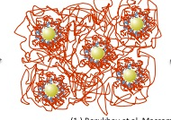
The strong adsorption of chains onto fillers in a composite
Dielectric spectroscopy could be used to examine the
Host chain dynamics
The dynamics of chains that are adsorbed strongly to a substrate
Differences between the adsorption of linear and branched chains in composite

Slide 7
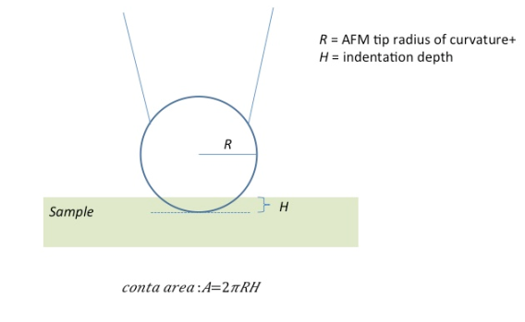
Force Measurements with AFM using a silica particle to measure: adhesion, friction, deformation
Force Measurements with AFM
The AFM measurements can be performed by placing a silica particle at the end of the tip and measuring the adhesion, stiffness and deformation of linear and branched chains
Approach
A
F
Retraction
C
B
E
Cantilever Deflection
A
D
B
F
C
D
E
Approach
Retraction
Piezo displacement

Slide 8
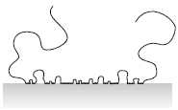
Adsorbed chain statistics
Topology of the adsorbed layers can be controlled
Loops
Tails
Trains
Distributions are dependent on PDI and ε. Influence wetting and reinforcement:investigated via simulations and AFM

Slide 9
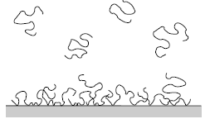
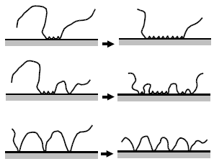
MC simulations – elucidates structure control
dispersion (ex: nanoparticles)
Entanglements through loops
reinforcement
Surfactant efficacy and wettability
Control adsorbed layer topology
Fundamental insights into equilibrium and metastable structures, thermodynamics and kinetics
Surface coverage and protection

Slide 10
OVERVIEW
GOAL: We propose to understand interactions at interfaces between polymers and surfaces in two types of systems: (1) thin polymer films on surfaces; (2) fillers (e.g.: silica) in polymer hosts. The fillers will range in size from the nano-scale to microns.
EXPERIMENTS: (1) Synthesis of desired chain architectures; (2)Dielectric spectroscopy to examine the adsorption of chains from a melt to flat and curved surfaces; (3)Spectroscopic ellipsometry, to examine adsorption to flat interfaces; (4)AFM to study adhesion and friction at interfaces; (5)Neutron and x-ray reflectivity to study surface composition profiles.
SIMULATIONS: Monte Carlo molecular simulations using generic potentials. (1) equilibrium structure (2) statistics of loops, tails, trains, (3) effect of surface curvature, (4) topological effects on reinforcement

