Slide 1

Center for Macromolecular Topology: Center Concept and Summary
Ronald Larson, Greg Beaucage, Rick Laine, Steve Clarson, Peter Green, Vikram Kuppa, Mike Solomon, Nikos Hadjichristinis and Jimmy Mays
Univ. of Michigan, Univ. of Cincinnati, KAUST/Univ. Athens, Univ. of Tennessee
Associates: Greg Smith, Ron Jones, Jan Ilavsky
Oak Ridge National Lab, National Institute of Standards and Technology, Argonne National Laboratory

Slide 2
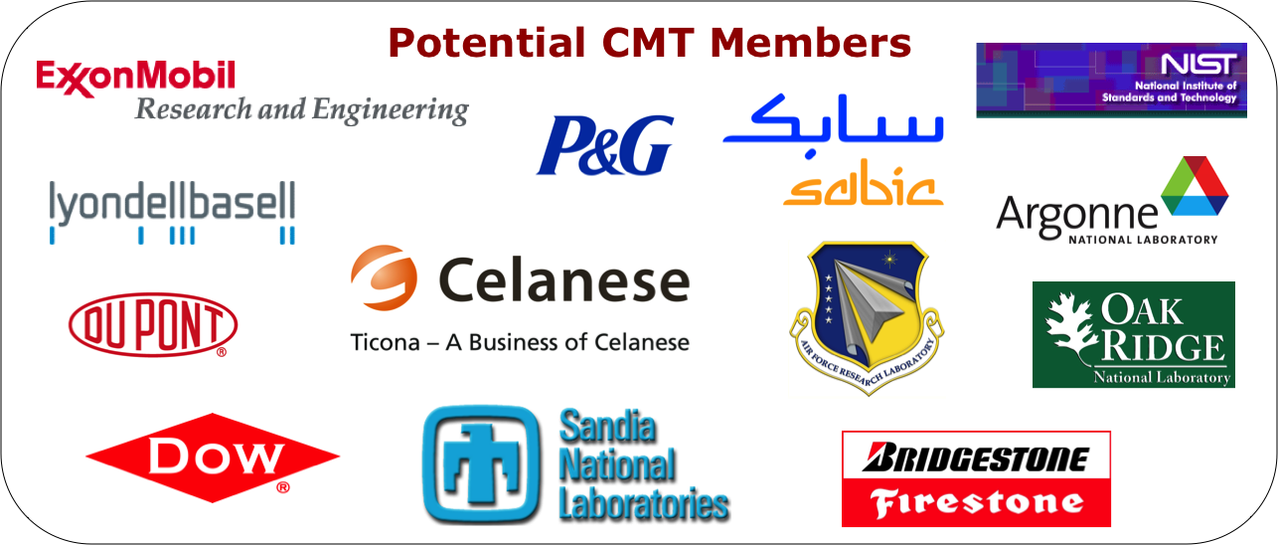
Center Concept
The Center for Macromolecular Topology (CMT) will address the need in the polymer industry to synthetically control, characterize, model and simulate complex macromolecular and nano- architectures for improved mechanical and rheological properties and controlled processing.

Slide 4
Grand Challenge
To develop methods to measure and manipulate chain (and nano-) topology to optimize processing and properties.
If successful, the project would, for example, allow specific molecular topologies to be identified that would enhance processing with little or no reduction in properties. To do this, we would need to show how to enhance extensional rheology while not affecting or improving crystal/amorphous structure and orientation.

Slide 5
Activities of the Center
-Center will fund projects targeting the interests of the Industrial Advisory Board (5 proposed)
-Center organized access to characterization facilities, deuteration of materials, TREF facility for polyethylene, services for routine samples such as filled polymers
-Access to services provided by Associate Members through in-kind contributions such as specialized processing, characterization and synthesis capabilities
-Symposia, short courses, recruitment, reports on research, exclusive license to IP, independent consulting and contract research associated with center activities, software development

Slide 6
Organization
The Center will initially have two sites:
University of Michigan:
Rheology, Synthesis, Experimental Interface Studies, Colloids, Synthesis, Modeling, Simulation
University of Cincinnati:
Scattering, Synthesis, Simulation, Modeling
Affiliate Sites:
University of Tennessee, University of Athens, KAUST, Oak Ridge National Laboratory, National Institute of Standards and Technology, Argonne National Laboratory, Eclipse Film Technology

Slide 7
Organization
An Industrial Advisory Board (IAB):
Full Members: $75,000/year at 10% IDC with a two year commitment. IAB Suggests Projects from Center Fees, suggests bylaws, organization, membership fee rates, suggest approval of Associate Members. Membership fee paid to one of the two sites.
Center Wide Panel:
Associate Members & Full Members: Suggest Projects for 10% IDC and NSF funded startup projects (~$45,000 total funds).
Other administrative structure seen in the diagram that follows.

Slide 8
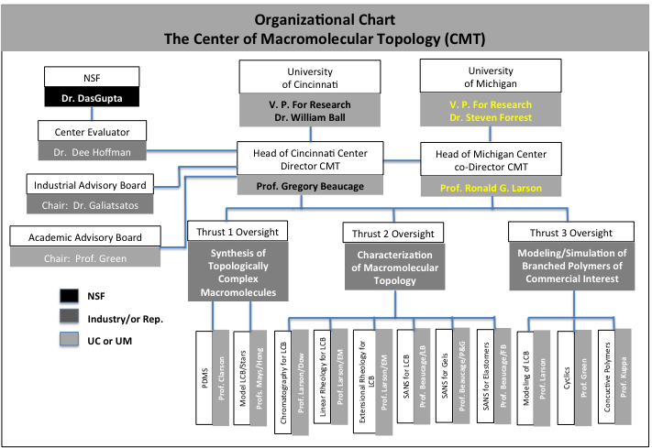
Organization

Slide 10
Status of Letters February 17, 2012
Needed for the National Science Foundation:
3 Members per site
2 Sites Cincinnati and Michigan
1 Member can be “in-kind” for first year
ExxonMobil one letter + one from Chemical Division in works (50%)
Procter & Gamble one letter + one from Baby Care Division (50%)
Dow 85%
Bridgestone letter promised 80%
Celanese 80%
SABIC 50%
NOVA ?
Chevron Phillips ?
Oak Ridge National Laboratory letter in-kind
Eclipse Film Technology letter in-kind
Dupont: Next year
LyodellBasell: Next year
Air Force Research Laboratory: Next year

Slide 11
5 Projects
Potential Supporters
Research Sites
Each Project is described in
the executive summaries and in
separate Power Point slides

Slide 12
Project 1 Controlling Polymer Rheological Properties Using Long-Chain Branching
Dupont Cincinnati
LyondellBasell Michigan
ExxonMobil ORNL/CNMS/Tennessee
Dow NIST Consortium
Nova
Celanese
Procter & Gamble
Project 2 Adsorption, Adhesion, and Topology of Linear and Branched Macromolecules on Curved and Flat Surfaces
AFRL Cincinnati
Bridgestone Michigan
Procter & Gamble ORNL/CNMS/Tennessee

Slide 13
Project 3 Effect of Branching on Flow-Induced Crystallization and Crystalline Orientation
Dupont Cincinnati
LyondellBasell Michigan
ExxonMobil ORNL/CNMS/Tennessee
Dow Argonne National Lab
Nova
Celanese
Procter & Gamble
Project 4 Gel Structure, Molecular Aggregation/Agglomeration and Gelation in Colloidal Fluids
Procter & Gamble Cincinnati
Bridgestone Michigan
Others ORNL/CNMS/Tennessee
NIST Consortium

Slide 14
Project 5 Network/Reinforcing Filler
Mechanical Response
Bridgestone Cincinnati
ExxonMobil Michigan
Dow Argonne National Lab
Procter & Gamble
AFRL
Future Projects
-Network Conductive Polymers for PV
-Software Development for Rheological Analysis
-Synthesis of Topological Systems for Coatings
-Two-Dimensional SAXS/DMA for Reinforcing Fillers
-Model Polymers for Topological Studies

Slide 15
Short Courses, Conferences
Targeted Strategy Groups
Structure and Rheology of Molten Polymers
Ron Larson & Mike Solomon
Scattering Techniques for Topological Structures of Complex Macromolecules
Greg Beaucage, Mike Solomon
Simulation Methods for Prediction of Properties in Branched Polymers
Ron Larson, Vikram Kuppa
Synthetic Mechanisms for Chain Branching in Polyolefins
Ron Largon, Jimmy Mays
Long Chain Branching in Polyethylene Strategy Group

Slide 17
Potential Center Associate Members:
ORNL, Argonne, NIST, Eclipse
Oak Ridge National Laboratory: Neutron Scattering, Synthesis of Model Materials, Other Characterization Facilities
Argonne National Laboratory: Advanced Photon Source: X-ray Scattering
National Institute of Standards and Technology: Neutron Scattering, Other interactions with the Polymer Division
Eclipse Film Technologies: Polymer processing facilities, MDO, processing equipment for in situ SAXS

Slide 18
Relationship with other Centers
Consortium for Soft Material Manufacturing at NIST.
IRC at University of Leeds (and other UK Universities)
CNMS ORNL, Scattering Centers at NIST, Oak Ridge, Argonne

Slide 19
National Science Foundation Role
Each site requires a minimum of $150,000/year from Membership Fees and 3 Members. (One member can be an Associate Member.) NSF requires 10% indirect charges on membership fees.
NSF will contribute $60,000/year per site with 56% indirect charges. (Net $109,100) This could go towards center wide projects. NSF will also pay $20,000 to Cincinnati for administration.
NSF provides avenues to other funds:
International Travel Supplements for Centers ($25,000), IGERT, REU, academic center grants. Funds for industrial participants to travel to foreign centers or to have extended stays at university sites or national labs.
NSF audits/certifies the center operations.

Slide 20
Center for Macromolecular Topology: Capabilities
Laboratories of Ronald Larson Greg Beaucage, Rick Laine, Steve Clarson, Peter Green, Vikram Kuppa, Mike Solomon, and Jude Iroh, Jimmy Mays
Univ. of Mich., Univ. of Cincinnati, Univ. of Tennessee

Slide 21
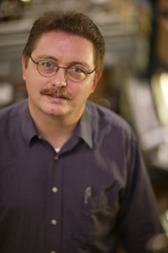
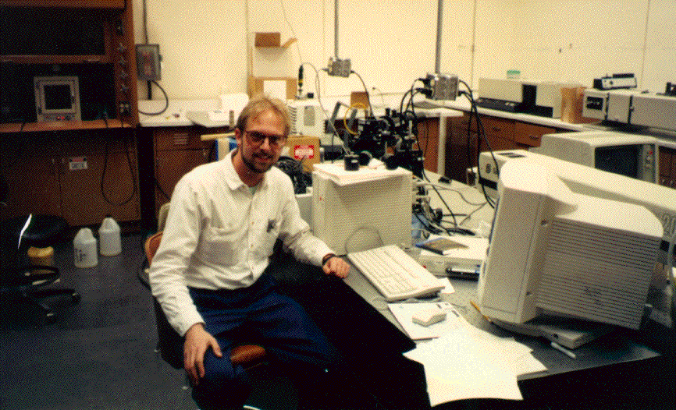
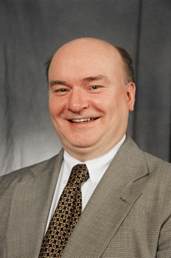
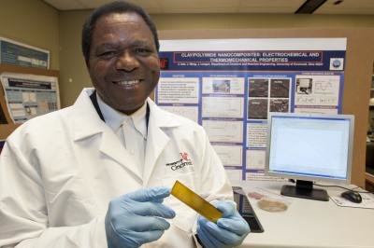



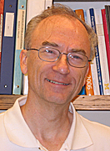
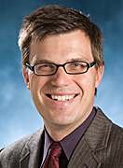
The faculty
Jimmy Mays, UT
Greg Beaucage,UC
Jude Iroh, UC
Vikram Kuppa, UC
Steve Clarson,UC
Peter Green,UM
Ron Larson, UM
Rick Laine, UM
Mike Solomon,UM

Slide 22
Equipment & Facilities

Slide 23
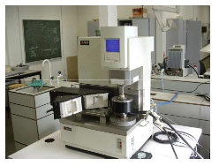
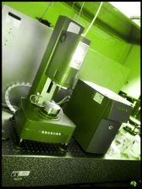
Rheometers
ARES AR-G2 rheometer (low stress)
TA Instruments ARES rheometer
AR 1000 constant stress rheometer
Assessment of impact of changing
Ubbelohde viscometry
Solomon/Larson lab

Slide 24
Collective dynamics by means of dynamic light scattering
Laser
q
I(t)
<I(t)I(0)>
detector
Scattering Intensity
Dynamic Structure Factor
I(t)
f(q,t)
Special methods for non-ergodic samples: Pusey and van Megen, 1989
Solomon lab

Slide 25
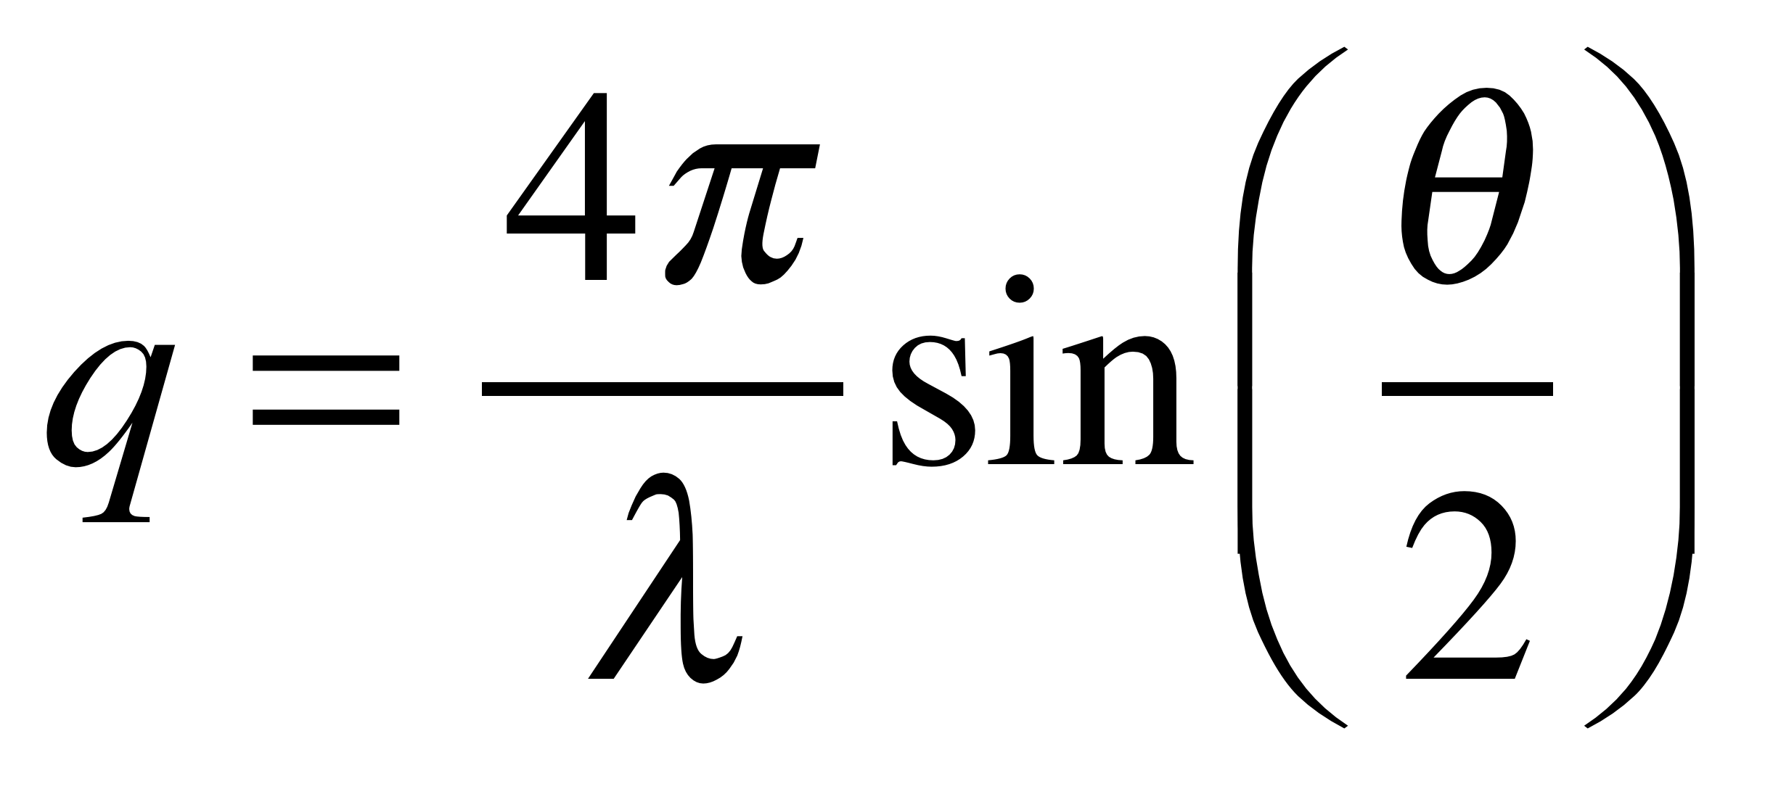
Structure from Scattering
Structure factor, S(q), depends on particle configuration
scattering volume
Incident light, λ
θ
q
Intensity, I_{s}
detector
I_{s} ~ ρP(q)S(q)
q: scattering vector
ρ: density
P(q): form factor
S(q): structure factor
Typical
gel S(q)
Light scattering detects structure on scales from ~20 nm to ~ 20 μm
Solomon lab

Slide 26
Static Light Scattering
Sample
USALS
λ₀ = 0.633 μm
0.0461 μm^{–1} < q < 1.85 μm^{–1}
Beam Expander
Beam Stop
CCD
Camera
Parab.
Mirror
Sample
Detector
Pinhole
CCD
Camera
Beam Stop
Beam Splitter
Beam
Stop
Detector
Index Matching Vat
Sample
SALS
λ₀ = 0.532 μm
0.822 μm^{–1} < q < 6.76 μm^{–1}
WALS
λ₀ = 0.488 μm
3.58 μm^{–1} < q < 33.1 μm^{–1}
Scattered Beam
Solomon lab

Slide 27
In house Pinhole and Bonse-Hart X-ray Scattering Cameras and Static Light Scattering Facilities
In house X-ray reflectivity, spectroscopic elipsometry and a variety of other surface analysis techniques
Access to the Advanced Photon Source (ANL) for USAXS (See poster by Jan Ilavsky attending)
Access to NIST Neutron Scattering Center (Ron Jones attending)
Access to ORNL Neutron Scattering Facilities (Greg Smith attending)
Center for Nanophase Materials Science at ORNL (Jimmy Mays, M.S. Rahman (attending & poster), Greg Smith/Mussie Alemseghed (both attending))

Slide 28
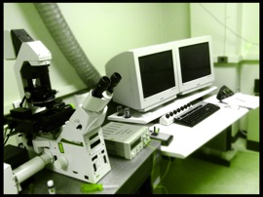
Leica TCS SP2 Confocal Laser Scanning Microscope
Excitation wavelengths : a blue Argon/Argon-Krypton laser (458/488nm), a green laser (543nm), and a red Helium-Neon laser (633nm).
Detectors: wavelengths between 400 - 850nm
Image resolution: up to 4096 x 4096
Image speed up to 3 frames per second at 512 x 512 pixels.
Solomon/Larson/… lab

Slide 29
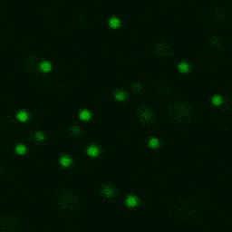
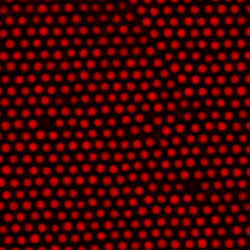
Particle Imaging
Brownian
Motion
Pair potential
interactions
1 nm
10 nm
100 nm
1 μm
10 μm
molecular
granular
(slide from Solomon group)

Slide 30
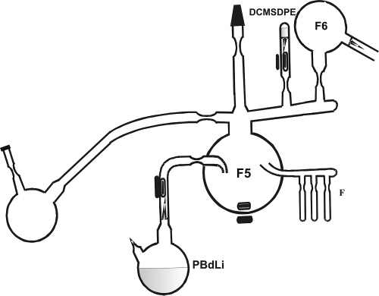
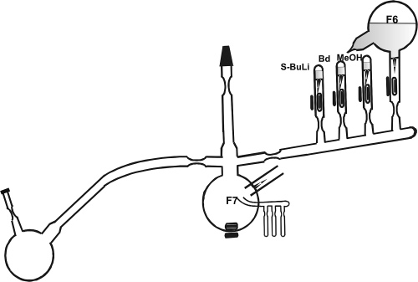
Polymer Synthesis
Synthesis of star
Mays lab
Coupling of two arms

Slide 31
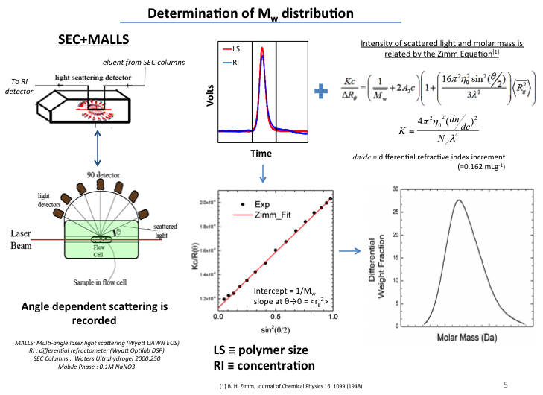
Size exclusion chromatography

Slide 32
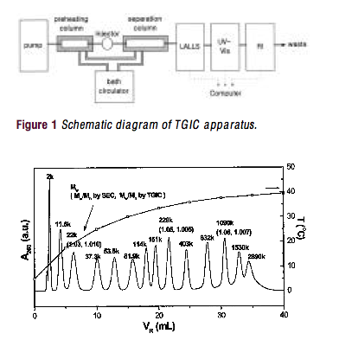
Temperature Gradient Interaction Chromatography (TGIC)
from group of Taihyun Chang, Pohang Univ., Korea

Slide 33
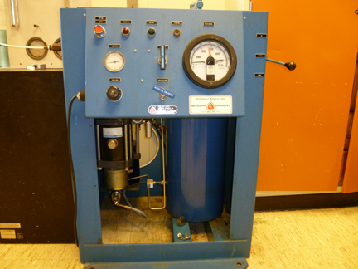
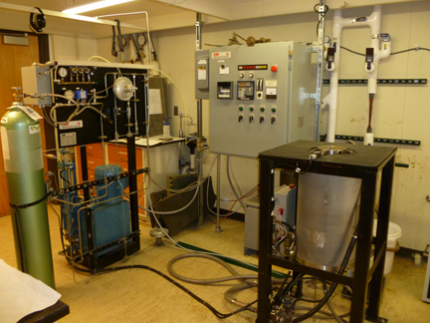
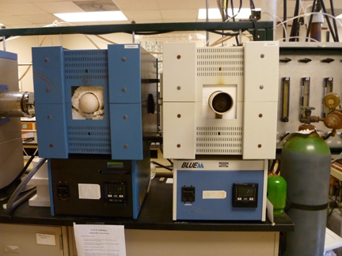
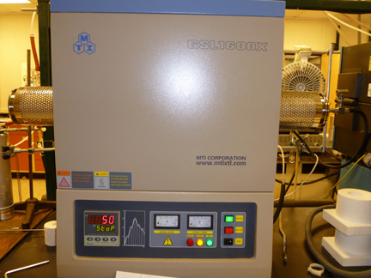
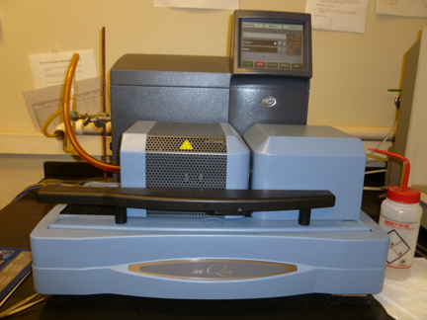
Processing/analysis Equipment
Cold and hot Isostatic Presses
Burnout and sintering furnaces
Differential scanning calorimetry /thermal gravimetric analysis
Dilatometers
Extruders and Lab Scale Film Blowing
Laine lab

Slide 34
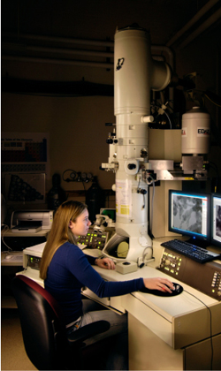
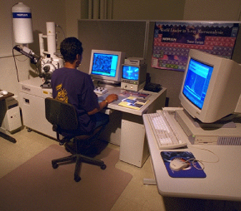
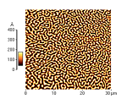
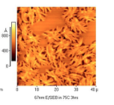
Electron Microbeam Analysis Laboratory
Scanning electron microscopy
Transmission electron microscopy
Atomic force microscopy
Focused Ion beam
X-ray diffraction and SAXS

Slide 35
Computational Capabilities: Kinetic Modeling
Algorithm for Monte Carlo simulation of LCB PE using single-site catalyst
Reaction kinetics of LCB PE using single-site catalyst
Start
monomer addition
Generate random
number R: U(0,1)
addition of unsaturated chain
NO
R>pp
YES
generation of dead structured chain
Propagation
Termination
Generate random
number R: U(0,1)
Save molecule
-hydride elimination
Monte Carlo probabilities
NO
R>lp
YES
Add monomer
Add macromonomer
propagation probability
monomer selection probability
Costeux et al., Macromolecules (2002)

Slide 36
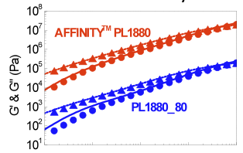
Computational Capabilities: Model of Polymer Linear Rheology
A complex commercial branched polymer is represented by an ensemble of up to 10,000 chains, all with different molecular weights and branching structures.
The ensemble is generated from a combination of GPC characterization, knowledge of reaction kinetics, and rheology.
The ensemble is fed into the “Hierarchical Code,” and a prediction of the linear rheology (G’ and G”) emerges.
Larson et al., (2001, 2006, 2011)

Slide 37
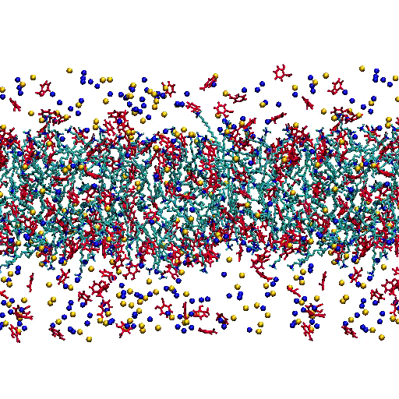
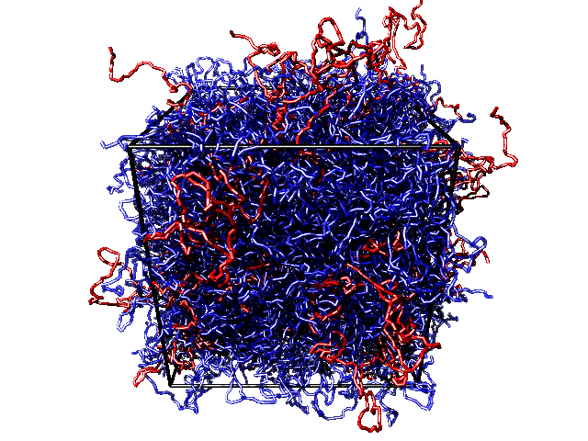
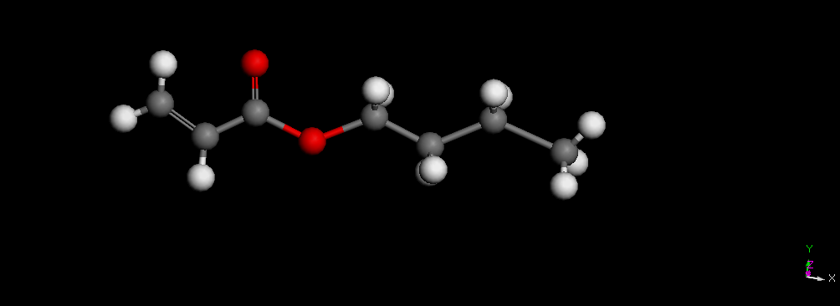
Computational Capabilities: Molecular Simulations
atomistic & coarse-grained simulations of polymers, surfactants, etc.

Slide 39
Project 1: Controlling Polymer Rheological Properties Using Long-Chain Branching
PI’s: Ronald Larson¹ and Greg Beaucage²
Team: Jimmy Mays³, Nikos Hadjichristidis⁴, Greg Smith⁵, Ron Jones⁶
1 Univ. Michigan; 2 Univ. Cincinnati; 3 Univ. Tennessee; 4 Univ. Athens/KAUST; 5 Oak Ridge National Lab; 6 National Institute of Standards and Technology
Proposed Budget: $150,000/year; In Kind Support ORNL $40,000/year; NIST $40,000/year
Project Duration: 4 years

Slide 40
Outcomes/Deliverables
Inference of long-chain branching structures from rheological, neutron scattering, SEC, and other measurements.
Development of computer software for inference of long-chain branching structure from characterization data and catalyst information
Inference of nonlinear rheology and processing characteristics from branching structure
Tools for optimization of branching

Slide 41
Impact
Improved ability to design and control polymer processing properties
Ability to infer likely branching characteristics from rheology
Understanding of complex catalyst systems and resolution of some longstanding debates over molecular structure in certain resin systems

Slide 42
Supplementary Material

Slide 43
Industrial Relevance
“The flow behavior (‘rheology’) [of polymers] is enormously sensitive to LCB [long chain branching] concentrations far too low to be detectable by spectroscopic (NMR, IR) or chromatographic (SEC) techniques. Thus polyethylene manufacturers are often faced with ‘processability’ issues that depend directly upon polymer properties that are not explainable with spectroscopic or chromatographic characterization data. Rheological characterization becomes the method of last resort, but when the rheological data are in hand, we often still wonder what molecular structures gave rise to those results.”
        Janzen and Colby, J. Molecular Structure, 1999

Slide 44
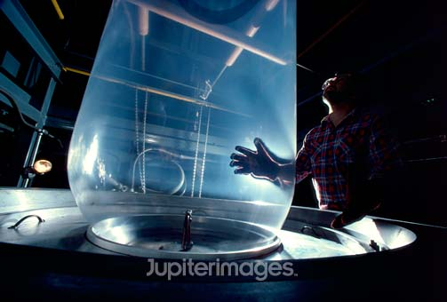
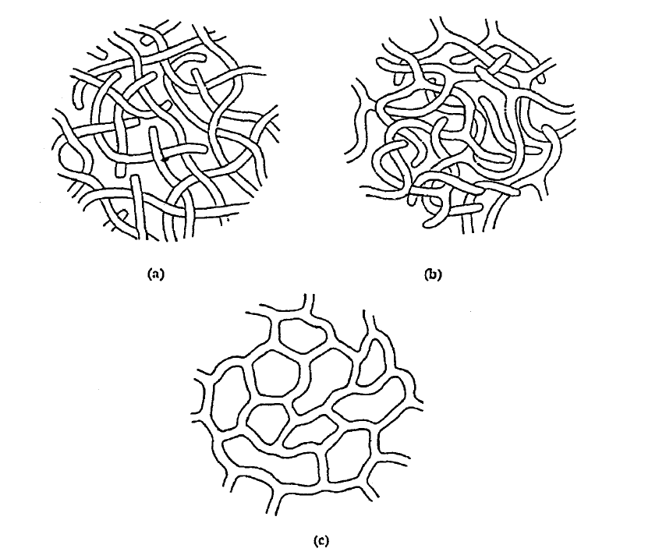
Rheology, Processing and Long-Chain Branching
< 1 LCB’s per million carbons significantly affects rheology!
branched polymers
branched thread-like micelles

Slide 45
Blends of Linear Exact 3128 and Branched PL1880 Polyolefins
X.Chen, C. Costeux, R. Larson. J. of Rheology 54(6) 1185-1206, 2010

Slide 46
Rheology of Blends of Linear Exact 3128 and Branched PL1880 Polyolefins
T=150C
Increasing LCB
<1 LCB per million carbons!

Slide 47
A Priori Predictions of Commercial Branched Polymer Rheology with Levels of LCB down to one Branch per Million Backbone Carbons

Slide 48
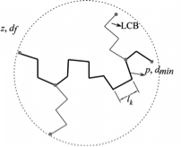

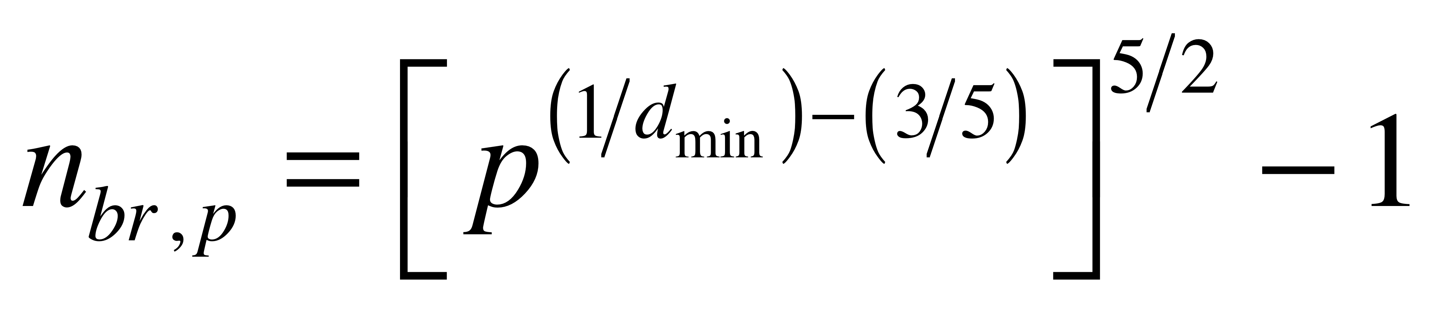
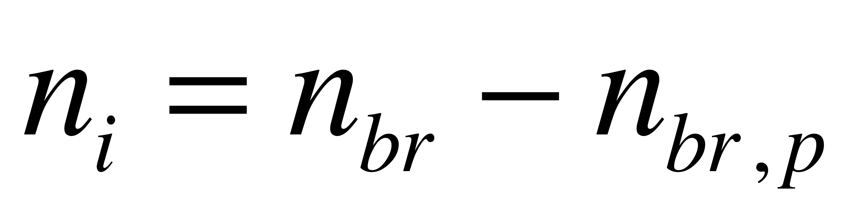
Small-Angle Neutron Scattering
Branch content of metallocene polyethylene Ramachandran R, Beaucage G, Kulkarni AS, McFaddin D, Merrick-Mack J, Galiatsatos V Macromolecules, 42 4746-4750 (2009).

Slide 49
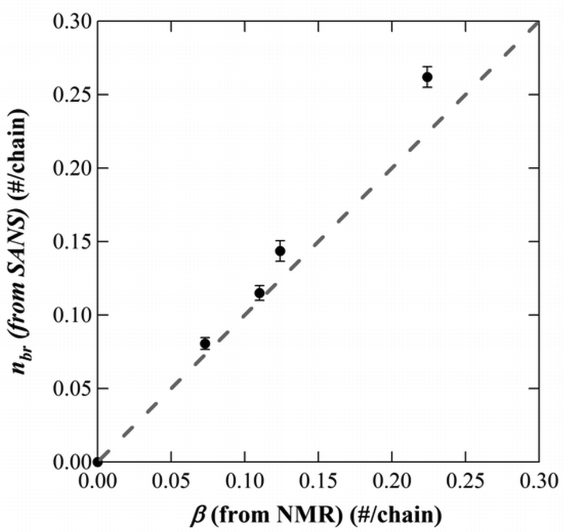
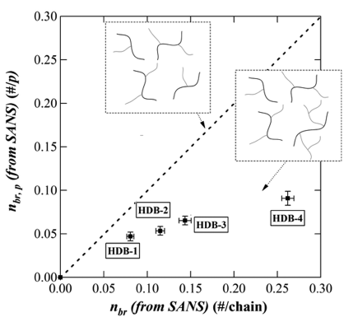
Metallocene Resins
Branch content of metallocene polyethylene Ramachandran R, Beaucage G, Kulkarni AS, McFaddin D, Merrick-Mack J, Galiatsatos V Macromolecules, 42 4746-4750 (2009).

Slide 51
Branches per Chain
Compare Catalysts

Slide 52
Hyperbranch Content
Compare Catalysts

Slide 53
Proposed Work
-Scaling Method: Beaucage has developed a new method for the quantification of macromolecular topology, that can be used to analyze small-angle scattering data. The method yields unique parameterization of the average branch length, number of inner segments (branch on branch or hyperbranch content) and quantitative (with error bars) measures of the number of branches, mole fraction branches as well as a number of other parameters.
-Linear Rheology: We propose to combine this new method with methods developed in the Larson group for inferring branching structures from linear rheology data and catalyst reaction pathways to improve determination of branching structures in polymers of industrial importance.
-Non-Linear Rheology: This will be combined with predictions of nonlinear rheology to determine how to tailor branching levels to obtain optimal processing behavior.

Slide 55
Project 3: Effect of Branching on Flow-Induced Crystallization and Crystalline Orientation of Polyolefins
PI’s: Mike Solomon¹, Greg Beaucage², Ryan Breese³, Ron Larson¹
Team: Jan Ilavsky⁴, Jimmy Mays⁵, Nikos Hadjichristidis⁶
1 Univ. Michigan; 2 Univ. Cincinnati; 3 Eclipse Film Technologies; 4 Argonne National Lab; 5 Univ. Tennessee/ORNL; 6 Univ. Athens/KAUST
Proposed Budget: $150,000/year; In Kind Support Eclipse Film Technologies $75,000/year, Argonne National Lab $25,000/year, ORNL $25,000/year
Project Duration: 4 years

Slide 56
Outcomes/Deliverables
Correlation of polyolefin branching structure on crystallization kinetics, crystallization morphology (e.g. spherulite size and density) and orientation.
Quantification of effect of linear and long- and short-chain branched fraction on polyolefin crystallization kinetics and morphology
Measurements of interaction of branching structure and shear deformation on crystallization kinetics, orientation and morphology
Development of scattering and rheological tools to probe effect of branching on crystallization

Slide 57
Impact
Improved ability to link long chain branching structure to crystallization kinetics, crystallization morphology and orientation of polyolefins
Potential to manipulate crystallite morphology (e.g. size, density and orientation) by means of polyolefin branching structure
Processing/structure interaction in long and short chain-branched polyolefins.

Slide 58
Prior work and project scope
A comb-shaped long-chain branched molecule added at approximately the overlap concentration significantly increased the crystallization kinetics of a hydrogenated polybutadiene blend¹
Isotactic polypropylenes of varying branching index showed enhanced crystallization kinetics and oriented crystallites due to long chain branching²
To extend the state-of-the-art, we should apply an integrated set of scattering, rheology and modeling studies to a series of polyolefin materials in which long-chain branch structure is homologously varied.
¹E.L. Heeley et al., “Shear-induced crystallization in blends of model linear and long-chain branched hydrogenated polybutadienes,” Macromolecules, 39, 5058 (2006).)
²P.K. Agarwal et al, “Shear-induced crystallization in novel long chain branched polypropylenes by in situ rheo-SAXS and -WAXD,” Macromolecules, 36, 5226 (2003);

Slide 59
Prior work and project scope
Beaucage in collaborative work with LyondellBasell over a number of years has published in this area , J. of Polym. Sci. B 39, 2923-36 (2001); 45, 1834-44 (2007); 46, 607-18 (2008); Polymer 42, 3103-13 (2001); 44, 1103-15 (2003); Curr. Opin. In Sol. St. Mat. Sci. 8 436-48 (2004).
These papers detail the use of SAXS and WAXS to understand the relationship between the properties of polyolefin films and the nano- and crystallographic structure and orientation.
Orientation in processed films is linked to long chain branching.

Slide 60
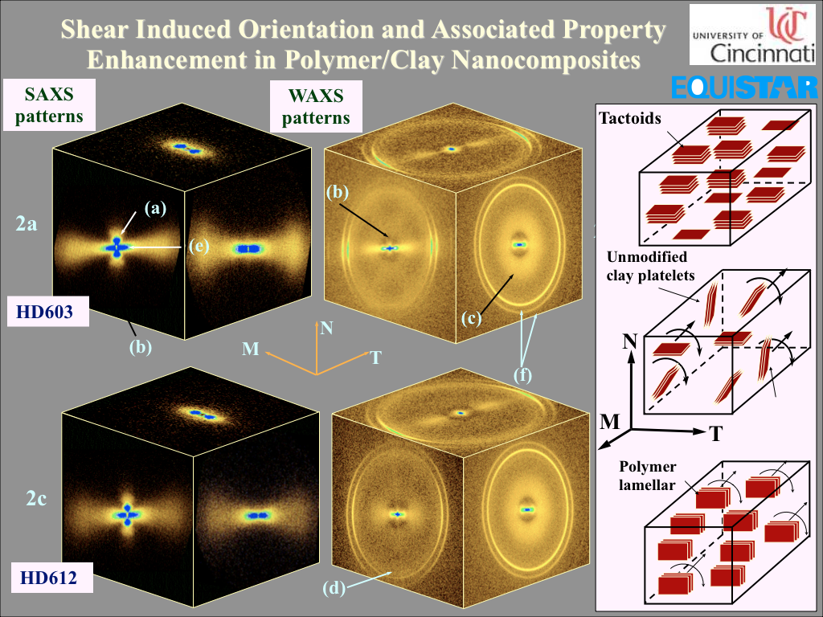
Supplementary Material
Bafna/Beaucage et al. Polymer 44, 1103-15 (2003)

Slide 61
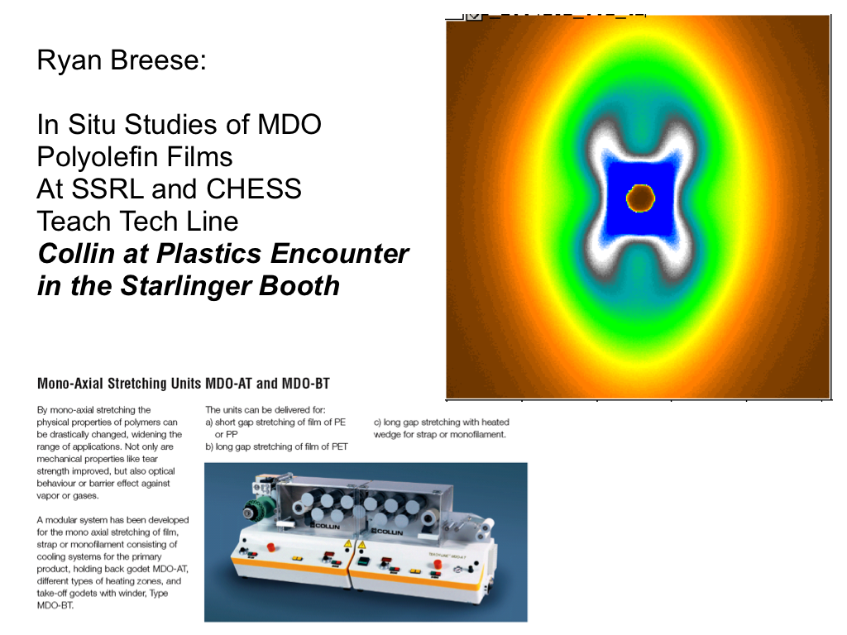
Breese/Beaucage et al. J. of Polym. Sci. B 46, 607-18 (2008)

Slide 62
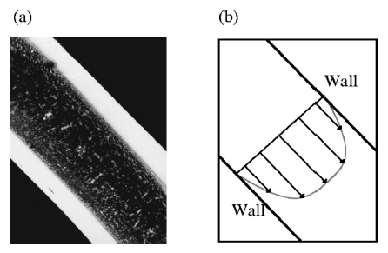
Shear-induced crystallization of polypropylene
spherulitic core
• crystallization kinetics and morphology affected by shear
• controlled experiments with short shear times best model processing conditions
(Liedauer et al., 1993)
• crystallization time depends on M_{w}, γ and t_{s}
oriented skin
Polarized light micrograph
cross slot flow profile
Spatially dependent PP crystallization
in cross slot flow
(gap = 0.5 mm, τ_{w} =0.05 MPa, ts = 4 s)
•
(Kumaraswamy et al., 1999)

Slide 63
Methods: light scattering
a = 4.00±0.29 μm
12-bit
CCD camera
pin hole
detection lens
beam stop
collimating lens
polarizer
Linkam shearing hotstage
1 s⁻¹ < γ’ < 60 s⁻¹
50 μm gap
pin hole
Freq. Doubled Nd-Yag
= 532 nm
polarizer
focusing lens
mirror
waveplate

Slide 64
Master curve behavior: effect of shear strain
For PP nanocomposites, effect appears to scale with strain over range probed

Slide 65
Project will present a comprehensive understanding of topological control over crystallinity in processing
-Growth rate and structural effects under controlled shear
-In situ and ex situ orientation studies of crystallographic and nano-structures
-Study of cold drawing through MDO processing of films produced from branched polyolefins
-Use of model polymers and commercial grade polymers

