Slide 1
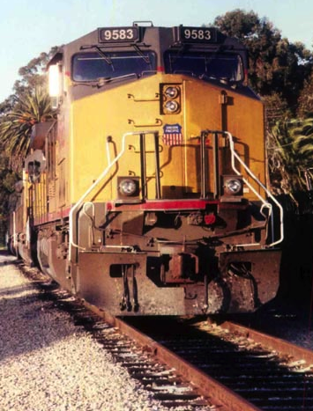
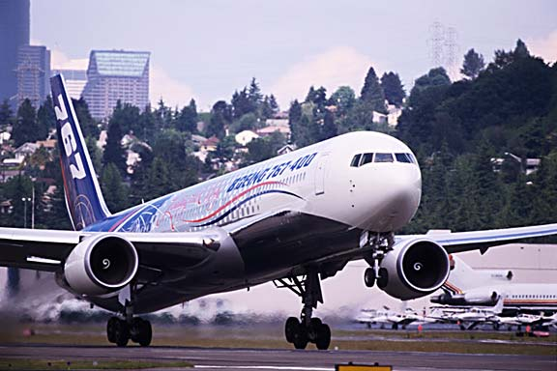
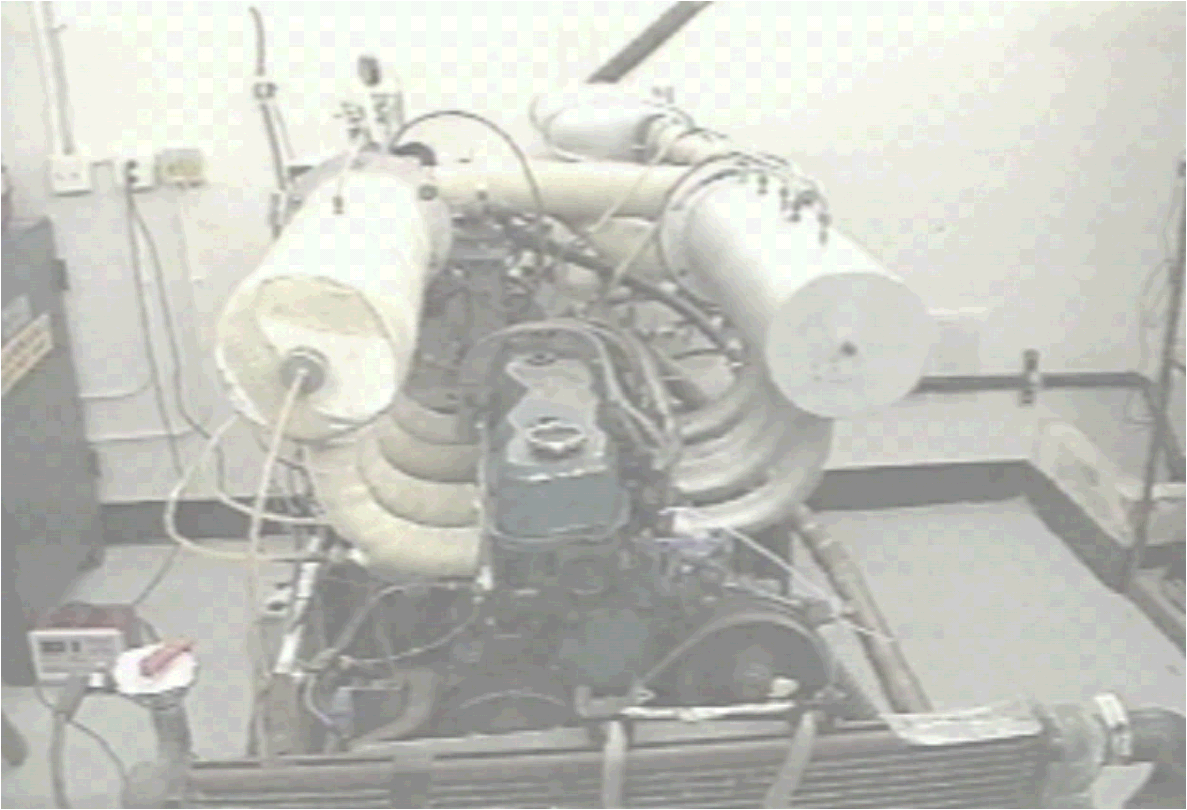
AME 436 Energy and Propulsion
Lecture 8
Unsteady-flow (reciprocating) engines 3:
ideal cycle analysis

Slide 2
Outline
Common cycle types
Otto cycle
Why use it to model premixed-charge unsteady-flow engines?
Air-cycle processes
P-V & T-s diagrams
Analysis
Throttling and turbocharging/supercharging
Diesel cycle
Why use it to model nonpremixed-charge unsteady-flow engines?
P-V & T-s diagrams
Air-cycle analysis
Comparison to Otto
Complete expansion cycle
Otto vs. Diesel - Ronney's Catechism
Fuel-air cycles & comparison to air cycles & "reality”

Slide 3
Common cycles for IC engines
No real cycle behaves exactly like one of the ideal cycles, but for simple cycle analysis we need to hold one property constant during each process in the cycle
Process → ↓ Cycle Name↓ | Comp-ression | Heat addition | Expan-sion | Heat rejection | Model for
Otto | s | v | s | v | Premixed-charge unsteady-flow engine
Diesel | s | P | s | v | Nonpremixed-charge unsteady-flow engine
Brayton | s | P | s | P | Steady-flow gas turbine
Complete expansion | s | v | s | P | "Late intake valve closing" premixed-charge engine
Stirling | v | T | v | T | "Stirling" engine
Carnot | s | T | s | T | Ideal reversible engine

Slide 4
Why use Otto cycle to model premixed-charge engines?
Volume compression ratio (r) = volume expansion ratio as reciprocating piston/cylinder arrangement provides
Heat input at constant volume corresponds to infinitely fast combustion - not exactly true for real cycle, but for premixed-charge engine, burning time is a small fraction of total cycle time
As always, constant entropy (s) compression/expansion corresponds to an adiabatic and reversible process - not exactly true but not bad either
Recall that V on P-V diagram is cylinder volume (m³), a property of the cylinder, NOT specific volume (v, units m³/kg), a property of the gas
Note that s is specific entropy (J/kgK) which IS a property of the gas, heat transfer = ∫ Tds if mass doesn't change during heat addition

Slide 5
Ideal 4-stroke Otto cycle process
Compression ratio r = V₂/V₁ = V₂/V₃ = V₅/V₄ = V₆/V₇
Stroke | Process | Name | Constant | Mass in cylinder | Other info
A | 1 → 2 | Intake | P | Increases | P₂ = P₁; T₂ = T₁ At 1, exhaust valve closes, intake valve opens
B | 2 → 3 | Compression | s | Constant | P₃/P₂ = r^{γ}; T₃/T₂ = r^{(γ-1)} At 2, intake valve closes
--- | 3→ 4 | Combustion | V | Constant | T₄ = T₃ + fQ_{R}/C_{v}; P₄/P₃ = T₄/T₃ At 3, spark fires
C | 4 → 5 | Expansion | s | Constant | P₄/P₅ = r^{γ}; T₄/T₅ = r^{(γ-1)}
--- | 5 → 6 | Blowdown | V | Decreases | P₆ = P_{ambient}; T₆/T₅ = (P₆/P₅)^{(γ-1)/γ} At 5, exhaust valve opens, exhaust gas "blows down"; gas remaining in cylinder experiences ≈ isentropic expansion
D | 6 → 7 | Exhaust | P | Decreases | P₇ = P₆; T₇ = T₆

Slide 6
P-V & T-s diagrams for ideal Otto cycle
Model shown is open cycle, where mixture is inhaled, compressed, burned, expanded then thrown away (not recycled)
In a closed cycle with a fixed (trapped) mass of gas to which heat is transferred to/from, 6 → 7, 7 → 1, 1 → 2 would not exist, process would go directly 5 → 2 (Why don't we do this? Remember heat transfer is too slow!)

Slide 7
Otto cycle analysis
Thermal efficiency (ideal cycle, no throttling or friction loss)
Note η_{th} is independent of heat input (but in real cycle if mixture is too lean (too little heat input) it won't burn, if rich some fuel can't be burned since not enough O₂)
Note that this η_{th} could have been determined by inspection of the T - s diagram - each Carnot cycle strip has same 1 - T_{L}/T_{H} = 1 - (T₂/T₃) =
1 - (V₃/V₂)^{γ-1} = 1 - (1/r)^{γ-1}

Slide 8
Effect of compression ratio (Otto)
Animation: P-V diagrams, increasing compression ratio (same displacement volume, same fuel mass fraction (f), thus same heat input)

Slide 9
Effect of compression ratio (Otto)
Animation: T-s diagrams, increasing compression ratio (same displacement volume, same fuel mass fraction (f), thus same heat input)
Higher compression clearly more efficient (taller Carnot strips)

Slide 10
Effect of heat input (Otto)
Animation: P-V diagrams, increasing heat input via increasing f (same displacement volume, same compression ratio)

Slide 11
Effect of heat input (Otto)
Animation: T-s diagrams, increasing heat input via increasing f (same displacement volume, same compression ratio)
Heat input does not affect efficiency (same T_{L}/T_{H} in Carnot strips)

Slide 12
Otto cycle analysis
η_{th} increases as r increases - why not use r → ∞ (η_{th} → 1)?
Main reason: KNOCK (lecture 10) - limits r to ≈ 10 depending on octane number of fuel
Also - heat losses increase as r increases (but this matters mostly for higher compression ratios as in Diesels discussed later)
Typical premixed-charge engine with r = 8, γ = 1.3, theoretical η_{th} = 0.46; real engine ≈ 0.30 or less - why so different?
Heat losses - to cylinder walls, valves, piston
Friction
Throttling
Slow burn - combustion occurs over a finite time, thus a finite change in volume, not all at minimum volume (thus maximum T); as shown later this reduces η_{th}
Gas leakage past piston rings ("blow-by") & valves (minor issue)
Incomplete combustion (minor issue)

Slide 13
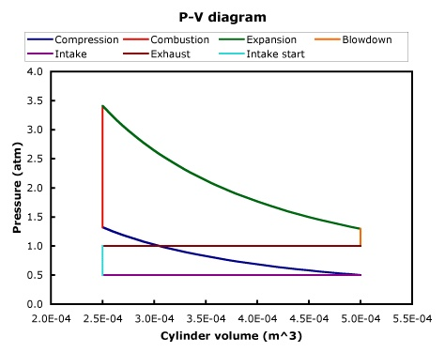
Throttling losses
Animation: gross & net indicated work, pumping work
Net indicated work
(+)
Gross indicated work
(-)
Pumping work

Slide 14
Throttling losses
When you need less than the maximum IMEP available from a premixed-charge engine at Wide Open Throttle (WOT) (which is most of the time), a throttle is used to control IMEP, thus torque & power
Throttling adjusts torque output by reducing intake ρ through decrease in intake P; when throttled, mass flow (thus volumetric efficiency η_{v}) decreases with η_{v} ≈ η_{v,WOT}(P_{intake}/P_{ambient}); recall (Lecture 7)
where K ≈ constant (not a function of throttle position or P_{intake})
Throttling loss significant at light loads (see next page)
Control of fuel/air ratio can adjust torque, but cannot provide sufficient range of control - misfire problems with lean mixtures
Diesel - nonpremixed-charge - use fuel/air ratio control - no misfire limit - no throttling needed

Slide 15
Throttling loss
How much work is lost to throttling for fixed work or power output, i.e. a fixed BMEP, if fuel mass fraction (f) and N are constant?

Slide 16
Throttling loss
Throttling loss increases from zero at wide-open throttle (WOT) to about half of all fuel usage at idle (other half is friction loss)
At typical highway cruise condition (≈ 1/3 of BMEP at WOT), about 15% loss due to throttling
Throttling isn’t always bad, shifting to lower gear to reduce vehicle speed uses throttling loss (negative BMEP) and high N to maximize negative power
Double-click plot
To open Excel chart

Slide 17
Throttling loss
Another way to reduce throttling losses: close off some cylinders when low power demand
Cadillac had a 4-6-8 engine in the 1981 but it was a mechanical disaster
Mercedes had "Cylinder deactivation" on V12 engines in 2001 - 2002
GM uses a 4-8 "Active Fuel Management" (previously called "Displacement On Demand") engine
Nowadays several manufacturers have variable displacement engines (e.g Chrysler 5.7 L Hemi, "Multi-Displacement System")
Good summary articles on the mechanical aspects of variable displacement:
http://www.autospeed.com/A_2618/xBXyt34qy_1/cms/article.html
http://www.autospeed.com/cms/article.html?&title=Cylinder-Deactivation-Reborn-Part-2&A=2623
Certainly reduces throttling loss, but still have friction losses in inoperative cylinders

Slide 18
Throttling loss
Aircycles4recips.xls (to be introduced in next lecture) analysis
Defaults: r = 9, V_{d} = 0.5 liter, P_{intake} = 1 atm, FMEP = 1 atm)
Predictions: P_{intake} = 1 atm, 13.45 hp, η = 29.96%
1/3 of max. power via throttling: P_{intake} = 0.445 atm, 4.48 hp, η = 22.42%
1/3 of max. power via halving displacement
(double FMEP to account for friction losses in inoperative cylinders)
P_{intake} = 0.806 atm, 4.48 hp, η = 24.78%
(10.3% improvement over throttling)
Smaller engine operating at wide-open throttle to get same power:
V_{d} = 0.5 liter / 3 = 0.167 liter, 4.48 hp, η = 29.96%
(33.6% improvement over throttling bigger engine)
Moral: if we all drove under-powered cars (small displacement) we'd get much better gas mileage than larger cars with variable displacement – could use turbocharging to regain maximum power (e.g. Ford EcoBoost)
Hybrids use the "wide-open throttle, small displacement" idea and store surplus power in battery

Slide 19
Turbocharging & supercharging
Best way to increase power is to increase P_{in} above ambient using an air pump that forces air into engine
Instead of pumping loss, you have a pumping gain! ☺
Turbocharging: instead of blowdown (5 → 6), divert exhaust gas through a turbine & use shaft power to drive air pump; makes use of high pressure gas otherwise wasted during blowdown, thus thermal efficiency is increased
Supercharging: air pump is driven directly from the engine rather than a separate turbine; if pump is 100% efficient (yeah, right…) then no loss or gain of overall cycle efficiency
Limitations / problems
To get maximum benefit, need "intercooler" to cool intake air (thus increase density) after compression but before entering engine
Need time to overcome inertia of rotating parts & fill intake manifold with high-pressure air ("turbo lag")
Turbochargers: moving parts in hot exhaust system - not durable
Cost, complexity
If an engine isn't turbocharged or supercharged, it's called "naturally aspirated"

Slide 20
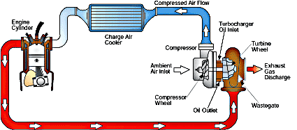
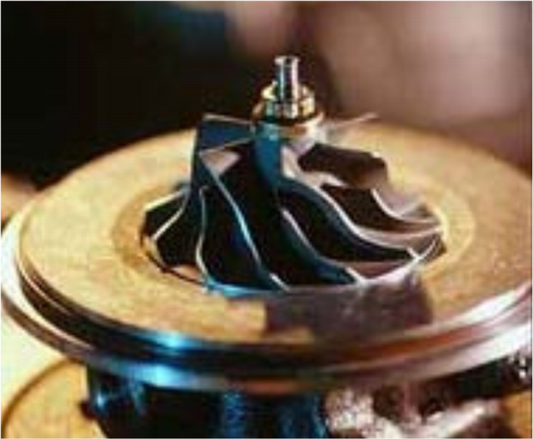
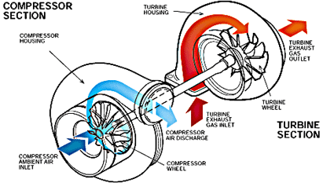
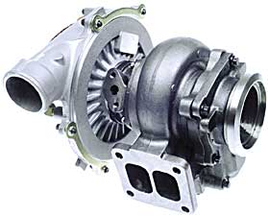
Turbocharging & supercharging
Source: http://auto.howstuffworks.com/turbo.htm

Slide 21
Turbocharging & supercharging
Work available
to turbocharger
Pumping gain

Slide 22
Turbocharging & supercharging
v
v
P
P > 1 atm
P = 1 atm
Blowdown becomes
expansion process for turbine

Slide 23
Why use Diesel cycle to model nonpremixed-charge engines?
Volume compression ratio = (volume ratio during heat addition) x (volume expansion ratio) as with reciprocating piston/cylinder arrangement (same reason as Otto/premixed)
Heat input at constant pressure corresponds to slower combustion than constant-volume combustion - represents slower combustion than premixed-charge engine while still maintaining simple cycle analysis
In reality, if burning were slow you would never wait until TDC to inject fuel, plus there is no way to ensure cylinder expansion rate exactly matches burning rate to obtain constant-P combustion
Diesels have slower combustion since fuel is injected after compression, thus need to mix and burn, instead of just burn (already mixed before spark is fired) in premixed-charge engine
Constant s compression/expansion corresponds to adiabatic & reversible process - not exactly true but a good first assumption
Diesels not throttled (for reasons discussed later) (though often turbo/supercharged)

Slide 24
Ideal Diesel cycle analysis
Compression ratio r = V₁/V₂ = V₂/V₃ = V₅/V₃ = V₆/V₇
New parameter: Cutoff ratio β = V₄/V₃; since 3 → 4 is const. P not const. V
β = V₄/V₃ = (mRT₄/P₄)/(mRT₃/P₃) = T₄/T₃ (Cutoff ratio β not to be confused with non-dimensional activation energy β)
Stroke | Process | Name | Constant | Mass in cylinder | Other info
A | 1 → 2 | Intake | P | Increases | P₂ = P₁; T₂ = T₁ At 1, exhaust valve opens, intake valve closes
B | 2 → 3 | Compression | s | Constant | P₃/P₂ = r^{γ}; T₃/T₂ = r^{(γ-1)} At 2, intake valve closes
--- | 3→ 4 | Combustion | P | Constant | T₄ = T₃ + fQ_{R}/C_{P}; T₄/T₃ = V₄/V₃ At 3, fuel is injected
C | 4 → 5 | Expansion | s | Constant | P₄/P₅ = (r/β)^{γ}; T₄/T₅ = (r/β)^{(γ-1)}
--- | 5 → 6 | Blowdown | V | Decreases | P₆ = P_{ambient}; T₆/T₅ = (P₆/P₅)^{(γ-1)/γ} At 5, exhaust valve opens, exhaust gas "blows down" as with Otto
D | 6 → 7 | Exhaust | P | Decreases | P₇ = P₆; T₇ = T₆

Slide 25
P-V & T-s diagrams for ideal Diesel cycle
Work is done during both 4 → 5 AND 3 → 4 (const. P combustion, volume increasing, thus w_{3→4} = P₃(v₄ - v₃)
Ambient intake pressure case shown (no pumping loop)

Slide 26
Diesel cycle analysis
Thermal efficiency (ideal cycle, no throttling or friction loss)

Slide 27
Otto vs. Diesel cycle comparison
Thermal efficiency (ideal cycle, no throttling or friction loss)
⇒ For same r, η_{th} (Otto) > η_{th} (Diesel)
⇒ η_{th} (Otto) ≈ η_{th} (Diesel) as β → 1 (small heat input)
Lower η_{th} is due to burning at increasing volume, thus decreasing T - thus less efficient Carnot-cycle strips; most efficient burning strategy is at minimum volume, thus maximum T
Note that (unlike Otto cycle) η_{th} is dependent on the heat input
Higher heat input ⇒ higher f ⇒ larger β ⇒ lower η_{th}

Slide 28
Otto vs. Diesel cycle comparison
Must have V₄/V₃ ≤ V₅/V₃ (otherwise burning is still occurring at bottom of piston travel) thus we require β ≤ r
For r = 20, Q_{R} = 4.3 x 10⁷ J/kg, C_{P} = 1400 J/kgK, γ = 1.3, T₂ = 300K, requirement is f < 0.417, which is much greater than stoichiometric f
(≈ 0.065) anyway so in practice this limit is never reached
Typical f ≈ 0.04 (other parameters as above): β ≈ 2.67, η_{th} ≈ 0.515 (Diesel) vs. 0.593 (Otto), so difference not large for realistic conditions
As with Otto, η_{th} increases as r increases - why not use r → ∞
(η_{th} → 1)? Unlike Otto, knock is not an issue - Diesel compresses air, not fuel/air mixture; main reason: heat losses
No knock issue so Diesels use much higher r
As gas is compressed more, T increases and V decreases, increasing temperature gradient ΔT/ΔX for conduction loss
As conduction loss increases, compression work lost increases
At some point, lost work outweighs higher η_{th} of cycle having higher r
Also - as r increases, peak pressure increases - larger mechanical stresses for little improvement in η_{th}

Slide 29
Otto vs. Diesel cycle comparison
Unthrottled Otto & Diesel with same compression ratio & heat input: Otto has higher peak P & T, more work output
Otto
Diesel

Slide 30
Otto vs. Diesel cycle (animation)
Otto clearly has higher η_{th} - every Carnot strip has same T_{L} for both cycles, but every Otto strip has higher T_{H}
Unlike Otto cycle, η_{th} for Diesel cannot be determined by inspection of the T - s diagram since each Carnot cycle strip has a different 1 - T_{L}/T_{H}
Otto
Equal areas
Diesel
Otto work
Diesel work
Otto heat input
Diesel heat input

Slide 31
Effect of compression ratio (Diesel)
Animation: P-V diagrams, increasing compression ratio (same displacement volume, same fuel mass fraction (f), thus same heat input)

Slide 32
Effect of compression ratio (Diesel)
Animation: T-s diagrams, increasing compression ratio (same displacement volume, same fuel mass fraction (f), thus same heat input)
Higher compression clearly more efficient (taller Carnot strips)

Slide 33
Effect of heat input (Diesel)
Animation: P-V diagrams, increasing heat input via increasing f (same displacement volume, same compression ratio)

Slide 34
Effect of heat input (Diesel)
Animation: T-s diagrams, increasing heat input via increasing f (same displacement volume, same compression ratio)
Heat input does affect efficiency (shrinking T_{L}/T_{H} in Carnot strips as f increases)

Slide 35
Example
For an ideal Diesel cycle with the following parameters: r = 20, γ = 1.3, M = 0.029 kg/mole, f = 0.05, Q_{R} = 4.45 x 10⁷ J/kg, initial temperature T₂ = 300K, initial pressure P₂ = 1 atm, P_{exh} = 1 atm, determine:
a) Temperature (T₃) & pressure (P₃) after compression & compression work per kg
b) Temperature (T₄) and pressure (P₄) after combustion, and the work output during combustion per kg of mixture

Slide 36
Example (continued)
c) Cutoff Ratio
d) Temperature (T₅) and pressure (P₅) after expansion, and the expansion work per kg of mixture
e) Net work per kg of mixture
Net work = Compression work + Work during combustion + Expansion work
= -417.6 + 992.9 + 513.5 = 1089 kJ/kg

Slide 37
Example (continued)
f) Thermal Efficiency
η_{th} = (Net work per unit mass) / (Heat input per unit mass)
= (Net work)/fQ_{R} = (1.089 x 10⁶ J/kg)/(0.05)(4.45 x 10⁷ J/kg) = 0.489 = 48.9%
compare this to the theoretical efficiency (should be the same since this is an ideal cycle analysis)
g) IMEP
Note that the "mass" does not include the mass in the clearance volume; it is assumed that this mass is inert (i.e. exhaust gas) which does not yield additional heat release, plus its compression/expansion work cancels out

Slide 38
Examples of using P-V & T-s diagrams
Consider the "baseline" ideal Diesel cycle shown on the P-V and T-s diagrams. Sketch modified diagrams if the following changes are made. Unless otherwise noted, assume in each case the initial T & P, r, f, Q_{R}, etc. are unchanged.
a) The compression ratio is increased (same maximum volume)
The minimum volume must decrease since r increases but the maximum volume does not. The cutoff ratio = 1 + fQ_{R}/C_{P}T₂r^{γ-1} decreases. The temperature after compression T₃ as well as the maximum temperature T₄ = T₃ + fQ_{R}/C_{P} increase. In order to maintain equal heat addition and thus equal areas on the T-s diagram, s₄ decreases.
Equal areas

Slide 39
Examples of using P-V & T-s diagrams
b) Part way through the constant-pressure burn, the remainder of the burn occurs instantaneously at constant volume
The cycle is the same until the 2nd part of the burn occurs at constant volume rather than constant pressure, which has a higher slope on the T-s diagram. To maintain the same total heat release, s₄ must decrease. Also, because constant volume combustion results in higher T than constant pressure combustion (since C_{V} < C_{P}), the maximum T increases.
Higher max. T for modified cycle
v
Equal areas

Slide 40
Examples of using P-V & T-s diagrams
c) The intake valve closes late (i.e. after part of the compression stroke has started; the pressure stays at ambient pressure and no compression occurs until after the intake valve closes) in such a way that the pressure after the expansion is ambient.
In order to have the pressure after expansion be ambient, the P-V curve for the expansion part of the modified cycle must be the same as the compression part of the base cycle. The pressure remains at ambient part way through the compression stroke, until the intake valve closes. The compression ratio is lower, thus the P and T after compression (state 3) are lower. s₄ must increase in order for the heat release (thus area) of the modified cycle to be the same as that of the baseline cycle.
Lower max. T for modified cycle
v
Equal areas
P

Slide 41
Complete Expansion cycle
Highest efficiency cycle consistent with piston/cylinder engine has constant-V combustion but expansion back to ambient P – Complete Expansion or Humphrey cycle (caution: different sources have different cycle naming conventions – Atkinson, Humphrey, Miller etc. – wikipedia.com is becoming the new default standard!)
Needs different compression & expansion ratios - can be done by closing the intake valve AFTER the "compression" starts or by extracting power in a turbine whose work is somehow connected to the main shaft power output
r_{compression} = 3
r_{expansion} = 5.5
constant v
Don't forget this -work when computing η!
constant P

Slide 42
Ideal 4-stroke Complete expansion cycle
Compression ratio r_{c} = V₂/V₃; Expansion ratio r_{e} = V₅/V₄
Stroke | Process | Name | Constant | Mass in cylinder | Other info
A | 1 → 2 | Intake | P | Increases then decreases | P₂ = P₁; T₂ = T₁ At 1, exhaust valve closes, intake valve opens; volume increases from V₁ (minimum) to V₅ (maximum) then back to V₂
B | 2 → 3 | Compression | s | Constant | P₃/P₂ = r_{c}^{γ}; T₃/T₂ = r_{c}^{(γ-1)} At 2, intake valve closes
--- | 3→ 4 | Combustion | V | Constant | T₄ = T₃ + fQ_{R}/C_{v}; P₄/P₃ = T₄/T₃ At 3, spark fires
C | 4 → 5 | Expansion | s | Constant | P₅ = P₂ = P₁; P₄/P₅ = r_{e}^{γ}; T₄/T₅ = r_{e}^{(γ-1)}; V₅ = V₁
 | 5 → 6 | “Blowdown” | Every-thing | Constant | No blowdown in complete expansion cycle, nothing happens
D | 6 → 7 | Exhaust | P | Decreases | P₇ = P₆ = P_{ambient}; T₇ = T₆; V₇ = V₁ At 6, exhaust valve opens

Slide 43
Complete Expansion cycle analysis

Slide 44
Complete expansion cycle analysis

Slide 45
Otto vs. Complete Exp. cycle comparison
Thermal efficiency (ideal cycles, no throttling or friction loss)

Slide 46
Otto vs. Complete Exp. cycle comparison
For same r_{c}, η_{th} (Complete Expansion) > η_{th} (Otto) (obviously, since more expansion work with compression work and heat input is the same)
η_{th} (Complete Expansion) ≈ η_{th} (Otto) as Γ → 0 (small heat input)
Like Diesel, Complete Expansion and Otto converge to same cycle at small heat input due to complete expansion (same T_{H} & T_{L} as Otto)
Unlike Otto cycle, but like Diesel cycle) η_{th} in Complete Expansion cycle is dependent on the heat input (through Γ), but unlike Diesel cycle, η_{th,CompleteExpansion} increases (rather than decreases, as in Diesel) with increasing heat input

Slide 47
Complete Expansion cycle
Thermodynamically, ideal Complete Expansion cycle is same as turbocharged cycle if you take turbine work as net work output rather than driving an air pump
Gain due to complete expansion is substantial
Low-r cycle ideal shown on page 41: η_{th} = 0.424 vs. 0.356
Realistic cycle parameters (next lecture): η_{th} = 0.366 vs. 0.295
No muffler needed if exhaust always leaves cylinder at 1 atm!
Late intake valve closing is preferable (higher η_{th}) to throttling for part-load operation, but
Mechanically much more complex
Every power level requires a different intake valve closing time, thus a different r_{compression}, thus a different r_{expansion}
Since intake valve is closed late, maximum mass flow is less than conventional Otto cycle, so less power - at higher power levels can't sustain complete expansion cycle
This is an alternative to throttling for premixed-charge engines, but why don't we throttle Diesel engines? (Answer in 2 slides…)

Slide 48
Complete Expansion cycle
What is kept constant in comparison below? Clearance volume
Complete Expansion cycle provides higher BMEP (based on V_{d} for maximum-power cycle) AND higher efficiency, but at the expense of greatly increased mechanical complexity (and need for 2x larger piston stroke for wide-open throttle operation)
Displacement-on-demand (1/2 displacement) similar to Complete Expansion, but doesn’t benefit high end of power range
r_{c} = 8 (throttled & DoD), γ = 1.3, f = 0.068, Q_{R} = 4.5 x 10⁷ J/kg, T_{in} = 300K, P_{in} = 1 atm (CE), P_{exh} = 1 atm, ExhRes = TRUE, Const-v comb, BurnStart = 0.045, BurnEnd = 0.105, h = 0.01, η_{comp} = η_{exp} = 0.9, FMEP = 1 atm

Slide 49
Ronney's catechism (1/4)
Why do we throttle in a premixed charge engine despite the throttling losses it causes?
Because we have to reduce power & torque when we don't want the full output of the engine (which is most of the time in LA traffic, or even on the open road)
Why don't we have to throttle in a nonpremixed charge engine?
Because we use control of the fuel to air ratio (i.e. to reduce power & torque, we reduce the fuel for the (fixed) air mass)
Why don't we do that for the premixed charge engine and avoid throttling losses?
Because if we try to burn lean in the premixed-charge engine, when the equivalence ratio (φ) is reduced below about 0.7, the mixture misfires and may stop altogether
Why isn't that a problem for the nonpremixed charge engine?
Nonpremixed-charge engines are not subject to flammability limits like premixed-charge engines since there is a continuous range of fuel-to-air ratios varying from zero in the pure air to infinite in the pure fuel, thus someplace there is a stoichiometric (φ = 1) mixture that can burn. Such variation in φ does not occur in premixed-charge engines since, by definition, φ is the same everywhere.

Slide 50
Ronney's catechism (2/4)
So why would anyone want to use a premixed-charge engine?
Because the nonpremixed-charge engine burns its fuel slower, since fuel and air must mix before they can burn. This is already taken care of in the premixed-charge engine. This means lower engine RPM and thus less power from an engine of a given displacement
Wait - you said that the premixed-charge engine is slower burning.
Only if the mixture is too lean. If it's near-stoichiometric, then it's faster because, again, mixing was already done before ignition (ideally, at least). Recall that as φ drops, T_{ad} drops proportionately, and burning velocity (S_{L}) drops exponentially as T_{ad} drops
Couldn’t I operate my non-premixed charge engine at overall stoichiometric conditions to increase burning rate?
No. In nonpremixed-charge engines it still takes time to mix the pure fuel and pure air, so (as discussed previously) burning rates, flame lengths, etc. of nonpremixed flames are usually limited by mixing rates, not reaction rates. Worse still, with initially unmixed reactants at overall stoichiometric conditions, the last molecule of fuel will never find the last molecule of air in the time available for burning in the engine - one will be in the upper left corner of the cylinder, the other in the lower right corner. That means unburned or partially burned fuel would be emitted. That's why diesel engines smoke at heavy load, when the mixture gets too close to overall stoichiometric.

Slide 51
Ronney's catechism (3/4)
So what wrong with operating at a maximum fuel to air ratio a little lean of stoichiometric?
That reduces maximum power, since you're not burning every molecule of O₂ in the cylinder. Remember - O₂ molecules take up a lot more space in the cylinder that fuel molecules do (since each O₂ is attached to 3.77 N₂ molecules), so it behooves you to burn every last O₂ molecule if you want maximum power. So because of the mixing time as well as the need to run overall lean, Diesels have less power for a given displacement / weight / size / etc.
So is the only advantage of the Diesel the better efficiency at part-load due to absence of throttling loss?
No, also you can use higher compression ratios, which increases efficiency at any load. This helps alleviate the problem that slower burning in Diesels means lower inherent efficiency (more burning at increasing cylinder volume)
Why can the compression ratio be higher in the Diesel engine?
Because you don’t have nearly as severe problems with knock. That’s because you compress only air, then inject fuel when you want it to burn. In the premixed-charge case, the mixture being compressed can explode (since it’s fuel + air) if you compress it too much

Slide 52
Ronney's catechism (4/4)
Why is knock so bad?
We’ll discuss that in the section on knock in lecture 10.
So, why have things evolved such that small engines are usually premixed-charge, whereas large engines are nonpremixed-charge?
In small engines (lawn mowers, automobiles, etc.) you're usually most concerned with getting the highest power/weight and power/volume ratios, rather than best efficiency (fuel economy). In larger engines (trucks, locomotives, tugboats, etc.) you don't care as much about size and weight but efficiency is more critical
But unsteady-flow aircraft engines, even large ones, are almost always premixed-charge, because weight is always critical in aircraft
You got me on that one! (Though there is at least one production Diesel powered aircraft.) But of course most large aircraft engines are steady-flow gas turbines, which kill unsteady-flow engines in terms of power/weight and power/volume (but not efficiency.)

Slide 53
Fuel-air cycles
So far we’ve studied “air cycles” where gas properties (C_{P}, C_{v}, γ… ) are assumed constant so simple relations like Pv^{γ} = constant & T_{ad} = T∞ + fQ_{R}/C_{v}) can be used
This yields simple closed-form results, but isn’t realistic
More realistic estimate obtained using "real" gas properties from GASEQ or other chemical equilibrium program
Uses variable gas properties and compositions
Shows that rich mixtures have low η_{th} due to throwing away fuel that can't be burned due to lack of O₂
Shows limitation on work output because of limitation on heat input provided by combustion
Still doesn’t consider effects of
Finite burning time (especially lean & rich mixtures)
Incomplete combustion (crevice volumes, flame quenching, etc.)
Heat & friction losses
Hydrodynamic (pressure) losses in intake/exhaust
Etc., etc.

Slide 54
Fuel-air cycle analysis using GASEQ
Under "Units" menu, check "mass", "Joules" and "atm"
At the top of the page, under "Problem type" select "adiabatic compression/expansion" and make sure the box "frozen composition" is checked
Under "Reactants" select appropriate set of reactants, e.g. "Iso-octane-air flame"
To set the stoichiometry, first click on one of the species (e.g. the fuel), then to the right of the "Stoichiometry" box, click the button called "set"; in the dialog box that pops up, enter the equivalence ratio you want, then close the box
Note (i.e. write down) the mass fraction of fuel
In the box below the reactants box, enter the reactant temperature and pressure (e.g. 298K, 1 atm) and the volume ratio of the compression process (e.g. 1/8 = 0.125 for compression ratio of 8) OR the final pressure (NOT pressure ratio) (e.g. 5 atm for a pressure ratio of 10 with reactants at 0.5 atm) in the locations provided
Click on the "calculate" box. Note the internal energy, enthalpy and specific volume of both the reactants (call them u₂, h₂, v₂) and the products (u₃, h₃, v₃)
Click on the "R<<P" button to make the products from this calculation the reactants for the next calculation
At the top of the page, under "Problem type" select "adiabatic T and composition at const P" or "adiabatic T and composition at const v" depending on whether the assumption is constant pressure or constant volume combustion
On the right side of the page, under "Products" select the appropriate products (e.g. "HC/O2/N2 products (extended)")
Click on the "calculate" button. Note the internal energy, enthalpy and specific volume of the products (u₄, h₄, v₄). If Diesel cycle, compute the cutoff ratio β = v₄/v₃.

Slide 55
Fuel-air cycle analysis using GASEQ
Click on the "R<<P" button to make the products from this calculation the reactants for the next calculation
At the top of the page, under "Problem type" select "adiabatic compression/expansion" and make sure the box "frozen composition" is either checked or not checked, depending on your assumption (usually you want to assume NOT frozen)
In the box below the products box, enter the required volume expansion ratio (e.g. same as r_{c} for Otto, or r_{c}/β for Diesel) or the final pressure (again, NOT pressure ratio) in the location provided
Click on the "calculate" button. Note product internal energy, enthalpy and specific volume (u₅, h₅, v₅)
Calculate the heat input per unit mass of reactants
= [fuel mass fraction (f)] x [heating value of fuel (Q_{R})]
Determine work for each process according to the following table
Determine net work done per unit mass = work in + work out
Determine thermal efficiency = (net work per unit mass)/(heat input per unit mass)
Process | Compression work in | Heat addition, constant P | Heat addition, constant v | Expansion work out
Control mass (unsteady flow) | u₂ - u₃ | P₃(v₄ - v₃) | 0 | u₄ - u₅
Control volume (steady flow) | h₂ - h₃ | 0 | N/A | h₄ - h₅

Slide 56
Fuel-air cycle analysis
Air cycle: doesn't know about combustion limitations, so η_{th} = 1 - (1/r)^{γ-1}, but γ decreases as φ increases (more "heavy" fuel molecules with high molecular mass M, thus low γ)
Fuel-air cycle
At low φ, just like air cycle since less fuel or anything other than air
As φ increases, η_{th} decreases because T_{ad} increases and thus γ decreases
Also as φ increases,
φ > 1: not enough O₂ to burn all fuel, so η_{th} decreases rapidly
Real engine
Lower η_{th} even at φ = 1, drops off rapidly below ≈ 0.65 due to lean misfire (lower φ ⇒ lower T_{ad} ⇒ much lower S_{L}, not enough burn time)
η_{th} peaks at slightly < 1 since φ < 1 ensures there's enough air to burn every fuel molecule)

Slide 57
Fuel-air cycle analysis

Slide 58
Fuel-air cycle analysis
BMEP = Work/V_{d} = (Work/mass)/(V_{d}/mass) = ρ_{intake}(Work/mass)
Work/mass or BMEP peaks at φ slightly > 1 (unlike η_{th} which peaks slightly < 1) - why? BMEP is limited by the ability to burn all O₂, which takes up most of the space (each O₂ attached to 3.77 N₂, fuel occupies only ≈ 2% by moles or volume), so burning rich ensures all O₂ is burned

Slide 59
Example
Repeat the previous example of the ideal Diesel air-cycle analyis using a fuel-air cycle analysis (using GASEQ) with a lean iso-octane air mixture with φ = 0.792.
P₂ = 1 atm, T₂ = 300K, f = 0.05 (φ = 0.792), u₂=-172.54 kJ/kg, ρ₂=1.2176 kg/m³
From GASEQ with "Adiabatic Compression/Expansion," "Frozen Chemistry," and "Volume Products/Volume Reactants" = 0.05 (r = 20), we obtain
P₃=53.7 atm, T₃=805K, u₃=260.17 kJ/kg, ρ₃=24.35 kg/m³
Click "R<<P," select "Adiabatic T and Composition at constant P" which yields
P₄=53.7 atm, T₄=2422K, u₄=-220.57 kJ/kg, ρ₄=7.725 kg/m³
The final volume must be the same as the initial volume, and the volume ratio during combustion is v₄/v₃ = ρ₃/ρ₄ = 24.366/7.7288 = 3.153, so the volume ratio during expansion must be 20/3.153 = 6.343. Thus, click "R<<P," select "Adiabatic Compression/Expansion," uncheck "Frozen Chemistry," and in "Volume Products/Volume Reactants" enter 6.343. This yields
P₅=5.34 atm, T₅=1530 K, u₅=-1270.00 kJ/kg, ρ₅=1.2178 kg/m³
(which is essentially the same as the initial density of 1.2176 kg/m³, thus we did the expansion right, because the initial mass and volume are the same as the final mass and volume.)

Slide 60
Example
Compression work = u₂ – u₃ = -172.54 – 260.17 = -432.71 kJ/kg
Expansion work = u₄ – u₅ = -220.57 – (-1270.00) = 1049.43 kJ/kg
Work during combustion = P₃(v₄ – v₃) = P₃(1/ρ₄ - 1/ρ₃)
= (53.7 atm)(1.01325 x 10⁵ N/m²atm)(1/7.725 – 1/24.35)m³/kg (1 kJ/1000J)
= 480.90 kJ/kg
Net Work = -432.71 + 1028.11 + 480.90 = 1076.3 kJ/kg = 1.0763 x 10⁶ J/kg
Cut off Ratio = v₄/v₃ = ρ₃/ρ₄ = 24.35/7.725 = 3.152
Thermal efficiency = Net work / heat in
= (1.0763 x 10⁶ J/kg)/ (0.05 x 4.45 x 10⁷ J/kg) = 48.4%
Comment: GASEQ considers dissociation of products, and C_{p} and C_{V} are increase with temperature, both of which greatly decrease T₄ compared to the air cycle analysis. The net work, efficiency and IMEP are similar to the previous air-cycle example because of the use of an effective γ = 1.3; if we had used γ = 1.4, the air-cycle analysis would have yielded considerably higher efficiency and IMEP

Slide 61
Summary
Air-cycle analysis is very useful for understanding ICE performance
P-V & T-s diagrams and numerical analysis are complementary
Various cycles used to model different "real" engines, but most involve isentropic compression/expansion & constant V or P heat addition
Engines are air processors; more air processed ⇒ more power produced
The differences between premixed (gasoline-type) and non-premixed charge (diesel-type) combustion lead to major differences in performance and thus which applications are most appropriate
Power is controlled by air flow (via throttle) in premixed charge engines but via fuel/air ratio (FAR) in nonpremixed charge engines
Compression ratio is limited by knock in premixed charge engines but by heat losses in nonpremixed charge engines
Fuel-air cycles, where "real" gas properties are employed, are more realistic approximations than air cycles but still removed from reality
The ideal cycle analyses do NOT show the limitations of performance imposed by heat losses, slow burning, knock, friction, etc. - coming up in next 2 lectures

