Slide 1
Chapters 2 & 3 Energy Balances
Work done by the system, Δ W = - Force applied to the system times distance, F Δx
or
Expansion/Contraction of a Closed System (PV work)
Force leads to a change in
Volume in EC work. Pressure
can be a function of V.
Shaft Work for an Open System
Pump leads to a change in pressure
at constant volume for liquids (incompressible fluid)

Slide 2
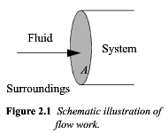
Work Associated with Flow
Lost Work
Viscosity Gradient (Pressure Gradients)
Viscous Dissipation
Temperature Gradient
Thermal Diffusion
Concentration Gradient
Diffusive Dissipation
Friction (of a piston for instance)
A Reversible Process such as Laminar Flow
vs. Turbulence/Diffusion
Small Gradients/Small Steps approaches Reversibility

Slide 3
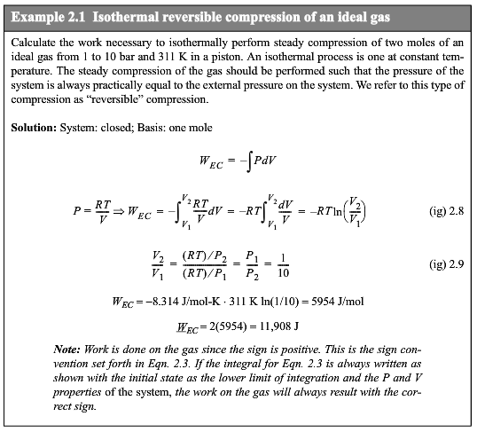

Slide 4
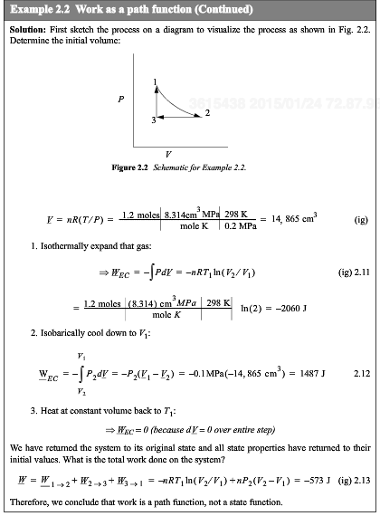
Work is a path function not a state function

Slide 6
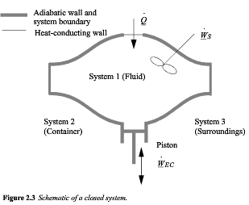
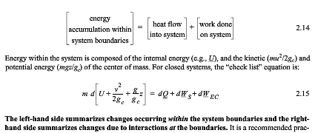

Slide 8
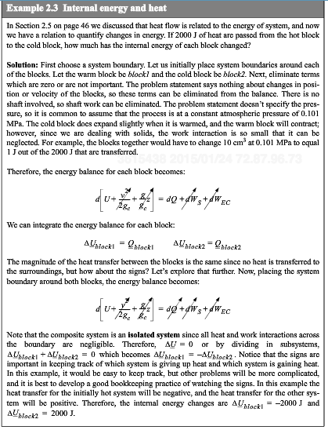
Two insulated steel blocks of different T placed in contact
Q_{block1} = - Q_{block2}
A diathermal wall

Slide 9
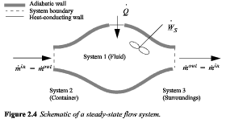
Steady-State Open System

Slide 10
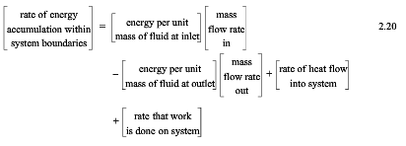
Energy to move a fluid element a distance L in a pipe of cross-sectional area A
P A L = PV

Slide 11
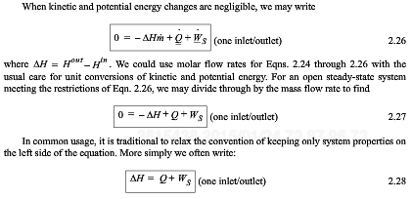
Also for state change and chemical reactions

Slide 12
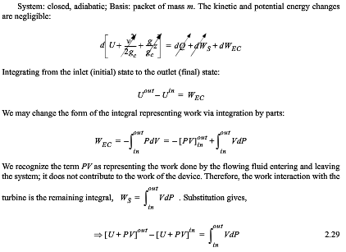
Open System

Slide 14
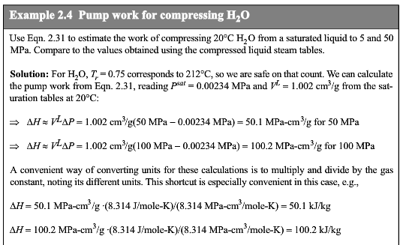
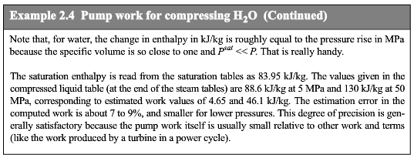

Slide 15
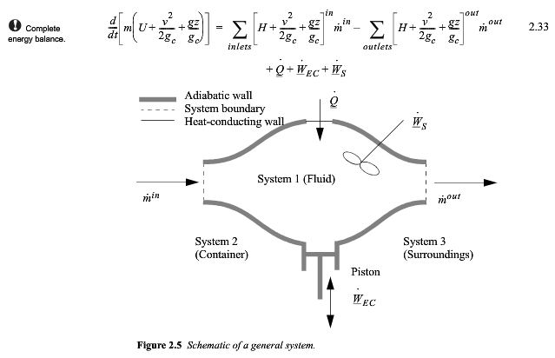
General Equation for Open System

Slide 17
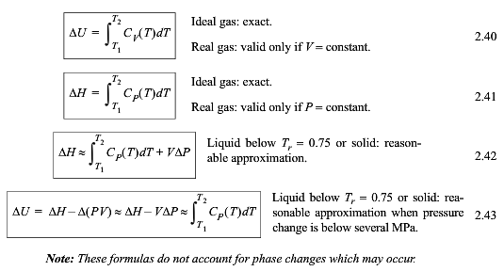

Slide 18
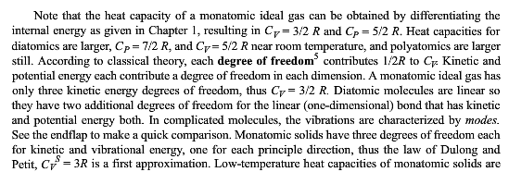

Slide 19
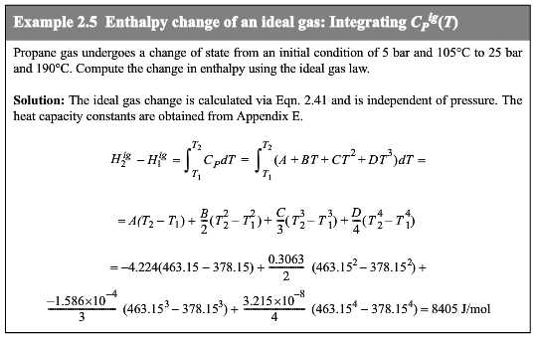

Slide 20
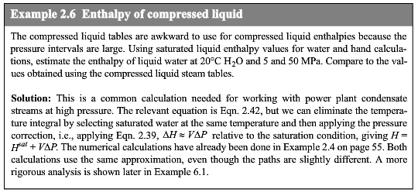
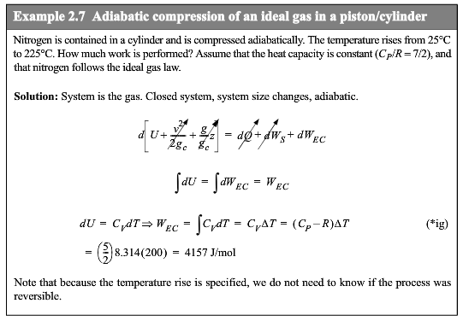

Slide 21
Vapor Pressure
If a free energy ΔG = ΔH – T ΔS is required for a liquid molecule to enter the vapor, and the pressure is related to the probability of this escape from the liquid state, then Boltzmann’s law would indicate,
P_{vap} = P_{vap,0} exp(- ΔG/kT) Where P_{vap,0} is the vapor pressure at T₀ = ΔH/ΔS
P_{vap} = P_{vap,0} exp(-(ΔH – T ΔS )/kT) = P_{vap,0} exp(ΔS/k - ΔH/kT)
If P_{vap} is 0 at a temperature above T = 0 K, T*, such as the crystallization temperature, then it could be written,
P_{vap} = P_{vap,0} exp(ΔS/k – (ΔH/k)/(T-T*)) =10^{(A-B/(T+C)}
The last expression is called the Antoine equation
From this you can also see that if T>>T*, Then ΔH_{vap} = -R d(lnP_{sat}/d(1/T))
Known as the Clausius-Clapyron Equation.

Slide 22
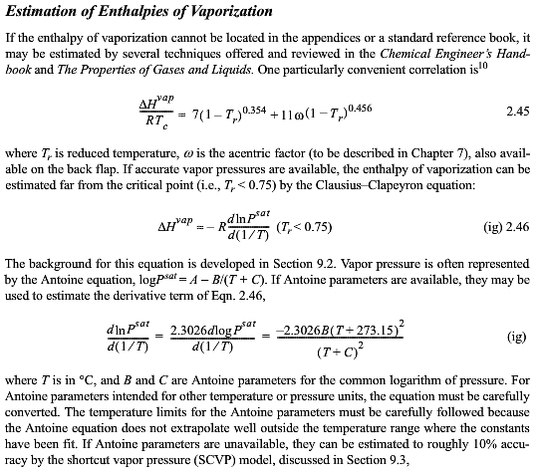

Slide 23
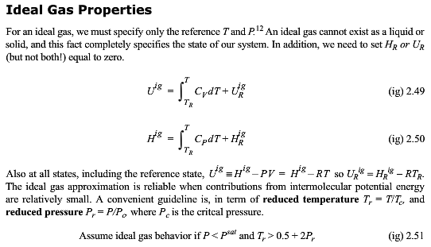

Slide 24
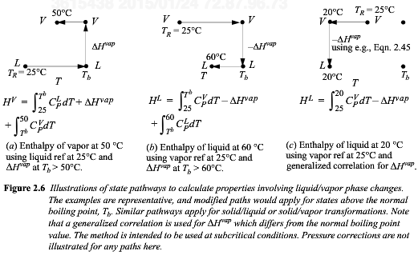

Slide 25
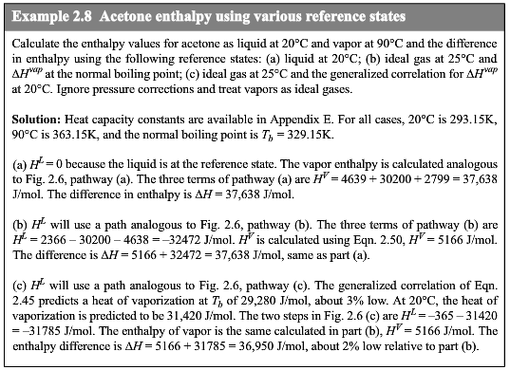

Slide 26
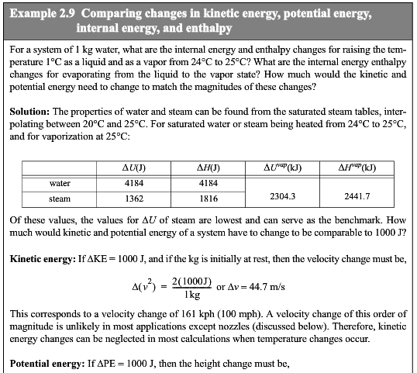
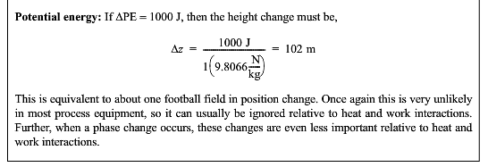

Slide 27
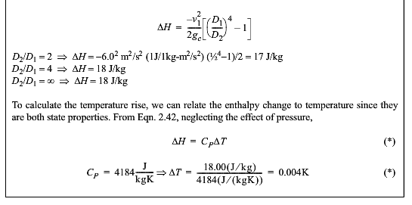

Slide 28
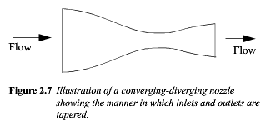

Slide 29
Cocurrent
Countercurrent
Superheater

Slide 30
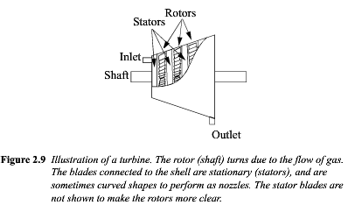

Slide 31
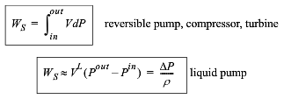

Slide 32
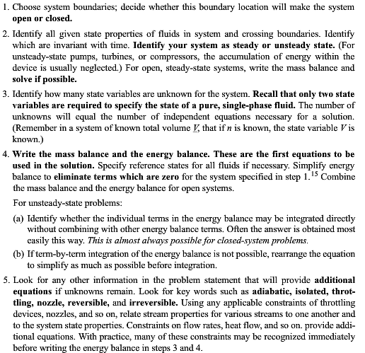

Slide 33
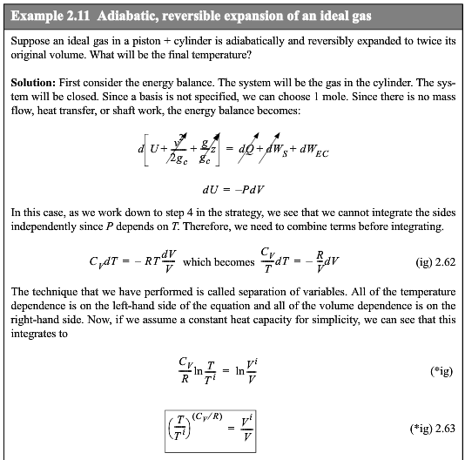
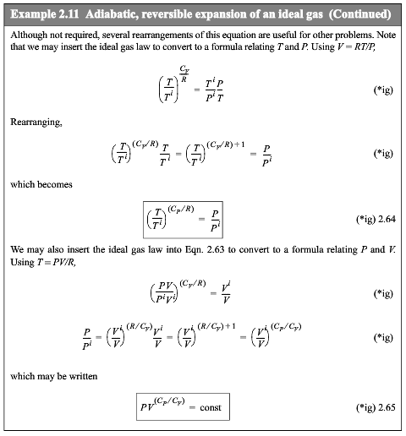

Slide 34
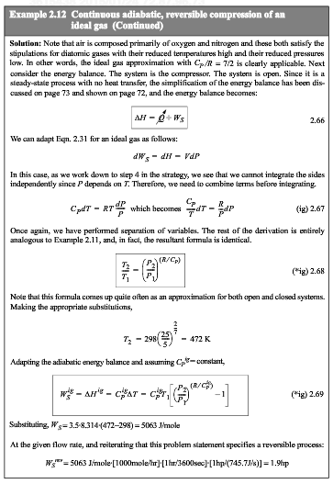

Slide 35
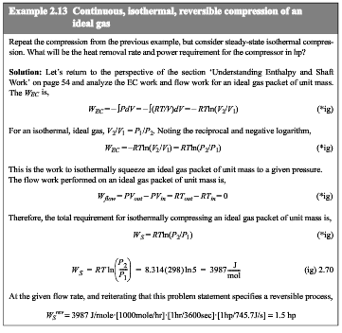

Slide 36
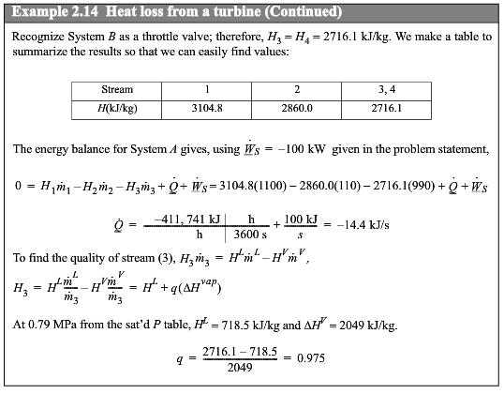
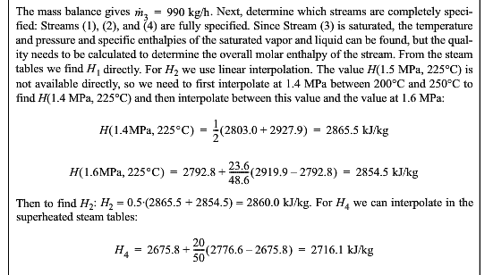

Slide 37
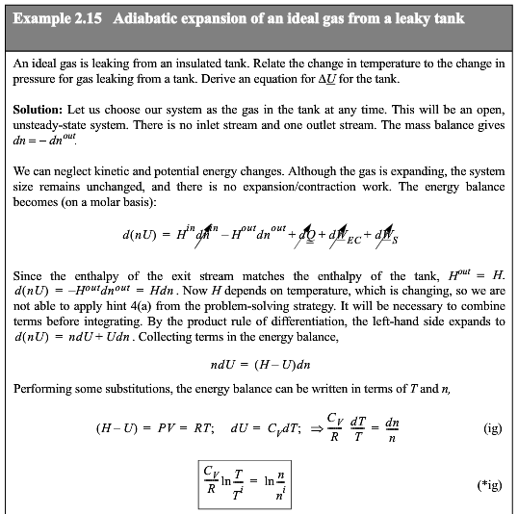
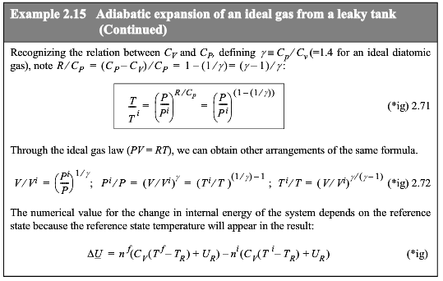
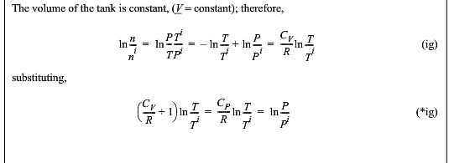
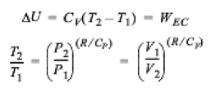
Adiabatic

Slide 38
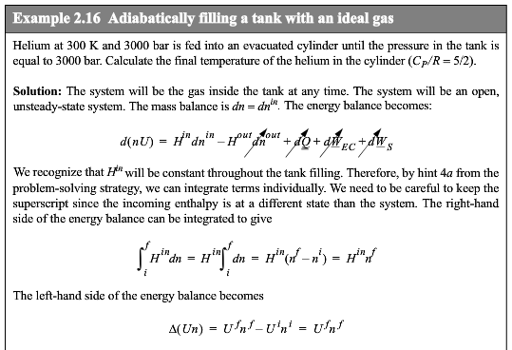
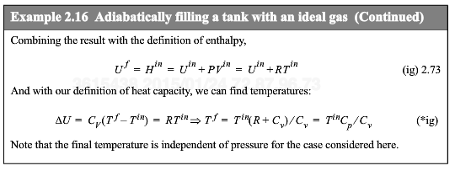
Adiabatic

Slide 39
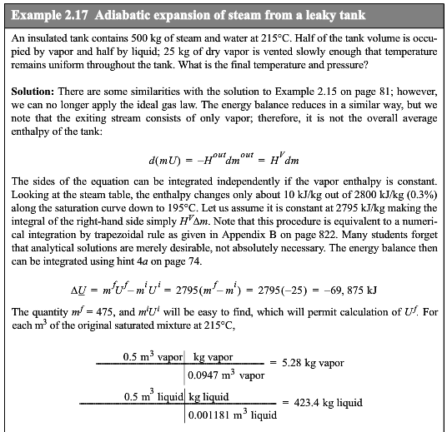

Slide 40
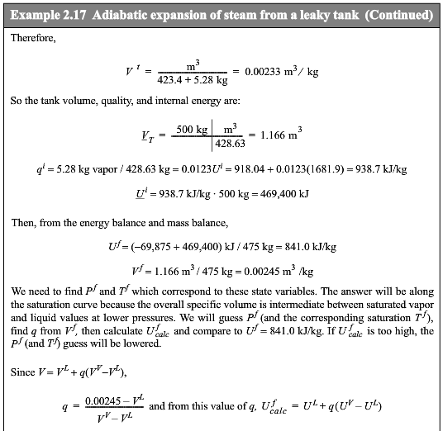
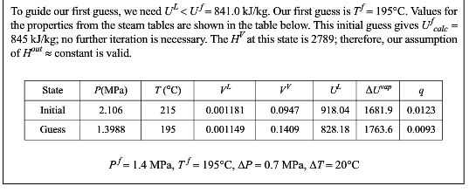

Slide 41
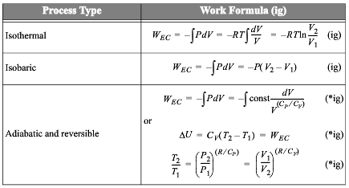

Slide 42
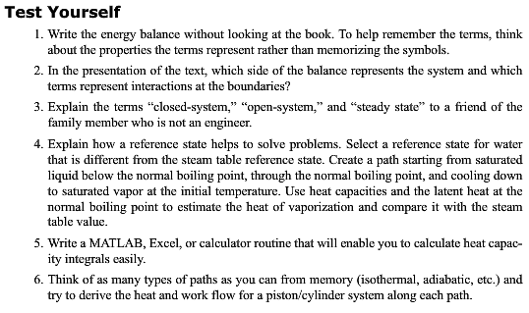

Slide 43
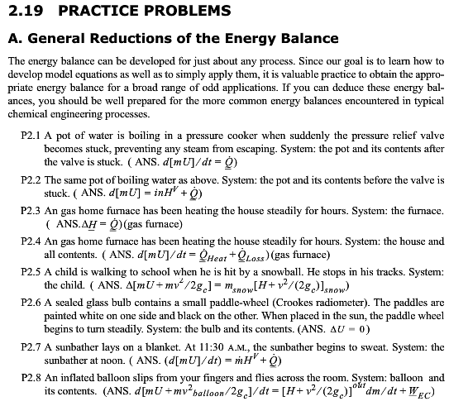

Slide 44
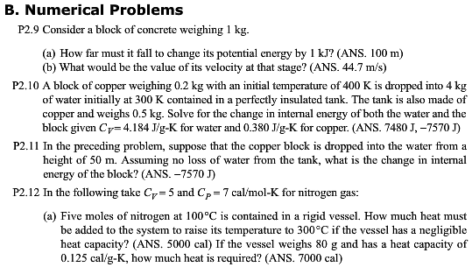
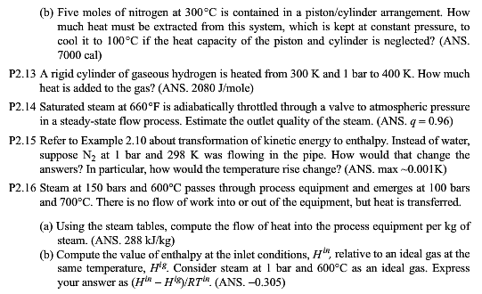
10,12,14,15,16,17

Slide 45
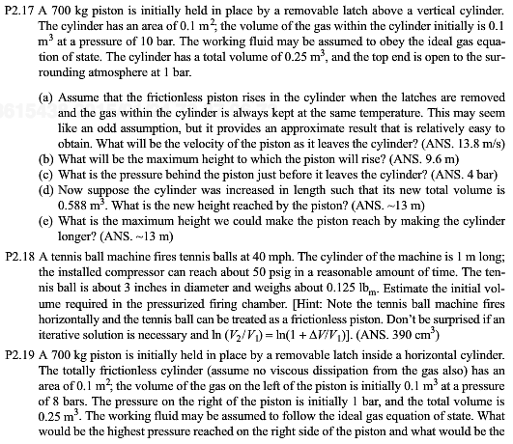

Slide 46
2.2, 2.4

Slide 47
2.6

Slide 48
7,8,12,13,15

Slide 49
16,17,18,21,22

Slide 50
23

