Slide 1
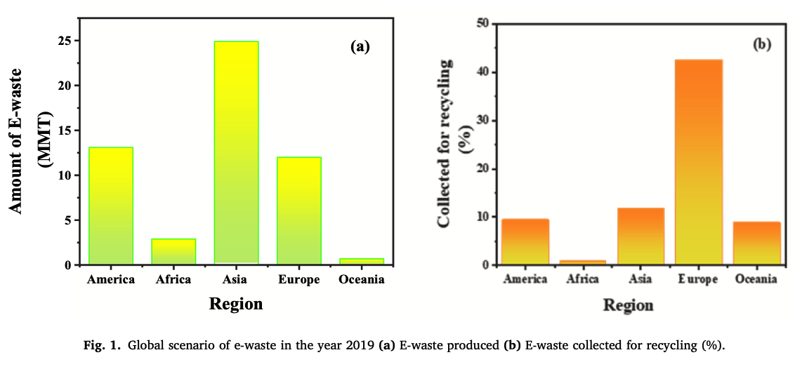
Electronics and Electrical Plastics Waste
Waste Electrical and Electronic Equipment (WEEE)
Brominated Flame Retardants (BRFs)
Antimony Trioxide Flame Retardants

Slide 2
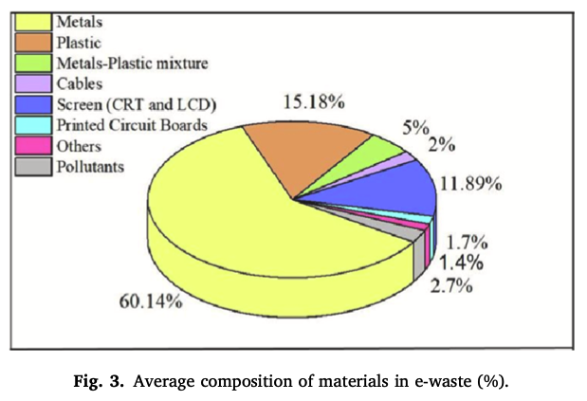
Electronics and Electrical Plastics Waste

Slide 3
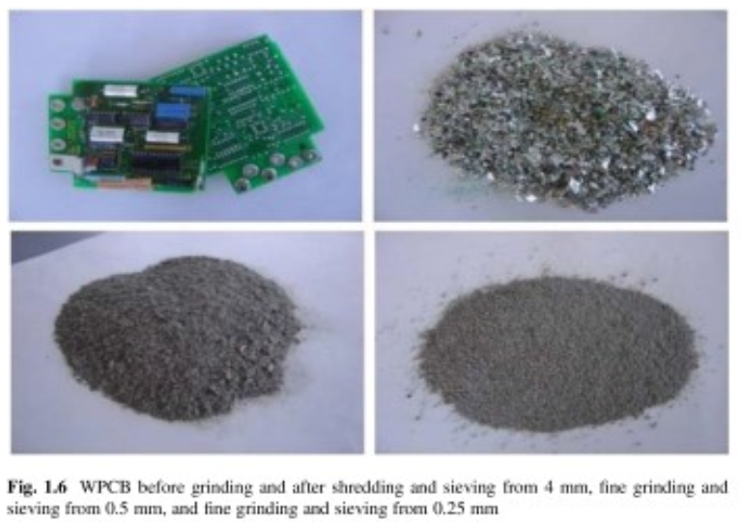
Electronics and Electrical Plastics Waste

Slide 4
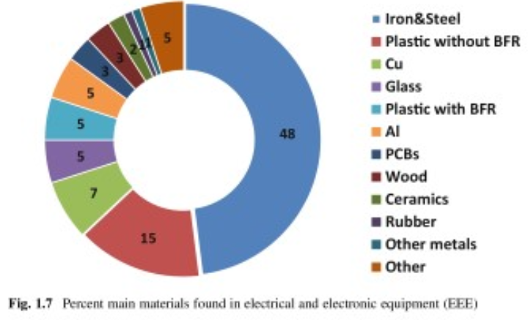
Electronics and Electrical Plastics Waste

Slide 5
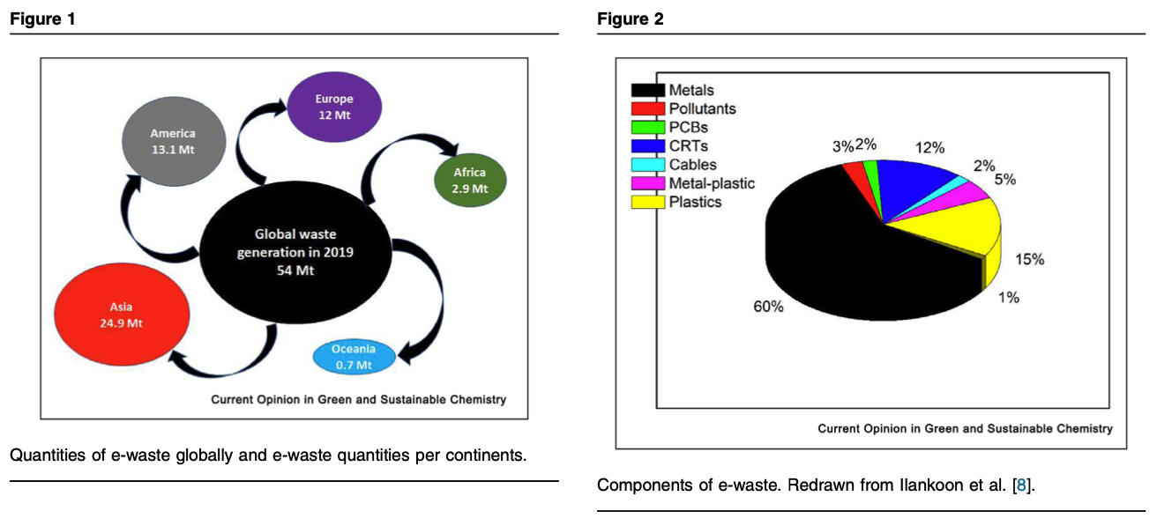
Electronics and Electrical Plastics Waste

Slide 6
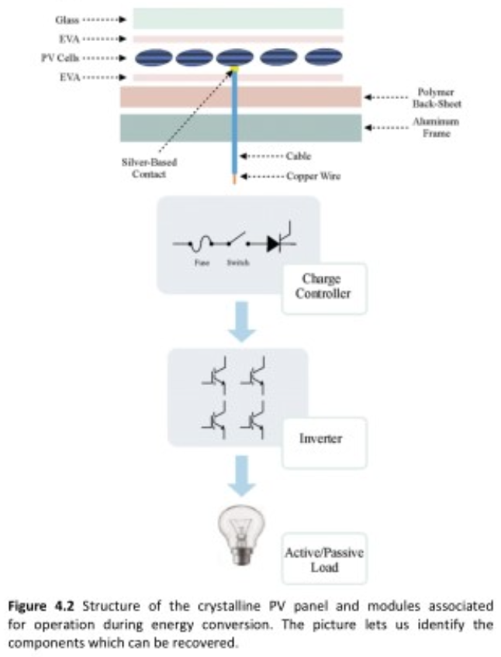
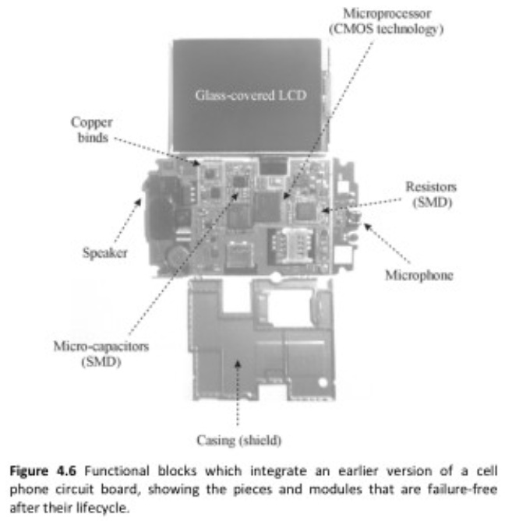

Slide 7
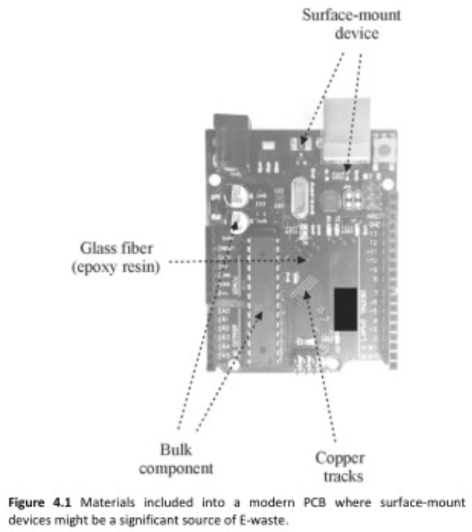

Slide 8
Electronics and Electrical Plastics Waste

Slide 9
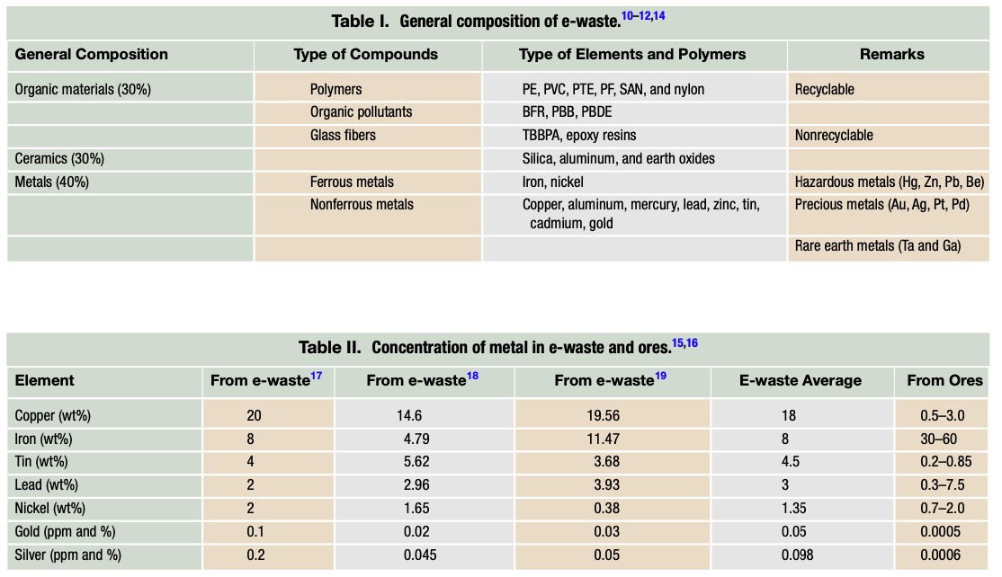
Electronics and Electrical Plastics Waste

Slide 10
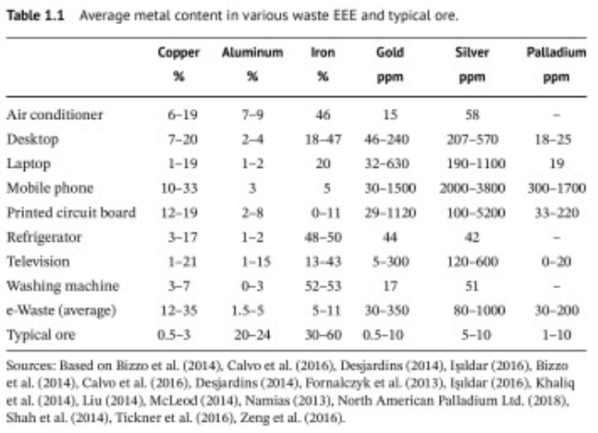
Electronics and Electrical Plastics Waste

Slide 11
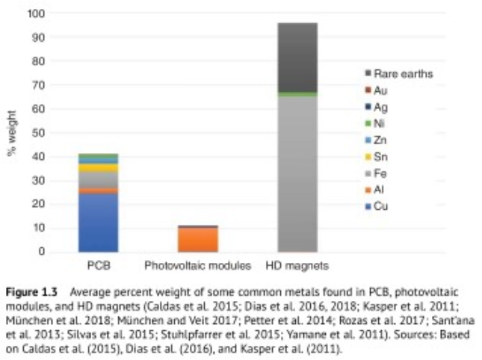
Electronics and Electrical Plastics Waste

Slide 12
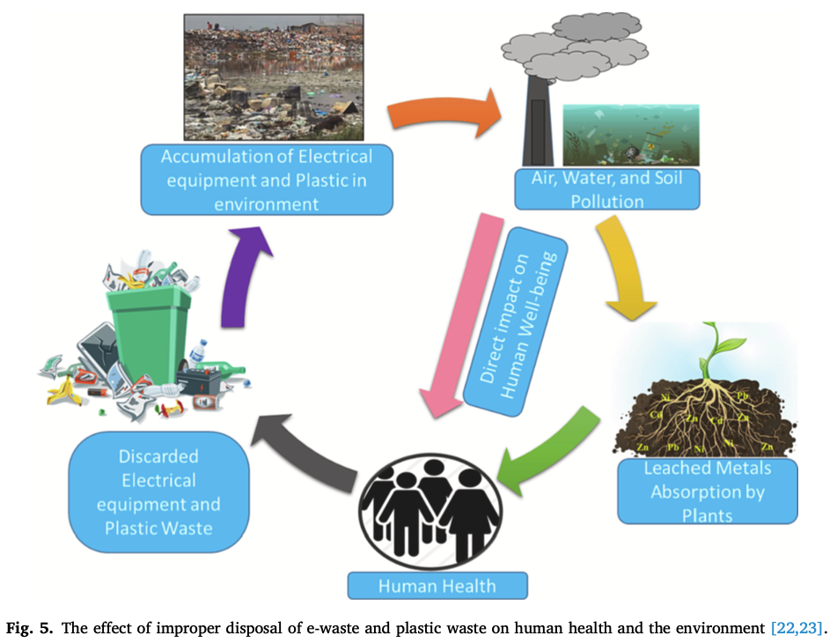
80% goes to landfill
Electronics and Electrical Plastics Waste

Slide 13
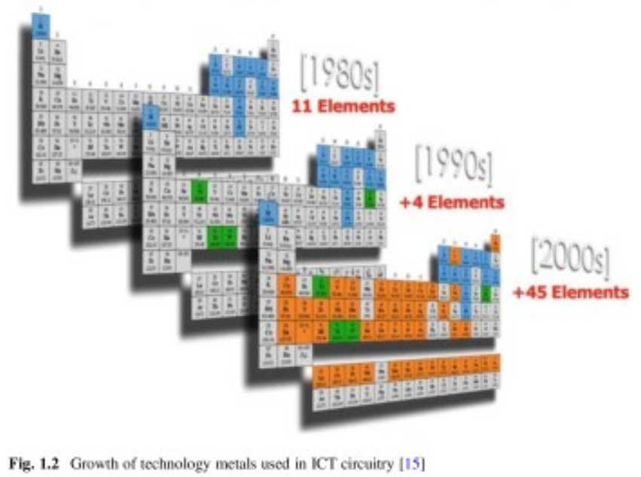
Electronics and Electrical Plastics Waste

Slide 14
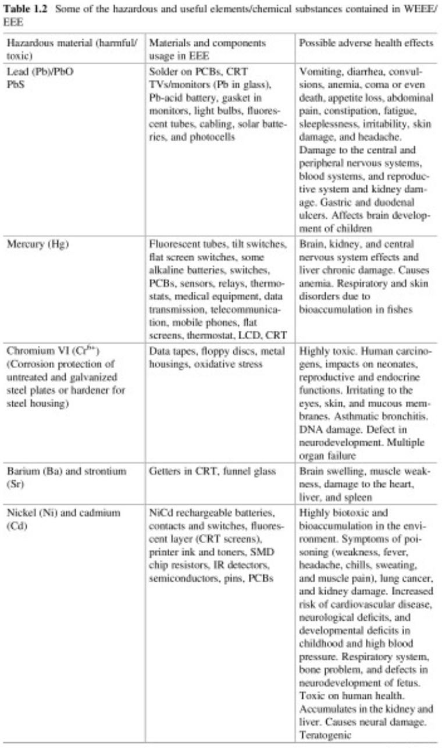
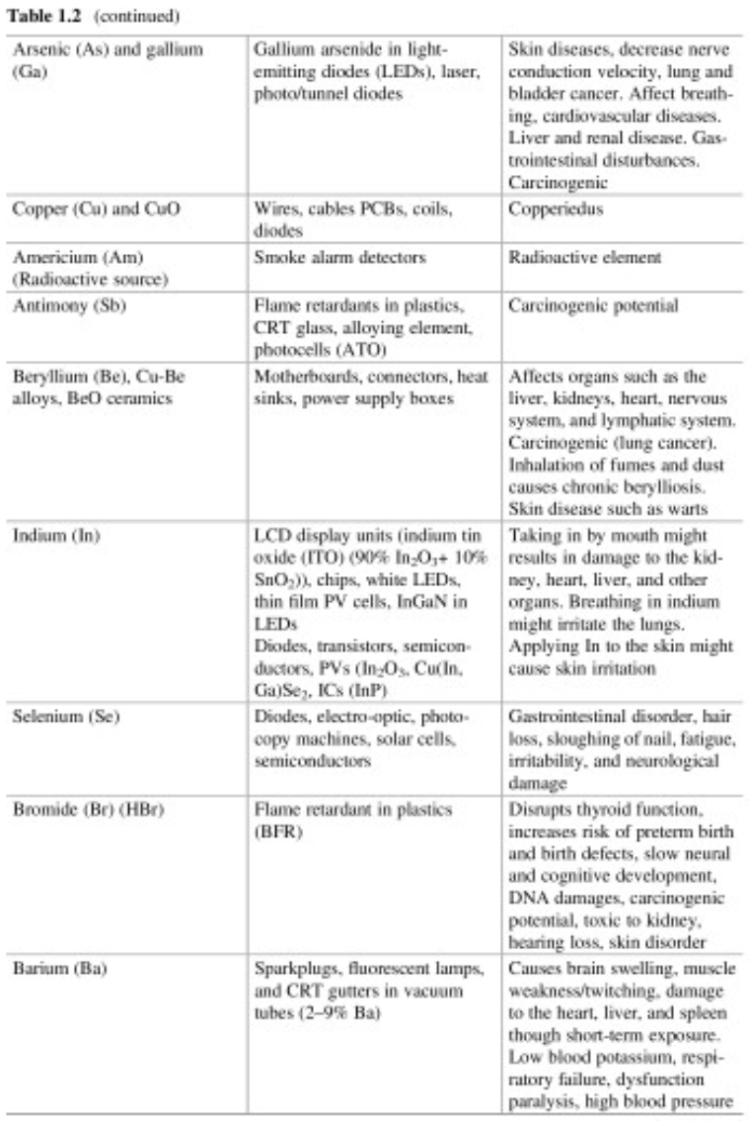

Slide 15
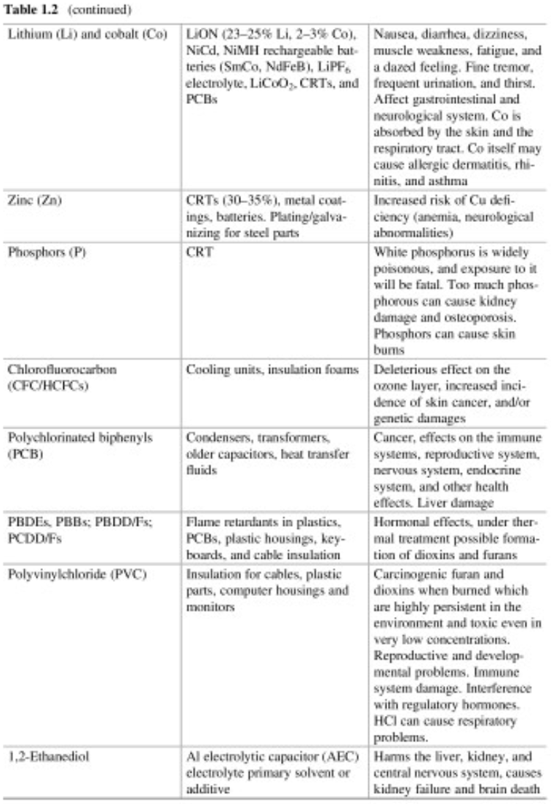
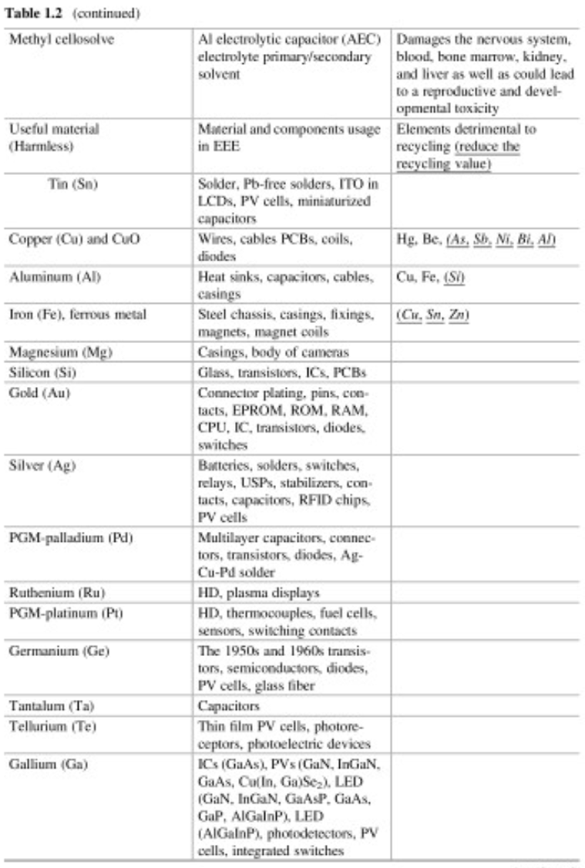

Slide 16
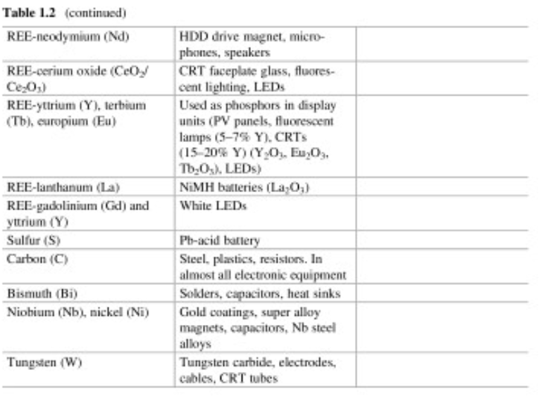

Slide 17
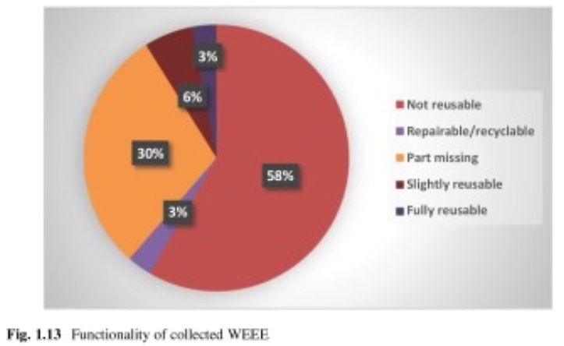
Electronics and Electrical Plastics Waste

Slide 18
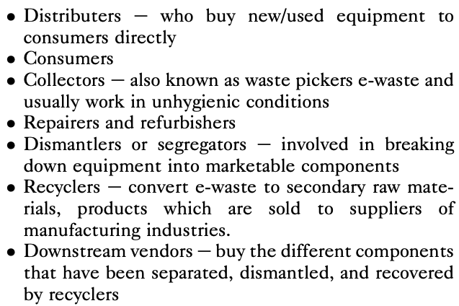
E-Waste Value Chain

Slide 19
According to The Global E-waste Monitor 2020, it was reported that in 2019, about 54 million metric tonnes of e-waste was annually produced of which only 17% was collected and recycled. The rest (estimated to have a monetary value of US $ 64 billion) is dumped in landfills or illegally exported to African and Asian countries where it is managed/recycled by informal workers.
70% of hazardous waste in landfills are WEEE

Slide 20
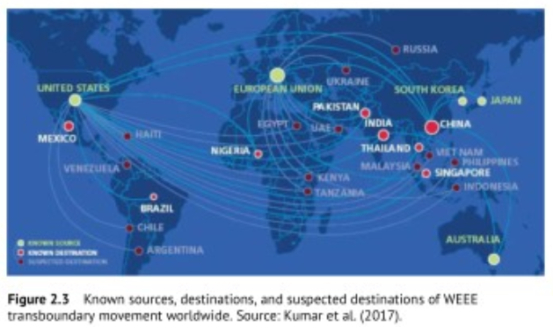

Slide 21
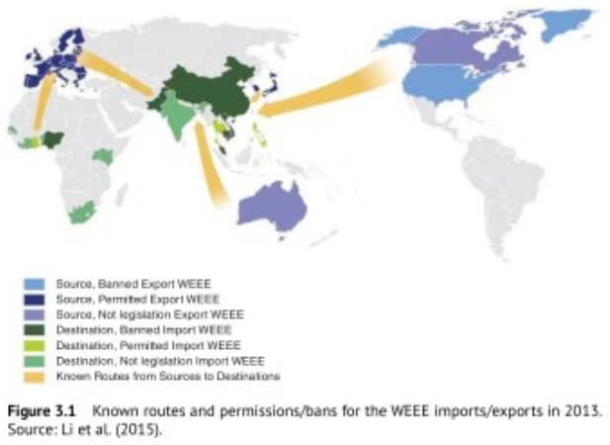

Slide 22
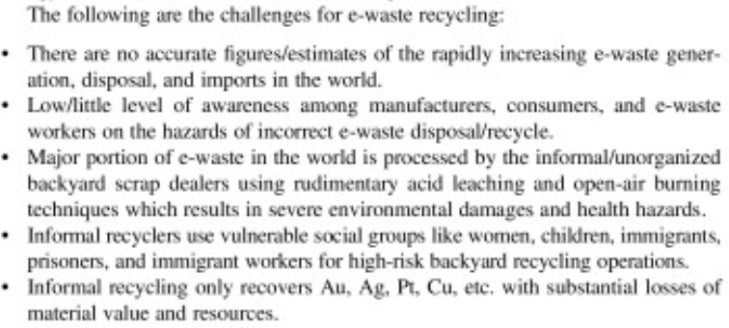

Slide 23
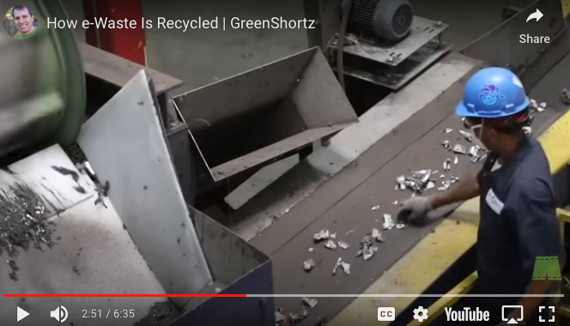
How e-Waste is Recycled

Slide 24
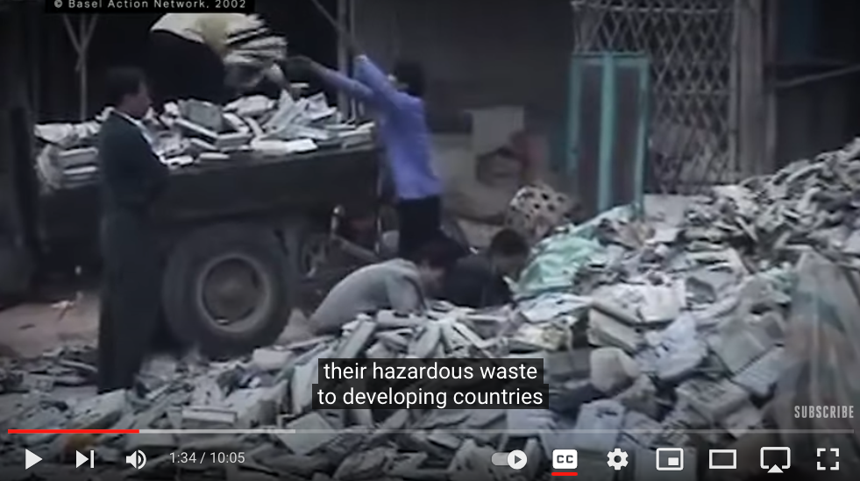
Tracking e-Waste

Slide 25
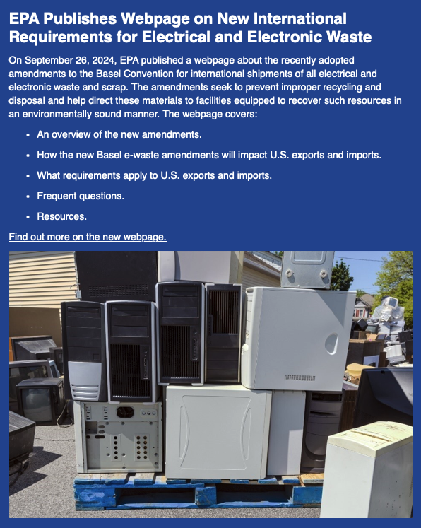
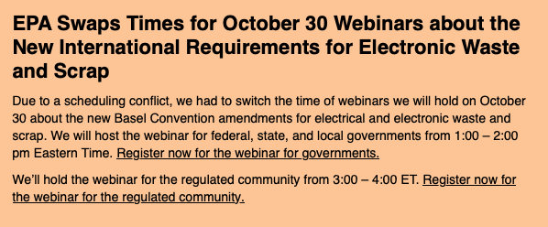

Slide 26
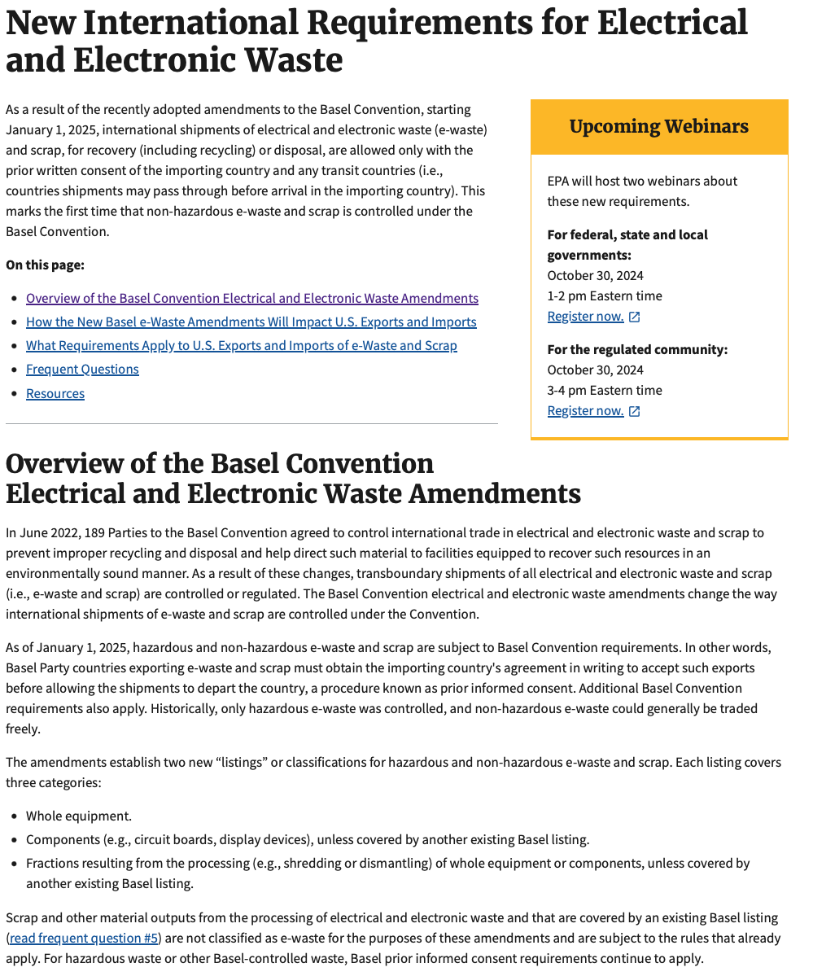

Slide 27
Recycling of e-Waste
-Step 1 Collection
-Step 2 Manual sorting
-Step 3 Dismantling
-Step 4 Shredding
-Step 5 Mechanical separation
Metals from non-metal
Plastics: PC, ABS, HIPS, PA, PP, PE,
polyesters, epoxy fiberglass composites
BFRs

Slide 28
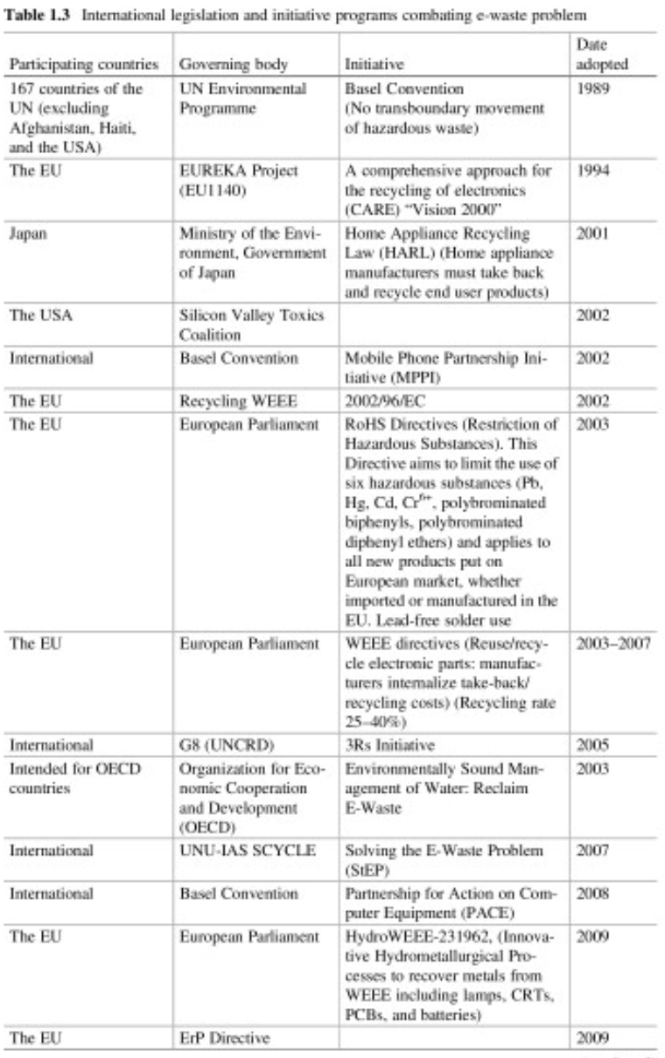
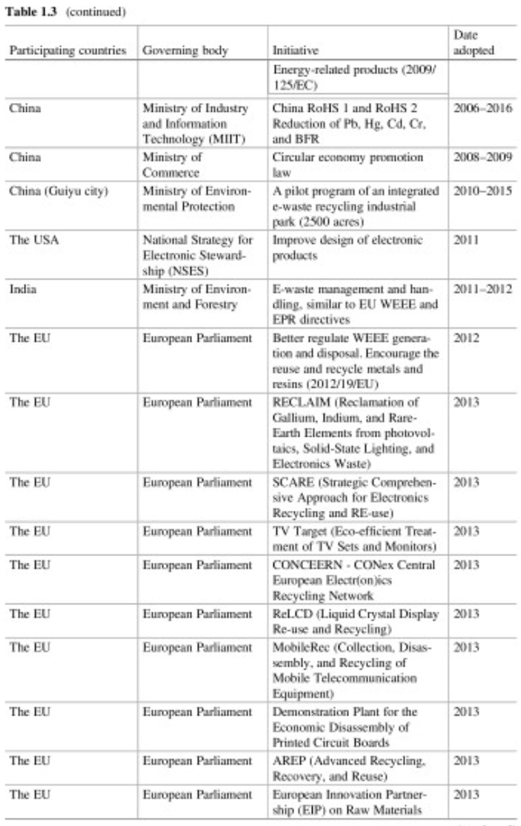

Slide 29
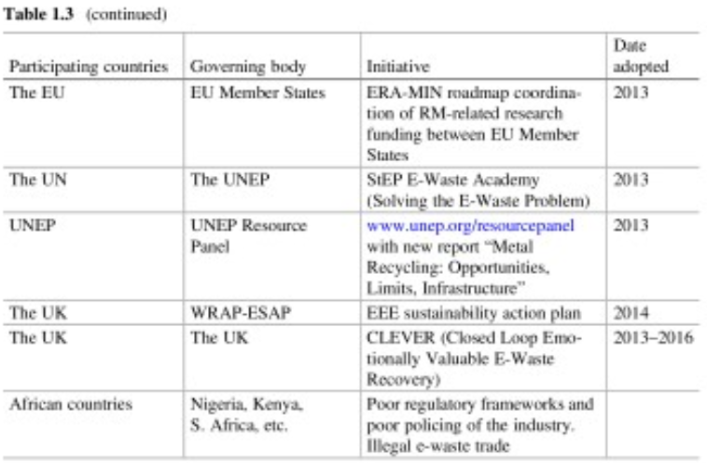

Slide 30
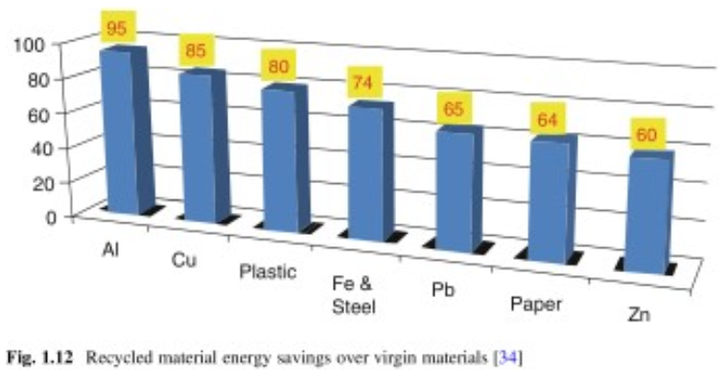

Slide 31
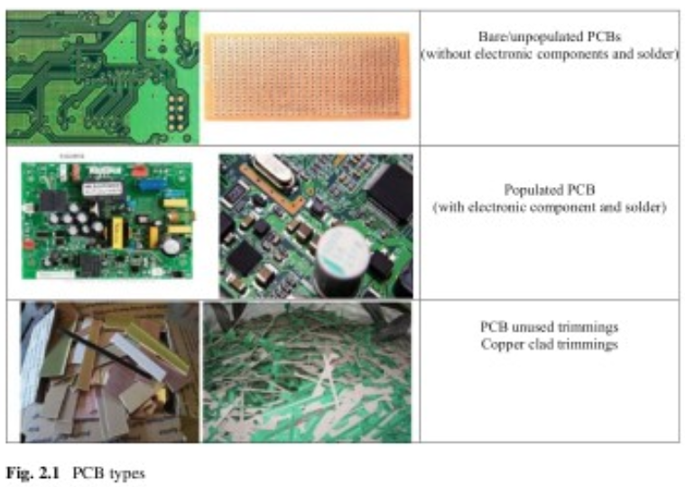
Printed Circuit Boards (PCBs)

Slide 32
Printed Circuit Boards (PCBs)

Slide 33
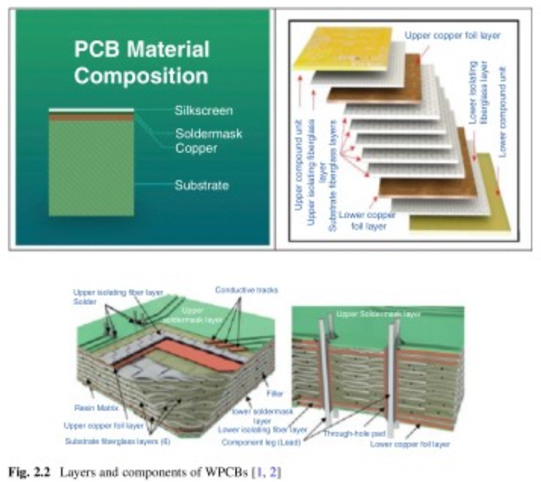
Paper and phenolic resin
(low grade brown)
Epoxy and fiber composite
(high grade green)

Slide 34
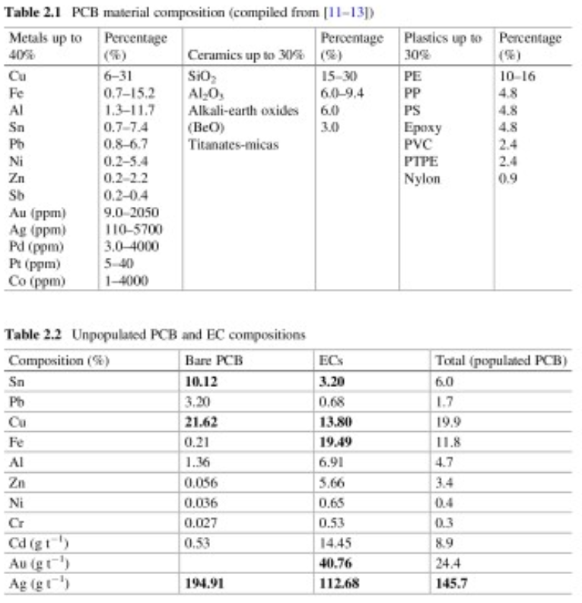

Slide 35
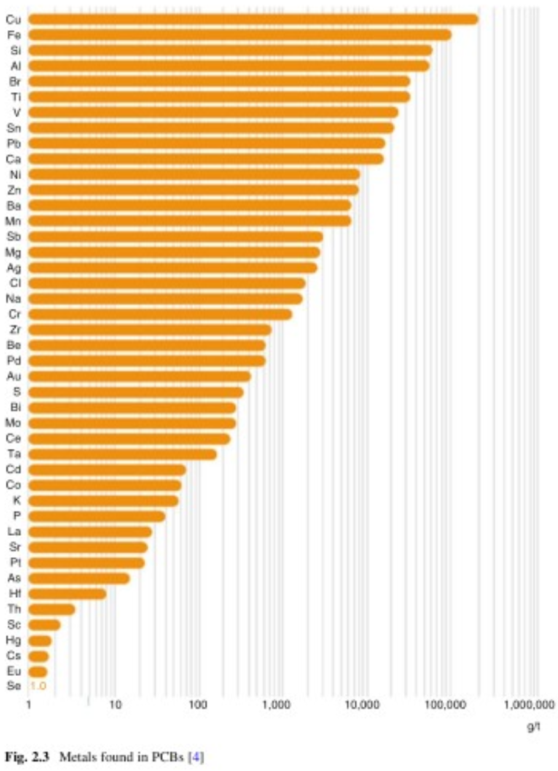

Slide 36
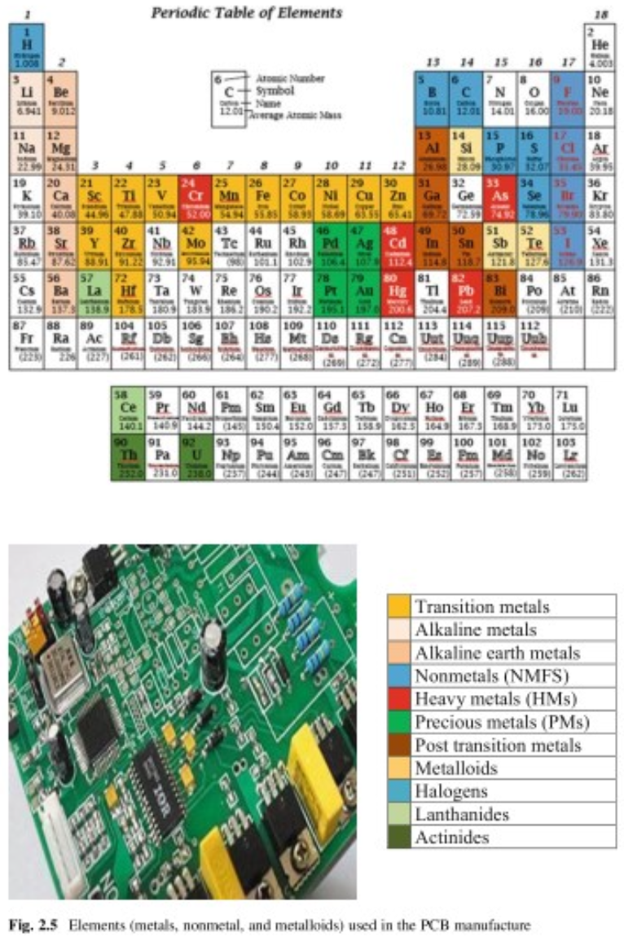

Slide 37
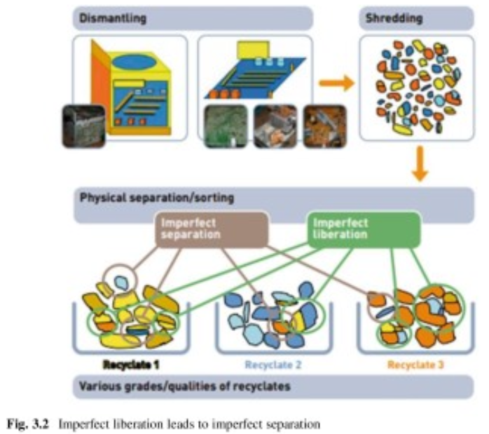

Slide 38
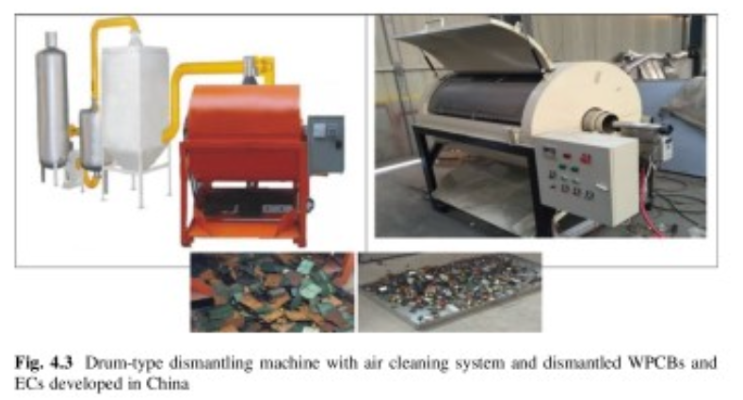

Slide 39
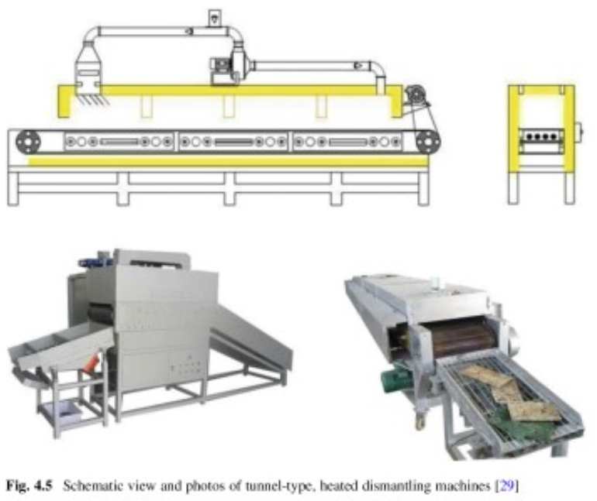

Slide 40
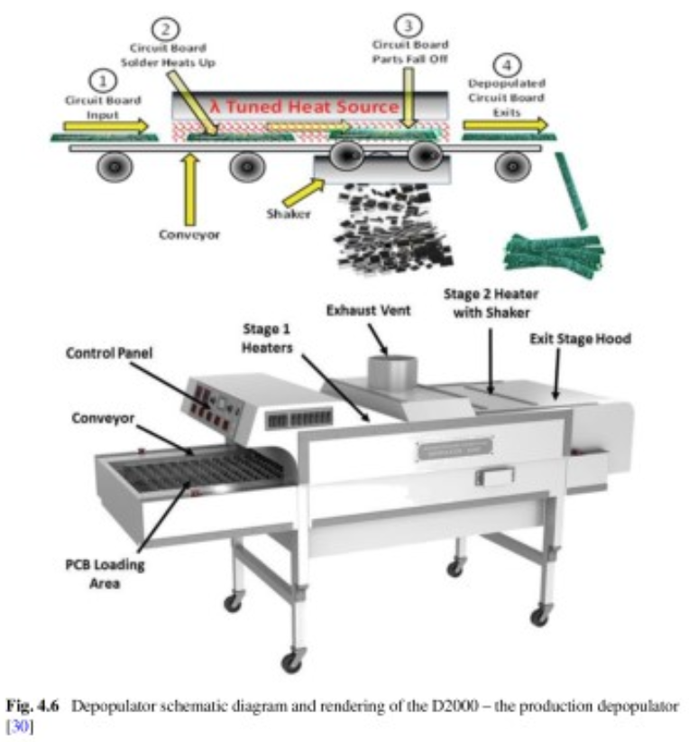

Slide 41
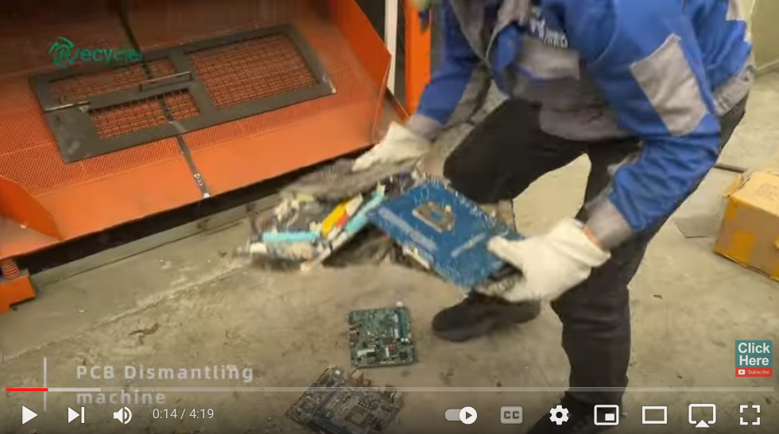
PCB Recycling

Slide 42
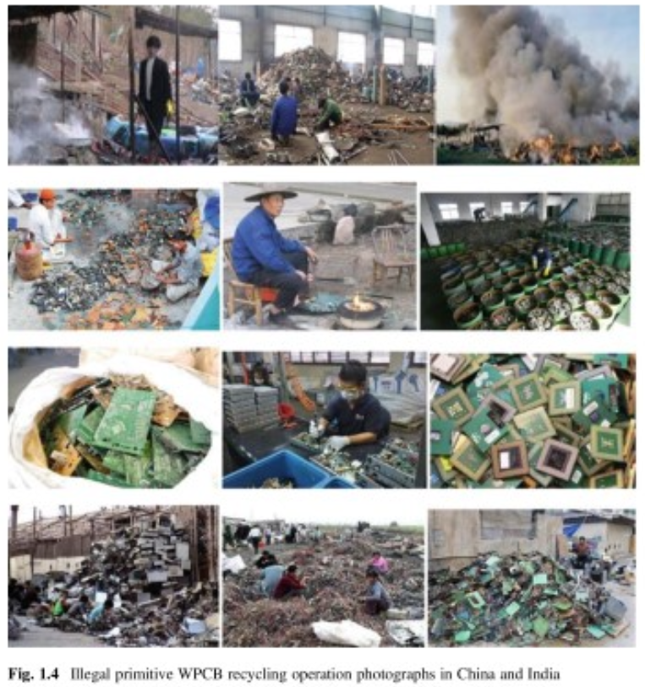
PCB Recycling

Slide 43
Non-metallic Fraction (NMF) from waste printed circuit boards (WPCBs)
Brominated flame retardants are a problem (BFRs)
Use as filler or concrete additive (16%)
Combustion, Pyrolysis (Ash contains metals)

Slide 44
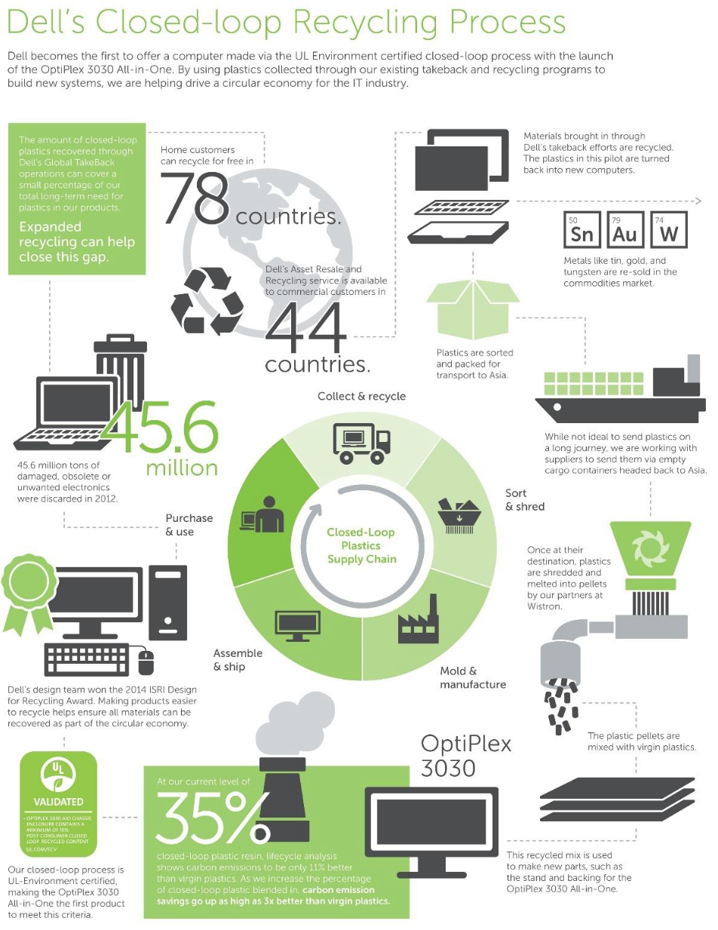
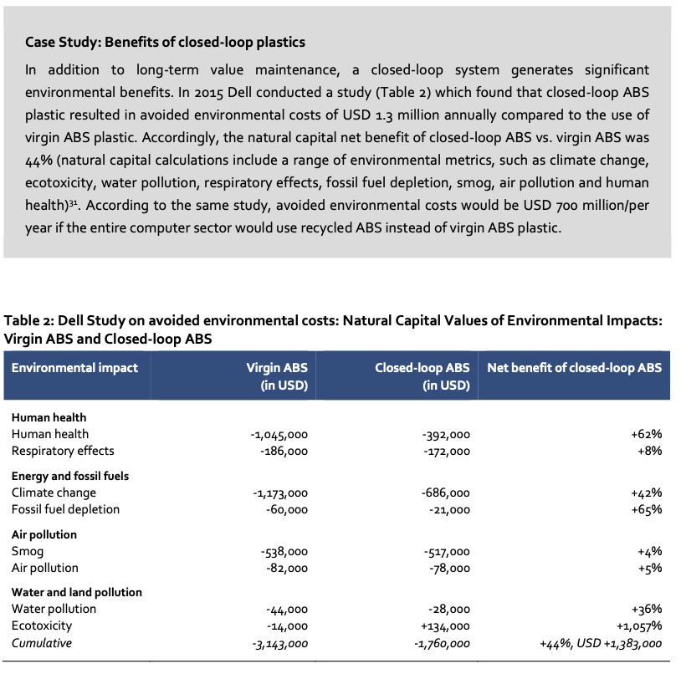

Slide 45
CLEVER PROJECT

Slide 46
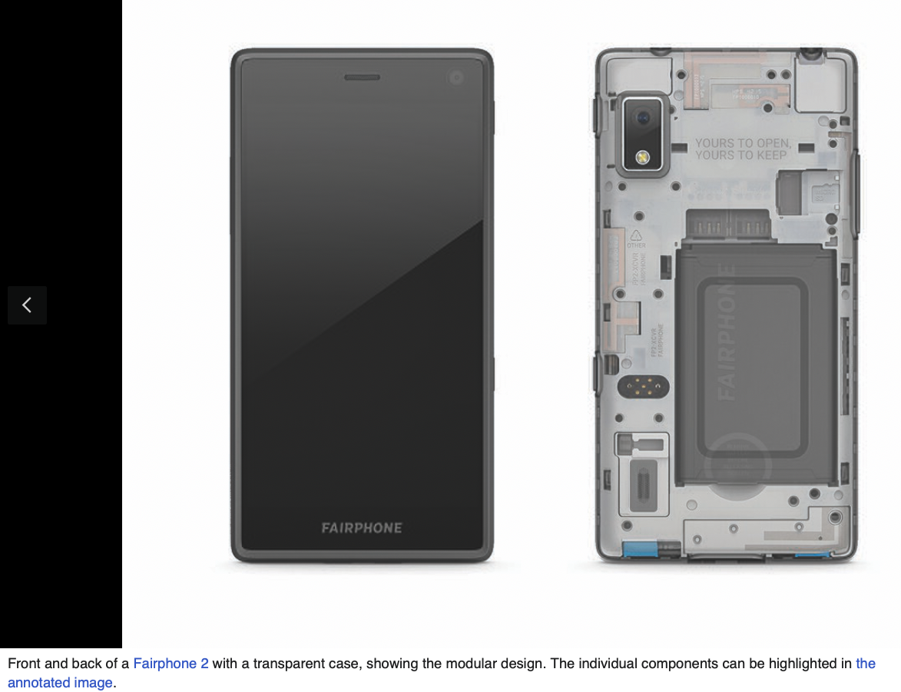
Modular Smart Phones
Main Board
Camera
Batteries
Open-Source Hardware
Reduce e-Waste
Customizable
Repairable
Component Lending

Slide 47
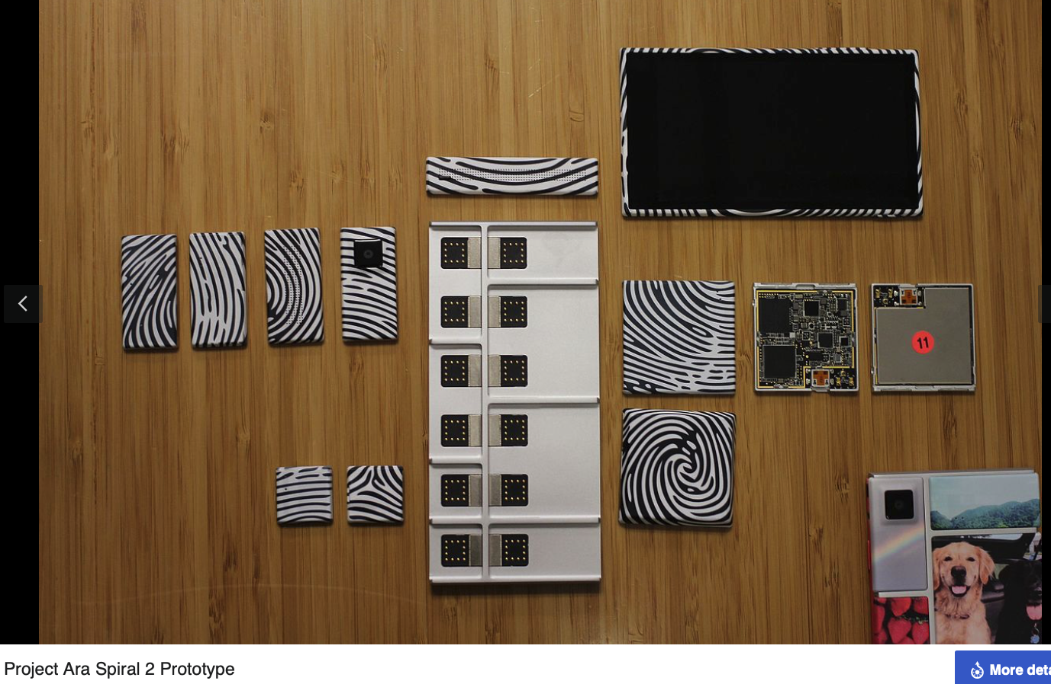
Modular Smart Phones
Modo 2006 Israel
Google purchased 2011 made Ara
No product

Slide 48
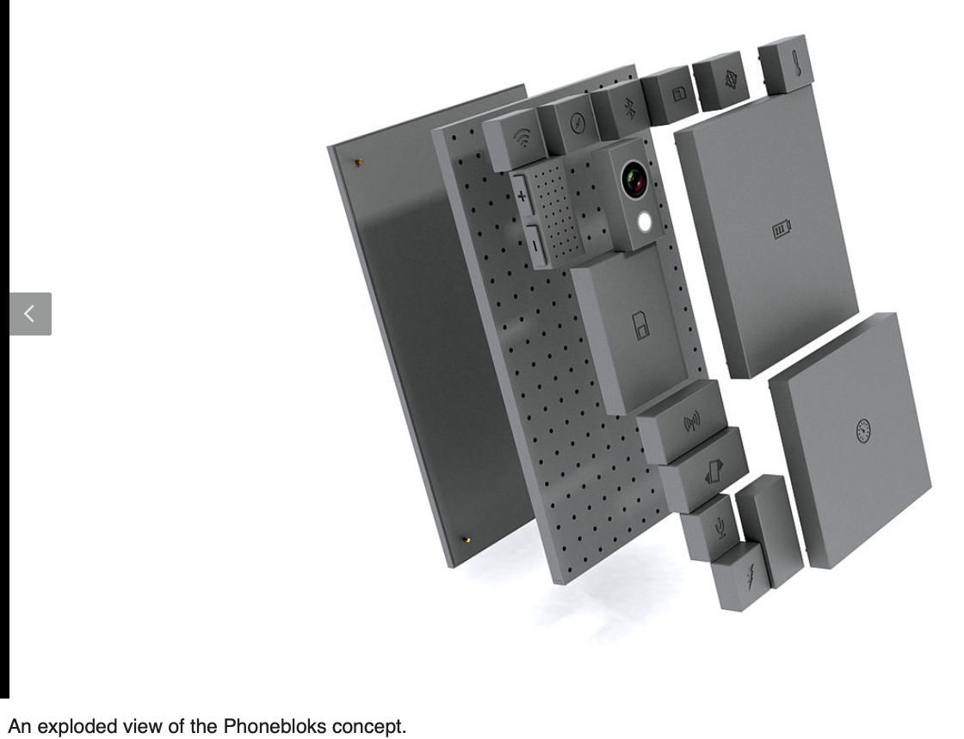
Modular Smart Phones
Modo 2006 Israel
Phonebok merged with ARA in 2013
Google purchased Modo 2011
made Ara
No product

Slide 49
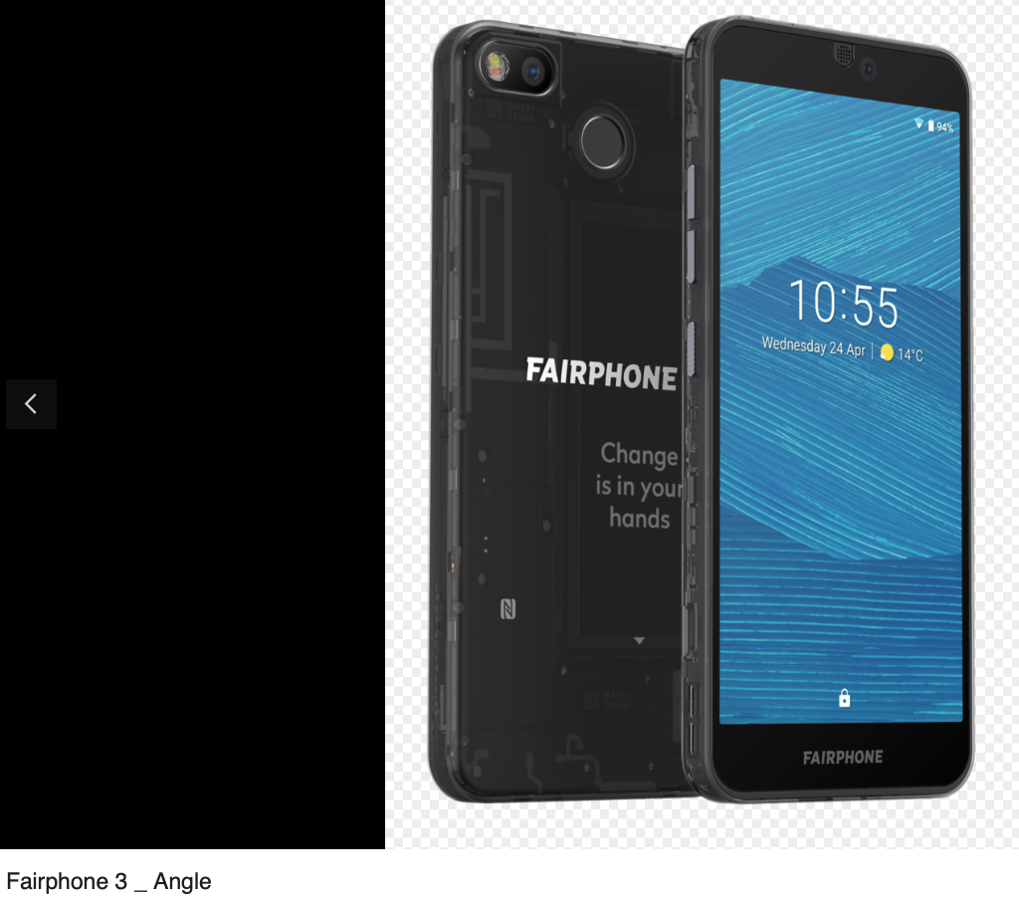
Modular Smart Phones
Modo 2006 Israel
Google purchased 2011 made Ara
Fairphone. 2019

Slide 50
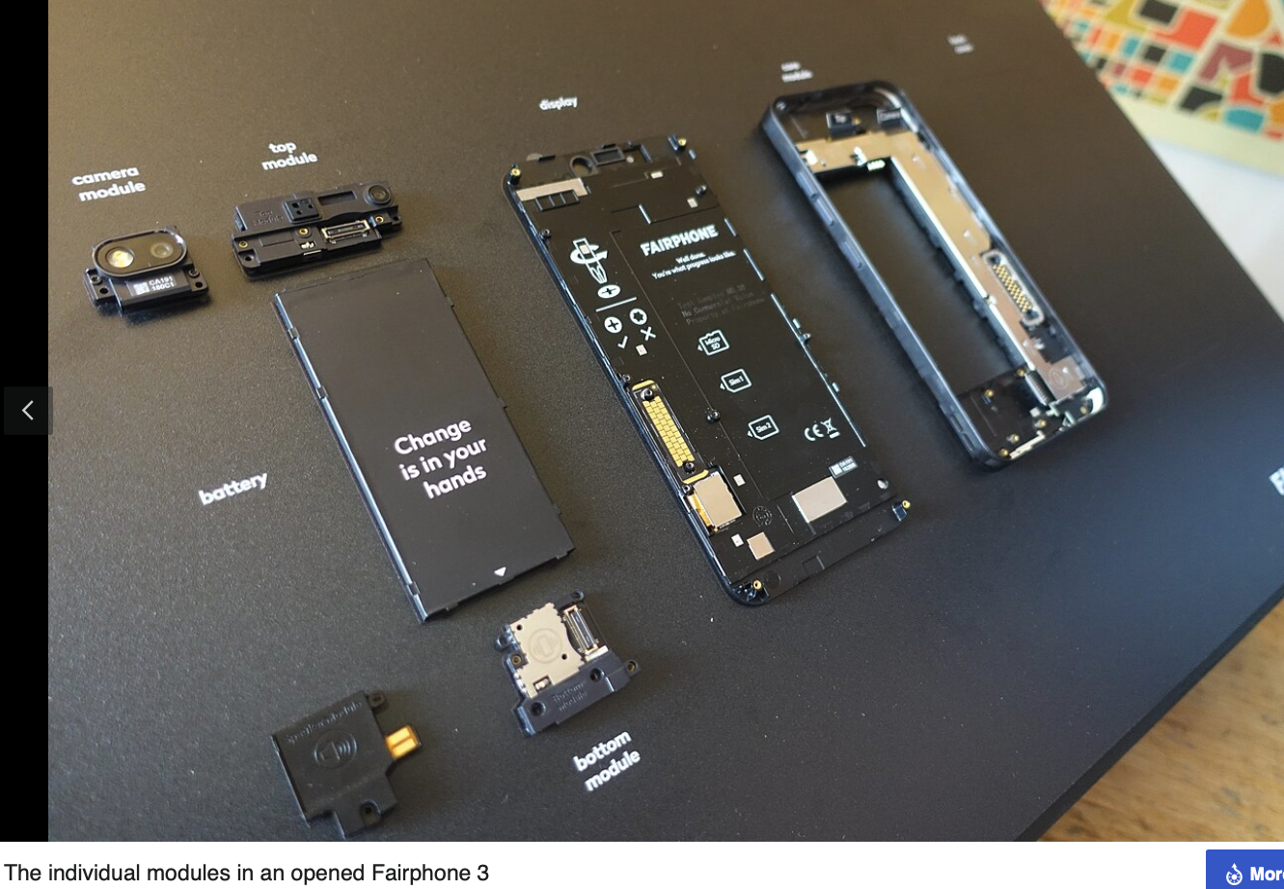
Modular Smart Phones
Modo 2006 Israel
Google purchased 2011 made Ara
No product
Fairphone. 2019

Slide 51
Modular Smart Phones

Slide 52
Modular Smart Phones

