Slide 1
Industrial Composting
and
Plastics
Scott Shilling

Slide 2
Plastics Life Cycle
Most of the 1900s the only goal when designing plastics was its use and nothing of its end of life.
Recycling has been the big push recently yet a large majority of plastics still end up land filled.

Slide 3
Plastics End of Life
Land Filled
Pyrolysis
Compost - Limited to some plastics
Biodegradation - Limited to even fewer plastics

Slide 4
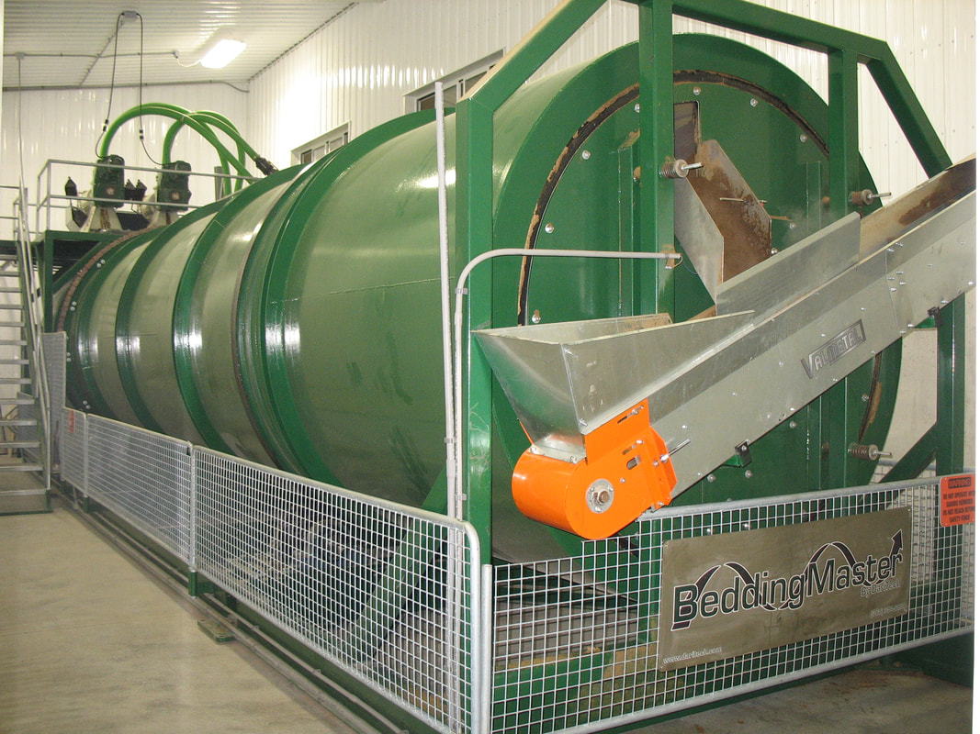
Industrial Composting
Industrial Composting Requires
High Temperature
130℉ to 160℉
High Pressure
Nutrients
Specific Ratios

Slide 5
Biodegradation Resistance
Least to most resistance - alkanes, branched alkanes, low molecular weight aromatics, cyclic alkanes, high molecular weight aromatics, polar polymers
Hydrolysis is the main reaction breaking down molecules.

Slide 6
Biodegradable Plastics
Fossil Based and Biodegradable
PCL, PVA, PBS, PBAT
Bio-based and Biodegradable
PHB, PGA, bioPBS
Under a certain thickness
Depends on type of plastic. Europe has some standards and they range from 40 microns to 120 microns.

Slide 7
Steps Forward
Invest in more compostable plastics
Look into making layered packages out all compostable plastics to replace current layered packaging.
Make industrial composting more widely available.
Industrial composting can apply to much more than just plastics and can help reduce the amount of waste land filled.
Improve composters to also extract the bio-gas that comes along with composting.
Composting may be able to become economically viable from selling high quality dirt and the bio-gas as well as the disposal fee.

Slide 8
Composting Complements Recycling
Any Questions?

