Slide 1
Directions for E-Waste Recycling

Slide 2
Perspective on Recycling in This Presentation
Absence list
boycott
Head injury
Climate Change is a “Hoax”
unclear
2024 United Nations
Climate Change Conference
11/11/24 - 11/22/24
busy
47th winner
11/05/24
no money
My Opinion
Environmental protection needs money and political interests.
Even if we gather with good intentions and hold a meeting, we end up watching the most powerful person and fighting over who will pay the cost.
That is why when finding ways to protect the environment, it is important to make it beneficial to individuals who protect the environment.
King is busy
IDK
Confused

Slide 3
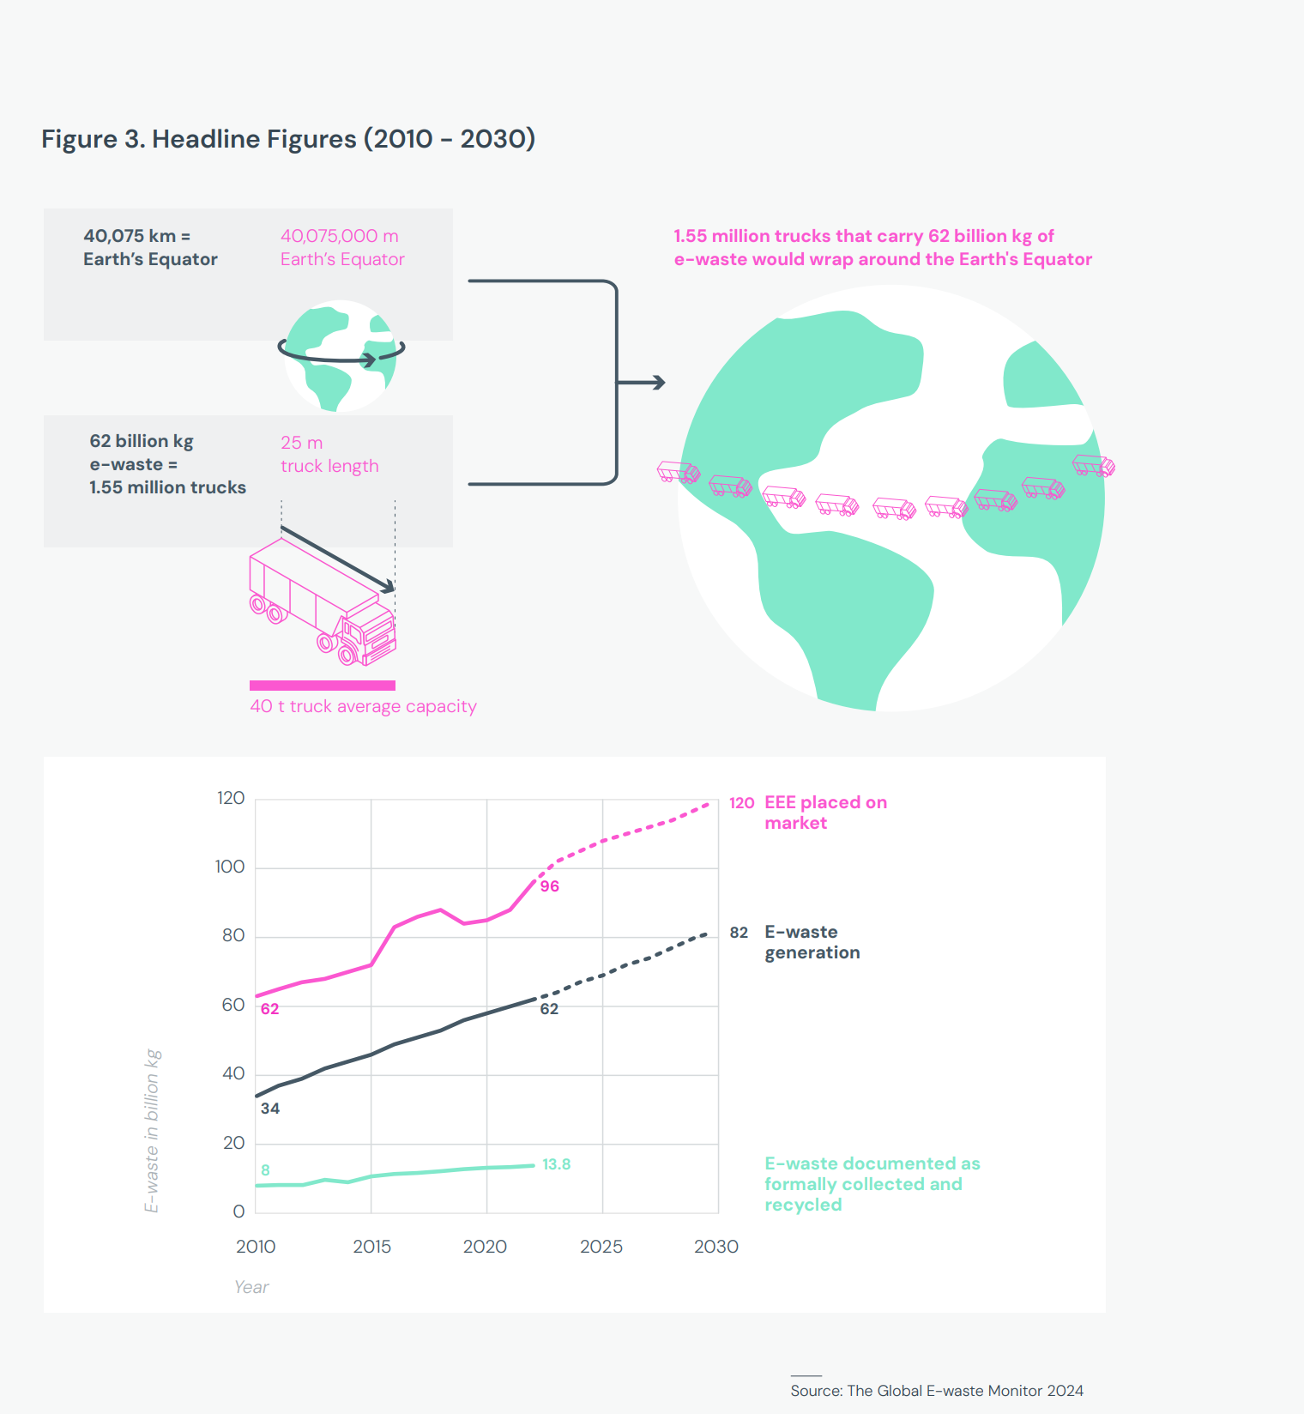
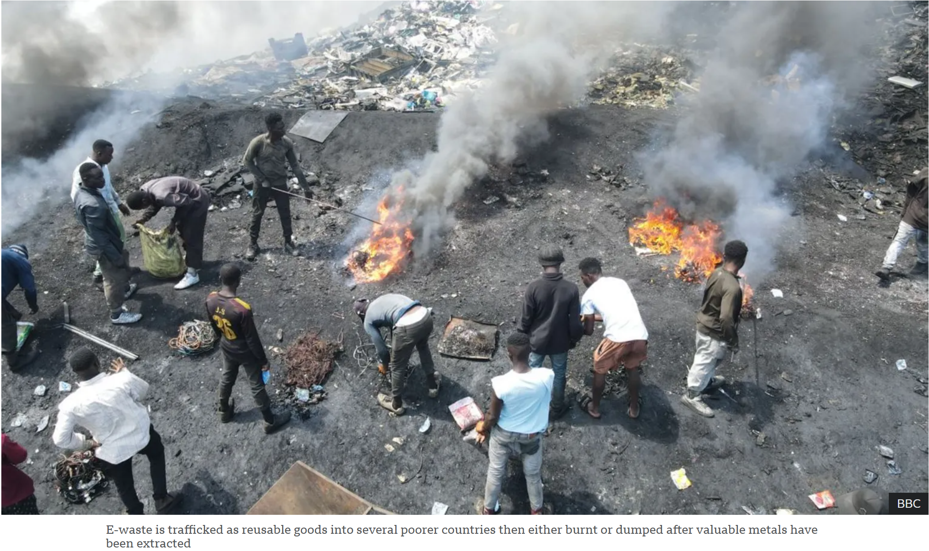
Why Is E-Waste Recycling Necessary?
Let’s keep it brief:
The rapid advancement of AI and other technologies is causing e-waste to accumulate at an alarming rate.
E-waste contains high-value metals.
If improperly dismantled, e-waste is often burned in countries like Ghana, leading to severe environmental pollution.

Slide 4
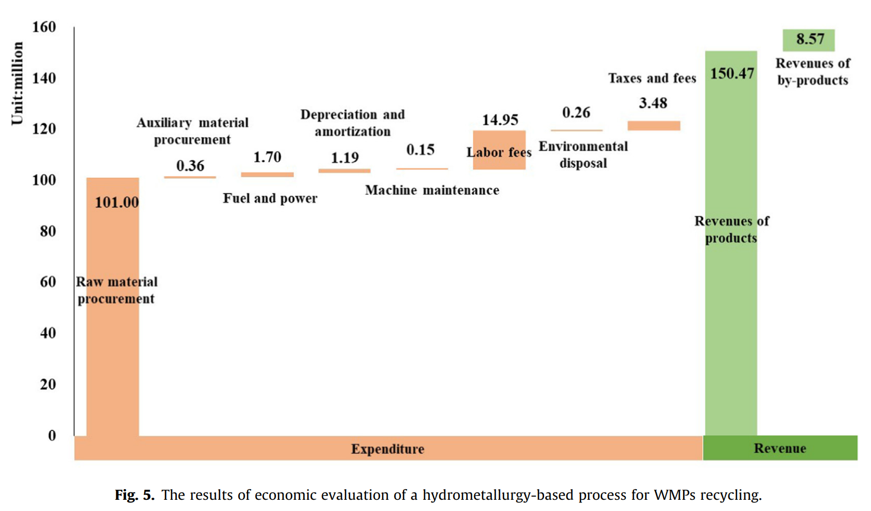
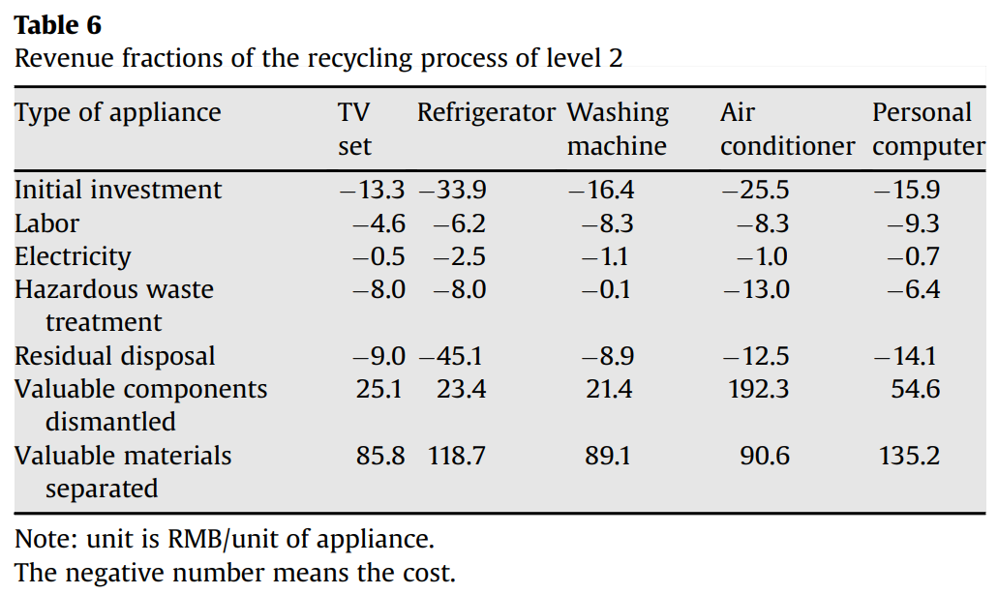
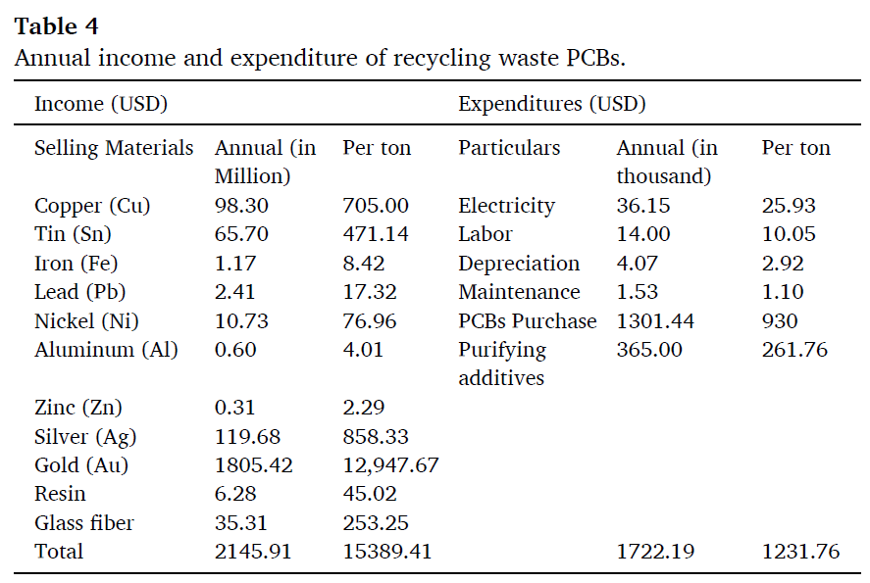
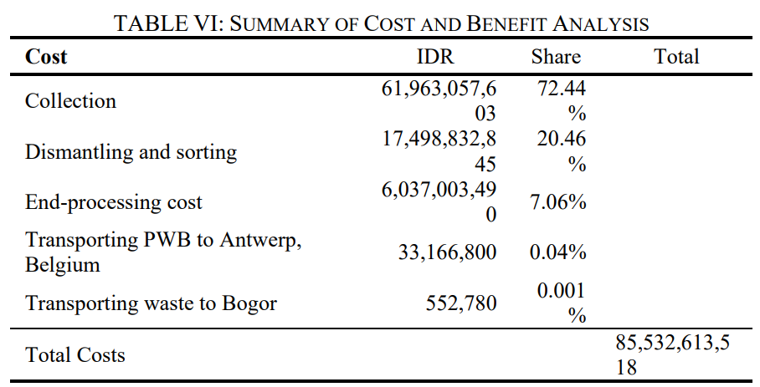
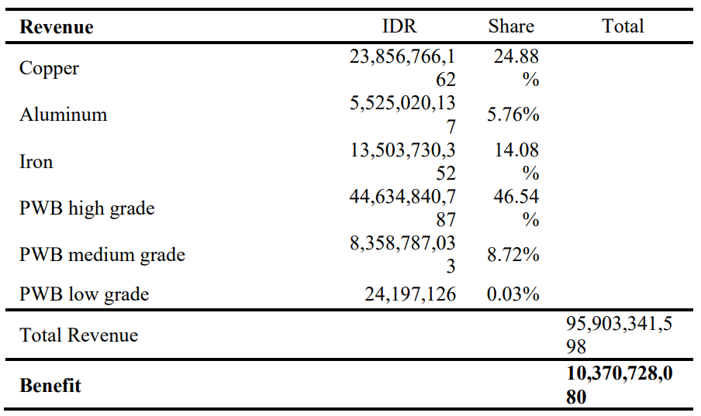
Economic Feasibility of Current E-Waste Recycling
Cost
Cost
Revenue
Revenue
Economic and environmental feasibility of hydrometallurgical process for recycling waste mobile phones
Economic evaluation of optional recycling processes for waste electronic home appliances
Revenue
Cost
Environmental and economic performance analysis of recycling waste
printed circuit boards using life cycle assessment
Cost
Revenue
Preliminary Assessment of Economic Feasibility for Establishing a Households’ E-Waste Treating Facility in Serang, Indonesia

Slide 5
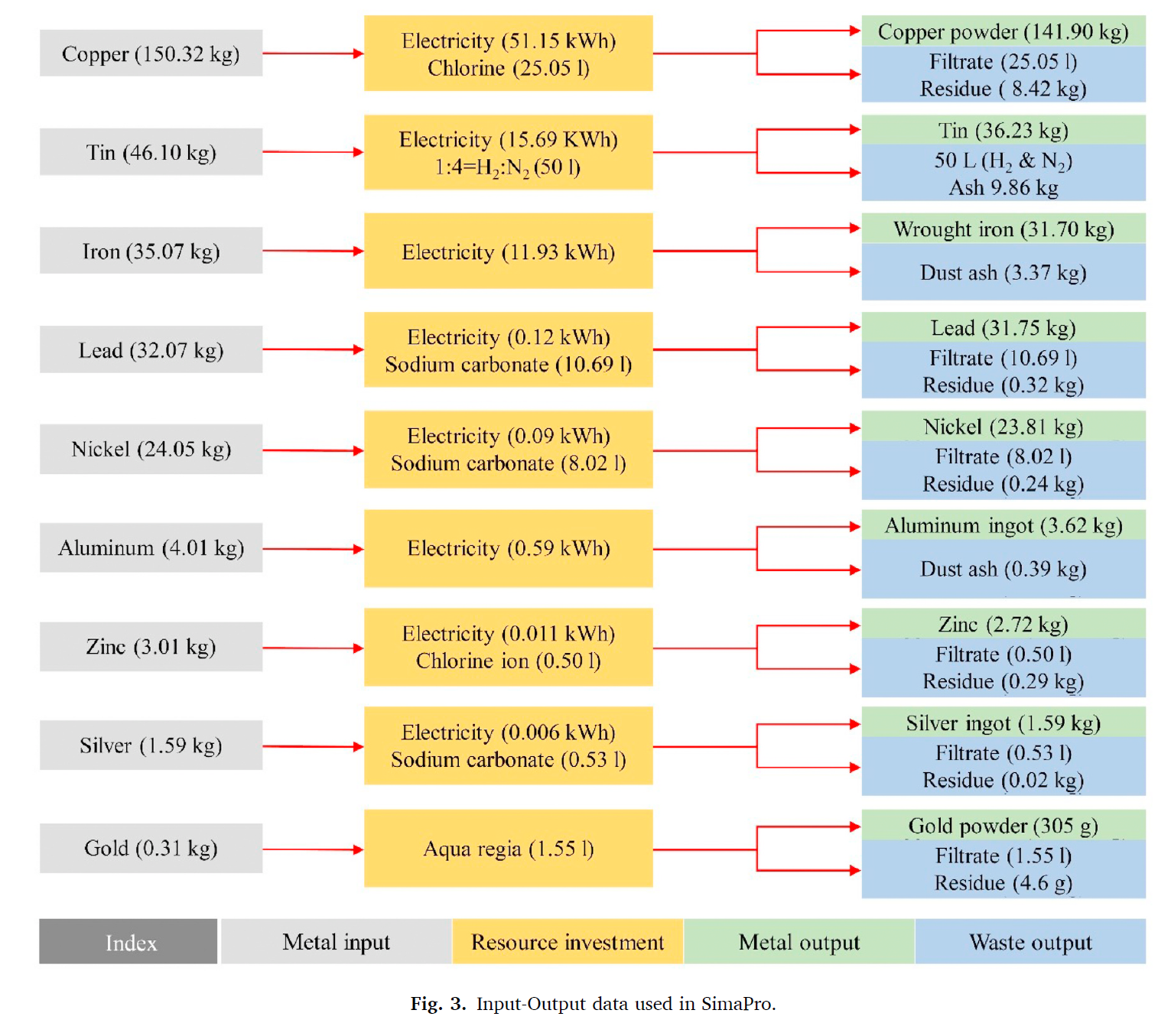
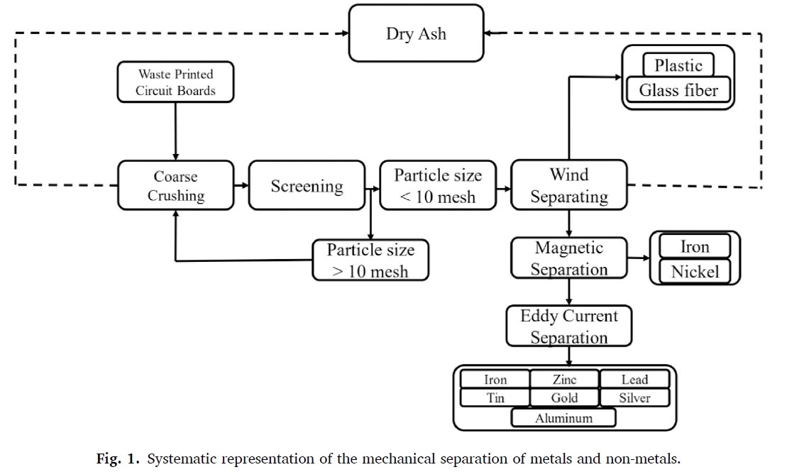
Overview of the E-Waste Recycling Process (e.g., PCB Scrap)
Initial Crushing:
Simple and produces minimal environmental impact. Just grind it physically.
Chemical Processing for Metal Refinement:
This stage generates significant pollution due to the
heavy use of chemicals needed to increase metal purity.

Slide 6
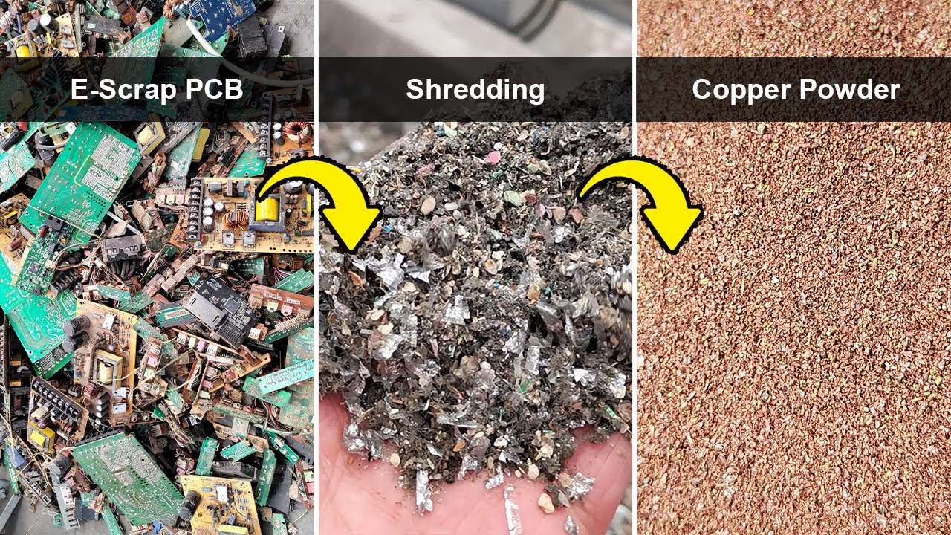
Overview of the E-Waste Recycling Process (e.g., PCB Scrap)
Formal way
Simple, Cheap, No pollution
Actual happen
in developing
countries
It costs $25 to operate the machine
to grind 1 ton of e-waste.
Too much harmful vapor, A lot pollution

Slide 7
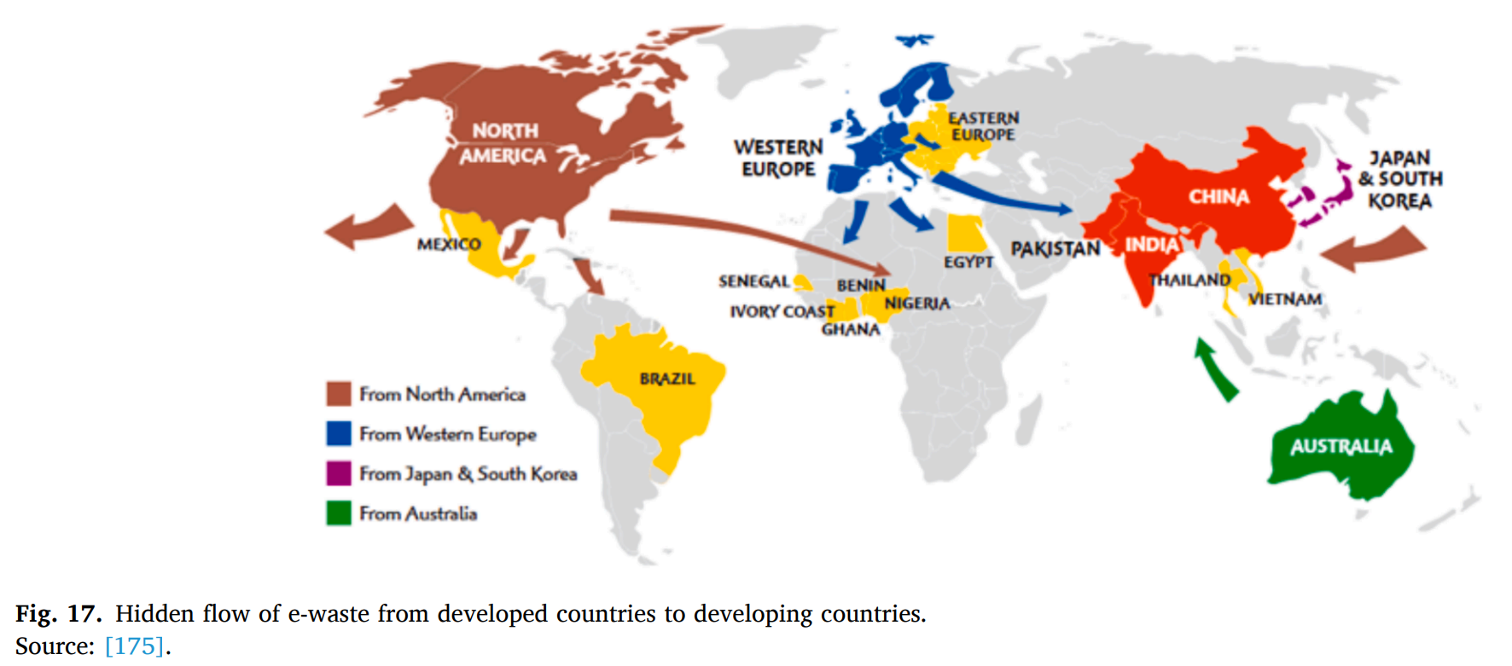
Conclusion
The economic feasibility of e-waste recycling,
as shown in previous slides, often turns negative
when factoring in the cost of acquiring e-waste.
To establish it as a viable business, the costs associated
with regulating e-waste would erode its profitability.
If left unchecked, companies may resort to
covertly dumping e-waste in developing
countries, creating unnecessary and massive environmental pollution.
Operating large-scale e-waste recycling plants in developed countries can:
Prevent unnecessary environmental harm.
Provide economic benefits to national budgets.

