Slide 1
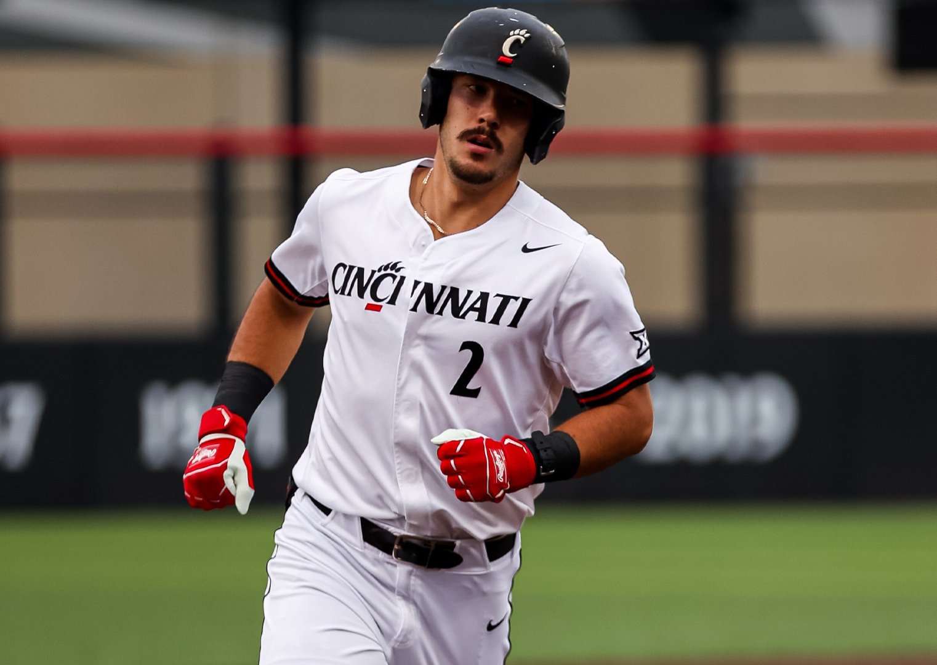
Where Are We Going From Here?
By: Kerrington Cross
(5th year UC Baseball Player)
University of Cincinnati Athletics Edition

Slide 2
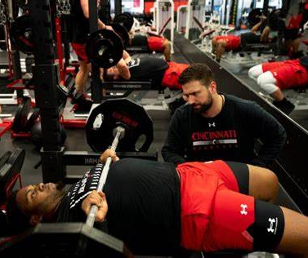
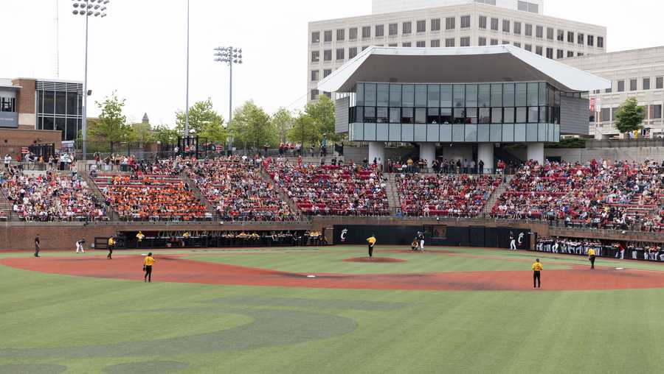
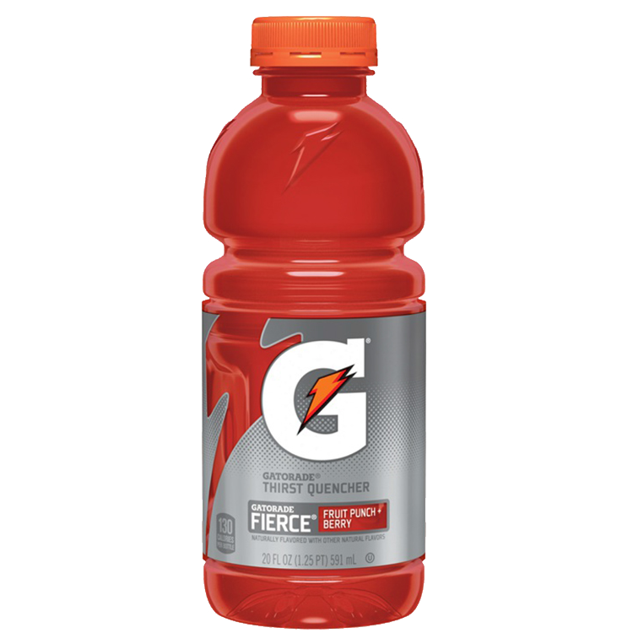
Player Development (Provided through UC Athletics)
Nutrition
Gatorade (Electrolytes and Hydration)
Protein Consumption (Shakes and Food)
Individual Workouts
Weight Room Access
24/7 On Field Access
Why Does This Matter?

Slide 3
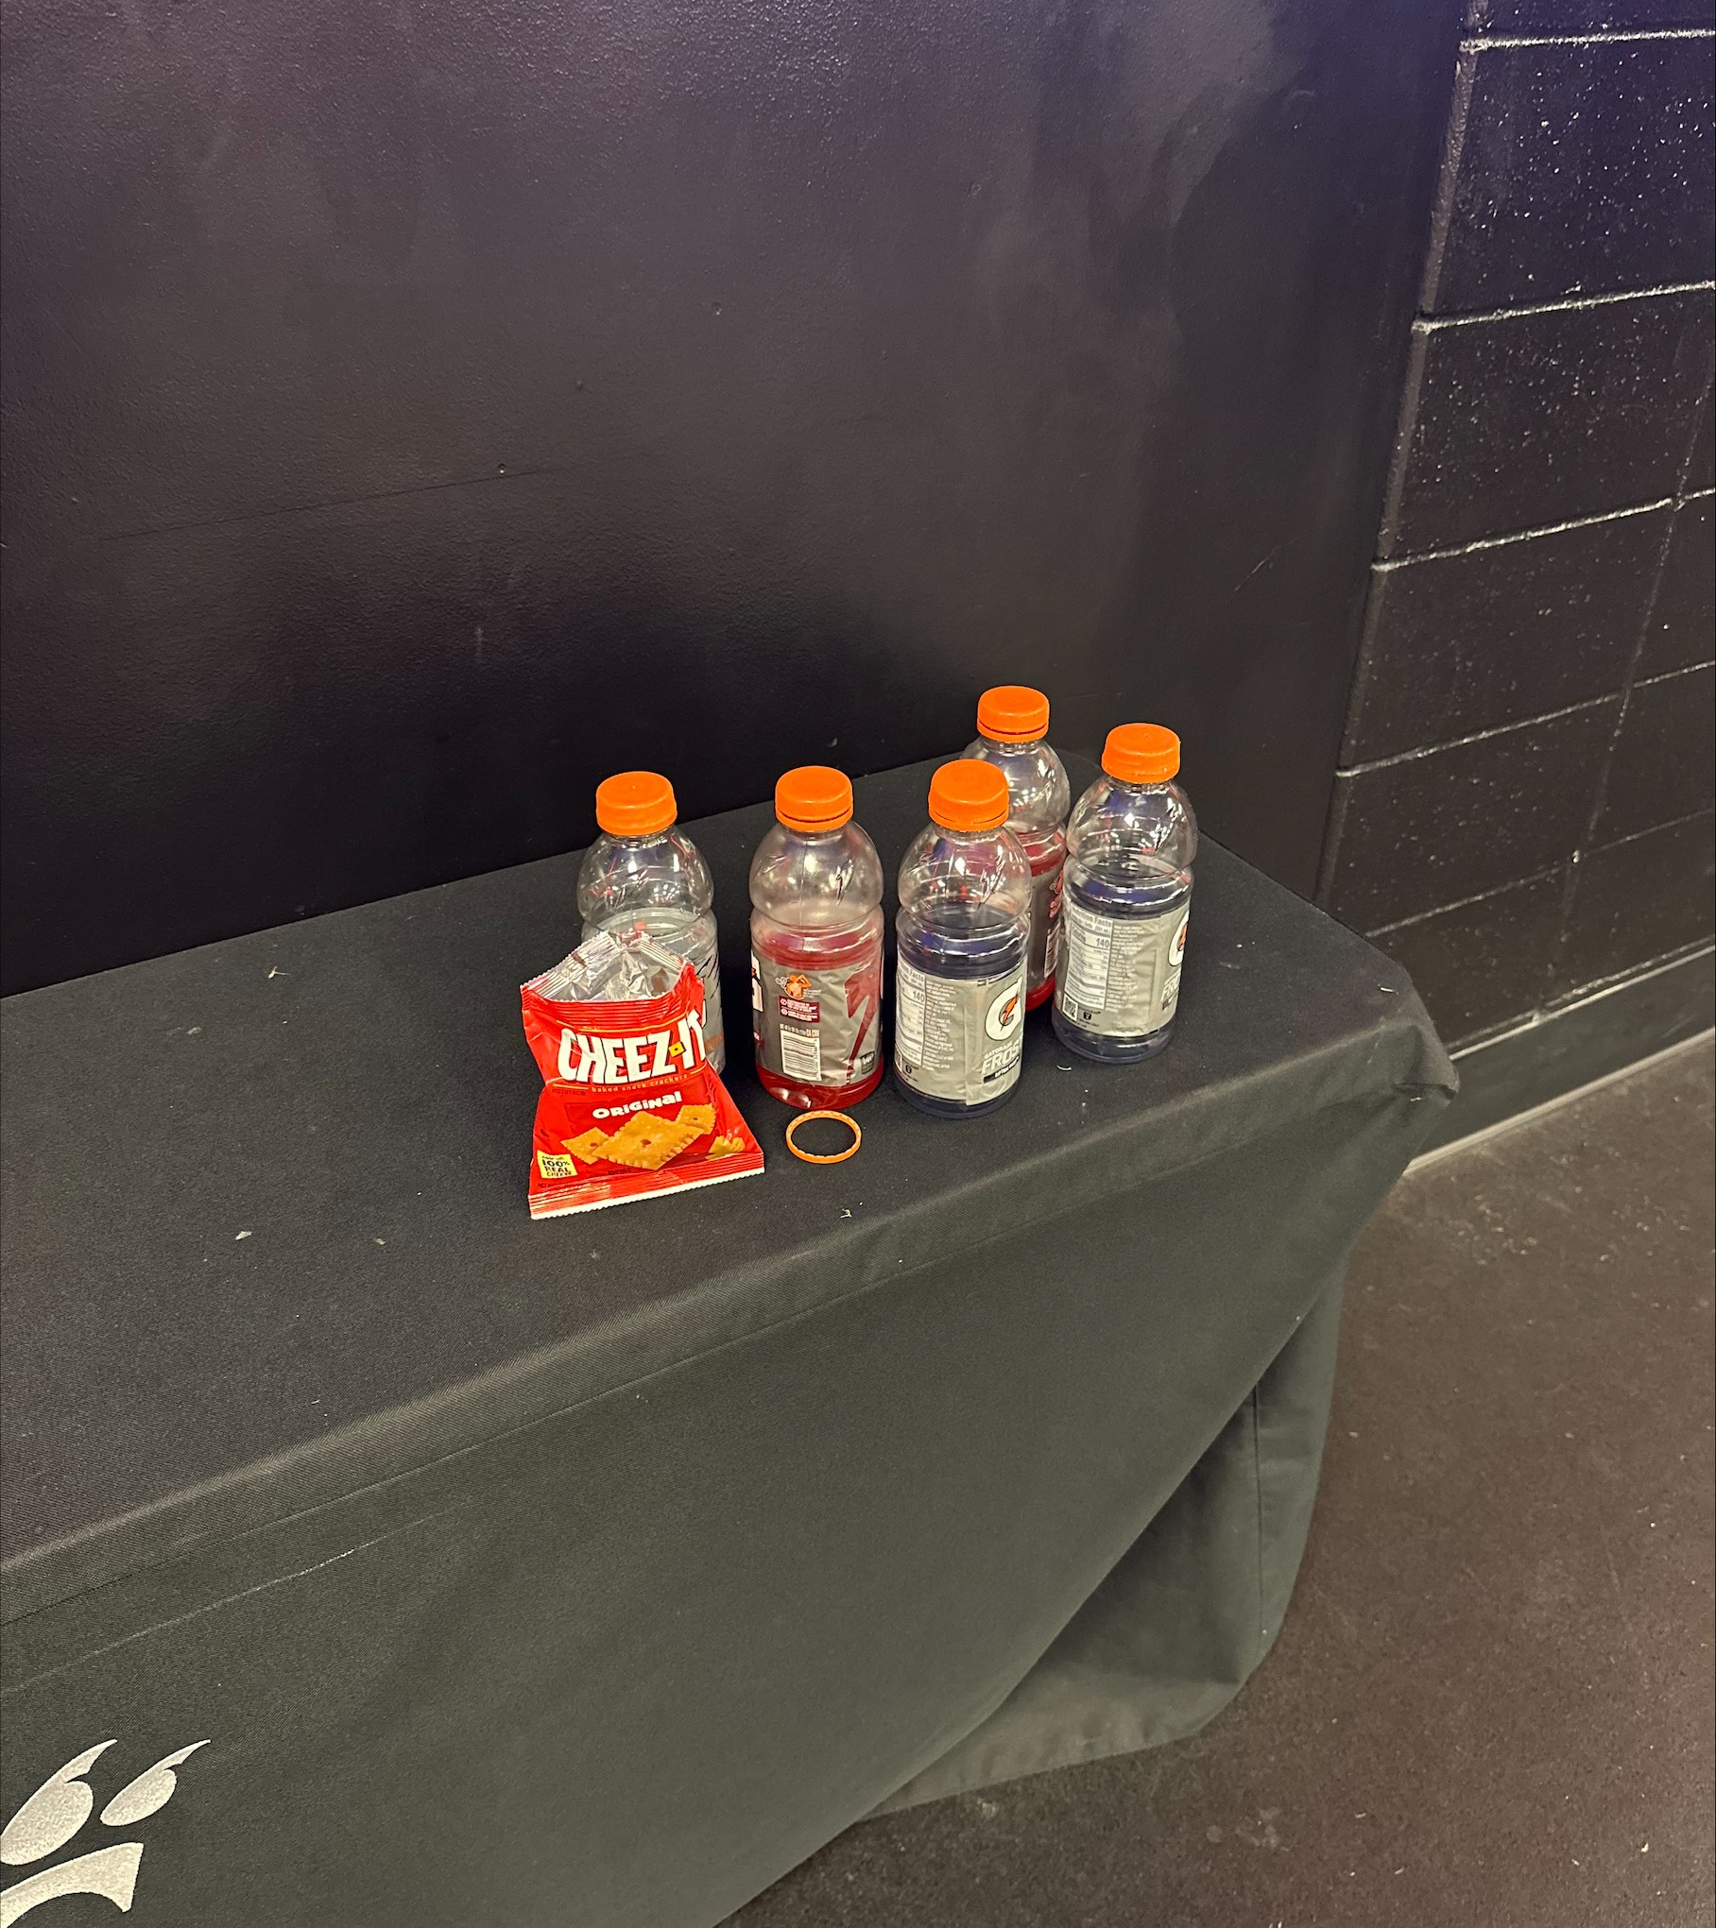
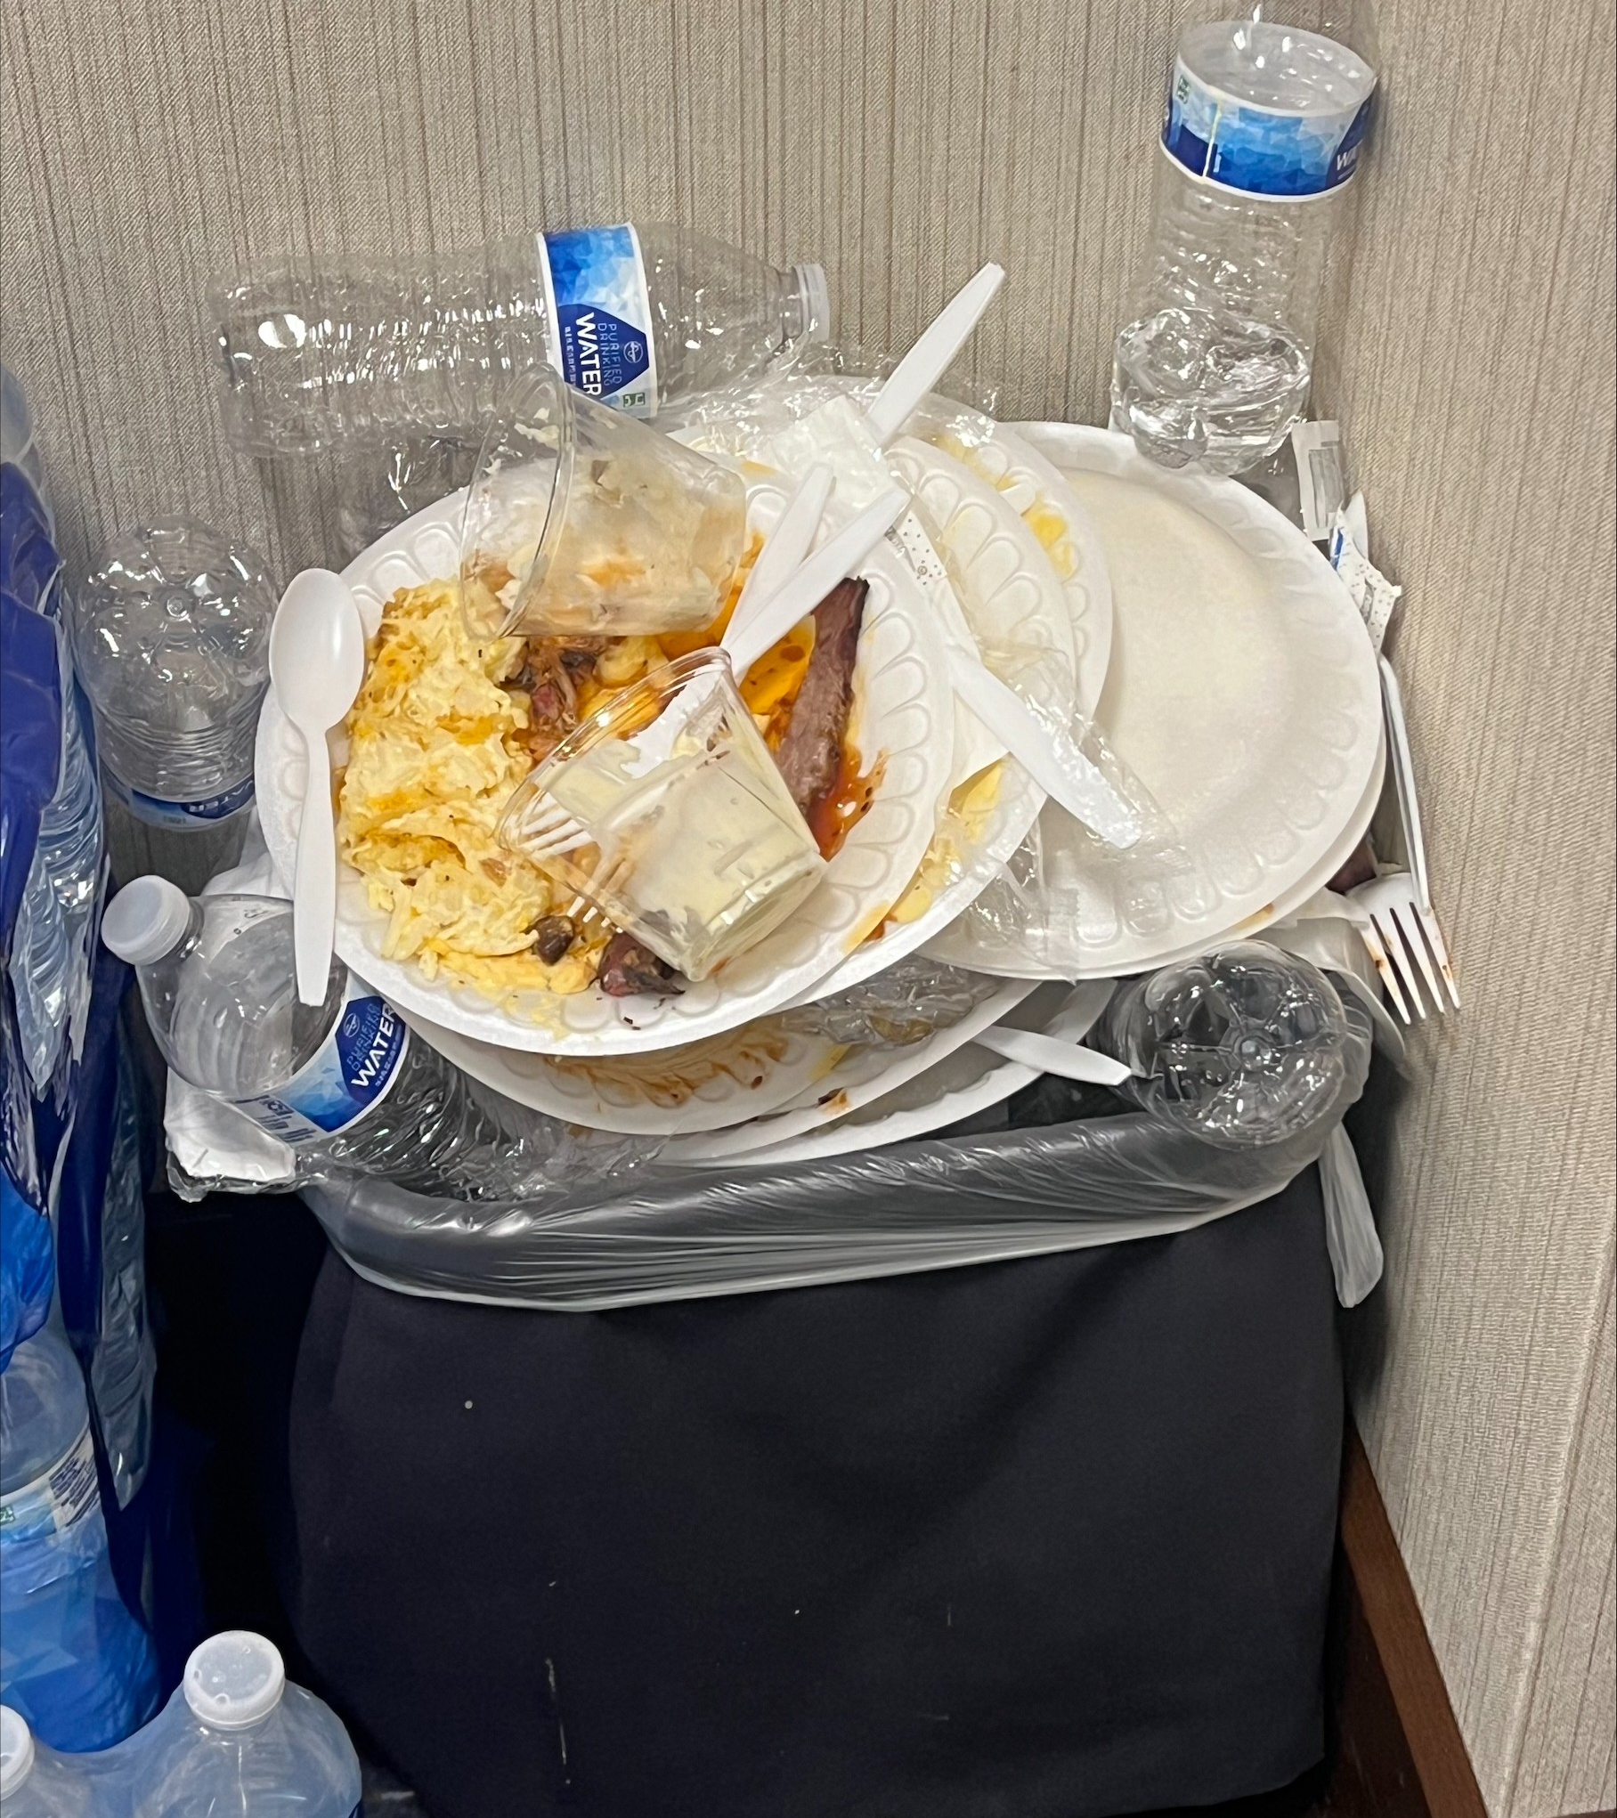
NO RECYCLING
Image:
Bottles Left around after Lift, disposed of in trash can
Image:
Trash Can at UC Baseball Field after post game meal
Thousands of Plastics are disposed of in the trash per day in athletics.

Slide 4
Chain Reaction
I have only mentioned one specific sport at UC
Now imagine bigger sports teams such as football, track, etc.
The amount of plastic waste are quadrupled compared to the images shown above (excluding sporting events)

Slide 5
Overall Effects from Not Recycling
Garbage piles up
Landfills Increases in Number
Greenhouse Gasses Increase
Fossil Fuels Disappear Sooner
Natural Resources Diminish

Slide 6
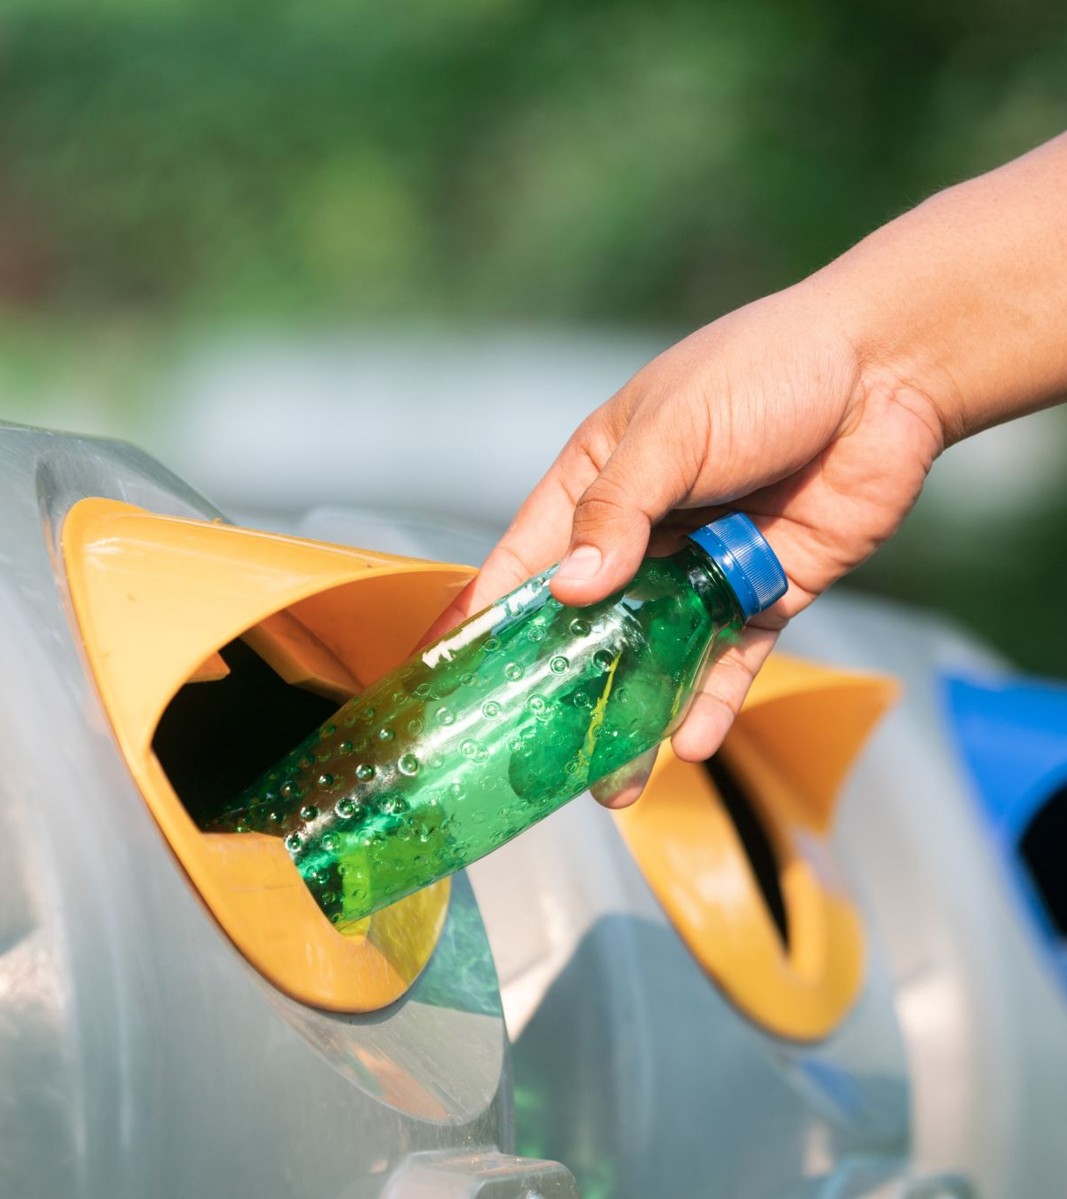
What to do next….
Simple Solution:
Add recycling bins!
Clearly marked and color coordinated bins
Place in high traffic area of the athletics complexs
Post signage!
Offer educational lessons and guides through UC athletics
Offer incentive to teams?

Slide 7
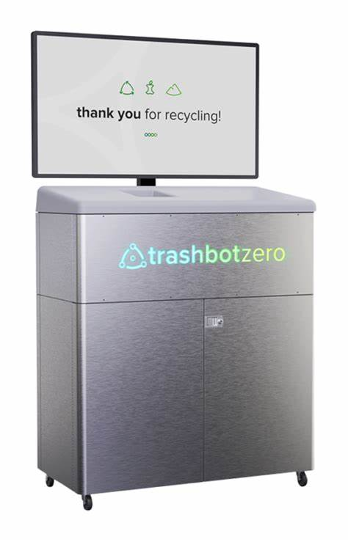
Technological Advancement Solution
Robot that systematically differentiates specific plastics and waste
Helps Zero Waste facilities increase sorting accuracy to 95%, in comparison to 30% of conventional bins
Increase waste composting by 200% or more
Statistics: 40 TrashBots can divert 417 tons of recyclables a year = 11,111.30 metric tons of carbon dioxide equivalents = hundreds of cars off the road

Slide 8
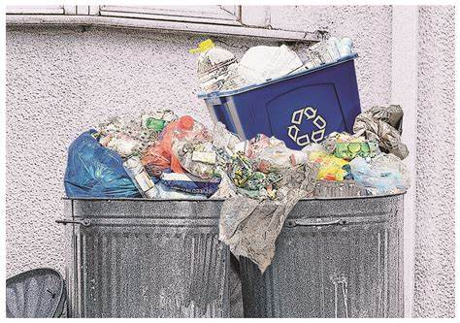
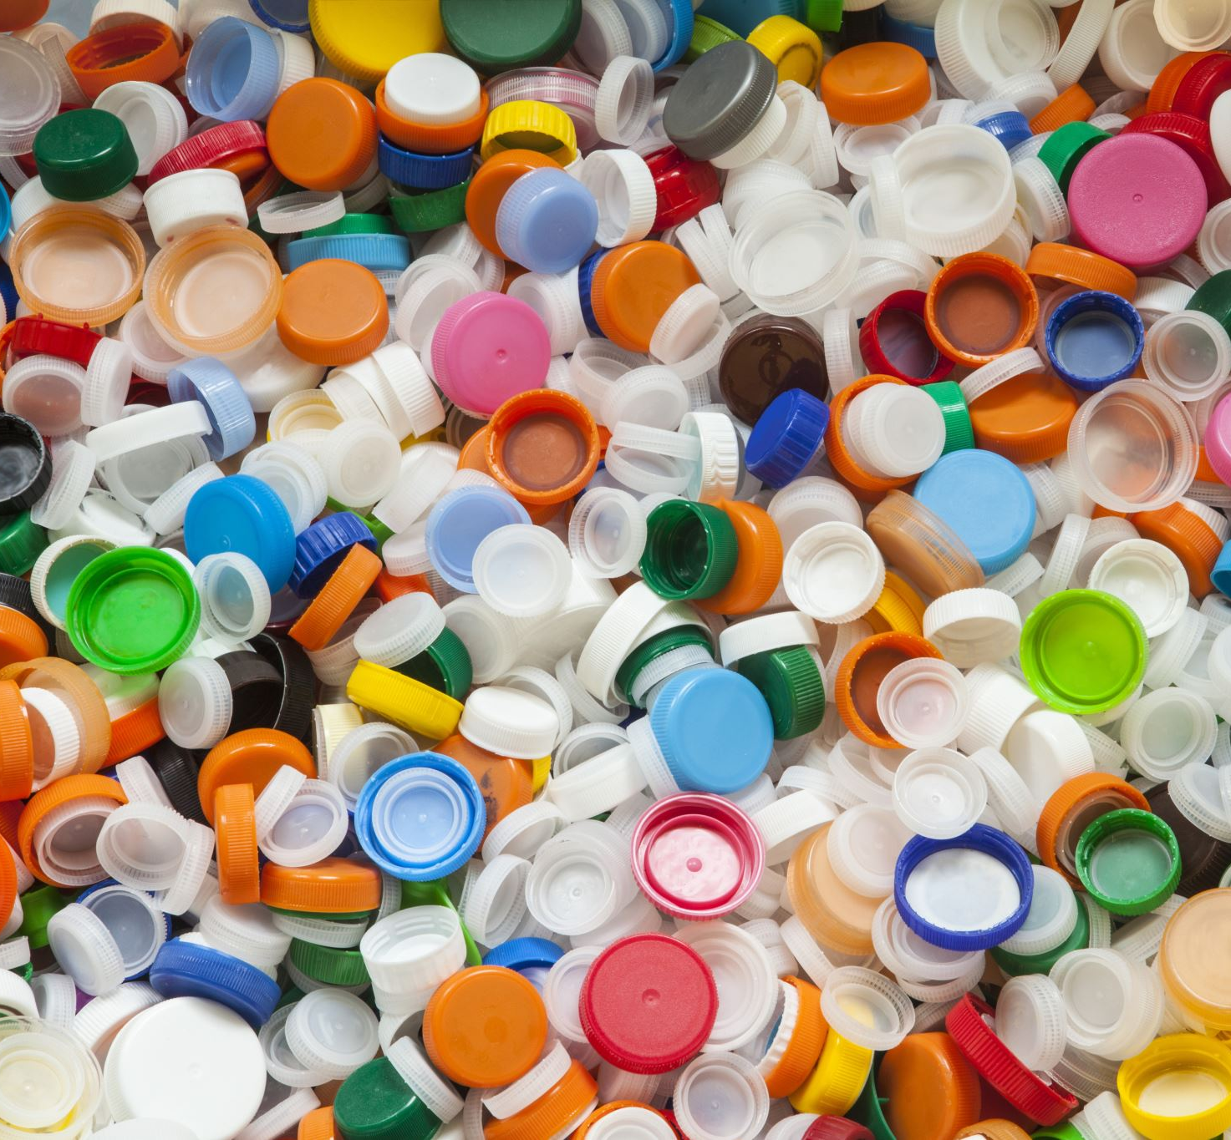
Potential Issues
Simple Solution:
Breaking the standard → people will do what they’ve always done, its hard to change
Waste and Plastics will get mixed
Technological Advancement Solution (TrashBot):
COST!!!

Slide 9
Outcome
Environmental Impact:
Reduced landfill waste and pollution.
Conservation of resources by reusing plastics.
Lower carbon footprint for the team and athletics program.
Community Leadership:
Sets an example of sustainability for fans and peers.
Encourages broader adoption of recycling practices.
Financial Benefits:
Potential cost savings through recycling partnerships.
Revenue opportunities from selling recyclables.
Team Identity & Culture:
Builds a reputation as a responsible, eco-conscious team.
Fosters teamwork and pride in shared sustainability efforts.
Long-term Sustainability:
Protects the environment for future athletes.
Aligns athletics with global environmental goals.

