Slide 1
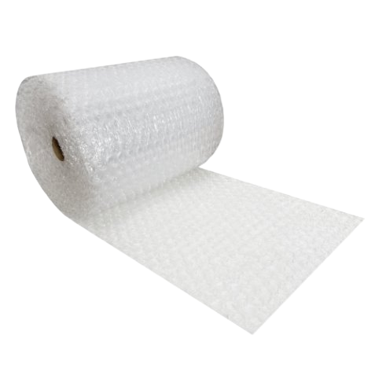
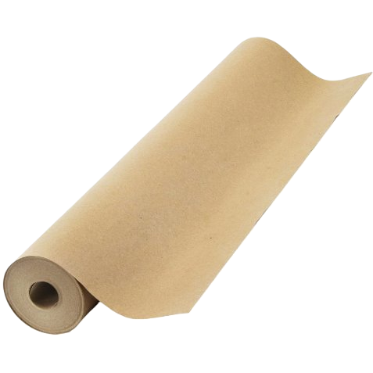
Advancing Circularity in Protective Packaging: The Future of Bubble Wrap
A Vision for Sustainable Protective Packaging

Slide 2
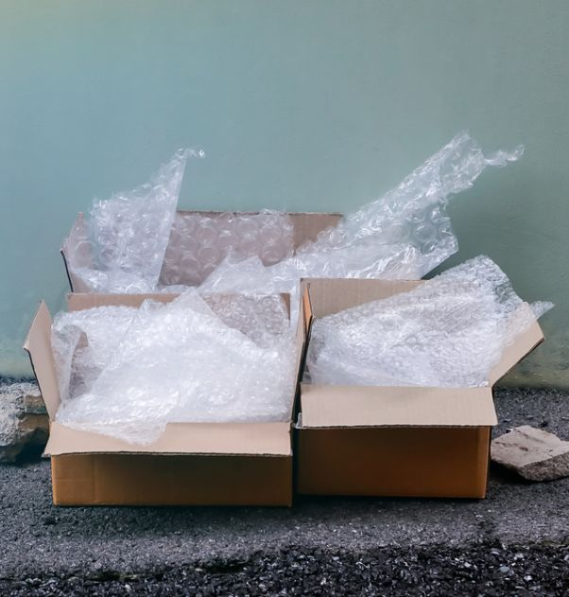
Introduction
Bubble wrap is one of the most widely used protective packaging materials globally
Lightweight, durable, shock-absorbing, and cost-effective
Made from polyethylene, fossil fuel-based plastic that is non-biodegradable
Thin film plastics like bubble wrap are difficult to recycle

Slide 3
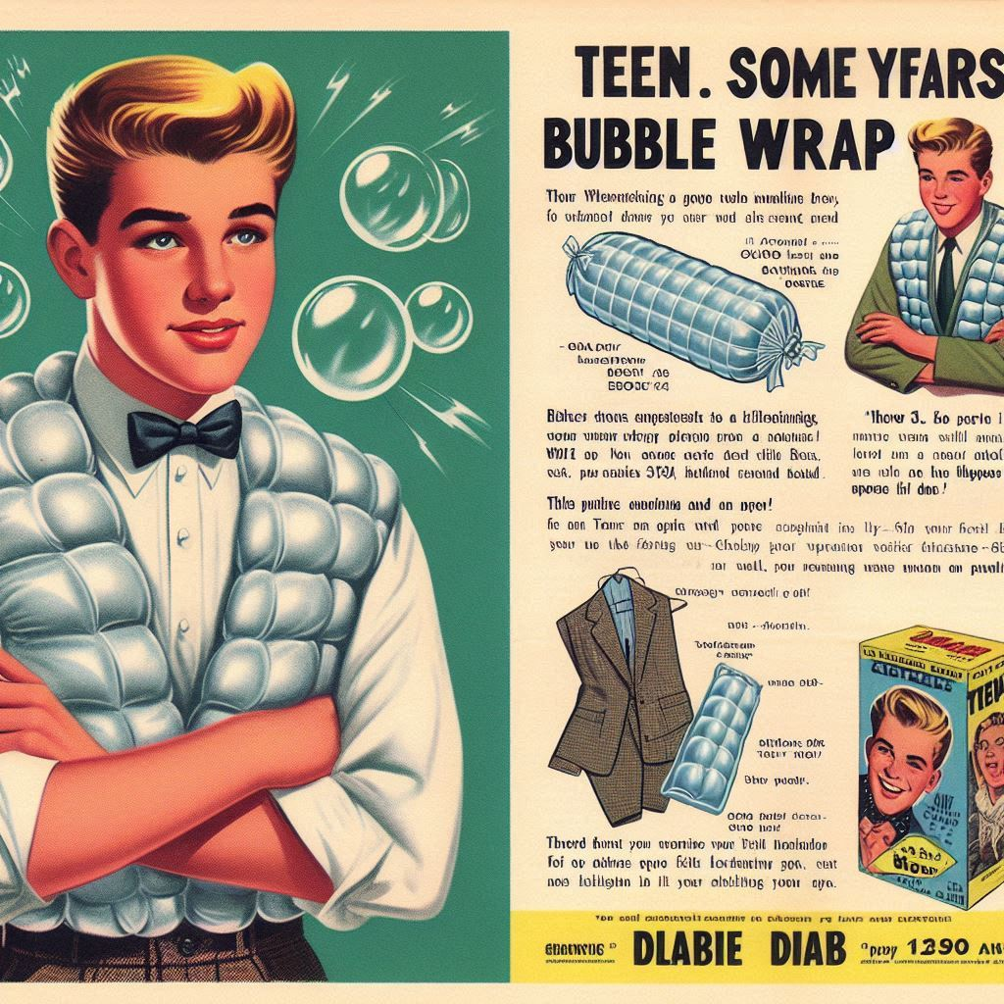
The Past: How Bubble Wrap Became Ubiquitous
Old newspaper used before
Invented in 1957 as wallpaper
Made from polyethylene, fossil fuel-based, non-biodegradable plastic
Rapid adoption in shipping industries due to its lightweight and protective properties

Slide 4
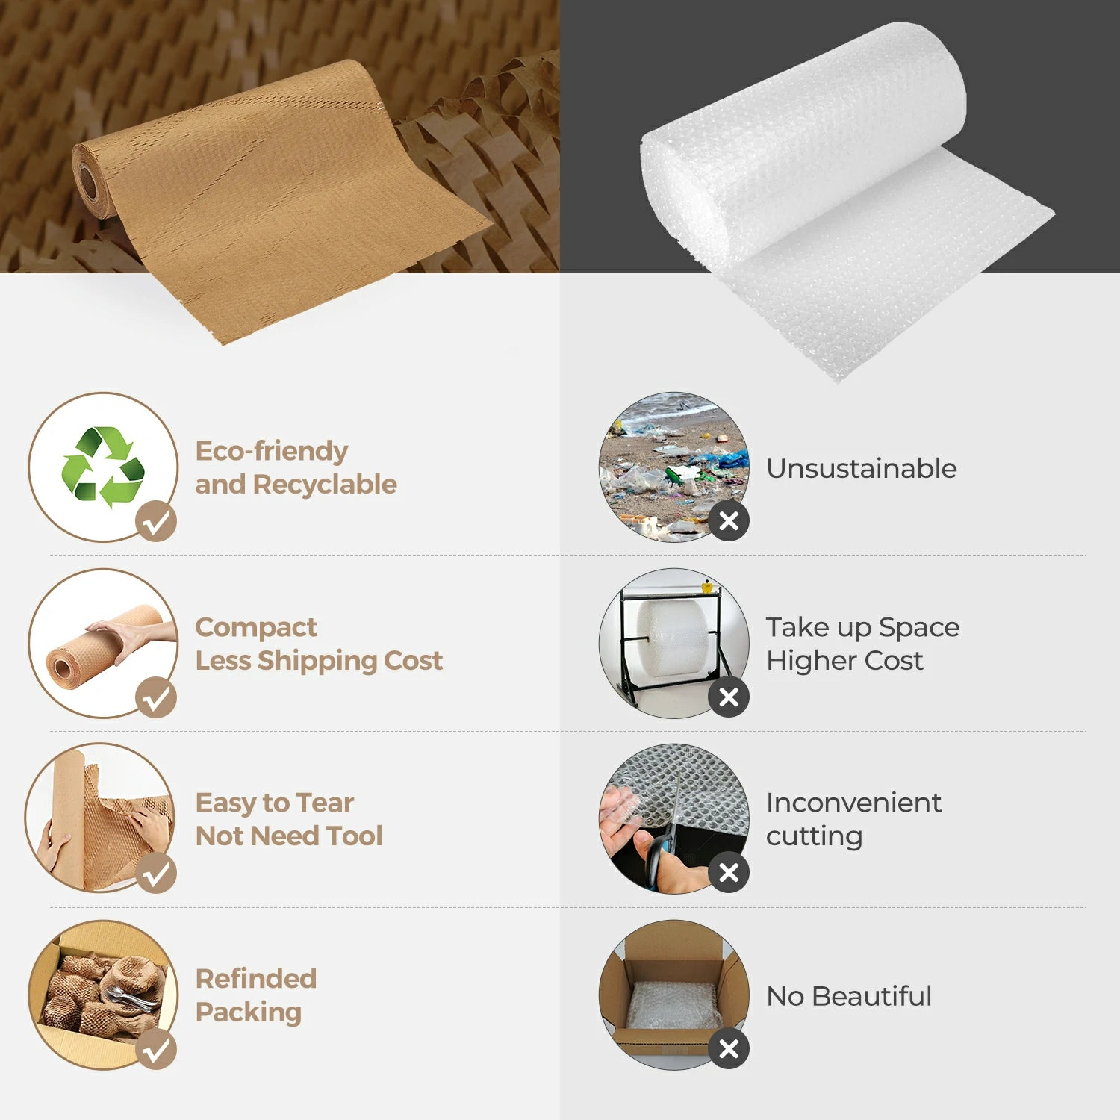
The Present: Sustainable Alternatives and Challenges
Current Alternatives:
Paper-based products (honeycomb wrap)
Biodegradable bubble wrap from bio-polymers
Air pillow packaging (recyclable plastics)
Challenges: higher cost, limited awareness, and gaps in infrastructure
Amazon announced in June it is removing plastic protection by end of 2024

Slide 5
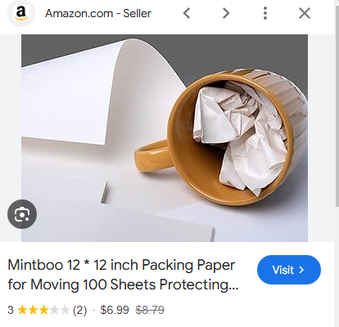
Scenario 1: Scaling Paper-Based Protective Solutions
Kraft paper cushioning and honeycomb wraps
Benefits: recyclable, biodegradable, and cost-effective
Challenges: may not provide sufficient protection for extremely fragile items

Slide 6
Scenario 2: Fully Biodegradable Bubble Wrap
Using bio-based materials like PLA or PHA in lieu of PE
Benefits: decomposes naturally, reducing landfill waste
Challenges: Scaling production and managing costs

Slide 7
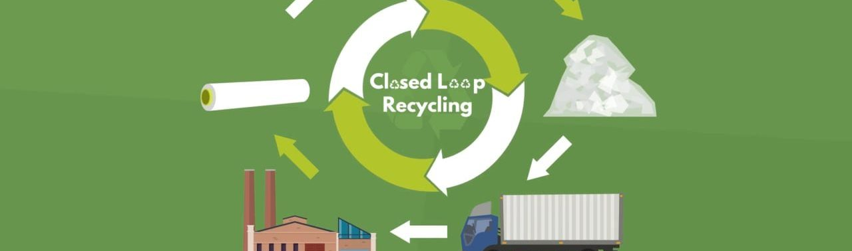
Scenario 3: Circular Systems for Thin Plastics
Developing advanced recycling technologies for polyethylene
Corporate take-back programs to recover and recycle bubble wrap
Benefits: keeps existing materials in use, reducing waste
Challenges: downcycling, collection logistics, expensive processing

Slide 8
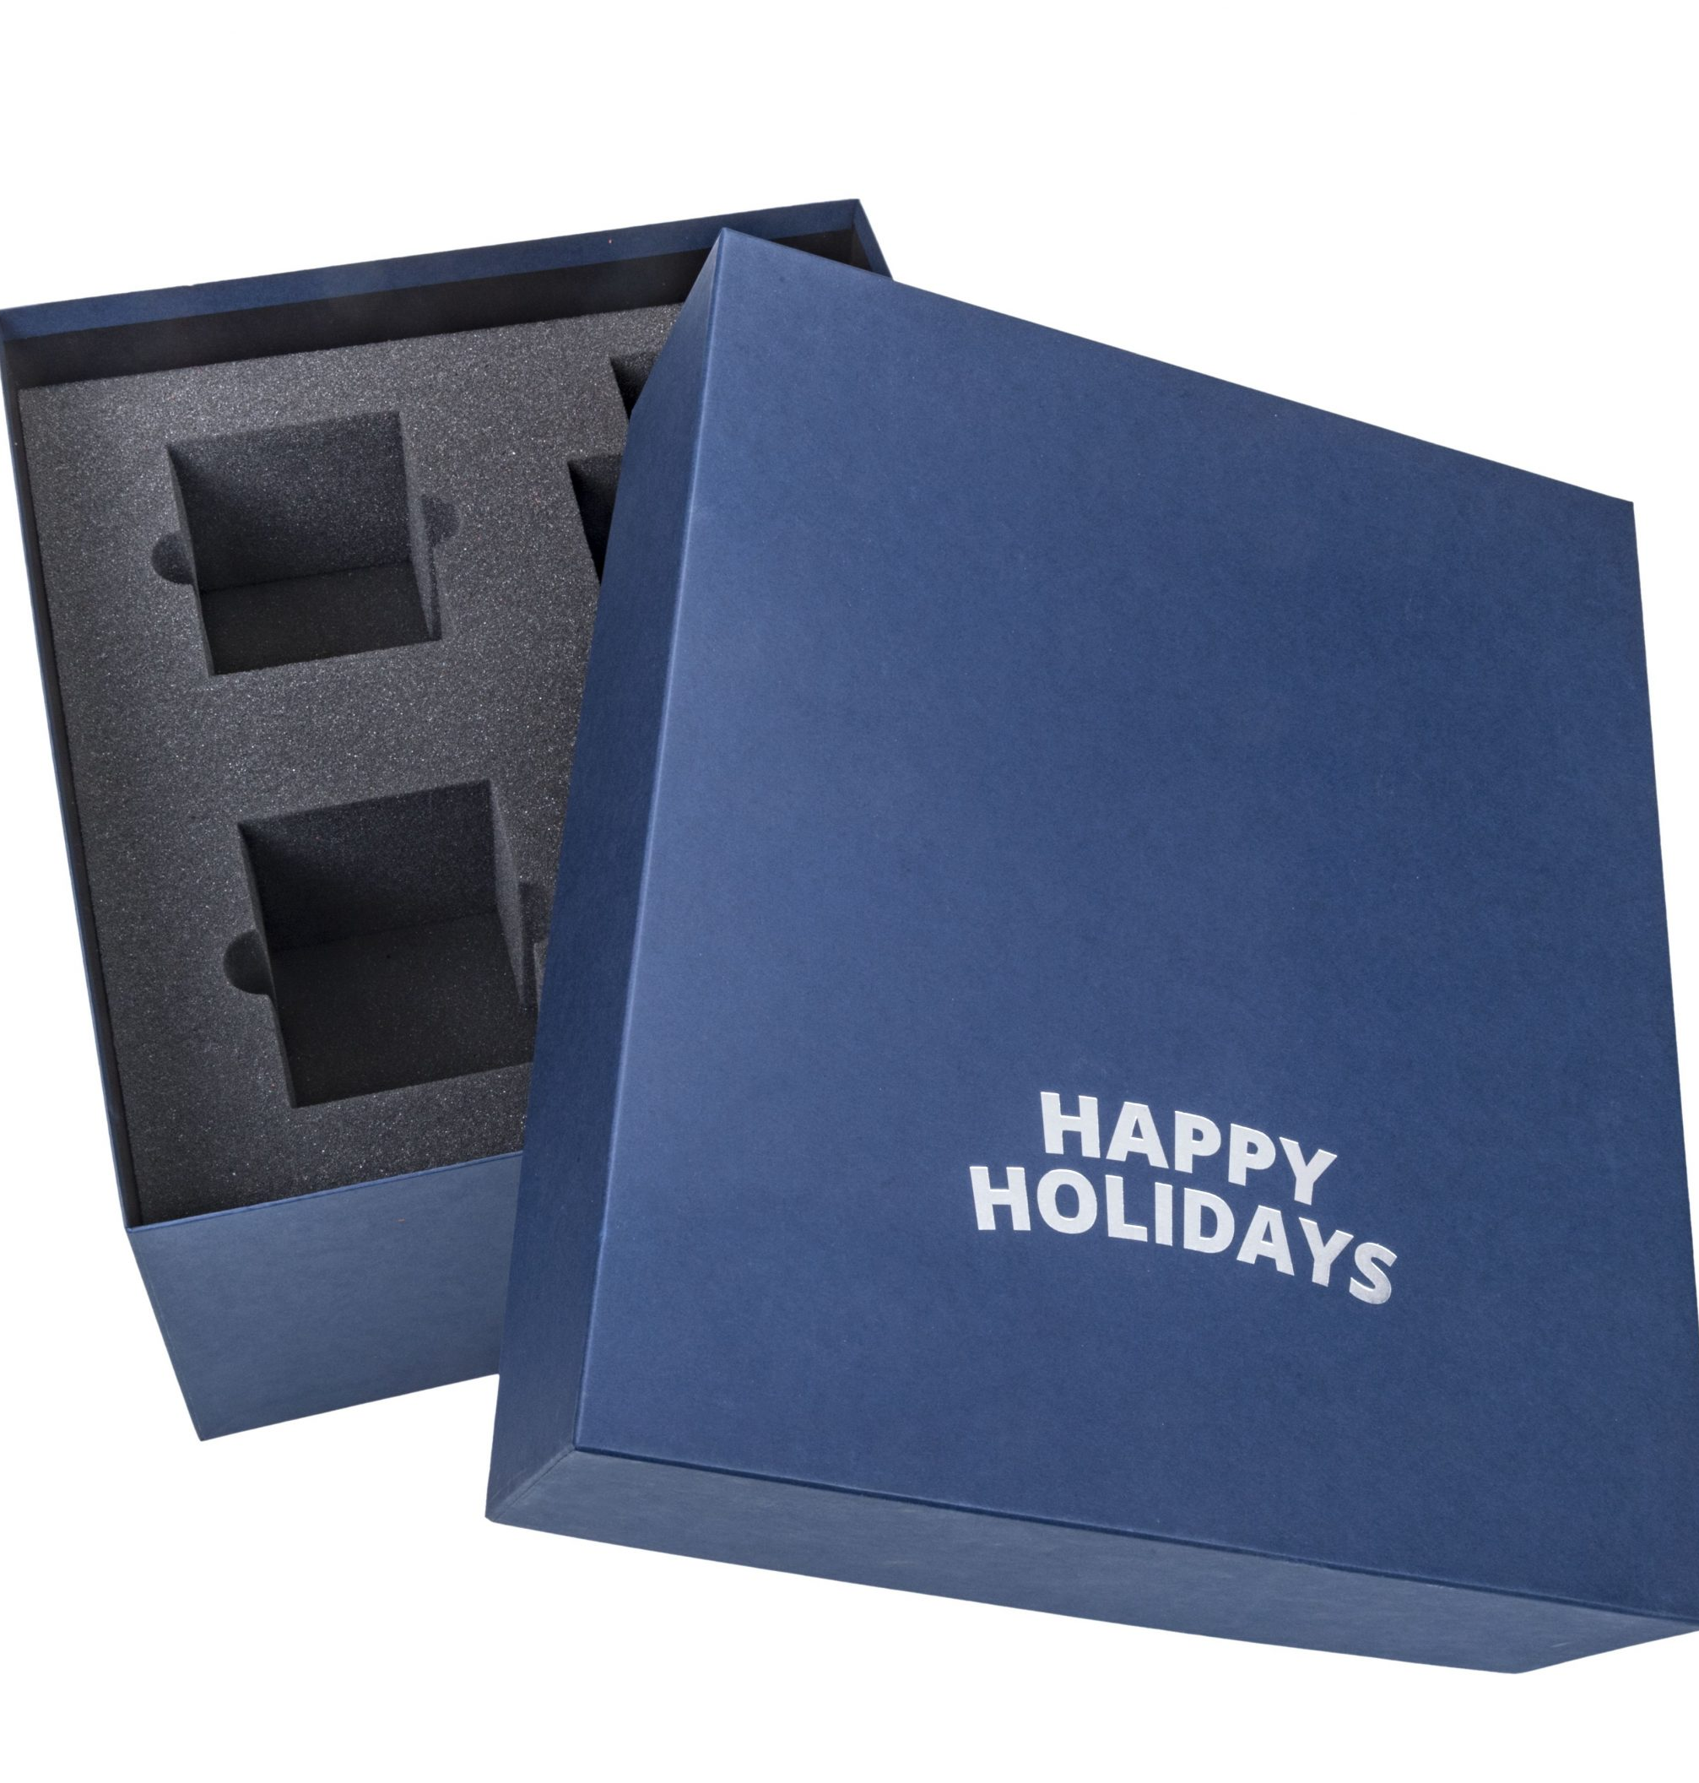
Scenario 4: Moving to Reusable Systems
Reusable foam inserts or air cushions for bulk shippers
Platforms like Loop for logistics could extend to protective packaging
Benefits: potential for long-term cost savings and waste reduction
Challenges: high initial costs, reverse logistics, cleaning and sanitation

Slide 9
Solutions to Address Scenario Challenges
Incentives for Returns
Offer deposit systems or discounts for customers who return packaging
Standardization
Design modular, standardized reusable packaging to simplify logistics and compatibility across products
Local Solutions
Establish localized return and cleaning hubs to minimize transportation distances
Partnerships
Collaboration between logistic companies to create efficient reverse supply chains

Slide 10
Potential Environmental Benefits
Reduction in landfill and ocean waste
Decreased reliance on fossil fuels for PE production

Slide 11
What Needs to Be Done
Encourage businesses to switch to sustainable packaging
Advocate for government incentives for eco-friendly innovations
More likely to be successful in more liberal states, like NY and CAL than nationally.
Increase consumer awareness about sustainable packaging options

