Slide 1
Controlling PAH exposures from tire wear
Final presentation
Plastics in circular economy
Sazzadul Alam Rahat
Graduate Student
Mechanical and Materials Engineering

Slide 2
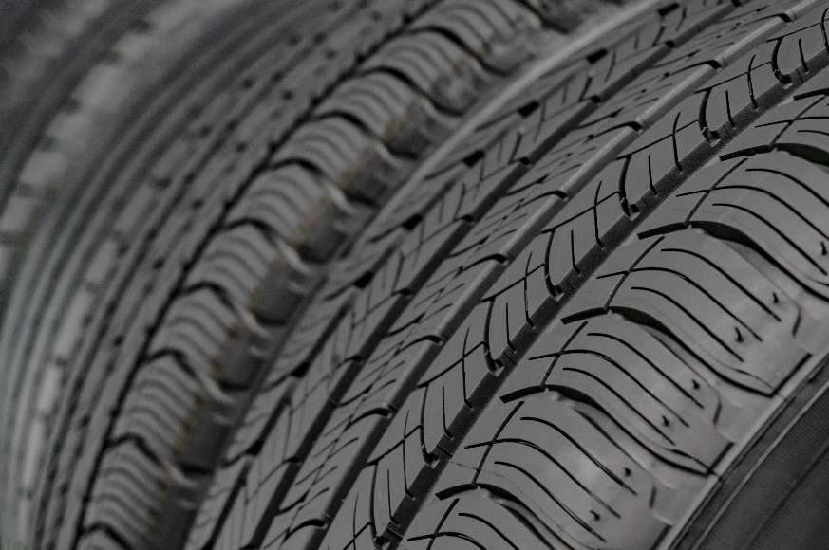
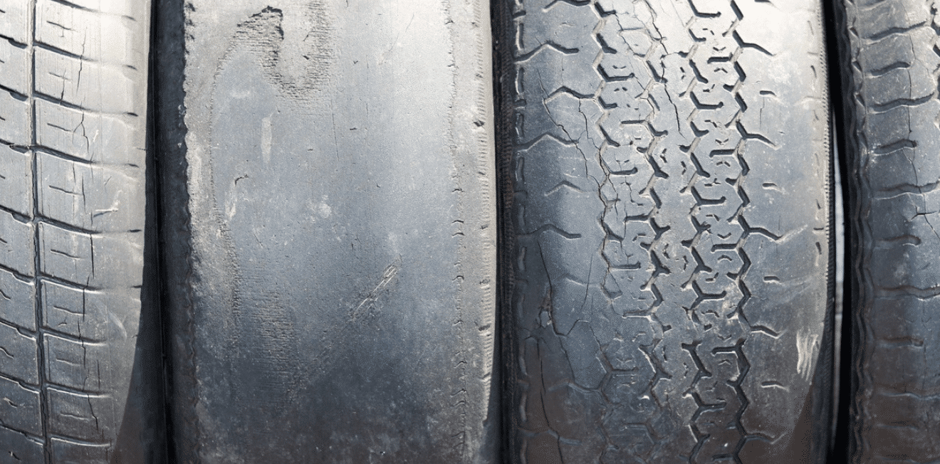
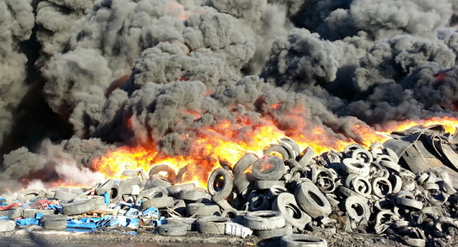
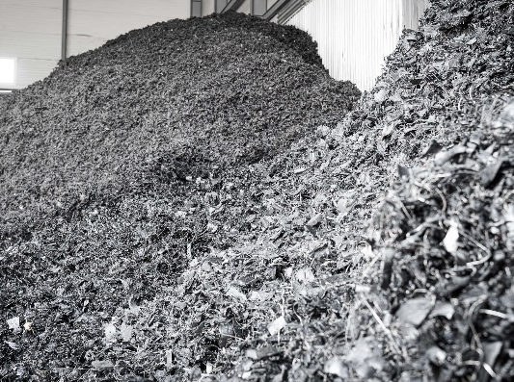
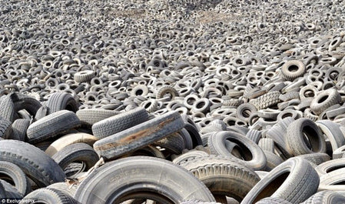
How tire debris lead to health hazard?
Tire wear
Burning
Rubber Polymer 40-60%
Reinforcing agents 20-35%
Mineral oils 15-20%
Shredding
Landfill
PAH
polycyclic aromatic hydrocarbon
Notes:
Mineral oils used in tire manufacturing are highly aromatic oils as softener contains PAHs.

Slide 3
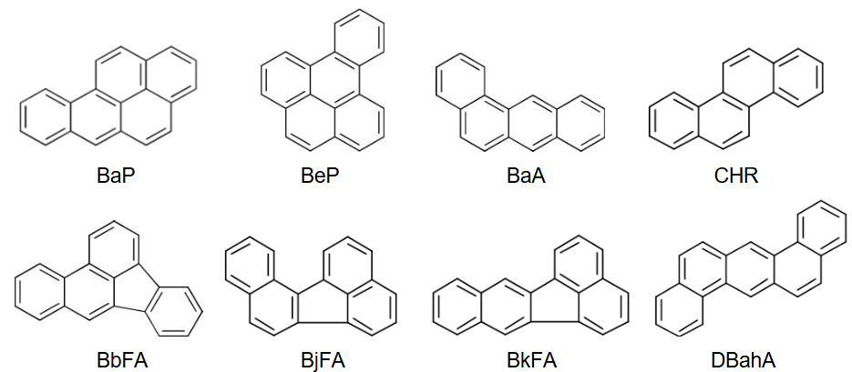
Developing non-carcinogenic oils for tire production
Highly Aromatic oils (HA)
Treated Distillate Aromatic Extract
Solvent extraction and hydrotreating
Reduce PAH content below 3%
Mild Extracted Solvate
Paraffinic vacuum distillate fraction
PAH content below carcinogenic level
Naphthenic Oils
Low aromatic content
Good compatibility with SBR and diene rubbers
Replacing HA
Reduce PAH emission
by more than 90%
Natural Oils
Improve processing properties, filler dispersion
Inconsistent performance
Ismail et al., WAPLAC, 2022

Slide 4
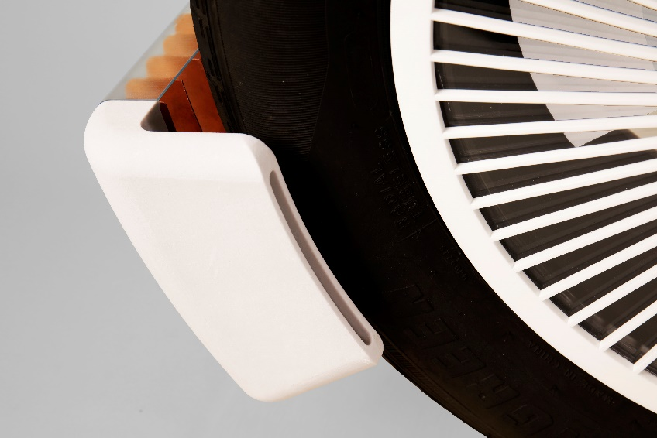
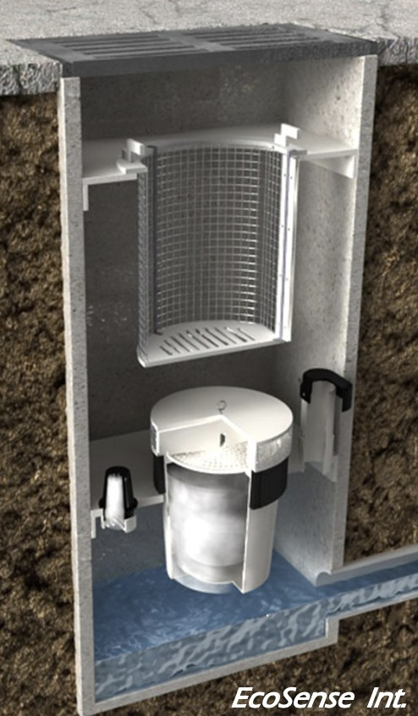
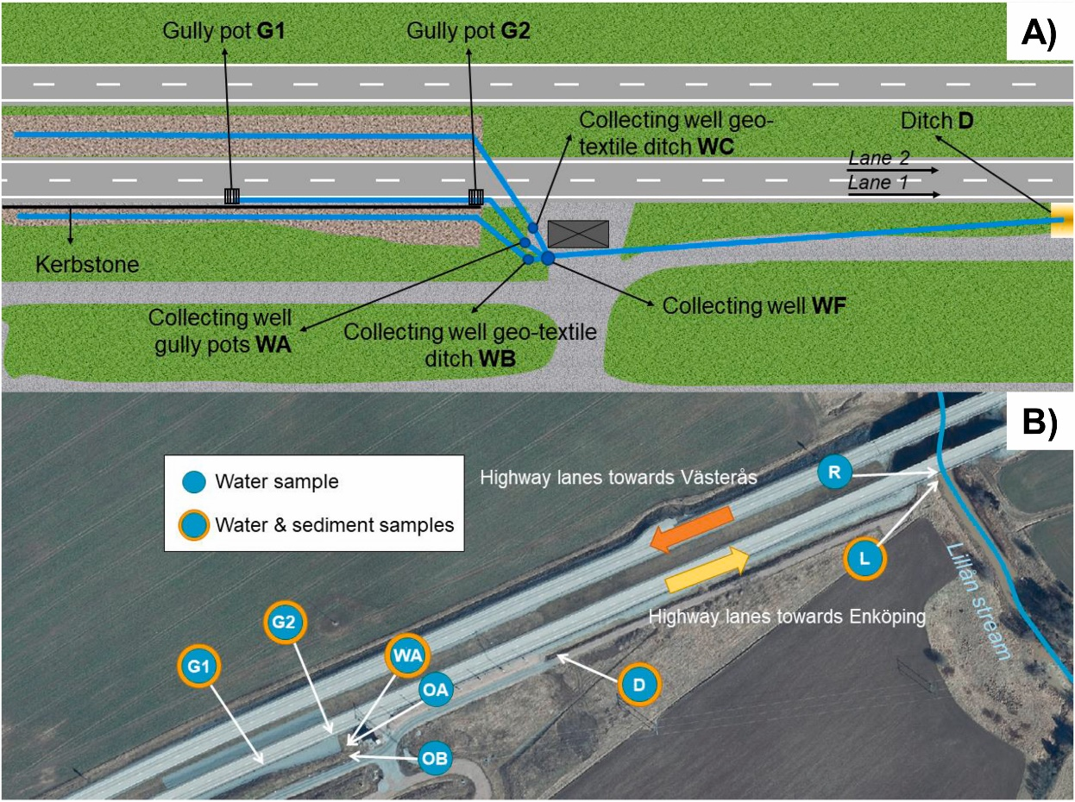
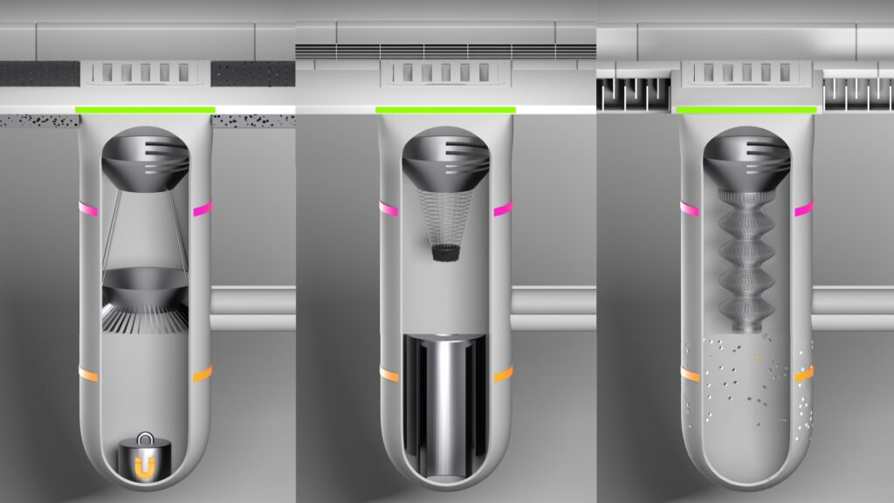
Tire wear collection technology
The Tire Collective
EcoSense
El Gaggini et al., JEM, 2024
Urbanfilter

Slide 5
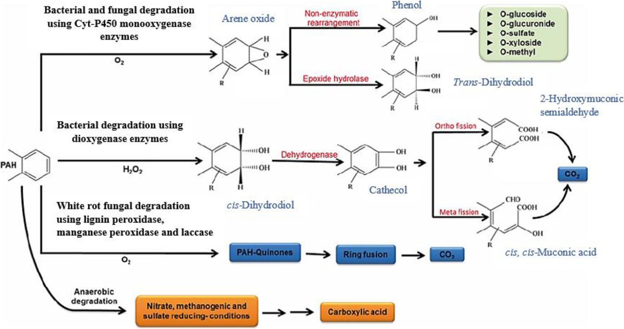
Chemical and bioremediation methods
Waste tire pyrolysis oil (WTPO) treatment
Bioremediation using bacteria and fungi
$$H_{2}$$
$NiMo/γ−Al_{2}O_{3}$
WTPO
$NiMo/γ−Al_{2}O_{3}$ removes 66% PAH
S Kingputtapong et al., J. Energy Res., 2022
Ismail et al., WAPLAC, 2022

Slide 6
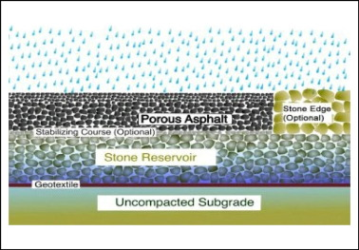
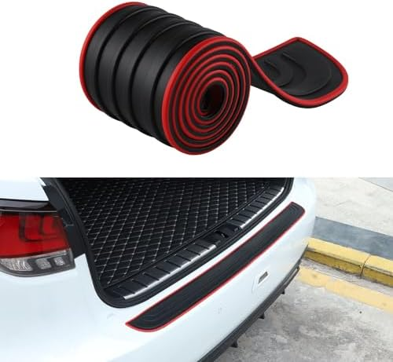
Where are we going from here? – Developing collection methods
Improving road surface design
Improving efficiency
The Tire Collective
Tire debris capture using adhesive attachments

Slide 7
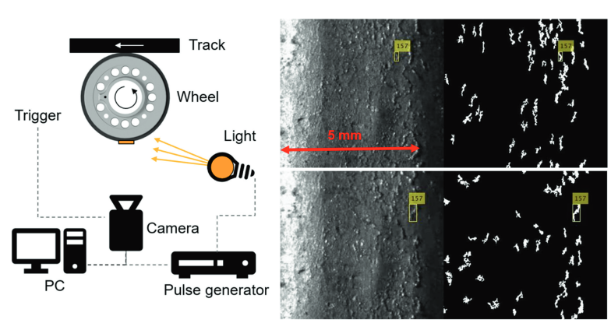
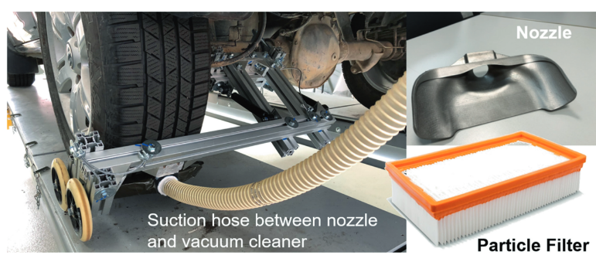
Where are we going from here? – Improving road design
LiDAR to detect tire debris
Integration
El Gaggini et al., JEM, 2024
F. Schmerwitz et al., Munich Chassis Sym., 2022

Slide 8
Where are we going from here?
Research and development
Enhance tire formulation: non-carcinogenic oils, developing biodegradable alternatives
Advanced vehicle design: Specialized instrumentation, improved suspension, Airless tires, Braking system
Developing tire debris collection technology: Like Tire collective
Modeling and Prediction Tools: Developing advanced model to predict tire wear
Improving scalable remediation (Chemical, Biological)
Government and policy maker
Regulatory Measures: Mandatory tire wear monitoring, Establish stricter standards for tire composition
Infrastructure Improvements: Road surface optimization, advanced stormwater management, tire debris collection
Research and Innovation Support: Support studies on eco-friendly tire materials and
tire wear reduction technologies
Economic Incentives: Offer tax breaks for manufacturers, recycling programs with incentives for consumers
Public Awareness and Education

Slide 9
Thank you

