Slide 1
Where Are We Going from Here?
Insights from The Plastics Paradox by Chris DeArmitt
Presented by: Mitchell Peter Date: 12-05-24

Slide 2
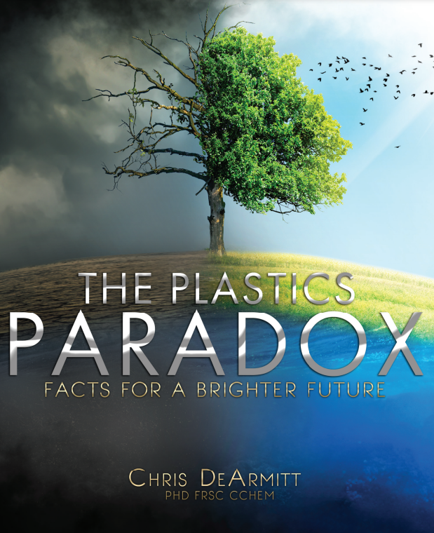
Introduction
Context:
During my co-op, I wrote an article that summarizes Chris DeArmitt's book, The Plastics Paradox, which I believe is highly relevant to this course.
The Plastics Paradox challenges popular views on plastics and their environmental impact.
Purpose:
This presentation clarifies common misconceptions and explains the next steps in addressing global circularity.
Focuses on improving recycling and sustainability.

Slide 3
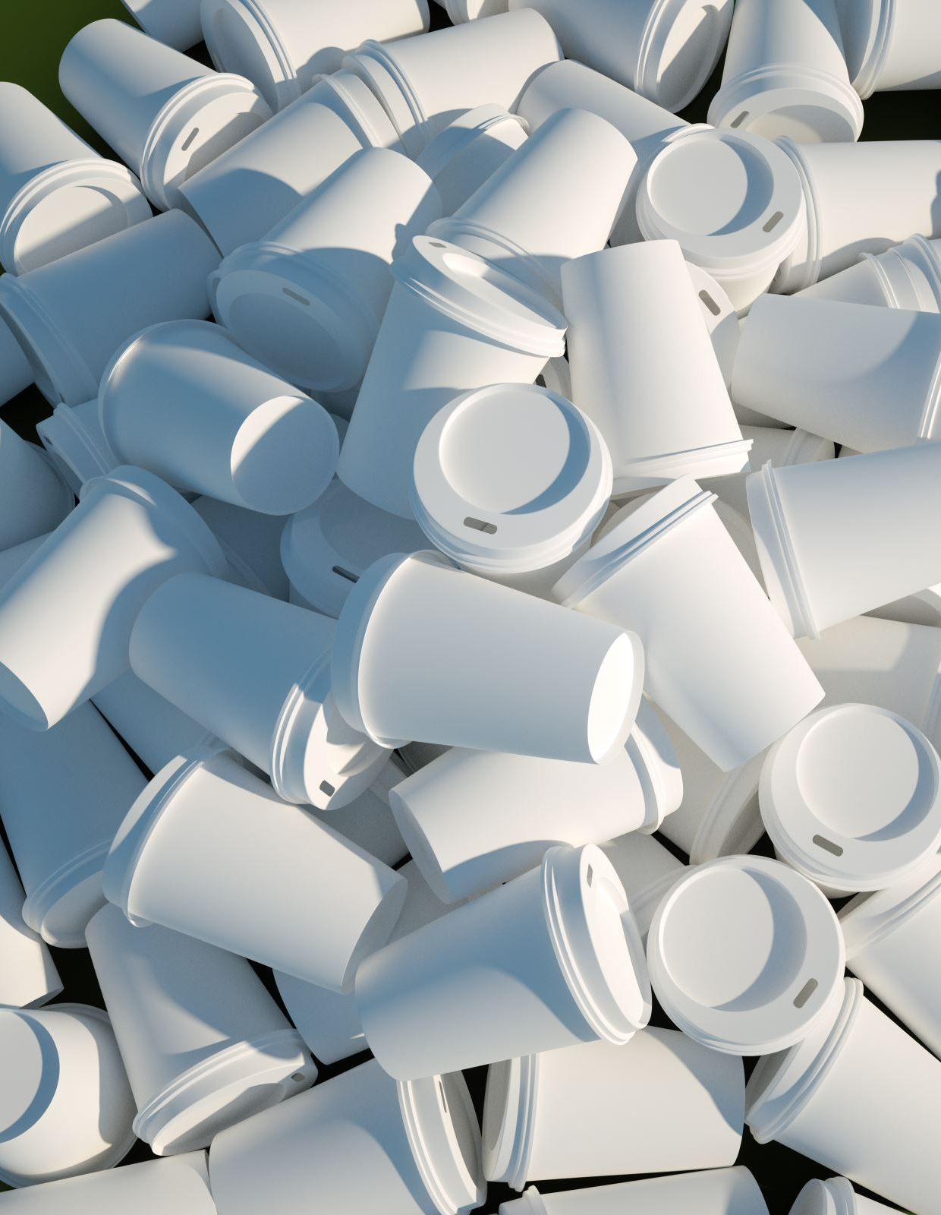
Past: Misconceptions about Plastics
Common beliefs:
Plastics are major contributors to global warming.
Plastics take thousands of years to degrade.
Microplastics pose significant risks.
Alternatives (aluminum, glass, and paper) are better for the environment.
Public Campaigns:
Calls for shifting away from plastics often overlook the full environmental impact and recycling difficulties of alternatives.

Slide 4
Present: The Reality of Plastics
Life Cycle Findings:
Plastics often have a lower carbon footprint than alternatives like aluminum, glass and paper.
Example: Replacing PET with aluminum can double CO₂ emissions.
Misplaced Blame:
The large problem lies more with waste management and consumer practices than plastic production.
Plastic litter is a behavioral issue
Lithuania recycles 75%, proving feasibility

Slide 5
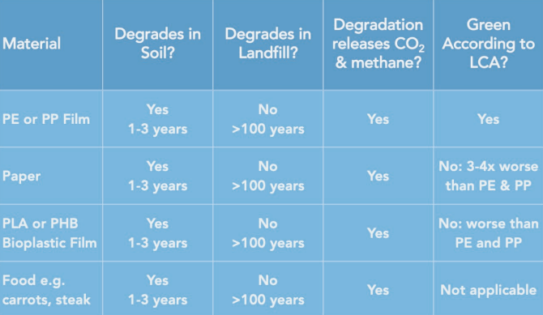
Present: The Reality of Plastics
Microplastics:
Concerns are often based on flawed data or exaggeration.
Some plastics (e.g., polypropylene) are FDA-approved and considered safe.
Degradation:
Plastics degrade at similar rates to other materials.

Slide 6
Future: Producer Responsibility
Simplified Designs: Focus on mono-layer plastics for easier recycling.
Non-toxic Additives: Avoid harmful chemicals that hinder recycling.
Recyclable Plastics: Prioritize fully recyclable materials in production.

Slide 7
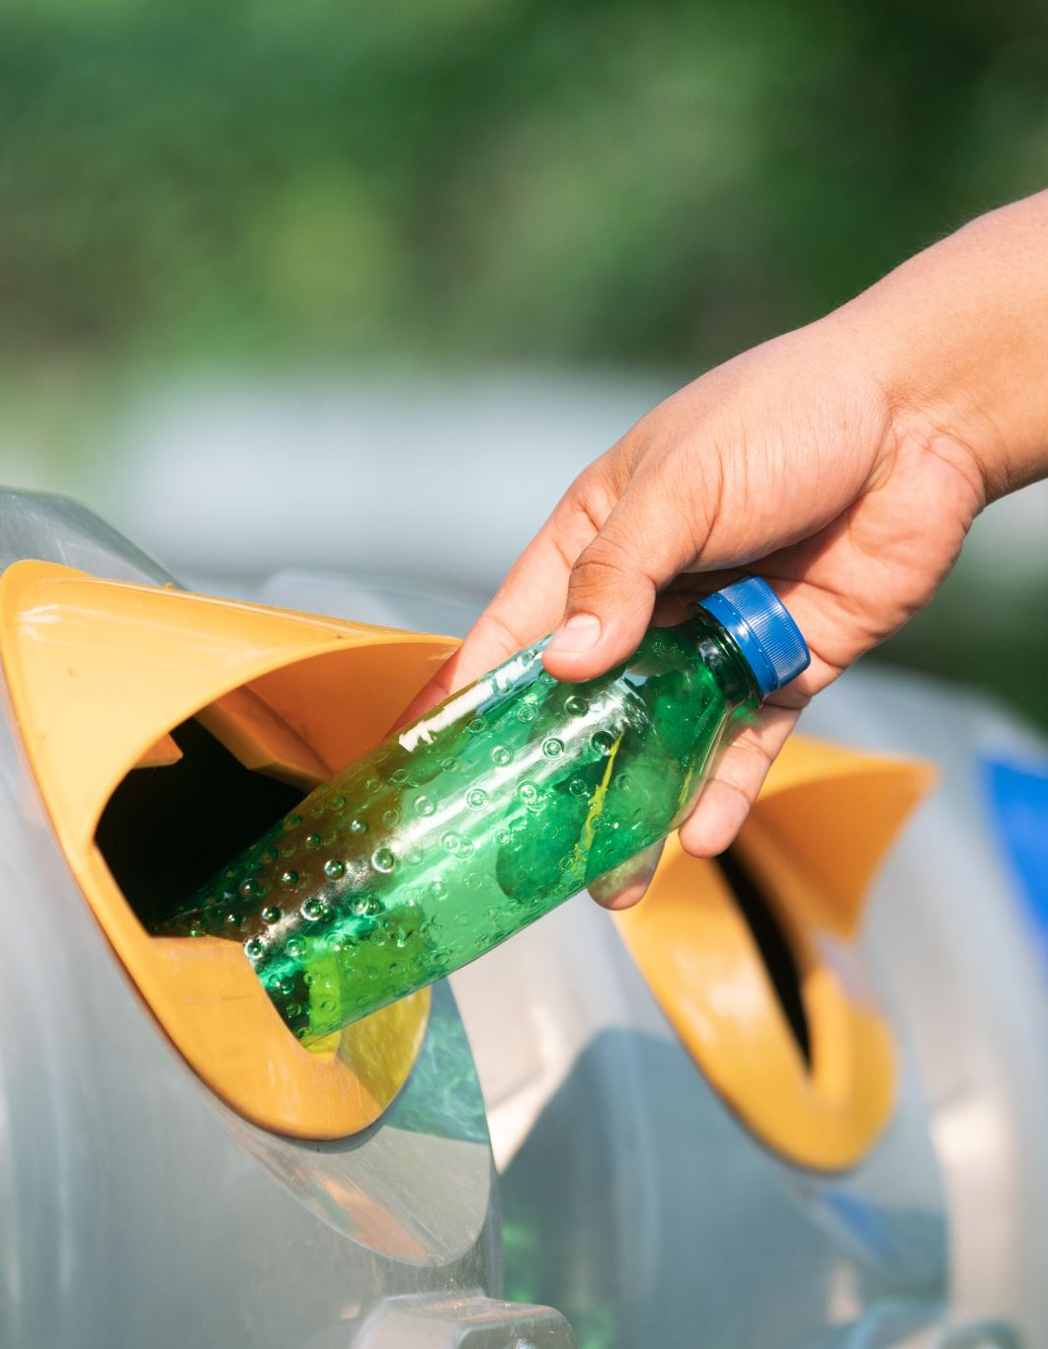
Future: Consumer Action
Reduce Litter: Practice responsible disposal to avoid contamination.
Boost Recycling: Increase participation in recycling programs.
Support Circular Economy: Choose products with recyclable packaging.

Slide 8
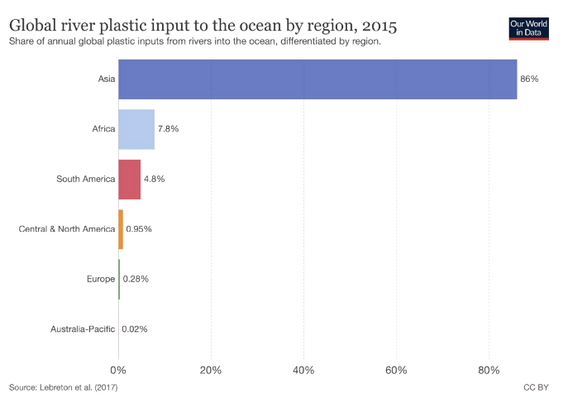
Future: Global Initiatives
Recycling Success: Lithuania achieves 75% recycling rate.
System Coordination: Governments, industries, and consumers must collaborate.
Global Policies: Support for international recycling standards for better global coordination.

Slide 9
References

