Slide 1
Where Do We Go From Here?
Aiden Poe

Slide 2
Where Do I Go From Here?
Recycling was never a focus growing up
My significant other started recycling at home
This class had a subconscious effect on my waste management at home
I will now make a conscious effort when buying, using, and throwing away products

Slide 3
My Recycling Habits Before This Class
I recycled
Paper, Aluminum cans, Plastic bottles
Flexibles went into the garbage
Grocery bags went into store drop offs
Nearest recycle drop off known to me was 20 minutes away and took limited items
This caused infrequent trips and recyclables in the trash

Slide 4
Since Class Has Started, I Have Began…
Reducing single use products by using:
Water Filter, Washable duster, Cheap cleaning rags
Focusing more on cleaning my recycle
Researching the sources from class on better waste management
Looking for closer recycle drop offs
Bringing up waste management concerns to the sustainability team at work

Slide 5
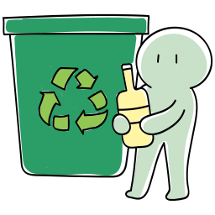
After Class is Over, I Plan to..
Start going to the closer drop off
Set up bi-weekly cadence of going to recycle drop off
Post what can be recycled on bin
Buy a second bin for the Hefty Renew flexibles
Take electronic waste and other larger items to the CRRH or a closer alternative

Slide 6
Why Now?
Throw away items can be valuable to recyclers
Recycle is actually recycled
More people recycle than I had previously thought
Recycling makes a difference

Slide 7
What Else?
I realized how materialistic regular day life can be
I have found that I would like to work in plastics
I want to focus on more sustainable improvements in my own life

