Slide 1
Reducing Plastic Waste in Your Community
Cadence Gulaskey

Slide 2
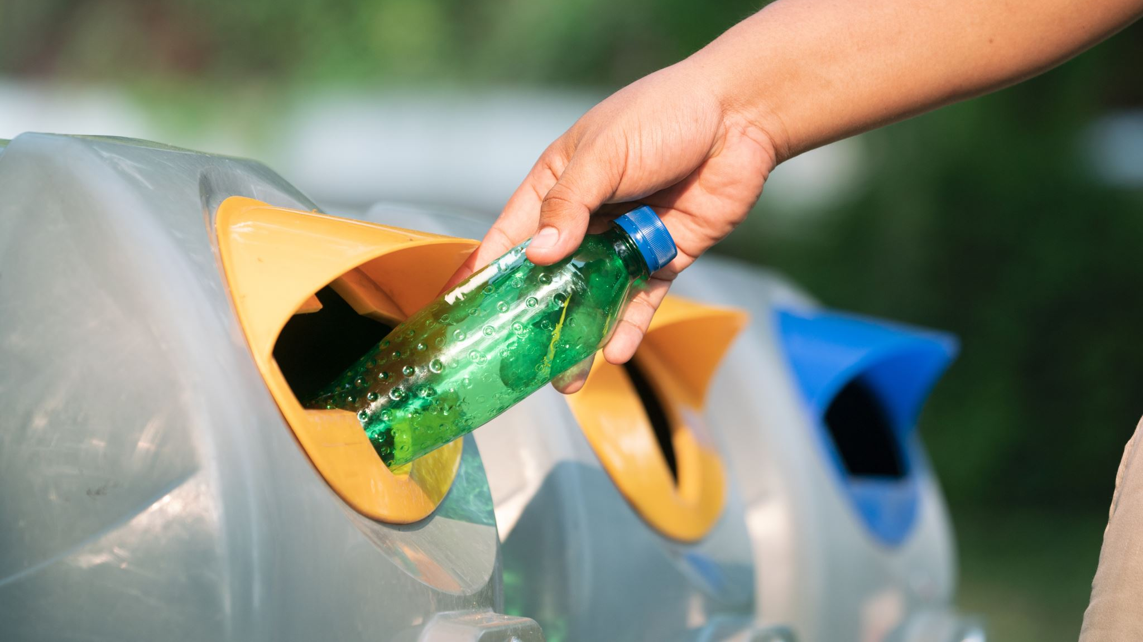
Why is Recycling Participation Important?
United States Recycling rate is 32%
(EPA)
US national recycling goal: increase participation to 50% by 2030
76% of recyclables are lost to trash in homes
(Recycling Partnership)
Company Environmental Sustainability Goals
Advancing Recycling Technology
Most companies aim to reduce environmental harm by advancing circular plastic economy technologies
Advancing recycling technology requires a market need for recycled materials.
Consumer participation is essential to drive progress in recycling efforts.
Notes:
https://recyclingpartnership.org/report-shows-only-21-of-u-s-residential-recyclables-are-captured-points-to-policy-and-investment-as-immediate-solutions/

Slide 3
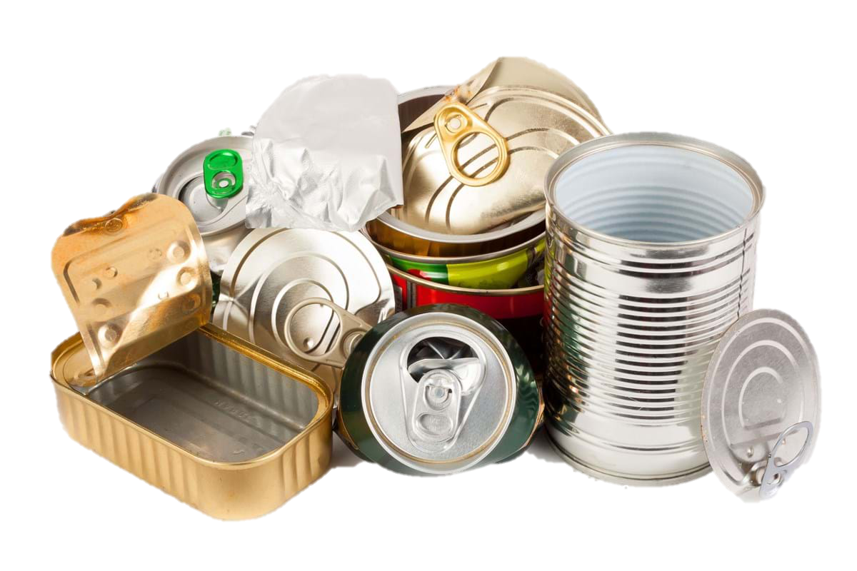
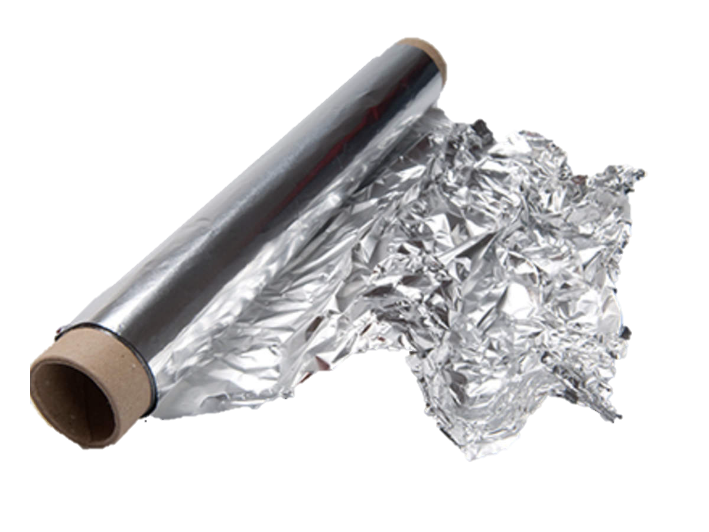
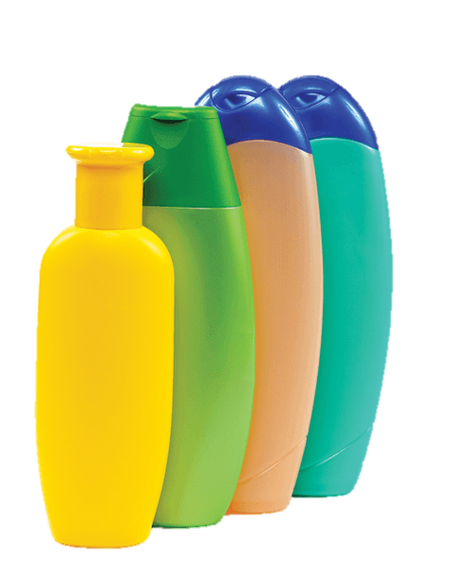
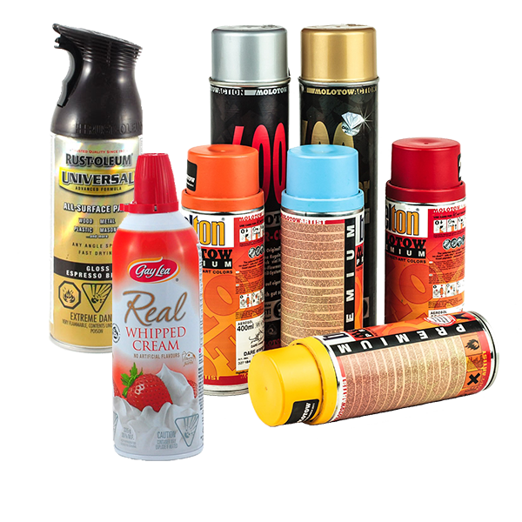
Personal Take-Aways
I have not been doing my fair share of recycling and upcycling my waste
Items to recycle moving forward
Many food cans and containers (if rinsed)
Personal Cleansing Products (remove pumps)
Cleaning supplies bottles (after rinse)
Packaging for products
Aerosols (empty)
Foil
Paper product rolls (no paper)
Notes:
Cleasing items – shampoo, moisturizer, skin care packages. But remove pumps
Cleaning supplies – bleach, bathroom sprays
Many packaging for products – skin care
Aerosols – make sure you are doing it safely and remove cap.
Pharmacy Recycling Program ; https://www.farmacybeauty.com/pages/recycle
https://naparecycling.com/guide/paper-towel-toilet-paper-rolls/
https://www.recyclecoach.com/blog/5-mistakes-to-avoid-when-recycling-aerosol-cans

Slide 4
What is my plan from here?
Increase My Recycling Rates
Educate Friends & Family
Create a Recycling Proposal for my church
Clothing Mindfulness
Notes:
Recycling Rate:
- Continue to educate myself on the products and packages I buy.
- Take my hard-to-recycle items to Cincinnati Reuse and Recycle
- When I buy a home, learn how to compost
Clothing:
- Stop buying Taylor Swift Clothing Merch ☹
- Donate or Sell Old Clothes
- With destroyed items sent into Trashie’s “take back bag” program
Educate Friends & Family:
- Offer to take recyclables
Show people how to sign up for recycling
https://shop.trashie.io/products/take-back-bag?nbt=nb%3Aadwords%3Ag%3A21153733384%3A164355080390%3A694442610372&nb_adtype=&nb_kwd=recycling%20clothes&nb_ti=kwd-314450230307&nb_mi=&nb_pc=&nb_pi=&nb_ppi=&nb_placement=&nb_li_ms=&nb_lp_ms=&nb_fii=&nb_ap=&nb_mt=e&gad_source=1&gclid=Cj0KCQiAr7C6BhDRARIsAOUKifjRDnuH-yNddJjsXiaNi2YH1SCwDTO9CchqJTHPdMc96J614jrBd2gaAnF1EALw_wcB

Slide 5
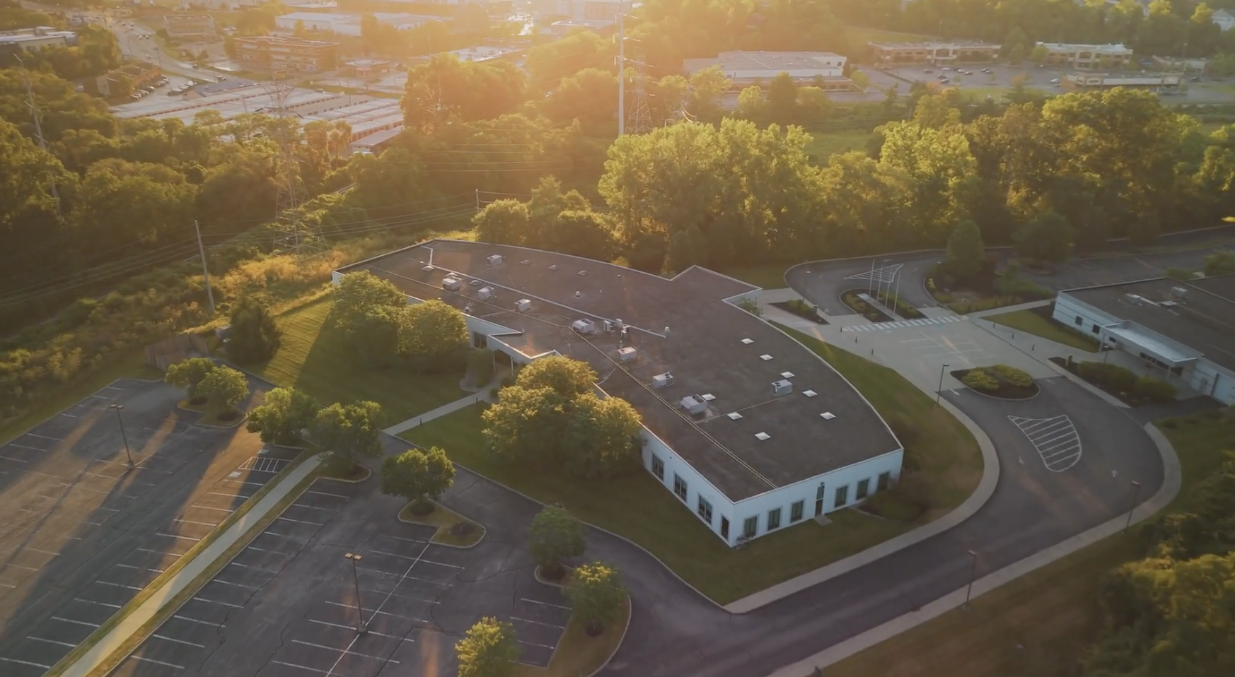
Recycling Sundays
In Spring 2025, Queen City Church will get a full-time location and will have the ability to set up a recycling program
Dream Team Recycling Group
Recycling through Rumpke Cost Breakdown
Recycling Dumpster 1-time fee $120
EOW service monthly costs $101
Notes:
Destiny.Patterson@rumpke.com

Slide 6
Why church communities should recycle
63% of all multifamily homes are excluded from recycling
Stewardship of Creation
Community Engagement
Leadership by Example
Environmental Impact
Connection and Outreach
Practical Benefits
Positive Public Perception
25% of single-family homes don’t have recycling access
(recycling partnership)
Notes:
Destiny.Patterson@rumpke.com
Psalm 89:11

Slide 7
Environmental Impact
Waste Reduction
Energy Conservation
Protecting the Earth
^{8 “}Ask the former generation and find out what their ancestors learned, ⁹for we were born only yesterday and know nothing, and our days on earth are but a shadow. ¹⁰Will they not instruct you and tell you? Will they not bring forth words from their understanding? ¹¹Can papyrus grow tall where there is no marsh? Can reeds thrive without water? (Job 8: 8-11 NIV)
Notes:
Reduction: Recycling helps divert waste from landfills, conserving natural resources and reducing pollution.
Conservation: Recycling often requires less energy than producing new materials, which helps combat climate change.

Slide 8
Positive Public Perception
Improved Image
Attracting New Members
¹³Now listen, you who say, “Today or tomorrow we will go to this or that city, spend a year there, carry on business and make money.” ¹⁴Why, you do not even know what will happen tomorrow. What is your life? You are a mist that appears for a little while and then vanishes. ¹⁵Instead, you ought to say, “If it is the Lord’s will, we will live and do this or that.” ¹⁶As it is, you boast in your arrogant schemes. All such boasting is evil. ¹⁷If anyone, then, knows the good they ought to do and doesn’t do it, it is a sin for them. (James 4:13-17 NIV)
Notes:
Image: The program can enhance the church's reputation as a socially responsible organization that cares about the environment and its community.

Slide 9
Leadership by Example
Building a Legacy
Inspiring Others
⁹Let us not become weary in doing good, for at the proper time we will reap a harvest if we do not give up (Galatians 6:9 NIV)
Notes:
Building a Legacy: Establishing a recycling program creates a lasting impact that extends beyond the church’s walls.
Inspiring Others: By taking proactive steps to care for the environment, your church can serve as a role model for other organizations and faith communities, inspiring them to adopt similar initiatives.

Slide 10
Community Engagement
Service to the Community
Educational Opportunity
Strengthening Relationships
Outreach Potential
³Do nothing out of self ambition or vain conceit. Rather, in humility value others above yourselves, ⁴not looking to your own interests but each of you to the interests of the others (Philippians 2:3-4 NIV)
Notes:
Service: A recycling drop-off center can serve as a valuable resource for the community, especially in areas where recycling services are limited or inaccessible.
Education: It provides an avenue to educate congregants and neighbors about environmental issues and sustainable practices, encouraging broader participation.
Make service an ascpect of your whole life. Humility is thinking of others more than yourself.

Slide 11
Stewardship of Creation
Faith-Based Responsibility
⁹ I tell you, use worldly wealth to gain friends for yourselves, so that when it is gone, you will be welcomed into eternal dwellings. ¹⁰“Whoever can be trusted with very little can also be trusted with much, and whoever is dishonest with very little will also be dishonest with much. ¹¹ So if you have not be trustworthy in handling worldly wealth, who will trust you with true riches? ¹² And if you have not been trustworthy with someone else’s property, who will give you property of your own? (Luke 16:9-12 NIV)
Notes:
Many faith traditions emphasize caring for God's creation. A recycling program aligns with this mission by promoting sustainability and reducing waste, demo

Slide 12
How can you impact your communities?

Slide 13
Questions?

Slide 14
My message for the class
Find where you can make a difference

Slide 15
Practical Benefits
Cost Savings
Fundraising Potential
Notes:
Cost Savings: Recycling can reduce trash disposal costs for the church and participating households.
Fundraising Potential: Some recycling programs (e.g., aluminum can or bottle returns) can generate funds that support other church activities or missions.

Slide 16
Community Connection and Outreach
Strengthening Relationships
Outreach Potential
Notes:
Relationships: A program like this fosters connections among members of the congregation as they work together on a shared mission.
Outreach: Offering a recycling drop-off can draw people from the broader community to the church, opening doors for dialogue and potential ministry opportunities.

Slide 17
BackUp/Old Slides

Slide 18
Why is Recycling Participation Important?
The United States Recycling rate is 32% (EPA)
The US national recycling goal is to increase participation to 50% by 2023
76% of recyclables are lost to trash in homes (Recycling Partnership)
Based on our in-class discussions
(Most) Companies want to reduce their environmental harm and are working to increase technologies that support a circular plastic economy
For companies to continue advancing recycling technology, there must be two things: 1. a need for the material on the market and 2. consumer participation.
Notes:
https://recyclingpartnership.org/report-shows-only-21-of-u-s-residential-recyclables-are-captured-points-to-policy-and-investment-as-immediate-solutions/

Slide 19
Personal Take-Aways
I have not been doing my fair share of recycling and upcycling my belongings
Items can be recycled than what I knew
Many food cans/containers (if rinsed)
Cleansing items bottles (shampoo, moisturizer, etc.) but remove pumps
Cleaning supplies like bleach bottles after rinse
Packaging for projects like skincare, make-up, etc
Aerosols (when empty and plastic caps removed)
Foil
Paper towels and toilet paper rolls (flattened)

