Slide 1
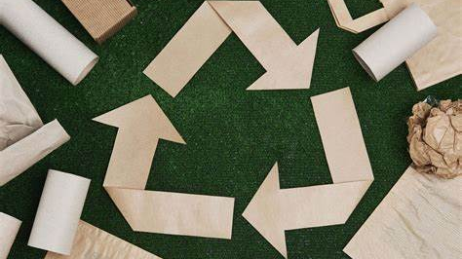
Past, Present, and Promising Future of the Paper Industry
Austin Menze
Plastics in Circular Economy 2024

Slide 2
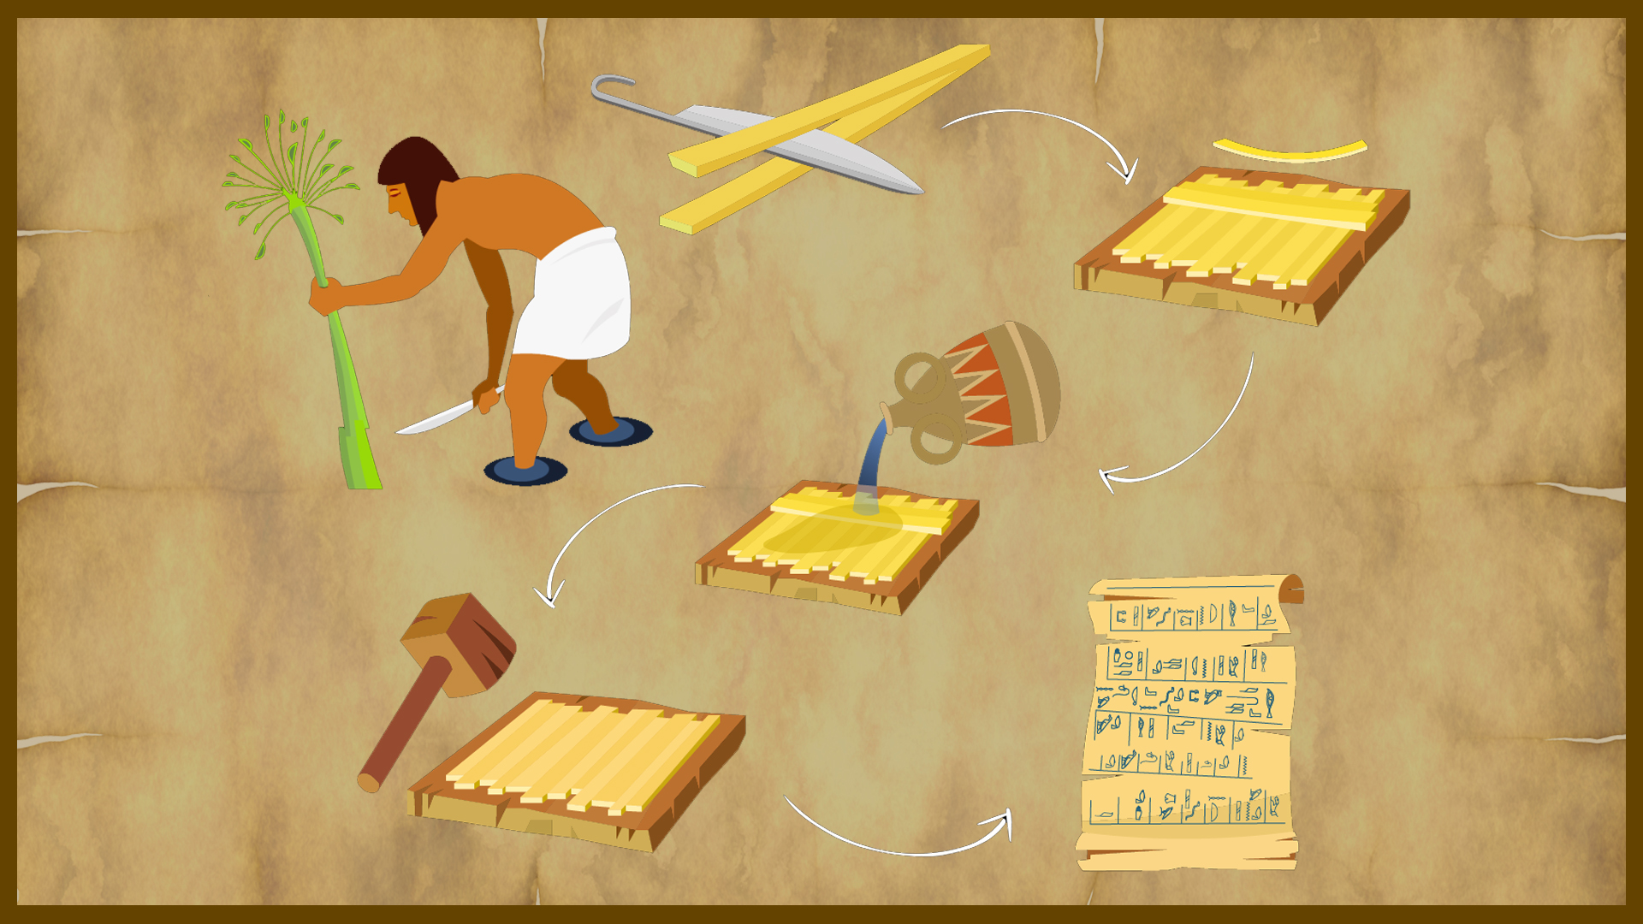
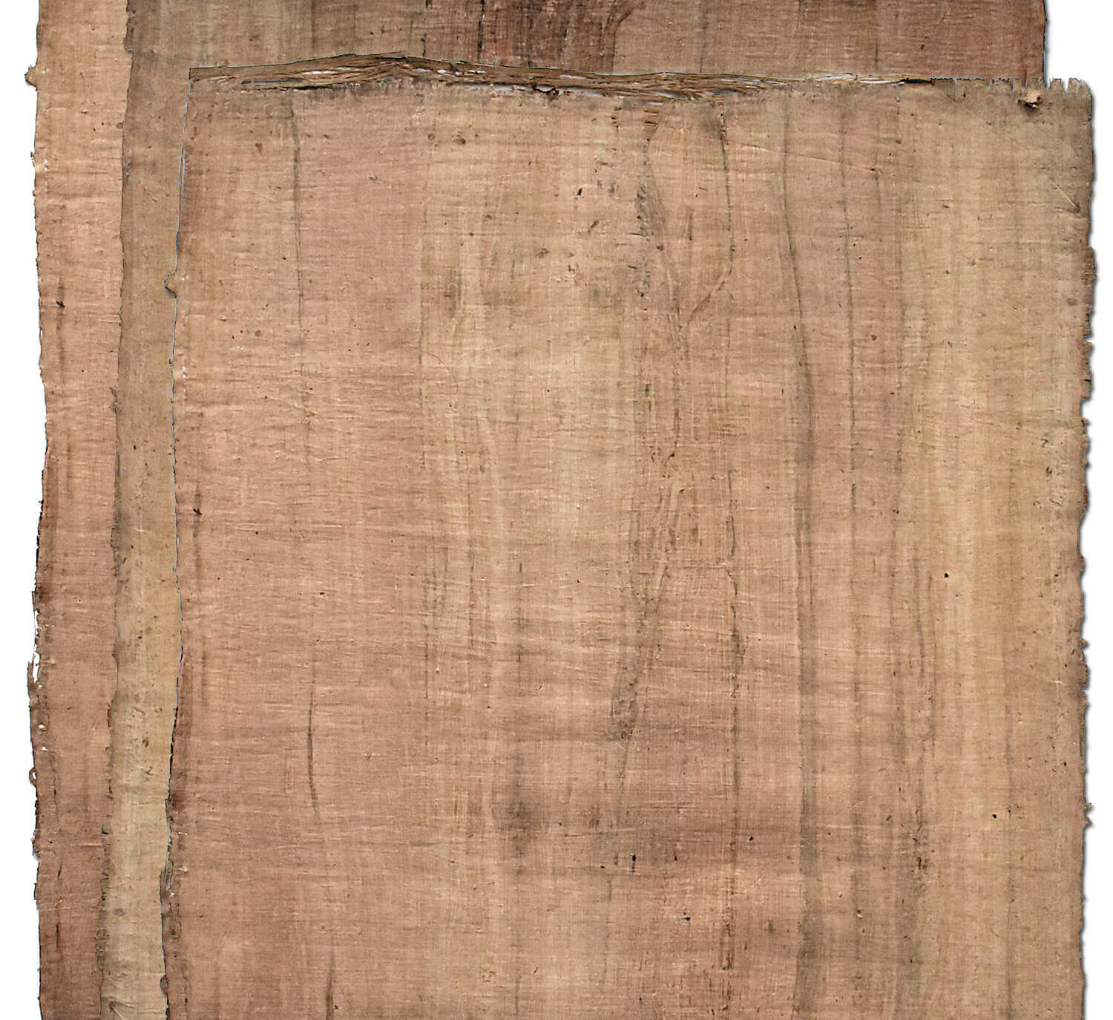
Origins of Paper
Papermaking can be traced to about ad 105, when Ts’ai Lun, an official attached to the Imperial court of China, created a sheet of paper using mulberry and other bast fibers along with fishnets, old rags, and hemp waste.
By the 14th century, a number of paper mills existed in Europe, and through the 18th century the papermaking process remained essentially unchanged, using linen and cotton rags as base materials.
Around the turn of the 19th century, it was found that wood pulp and other vegetable pulps were effective for making paper and were in much higher supply than the cotton rags and linens used previously.
In the beginning, these papermaking processes were extremely slow and labor-intensive with each sheet of paper being made individually and non-continuously.

Slide 3
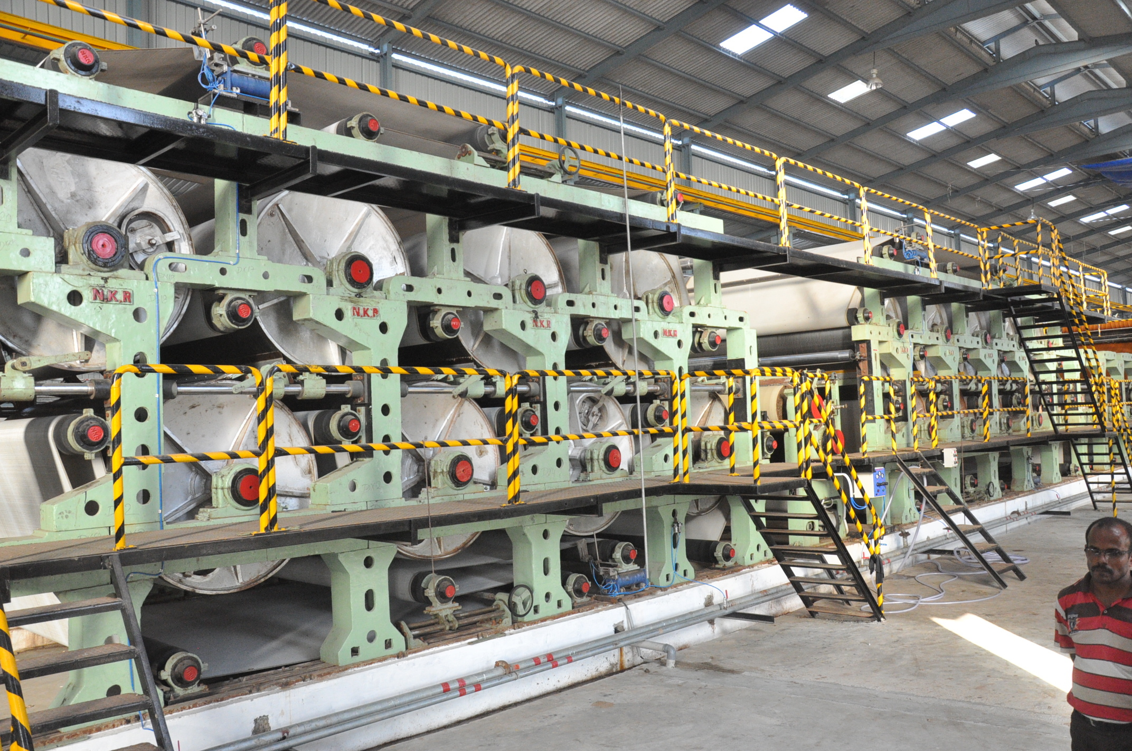
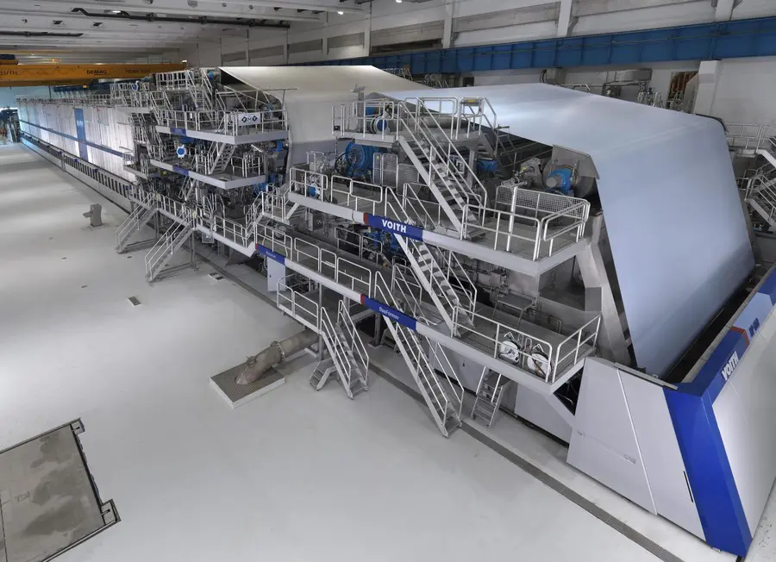
Present Paper Process
z
The modern papermaking process begins with harvesting a variety of trees like pine, spruce, fir, oak, birch, etc.
The bark from these trees is chipped into small pieces and then boiled into a pulp. This pulp can vary greatly depending on the expected final product.
This pulp is then suspended in water, filtered, and layered onto a woven screen to be flattened and dried.
Different grades of paper, varying by thickness, opacity, brightness, require different chemical additives and adjustments to the process as well.

Slide 4
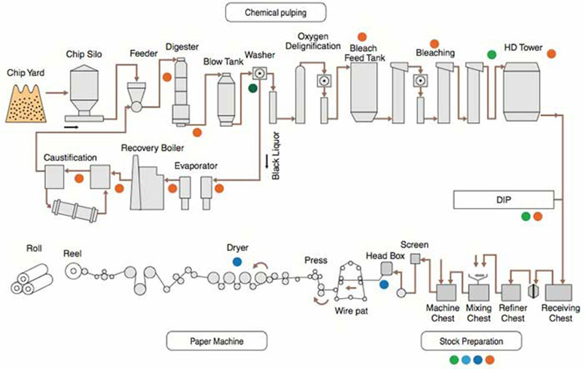
Improvements from Past
As mentioned, the earliest methods were extremely slow and required copious amounts of hard work.
Modern papermaking is largely automated, with the main machine running continuously and churning out up to 3,900 feet per minute of paper!
Nearly all the initial preparation of the pulp prior to entering the machine is also automated and carefully controlled, limiting much of the prior hazards to personnel.

Slide 5
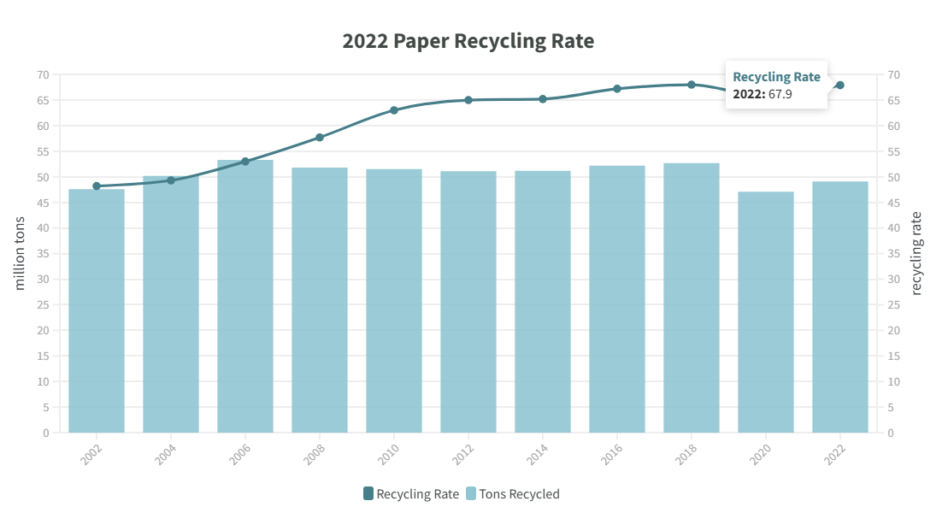
Additional Improvements
The papermaking industry also made large strides in using recycled paper to supplement and supplant the use of wood chips.
The paper industry boasts a recycling rate of 67.9% totaling to nearly 50 million tons.
These recycling plants also don’t use any of the harsh chemicals found in the white and black liquors used in virgin plants

Slide 6
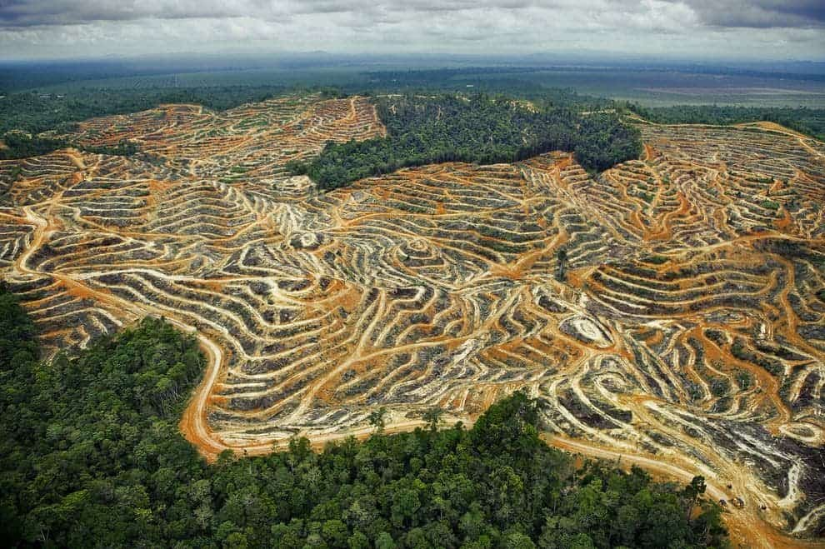
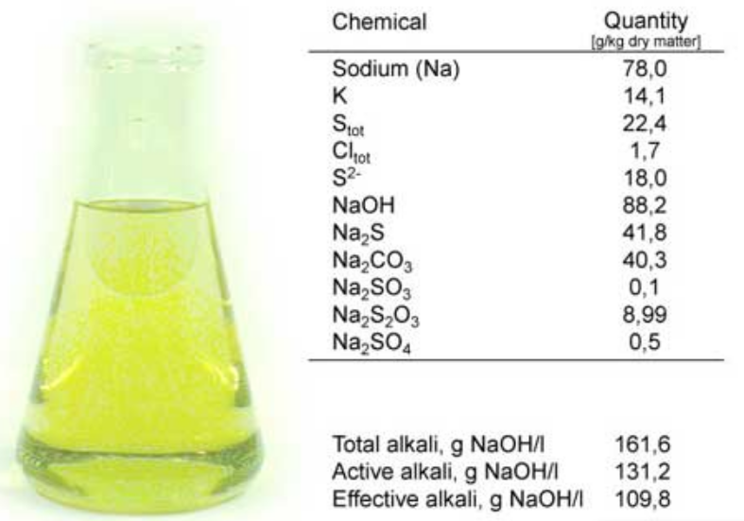
Overlying Issues
Despite the large recycling rate, and improvements made to the process over the centuries, the papermaking process still has some glaring issues.
The largest issue facing paper plants is reducing their pollution. The wastewater from papermaking has been noted to cause extreme disruption to ecosystems.
In addition to the disruption from wastewater, the wood chips needed to create paper lead to deforestation, energy consumption, and greenhouse gas emission.
While recycled material greatly helps the paper industry, a large problem with it is supplier integrity and consistency.

Slide 7
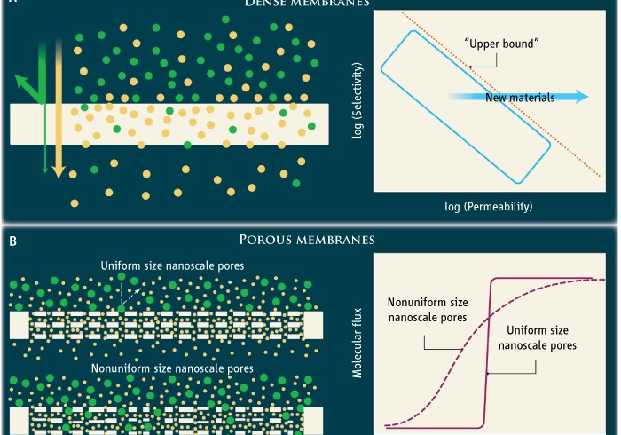
Moving Forward
There are already a few methods being investigated/ used in the industry to help reduce the amount of harmful pollutants in wastewater.
A method that is new to the industry is membrane usage, which is what I believe is the best path. Membranes are extremely versatile and can be used to remove various pollutants.

Slide 8
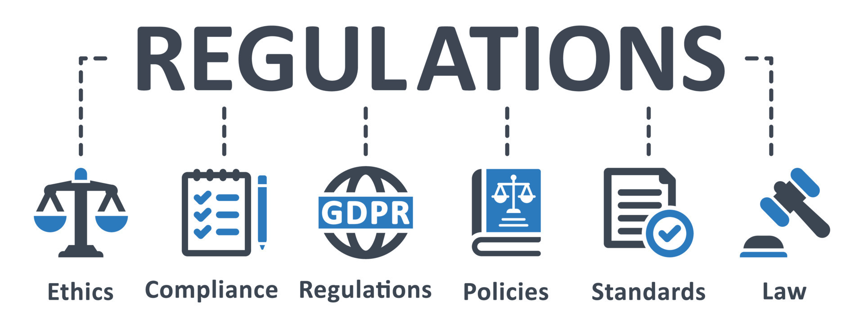
Moving Forward
Another key improvement that needs to be made is regulation/ accountability of suppliers.
Suppliers of recycled paper should be held accountable further than basic contracts and trust between corporations.
A good example is how the FDA has say in farmer’s goods along with the supermarket holding them accountable for quality goods.

