Slide 1
Lignin: A Paper Industry Byproduct with Circularity Potential
Date: December 5, 2024
By: Andrew Perry

Slide 2
Outline
What is Lignin?
Paper Pulp Making Process Overview
What Currently Happens to the Lignin Byproduct?
Circular Alternatives
Aromatic Feedstock Uses
Conclusion

Slide 3
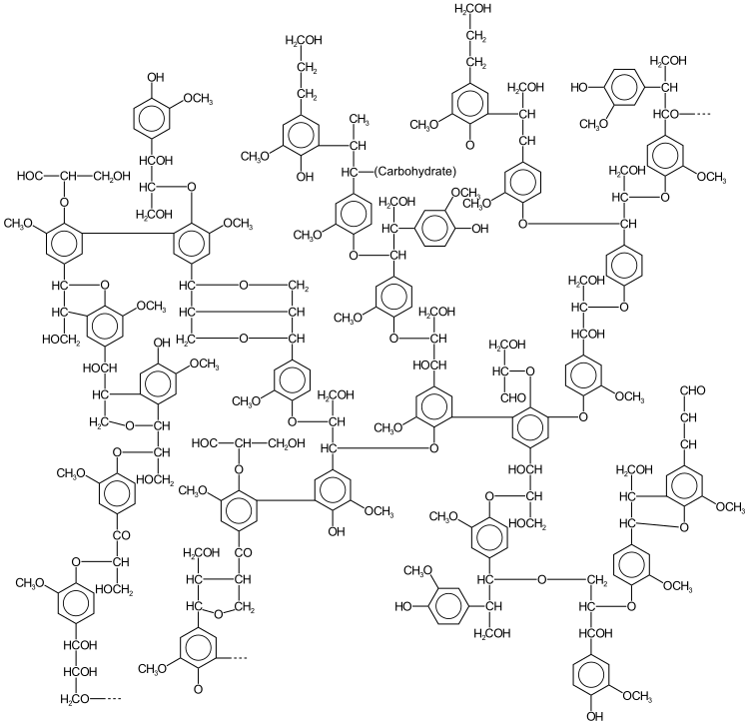
What is Lignin?
Irregular crosslinked aromatic polymer found in plant cell walls, especially in wood
Primarily composed of p-coumaryl alcohol, coniferyl alcohol, and sinapyl alcohol
Lignin is found alongside sugar polymers:
Cellulose
Hemicellulose
Composes 18-35% of wood
Provides strength, acts as glue
Figure 1, Sample Lignin Structure

Slide 4
Paper Pulp Making Process
Step 1: Debarking and chipping of logs
Step 2: Digester (High temperature cooking)
Sodium Hydroxide added to breakdown and dissolve lignin
Step 3: Pulp Washing
Pulp washed with water to remove the dissolved lignin
Step 4: Screening
Step 5: Bleaching (White paper only)
Bleach added to remove residual lignin making the pulp white
Why is the lignin removed?
Chemical Instability:
Lignin breaks down when exposed to air and sunlight causing paper to become to brittle over time
Inflexibility:
Lignin is rigid unlike cellulose
Reduces strength and durability of paper
Paper more susceptible to crack
Dark color:
Gives cardboard its brown color
Must be 100% removed for white paper applications

Slide 5
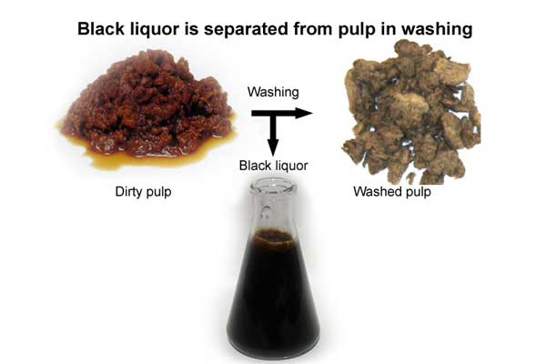
What Happens to the Lignin?
The digester waste is commonly referred to as black liquor
The black liquor is rich in lignin but also contains water, sodium hydroxide, and hemicellulose
An evaporator removes the most the water in the black liquor
The concentrated black liquor is then burned in a boiler to generate steam
This lowers natural gas usage
Sodium hydroxide can be recovered from the ash
Figure 2, Pulp washing step, before and after

Slide 6
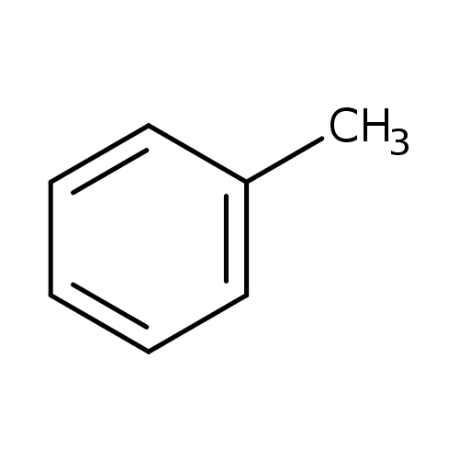
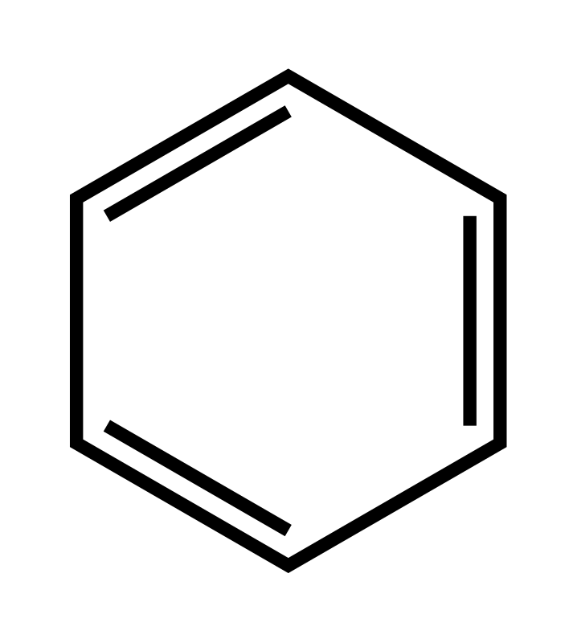
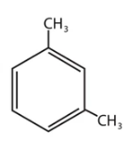
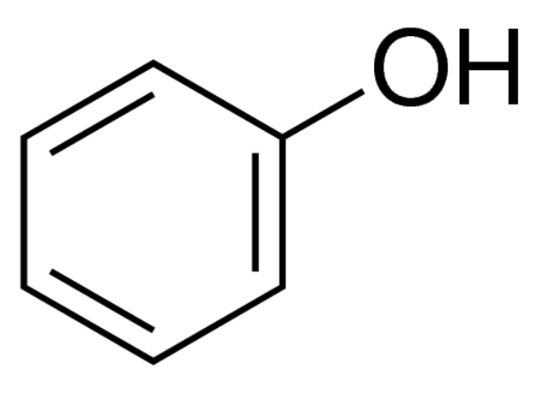
Circular Alternatives
Lignin can be used to make aromatic compounds
Ex. Benzene, Toluene, Xylene, Phenol
Currently nearly all aromatic compounds produced are derived from nonrenewable oil
Lignin one of few biomolecules rich in aromatic compounds
None as a convenient byproduct
Pyrolysis is one method to depolymerization lignin into aromatic monomers
Figure 3, Benzene Structure
Figure 4, Toluene Structure
Figure 5, Xylene Structure
Figure 6, Phenol Structure

Slide 7
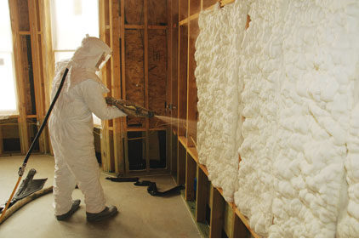
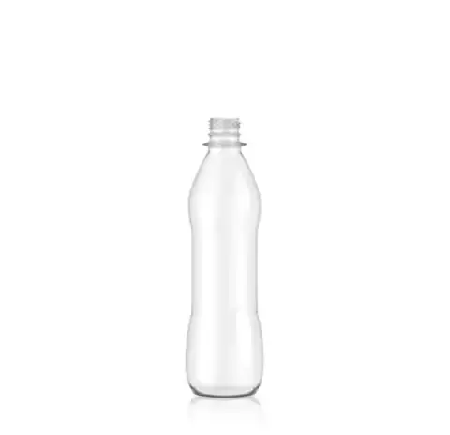
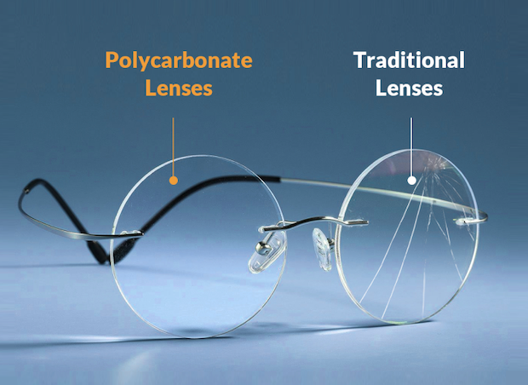
Aromatic Feedstock Uses
Benzene:
Precursor of styrene (polystyrene)
Precursor of adipic acid, an intermediate to nylon
Toluene:
Precursor of toluene diisocyanate used in polyurethane
Common paint/adhesive solvent
Xylene:
Precursor of terephthalic acid used in PET
Phenol:
Precursor of bisphenol-A used to make polycarbonate and resins
Figure 7, Polystyrene Foam Cup
Figure 8, Polyurethane Foam
Figure 9, PET Bottle
Figure 9, Polycarbonate Lense

Slide 8
Conclusion
Lignin is an irregular aromatic biopolymer found in the cell walls of plants
One of few aromatic biomolecules
It must be removed in the paper making process
The byproduct lignin is currently primarily only burned to generate steam
Can alternatively be utilized to make aromatic compounds
Aromatic feedstocks are currently manufactured using nonrenewable oil
These aromatic products can be used to make a variety of biobased polymers such as polystyrene, PET, nylon, polyurethane, and polycarbonate
Lignin, currently just an underutilized byproduct, is the key to circular production of crucial aromatic feedstocks used in countless plastics and final products

Slide 9
References
https://research.fs.usda.gov/treesearch/60379#:~:text=Abstract,the%20general%20phenylpropanoid%20biosynthetic%20pathway.
https://research.fs.usda.gov/treesearch/42245#:~:text=The%20major%20chemical%20component%20of,lignin%20(18%2D35%25).
https://paperpulpingmachine.com/introduction-to-liquor-of-paper-pulping/
https://biotechnologyforbiofuels.biomedcentral.com/articles/10.1186/s13068-022-02203-0
https://www.payneglasses.com/eyeglasses/polycarbonate-lenses.html
https://www.wconline.com/articles/89352-spray-polyurethane-foam-a-candid-look

