Slide 1
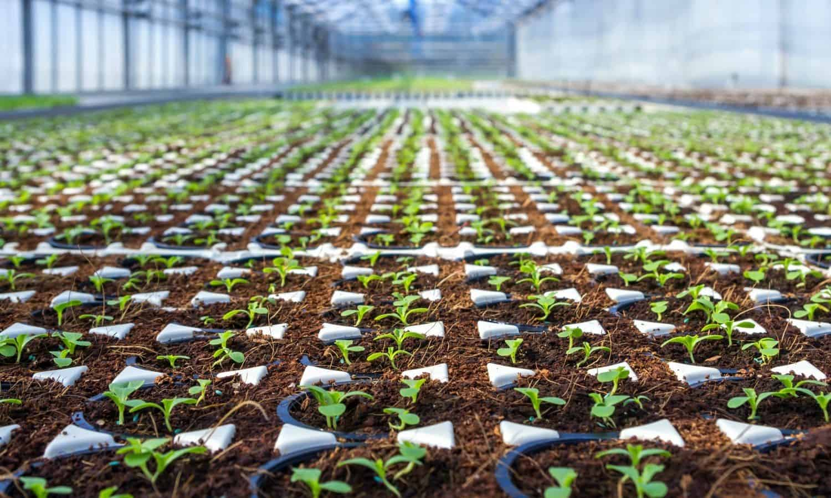
Microplastics iN Agriculture
Amy Herfel

Slide 2
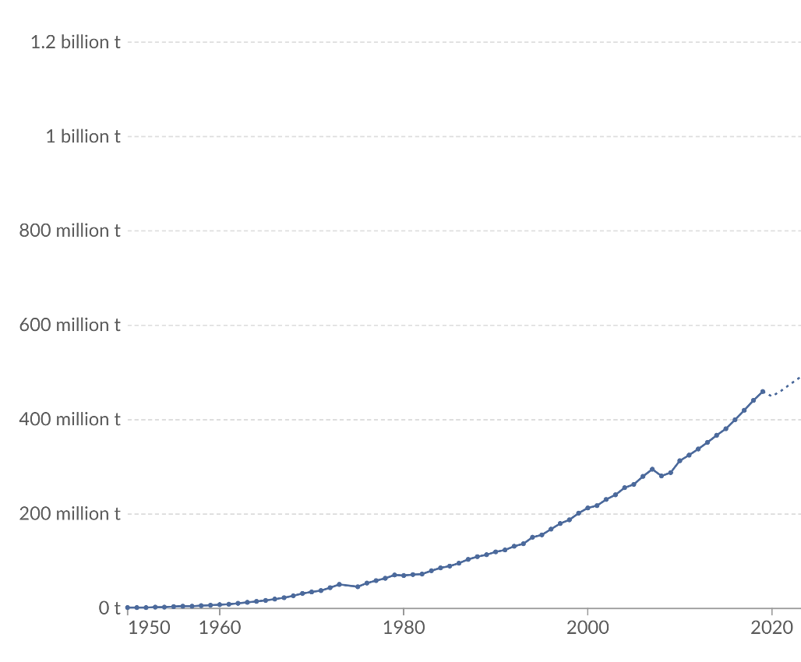
History of Plastics
Microplastics in the agriculture industry is a relatively new problem
First fully synthetic plastic called Bakelite was created in created in 1907 by Leo Baekeland.
Plastics Industry boomed in WWII due to wartime efforts.
Notes:
https://www.sciencehistory.org/education/classroom-activities/role-playing-games/case-of-plastics/history-and-future-of-plastics/#:~:text=In%201907%20Leo%20Baekeland%20invented,no%20molecules%20found%20in%20nature.

Slide 3
Microplastics
Despite widespread use of plastic, Microplastics were only discovered in 2004.
Professor Richard Thompson and his team were the first to show that microplastics have accumulated in oceans since the 1960s.
Microplastics in human blood for the first time in 2022 (scientists found particles in almost 80% of test subjects)

Slide 4
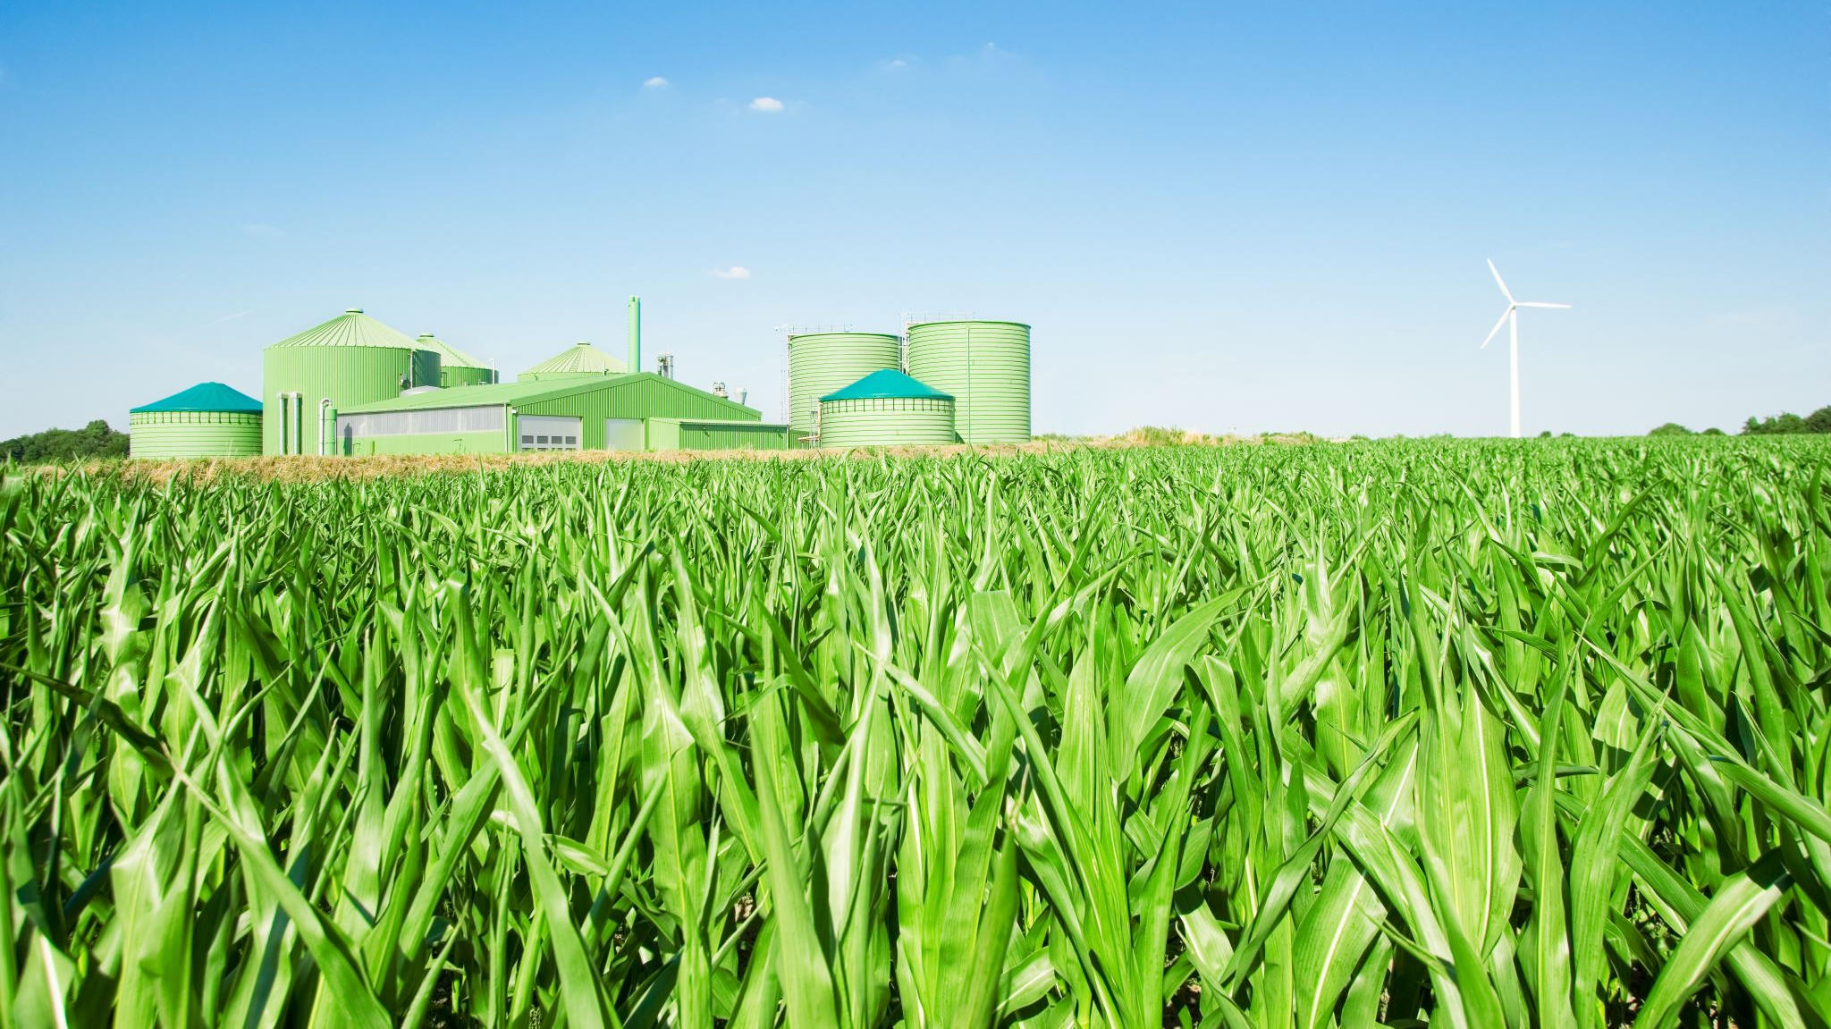
Use in Agriculture
The agricultural sector is one of the biggest users of intentionally added micro plastics
Plastic is used to coat pesticides and fertilizers which serves as a controlled release function
The market for microencapsulated pesticides is expected to reach $817 million by 2025, signifying an 11% growth since 2018
Notes:
https://resolutions.unep.org/resolutions/uploads/sowing_a_plastic_planet_-_how_microplastics_in_agrochemicals_are_affecting_our_soils_our_food_and_our_future_ciel.pdf_0.pdf

Slide 5
Impact
Synthetic polymer materials do not degrade well. Instead, they accumulate in the soil over time
Microplastics can penetrate edible fruits and vegetables and then can enter the food chain.
Linked to serious health issues including endocrine disruption, decreased reproductive health, and cancer.
Notes:
https://www.undp.org/kosovo/blog/microplastics-human-health-how-much-do-they-harm-us

Slide 6
Possible Solutions
Slow-release pesticides and fertilizers are a beneficial technology.
One solution to preserve the function but reduce harm is to used biodegradable bioplastics.
These bioplastics could be derived form corn-starch or other plant-based materials which will break down in soil, preventing accumulation.

Slide 7
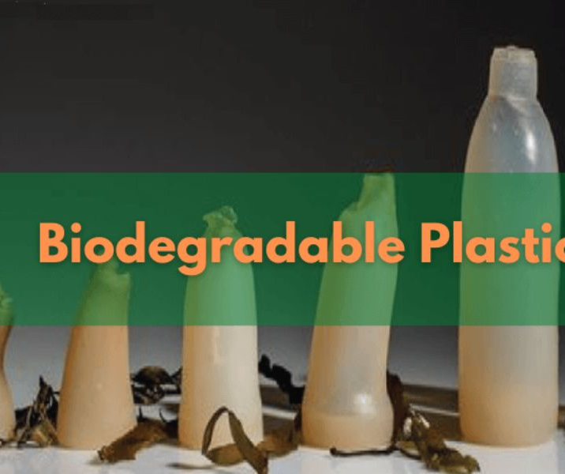
Regulation
To promote the move to biodegradable plastic regulations is likely need.
The Food and Agriculture administration of the United Nations recommended banning non-biodegradable polymer-coated fertilizer, seed coatings, and pesticides in their 2021 report.
In the US regulation such as this would affect states with more farms such as Texas , Missouri, and Iowa.

Slide 8
In the Mean Time…
While legislation is slow, here are other actions that can improve this issue…
Require Companies to disclose the amount of microplastics they are using in their products.
More research needs to be performed. Currently, severely lacking data in this area.

Slide 9
Wrap Up
What Existed in the past?
Microplastic have likely been around since the widespread use of plastic, but their effects were no always studied.
How has that situation improved?
Unfortunately, this situation hasn’t yet improved. Currently, unless addressed by legislation this problem is predicted to become worse.
What are the scenarios for the future and what will need to occur to reach each potential outcome, particularly outcomes with an improved circularity?
Biodegradable seed coatings
Regulation
Research and disclosure

