Slide 1
Marine Plastic Pollution in the Circular Economy
Where Did We Come From? Where Do We Go?
Garret Harrison
December 5th 2024

Slide 2
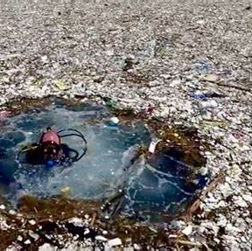
The Problem with Plastics
Increasing plastic consumption with no concern for end-of-life
Ineffective management of waste
Most waste that gets into water will end up in the ocean eventually
Outsourcing plastic waste to Southeast Asia where the situation is even worse
Fishing waste – nets, etc.
Marine life entanglement, ingestion, suffocation
Microplastics accumulation

Slide 3
Enter: The Circular Economy
Policy Measures
Bans/Reductions on single use plastics
Improved waste management
International Agreements (e.g. EU Plastic Strategy)
Basic Circular Principles
Increased recyclability/reusability
Bioplastics and biodegradable materials
Public Awareness & Initiatives
Increased public participation and demand

Slide 4
Breakthrough Innovations
Closed-Loop Recycling
Plastics which are able to be fully recycled, with no waste being generated, keeping it out of the oceans
Biodegradable Plastics
If it does end up in the ocean, it will not be there for long
Advanced Sorting
AI and robotics reduce contamination of plastic materials, allowing more of them to be recycled rather than end up as waste
Alternatives
Use of materials which are not plastic and do not linger in the oceans forever

Slide 5
Removal of Current Plastics
Ocean Cleanup
Passive Systems to collect plastics in one place (floating barriers)
Skimmers (ships with nets)
Drone or underwater robot development
Microplastic Removal
Filtration systems
Magnetic polymers
Biodegradation
Development of special enzymes or microorganisms which can break down plastic waste. Combine with others

Slide 6
How Do We Get There?
Investment in Infrastrcture
Particularly in developing countries where most plastic is mishandled
Globally Coordinated Regulation
Public Sector Collaboration
Incentives for companies to improve supply chain transparency, reduce plastic use and implement circular practices
Consumer Engagement
Public education
Supporting circular-focused companies and products

Slide 7
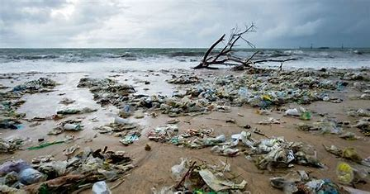
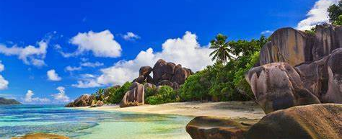
A Vision of the Future
With circular practices become more widespread, we have the potential to shape the future of our ocean ecosystems.
A global commitment is needed – press for action from governments, industries and fellow consumers
Cleaner oceans, healthier ecosystems and animals, and a more sustainable future are on the horizon if we act
Which do you Prefer?

