Slide 1
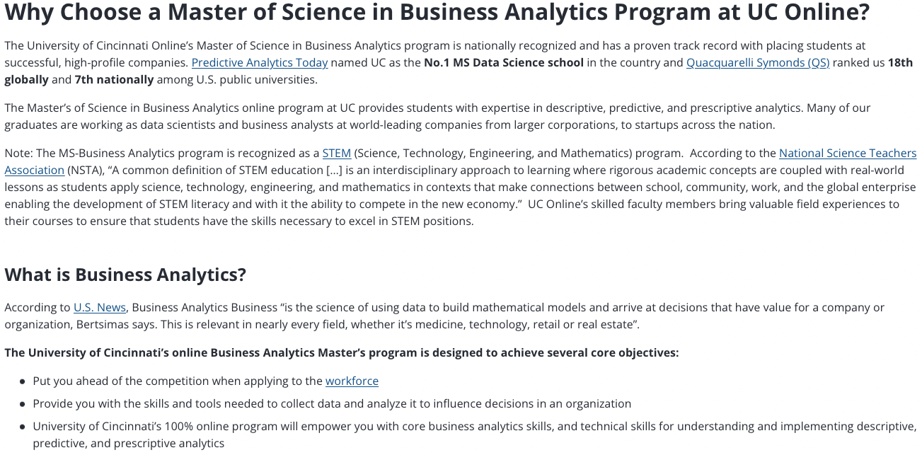
Machine Learning (ML),
Artificial Intelligence (AI),
the Internet of Things (IoT)
UC Center for
Business Analytics

Slide 2
Machine Learning (ML),
Artificial Intelligence (AI),
the Internet of Things (IoT)
Data Analytics ~ Convert raw data (information) to actionable and useful assessments
At what price should gas be set as a function of time of day/day of week/month/year/stock market/oil price etc…
(this would use the IoT, data gathered at the local Speedway pump)
Decide what information is potentially relevant
Collect that data
Apply a model or use ML to draw new (illogical in the current model) relationships
Make predictions for future behavior and actions that will optimize results
Implement these suggestions
If these operations are conducted with limited or no human interaction it appears to be AI (really an algorithm)

Slide 3
Machine Learning (ML),
Artificial Intelligence (AI),
the Internet of Things (IoT)
We know this works in some situations
Amazon suggests your next purchase (simple systems)
When it fails it can fail in embarrassing/frustrating ways
(automatic phone answering at the insurance company etc.)
Intellectual property issues: Who owns the data, who owns the results of data mining, who owns your choices

Slide 4
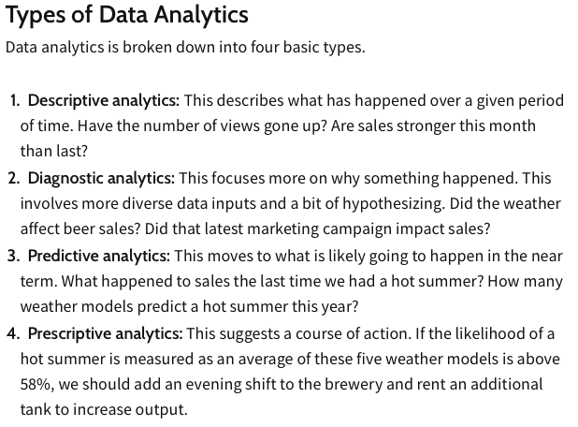
All are important to materials/polymer companies, research labs, academics
ML
AI
https://www.investopedia.com/terms/d/data-analytics.asp

Slide 5
Machine Learning (ML),
Artificial Intelligence (AI),
the Internet of Things (IoT)
Consider obvious problems that might be addressed by this approach:
-Selection of the best combination of materials for a super-conducting alloy
-Best metals for advanced manufacturing (rapid prototyping)
-Processing conditions/compounding for optimizing polymer pipe extrusion
-Optimize a better heterogeneous catalyst for polypropylene synthesis
(once you have the discovery by Ziegler/Natta)
And might not be addressed:
-Solution to global warming
-Solution to the plastics waste problem
-Discovery of room temperature super conductors
-Invention of the internet
-Invention of block-copolymers

Slide 6
Machine Learning (ML),
Artificial Intelligence (AI),
the Internet of Things (IoT)
ML, AI, IoT are hammers, but everything isn’t a nail

Slide 7
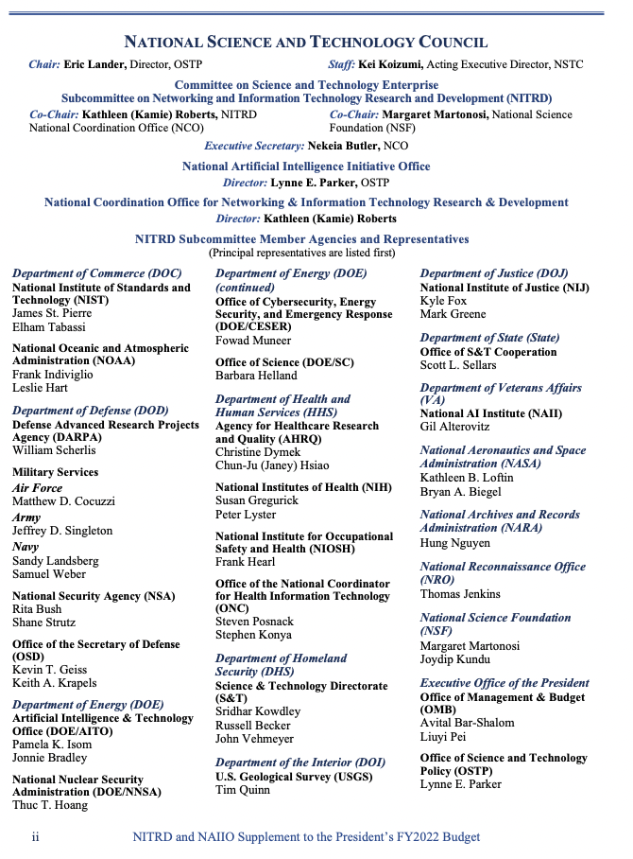
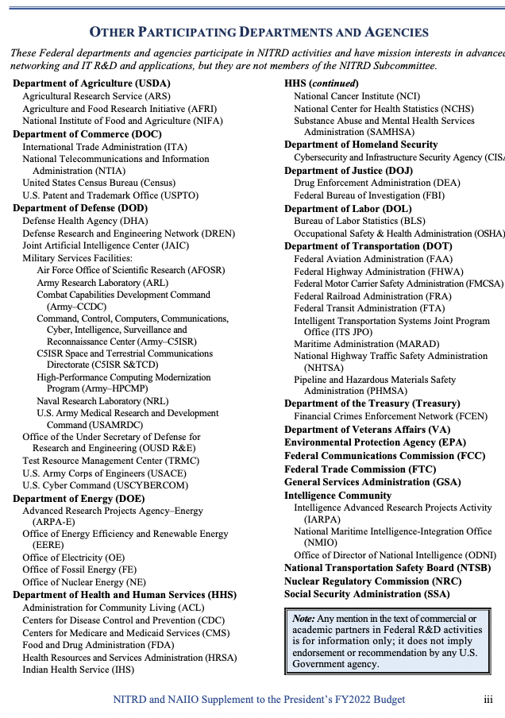
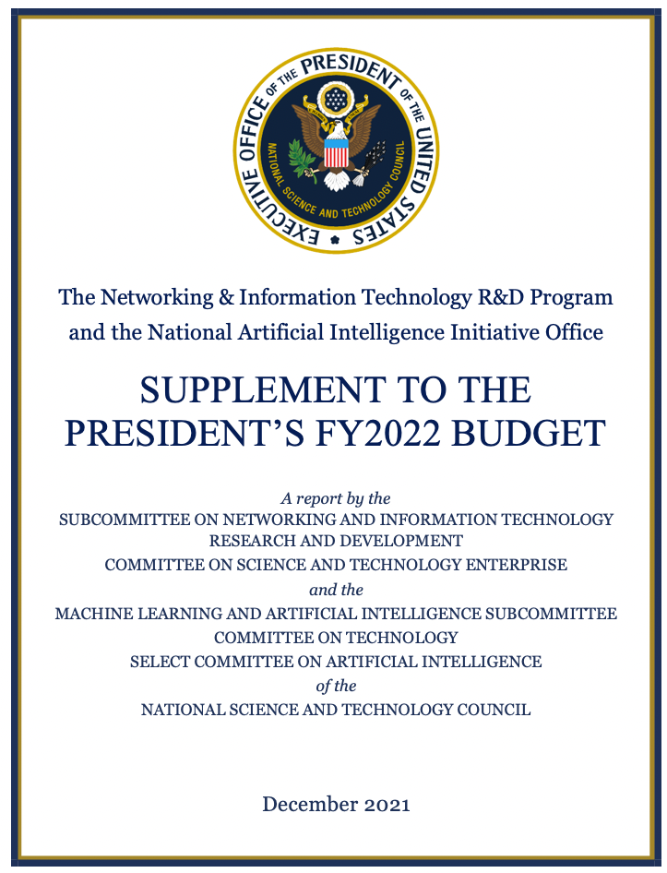
Machine Learning (ML),
Artificial Intelligence (AI),
the Internet of Things (IoT)
$1,670,200,000.00
FY 2022
The world is run on money:

Slide 8
Materials Informatics
-Identify superior materials from initial training sets and physics simulation scikit-learn; keras; pytorch
-Tailor materials data using ML. Take multiple sources, images, diffraction, scattering, spectroscopy, mechanical testing, electrical properties, thermal properties and generate models for materials design
-High–throughput data acquisition. Synchrotron sources is a chief example. Robotics, DFT.
-Post process STEM images.
-Use ML to optimize simulations e.g. modify atomic potential functions or use ML to couple simulations at different length scales (molecular MD, coarse grain MD, Dissipative Particle Dynamics).

Slide 9
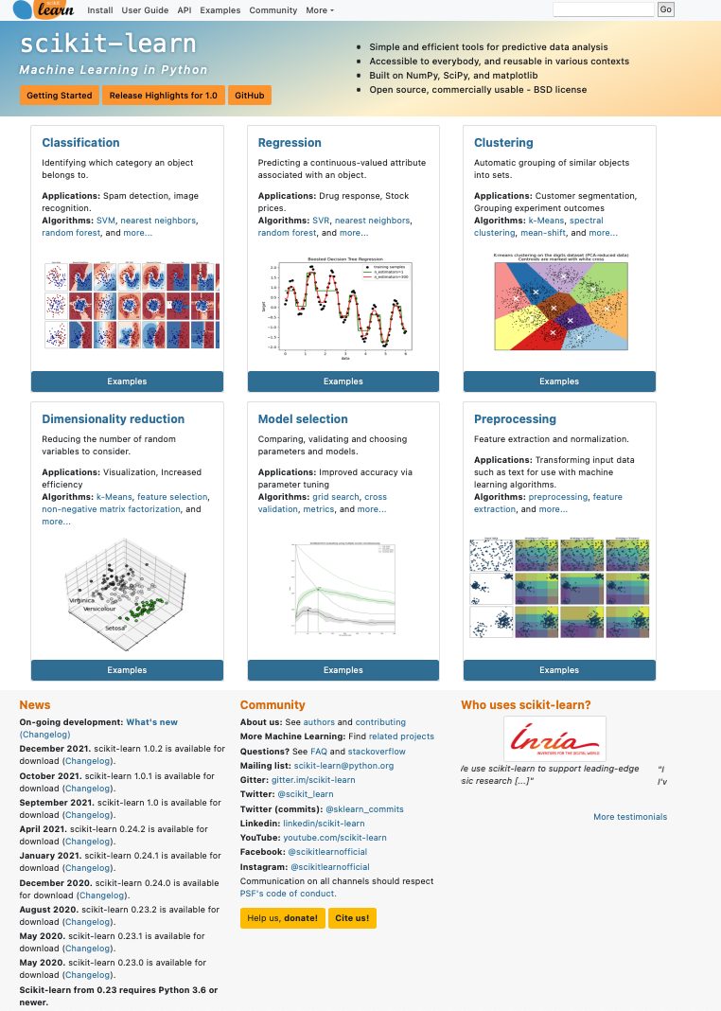


Slide 10
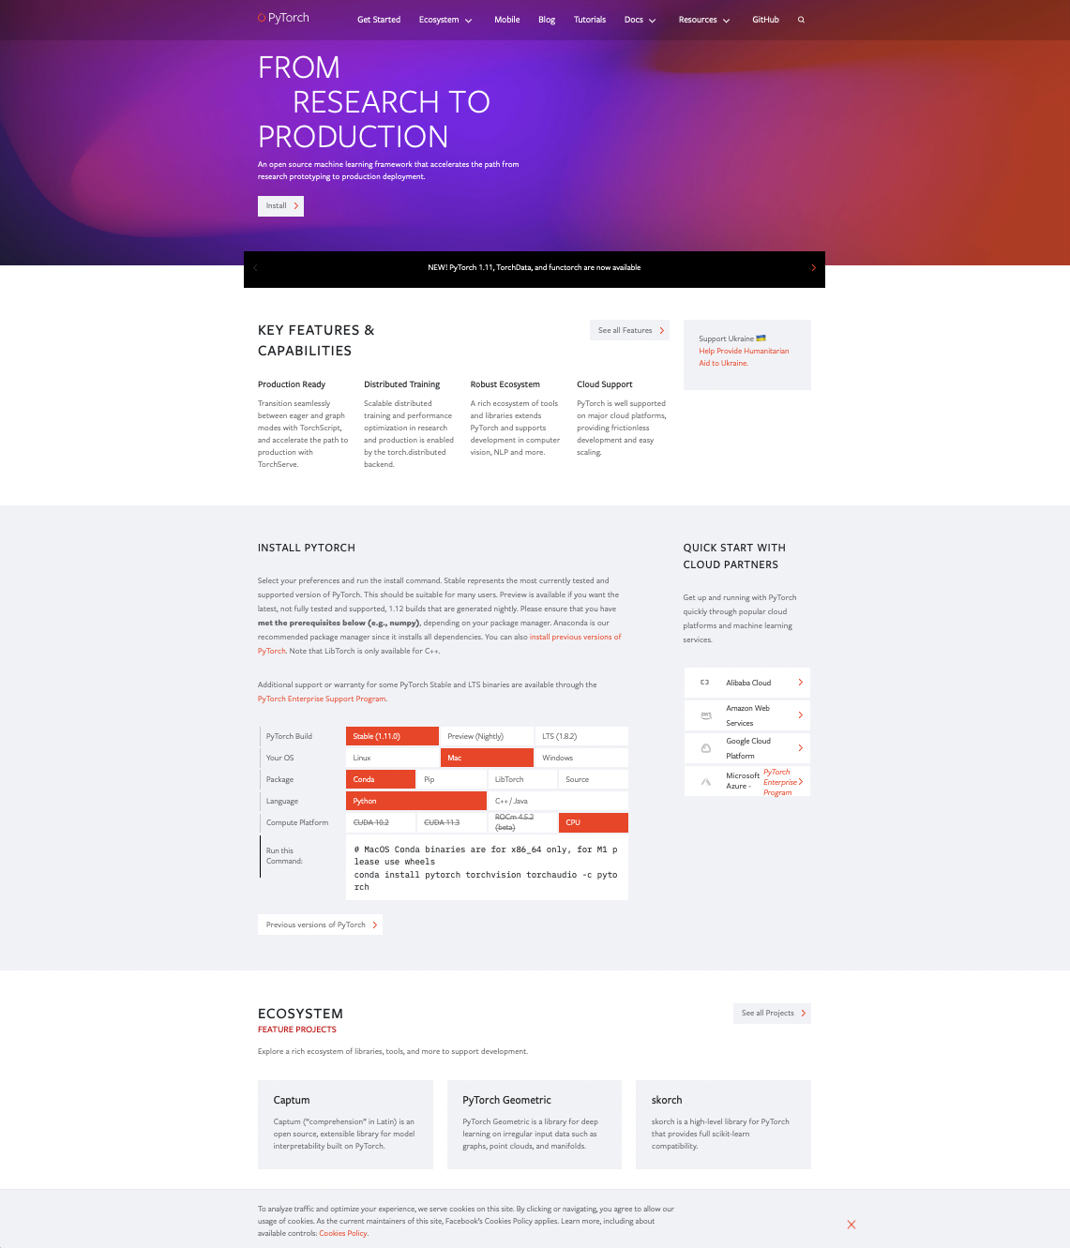

Slide 11
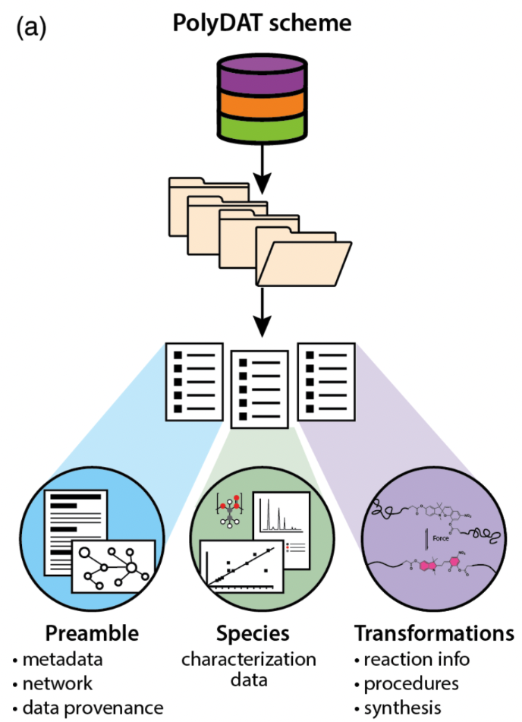
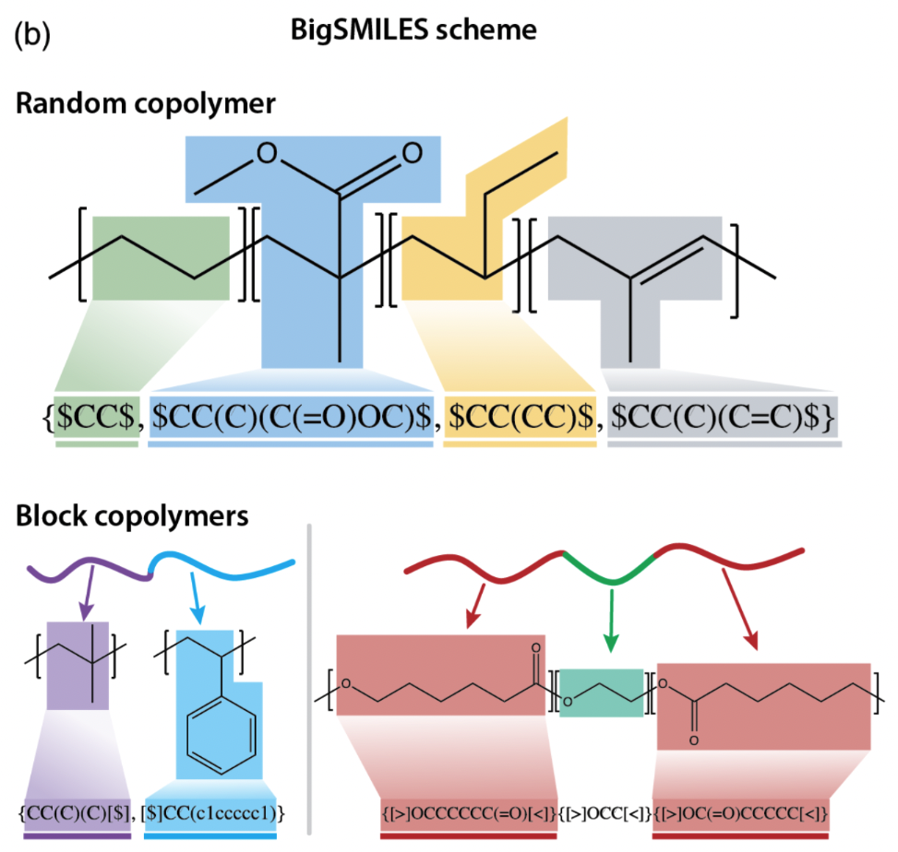
Cencer MM, Moore JS, Assary RS Machine learning for polymeric materials:an introduction Polym. Int. (2021) DOI 10.1002/pi.634

Slide 12
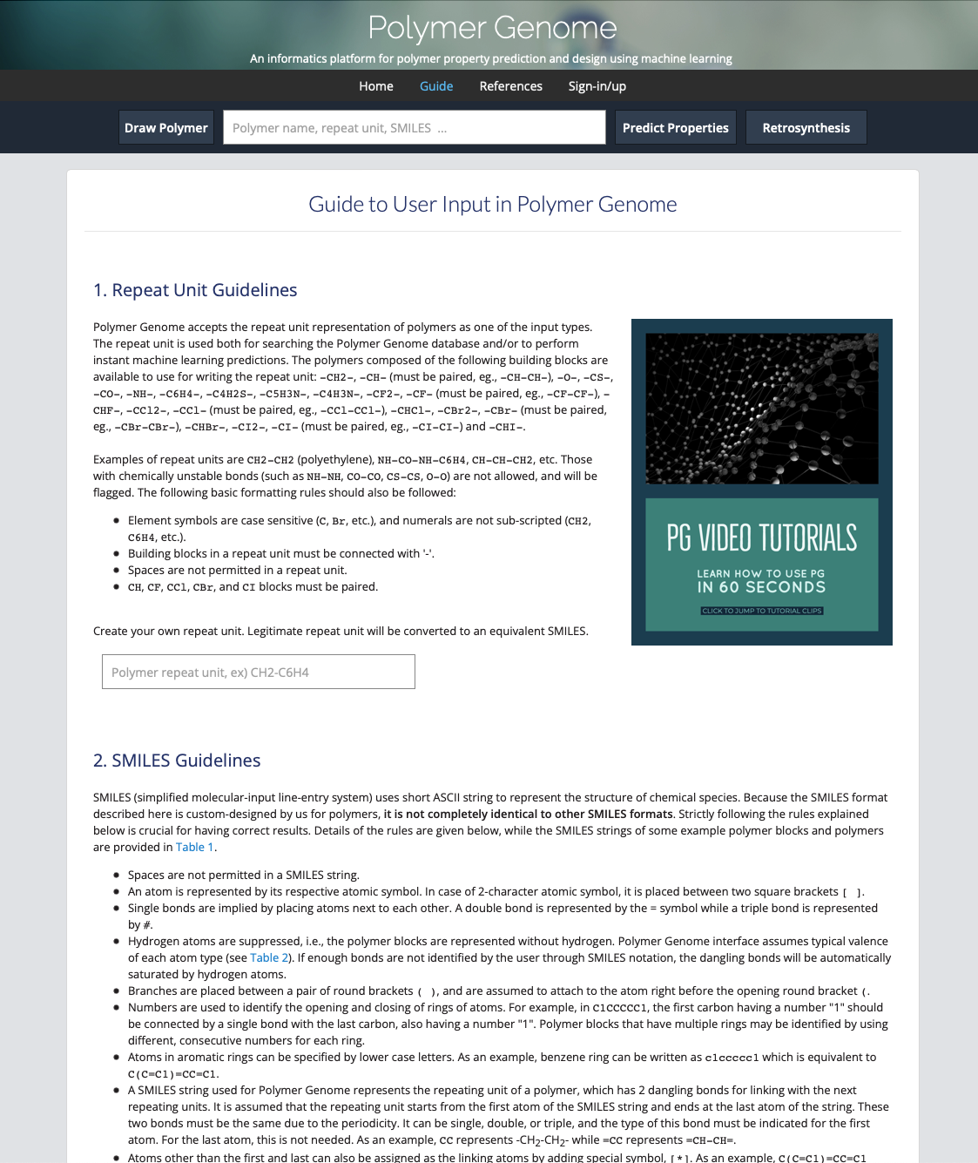

Slide 13
Zhu M-X, Deng T, Dong L, Chen J-M, Dang Z-M Review of machine learning-driven design of polymer-based dielectrics IET Nanodielectrics 5 24-38 (2022).
Evolution Searching (Inverse design method)
Generative Model (vs. Discriminative model)
Genome Approach
Identify Polymers with a linear notation (fingerprint)
simplified molecular‐input line‐entry system (SMILES)
Link fingerprint to properties (machine learning from training dataset)
Kernel regression (expected value within range of learned data)
Decision tree (various indications, some missing, predict answer from other examples)
Neural network (deep learning) (predictive modeling, adaptive control, or trained by dataset: take handwritten “0”’s from 1000 people break into pixels, correlate black and white pixels (1 and 0) with presence of 0 to get an overall probability you have a “0”)

Slide 14
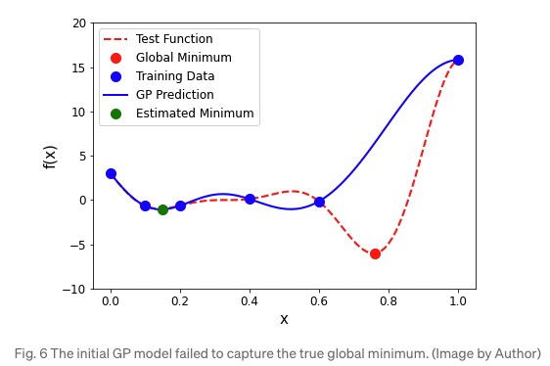
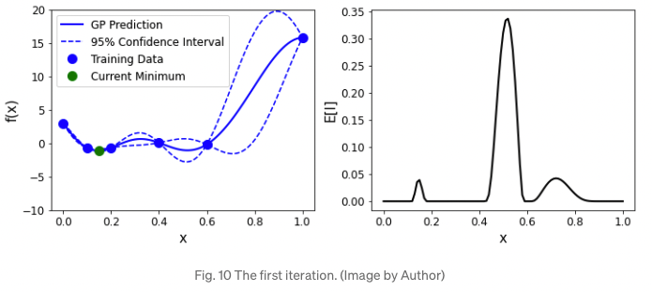
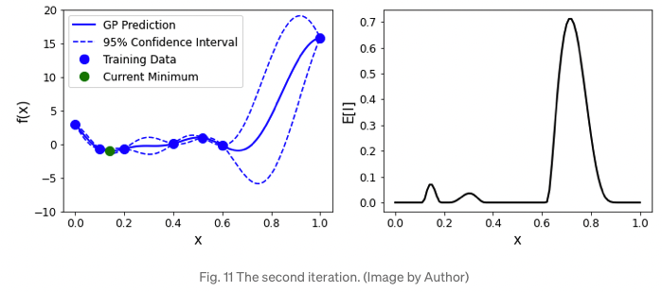
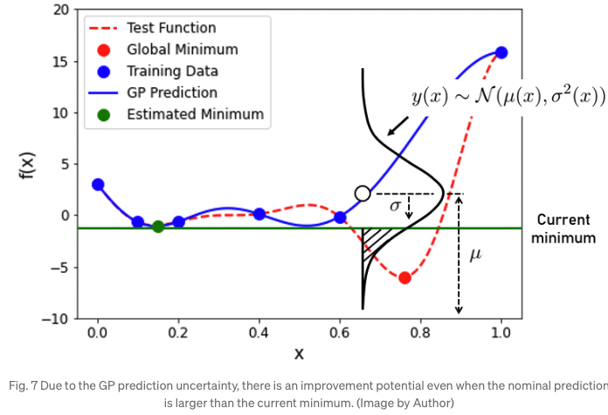
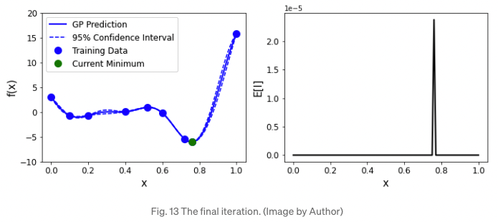
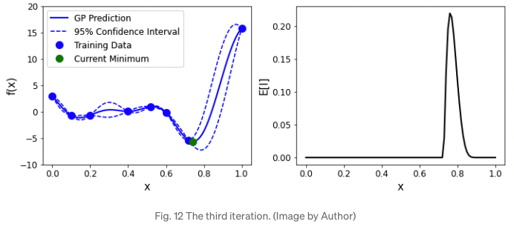
Zhu M-X, Deng T, Dong L, Chen J-M, Dang Z-M Review of machine learning-driven design of polymer-based dielectrics IET Nanodielectrics 5 24-38 (2022).
Surrogate model (example gaussian)

Slide 15
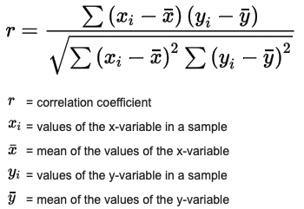
Pearson Correlation Coefficient

Slide 16
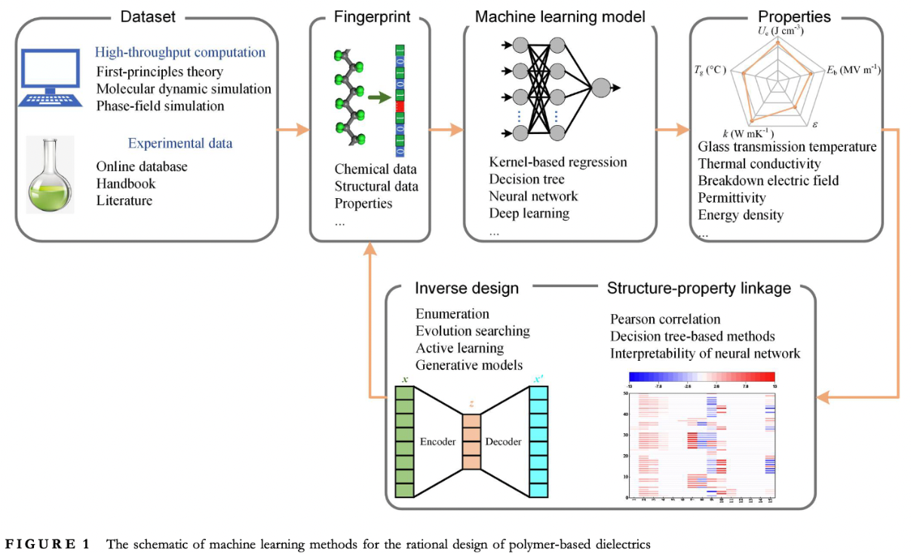
Zhu M-X, Deng T, Dong L, Chen J-M, Dang Z-M Review of machine learning-driven design of polymer-based dielectrics IET Nanodielectrics 5 24-38 (2022).

Slide 17
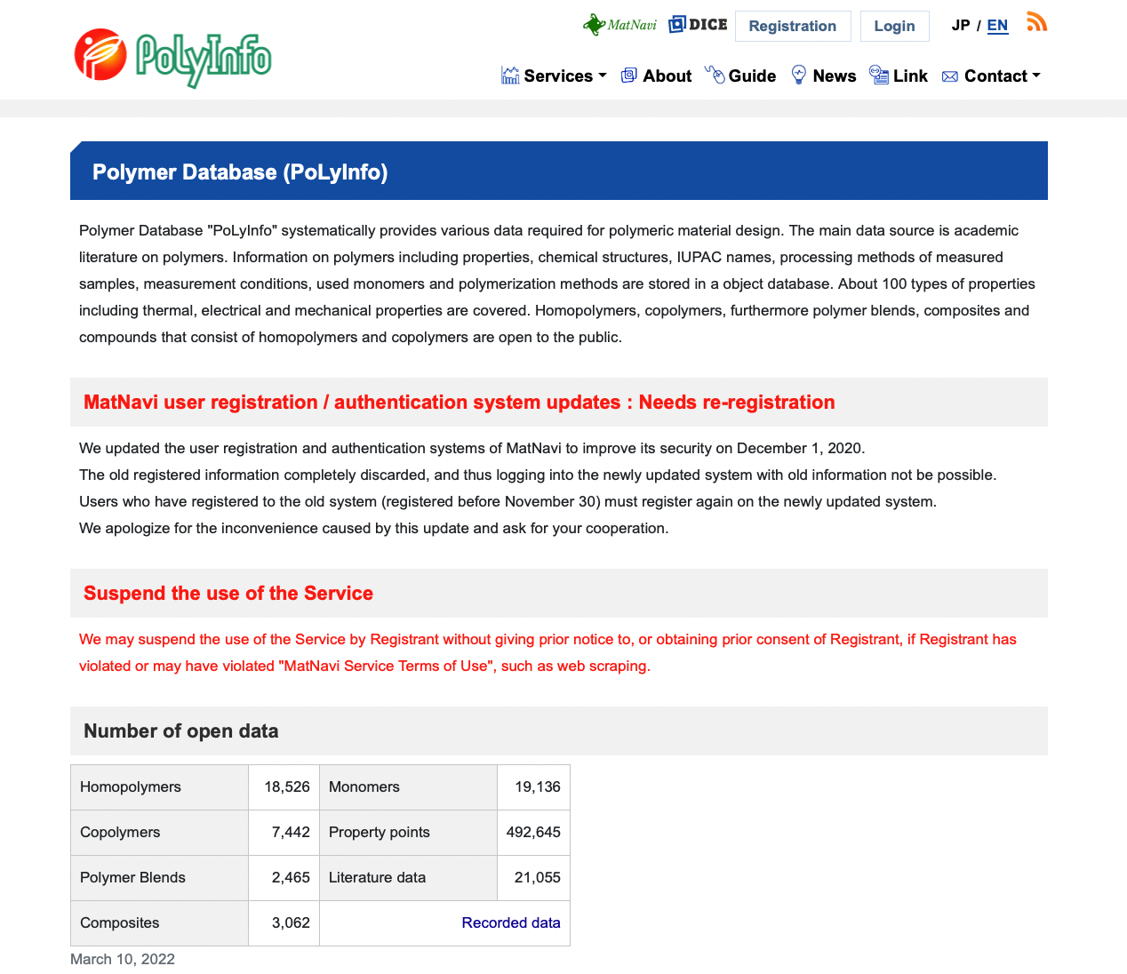
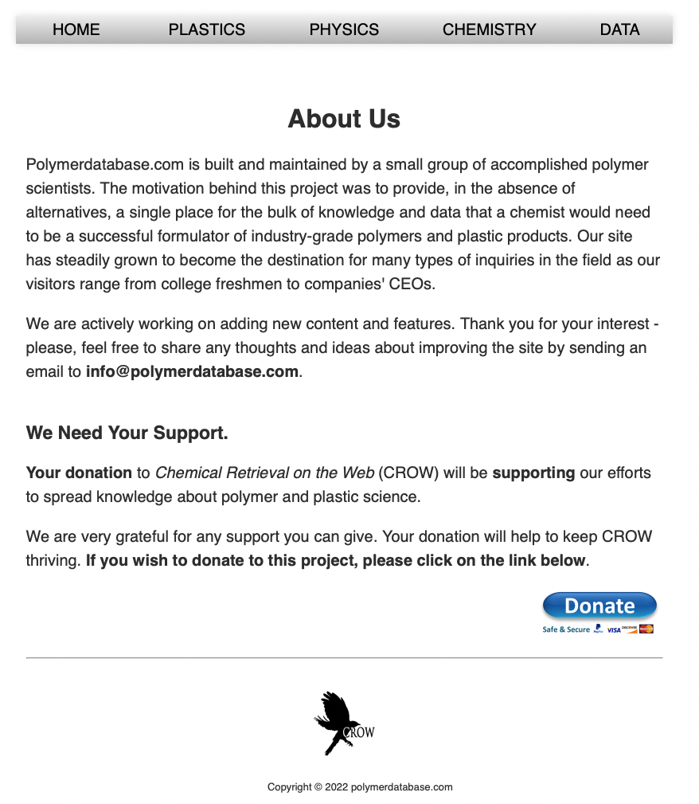
Dataset for polymer dielectrics
Online libraries, experiments and high‐throughput computations
PoLyInfo, CROW Polymer Property Database, Polymer Property Predictor, Database (NIST), Polymer Genome

Slide 18
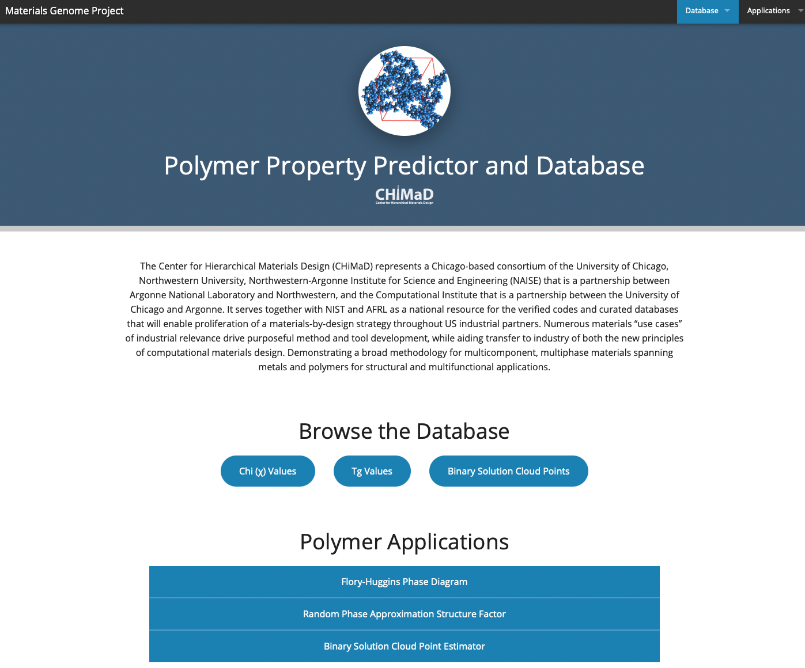
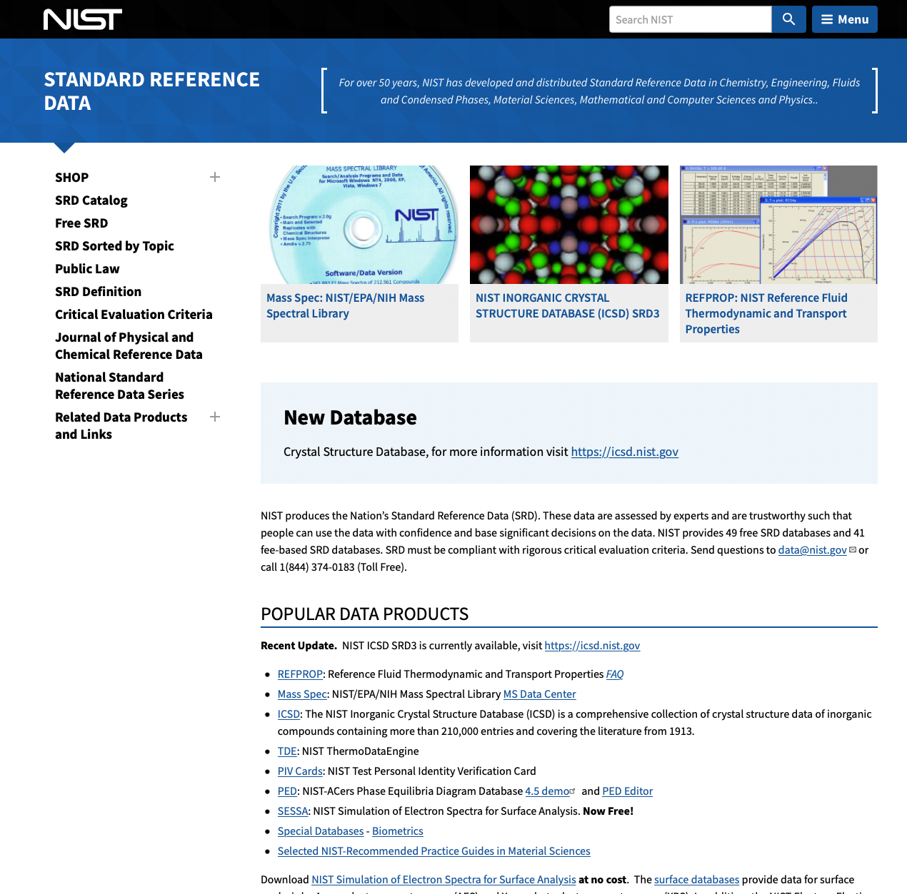
Dataset for polymer dielectrics
Online libraries, experiments and high‐throughput computations
PoLyInfo, CROW Polymer Property Database, Polymer Property Predictor, Database (NIST), Polymer Genome

Slide 19
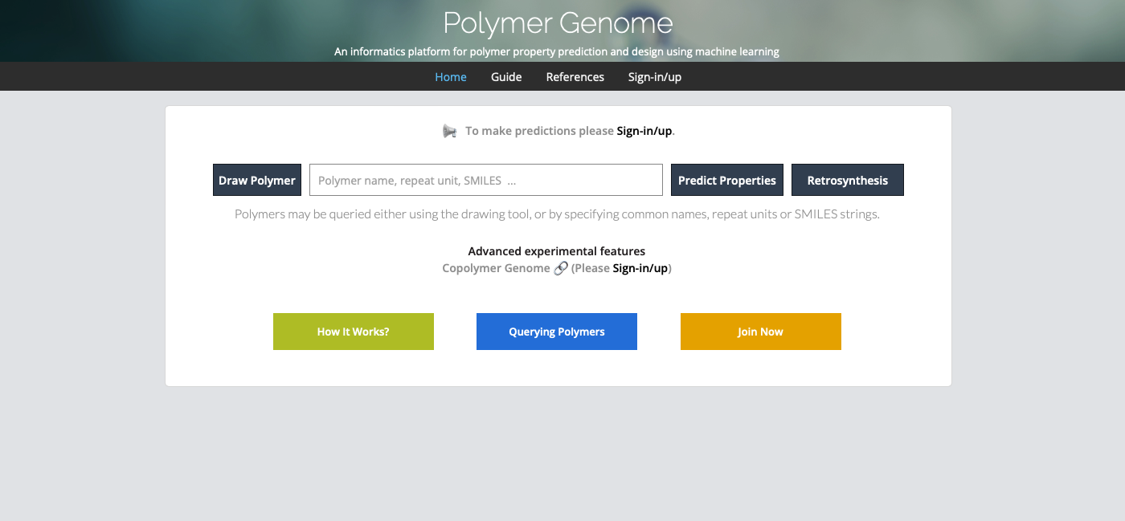
Dataset for polymer dielectrics
Online libraries, experiments and high‐throughput computations
PoLyInfo, CROW Polymer Property Database, Polymer Property Predictor, Database (NIST), Polymer Genome

Slide 20
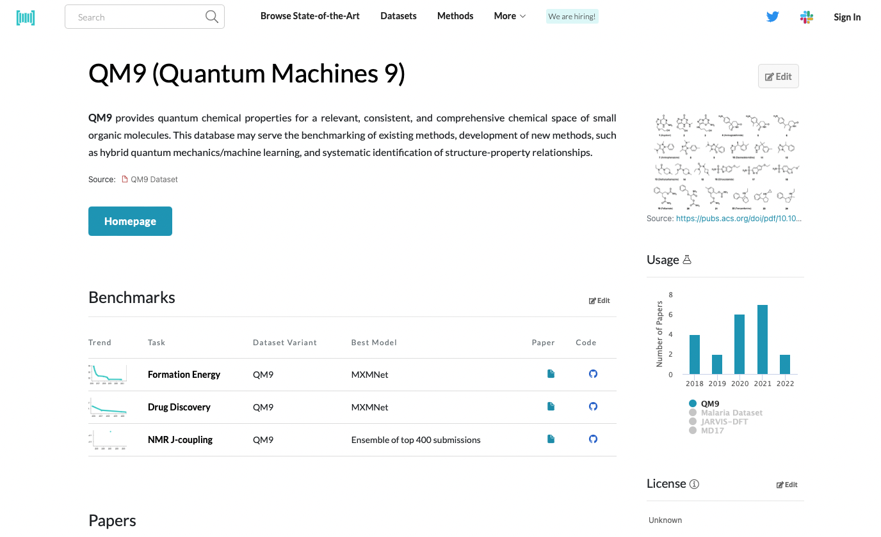
Dataset for polymer dielectrics
Online libraries, experiments and high‐throughput computations
PoLyInfo, CROW Polymer Property Database, Polymer Property Predictor, Database (NIST), Polymer Genome

Slide 21
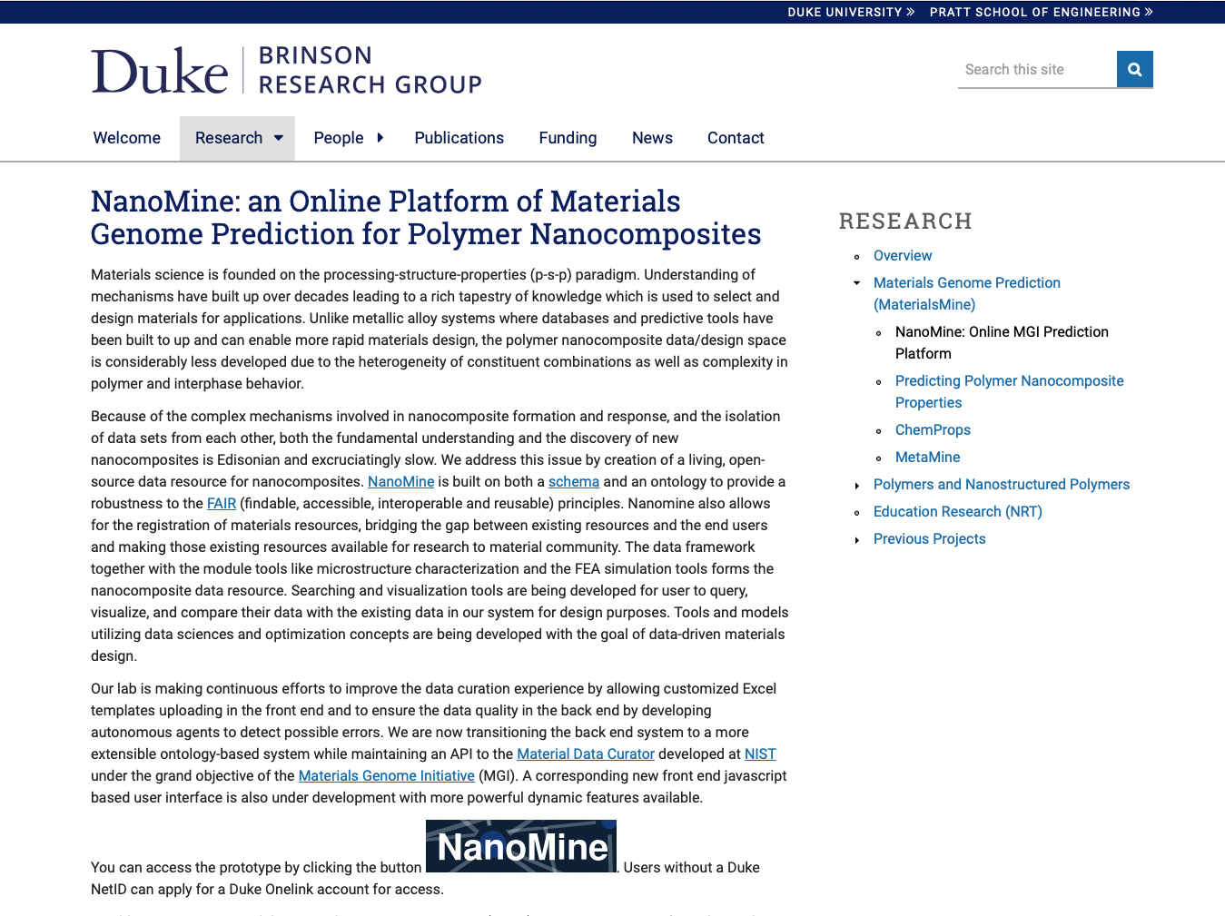
Dataset for polymer dielectrics
Online libraries, experiments and high‐throughput computations
NanoMine for nanocomposites

Slide 22
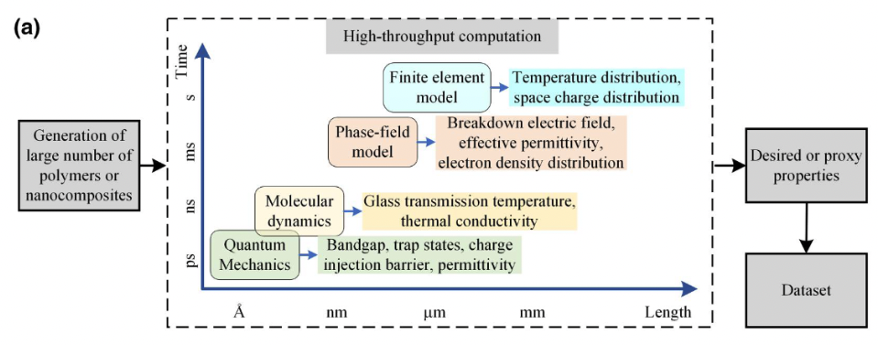
Dataset for polymer dielectrics
Manual search of the literature
High-throughput computations using first principles; MD simulations

Slide 23
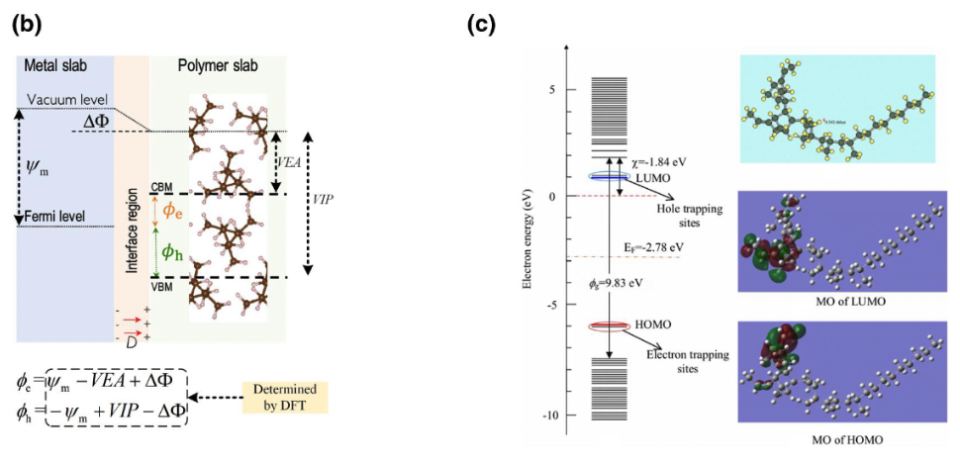
Dataset for polymer dielectrics
Density functional theory (DFT) for charge injection barrier from electrode to polymer, trap depth in polymer; ionic electronic and total dielectric constant

Slide 24
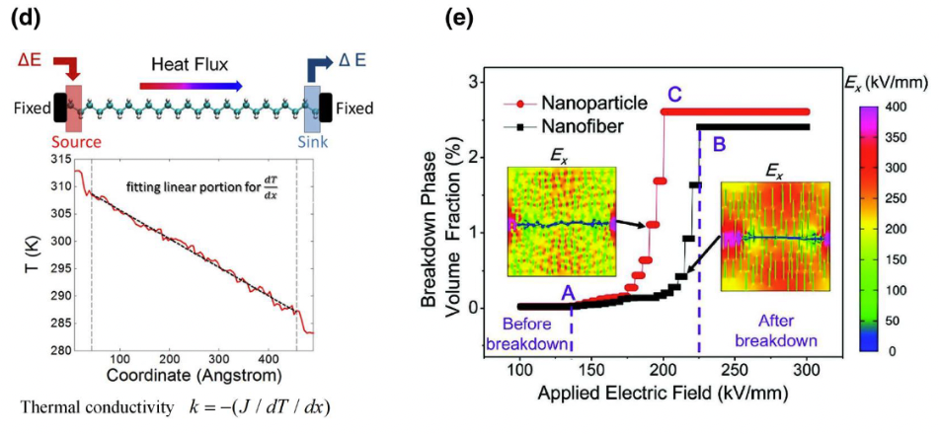
Dataset for polymer dielectrics
d) Non-equilibrium molecular dynamics for thermal conductivity
e) Phase field model for dielectric breakdown in polymer nanocomposites (free energy as a function of composition; composition is subject to diffusion; dynamic model with energy minimization at an interface)

Slide 25
Zhu M-X, Deng T, Dong L, Chen J-M, Dang Z-M Review of machine learning-driven design of polymer-based dielectrics IET Nanodielectrics 5 24-38 (2022).

Slide 26
Machine Learning Strategies
Fingerprinting: Numerical representation of the materials in the datasets
Learning: Map between target property and fingerprint

Slide 27
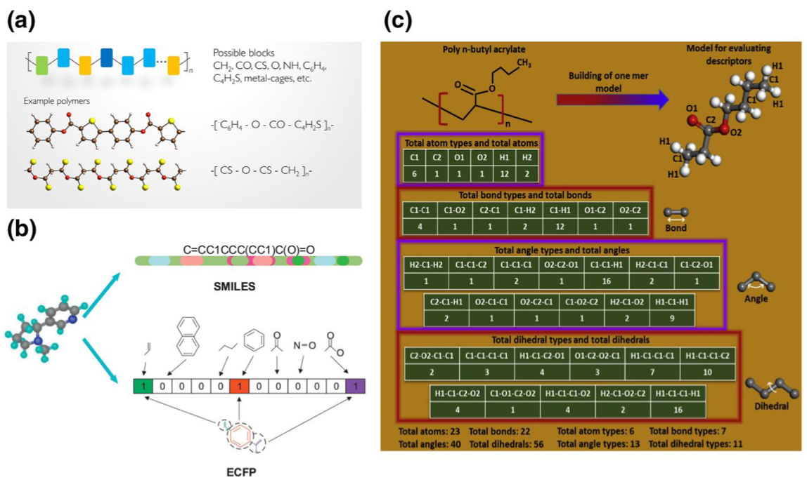
a) Fingerprint based on a group contribution method; b) Simplified Molecular‐Input Line‐Entry System (SMILES) and Extended‐Connectivity Fingerprints (ECFPs)

Slide 28
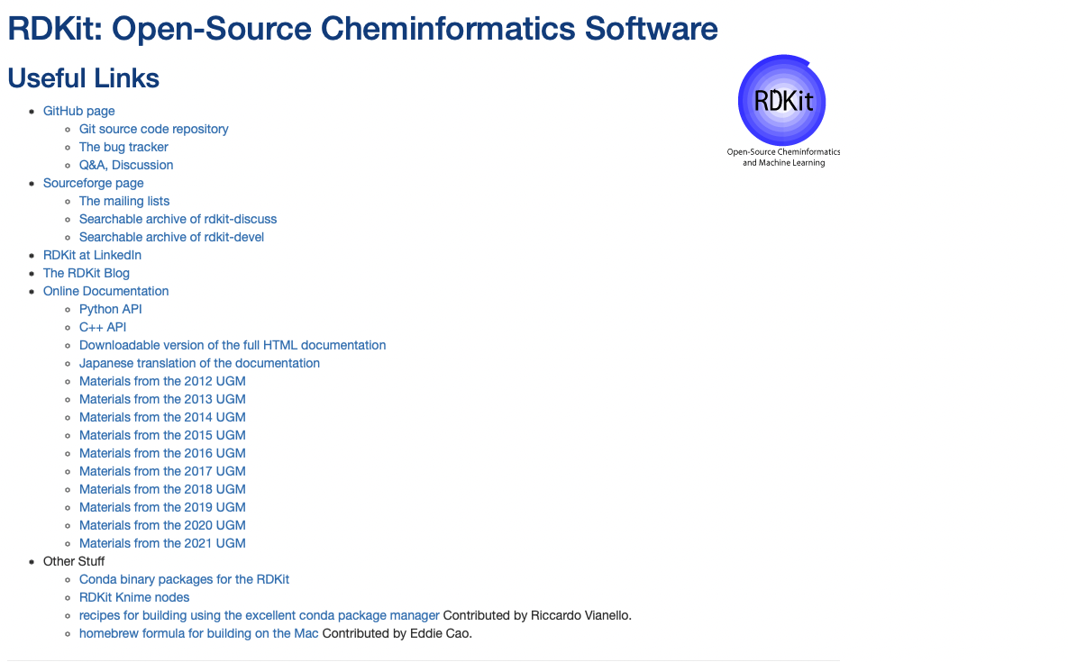
RDKit converts SMILES to numerical vectors

Slide 29
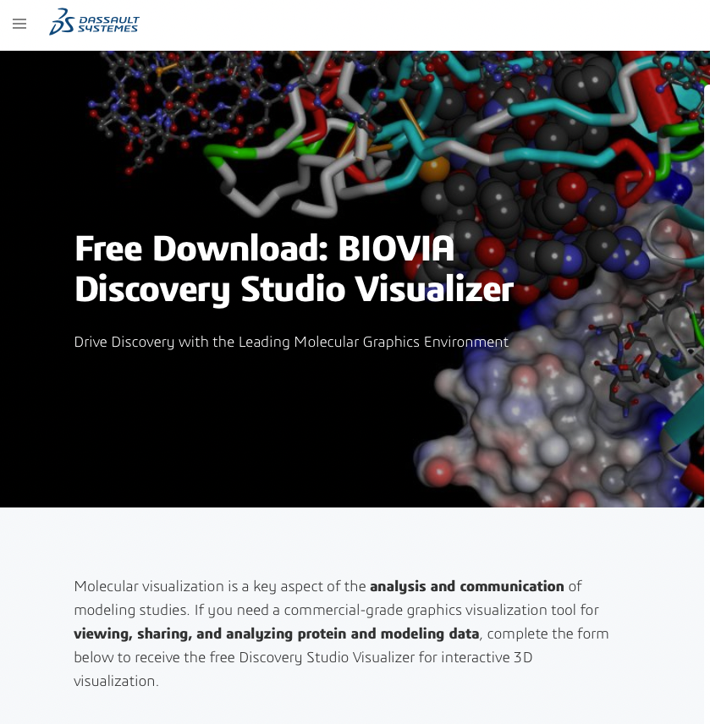
BIOVA gives hierarchical fingerprints

Slide 30
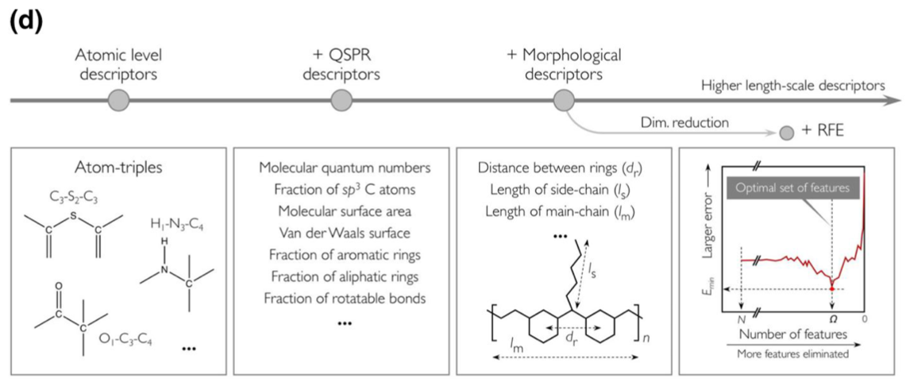
Hierarchical fingerprints

Slide 31
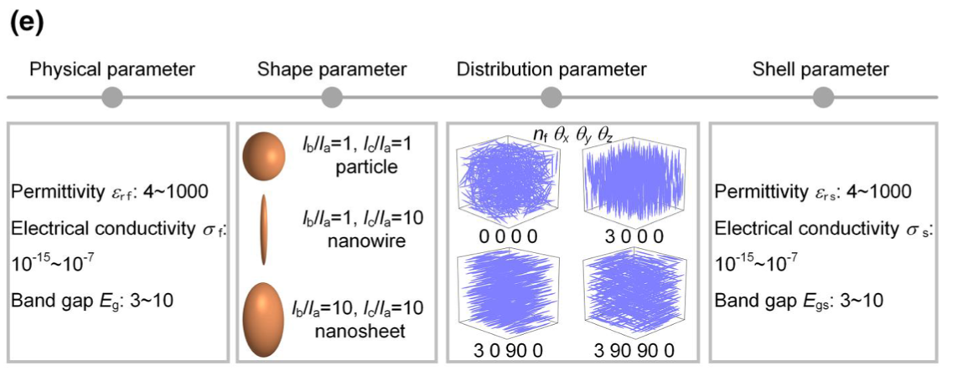
Nanocomposite fingerprint for dielectric properties

Slide 32
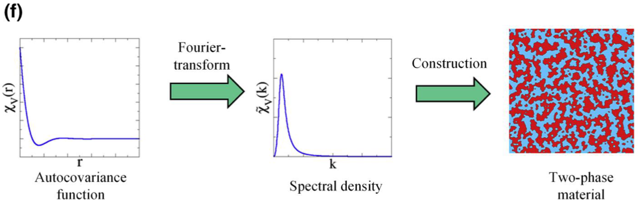
Inverse space nanocomposite fingerprint for structure

Slide 33
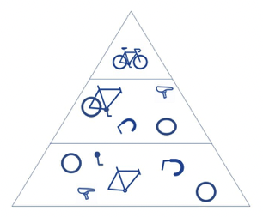
Convolutional neural network (CNN)
Neural network (decision tree type algorithm) with classification optimization using matrix multiplication for images to identify patterns, require GPUs.
-Convolution layer (Initial layer, image)
further convolution layers for color, edges, etc.
-Pooling layer
-Fully connected (FC) layer (Final layer)
Image (height, width, depth RGB)
Convolution, check if a feature is present such as an ”O” using a kernel or filter
Process by rastering across image with dot products resulting in a feature map, activation map or convolution feature
Number of filters; Stride (step of raster); zero padding (background) decides the complexity

Slide 34
For PNCs interfacial regions can be important
This is a major stumbling block

Slide 35
Zhu M-X, Deng T, Dong L, Chen J-M, Dang Z-M Review of machine learning-driven design of polymer-based dielectrics IET Nanodielectrics 5 24-38 (2022).

Slide 36
Machine Learning (ML) Algorithm
Fingerprint => ML => Property
Linear and non-linear regression algorithms
Fingerprint ~ property (linear)
Radial basis function: Property ~ SUM(f(fingerprint-x_{c}))
Polynomial: Property ~ SUM(k_{n} fingerprint^{n})
Kernel based algorithms (alternatives to least squares routines)
Kernel ridge regression (KRR)
Support vector machine (SVM)
Gaussian process regression (GPR)
Artificial neural networks (ANN)

Slide 37
Surrogate model (example gaussian)

Slide 38
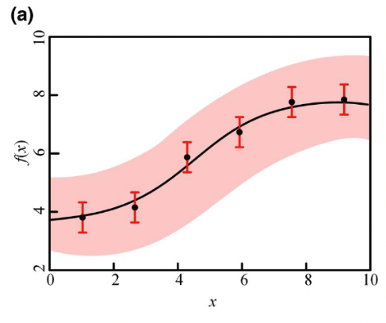
Gaussian process regression

Slide 39
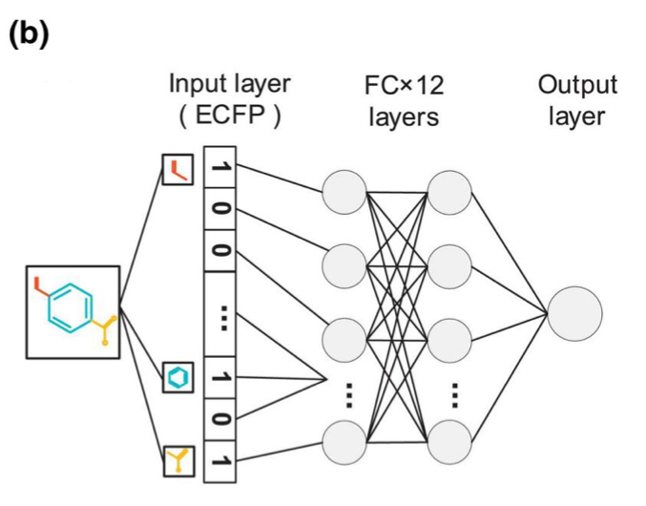
Decision tree algorithms, random forest (RF)
Decision trees with many levels tend to learn irregular patterns
By randomly grouping sets from the input fingerprint irregular patterns can be removed
Artificial neural network

Slide 40
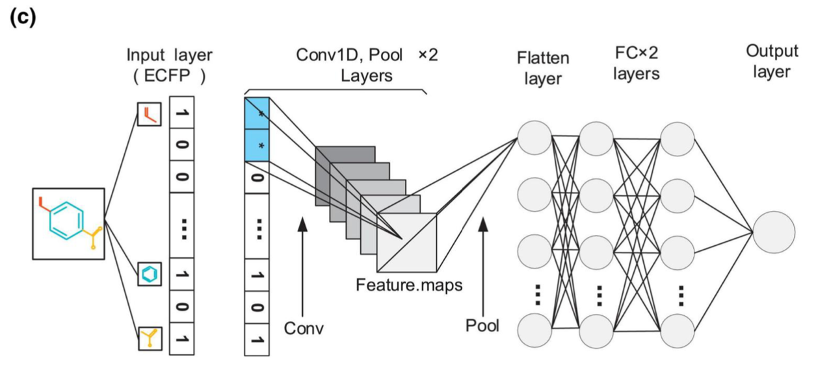
Convolution neural network

Slide 41
Convolutional neural network (CNN)
Neural network (decision tree type algorithm) with classification optimization using matrix multiplication for images to identify patterns, require GPUs.
-Convolution layer (Initial layer, image)
further convolution layers for color, edges, etc.
-Pooling layer
-Fully connected (FC) layer (Final layer)
Image (height, width, depth RGB)
Convolution, check if a feature is present such as an ”O” using a kernel or filter
Process by rastering across image with dot products resulting in a feature map, activation map or convolution feature
Number of filters; Stride (step of raster); zero padding (background) decides the complexity

Slide 42
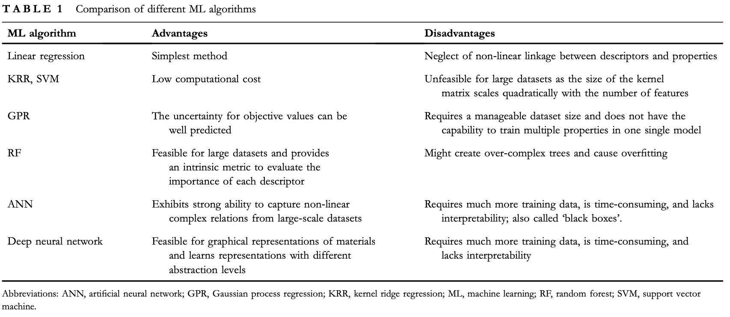

Slide 43
Zhu M-X, Deng T, Dong L, Chen J-M, Dang Z-M Review of machine learning-driven design of polymer-based dielectrics IET Nanodielectrics 5 24-38 (2022).

Slide 44
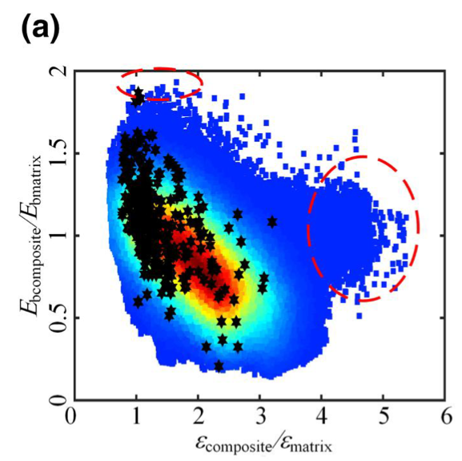
Inverse Design Methods
Enumeration method,
go through each possible solution (complete enumeration) or limit the solutions (incomplete enumeration)
GPR‐based ML model used to screen promising polymer nanocomposites with desired permittivity, breakdown strength and energy density, resulting in several kinds of nanocomposites with desired properties

Slide 45
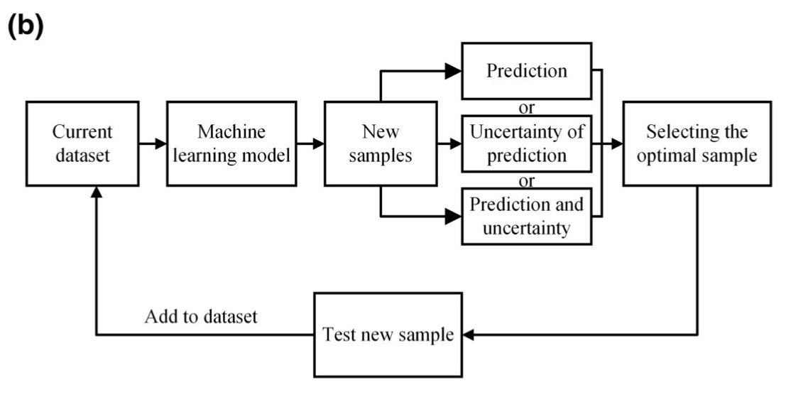
Inverse Design Methods
Active learning algorithm
training the ML‐based surrogate model for property prediction,
selecting the optimal sample based on the prediction results including values and uncertainties, and
supplementing the optimal sample into training dataset
Choosing the optimal sample requires ML models to provide both prediction and uncertainty values of the target property. As a result, the GPR algorithm and a combination of bootstrapping methods with standard ML algorithms (decision tree, SVM etc.), which can estimate the uncertainty of pre- dictions, are common ML methods in active learning.

Slide 46
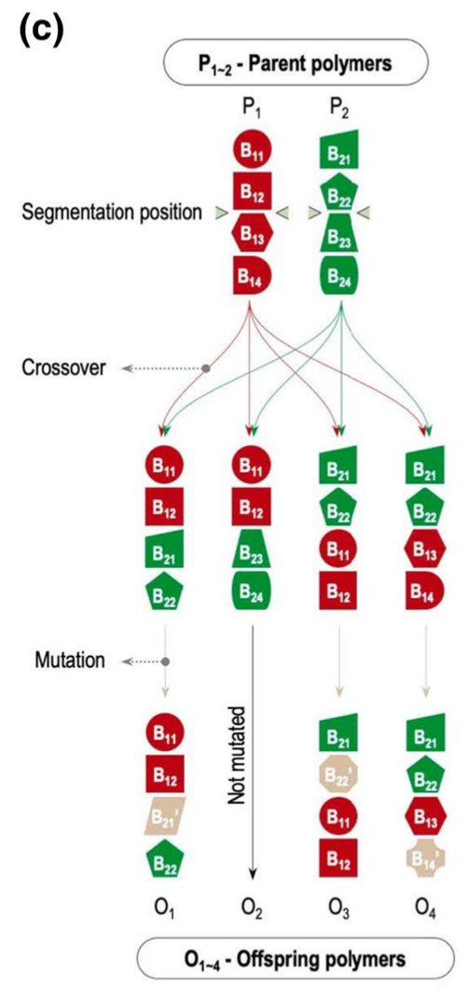
Evolutionary Strategy (ES)
Generic Algorithm

Slide 47
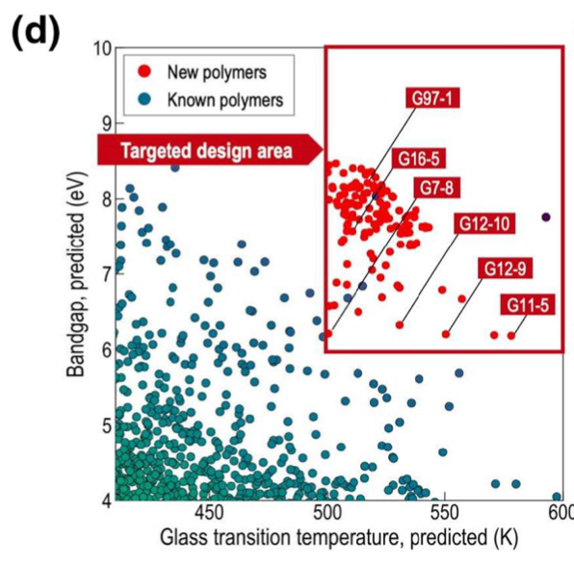
ES completes a structured search through procedures inspired by natural evolution.
At each iteration, parameter vectors (‘genotypes’, fingerprints in the ML) in a population are updated (selection, crossover and mutation in GA; movement of particle in PSO) to generate an offspring,
followed by an evaluation of the objection function value.

Slide 48
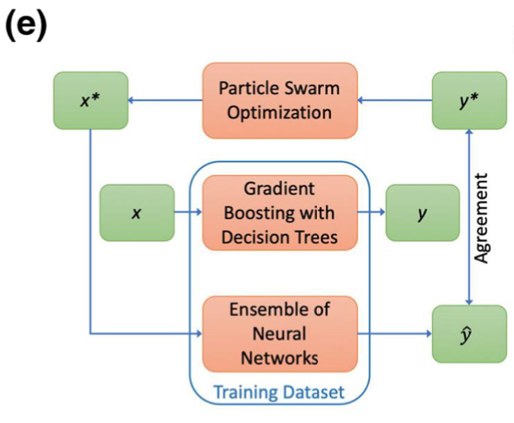
Particle Swarm Optimization (PSO)
Move a particle to improve the situation
moving one particle impacts the other particles
repeat and let the system evolve
Seems similar to a Monte- Carlo/Metropolis simulation

Slide 49
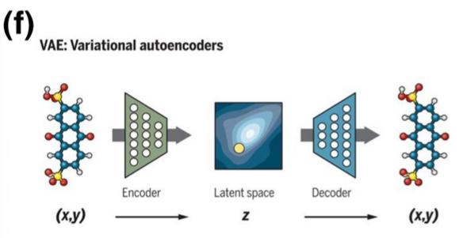
Take the known structure, find a relationship to the desired property, then invert that relationship to regenerate the structure, finally you can set the desired property to your target and generate the associated structure (possibly)

Slide 50
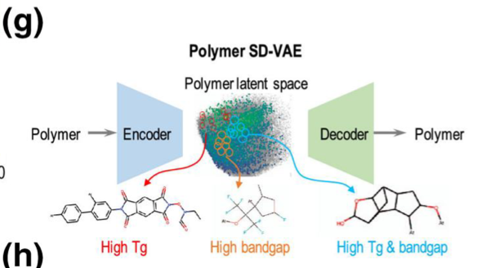

Slide 51
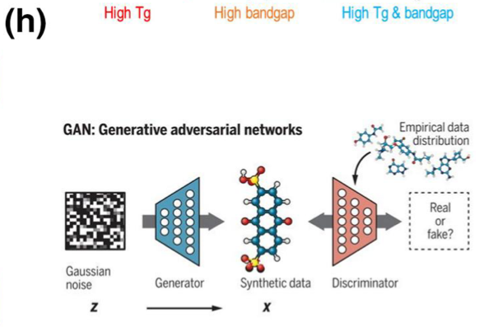
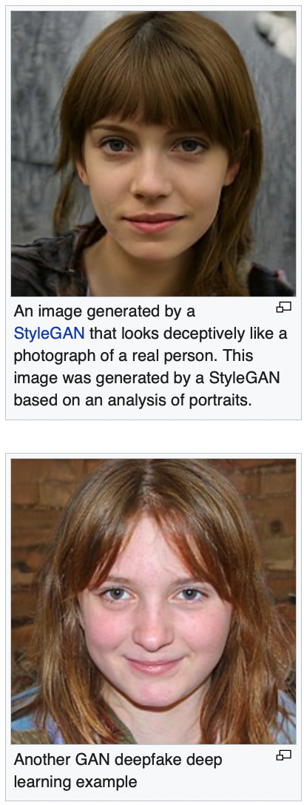
Generate molecule from desired properties
Generate properties from molecule
Learn to do this process correctly by repeating

Slide 52
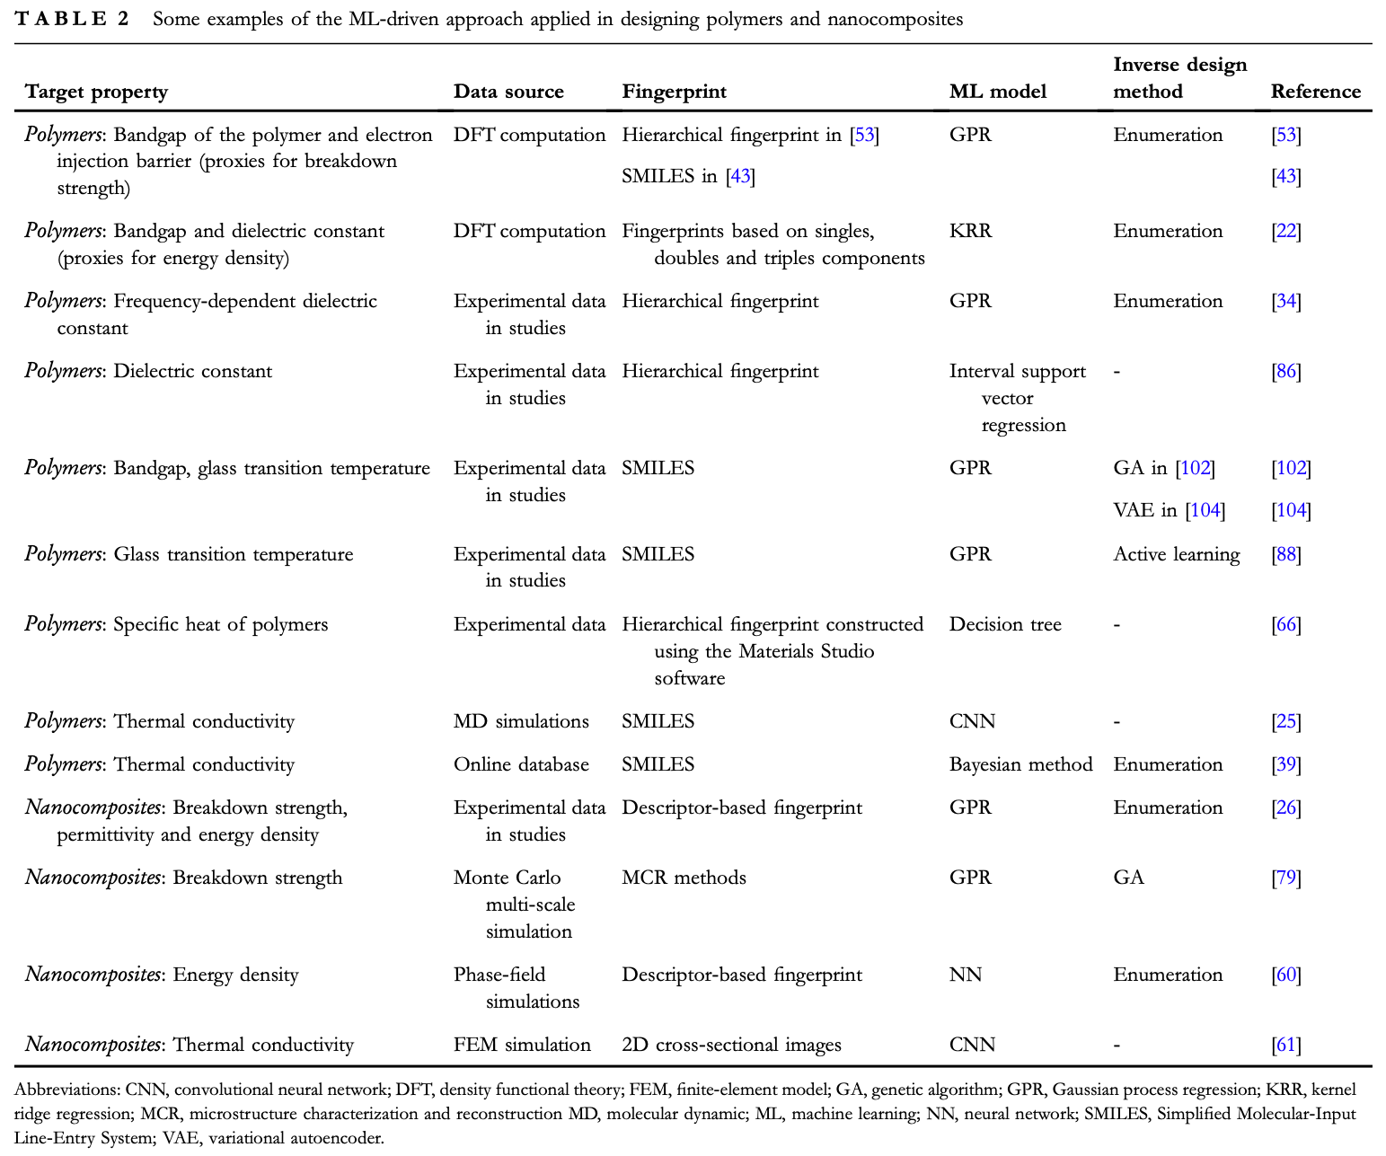

Slide 53
Zhu M-X, Deng T, Dong L, Chen J-M, Dang Z-M Review of machine learning-driven design of polymer-based dielectrics IET Nanodielectrics 5 24-38 (2022).

Slide 54
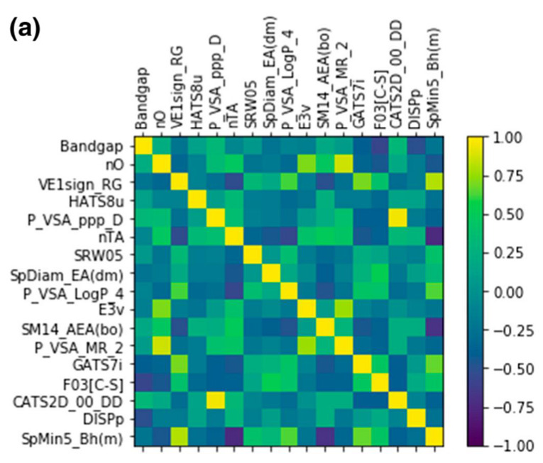
Variable Importance
the relevance of features with target properties
Pearson correlation coefficient

Slide 55

Variable Importance
Gradients of convolutional neural networks (CNNs) model

Slide 56


Variable Importance
Deep Learning Important FeaTures (DeepLIFT)

Slide 57

Variable Importance

Slide 58

Variable Importance

