Slide 1
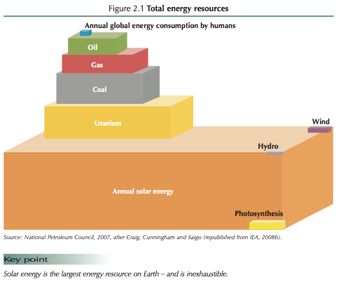
Non-Photovoltaic Solar Energy Harvesting
Solar Chimney
Solar Greenhouse
Biomass
Solar Heat
Passive Solar
Solar Water Heater
Solar Oven
Desalination
Solar Towers
ZnO Redox Reaction
Biomass/syngas
Solar Thermolysis
Solar Electricity & Electrolysis
Algae Tower

Slide 2
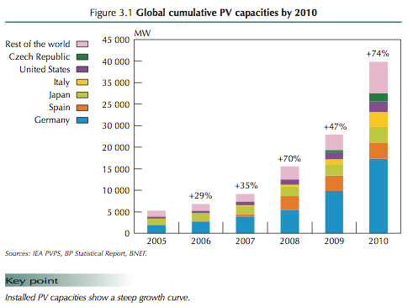
Solar Energy Perspectives
Solar Energy Engineering
Solar Energy Projects for the Evil Genius

Slide 3
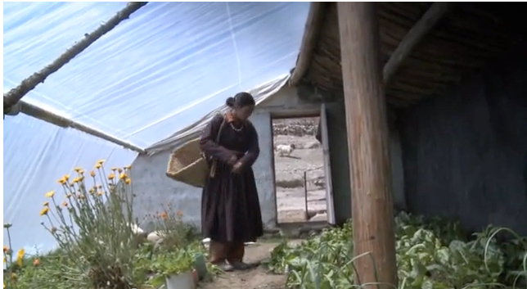
Solar Green Houses in India
(http://www.youtube.com/watch?feature=endscreen&v=8xFe91lMRH0&NR=1)
Tomato Green House in Kenya (http://www.youtube.com/watch?v=obsLwew-NT0)

Slide 4
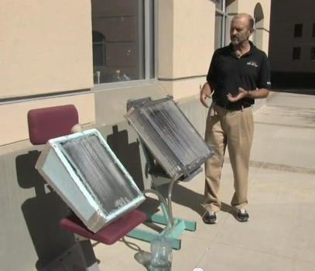
Solar Desalination/Water Purification
Solar Still Video (http://www.youtube.com/watch?v=GrPRnaS449w)

Slide 5
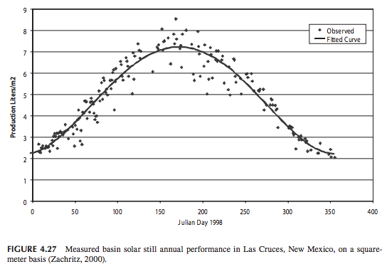
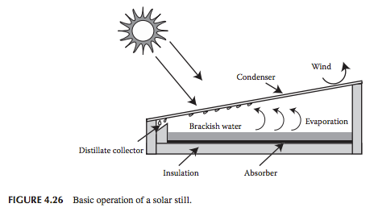
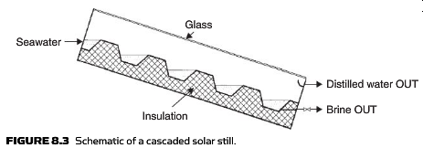
Solar Desalination/Water Purification

Slide 6
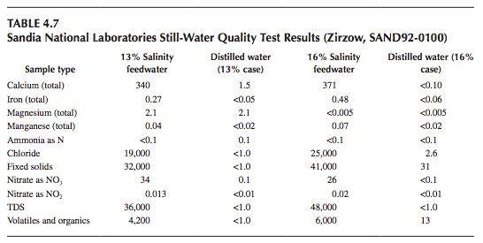
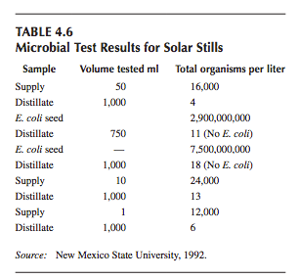
Solar Desalination/Water Purification

Slide 7
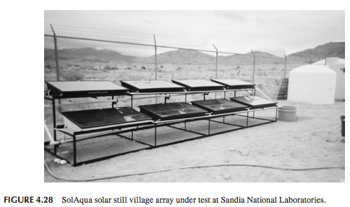

Slide 8
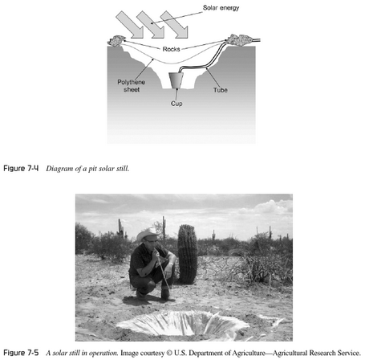
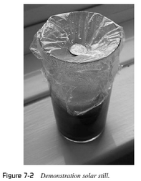
Solar Desalination/Water Purification

Slide 9
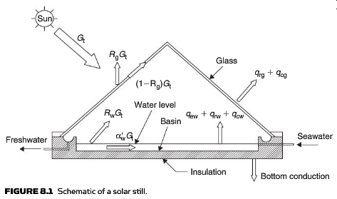
Solar Desalination/Water Purification

Slide 10
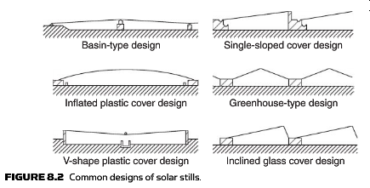
Solar Desalination/Water Purification

Slide 11
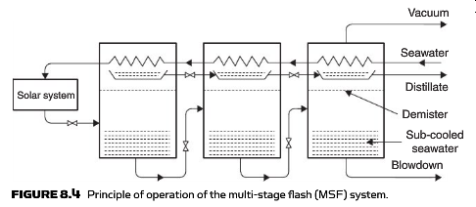
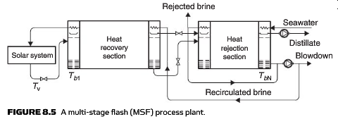
Solar Desalination/Water Purification

Slide 12
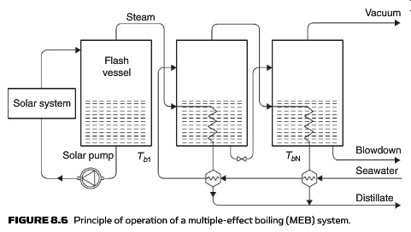
Solar Desalination/Water Purification

Slide 13
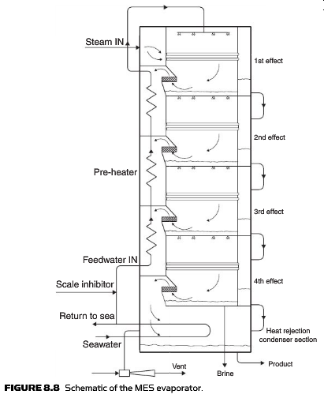
Solar Desalination/Water Purification

Slide 14
Solar Heat Collectors

Slide 15
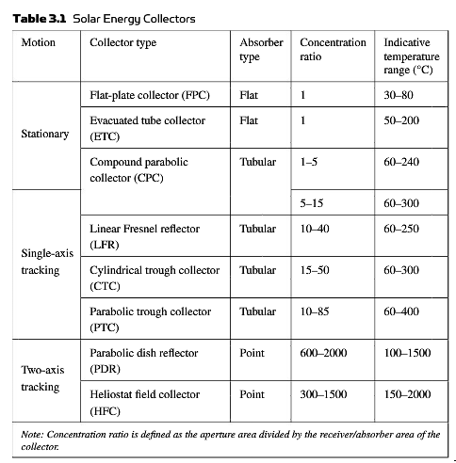
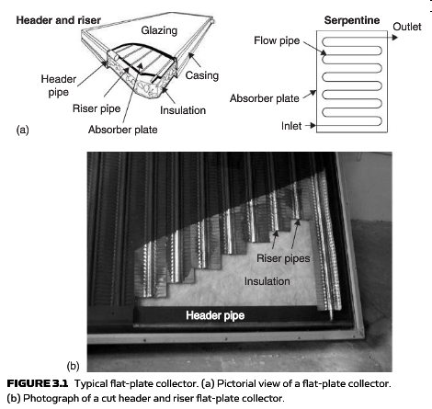
Solar Heat Collectors

Slide 16
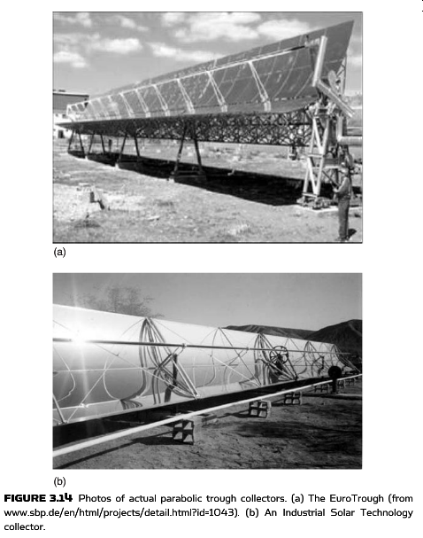
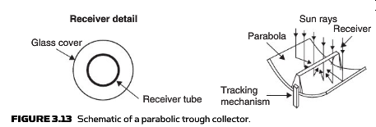
Solar Heat Collectors

Slide 17
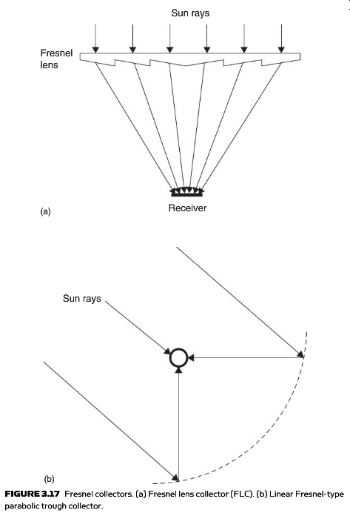
Solar Heat Collectors

Slide 18
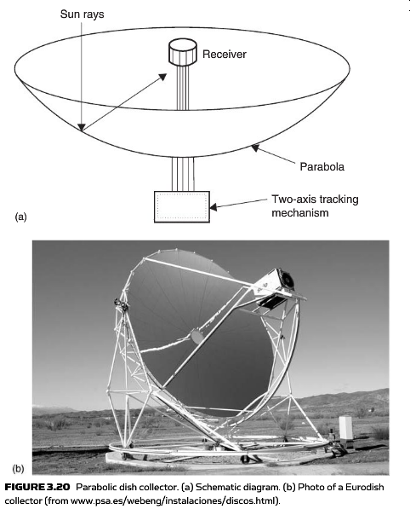
Solar Heat Collectors

Slide 19
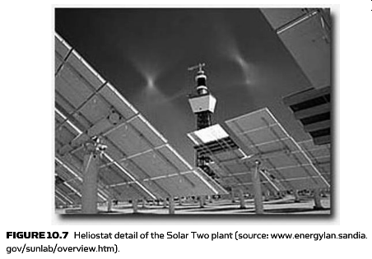
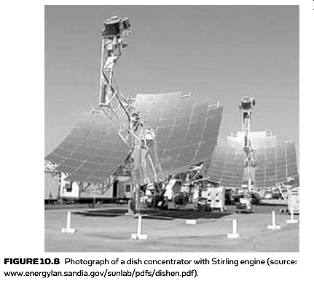
Solar Heat Collectors
Sterling Engine Wiki (http://en.wikipedia.org/wiki/Stirling_engine)
Sterling Engine Water Pump (Large) (http://www.youtube.com/watch?v=CEBuzq5iIqk)

Slide 20
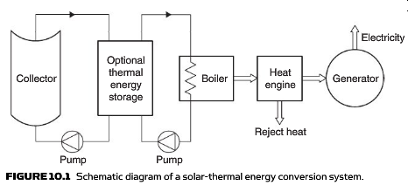

Slide 21
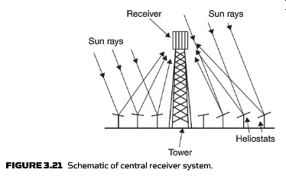
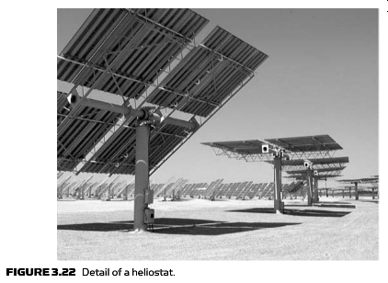
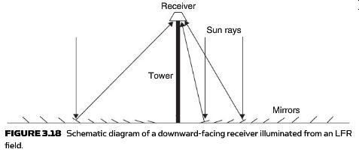
Solar Heat Collectors

Slide 22
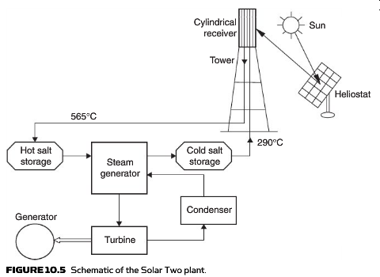
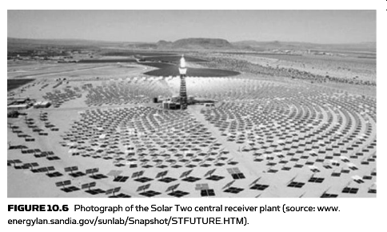
Solar Heat Collectors

Slide 23
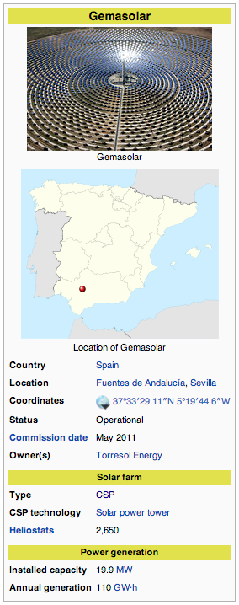
Solar Heat Collectors
Solar Tres (Gemasolar)
How it works

Slide 24
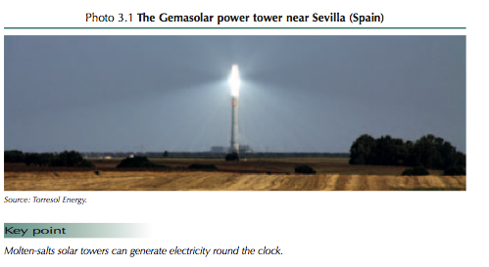

Slide 25
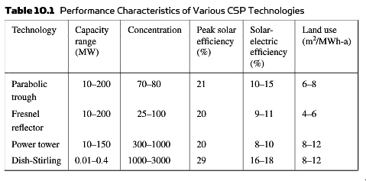

Slide 26
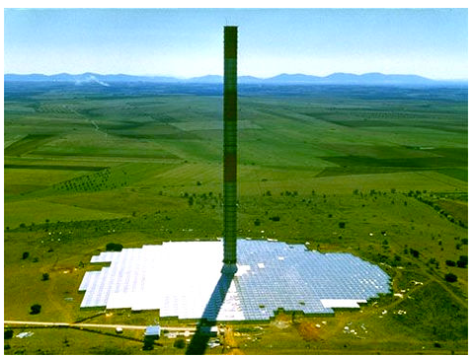
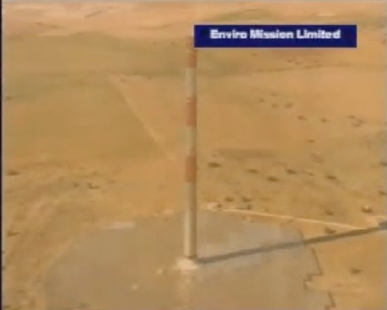
Solar Chimney’s
Enviromission (Australia)
Solar Chimney Spain (Madrid)

Slide 27
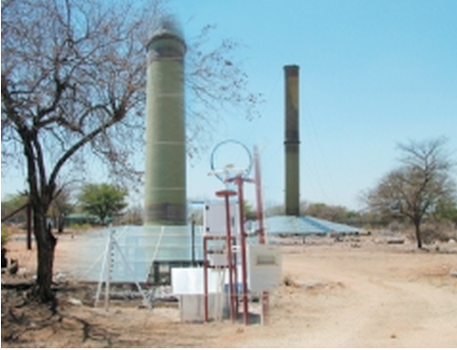
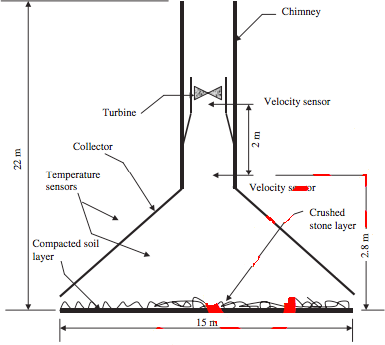
Solar Chimney’s
Gaborone, Botswana

Slide 28
Hot Water Systems

Slide 29
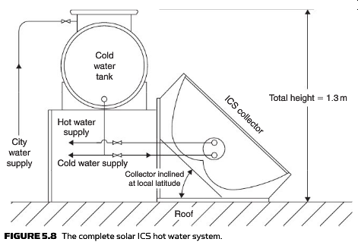
Hot Water Systems

Slide 30
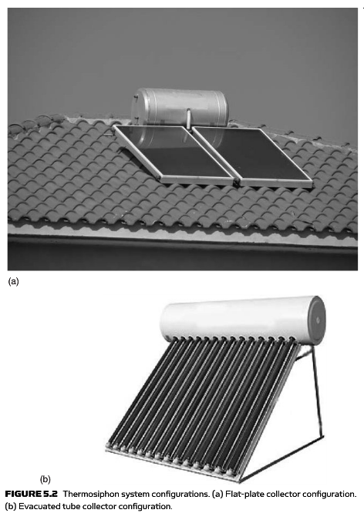
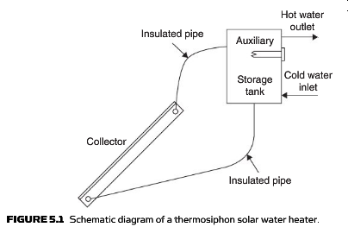
Hot Water Systems

Slide 31
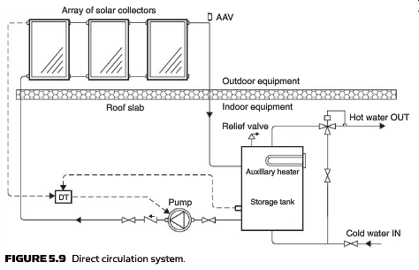
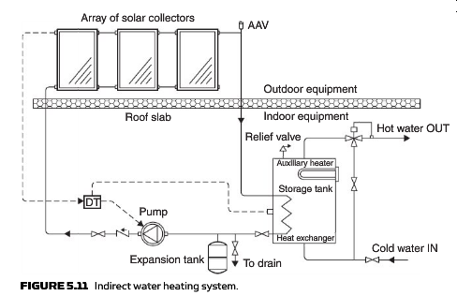
Hot Water Systems
Direct vs Indirect Systems

Slide 32
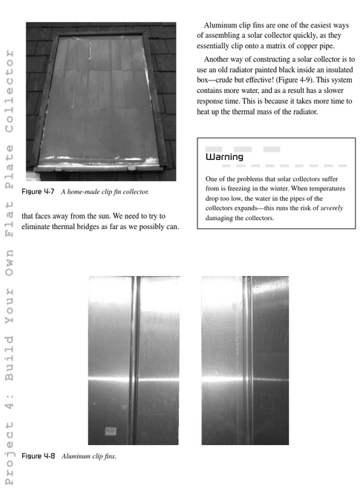
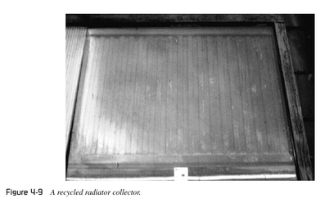
Hot Water Systems

Slide 33
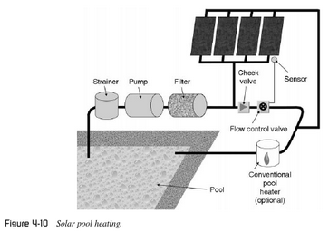
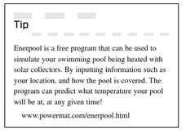

Slide 34
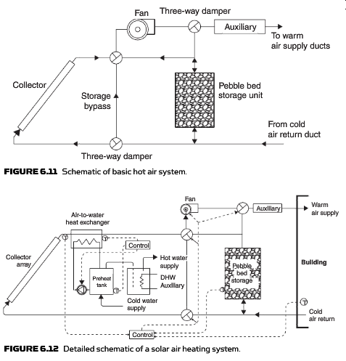

Slide 35
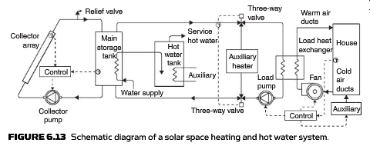

Slide 37
Passive Solar

Slide 38
Passive Solar: Trombe Walls

Slide 39
Passive Solar: Trombe Walls
Ice Fishing Shack

Slide 42
Solar Power Cooling

Slide 43
Swamp Cooler (http://www.youtube.com/watch?v=6ooAAcsbf_0)

Slide 44
A simple system (http://www.youtube.com/watch?v=cz-kquRmvqk)

Slide 49
How it works: Absorption Refrigerator
http://www.youtube.com/watch?v=hUNmDQu_fvY
Industrial Solar Refrigerator in Tunisia
http://www.youtube.com/watch?v=EPbjwv-7fWI

Slide 50
Example of one of these large scale systems (http://www.youtube.com/watch?v=AtMC2MXc_n8)

Slide 51
Einstein Refrigerator

Slide 54
SOPOGY Solar Air Conditioning LiBr

Slide 55
Issac Ice Maker (http://www.energy-concepts.com/isaac)

Slide 56
Ted Talk on Developing World Refrigerator

Slide 57
Solar Cooking

Slide 61
Go Sun Stove (http://www.kickstarter.com/projects/707808908/gosun-stove-portable-high-efficiency-solar-cooker)

Slide 62
Solar Cookers International (http://video.nationalgeographic.com/video/environment/energy-environment/solar-cooking/)

Slide 63
Zn => ZnO Cycle
(Solar Driven Redox Reactions)

Slide 64
Zn => ZnO Cycle (http://en.wikipedia.org/wiki/Zinc%E2%80%93zinc_oxide_cycle)
UNLV (http://www.hydrogen.energy.gov/pdfs/review06/pd_10_weimer.pdf)
PSI/ETHZ (http://www.psi.ch/lst/)

Slide 65
Biomass/Syngas

Slide 66
Biomass/Syngas
Single House Biogas (http://www.youtube.com/watch?v=3th2bcqHbsk)
Moderate Scale Plant (http://www.dailymotion.com/video/xit4aj_xylowatt-biomass-gasification-renewable-syngas_tech)
Biogas in Kenya (http://www.youtube.com/watch?v=qh3mmgiybTw)

Slide 67
Solar Thermolysis
Extreme House (http://www.youtube.com/watch?v=xEdQRVQtffw)
Direct solar theromlysis (http://www.youtube.com/watch?v=fBLGIVm-B2A)
Titania Catalyst (http://www.youtube.com/watch?v=8kJqsDh8cs0)

Slide 68
Algae Tower
CNET Algae Tower (http://www.youtube.com/watch?v=DXLy6E9iEnI)
NASA Algae Project (http://www.youtube.com/watch?v=c7Goyg12Reg)

Slide 69
Algae Tower
CNET Algae Tower (http://www.youtube.com/watch?v=DXLy6E9iEnI)
NASA Algae Project (http://www.youtube.com/watch?v=c7Goyg12Reg)
Hydrogen from Algae (http://www.youtube.com/watch?v=Or_F6qC0sK4)
Hydrogen from Algae Imperial College
(https://www.youtube.com/watch?v=OFByDMRbucs)

