Slide 1
Graphene-based Polymer Bulk Heterojunction Solar Cells
Fei Yu and Vikram Kuppa
School of Energy, Environmental, Biological and Medical Engineering
College of Engineering and Applied Science
University of Cincinnati
APS March Meeting 2012, Boston

Slide 2
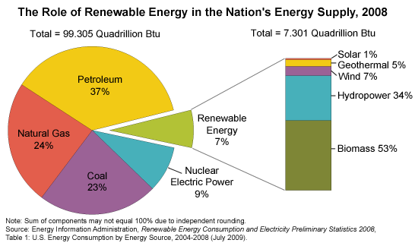
Solar Energy In Development
Renewable
Potential for High coverage
Low emission

Slide 3
A comparison
Inorganic solar cells
From 1941
High processing cost
Thickness in microns
Not flexible
25.0% for Si cells*
Organic solar cells
From 1954
Solution processible
100~300 nm thick
Flexible
6.1% for polymer BHJ cells**
* Green, Progress in Photovoltaics, 2009. 17(3): p. 183-189.
** Park et al., Nat. Photonics, 2009. 3(5): p. 297-U5.

Slide 4
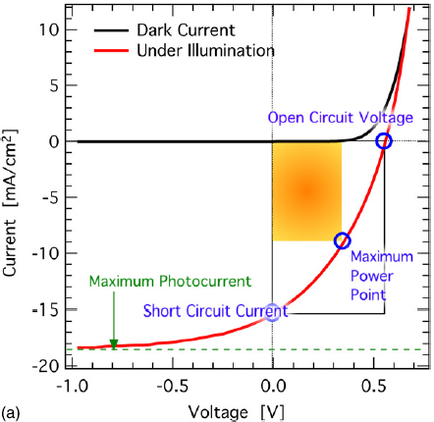
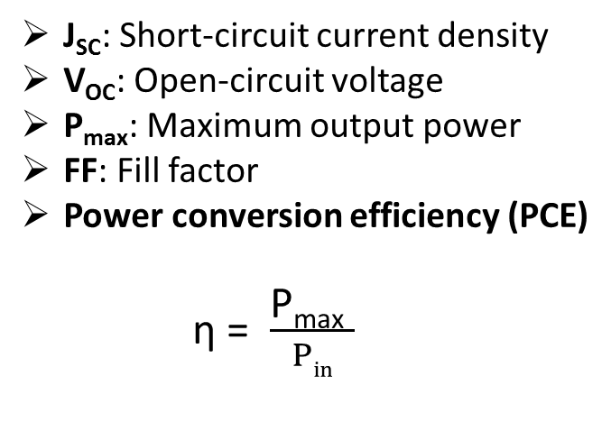
Solar Cell Parameters
J_{SC}: Short-circuit current density
V_{OC}: Open-circuit voltage
P_{max}: Maximum output power
FF: Fill factor
Power conversion efficiency (PCE)
η = $\frac{\text{P}\text{max} }{Pin}$
Picture source: Deibel and Dyakonov, Reports on Progress in Physics, 2010. 73(9): p. 1-39

Slide 5
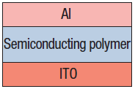
Polymer solar cells
Single-layer device
e⁻
LUMO
hν
Exciton
E_{polymer}
h⁺
HOMO
e⁻
HOMO: Highest Occupied Molecular Orbital
LUMO: Lowest Unoccupied Molecular Orbital
h⁺
~0.3 eV energy is needed to dissociate excitons
An external voltage is required
Recombination of free charge carriers

Slide 6
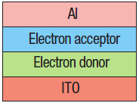
Bilayer Device
D-A interface
e⁻
LUMO_{Donor}
hν
LUMO_{Acceptor}
0.3eV
E_{Donor}
h⁺
E_{Acceptor}
HOMO_{Donor}
e⁻
h⁺
HOMO_{Acceptor}
D-A interface facilitates exciton dissociation
Electron transfer from donor(semiconducting polymer) to acceptor
Exciton dissociation is energetically favorable
Exciton diffusion length(~10 nm)
D-A interfacial area is limited by device geometry

Slide 7
Bulk Heterojunction(BHJ) Solar Cells
Nanoscale penetrating network
D-A interface close to where exciton is generated
Much increased D-A interfacial area
Over 6% PCE for P3HT:PCBM BHJs*
(Picture source: Deibel and Dyakonov, Reports on Progress in Physics, 2010. 73(9): p. 1-39)
*Peet et al., Nature Materials, 2007. 6(7) : p. 497-500.

Slide 8
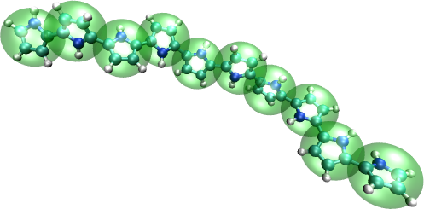
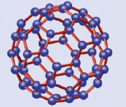
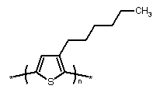
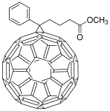
Donor Acceptor
Conjugated polymer
Fullerene(C₆₀)
P3HT
PCBM
Picture source: http://www.mpip-mainz.mpg.de/~andrienk/conferences/DPG_2009/
Castro Neto et al., Reviews of Modern Physics, 2009. 81(1): p. 109-162

Slide 9
Factors Affecting BHJ Performance
Choice of donor and acceptor materials: band gap and miscibility
Choice of solvent: polymer chain packing
Donor-acceptor ratio: domain size
Annealing conditions: reorganize polymer chains, crystallization
Other post-production treatments: DC voltage during annealing for ordered structure *
Morphology Performance
Pictures source: Dennler, Scharber and Brabec, Adv. Mater. 2009, 21(13): p. 1323-1338.
* Padinger, Rittberger and Sariciftci, Adv. Funct. Mater., 2003. 13(1): p. 85-88.

Slide 10
BHJ features
Polymer:Fullerene BHJ device
High interfacial area for exciton dissociation
Bicontinuous network for charge transport
50:50 w/w P3HT:PCBM for optimum performance
Increase P3HT ratio to capture more solar energy
P3HT
PCBM
Notes:
The most widely studied material in polymer:fullerene device is…
For such device, optimal device performance is achieved at 50:50 P3HT:PCBM ratio.
Excitons only generate in P3HT phase, and PCBM is photo-inactive
The goal of our research is to…

Slide 11
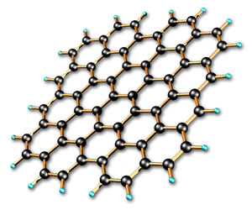
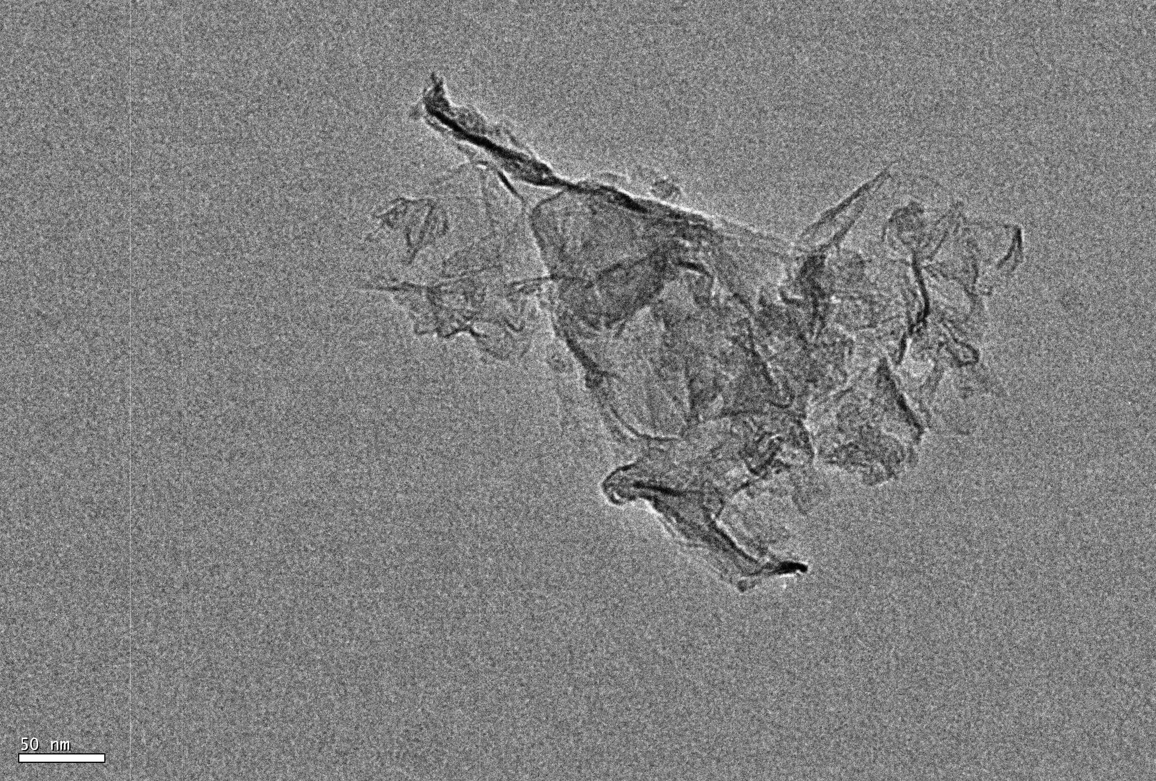
Pristine Graphene
OPVs with chemically modified graphenes were reported*
Excellent conductivity and high aspect ratio
Percolation paths at very low fraction
TEM image of pristine graphene flake
t=0.35 nm
Dia.~550nm
Scale bar=50nm
*Liu, Z. et al., Adv. Mater., 2008. 20(20),
Yu, D. et al., ACS Nano, 2010. 4(10), Yu, D. et al., J. Phys. Chem. Lett., 2011. 2(10).
Notes:
No functional groups
Conductivity: 2400 S m-1 for graphite
0.021 S m-1 for GO
As a result, we are able to make active layer with more than…

Slide 12
The Active layer
+
−
        P3HT(~90.99%)
        PCBM(~9%)
        Graphene(~0.01%)

Slide 13
Device Fabrication
Patterned ITO as bottom electrode
Anode
PEDOT:PSS by spin coating
10:1 P3HT:PCBM(w/w) with graphene by spin coating
LiF and Aluminum
Cathode
Fabricated and annealed in N₂

Slide 14
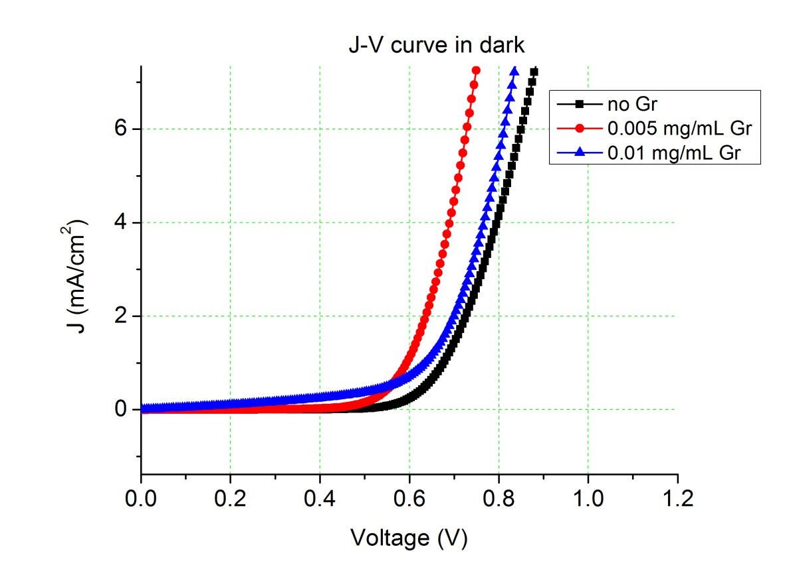
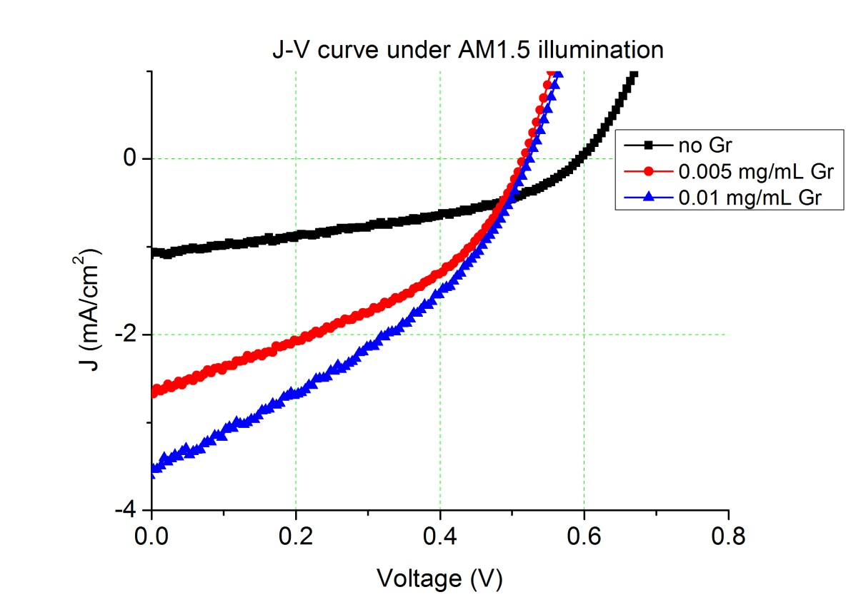
Device Characterization
J-V characteristics

Slide 15
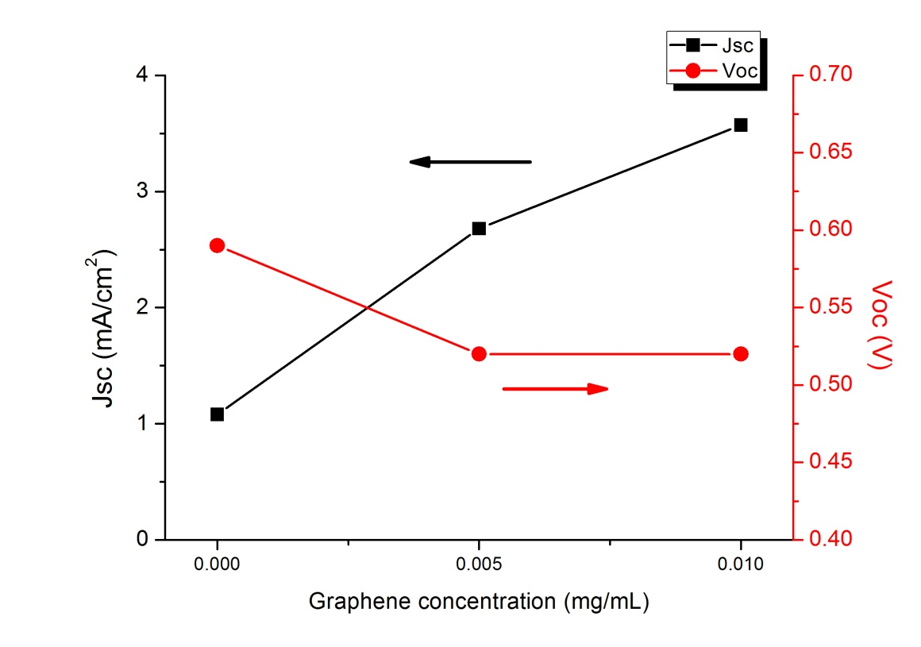
Cell performance summary
Notes:
Dramatically increased Jsc and efficiency
Evidence of efficient charge transfer
Reduced Voc
Low FF limit device efficiency

Slide 16
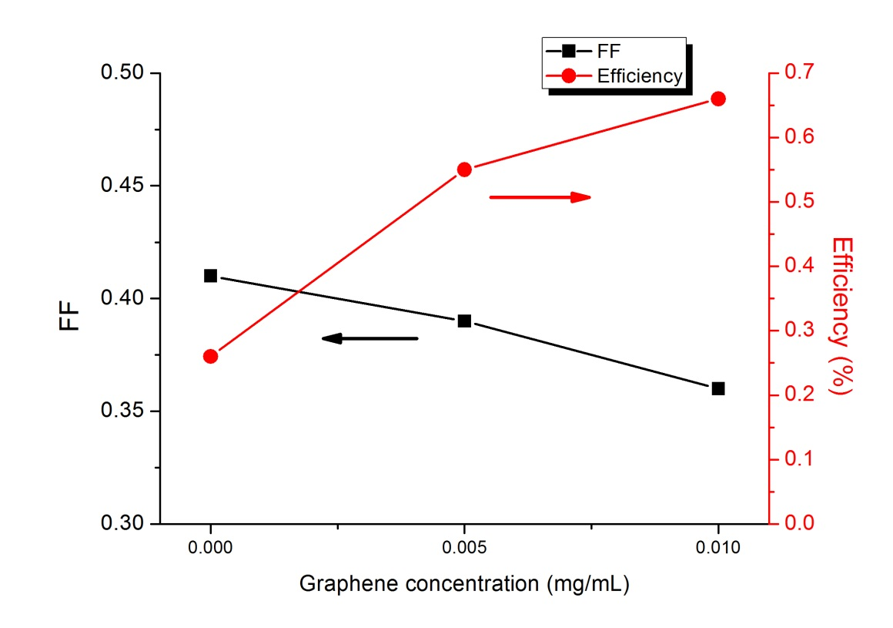
Cell performance summary(cont.)

Slide 17
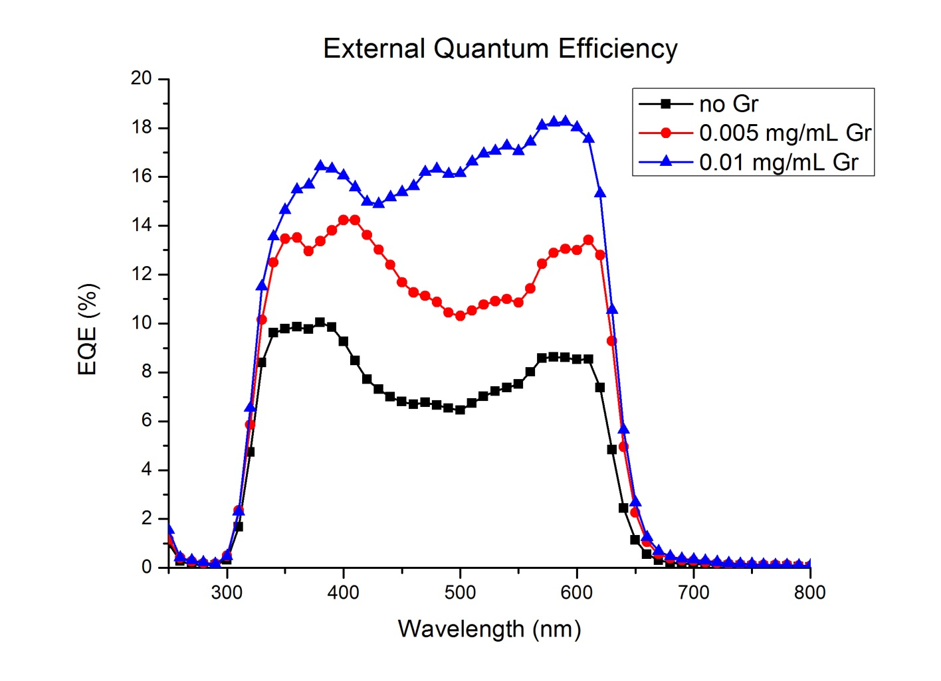
Device Characterization(cont.)
External Quantum Efficiency(EQE)*
Morphological change
*Yu and Kuppa, App. Phy. Lett. (submitted)
Notes:
One thing we should notice here is the change of peak shape, and it is related to morphological change when graphene is added

Slide 18
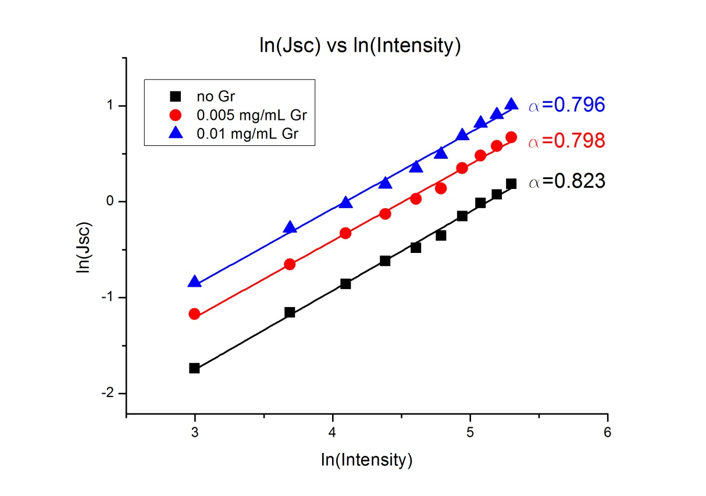
Device Characterization(cont.)
Recombination mechanism
J_{SC} ~ P_{In} ^{α}
α=1: monomolecular(geminate) recombination
α=0.5: bimolecular(non-geminate) recombination
greater bimolecular recombination
* Pientka, M. et al., Nanotechnology, 2004. 15(1): p. 163-170.
Notes:
Generally Jsc increase with illumination intensity exponentially, and the scaling behavior is an indicate of recombination mechanism.
Monomolecular: mobility of one charge carrier is much larger than the other.

Slide 19
Conclusions
Adding small fraction of graphene greatly enhances charge transport and leads to much better J_{sc} and η
Cells with more than 90% P3HT are viable
Introduction of graphene in active layer leads to change of morphology
Device physics change with increasing graphene fraction
*Yu and Kuppa, App. Phy. Lett. (submitted)

Slide 20
Future Work
Better dispersed and oriented graphene via morphological control
Increase FF by reducing interfacial roughness
Stability and device encapsulation
FY and VKK thank UC and the URC for funding and support

Slide 21

Thank you!

