Slide 2
Michael Grätzel, YouTube EPFL
How the cell is made
G24i

Slide 3
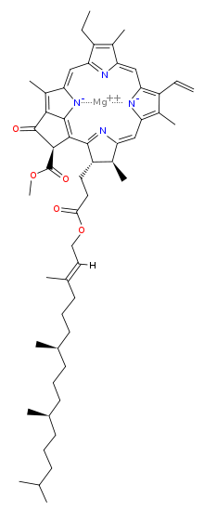
Why not make an artificial leaf?
Porphyrin Ring
Chlorophyll a
(Why Green
And not Black?)

Slide 4
Why not make an artificial leaf?
Incident light excites electrons in porphyrin ring.
Chlorophyll is in a protein complex that separates charge.
Charged chlorophyll is reduced by oxidation of water. 2 Waters are oxidized releasing O₂ and protons, 4H⁺.
The released electrons power the transport of protons further interact with ATP for cell energy eventually reducing CO₂ to sugars.
Porphyrin Ring
Light
Chlorophyll a

Slide 5
Why not make an artificial leaf?
1970 Helmut Tributsch
and Melvin Calvin wanted to
study the electrochemical
properties of chlorophyll in an extra
cellular environment (away from
the protein).
They found they could achieve charge separation
using large band gap semiconductors
ZnO or CdS in contact with an electrolyte.
Chlorphyll injects electrons from excited levels into
the conduction band giving an anodic photocurrent.
Charge separation is irreversible.
The electrolyte is oxidized at the chlorophyll molecule
and is reduced at the cathode to complete the circuit.
Porphyrin Ring
Light
Chlorophyll a

Slide 6
Why not make an artificial leaf?
1970 Helmut Tributsch
and Melvin Calvin used this
process to measure the absorption
Spectrum of various chlorophylls
And other natural organic dyes.
In the absence of an energy gap
the charged chlorophyll molecule is
quenched since both holes and electrons
can be conducted in metals.
They used ZnO semiconductor anode
Platinum cathode in KCl electrolyte solution.
Porphyrin Ring
Light
Chlorophyll a

Slide 7
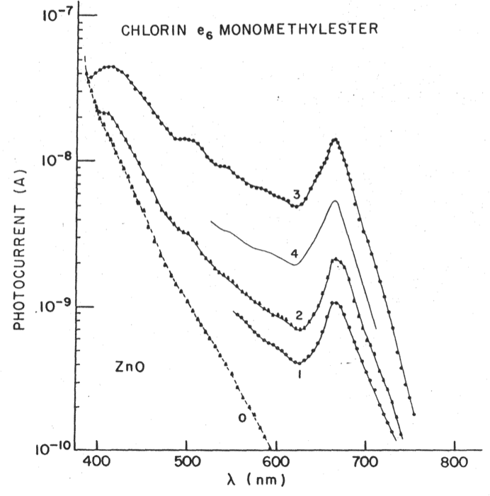
Why not make an artificial leaf?
Photocurrent measured
Porphyrin Ring
Light
Chlorophyll a

Slide 8
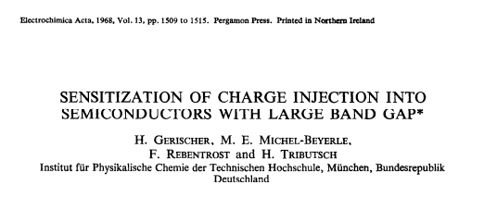
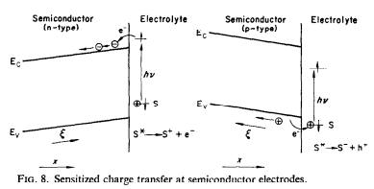

Slide 9
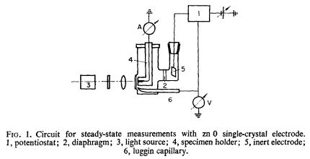

Slide 10
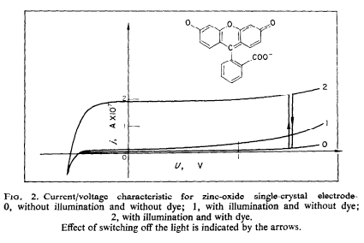

Slide 11
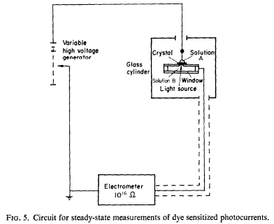
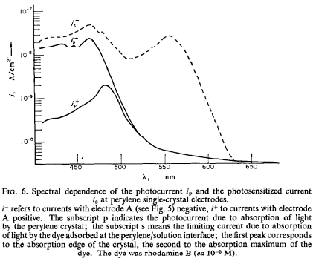

Slide 12
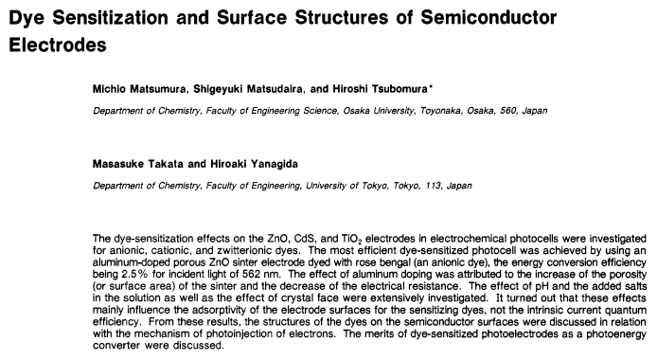

Slide 13
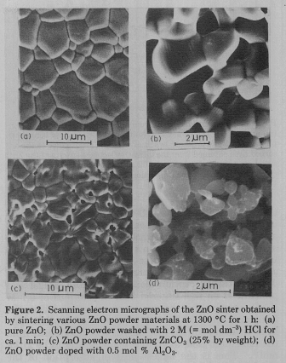
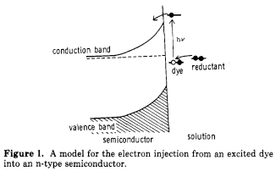
Use a Porous electrode to improve efficiency
Lifetime still a problem

Slide 14
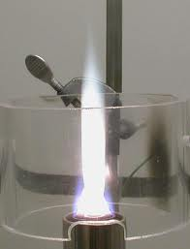
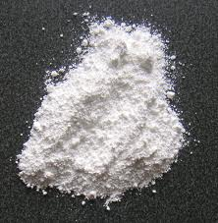
Optimum porous electrode is pyrolytic titania made in a spray flame as a
Pigment in white paint, paper etc.

Slide 15
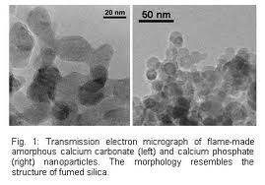
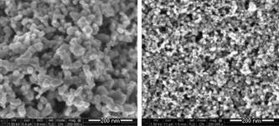
Optimum porous electrode is pyrolytic titania made in a spray flame as a
Pigment in white paint, paper etc.

Slide 16
Compared to a silicon solar cell the Grätzel cell separates duties that are done by the pn-junction.
Electron-hole pair are generated in the dye molecule (depletion zone in Si). Charge separation occurs at the dye/semiconductor interface due to the band gap in the semiconductor an ionization energy level difference between the dye and semiconductor conduction band (for electrons) or valence band (for holes). This is done also by the pn junction in silicon.
Charge transport is done by the semiconductor and the anode. At the cathode the elecrolyte is reduced and an electron is carried to the dye molecule to compete the circuit. This is all done by the silicon in a pn-junction cell.

Slide 17
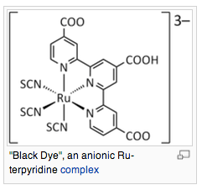

Slide 18
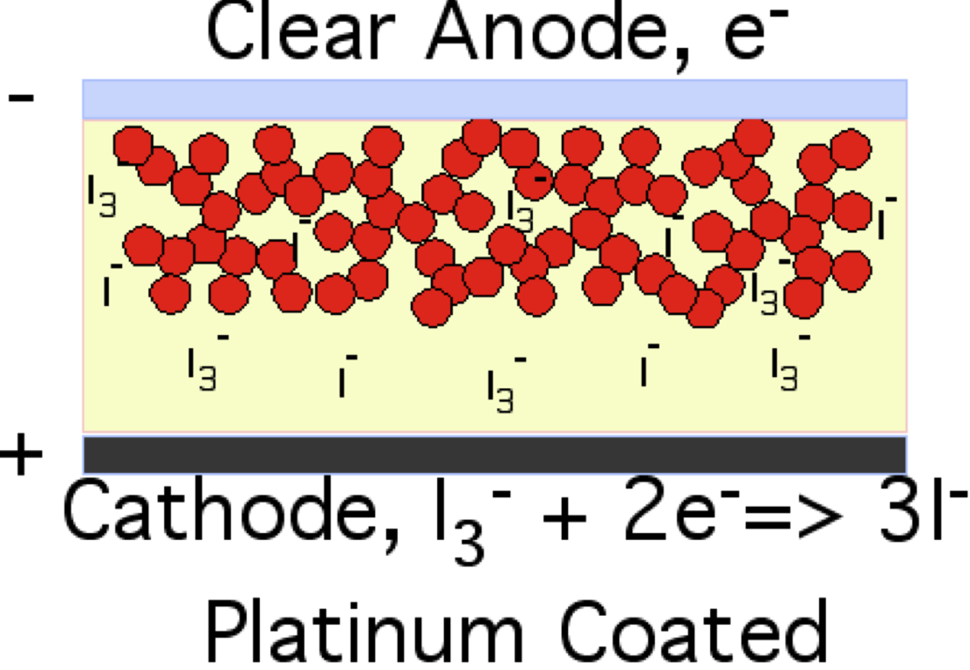
One type of simple photovoltaic device
that could be produced in Africa
Schematic of a Graetzel Cell. Red circles are titania aggregates coated with a dye. Pink background is an iodide electrolyte gel. Platinum coated cathode is at the bottom and a clear plastic sheet coated with fluorine doped tin oxide anode is at the top.

Slide 19
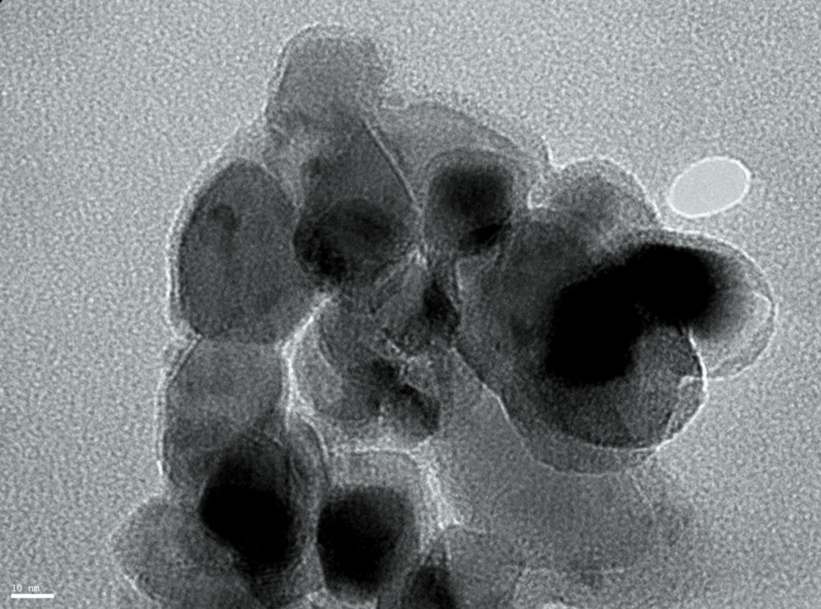
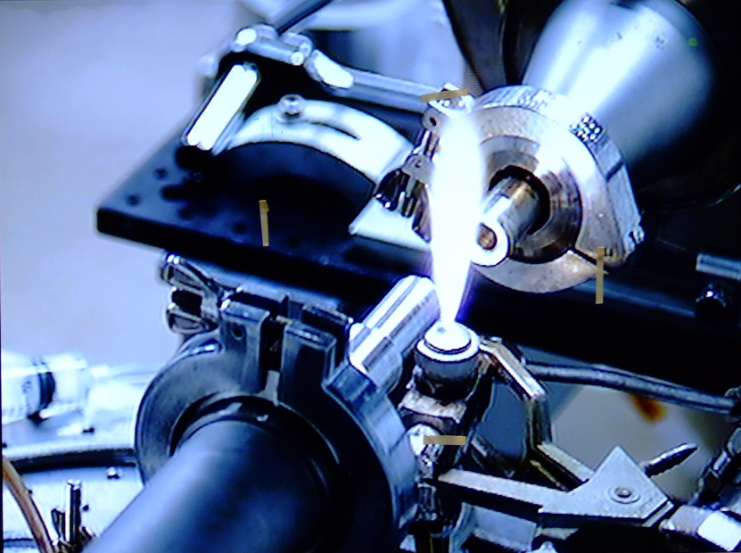
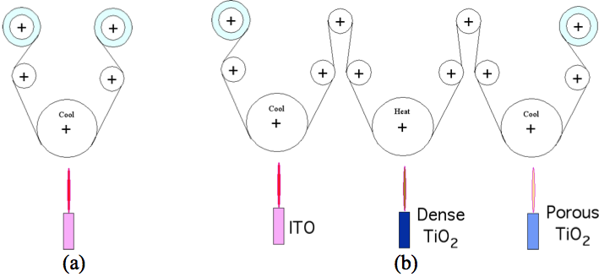
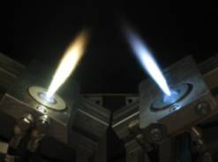
Grätzel Cell Production by Spray Flame
-Dye/titania development for inexpensive single step synthesis
-Use carbon coated titania to enhance interaction
-Use in situ synthesized CdS nano particles supported on titania
-A single reel-to-reel, flame-based process for coating of plastic substrates
in a continuous process for flexible solar cell sheets.

Slide 20
Grätzel Cell or Dye Sensitized Solar Cell
Web link to Grätzel Cell Fabrication
College/High School Lab to Make a DSSC

Slide 21
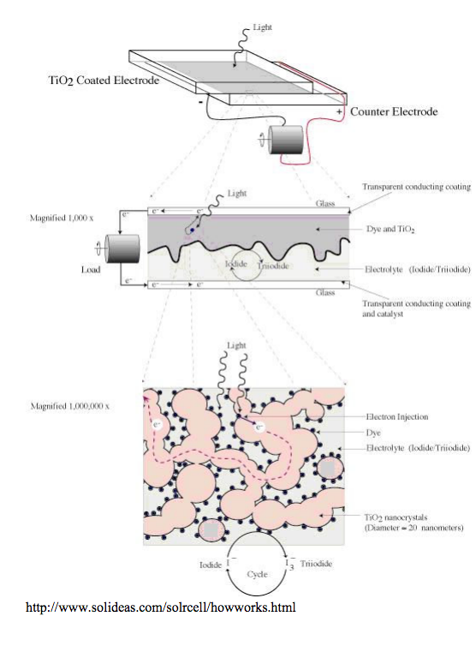
Grätzel Cell or Dye Sensitized Solar Cell
Lab UTexas

Slide 22
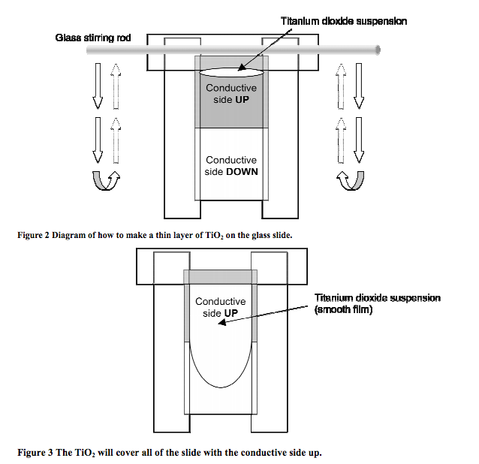
Grätzel Cell or Dye Sensitized Solar Cell
Lab UTexas

Slide 23
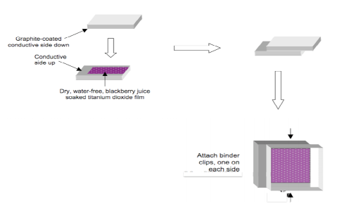
Grätzel Cell or Dye Sensitized Solar Cell
Lab UTexas

Slide 24
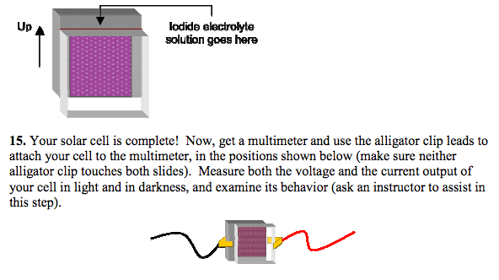
Grätzel Cell or Dye Sensitized Solar Cell
Lab UTexas

Slide 25
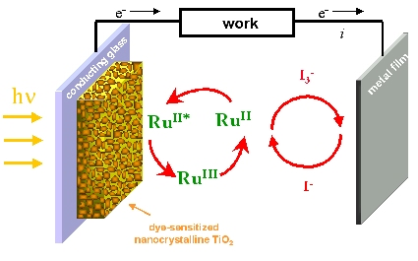
Grätzel Cell or Dye Sensitized Solar Cell

Slide 26
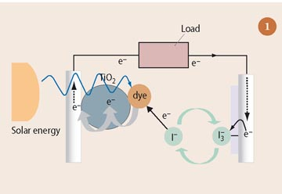
Grätzel Cell or Dye Sensitized Solar Cell

Slide 27
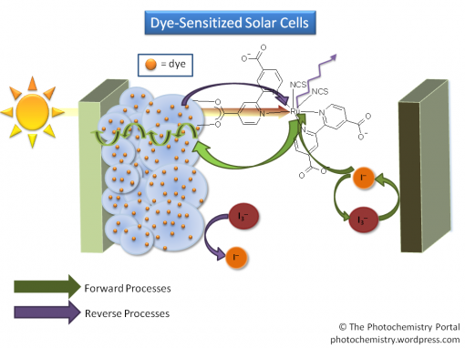
Grätzel Cell or Dye Sensitized Solar Cell

Slide 28
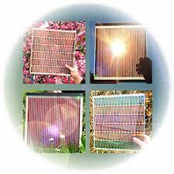
Grätzel Cell or Dye Sensitized Solar Cell

Slide 29
Dyesol, Queanbeyan, New South Wales

Slide 30
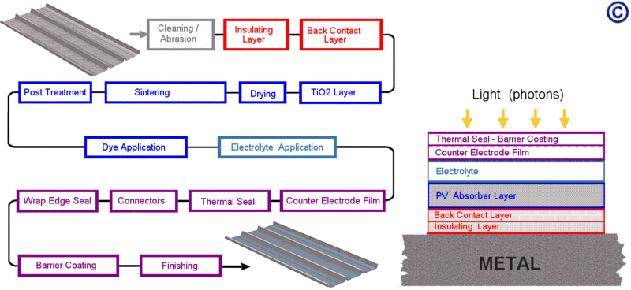
Dyesol, Queanbeyan, New South Wales

Slide 31
How to Make a Perovskite Cell
Solaronix Switzerland

Slide 32
Purchase DS Solar Cells
DSSC Chemicals for Sale
Solaronix Switzerland
Sony DSSCs
Gcell (Video in bottom left)
G24innovations Australia

Slide 33
Fujikura
Perovskite Solar Cell
Perovskite Improvements Park
TED Talk on Perovskite

