Slide 1
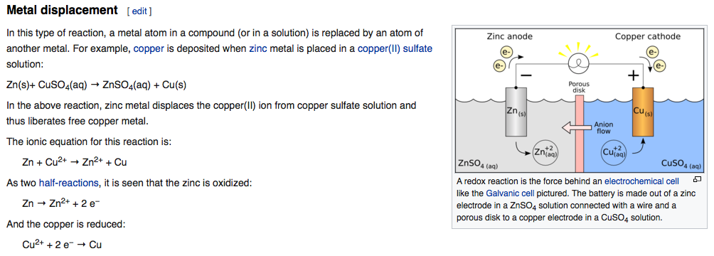
Oxidation/Reduction Metal Displacement Reaction
oxidation
reduction
1.10 Volts for each cell

Slide 2
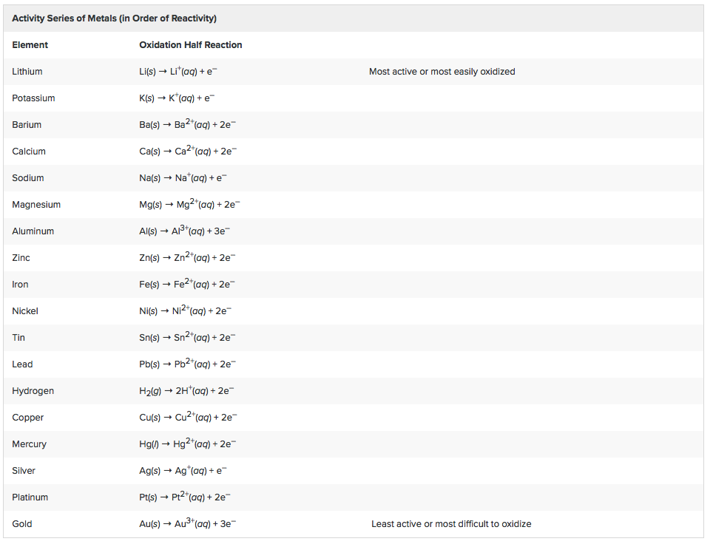
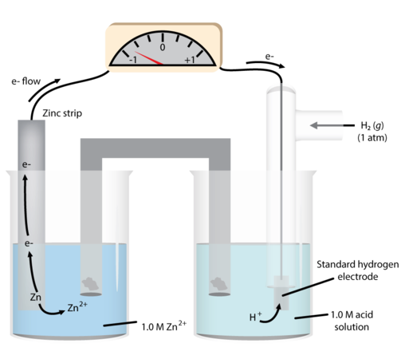
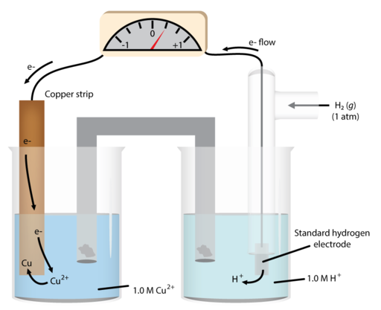
Oxidation/Reduction Metal Displacement Reaction
-0.76 V
0.34 V

Slide 3
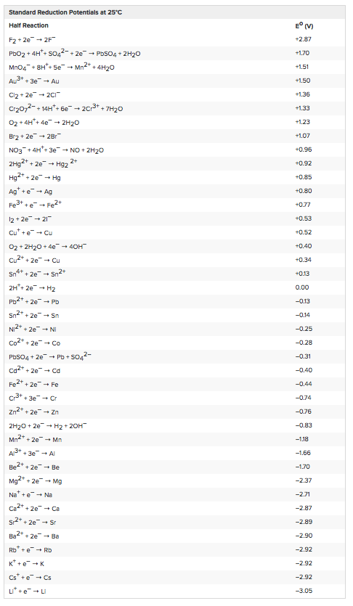

Slide 4
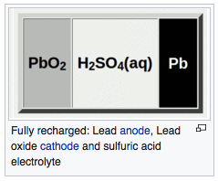
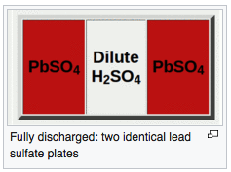
Deep Cycle Lead Acid Battery Manufacture
Lead Acid Battery Technologies (eBook at UC)

Slide 5
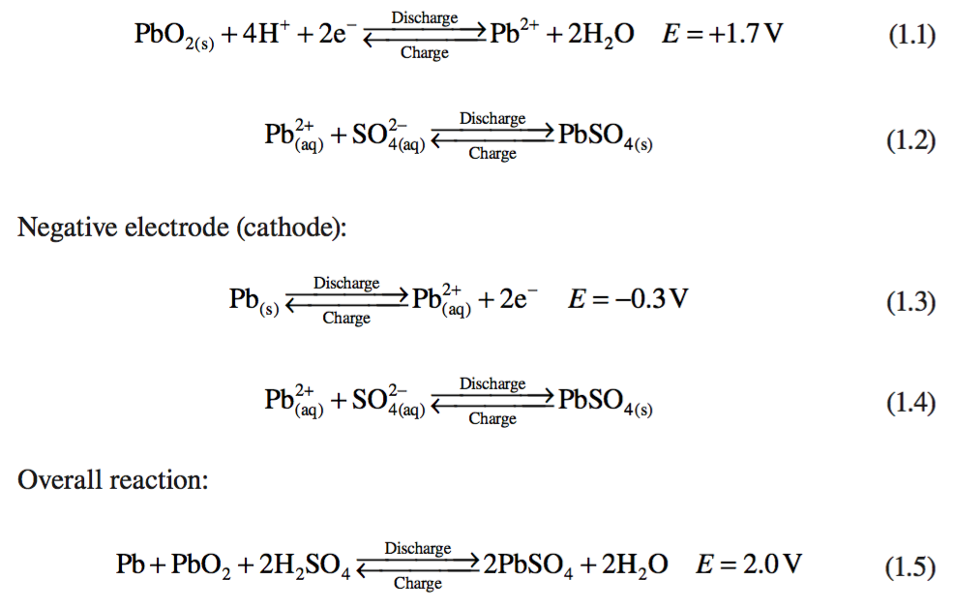
Reduction
Oxidation

Slide 6
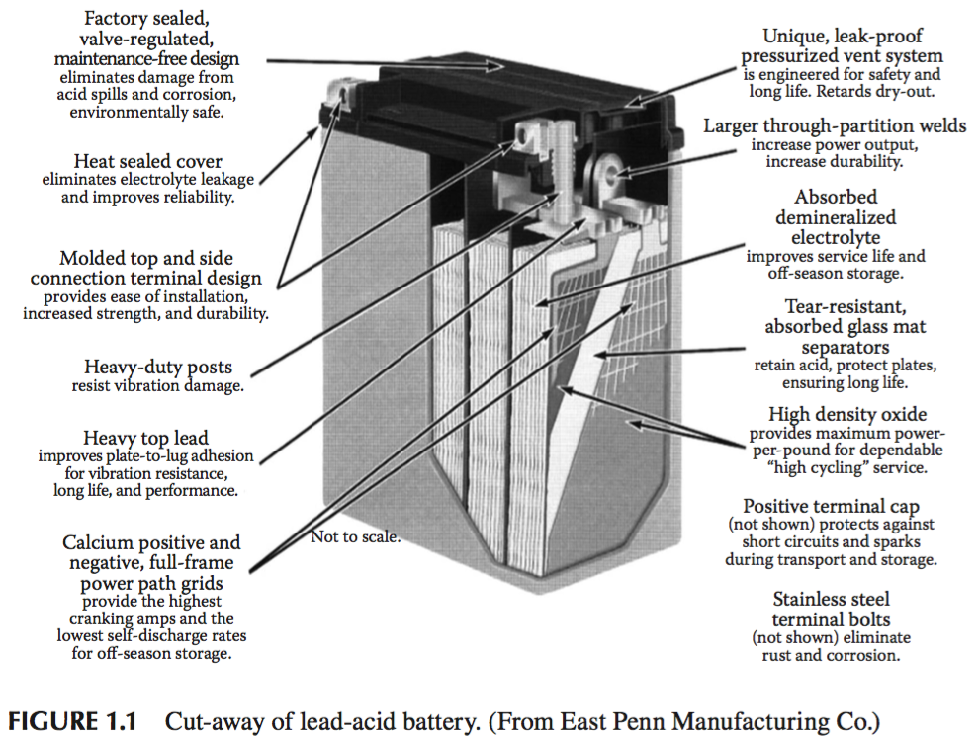

Slide 7
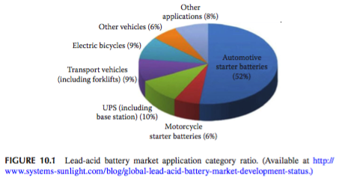

Slide 8
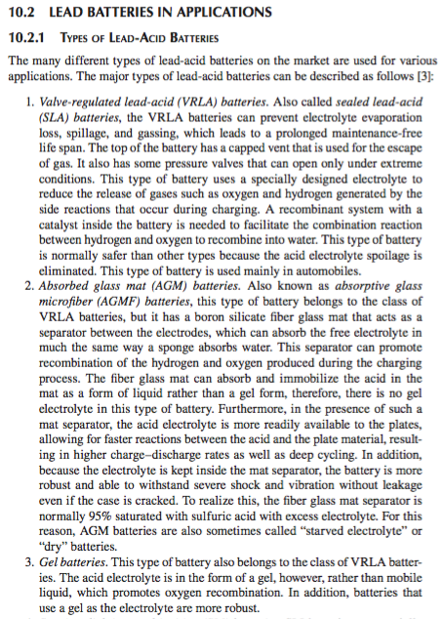

Slide 11
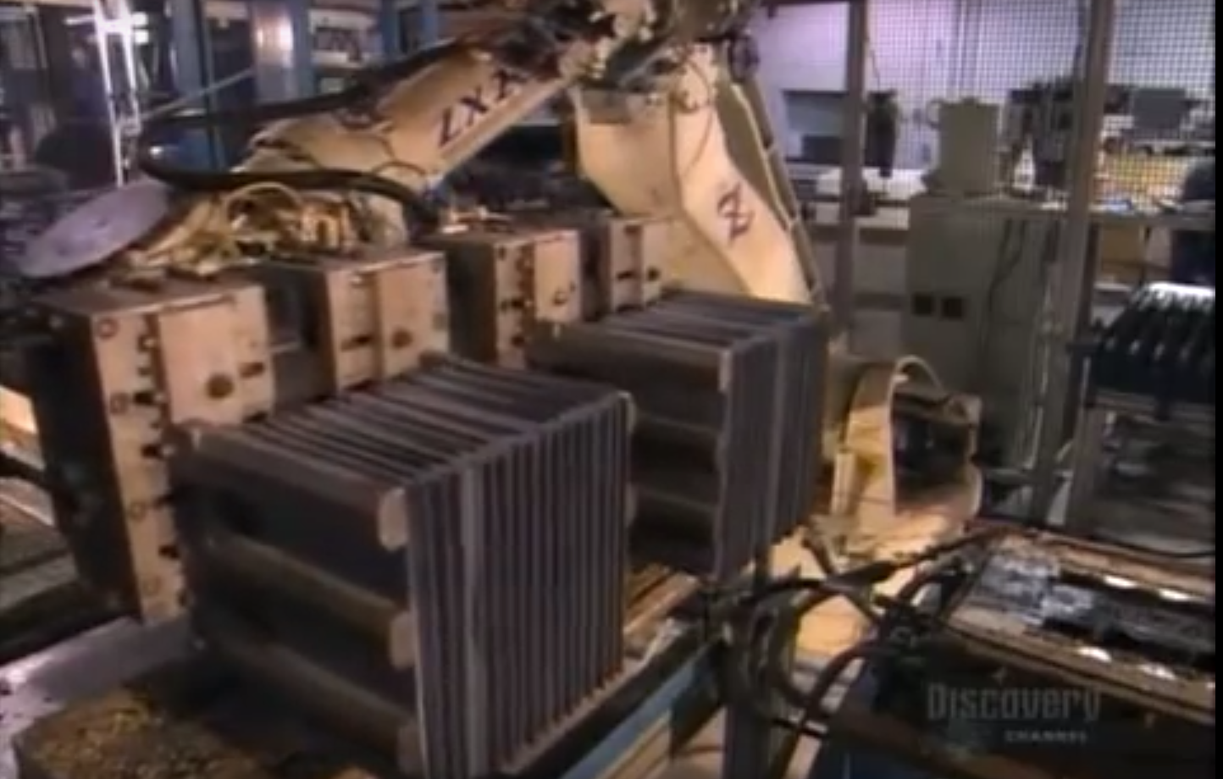
Deep Cycle Battery Manufacture in the Developed World

Slide 12
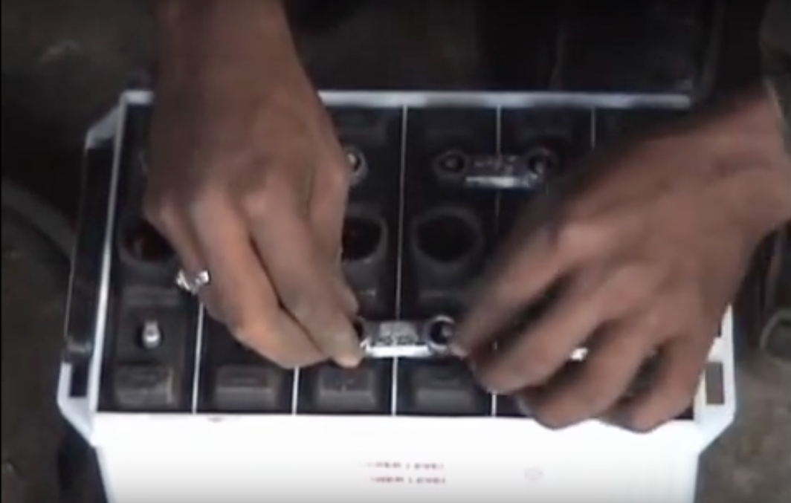
Battery Manufacture in Nepal Part 1
Battery Manufacture in Nepal Part 2

Slide 13
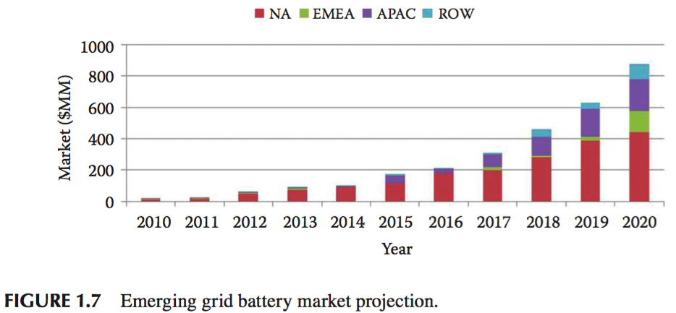

Slide 14
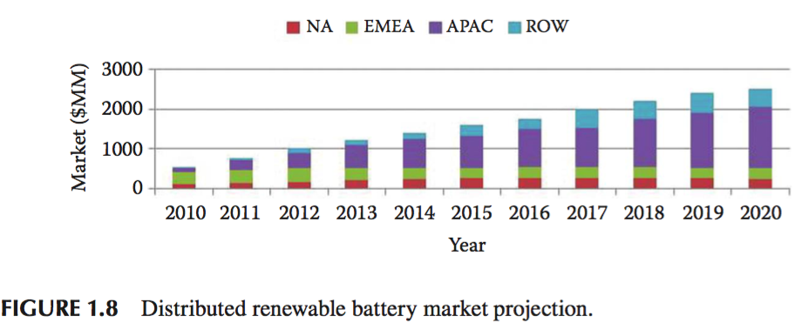

Slide 15
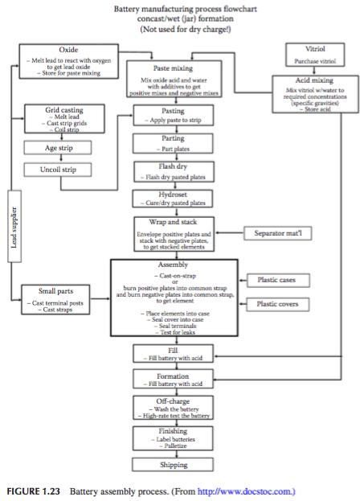
Vitriol = Sulfate

Slide 16
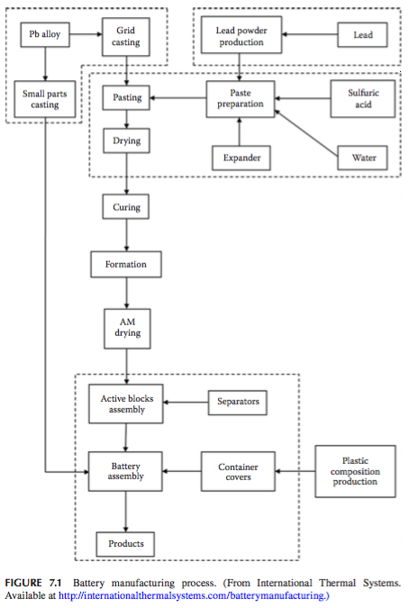

Slide 17
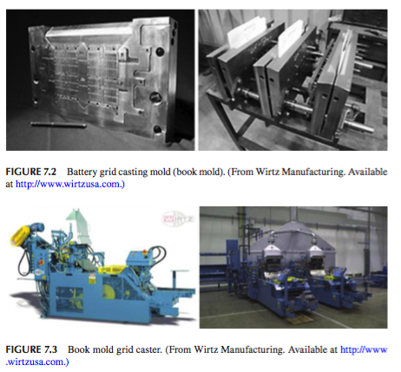

Slide 18
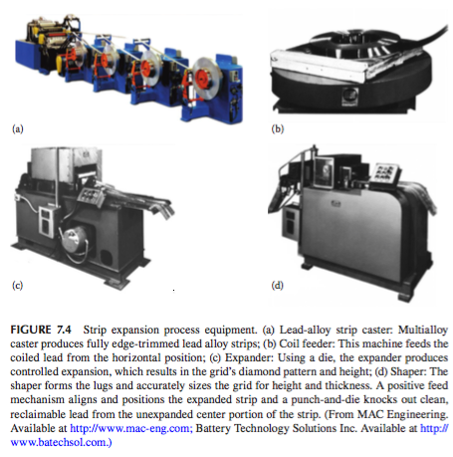

Slide 19
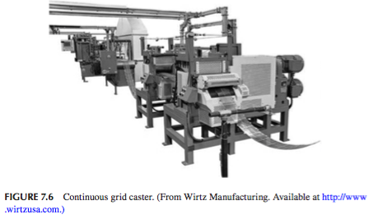

Slide 20
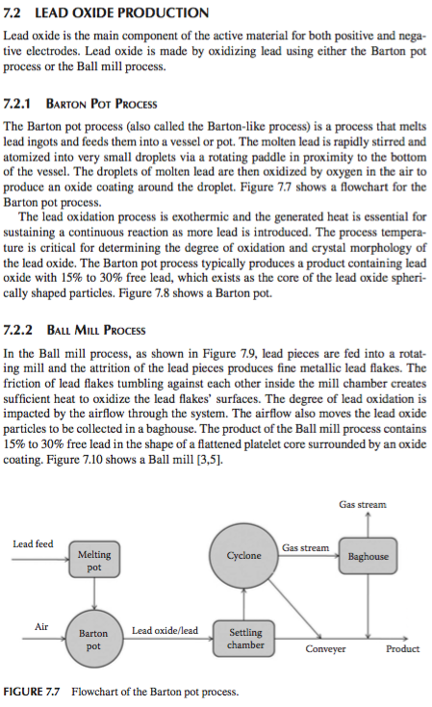

Slide 21
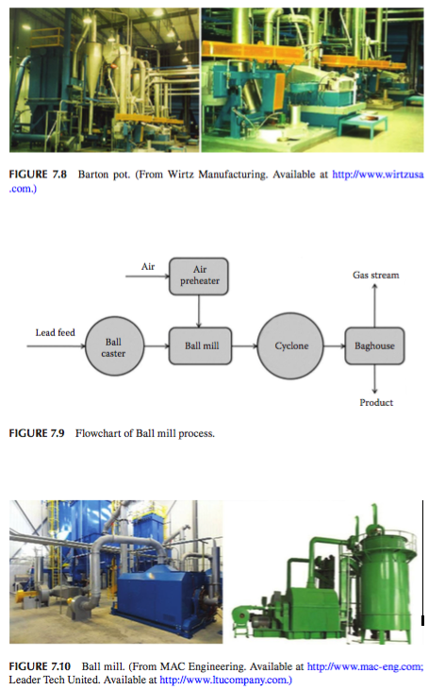

Slide 22
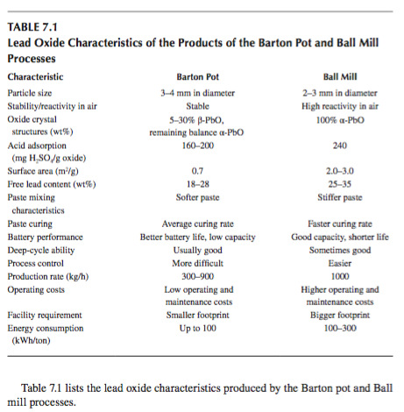

Slide 23
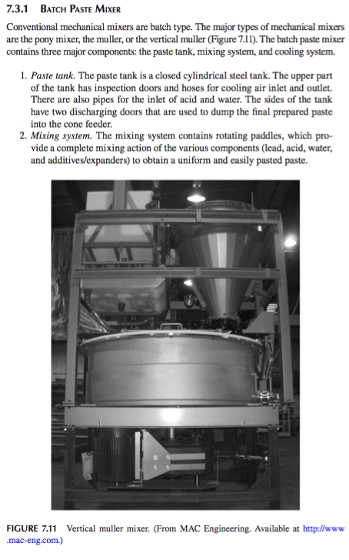

Slide 24
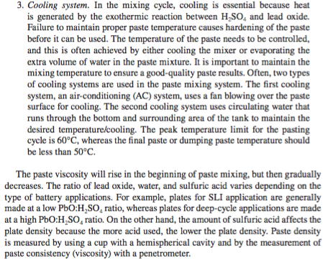

Slide 25
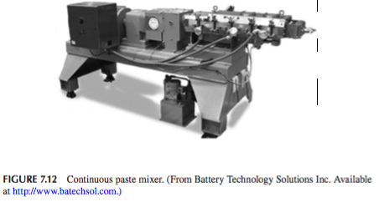

Slide 26
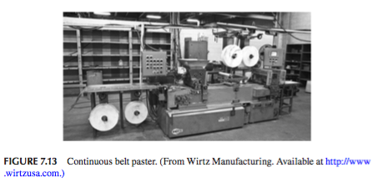

Slide 27
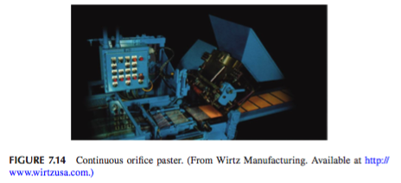

Slide 28
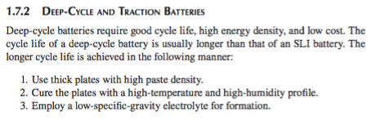

Slide 29
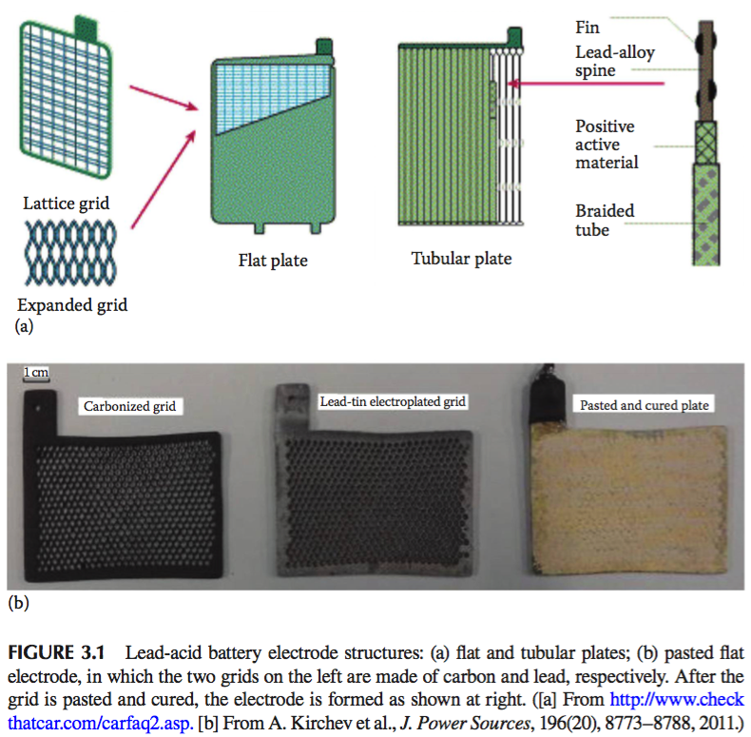

Slide 30
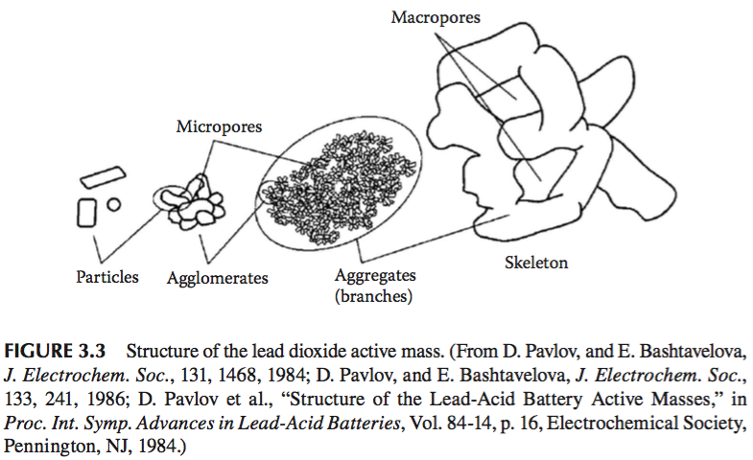

Slide 31
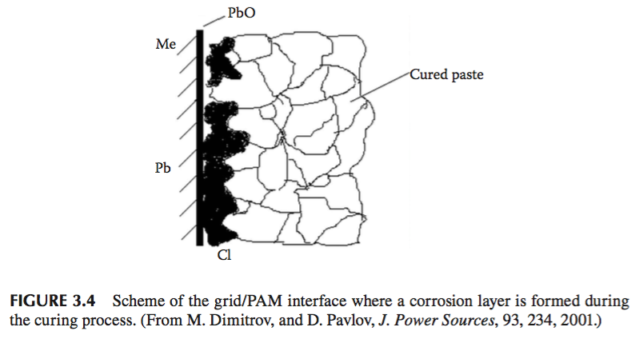

Slide 32
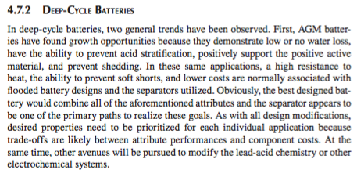

Slide 33
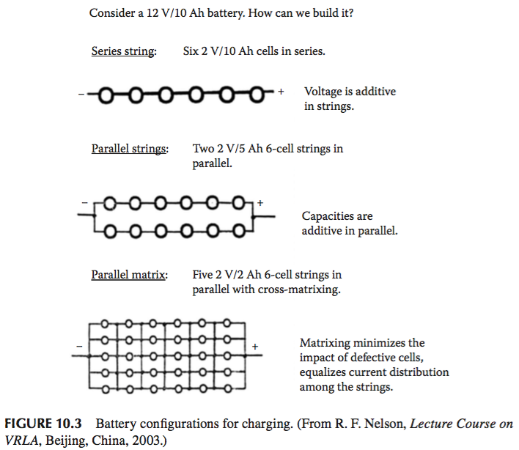

Slide 34
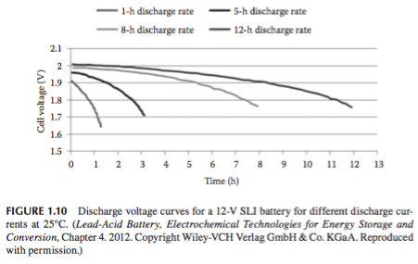

Slide 35
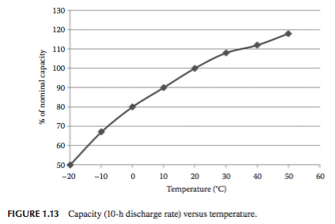

Slide 36
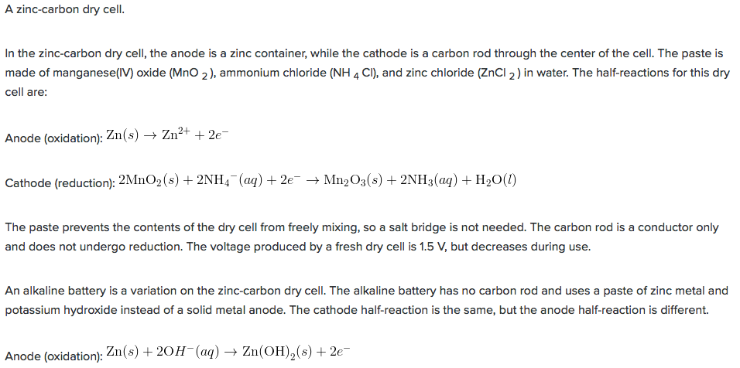
Alkaline Dry Cell

Slide 37
Flow Cells (Flow Batteries)

Slide 38
Zinc Bromide Flow Cell

Slide 39
Zinc Bromide Flow Cell

Slide 40
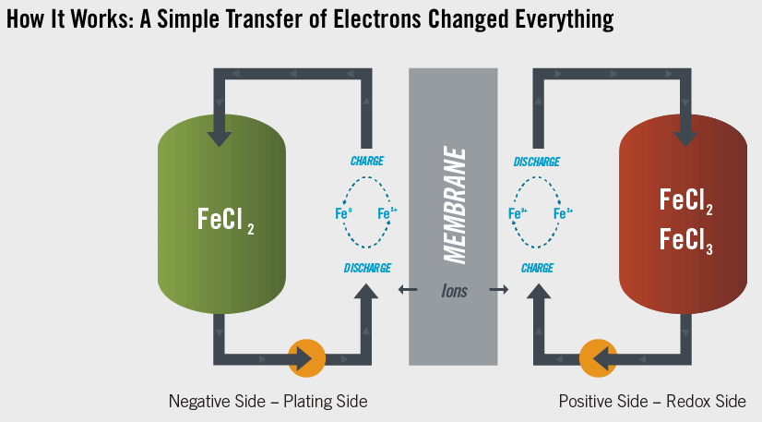
Iron Water Flow Cell
https://www.youtube.com/watch?v=HmtI8Wat7rY

Slide 41
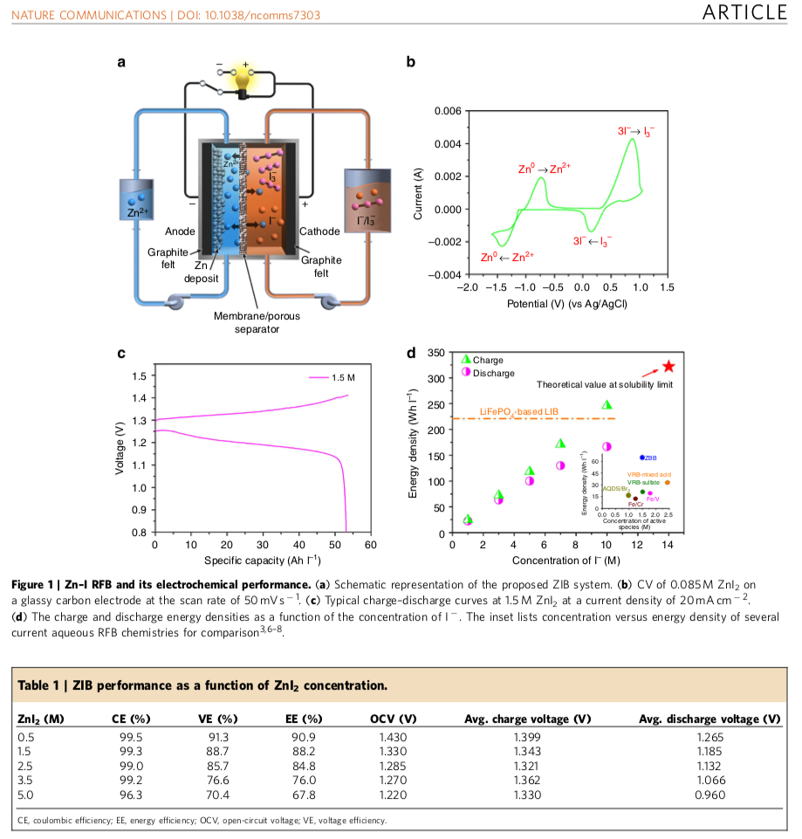
PNL
Zinc Polyiodide
Cell

Slide 42
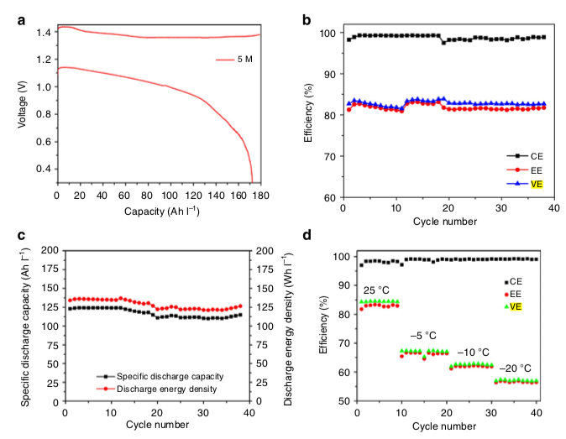
PNL
Zinc Polyiodide
Cell

Slide 43
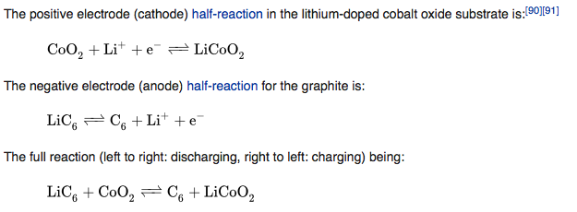
Lithium Ion Battery
Lithium
Cobalt Oxide
Cathode
Silicon
Anode

