Slide 1
US Energy Trends and Electrical Grid Challenges
October 2023
Sean Behm, Environmental & Chemistry Manager, Miami Fort Power Plant [North Bend, Ohio]

Slide 2
Discussion Topics
Electrical Grid Overview
  Local Transmission Infrastructure & Generation
  Robustness & Fragility –
    June15, 2022 AEP Columbus Incident
    2023 Winter Storm Elliot
    Challenges in CA & TX
Energy Transition in PJM
Energy & Electricity Trends (EIA) [If time]
Ohio Deregulation & Consumer Choice

Slide 3
ELECTRICITY - WATT IS IT?
The movement of electrons through a conductor
Measured in Watts= Voltage X Current
Made & Used INSTANTANEOUSLY
Miami Fort Station
Produces 1,100 Mega Watts
Or
1,100,000,000 Watts
Or
Enough electricity to light 11,000,000 100-watt lights bulbs at once…even more LEDs!
Enough electricity to power nearly 800,000 homes

Slide 4
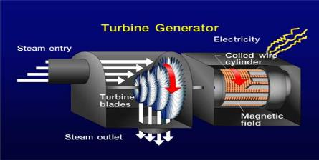
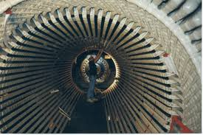
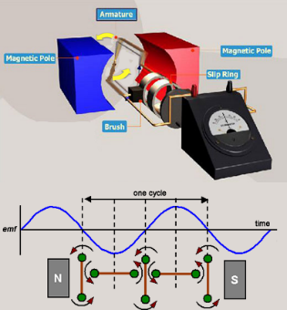

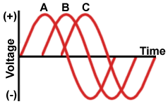
ELECTRICTY - How is it made?
Generator Facts
Similar to a large electric motor
The turbine shaft is connected to the shaft of the generator, where magnets spin within wire coils to produce electricity
Rotor spins at 3600RPMs = 60Hz
  60 revolutions per second
Generator produces 22,000 volts of electricity at 18,000 amps
Cooled with Hydrogen Gas

Slide 5
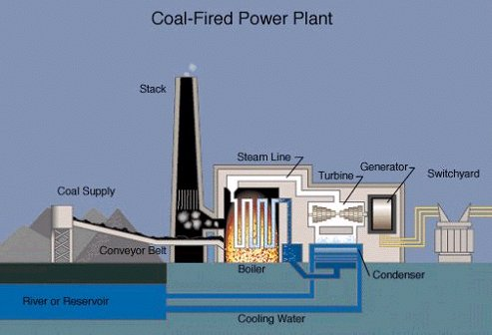
How do coal fired power plants work?

Slide 6
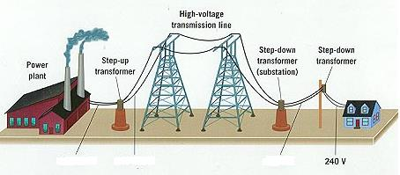
ELECTRICITY - How does it get to your house?
Electric Transmission Facts
From the generating stations, large amounts of electricity are transported on transmission lines.
Next, substations convert the transmission line voltage to lower levels that are used in local communities. Substations also control the flow of electricity and protect the lines and equipment from damage.
A transformer converts the distribution level voltage to levels that can be used inside your home or business. That voltage ranges from 120 to 480 volts.

Slide 7
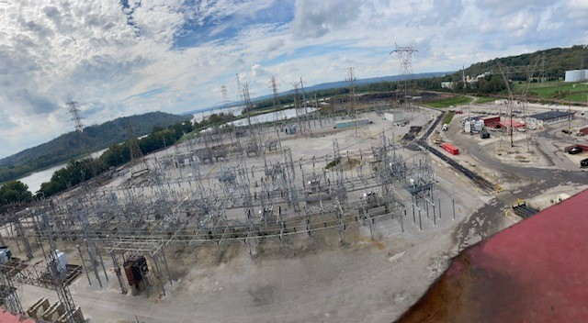
ELECTRICITY – Miami Fort Switchyard Picture

Slide 8
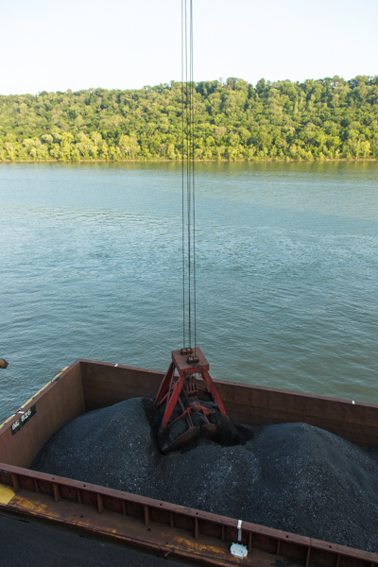
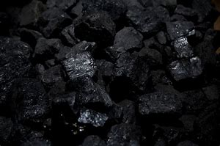
Component- COAL
Miami Fort Station Facts
Receives all its coal on river barges.
Coal comes from OH, KY, WV, IL.
Burns approximately 12,500 tons per day or 4.0 million tons per year
All coal is different

Slide 9
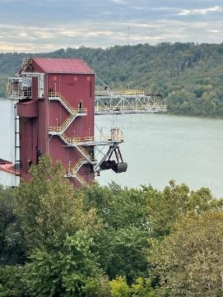
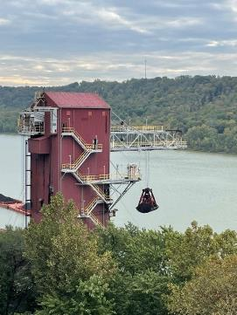
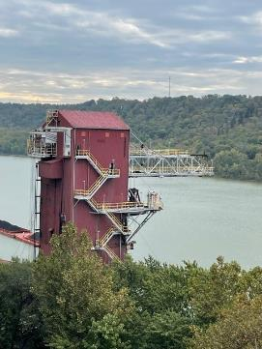
Coal Barge Unloader – Additional Pictures

Slide 10
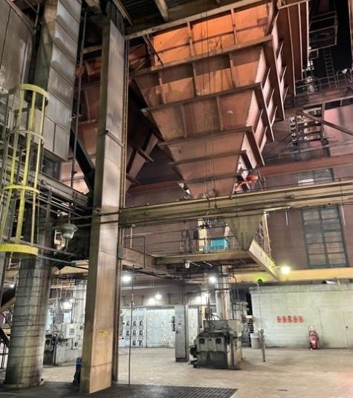
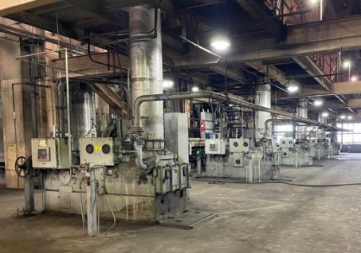
Component- Bunker and Feeder Pictures

Slide 11
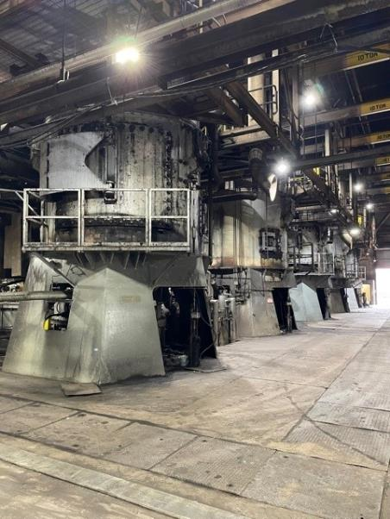
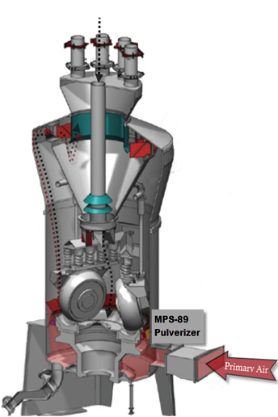
Component- Pulverizer Pictures

Slide 12
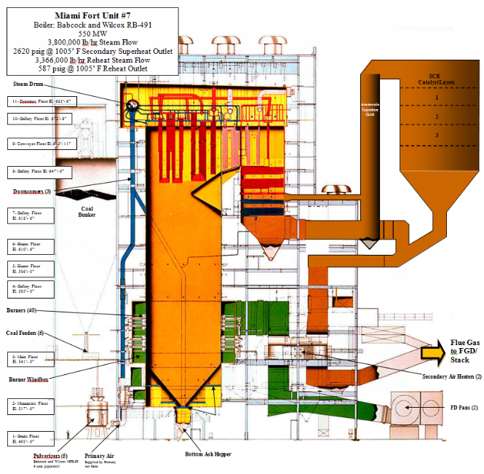

Component- Boiler
Boilers can produce flame temps of greater than 3,000°F at with steam pressures greater than 2,700 psi
1005°F superheated steam is then piped to the turbine

Slide 13
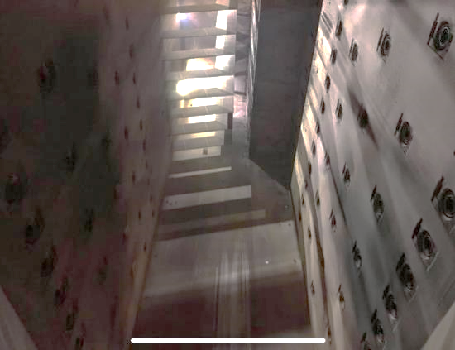
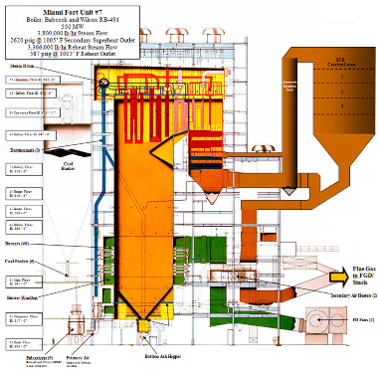
Component- Boiler Pictures
W. H. Zimmer Power Plant Steam Generator, largest formerly operating boiler in the world

Slide 14
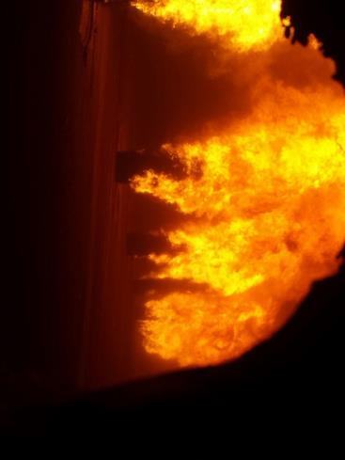
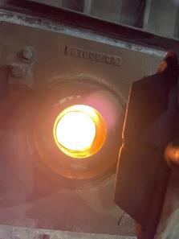
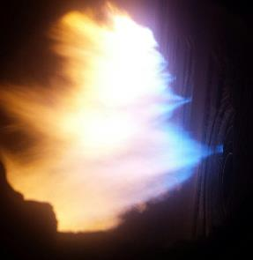
Component- Boiler Pictures

Slide 15
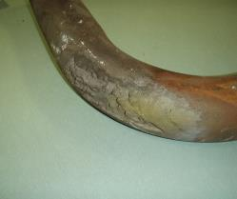
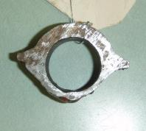
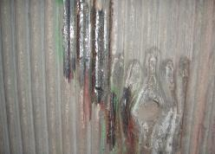
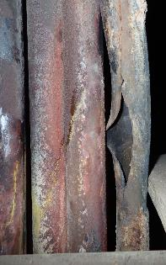
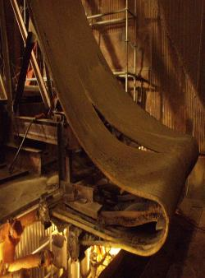
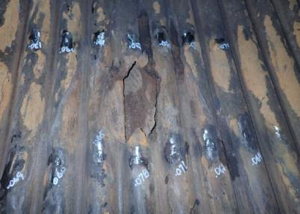
Component- Boiler problems
Boiler Tube Failures - #1 Cause of Forced Outages at plant
Poor Combustion / Overheating / Slag
Corrosion / Erosion
  Coal Specs
OUTAGES!!!! LOST $$$$

Slide 16
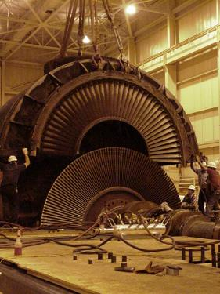
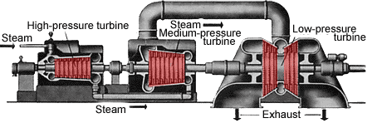
Component- Steam Turbines
Mechanical device that extracts thermal energy from pressurized steam and converts it into useful mechanical work.
  Rotates at 3,600 RPM’s
The high pressure steam (2,400 psi @ 1,005°F) drives the turbine through a series of “blades” which rotates the turbine shaft.
  The turbine shaft is connected to the shaft of the generator.
  The exhausted steam is condensed and returned to the boiler to go through the process again.
G

Slide 17
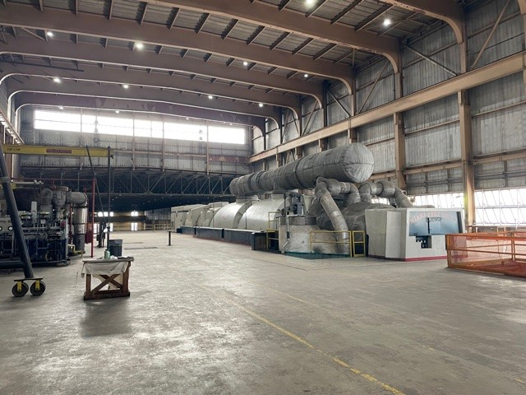
Component- Steam Turbine – Unit 7 Turbine

Slide 18
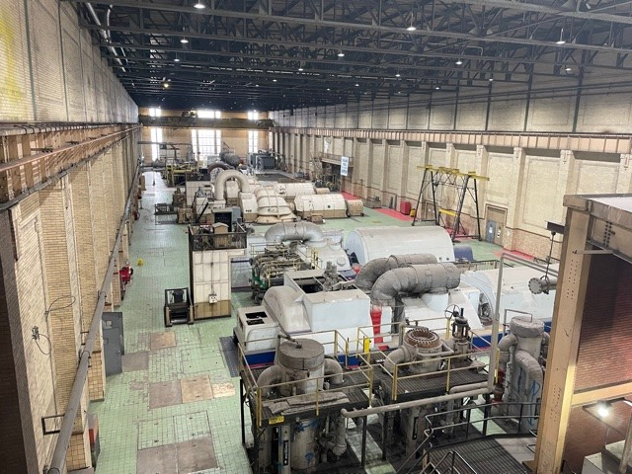
Component- Steam Turbines – Unit 8 Turbine Deck
Unit 8
Unit 3
Unit 4
Unit 5
Unit 6

Slide 19
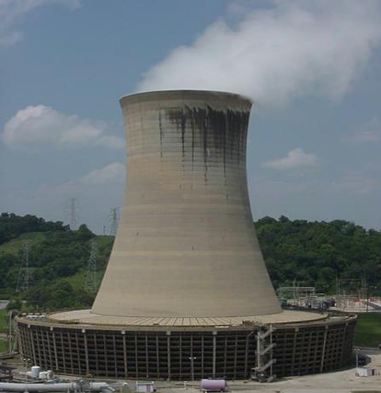
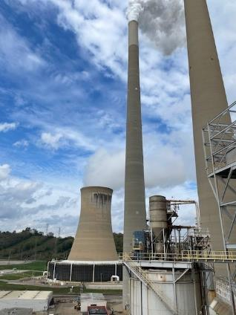
Component- Cooling Tower
The circulating cooling water is cycled between these types of towers and the condenser. The heat in the falling water is carried away by the upward air draft in the towers.
Natural Draft Cooling Tower
Heat
Water Vapor

Slide 20
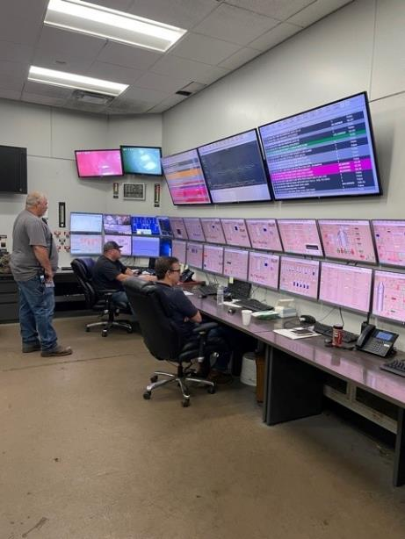
Control Room

Slide 21
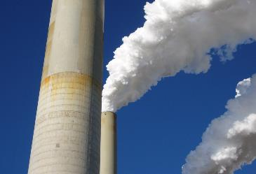

Component- Environmental Control
Selective Catalytic Reduction- SCR’s.
  Removes reduces 92% Nitrogen Oxide (NOx) emissions.
  Similar to catalytic converter in a car - ammonia is oxidized, NOx is reduced.
Electrostatic Precipitators- ESP’s.
  Removes approximately 99.9% Fly Ash from the flue gas stream.
  Fly ash is usable product.
Flue Gas De-Sulfurization- FGD.
  Removes 97% Sulfur Dioxide (SO2) emissions.
  SO2 can cause “acid rain”.
  Sulfur is naturally contained in the coal.
  Uses lime or limestone (CaCO3) to remove (scrub) the SO2 from the flue gas.
  Usable by-product is Gypsum for wall board manufacturing.
peregrine falcon

Slide 22
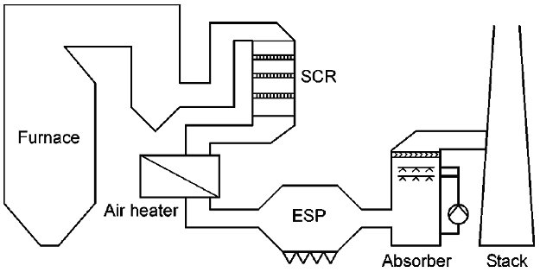

Component- Environmental Control
Flue Gases
SO2
NOx
Solid Particles
NOx
SO2
Solid Particles

Slide 23
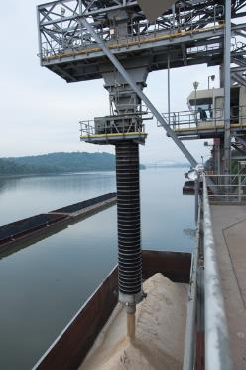
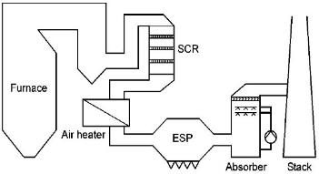
Component- Byproducts
Bottom Ash
  Used in structural fills for ODOT.
  Sandblasting media.
  Miami Fort will produce ~70,000 tons per year.
Fly Ash
  Used in concrete pavers.
  Filler for cement.
  Miami Fort will produce ~ 390,000 tons per year.
Gypsum
  The FGD Process creates a byproduct called Gypsum.
  Gypsum is used to make drywall.
  Miami Fort will produce ~2,000 tons per day.
    Enough gypsum to make: 95 semi-truck loads of drywall every day or build ~75,000 homes per year.

Slide 24
What is important to us?
Safety
The safety of our employees, contractors, and guest
Everyone goes home safe to their family every day
Reliability
Providing an essential service to the public
Making Power is how we make money as a business
Environment
We care about our community and protecting the air we all breath and the water we drink
Environmental Compliance is critical to our success

Slide 25
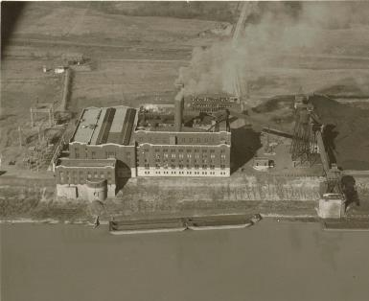
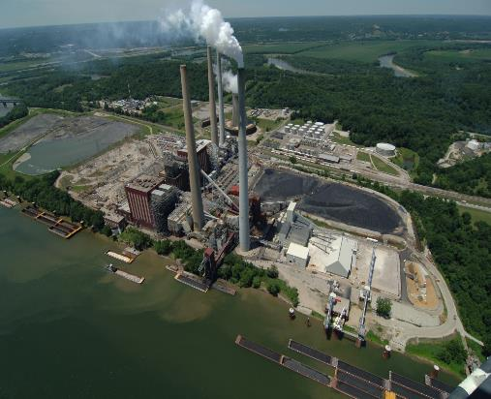
Miami Fort Power Station- Over 95 Years of Operation
1926
2021

Slide 26
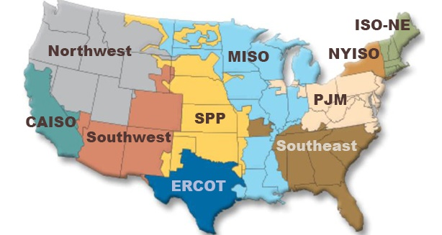
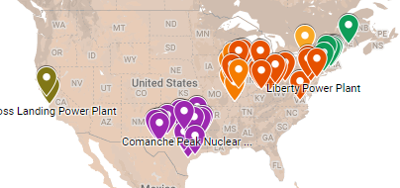
Market Information
PJM (Pennsylvania, New Jersey, and Maryland)
  As the primary task, to ensure the safety, reliability and security of the bulk electric power system.
  Create and operate robust, competitive and non-discriminatory electric power markets.
  Understand customer needs and deliver valued service to meet those needs in a cost-efficient manner.
https://www.luminant.com/about/

Slide 27
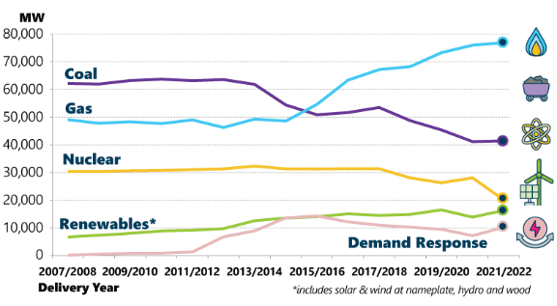
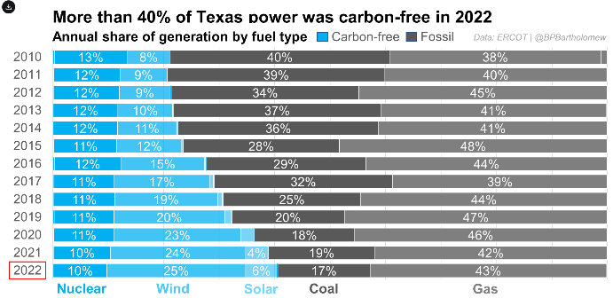
Energy Mix
PJM
ERCOT

Slide 28
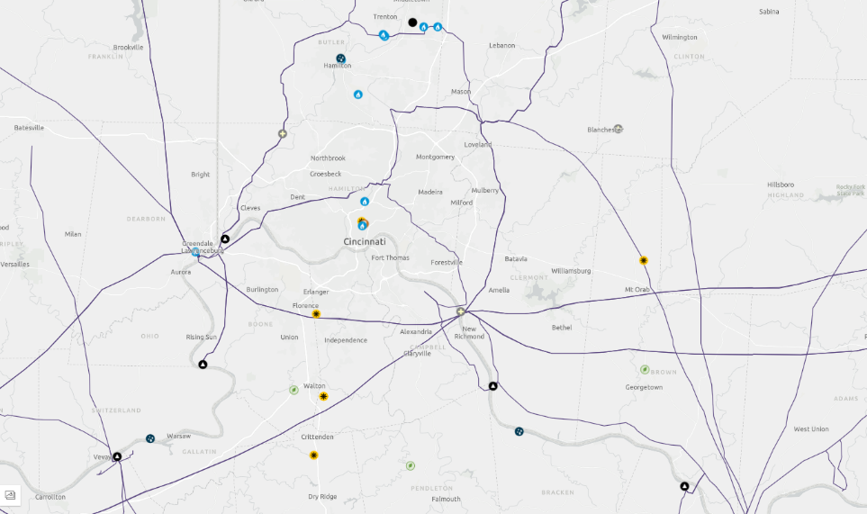
Electric Grid & Generation – Cincinnati - 345 kV
Source: atlas.eia.gov

Slide 29
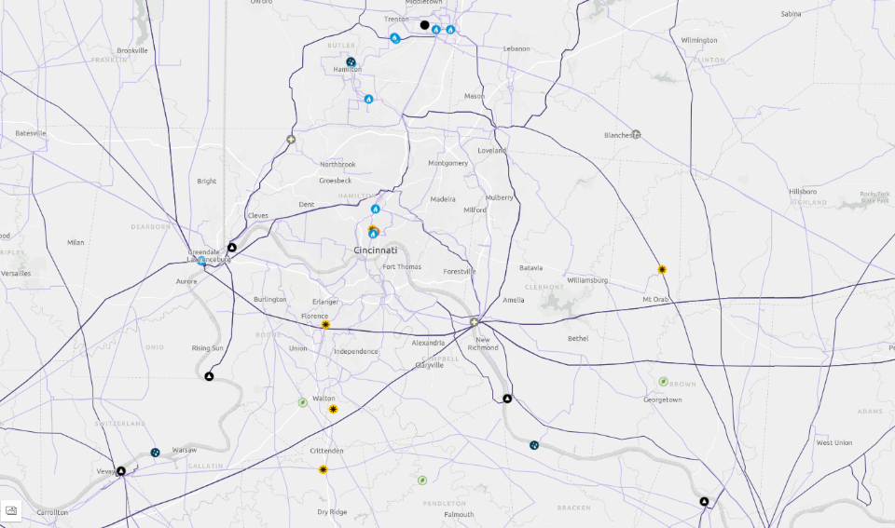
Electric Grid & Generation – Cincinnati – 69 kV+
Source: atlas.eia.gov

Slide 30
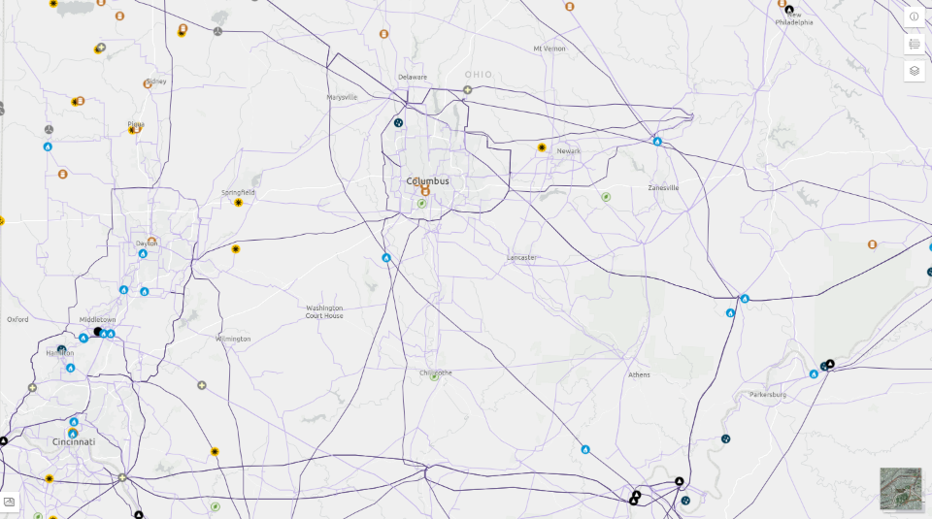
Electric Grid & Generation – Columbus – 69 kV+
Source: atlas.eia.gov

Slide 31
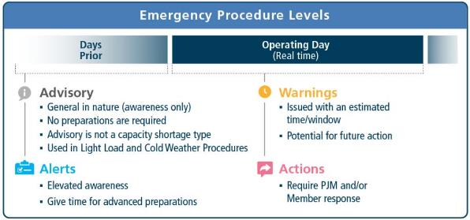
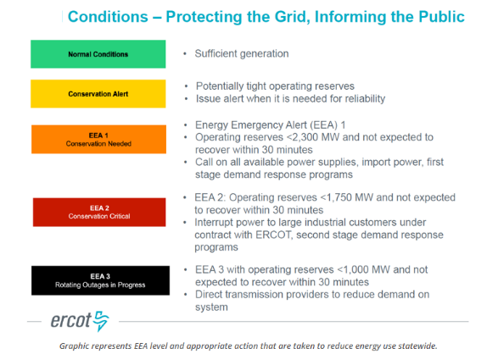
Emergency Alert Levels

Slide 32


News Articles regarding Columbus June Outages

Slide 33

June 13-16th Event – PJM - AEP Load Zone - Columbus
Source: emergencyprocedures.pjm.com

Slide 34

https://www.pjm.com/-/media/markets-ops/demand-response/estimated-demand-response-june-14-15-16-2022.ashx

Slide 35

www.pjm.com/-/media/committees-groups/committees/oc/2022/20220714/item-03---june-14-16-operations-review.ashx

Slide 36

2022 Winter Storm Elliott – 12/23 – 12/26
https://www.rtoinsider.com/32027-pjm-seeks-settlement-elliott-nonperformance-penalties/

Slide 37

PJM Capacity & Forced Outages – 12/24/22

Slide 38

Forced Outages by Tech

Slide 39

Renewables Performance

Slide 40


Load Forecasting Challenges

Slide 41

Synchronized Reserves

Slide 42

Demand Response

Slide 43

Demand Response

Slide 44

Effects on Energy Exports

Slide 45

Effects on Energy Exports

Slide 46



Slide 47

Financial Impacts – Energy Prices

Slide 48

Financial Impacts – Capacity Penalties

Slide 49


Solar Challenges – Evening Load Ramp

Slide 50


Hot Weather & Generation Challenges

Slide 51



Slide 52

‘Energy Transition in PJM’ - Highlights

Slide 53



Slide 54




Slide 55

Ohio Energy Choice
Ohio electricity & natural gas supply became deregulated in 1999
  Kentucky, Indiana, West Virginia still regulated utilities
https://www.energyknowledgebase.com/topics/deregulation-electricity.asp

Slide 56

Ohio Energy Choice – ‘Apples to Apples’
https://energychoice.ohio.gov/applestoapples.aspx

Slide 57


Slide 58

I personally recommend:
Fixed rate
No monthly Fee
No early termination fee
Renewable content will be from purchased Renewable Energy Credits (RECs), worth inquiring for details on location

Slide 59
Miami Fort Tour 10/12/23
Address: 11021 Brower Road, North Bend, Ohio 45052
  Should be 35 minute drive from UC
Please wear closed-toed shoes and long pants
  Hard hats, safety glasses, and ear plugs will be provided, feel free to bring your own if you wish
  There are numerous hazards in the plant, we will discuss safety and any unique risks from operation at the beginning of the tour
  Please bring a photo ID to be used at check-in
  Call my cell if you get lost/have trouble – 937-750-3182

Slide 60

Site Map/Entry
Gate 2
“Construction Entrance”
Brower Rd
Employee Lot
Drive down middle road toward south then turn around to north and park (one-way traffic)
Check in with guard at visitors center first. Then drive over to employee parking lot and meet at south end

Slide 61
Appendix

Slide 62
Energy Trends
Sourced from EIA (Energy Information Administration) – 2022 Annual Energy Outlook

Slide 63
Energy production and consumption
Energy production by source
AEO2022 Reference case
quadrillion British thermal units
Energy consumption by fuel
AEO2022 Reference case
quadrillion British thermal units
Note: Biofuels are shown separately and included in petroleum and other liquids.

Slide 64
U.S. natural gas production and prices
U.S. dry natural gas production
AEO2022 oil and gas supply cases
trillion cubic feet
Natural gas spot price at Henry Hub
AEO2022 side cases
2021 dollars per million British thermal unit
2021
history projections
High Oil and
Gas Supply
Reference
Low Oil and
Gas Supply

Slide 65
U.S. dry natural gas production
Dry natural gas production, AEO2022 oil and natural gas supply cases
Reference case
trillion cubic feet
Low Oil and Gas Supply case
trillion cubic feet
High Oil and Gas Supply case
trillion cubic feet
tight &
shale gas
other Lower
48 states
onshore
Lower 48
states
offshore
other
Note: Tight and shale gas includes tight gas, shale gas, and natural gas from tight oil formations.

Slide 66
U.S. electricity generation and shares from selected fuels and renewable sources

Slide 67
U.S. electricity generation levels from selected fuels and renewable sources
U.S. electricity generation, AEO2022 renewables cost cases
Note: Renewables category includes electricity generation from wind, solar, hydroelectric, geothermal, wood, and other biomass sources.

Slide 68
Installed electric generating capacity by source
other diurnal storage solar wind nuclear oil and natural gas coal

Slide 69
U.S. retiring and new generating capacity
Source: Form EIA-860M, Monthly Update to the Annual Electric Generator Report, August 2021
Annual electricity generating capacity additions and retirements
AEO2022 Reference case
gigawatts

Slide 70
Electricity prices by components and long-term average electricity prices

Slide 71
U.S. electricity generation by source
Hourly U.S. electricity generation and load by fuel for selected cases and representative years
billion kilowatthours
AEO2022 Reference case, 2021 AEO2022 Reference case, 2050 AEO2022 Low Renewables Cost case, 2050
hour of the day
curtailment battery storage pumped storage solar wind hydroelectric natural gas combined-cycle natural gas and oil peakers nuclear coal
Note: Negative generation represents charging of energy storage technologies such as pumped hydro and battery storage. Hourly dispatch estimates are illustrative and are developed to determine curtailment and storage operations; final dispatch estimates are developed separately and may differ from total utilization as this figure shows. Solar includes both utility-scale and end-use photovoltaic electricity generation

Slide 72
Transportation sector energy consumption
Transportation sector consumption by mode
AEO2022 Reference case
quadrillion British thermal units
Transportation sector consumption by fuel
AEO2022 Reference case
quadrillion British thermal units
light-duty
vehicles
medium- and
heavy-duty
vehicles
air
commercial
light trucks
rail
marine
other

Slide 73
Transportation sector delivered electricity and natural gas
Delivered electricity by mode
AEO2022 Reference case
quadrillion British thermal units
Delivered compressed and liquefied natural gas by mode
AEO2022 Reference case
quadrillion British thermal units

